Slide 1
ECFA review panel: for future large infrastructures for neutrino oscillation experiments
— possible way for ECFA to help in the coordination of neutrino activities

Slide 3
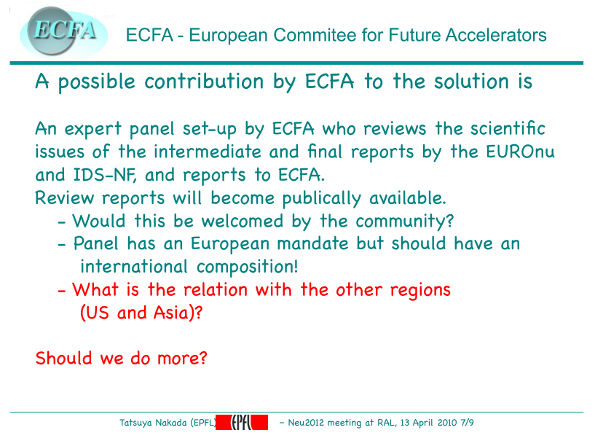

Slide 4
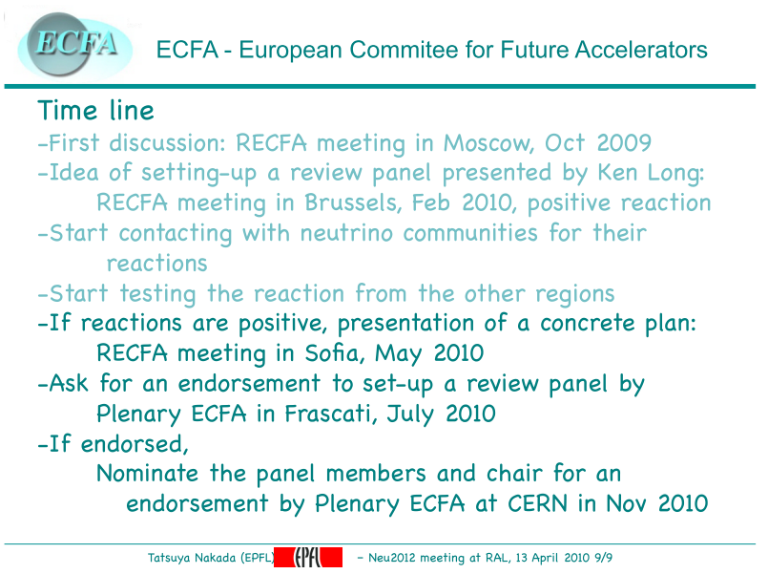

Slide 5
Community consultation; steps taken:
EUROnu:
  Concept explained to Management Board
    Welcomed proposed review panel
  Concept presented to delegates at EUROnu costing w/s, CERN, 15/16 March 2010:
    Positive reception
  Note:
    Formally, EUROnu reports to the Strategy Session of CERN Council:
      So, if the review of the IDR and EUROnu interim reports is deemed to be a success and the process moves on to the review of the RDR and the EUROnu final reports, it will be important that the review is included as part of the Strategy Session of CERN Council reporting process
IDS-NF
  Concept explained to Steering Group
    Proposed review panel was welcomed
      Comment:
        Ensure review panel is manifestly international
  Concept presented to IDS-NF plenary meeting, FNAL 08—10 April 2010
    Positive reception
Neu2012 (NA in EUCARD IA)
  Concept presented by T. Nakada to Neu2012 community
    Positive reception
Conclusion:
community welcomes proposed review panel.

Slide 6
Issues:
ECFA intention is that review panel shall be:
  International:
    European initiative; but international in scope and influence
  Composed of internationally recognised leaders in the field
Not sufficient for this to be the intention, nor sufficient even for it to be true in practice, unless:
  The international community recognises the panel as international and ‘heavy weight’
    i.e. essential that there be ‘buy in’ from:
      International neutrino community;
      ‘Stakeholders’:
        e.g. laboratory and funding-agency directors
    Implies:
      Care in establishing principle with stakeholders prior to launch of initiative
      Broad consultation to define composition of panel:
        Including appropriate cross membership (e.g. ICFA, ACFA, …)

Slide 7
Towards the terms of reference:
Noting the timescale defined by the Strategy Session of CERN Council, the ECFA review panel will:
  Receive IDS-NF IDR and EUROnu interim report, supported by appropriate presentations from the proponents
  Review and comment on the IDS-NF IDR:
    The robustness of the physics case;
    The specification of the baseline for the Neutrino Factory;
    The analysis of cost and schedule presented in the IDR; and
    The plans of the IDS-NF collaboration for the RDR.
  Review and comment on EUROnu interim report:
    The strengths of the super-beam, beta-beam, and Neutrino Factory facilities
    The development of baseline super-beam and beta-beam facilities;
    The plans of the EUROnu collaboration for the completion of the study.
  Report to ECFA:
    Also to ICFA etc. if successful in forming such partnerships

Slide 8
