Slide 1
CERN Report (II)

Slide 2
Scientific Strategy
Full exploitation of LHC physics potential
  Reliable operation (including consolidation and LINAC 4)
  Remove bottlenecks to benefit from nominal luminosity for both machine and detectors
  Focused R&D and prototyping for High-Luminosity LHC
  Re-establish standards for technical and general infrastructure
Preparation for the long-term future (>2015)
  Energy frontier
    CLIC/ILC collaboration and R&D (for detectors and machine)
    Generic R&D for High-Energy LHC (i.e. high field magnets)
  R&D for high-power proton sources (HP-SPL) e.g for ν-physics
World-class fixed-target physics programme

Slide 3
LHC Strategy (I)
Full exploitation of the LHC physics potential
→ maximize integrated luminosity useful for physics
- Longer running periods (~ two years)
Longer shutdowns in between, coordinated activities
between experiments and experiments/machine
Physics Run 2010/11 @ 7 TeV
decide about slightly higher energy later in the run
Shutdown 2012 to prepare LHC towards 14 TeV
(copper stabilizer consolidation, He-release valves, . . .)
Physics Run 2013/14 @ ~ 14 TeV

Slide 4
LHC Strategy (II)
Full exploitation of the LHC physics potential
→ maximize integrated luminosity useful for physics
- LHC operation until around 2030, aim at ∫Ldt ≈ 3000/fb
- Between 2010 and ~2020: ~design luminosity (~10³⁴/cm²/s)
connection of LINAC4 earliest 2015
detector modifications to optimize data collection
High Luminosity LHC (HL-LHC) from ~2020 to ~2030
luminosity around 5x10³⁴/cm²/s, luminosity leveling
new Inner Triplet around 2020 (combine both phases)
detector upgrades around 2020 → R&D NOW

Slide 5
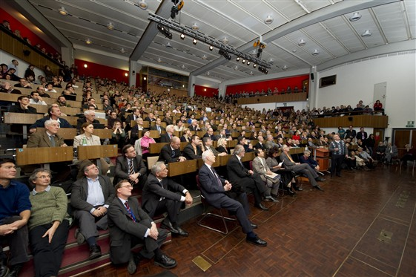
LHC fills lecture halls because it…
  - addresses fundamental science questions
  - stimulates general interest
  - fascinates and inspires
  - stimulates fantasy
  - increases knowledge
  - educates
  - trains scientists and engineers for tomorrow
  - drives innovation and technology
  - and, and, and
→ use this interest to promote
our field and basic science in general

Slide 6
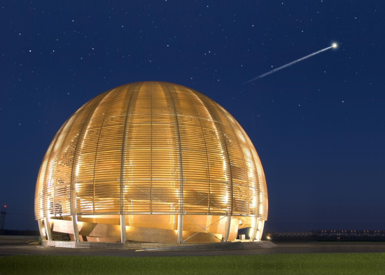
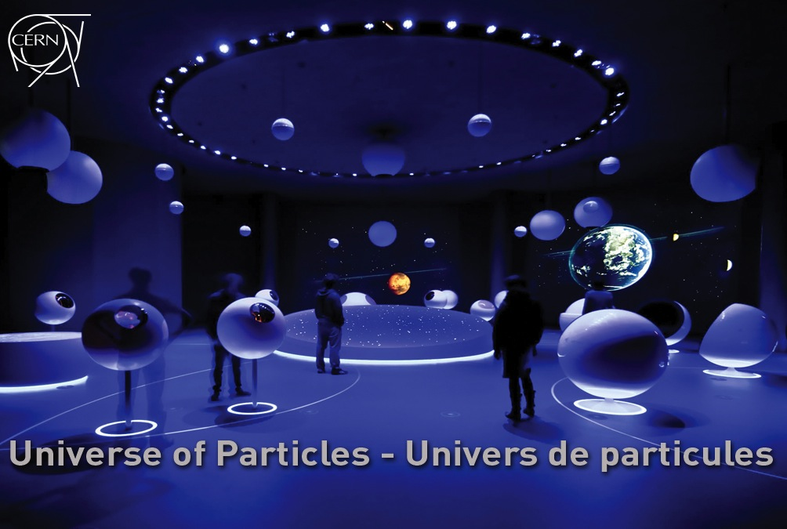
Universe of Particles – the new permanent CERN exhibition
From 1 July 2010 - Immersive and interactive
Open daily (except Sunday) from 10:00-17:00
Start and end point of CERN visits
New exhibition will attract (even) more visitors
GUIDES (“EXPLAINERS”) ARE NEEDED!

Slide 7
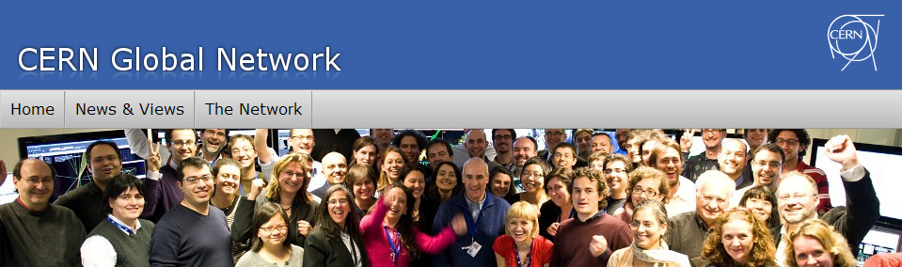
CERN Global Network
A facilitator
for knowledge
exchange
Dedicated web site
Visibility for partnership opportunities across the Network
Member database
Professional networking for CERN “Alumni”
Useful data on researcher’s mobility and career evolution in Europe
Discussion fora for special interest groups
Interactions between individual and institutional members
Exchange of best practices between institutions in specific thematic areas

Slide 8
Knowledge Transfer through Procurement
Results from a survey of companies involved in technology-intensive
procurement contracts with CERN (1997-2001).
178 questionnaires analyzed, related to 503 MCHF procurement
budget.
Results:
44% indicated technological learning
42% increased their international exposure
38% developed new products
36% indicated market learning
13% started new R&D teams
52% would have had poorer sales performance without CERN
41% would have had poorer technological performance

Slide 9
Opening the door…
Council opened the door to greater integration in particle physics when it recently unanimously adopted the recommendations to examine the role of CERN in the light of increasing globalization in particle physics.
  Particle physics is becoming increasingly integrated at the global level.
  Council’s decision contributes to creating the conditions that will enable CERN to play a full role in any future facility wherever in the world it might be.
The key points agreed by Council include:
  All states shall be eligible for Membership, irrespective of their geographical location;
  A new Associate Membership status is to be introduced to allow non-Member States to establish or intensify their institutional links with CERN;
  Associate Membership shall also serve as the obligatory pre-stage to Membership.
Applications for Membership from Cyprus, Israel, Serbia, Slovenia and Turkey have already been received by the CERN Council, and are undergoing technical verification.
“This is a milestone in CERN’s history and a giant leap for particle physics”, said Michel Spiro, President of the CERN Council. “It recognizes the increasing globalization of the field, and the important role played by CERN on the world stage.”

