Slide 1
XLS – Ka Band TW-Linearizer
Overview
A. Castilla, G. Burt
Lancaster University
Oct. 30th 2020.

Slide 2
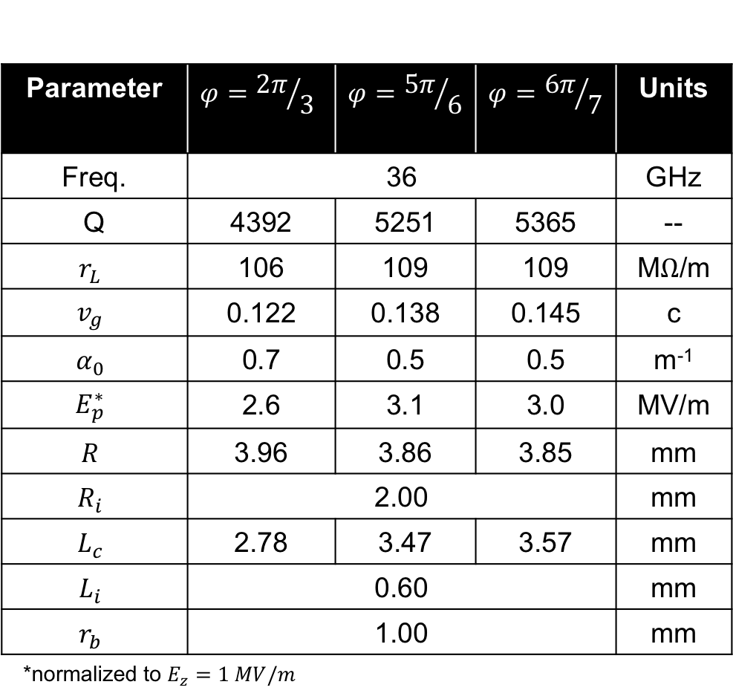




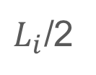

Single Cell Recap
Parameter | $$φ={2π}/3$$ | 150deg | $$φ={5π}/6$$ |  | $$φ={6π}/7$$ | Units
Freq. | 36 |  |  |  |  | GHz
Q | 4392 | 5251 | 5251 | 5365 | 5365 | --
$$r_{L}$$ | 106 | 109 | 109 | 109 | 109 | M$Ω$/m
$$v_{g}$$ | 0.122 | 0.138 | 0.138 | 0.145 | 0.145 | c
$$α_{0}$$ | 0.7 | 0.5 | 0.5 | 0.5 | 0.5 | m⁻¹
$$E_{p}^{∗}$$ | 2.6 | 3.1 | 3.1 | 3.0 | 3.0 | MV/m
$$R$$ | 3.96 | 3.86 | 3.86 | 3.85 | 3.85 | mm
$$R_{i}$$ | 2.00 |  |  |  |  | mm
$$L_{c}$$ | 2.78 | 3.47 | 3.47 | 3.57 | 3.57 | mm
$$L_{i}$$ | 0.60 |  |  |  |  | mm
$$r_{b}$$ | 1.00 |  |  |  |  | mm
*normalized to $E_{z}=1 MV/m$
$$r_{b}$$
$$L_{i}$$
$$R$$
$L_{i}$/2
$$R_{i}$$
$$L_{c}$$
A. Castilla – ULANCS Oct 30th 2020

Slide 3
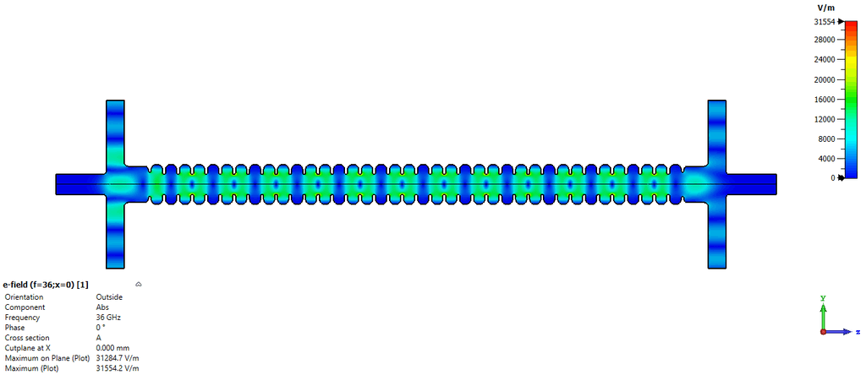
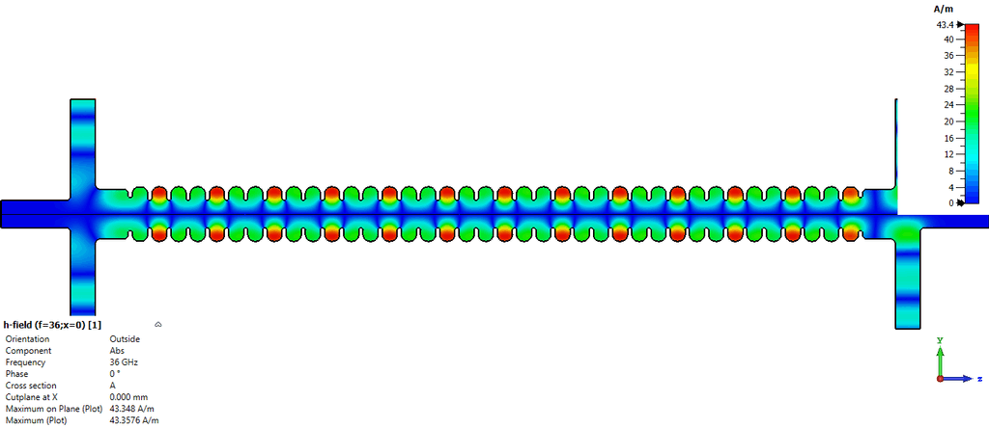
10cm (15cm effective) Travelling Wave Structure
G. Burt, A. Castilla (ULANCS)
E-Field
H-Field
A. Castilla – ULANCS Oct 30th 2020

Slide 4
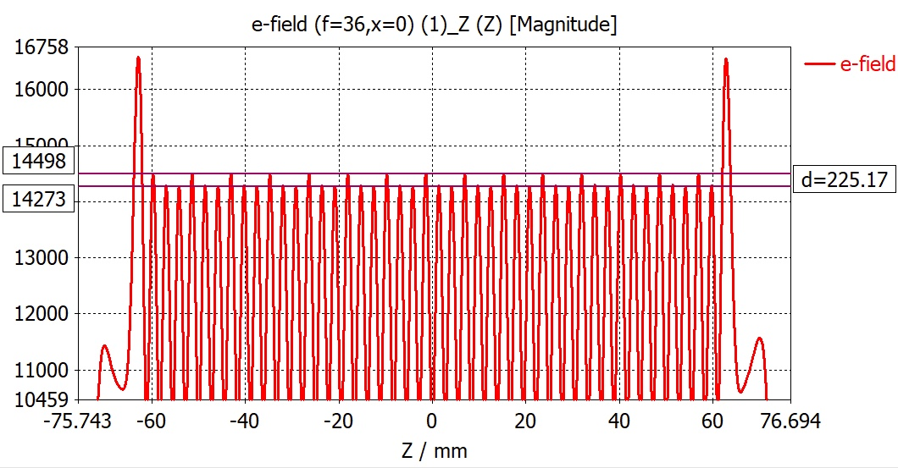
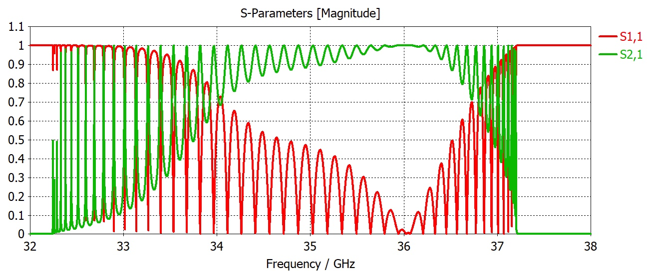
12cm Travelling Wave Structure
G. Burt, A. Castilla (ULANCS)
Ok matching.
<2% field flatness.
A. Castilla – ULANCS Oct 30th 2020

Slide 5
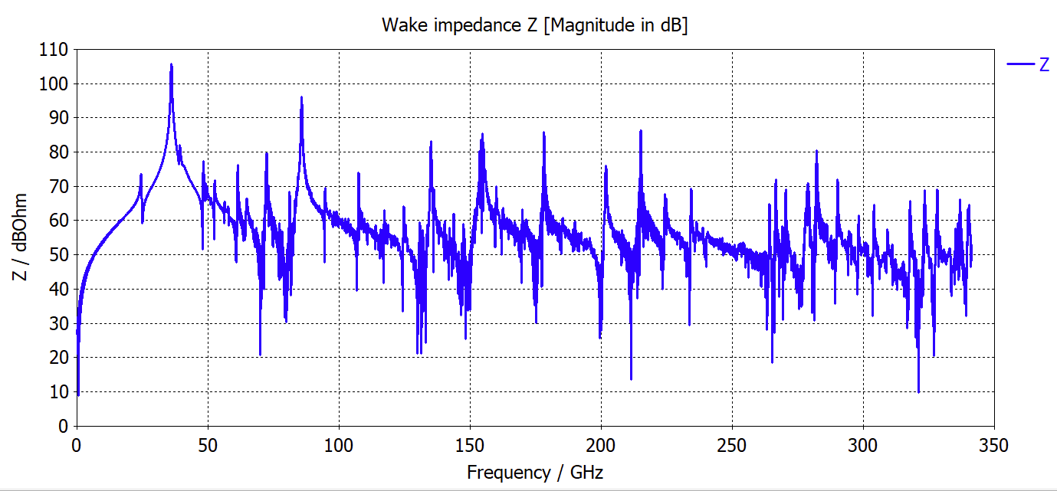
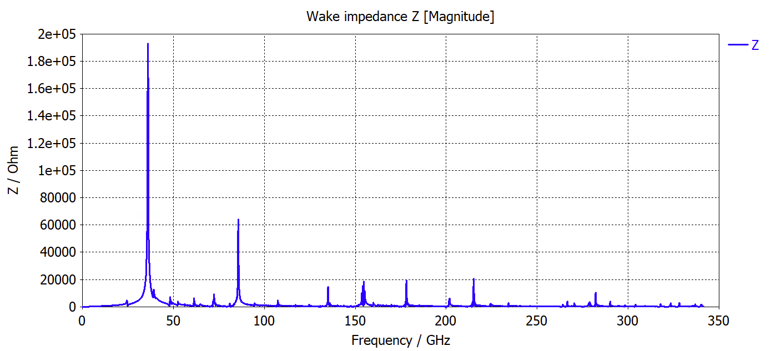
Long. Wakes
Parameter | Value | Units
Structure length | 0.1 | m
Wake length | 1.0 | m
Bunch sigma | 0.3 | mm
Bunch charge | 75 | pC
Wake-loss-factor | 2.103152e+02 | V/pC

Slide 6
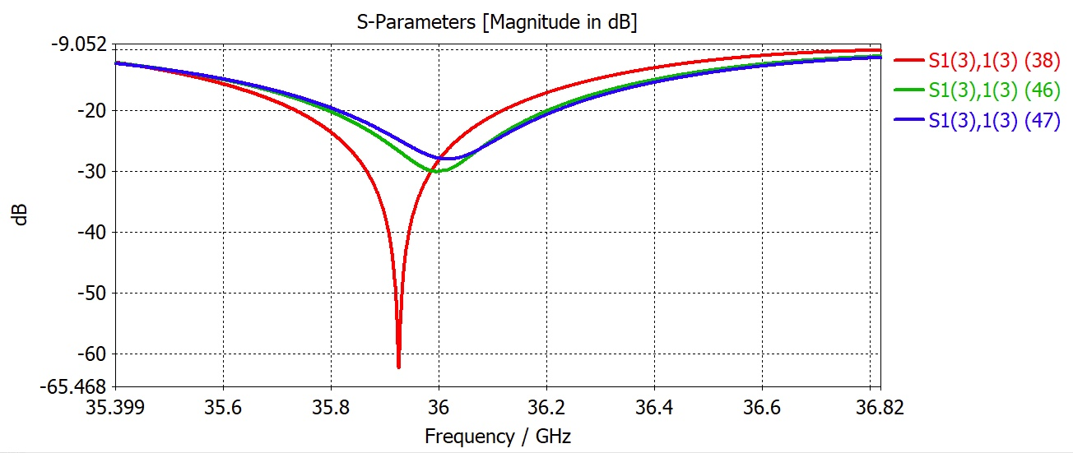
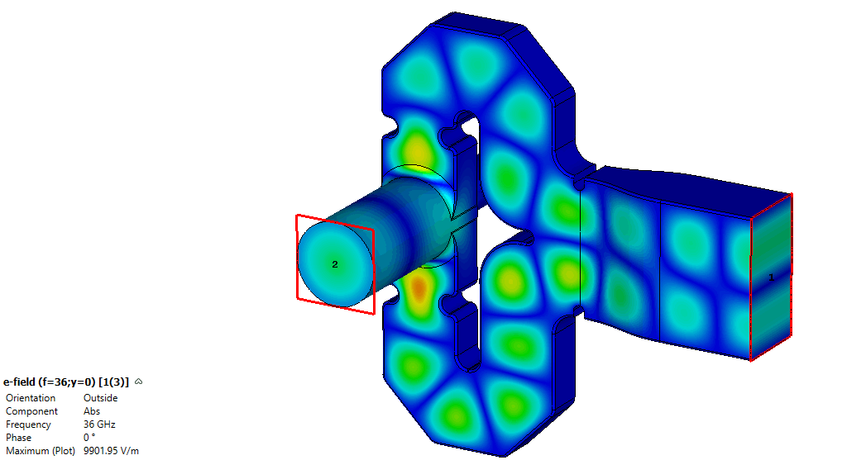
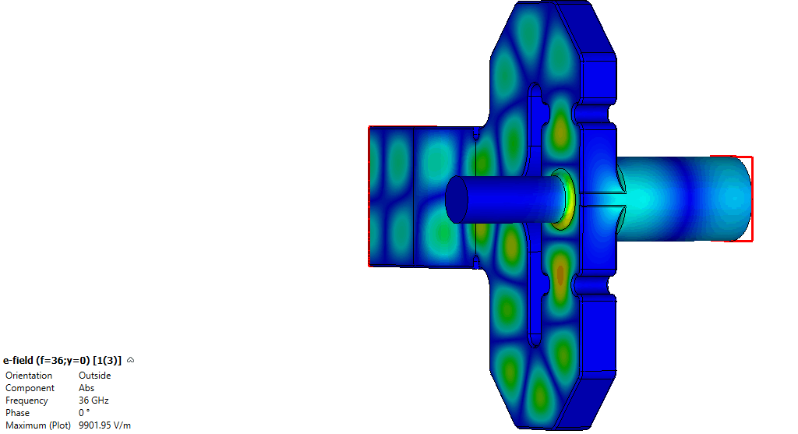
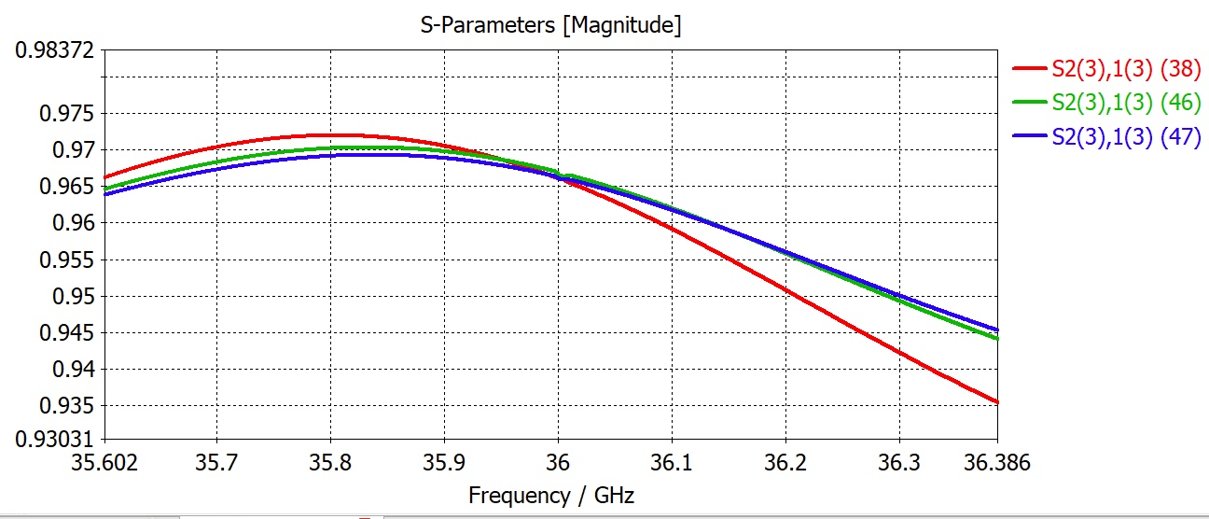
Input Coupler Version 2.0
Including a mode converter for low loss transport network.
A. Castilla – ULANCS Oct 30th 2020

Slide 7
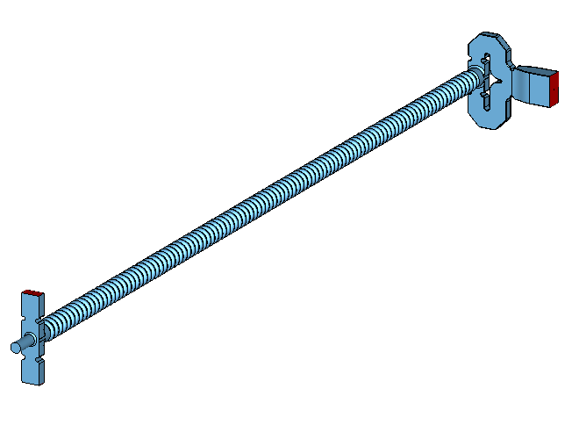
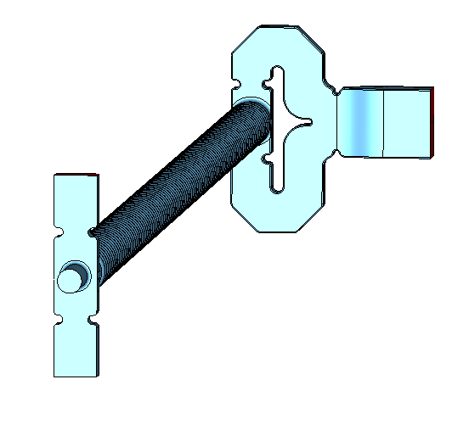
Input Coupler Version 2.0
Including a mode converter for low loss transport network.
A. Castilla – ULANCS Oct 30th 2020

Slide 8
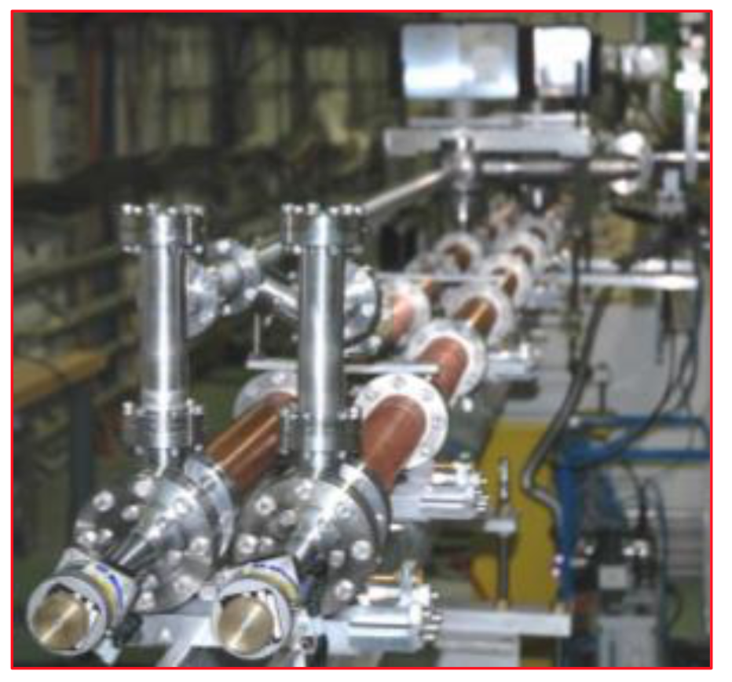
Pulse Compressor - SLEDII
X. Wu, W. Wuensch (CERN)
Compression ratio= Tkly / Tcompressed.
Similar gain curve at different frequencies:
  Shorter structures => Higher compression ratio.
  Longer Input pulse => Higher compression ratio.
Tcompressed
Tkly
A. Castilla – ULANCS Oct 30th 2020

Slide 9
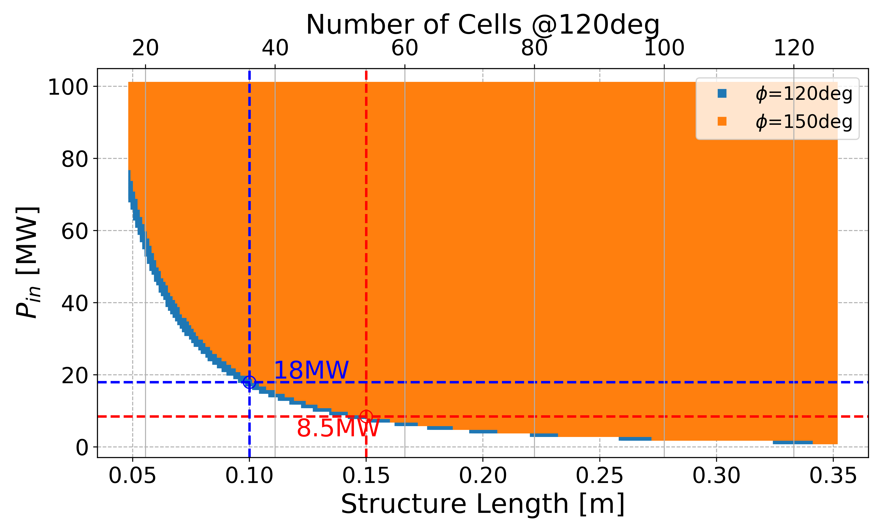
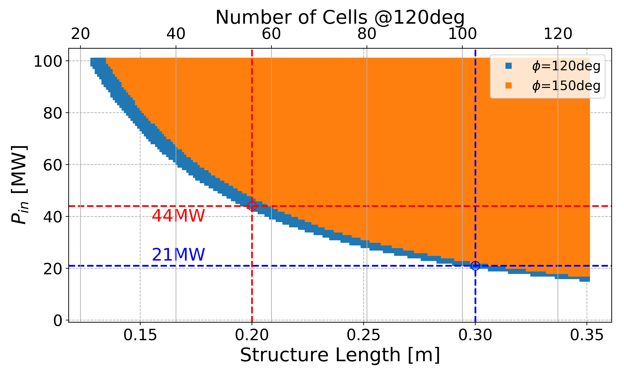
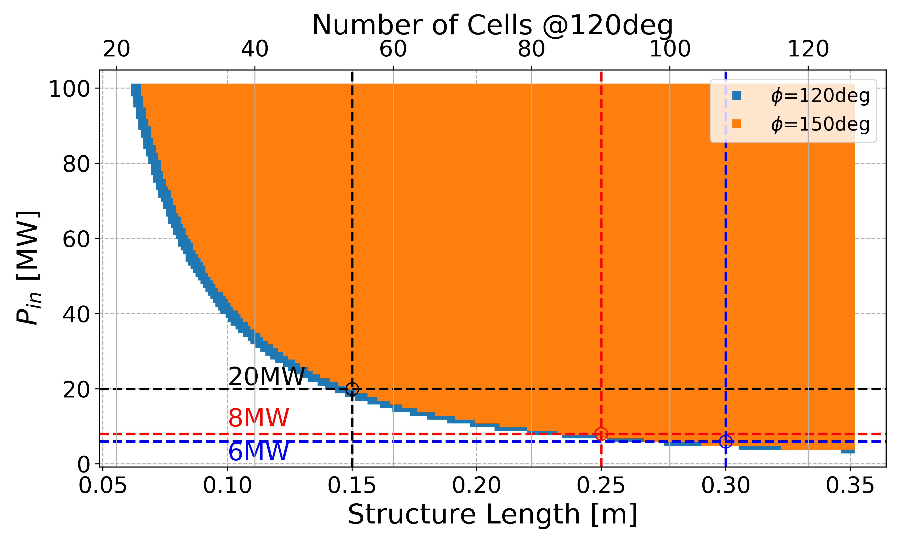
30cm active length
3x 10cm with 54 MW total power (18Mw/structure).
2x 15cm with 40MW total power (20MW/structure).
1x 30cm with 21MW.
For 5MV
For 15MV
For 7.5MV
A. Castilla – ULANCS Oct 30th 2020

Slide 10
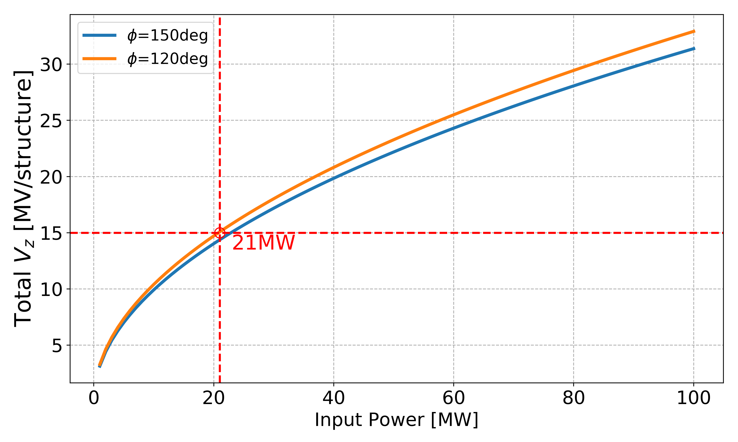
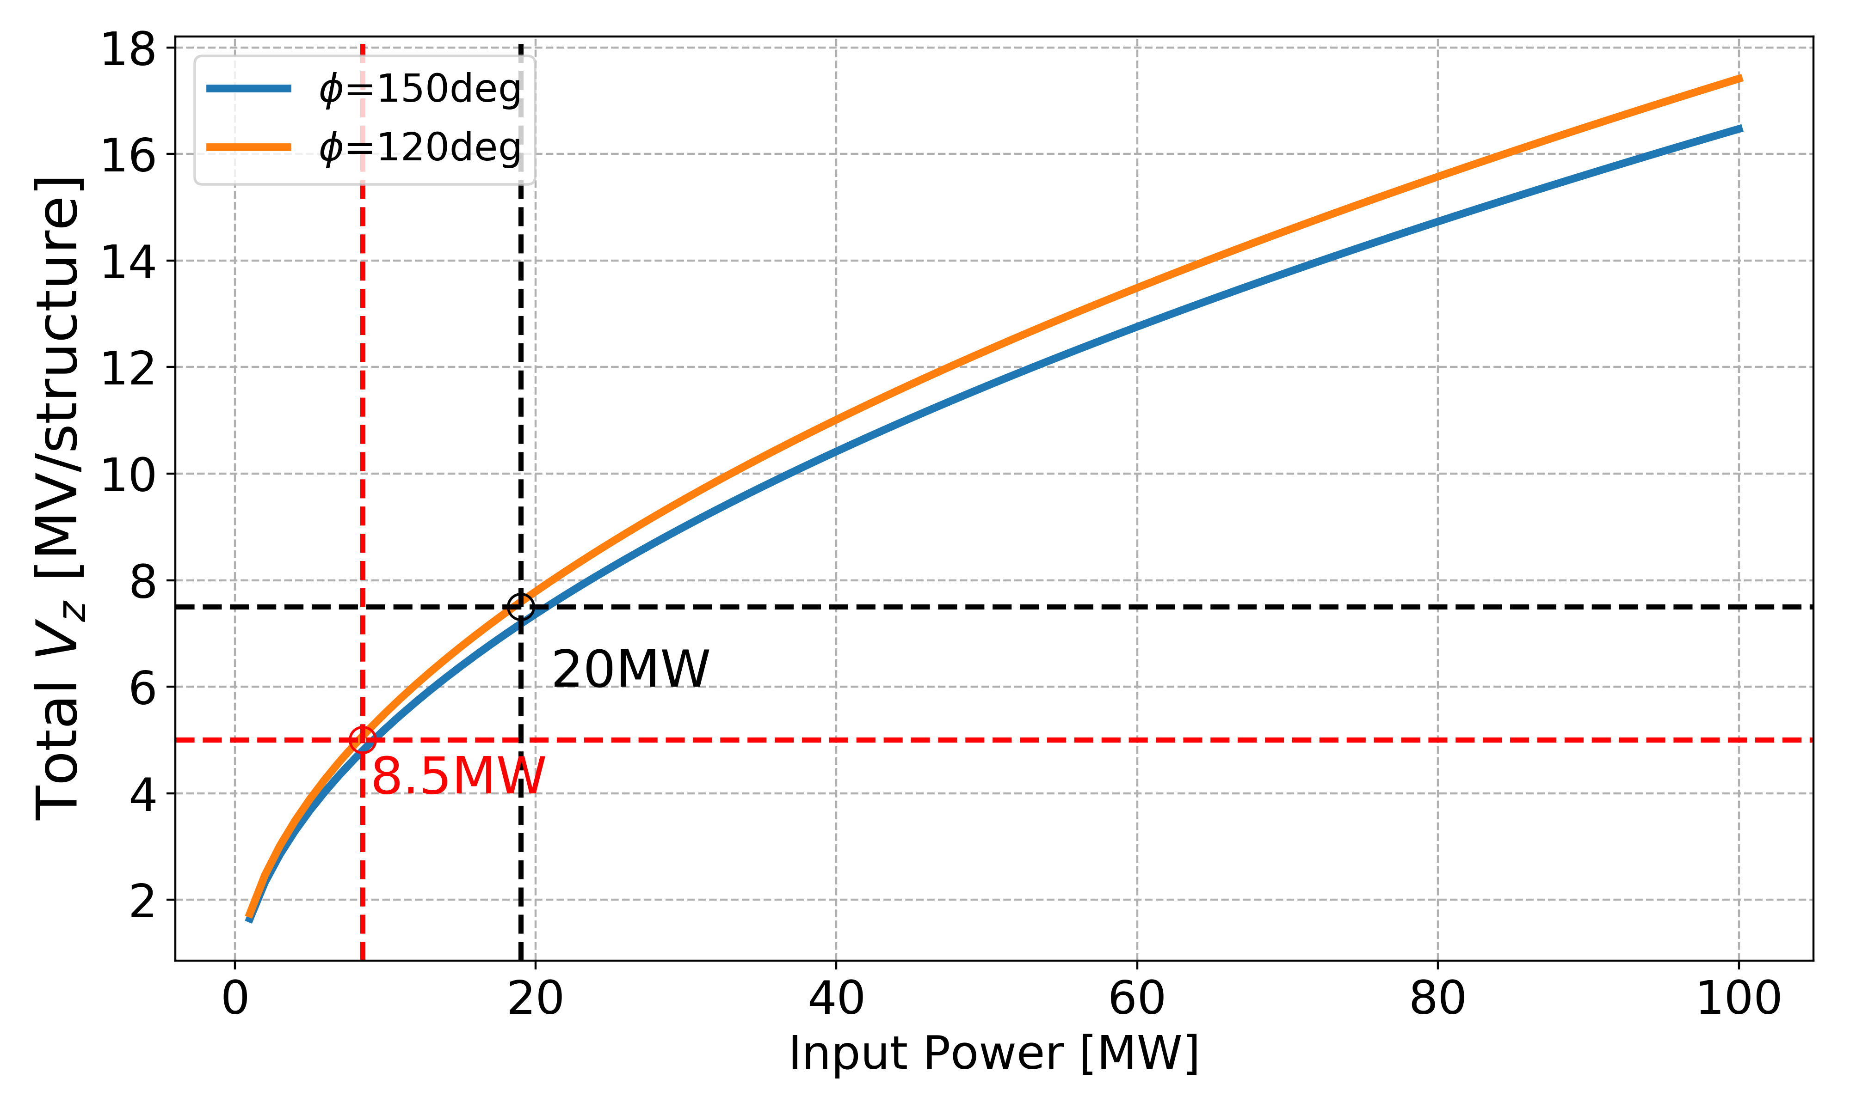
30cm active length
2x 15cm with 40MW total power (20MW/structure).
1x 30cm with 21MW.
For 30cm length
For 15cm length
A. Castilla – ULANCS Oct 30th 2020

Slide 11
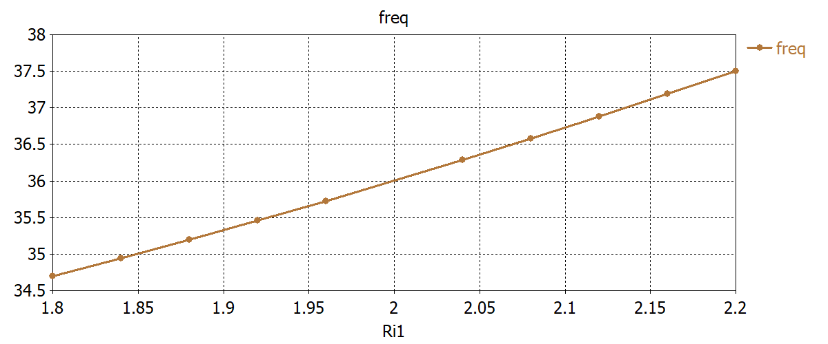
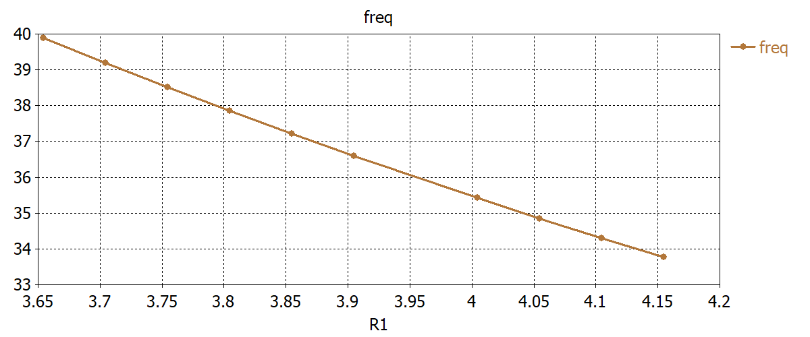
Single Cell Tolerances
$$r_{b}$$
$$L_{i}$$
$$R$$
$L_{i}$/2
$$R_{i}$$
$$L_{c}$$
A. Castilla – ULANCS Oct 30th 2020

Slide 12
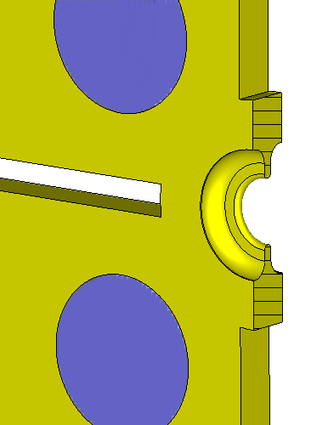
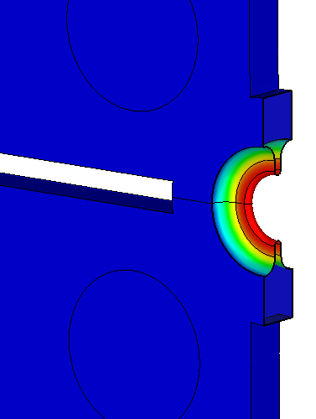
Thermal Analysis Ongoing
Relatively large cooling blocks/channels are possible for the small structure.
A. Castilla – ULANCS Oct 30th 2020

