Slide 1
Task Force on the 11 T dipole - Team
QA QC of coils and collared coils/magnets
WINDING
O. Housiaux, R. Berthet, B. Arias Alonso, R. Principe,
05/05/2021 – https://indico.cern.ch/event/969681/

Slide 2
Table of contents
  Applicable documentation and evolutions
  Components
  Tooling
  Differences in the 11T and MQXF production strategy
  Non conformities during production
  Adopted mitigations following major NCR
  Outcomes after cold tests inspections
  Future proposed improvements

Slide 3
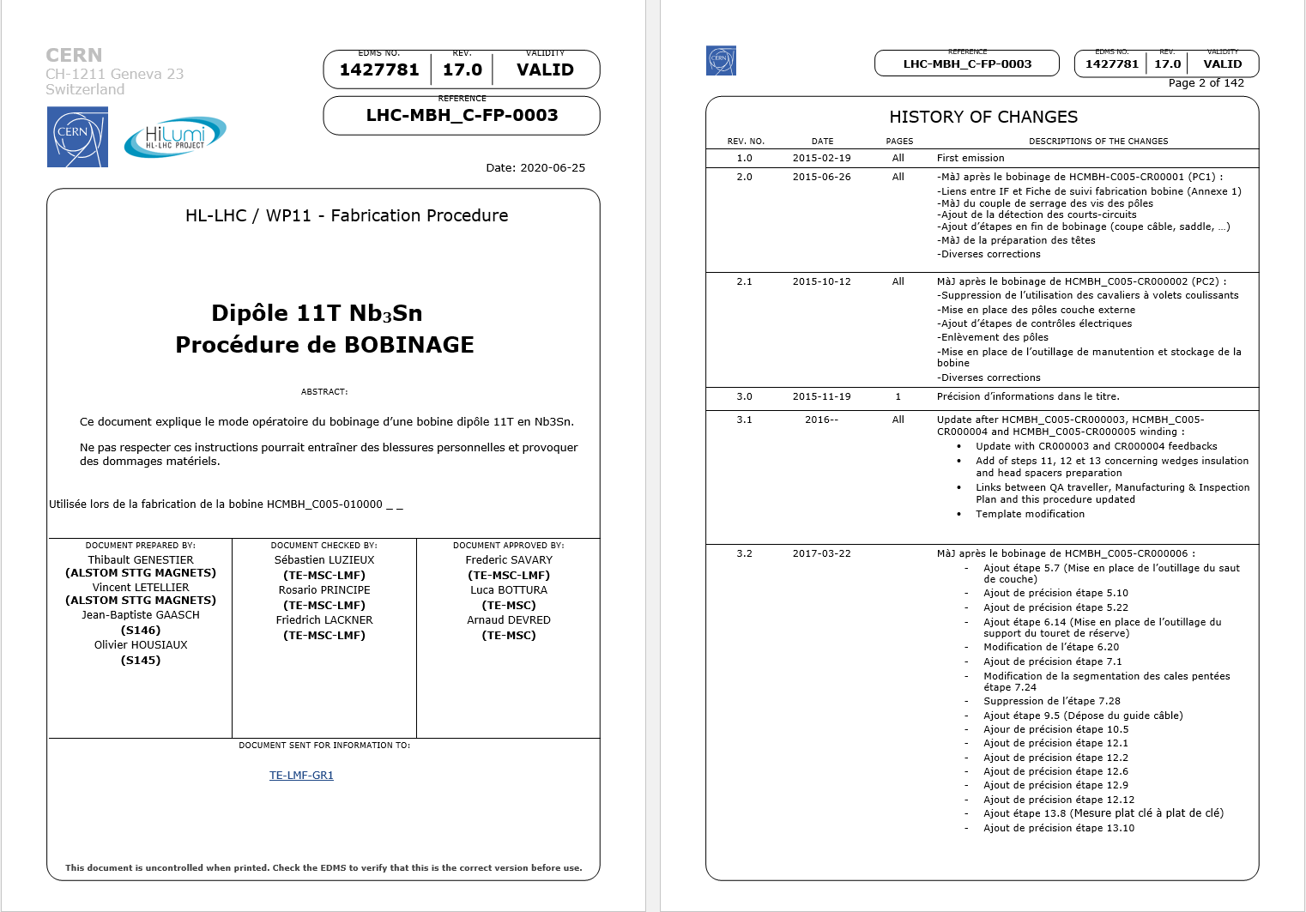
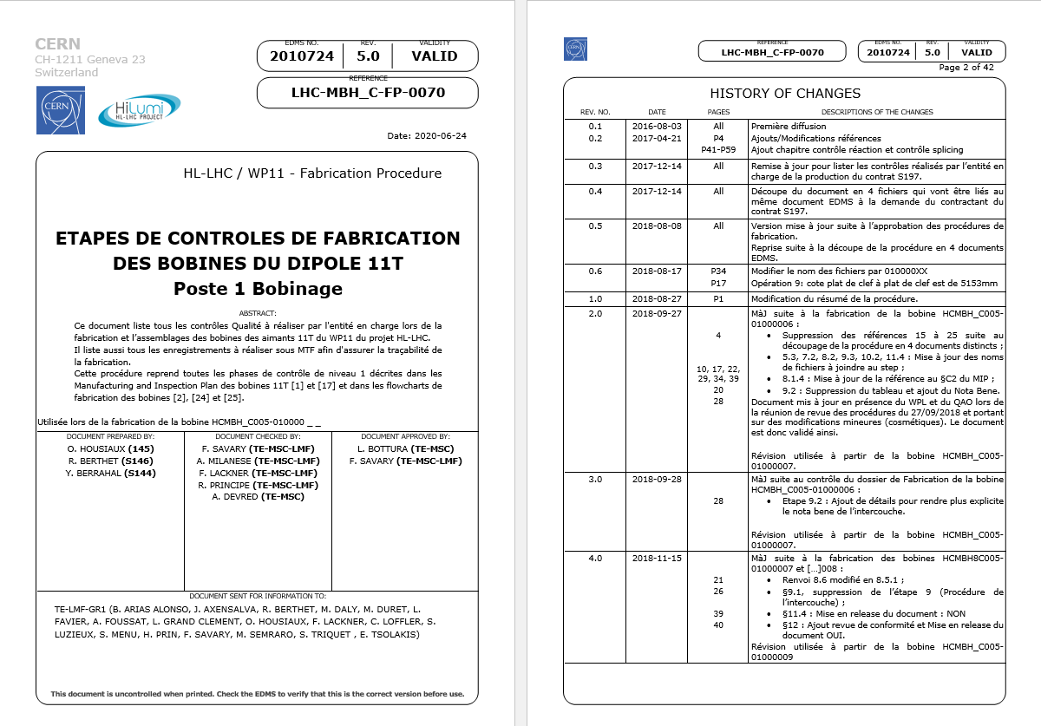
Applicable documentation and evolution
  Procedures:
  Modifications due to:
  Review of the applicable documentation with GE before starting production,
  Comments from operators,
  Minor NCRs mainly due to degradation of the fiberglass (1962584, 1974718, 1974457, 2004465, 2004468, 2021764, 2038193, 2151378),
  Knowledge transfer with MQXFB project.
  Critical NCRs :
    1995788 : Coil’s deformation during curing due to a forgotten pin (GE04 scrapped),
    2346532 : Coil’s deformation due to pushers’ poor placement (GE27 scrapped).
Manufacturing Procedure: | Contrôle Procedure
LHC-MBH_C-FP-0003 rev 17.0 | LHC-MBH_C-FP-0070 rev 5.0

Slide 4
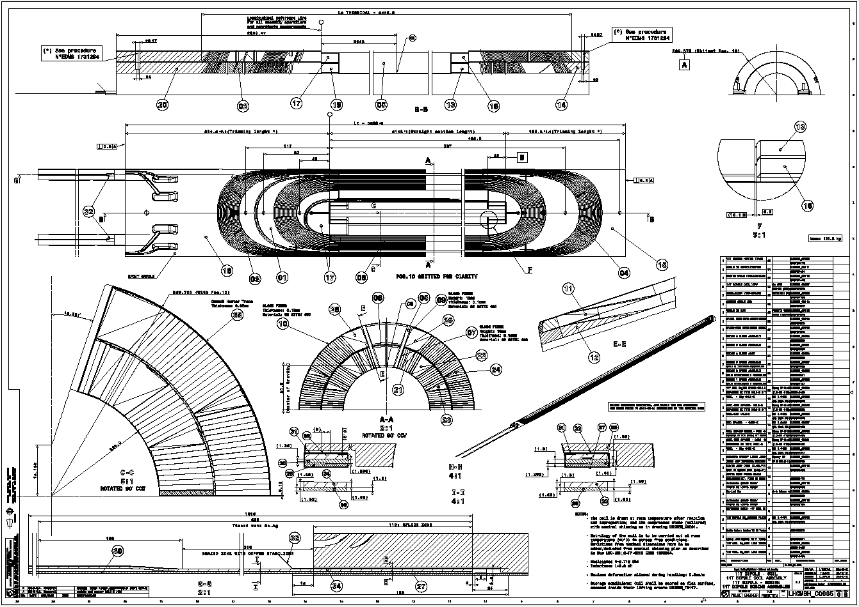
Applicable documentation and evolution
  Drawings:
  Inner layer: LHCMBH_C0011 rev A: Approved on 15/02/2018.
  Outer layer: LHCMBH_C0012 rev A: Approved on 15/02/2018.
  Beginning of series production : 27/02/2018.
  Coil: LHCMBH_C005 rev B: Approved on 20/02/2018 (this drawing was updated later due to the decision to place the quench heaters outside the coil).

Slide 5
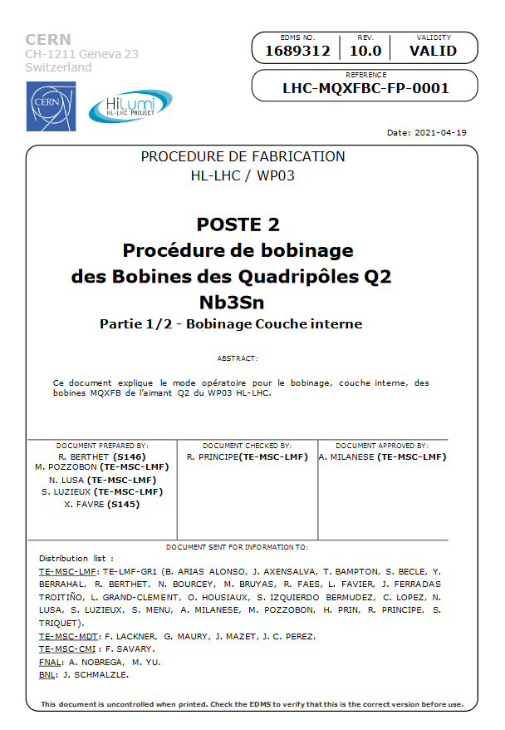
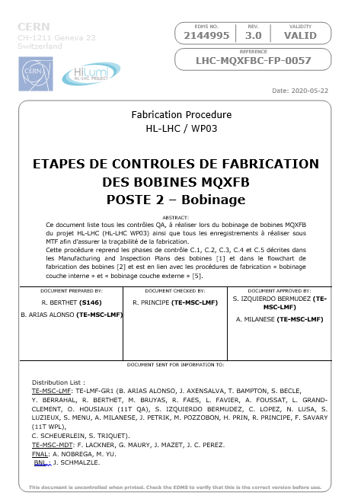
Applicable documentation and evolution
QXFB Series
Procedures:
  Modifications due to:
  Review of the applicable documentation during the “deverminage” campaign,
  Minor comments from operators,
  Critical NCR: 2419556: cable collapsed during winding (CR120 considered as test coil),
  Critical NCR: 1964025: Outer layer cable damaged (CR201 considered as test coil),
  Knowledge transfer with 11T project.
Manufacturing Procedure: | Contrôle Procedure
LHC-MQXFBC-FP-0001 v10.0 | LHC-MQXFBC-FP-0057 v3.0

Slide 6
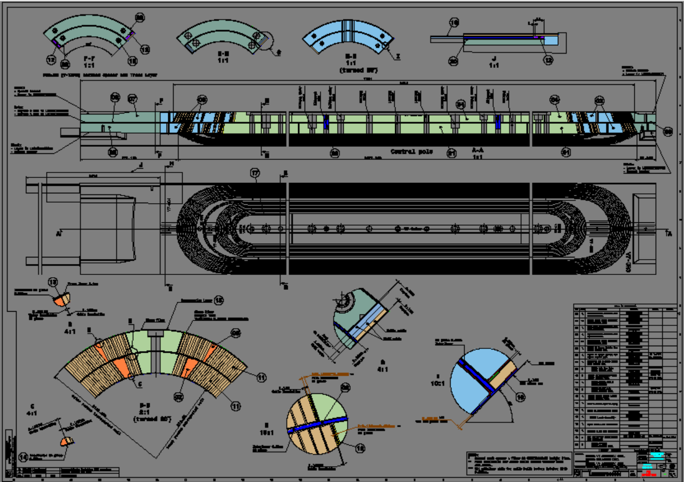
Applicable documentation and evolution
QXFB Series
  Coil Drawings:
  LHCMQXFBC0031 rev 0. Approved on 02/03/2018.
  First series coil: CR110.
  Signature of prod. start-up: 06/03/2019.
  LHCMQXFBC0031 rev A. Approved on 17/05/2019 (beginning of CR110 IL winding). Update of item references.
  LHCMQXFBC0031 rev B. Approved on 04/11/2019. Thickness update (midplane shims, pole insulation) and coil OR.

Slide 7
Components
  Reminder : Each component is formally accepted by the Project Engineer of the component before installation in coil (Step “delivery and acceptance” in MTF see 11T QP: Procurement LHC-LBH-QA-0001 v.2.0).
  Insulated cable:
  Thickness @ 5Mpa, out of tolerance up to 3 µm (tolerance < 105 µm) on 14 coils,
  Minor defects of the insulation: reparation performed during winding.
  Bare cable:
  No NCR.
  Wedges:
  Metrology performed by the manufacturer shows no geometrical defect.
  Note: no CERN metrology requested by the component’s PE on these pieces.
  Interlayer (manufactured @ CERN):
  2 NCR detected (geometrical measurement out of tolerance, 1907891 and stain, 2045653).
  These 2 interlayers were rejected.

Slide 8

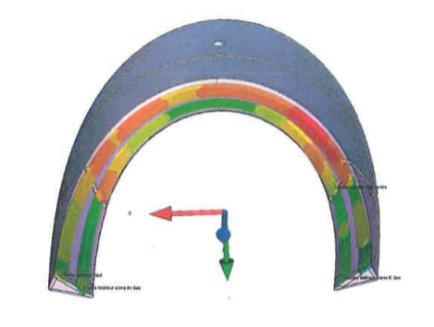
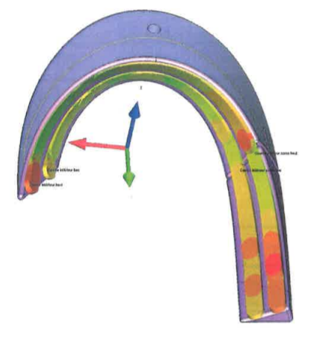
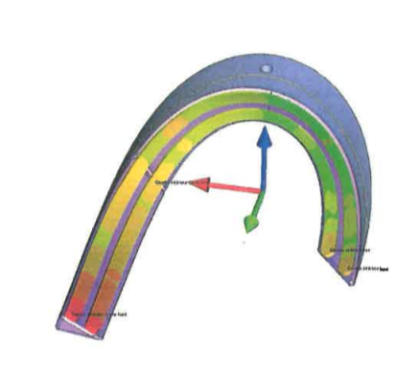







Components
  Spacers:
  NCR 1885777: Magnetic permeability out of tolerances @ 1.9K 1.0057 to 1.0066 (Tol.<1.005).
  The spacers are made of stainless steel (316L, 14435)
  NCR 1898188 and 1898125 : Geometrical defects
  For most of the defects the value is under 5 µm and few are up to 40 µm (shape defect ).
  Note 1: Metrology performed by the manufacturer on samples ≈25%
  Note 2: No CERN metrology requested by the component PE on these pieces.
C4LI-5
C4LI-6

Slide 9
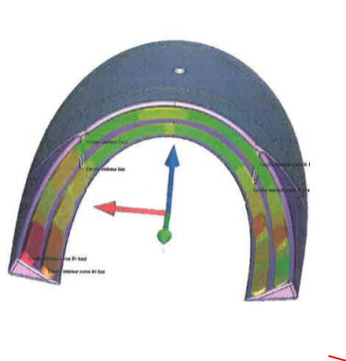
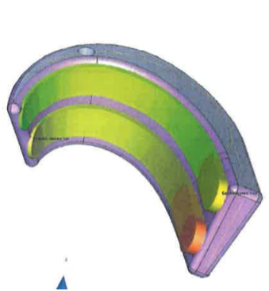








Components
  Spacers:
C4RI-3
C4LI-1

Slide 10
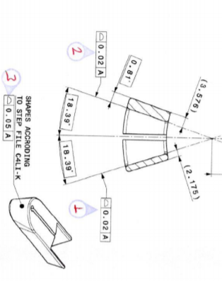
Components
  Winding keys:
  NCR 1885697: Magnetic permeability out of tolerances @ 1.9K 1.014 (Tol.<1.005)
  The spacers are made of stainless steel (316L, 14435)
  Note 1: Metrology performed by the manufacturer on all pieces (100%),
  Note 2: no CERN metrology requested by the component PE on these pieces.
  C4LI (internal layer, connection side):
On 7 parts (out of 38) shape defect up to 0.062
On 3 parts (out of 38) shape defect up to 0.080
On 17 parts (out of 38) shape defect up to 0.083

Slide 11
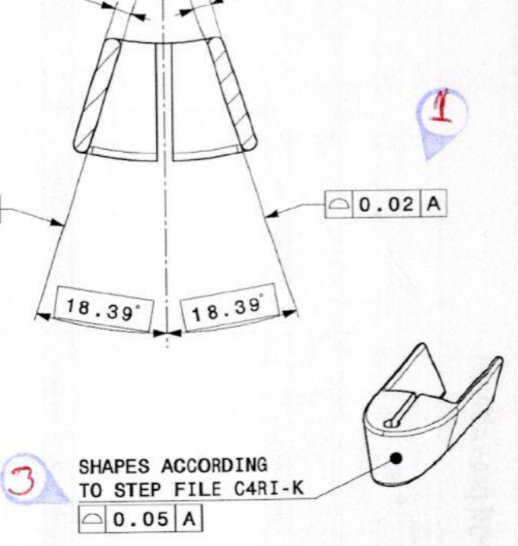
Components
  C4RI (internal layer, non connection side):
On 13 parts (out of 38) shape defect up to 0.028
On 6 parts (out of 38) shape defect up to 0.066
On 4 parts (out of 38) shape defect up to 0.076

Slide 12
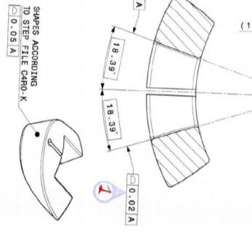
Components
  C4RO (external layer, non connection side):
On 3 parts (out of 38) shape defect up to 0.025
On 4 parts (out of 38) shape defect up to 0.094
On 3 parts (out of 38) shape defect up to 0.061

Slide 13
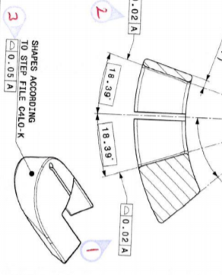
Components
  C4LO (external layer, connection side):
On 1 part (out of 38) shape defect up to 0.025
On 18 parts (out of 38) shape defect up to 0.098 (0.130 for one not used)
On 10 parts (out of 38) shape defect up to 0.075

Slide 14

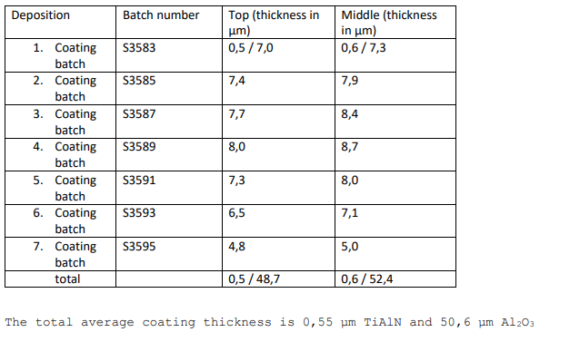
Components
  Coating of the winding keys:
    On all winding keys, coating thickness is ≈ 51µm (reports: EDMS 2058489 and 2021533).

Slide 15
Components – QXFB series production
  Remark: components procured via EN-MME.
  Spacers:
    Metallic parts: 2 deliveries
      Metrology reports Gevalco (sampling). 1st deliv.: 57% non-conform. 2nd deliv.: 0% non-conform.
      Metrology report (1 full set) from CERN available for the 2nd deliv.: 5/14 parts non-conform.
    Coated parts: US vendor. All the parts are measured. Thickness: 152.4 – 254 µm (6.0-10.0 minch)
  Poles: metrology by sampling. Most reports present values out of range. CERN metrology only for the last reception of outer poles: 100% parts non-conform.
  Wedges: 1 single batch used for the series for the time being. 1 NCR (wedge profiles bent and twisted - EDMS 2021818). 386/1150 parts returned to the supplier for rework after QA inspection.
  Interlayer (manufactured @ CERN): 3 NCRs detected (expired ceramic binder used
    EDMS 2274486, polymerization cycle longer than expected
    EDMS 2433071 and layer jump cut-off location
    EDMS 2441803) Minor/concession, all interlayers concerned were installed on coils.
  Bare cable:
    1 minor NCR : non conform cable length (CR115)
  Insulated cable: Thickness @ 5Mpa, out of tolerance on 7 coils (see separate presentation by F. Lackner)

Slide 16
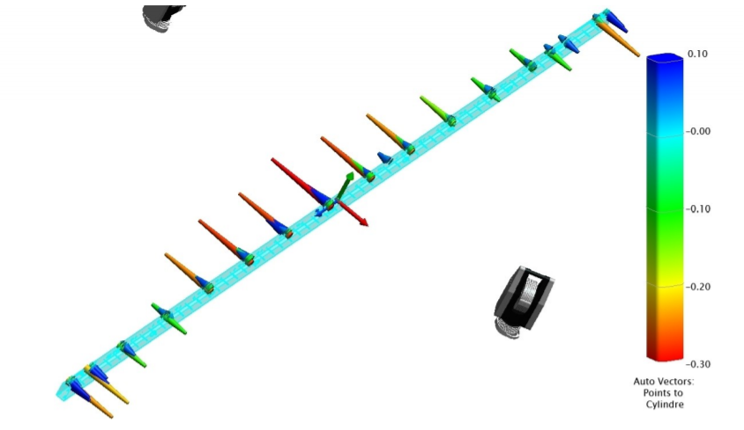
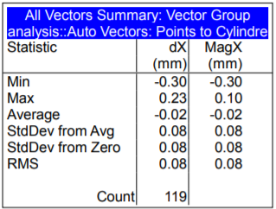
Tooling
  Mandrel inner layer: all drawings approved: LHC-MBH_T-DF-0025
  Mandrel outer layer: all drawings approved: LHC-MBH_T-DF-0026
  Reception: out of tolerance (LHC-MBH_T-RPT-0022)

Slide 17
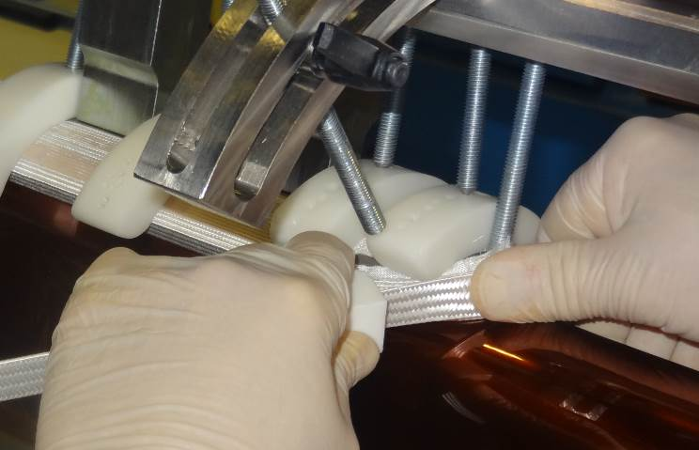
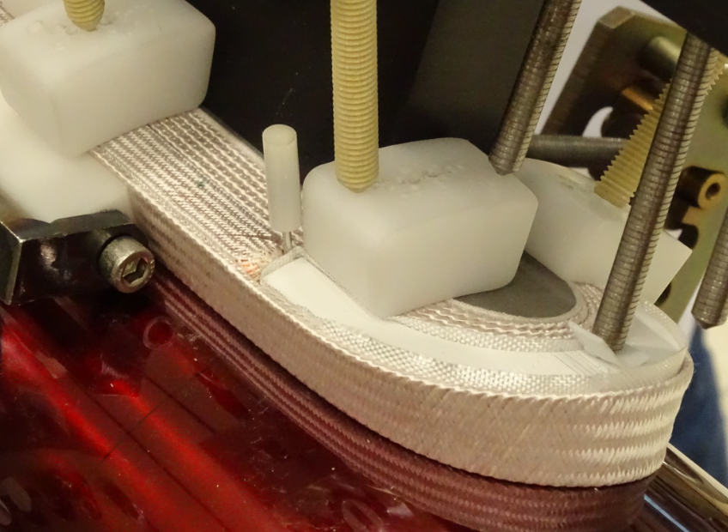
Differences in the 11T and MQXF production
  Note: In the turns, for 11T and MQXFB, the cable must be in contact with the mandrel during the entire turn.
  Tooling poles for 11T, final poles for MQXFB
  The winding tension is different on both due to the cable and coil geometry:
      11T: 23 kg for Inner layer and 17 kg pour outer layer,
      MQXFB: 19 kg for straight parts and 7 kg for turns on both layers (the tension in the turns is decreased following an analysis performed with US).
  Wedges: Sanded for MQXFB since beginning of series production.

Slide 18
Non conformities during production
  Non conformities (16 non critical, 2 critical)
  2 critical NCR on coils GE04 and 27 (scrapped).
  14 : Minor damages of the insulation.
  2 : important Pop out. Insulation damaged, repair needed.
Extracted from GE’s documentation

Slide 19
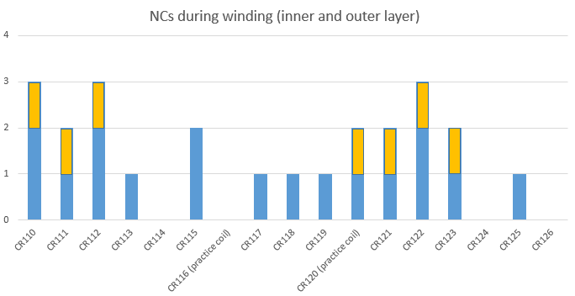
Non conformities during QXFB series Production
  24 non conformities (15 non critical, 9 critical)
  7 critical NCRs on cable insulation thickness
  (CR110, CR111, CR112, CR120, CR121, CR122, CR123)
  2 critical NCRs on coils CR120 and CR123:
    CR120: cable collapsed during winding
    CR123: cable insulation thickness + important pop out repaired (NCR 2455792)
  15 non critical NCRs related to cable insulation defects and minor issues during coil production.

Slide 20
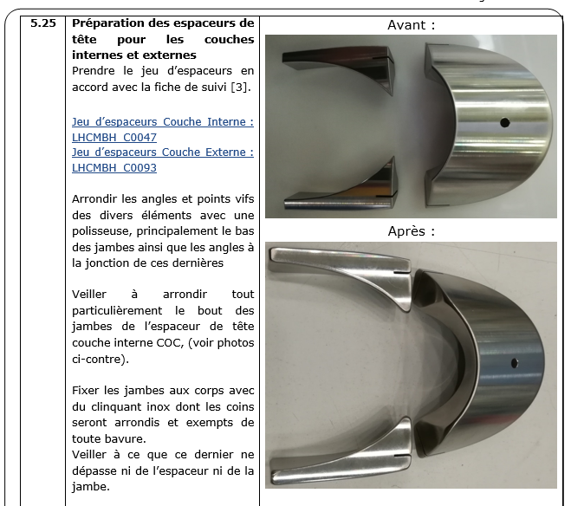
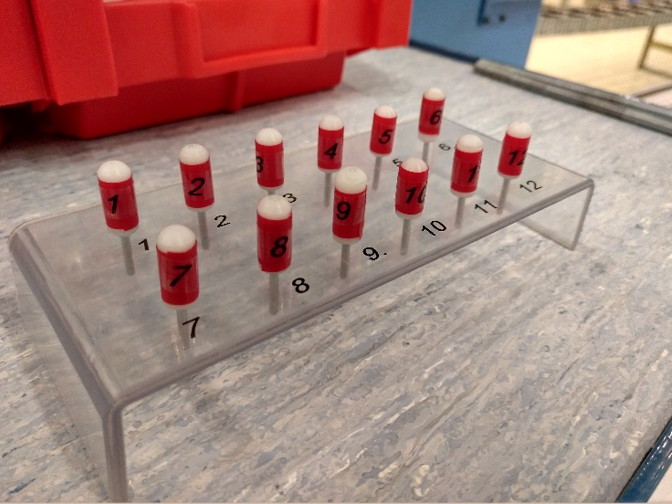
Adopted mitigations following major NCR (11T)
  Since GE03 (rev.8.0): the spacers are filed to avoid sharp edges (damage of cable ‘s insulation on GE02 during spacer installation, NCR 1962584):
  Since GE05 (rev.9.0): a pins storage box is used (major NCR on GE04 due to a forgotten pin, NCR 1995788):

Slide 21
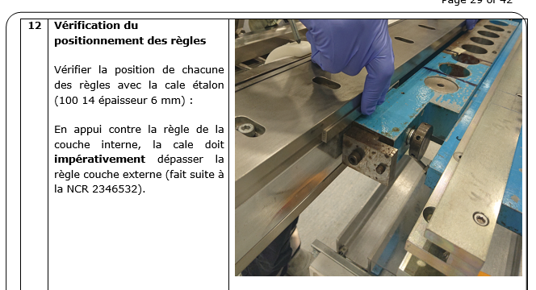
Adopted mitigations following major NCR (11T)
  Since GE28 (rev.17.0): an join inspection GE+ LMF-QA is carried out on the outer layer pushers (major NCR on GE27 due to a poor placement of the outer pushers, NCR 2346532):

Slide 22
Adopted mitigations following major NCR (MQXFB)
  Adopted mitigations before series production:
    Tooling: following NCR 2112154 (CR204) and NCR 2087338 (CR205), floating shim welded.
    Coil:
        following NCR 2025180 (CR201), NCR 2113779 (CR202), NCR 2142901 (CR203) and CR204, electrical insulation weakness: additional 5 turns of fiber glass around the pole parts
        Following NCR 2019982 (CR109), NCR 2113779 (CR202), NCR 2085135 (CR203), spacers coating damaged: new coating supplier.
  Adopted mitigations related to 11T magnet disassembly, before series production
    Coil component: copper wedges and pole parts sandblasted.
  Adopted mitigations during series production:
    Winding machine: following NCR 2341294 (CR115) and NCR 2419556 (CR120), consolidation of the cable tension sub-system and improvement of the cable unrolling sub-system.

Slide 23
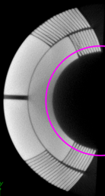
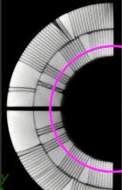
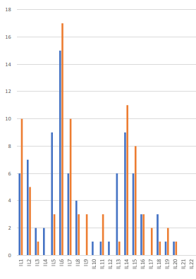
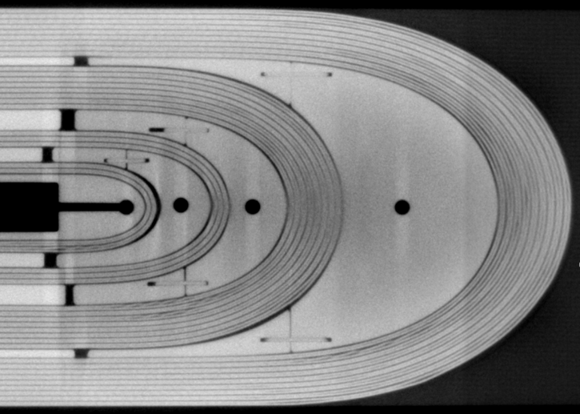
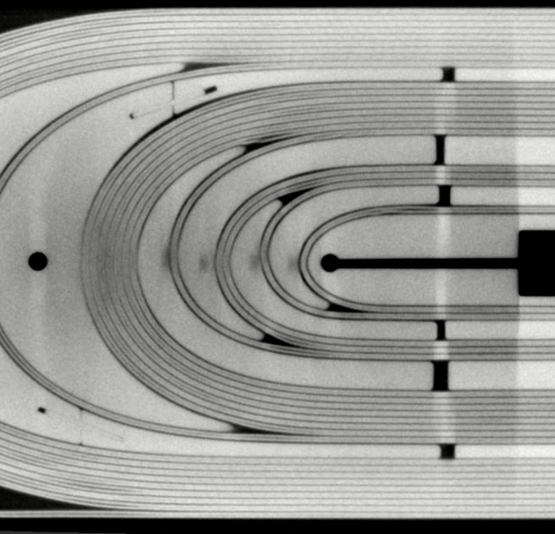
Outcomes after cold tests inspections
  Cable on inner layer (Tomography, courtesy of Dr S. Sgobba and B. Bulat)
GE11, Connection side
GE15, Non Connection side

Slide 24
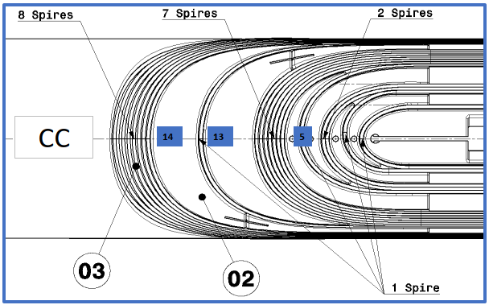
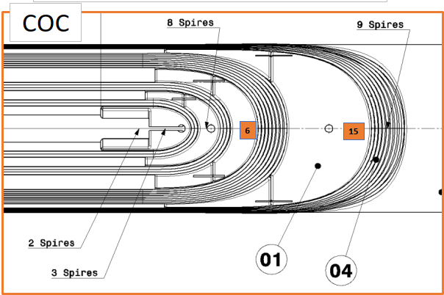
Outcomes after cold tests inspections
  Pop out during winding, on inner layer

Slide 25
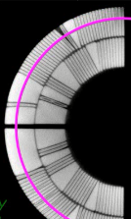
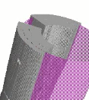
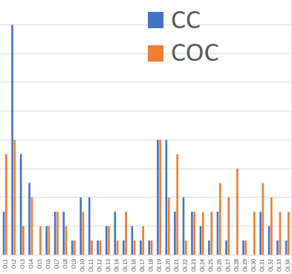
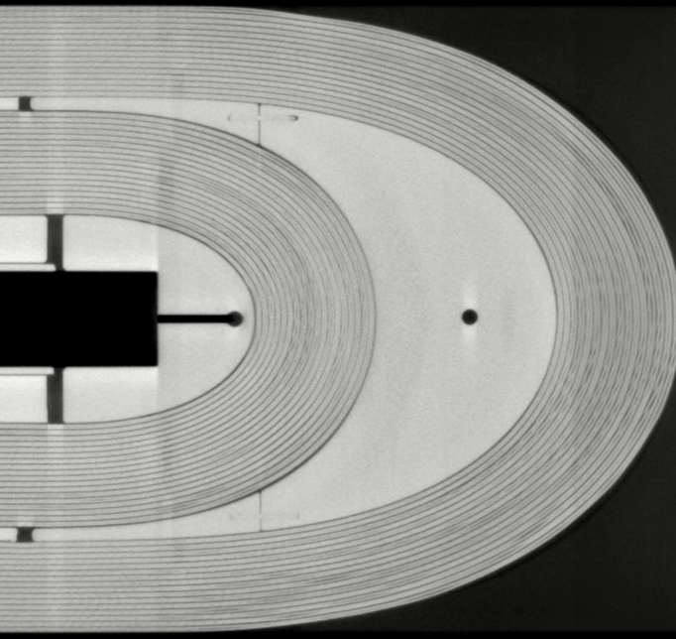
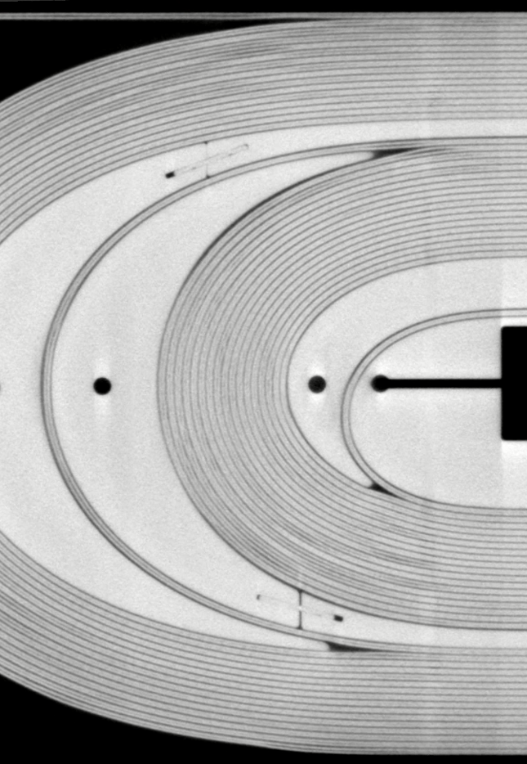
Outcomes after cold tests inspections
  Cable on outer layer (Tomography, courtesy of Dr S. Sgobba and B. Bulat):
GE11, Connection side
GE15, Non connection side
16
14
12
10
8
6
4
2

Slide 26
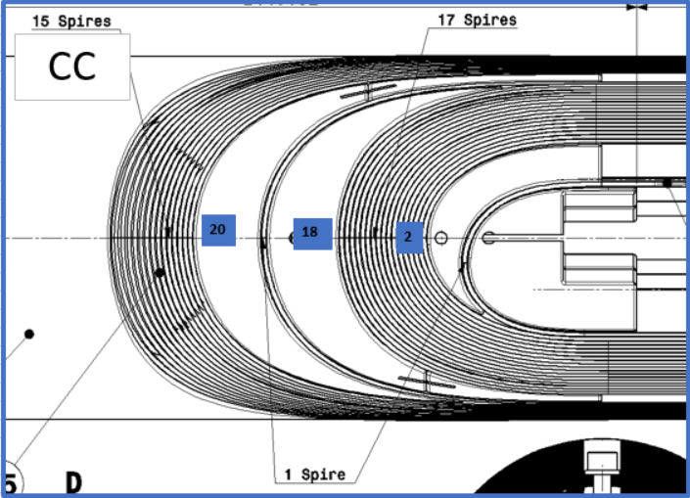
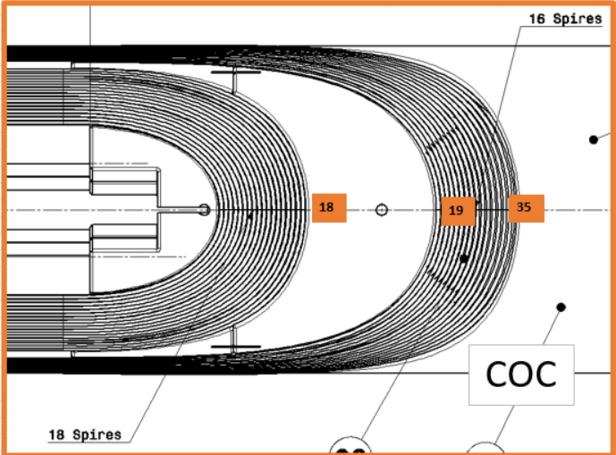
Outcomes after cold tests inspections
  Pop out during winding, on outer layer
16
14
12
10
8
6
4
2

Slide 27
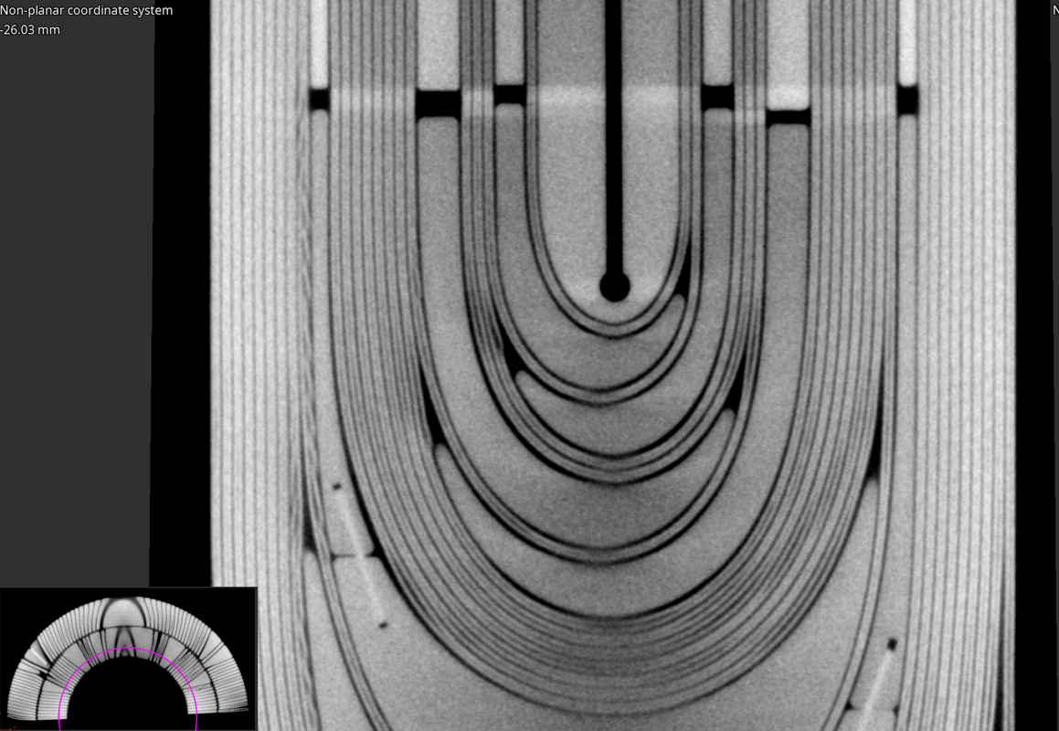
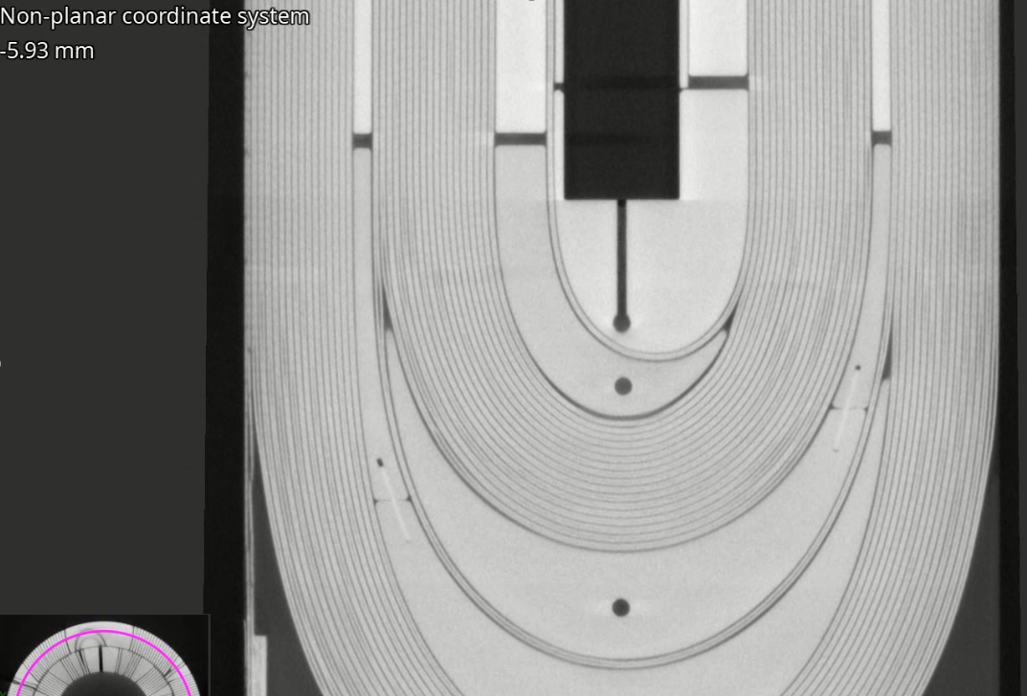
Outcomes after cold tests inspections
  Cable position on short coil 122 (Tomography, courtesy of Dr S. Sgobba and B. Bulat).

Slide 28
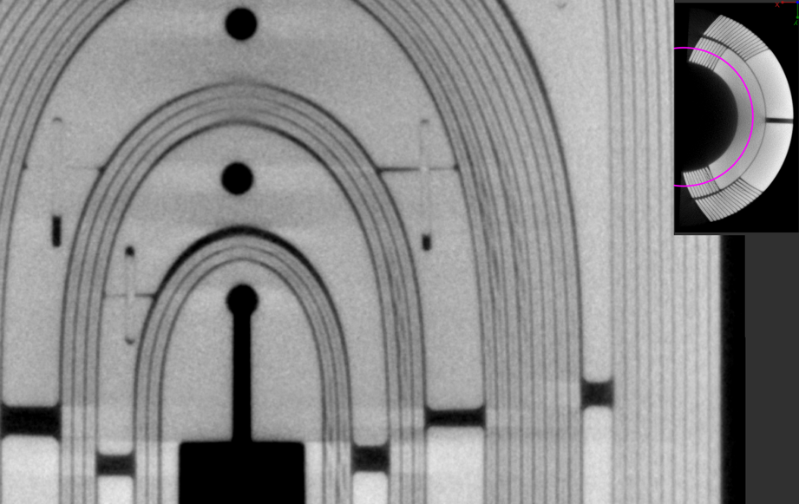
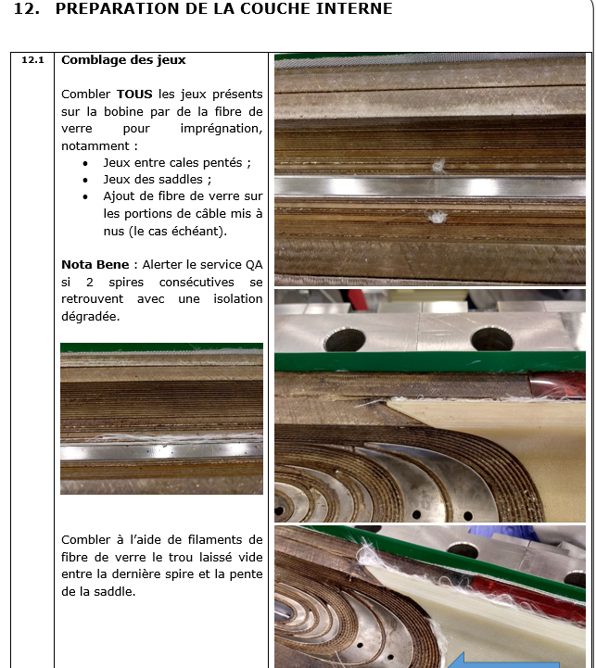
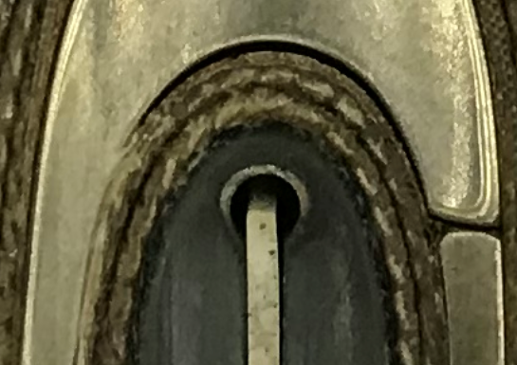
Outcomes after cold tests inspections
  On inner layer, empty spaces on non connection side (GE15).
  The gaps are filled with fiberglass before impregnation.
Does the fiberglass fill entirely the void (in depth)?

Slide 29
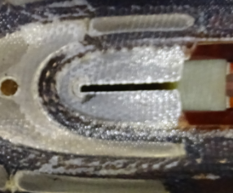
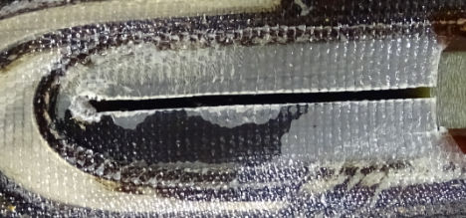
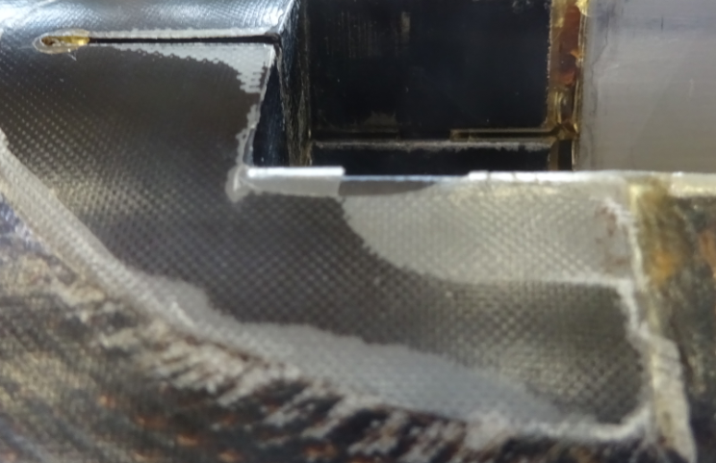
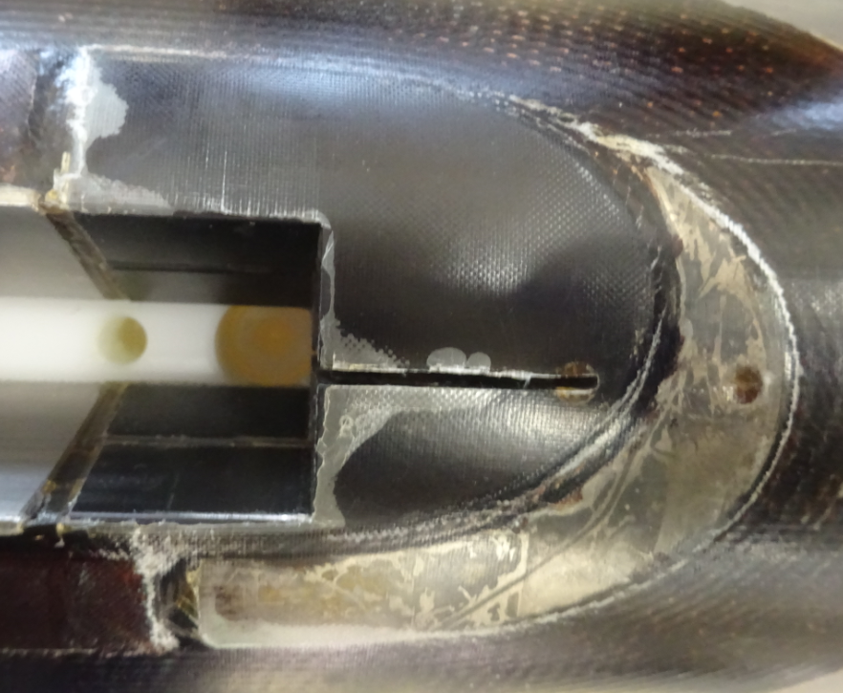
Outcomes after cold tests inspections
  Outcome from inspections after dismantling on GE02, GE03, GE08,GE09, GE10, GE12, GE14, GE15 and GE16.
  Recurent defects detected:
  Delamination on winding keys (both outer and inner layers):

Slide 30
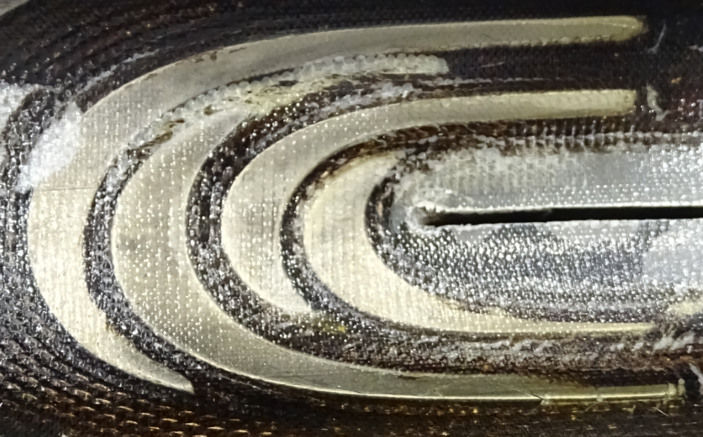
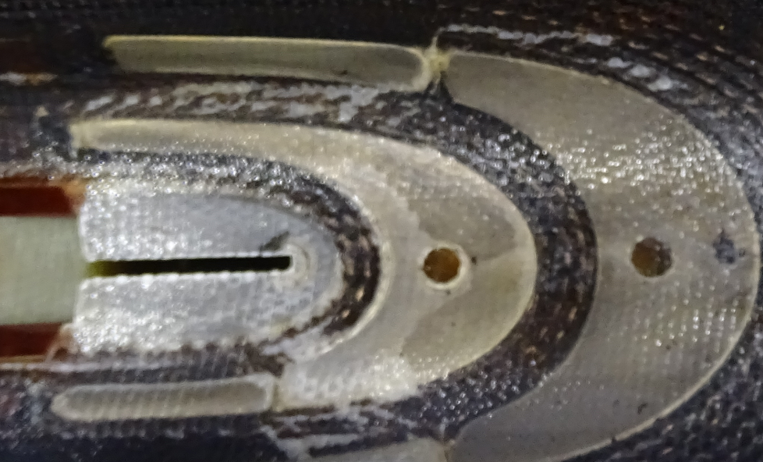
Non conformities and defects
  Cracks on the first turns on both sides (GE15):

Slide 31
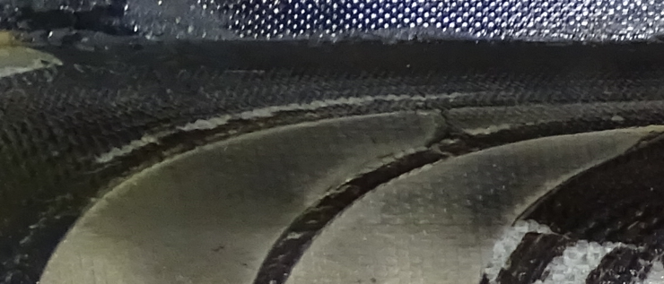


Outcomes after cold tests inspections
  Cracks on the between turns 14th and 15th on both sides:
Courtesy of Dr S. Sgobba and B. Bulat

Slide 32
Future proposed improvements
  Winding keys to be sanded for a better adhesion of the resin (action already taken on MQXFB).
  Spacers and winding keys geometry?
  Process? Choice to keep the cable in contact with the mandrel during the turns?
  The empty spaces on inner layer could be filled before outer layer winding (no more access later on the outer side of the inner layer).

Slide 33
Thank you

Slide 34

Annex 1: Drawing HCMBH_C0048 rev B (extract)

Slide 35

Annex 2: Drawing HCMBH_C0093 rev B (extract)

