Slide 1
11T and QXF SC cable insulation, production and sampling
TE-MSC-SMT, F. Lackner
TE-MSC-LMF, R. Principe
05.05.2021, 11T New Task Force - TEAM2 11T QA QC Meeting#1

Slide 2
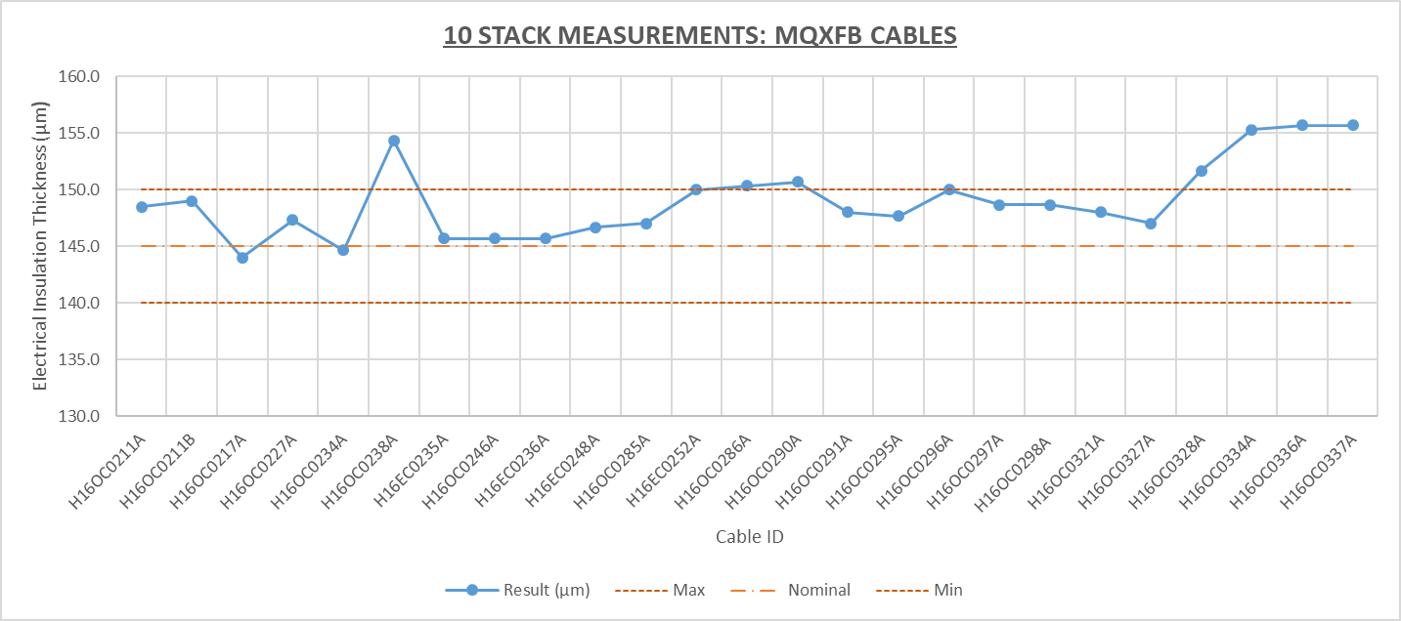
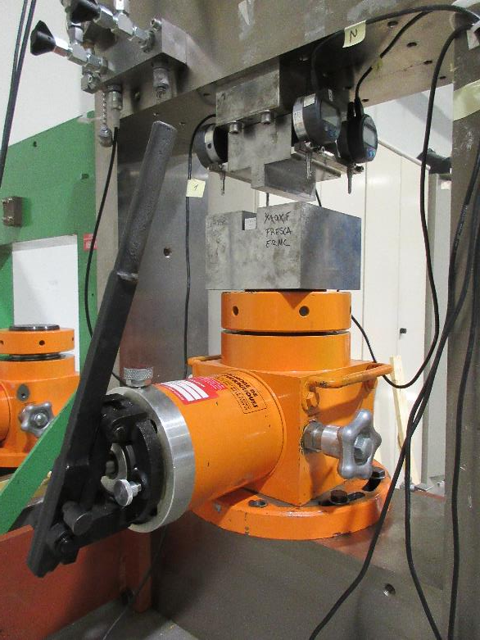
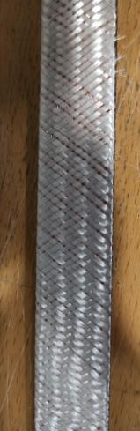
Recent NC on insulation thickness of MQXFB Rutherford cables
Main observations:
  Visual inspection: Irregular braiding (yarn count)
  Compressive test: 10-stack sample thickness out of tolerance
!
Courtesy of - Elena Fernández Mora TE-MSC-SMT

Slide 3

Company visit at (22nd of April)
Agenda:
Observed NC’s on CERN site related to the braiding uniformity
Feedback from CERN QC control of braiding thickness
Established production process/procedures at CGP for the different production lines
The procedure for the 6 m sample preparation at CGP
QC hardware and established QA at CGP
Documentation and reporting
Feedback and experience from CGP on the contract B1505 with CERN
Visit of production line
Conclusion and identification of mitigation/action items
Visit report EDMS
NC report EDMS

Slide 4
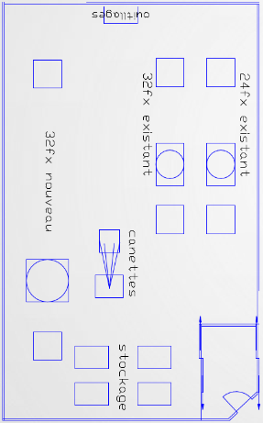
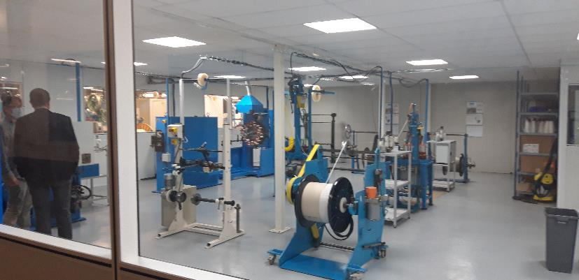
Visit at manufacturing lines for CERN
Dedicated braiding area for CERN contract
Stringent QA/QC including documentation of NC and mitigation
Online monitoring (geometrical QC), optical cameras (20000 points per cable length)
3 production lines in operation, varying in the amount of spindles used
2 vertical braiding lines (24 and 32 spindles max.)
1 new horizontal braiding line (32 spindles max.)

Slide 5
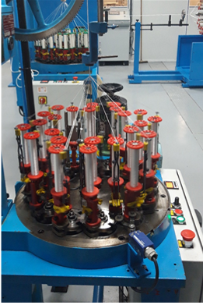
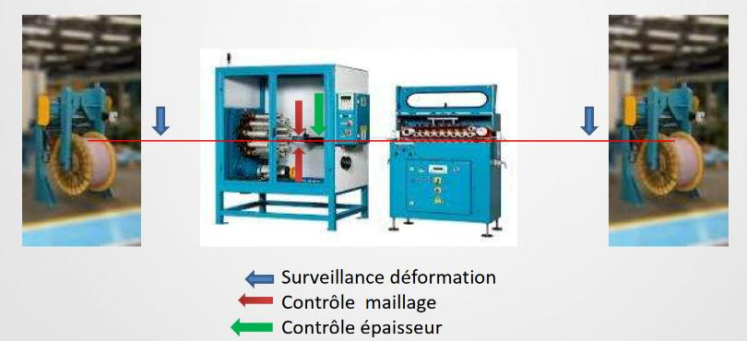
Horizontal braiding
Several advantages were listed for the horizontal braiding:
Increase of spindle volume, no interchange throughout long cable braiding
Easier trajectory of cable, less deformation in transverse direction
Reduced maintenance due to fact that small fibers are not filling up on the otherwise vertical filament guides, low risk in fiber pollution due to lubrication
Easier manipulation of 800 m cable reels, the portal support of the unrolling and collection rolling units allow improved logistics

Slide 6
Observations: Sample preparation
Change towards sample preparation at CGP
  6 m samples are required to verify insulation thickness based on 10-stacks in bldg. 927.
  Previously cutting performed at LMF in non dedicated zone, therefore strong wish to improve cutting operation.
  Change of procedure correlates with NC observations, therefore careful investigation of the sample preparation.
  Due to significant amount of NC with new horizontal machine CERN requested production on vertical braiding line.

Slide 7
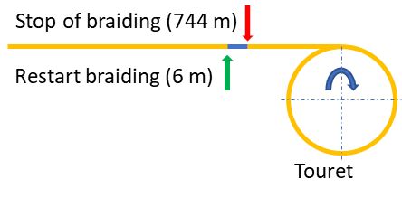
Procedure: The 6 m sample preparation at CGP
Braiding operation is launched for MQXFB based on usual parameters for both production lines (Old vertical and new horizontal braiding line)
Braiding full cable length (Lcable) minus the 6 m sample length (Lsample).
Stop after the condition Lcable – Lsample has been achieved.
Subsequent the braiding is cut and secured with tape. Tape is overlapping 50% of the fiber and 50% on the cable, avoiding opening or movement of the fiber scheme.
The braiding is prepared on the 6 m sample
The machine is restarted for the last 6 m. Reduced torque and tension!
The sample is cut after finalizing the 6 m braiding.
Packing and shipping of sample is prepared.
Risk: Sample not representative of full cable length?

Slide 8
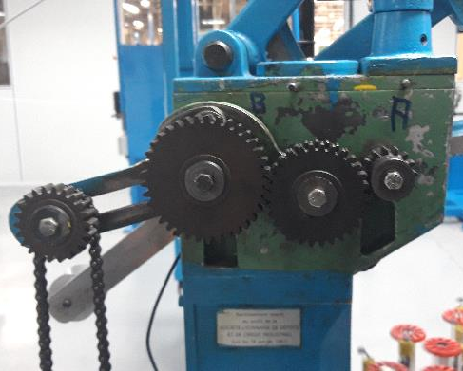
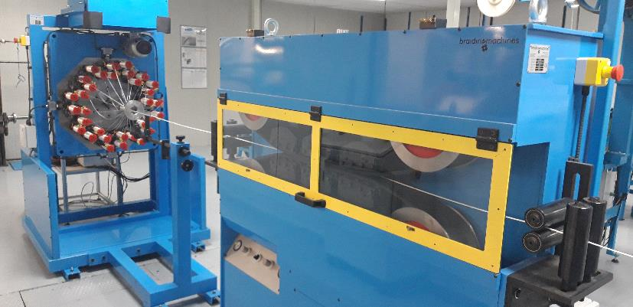
Facts
Very low amount of NC observations related to “old” purely mechanical controlled braiding line
Significant amount of NC on horizontal line
Feedback CGP: Mechanical braiding line is stabilizing very quick after a restart – 6 m sample shows better results
Newer electronic controlled production line requires longer distance to stabilize
Hypothesis:
Current sample preparation does not allow to represent quality of full braided cable length
Error less pronounced on vertical (“old”) machine due to faster stabilization

Slide 9
Mitigation
Why CGP is not unrolling the sample from finalized length?
According to CGP the cutting of braided fibre shall always be avoided. Taping shall always be carried out with a sufficient overlap to the base material.
With 2x 26 m long samples of the MQXFB Rutherford cable, CGP is asked to provide braiding on both, the horizontal and vertical machines. This shall allow to confirm the feedback and hypothesis regarding the sample preparation.
Vertical machine: 20 m braiding incl. a 6 m braided sample according to the same procedure as currently established for the full length production.
Horizontal machine: 20 m braiding incl. a 6 m braided sample according to the same procedure as currently established for the full length production.
If the hypothesis in confirmed further mitigation items will be discussed related to the sample preparation.

Slide 10
Conclusion
Investigation of observed NC ongoing, potential root cause is given by the sample preparation at CGP.
CGP sample is prepared with last 6 m of full cable length (about 750 m).
Prior sample braiding the machine is stopped to re-tape the fiber insulation, avoiding to cut the sensitive fibers.
Horizontal and Vertical machine differ in their stabilization time required to achieve homogeneous fiber matrix.
Mitigation on the way, 2 samples will be produced at each machine (shall allow to confirm observations).
Further action items will be defined subsequent to proposed analysis.

Slide 11
Thank you for your attention.

