Slide 1
Data-driven risk matrices
for CERN accelerators
A. Apollonio, G. Blarasin, T. Cartier-Michaud, J. Uythoven

Slide 2
Outline
Introduction to Risk Matrices
History of Risk Matrices at CERN
#Data-driven approach
Continuous Risk Curve (CRC)
Risk Matrices and CRC for
CERN accelerators

Slide 3
Risk Matrix: what, why, how? (1/2)
Decision tool summarizing occurrence (measured as probability or frequency) vs severity (measured in CHF, downtime, …) of an undesired event in order to derive reliability targets / risk reduction for systems under design
Failure mode analysis used to identify undesired events
Comparison of different events based on risk = probability * severity
 | Negligible | Marginal | Critical | Catastrophic
Certain | Moderate | High | Extreme | Extreme
Possible | Low | Moderate | High | Extreme
Rare | Low | Low | Moderate | High

Slide 4
Risk Matrix: Limitations (2/2)
Many events could result in the same classification, even being of very different nature
  High probability*low severity =?= low probability*high severity
Definition of axes depends on the application
  Strongly non-linear or non-logaritmic in some cases
  A wrong discretization can lead to significant errors in requirements definitions
 | Negligible | Marginal | Critical | Catastrophic
Certain | Moderate | High | Extreme | Extreme
Possible | Low | Moderate | High | Extreme
Rare | Low | Low | Moderate | High

Slide 5
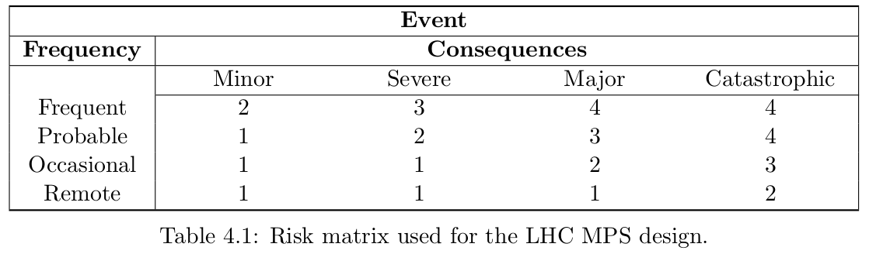
History of CERN’s risk matrices (1/2)
Risk matrix for LHC Machine Protection Design, most recent = 2013
M. Kwiaktowski (link to PhD), B. Todd, R. Schmidt
Frequent = once per 0 - 100 days
Probable = once per 100 - 1000 days
Occasional = once per 1000 – 10,000 d.
Remote = not expected in 10,000 days
Catastrophic = more than 200 days of repair or more than 50 MCHF
Major = 20 - 200 d. or 1 - 50 MCHF
Severe = 2 - 20 d. or 0.1 - 1 MCHF
Minor = 0 - 2 d. or 0 - 0.1 MCHF

Slide 6
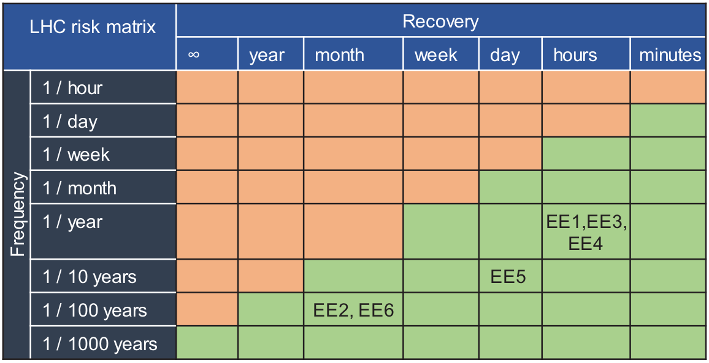
History of CERN’s risk matrices (2/2)
2019 Reliability Requirement and Initial Risk Evaluation (RIRE)
M. Blumenschein (link to paper), J. Spasic, J. Steckert, J. Uythoven
=> higher resolution (especially towards short / low impact faults)
=> use of recovery time to account for impact of high-energy dumps
=> based on LHC experience (expert estimates for acceptable/unacceptable)
LHC risk matrix filled with quench detection system End Effect (consequence of a given failure mode)

Slide 7
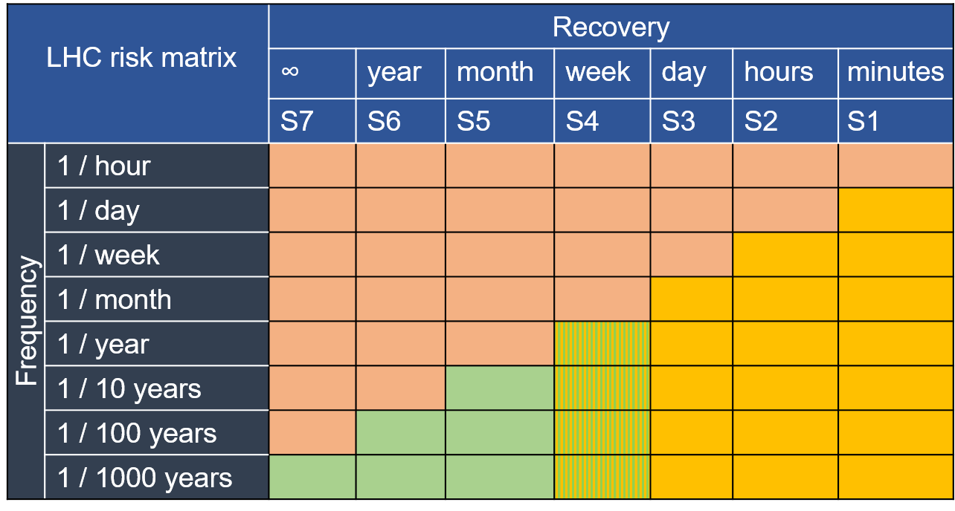
Protection and Availability
Protection
Availability
No statistics available: extrapolations based on operational experience
P_{F} * P_{prot_eff}
P_{F} * (1 - P_{prot_eff})
Statistics available: data-driven approach

Slide 8
Higher resolution: Continuous Risk Curve (1/3)
Discretization problem – statistical relevance
d
duration of fault
(not a timeline)
d

Slide 9
Higher resolution: Continuous Risk Curve (2/3)
Back to the definition of each column:
number of events of the order of a duration d
=> use of an extra parameter: alpha
=> continuous parameter
convolution product with rectangle window [d / alpha , d * alpha]
d = 60min
d
duration of fault
(not a timeline)
d = 61min
A unique fault is “visible” from different points of the curve

Slide 10
Higher resolution: Continuous Risk Curve (3/3)
Back to the definition of each column:
number of events of the order of a duration d
=> use of an extra parameter: alpha
=> continuous parameter
convolution product with rectangle window [d / alpha , d * alpha]
alpha = 5
[12min 60min 300min]
d
duration of fault
(not a timeline)
alpha = 3
[20min 60min 180min]

Slide 11
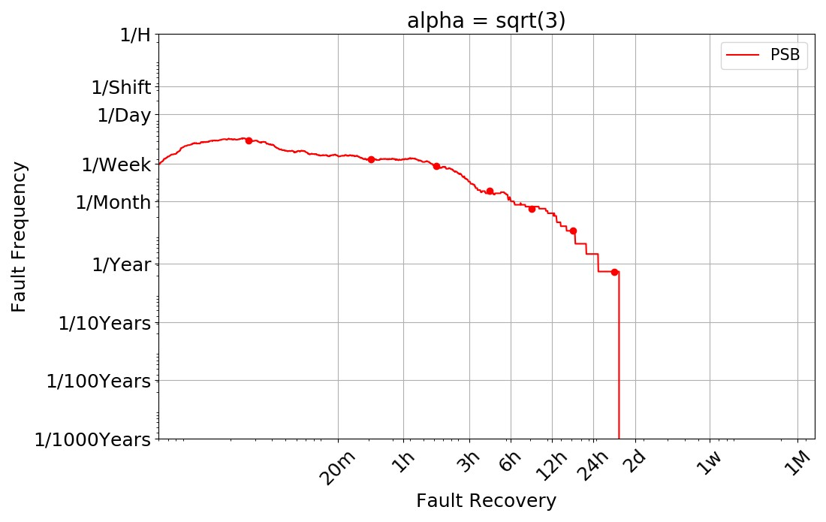
Construction of continuous curves
Each point of the curve represents faults with:
- a recovery time “of the order of ” the corresponding value on the x-axis
- a measured frequency indicated by the corresponding value on the y-axis

Slide 12
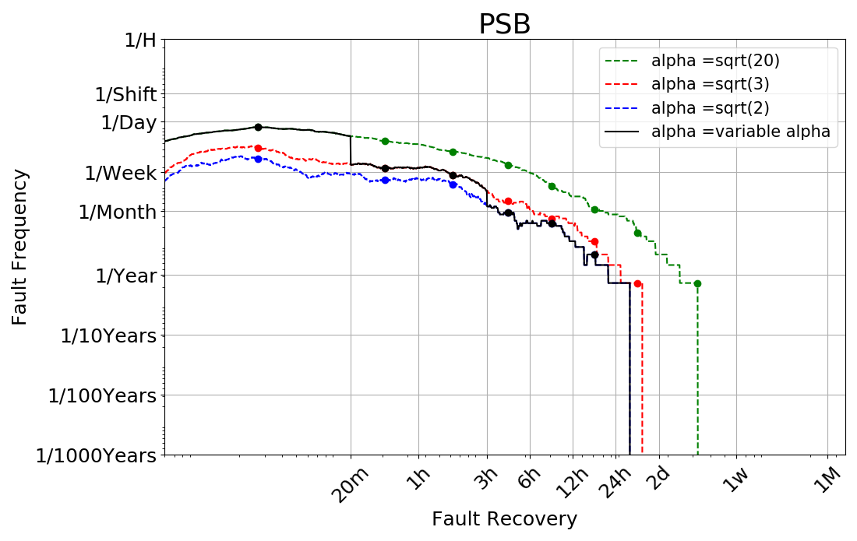
Advantages of CRC
Loss of information?
The discretisation of the matrix should follow the main variations of the curve (of every machine)
Acceptable vs unacceptable?
A failure mode is unacceptable if it does not lay in the shadow of the other failure modes
Solved with remote reset
Access to the machine
No access to the machine
Outliers

Slide 13
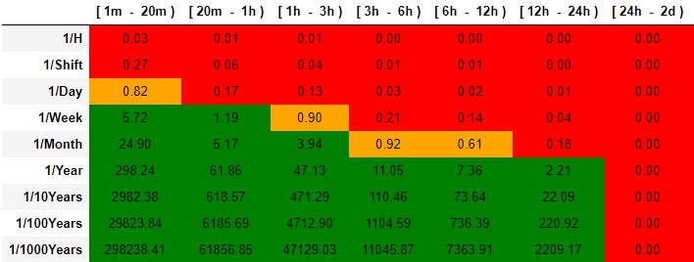
From CRC to
Risk Matrices
Calculation of failure frequency F for each cell
Acceptable if F >1
Unacceptable if F < 0.33
“At the limit” if 0.33 < F < 1
Note: this is the accelerator matrix, so all failure modes are contributing to each box. For individual systems a margin should be considered

Slide 14
Risk Matrices: Extension to Protection Scenarios
No statistics available for protection scenarios (low-frequency / high impact)
Need to define an acceptable “unavailability budget” due to the occurrence of such events
consider a machine with 95% availability (5% unavailability)
assume we allow a relative unavailability increase by 10%
(i.e. 0.5% absolute)
Then all combinations of frequency/recovery time should not exceed this limit in the protection scenarios
In the following we assume as acceptable a 10% relative unavailability increase to define the shape of the matrices

Slide 15
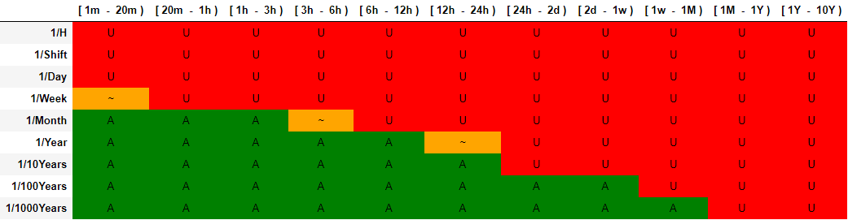
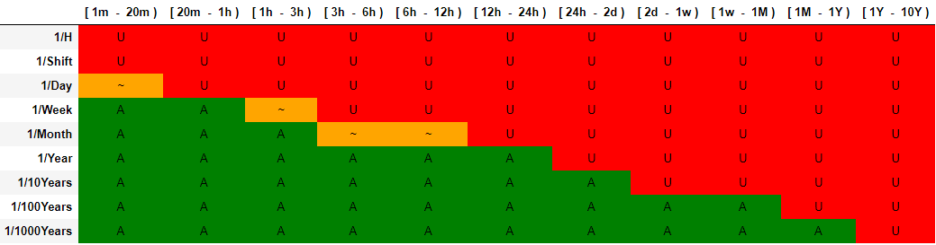
Linac2
PSB

Slide 16
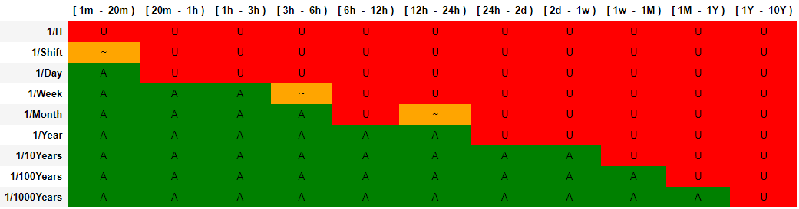
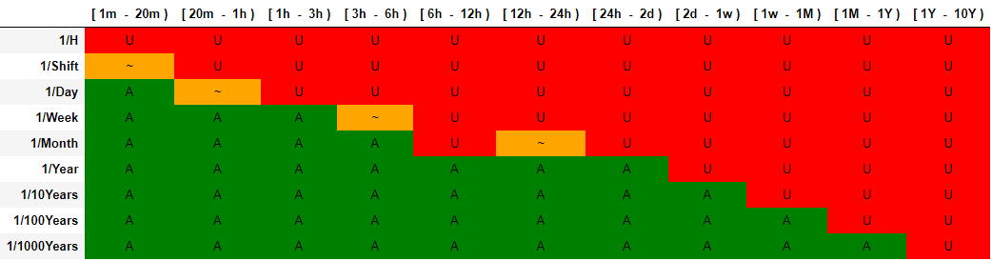
PS
SPS
*
*https://aft.cern.ch/faults/275215

Slide 17
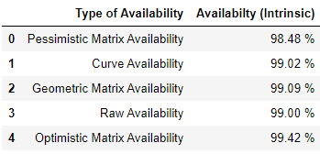
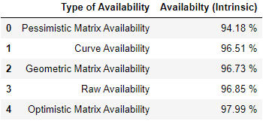
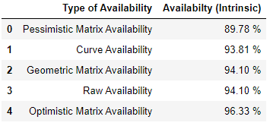
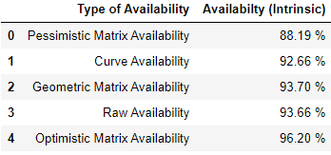
Availability estimates
LINAC2
PSB
PS
SPS

Slide 18
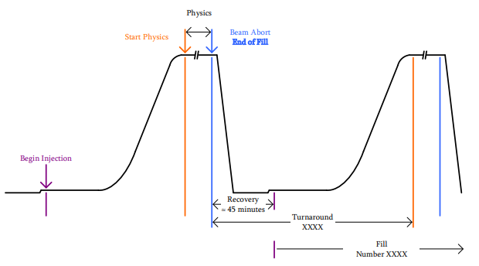
Top Energy Penalties
Turnaround ≈ 3h
https://cds.cern.ch/record/2650574/files/awg_p+_acc_note_2018_0081.pdf

Slide 19
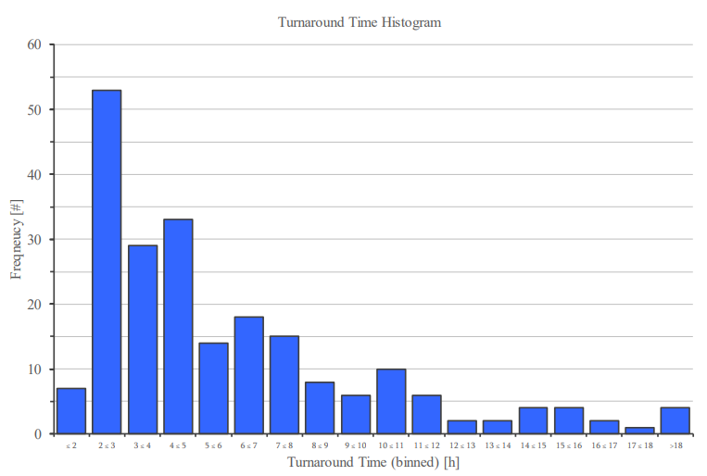
Turnaround Estimation ≈ 3h
≈ 3h

Slide 20
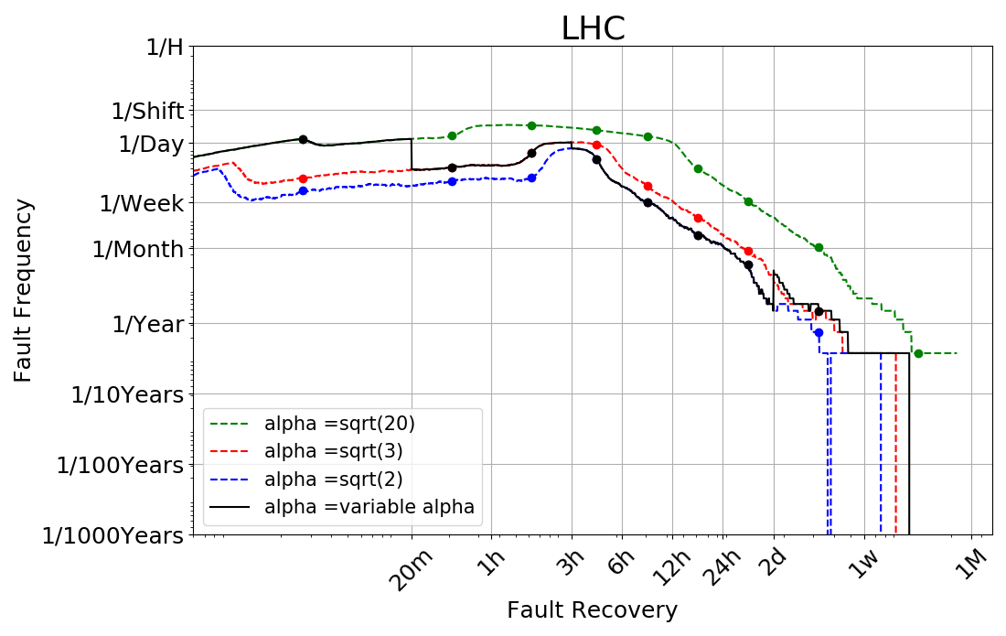

Slide 21
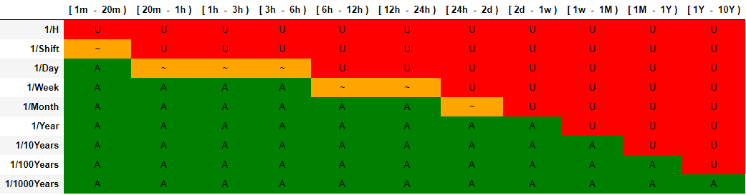
LHC Risk Matrix
The matrix well reflects how the LHC has operated in the last years
Faults with up to 6h recovery times are expected on a daily basis
(R2E dumps, UFOs, QPS trips, PC trips, etc.)
Longer stops (6h<d<24h) are expected on a weekly basis (e.g. quenches, cryo stops, …)
Some outliers are expected once per year (e.g. weasel)

Slide 22
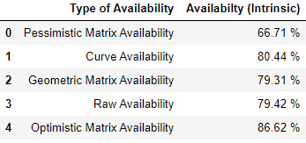
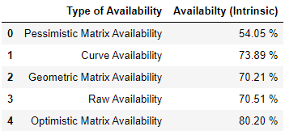
LHC – Correction Effect
Without Correction
With Correction
Corrections lead to a decrease in availability of about 9%

Slide 23
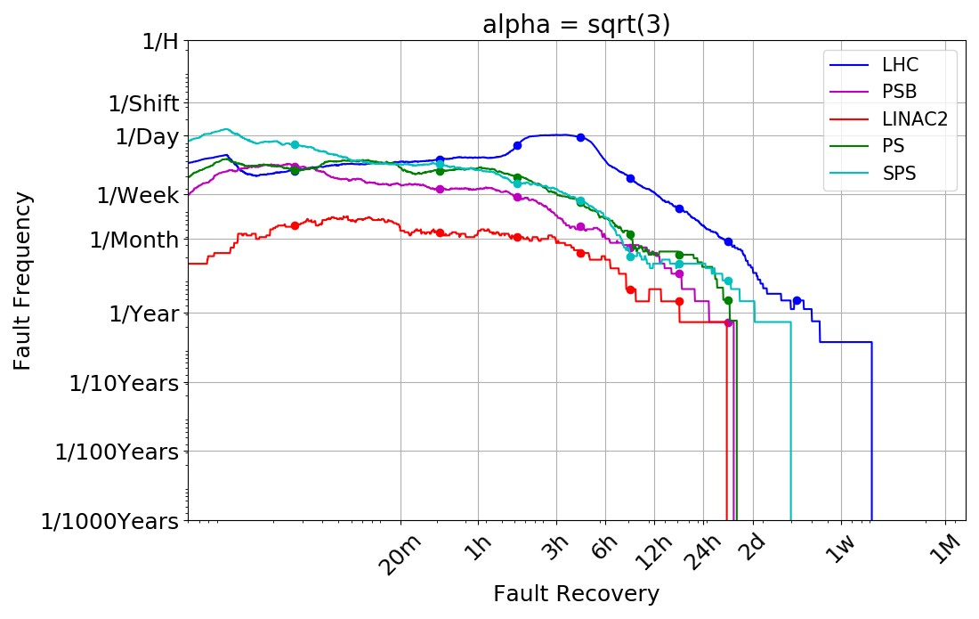
Comparison Among Machines

Slide 24
Conclusions
Risk matrices are a widely used tool for risk analysis
Their use at CERN goes back to the LHC design phase, where failure probabilities and consequences were estimated by experts
A new data-driven approach was proposed for a better definition of acceptable and unacceptable failure modes, thanks to the gained experience with the machine:
  Continuous risk curves
  New risk matrix discretisation
The approach was for the first time extended to all CERN machines
Data-driven risk matrices can be used to improve the definition of reliability requirements for new systems designs (e.g. BIS and SMP 2.0, D1 and D2 protection, R2E project goals, etc.)

Slide 25
Outlook
A note is under preparation to summarize the outcomes of the analysis (with a detailed description of the process and maths behind) under review of the MARP members
Proposition of an implementation of the data-driven approach directly in AFT: the matrices would be updated online and be self-maintained

Slide 26
Thank you :-)

Slide 27
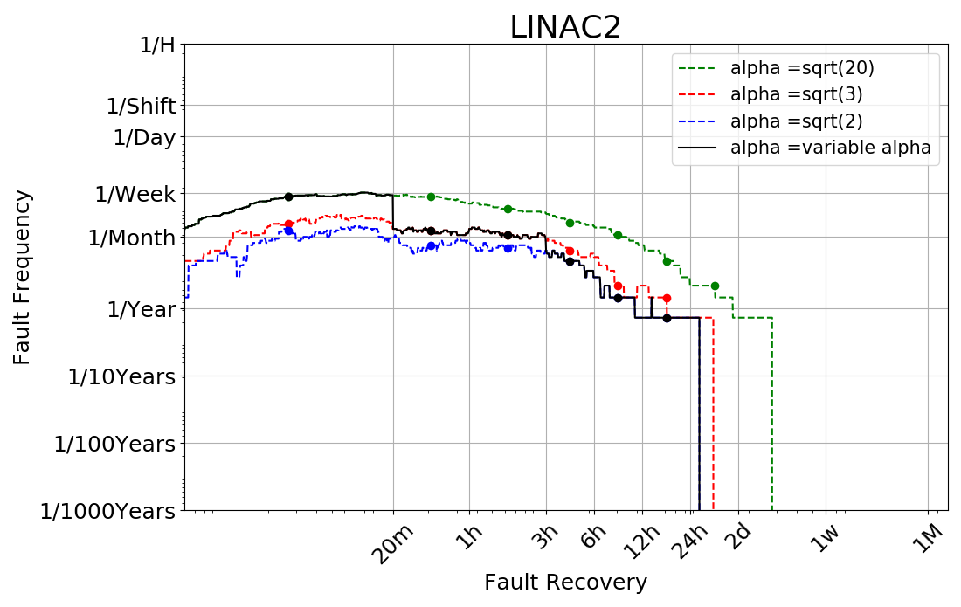

Slide 28
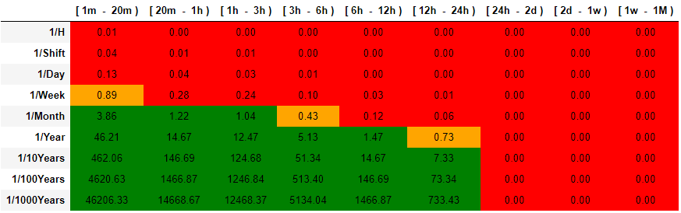
LINAC2

Slide 30
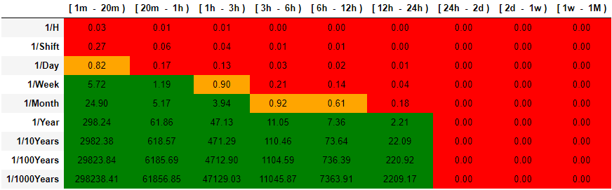
PSB

Slide 31
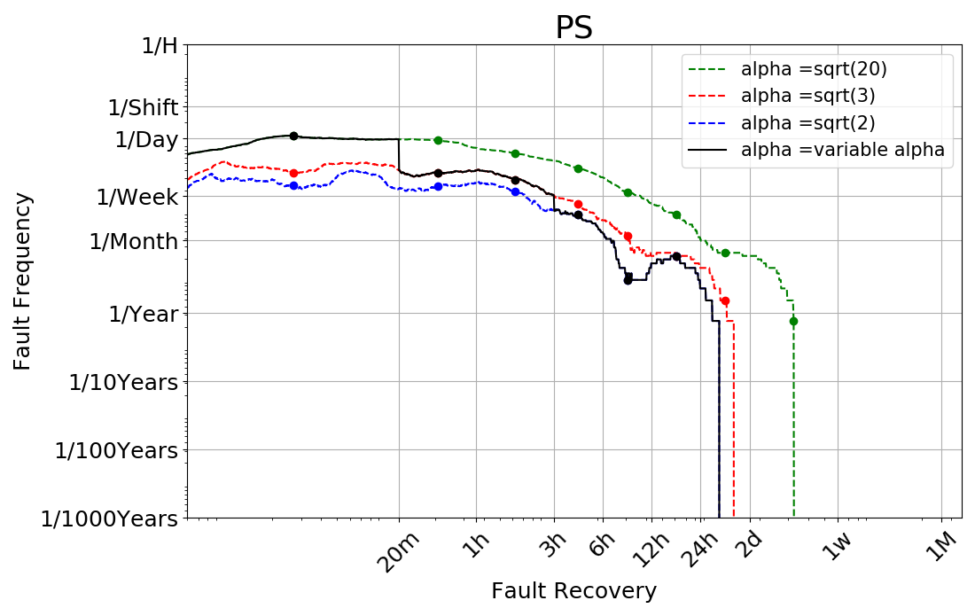

Slide 32
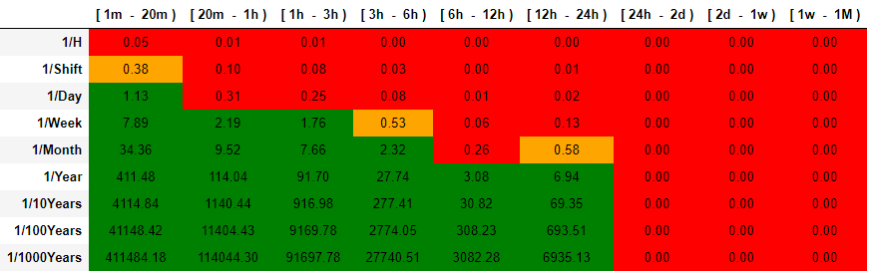
PS

Slide 33
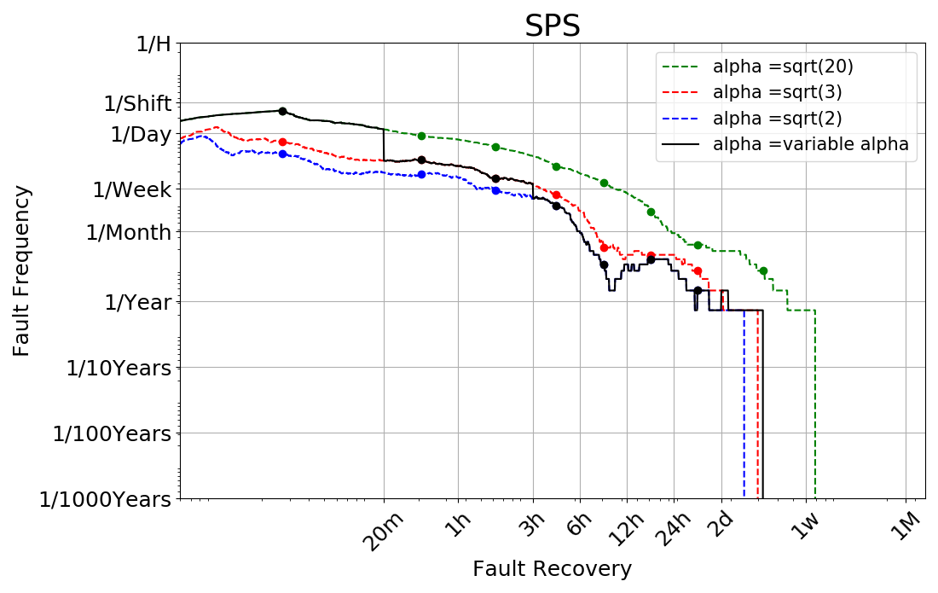

Slide 34
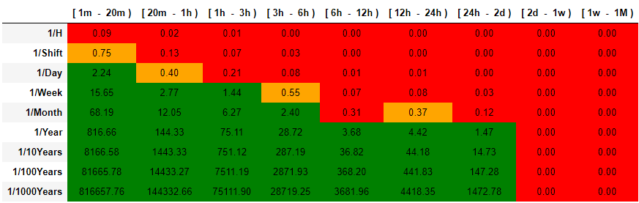
SPS

Slide 35
Latest developments
2020 Data-Driven risk matrices and continuous risk curves
A. Apollonio, G. Blarasin, T. Cartier-Michaud
=> use of AFT to populate the risk matrix #Data-Driven ;-)
=> introduction of “Continuous Risk Curve” to access the whole knowledge to define the discretization and acceptable / unacceptable criterion
How to better define the acceptable / unacceptable limit?
==> “unique solution” or “unique shape” of the matrix?
How to better define the discretisation in both dimensions?
==> quantification of the loss of information?

Slide 36
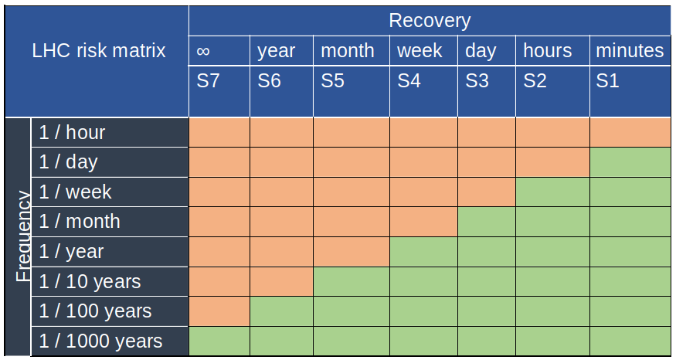
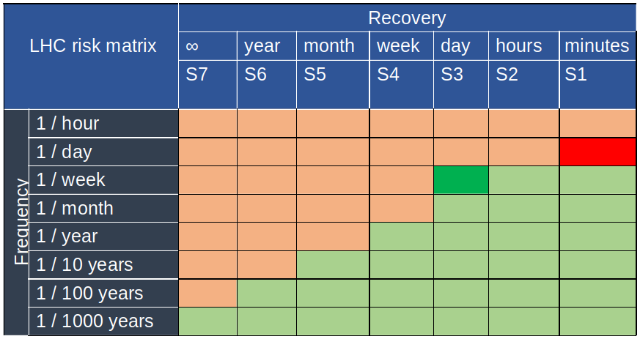
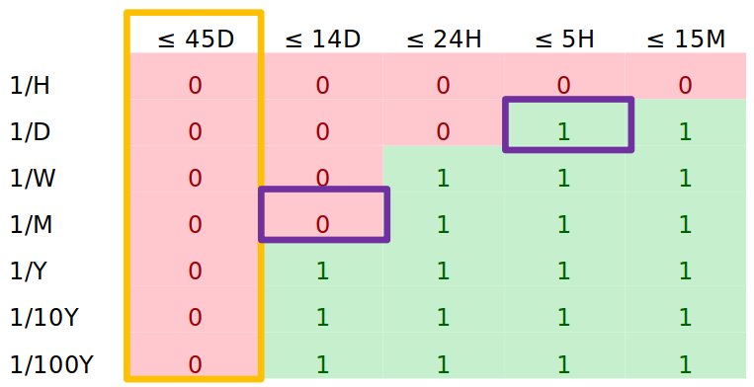
#Data-driven shapes
How to better define the acceptable / unacceptable?
==> “unique solution” or “unique shape” of the matrix?
Several shapes can lead to the same
recovery time / cost
Are we (more or less) pleased with
the way injectors operate already?
==> definition of the shape by
using AFT data + processing of data
Hedi Trabelsi
2 weeks intern

Slide 37

Extracting the data
Data-sources
Since the study is data-driven,
choosing and pre-processing
databases is an important task
Post Mortem
E-Logbook

Slide 38
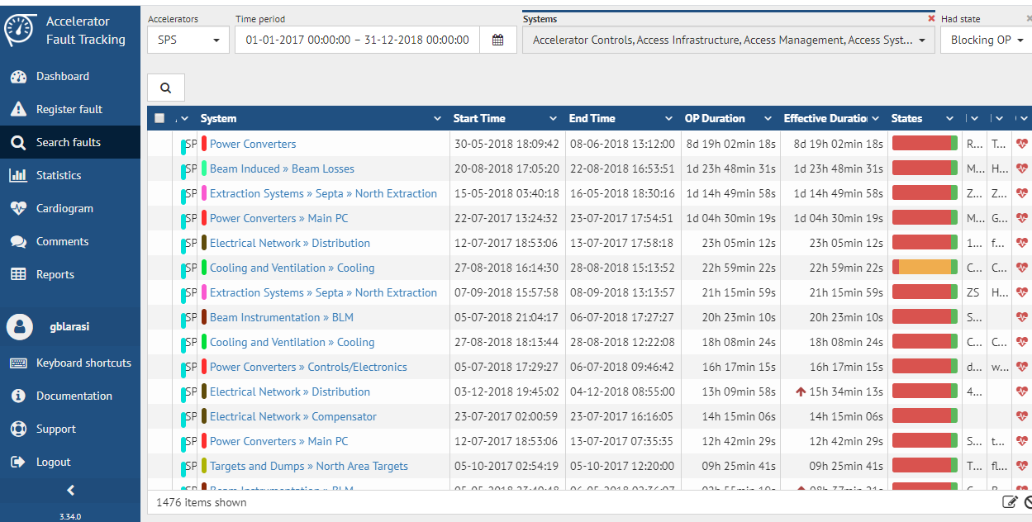
Extracting the data - Filters

Slide 39
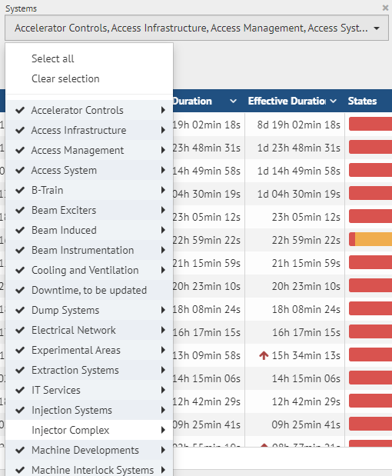
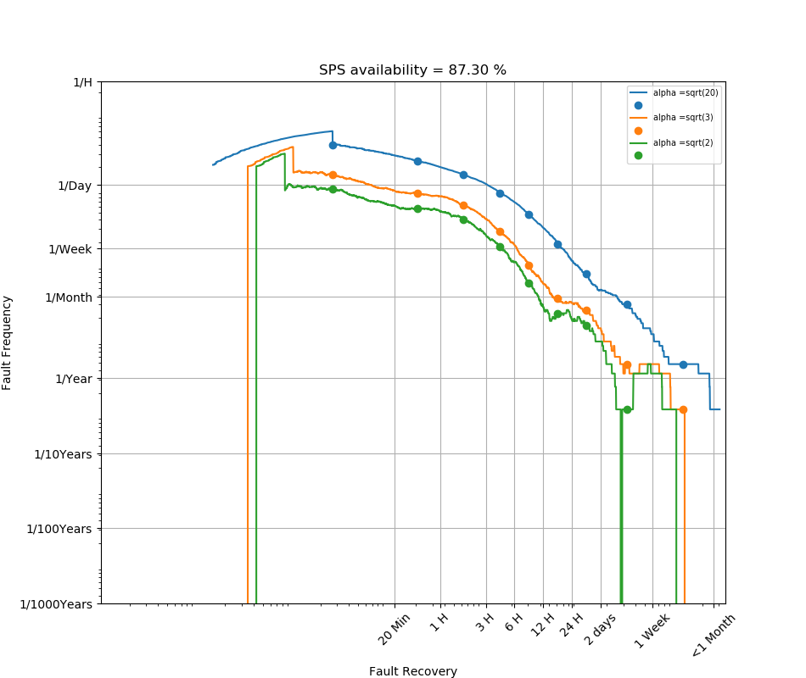
Extracting the data - Filters
Whenever beam is not available for a given machine due to faults of its injectors a fault is assigned to ”injector complex”

Slide 40
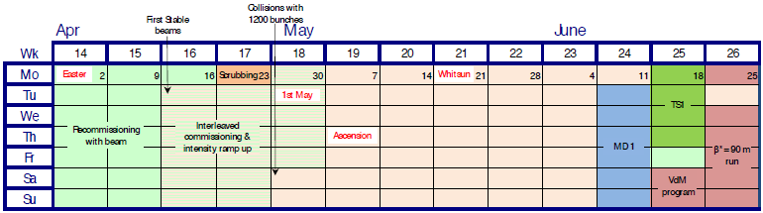
Extracting the data - Scope
Injectors: [2017 - 2018]
LHC: [2015 – 2018]
=> AFT has been in use in injectors since 2017, only considering 2 years to have the same accuracy
=> Operational Years. Double check with E-Logbook

Slide 41
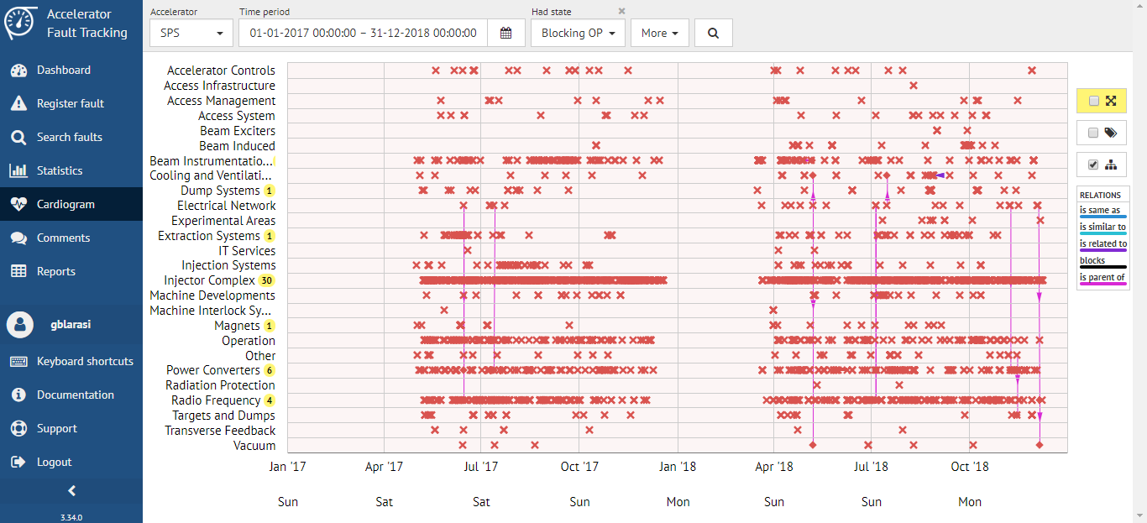
Scope - Cardiogram

Slide 42
Scope - Cardiogram
2017

Slide 43
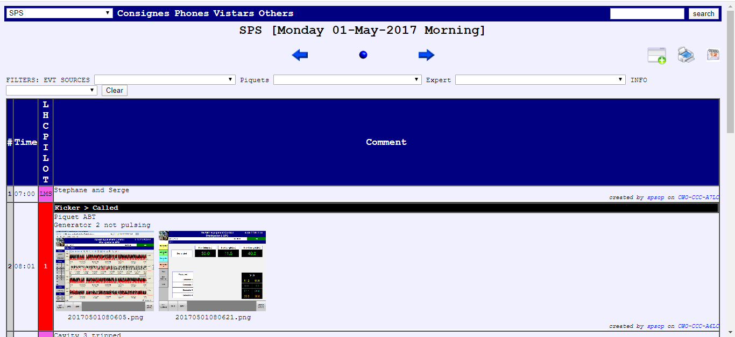
Scope – E-Logbook
Once we check that is the first (or last) fault, we can define the data extraction interval

Slide 44
Top Energy Penalties
First Approach:
Using Pandas
PM → Protection Dump → Top Energy → Search matches in AFT → Apply penalties
Event Timestamp | Event Category | Beam Mode | Beam Energy [MeV]
28-JUN-2017 10.12.26.564739 | PROGRAMMED_DUMP | INJECTION PHYSICS BEAM | 450000
28-JUN-2017 14.00.55.120649 | PROTECTION_DUMP | STABLE BEAMS | 6499320
28-JUN-2017 17.47.59.417364 | PROGRAMMED_DUMP | INJECTION PHYSICS BEAM | 450000
28-JUN-2017 18.03.54.215489 | PROGRAMMED_DUMP | INJECTION PHYSICS BEAM | 449880
29-JUN-2017 05.29.45.697000 | PROTECTION_DUMP | STABLE BEAMS | 6499320
29-JUN-2017 13.51.41.118703 | PROTECTION_DUMP | STABLE BEAMS | 6499440

Slide 45
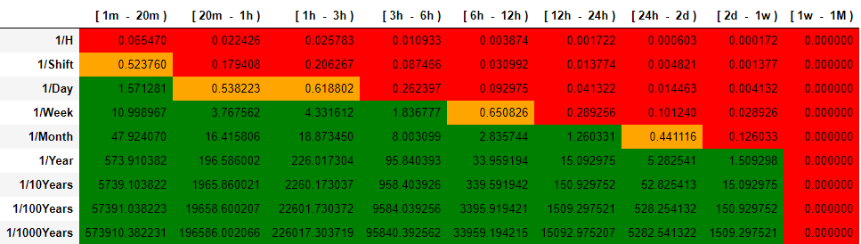
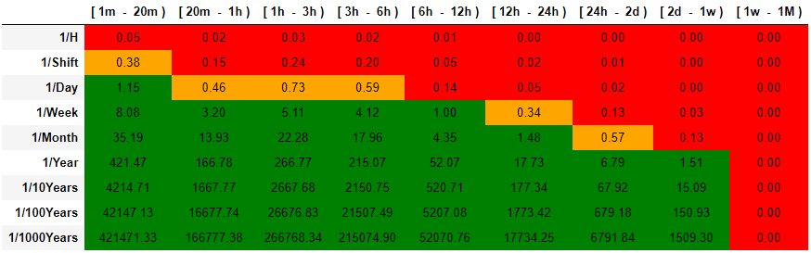
LHC – With/Without Penalties
Without penalties
With penalties

Slide 46
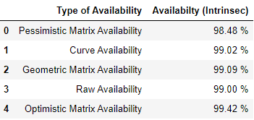
Computation of Availability
Availability = (operation time – down time) / operation time
(or recovery time)
Raw availability: sum duration of faults provided by AFT
Optimistic Risk Matrix Availability:
frequency * lowest bin of each box
Pessimistic Risk Matrix Availability:
frequency * highest bin of each box
Geometric Risk Matrix Availability:
frequency * “geometric center” of each box
Continuous Risk Curve Availability:
Integral of the curve

Slide 47
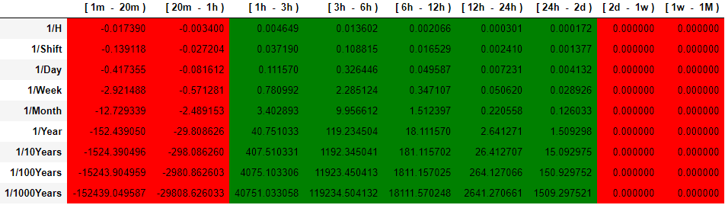
LHC – Penalty Effect
RM_Pen - RM_No_Pen =
As expected, penalties increase the frequency of “medium/long” duration.

