Slide 1
Final thoughts on RM note
1 October 2020
A. Apollonio
AFT: Why was it invented?
Notes:
1

Slide 2
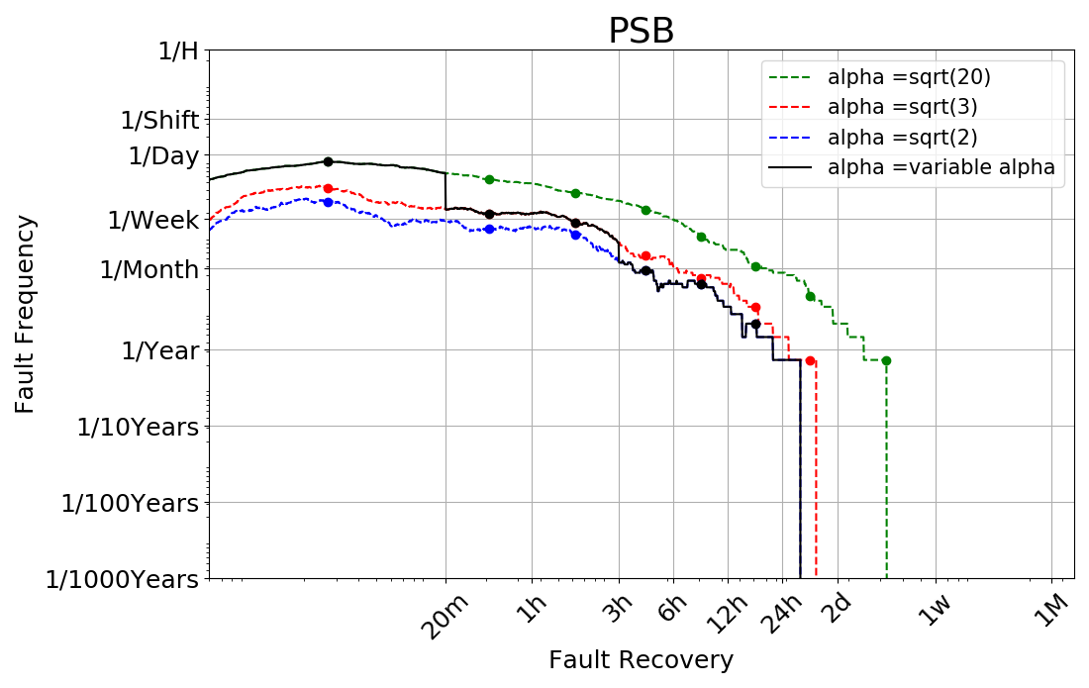
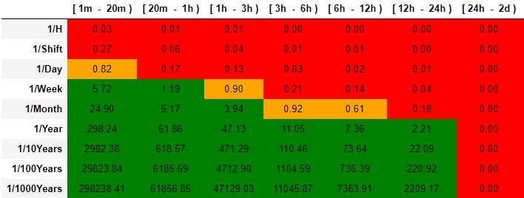
Risk Matrices
Data-driven risk matrices for all CERN machines
Based on 2015-2018 data for LHC
Based on 2017-2018 data for injectors
Calculation of failure frequency F for each cell
Acceptable if F >1
Unacceptable if F < 0.33
“At the limit” if 0.33 < F < 1
Note: this is the accelerator matrix, so all failure modes are contributing to each box. For individual systems a margin should be considered

Slide 3
Summary of MARP Observations
We implemented all received comments, but some are more ‘conceptual’.
Main observations J. Uythoven
  No need to distinguish machine with active machine protection (MPS) from machines without. I think we can remove the expression ‘low-beam power’, as we had damage in Linac4
    The approach was made to be as generic as possible (C = consequence), also because some machines at CERN don’t (yet) have MPS:
      P_{C1} = P_{F} * P_{prot_eff}
      P_{C2} = P_{F} * (1-P_{prot_eff}) = P_{F} * P_{prot_ineff}
    (Elegantly) For machines with no MPS P_{prot_eff} = 1
Main observations B. Todd
  Difficult to digest part on extension to non data-driven scenarios:
    Example for the LHC, assuming 20 % downtime (caused by ‘protected failures’). Question: how much increase of this downtime do we allow from ‘unprotected failures’? This has to be distributed (equally) across the intervals where we don’t have data
  (From MARP meeting) More granularity, less easy to use for decision making?
    True. Maybe one should define one risk matrix for the LHC and one for all other injectors? (see next slide). Using a dedicated discretization (with more granularity, reflecting the different failure modes) for the LHC would help
Notes:
3

Slide 4
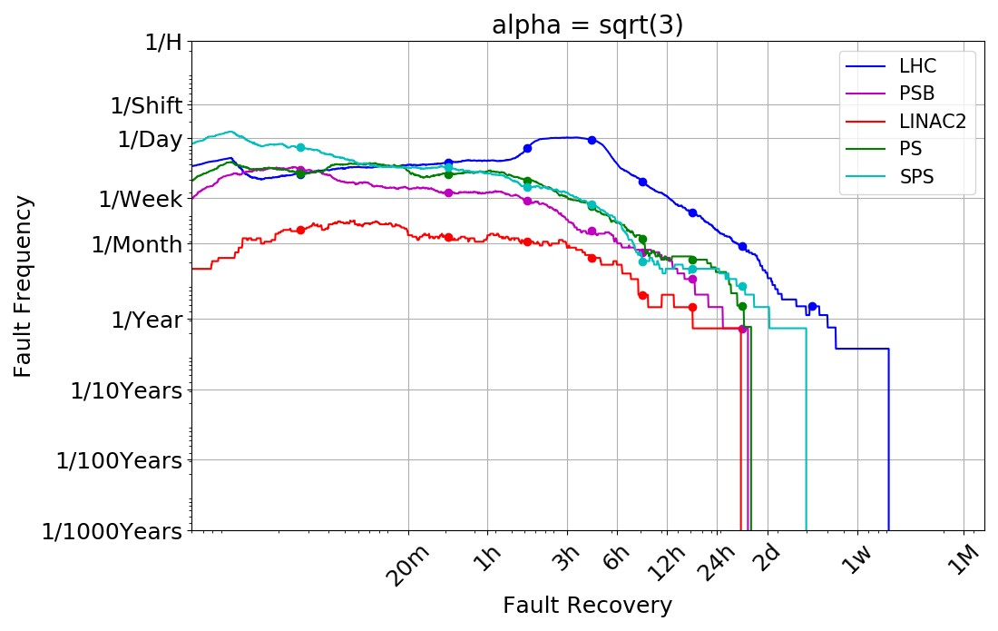
Comparison across machines
Notes:
4

Slide 5
Thanks for your attention!
Notes:
5

