Slide 1
Describo and RO-Crate - the FAIR data research helpers
Dr Marco La Rosa¹, Dr Peter Sefton²
PARADISEC and The University of Melbourne
University of Technology Sydney
Notes:
This is a 15 minute presentation so I’m thinking 12 slides

Slide 2
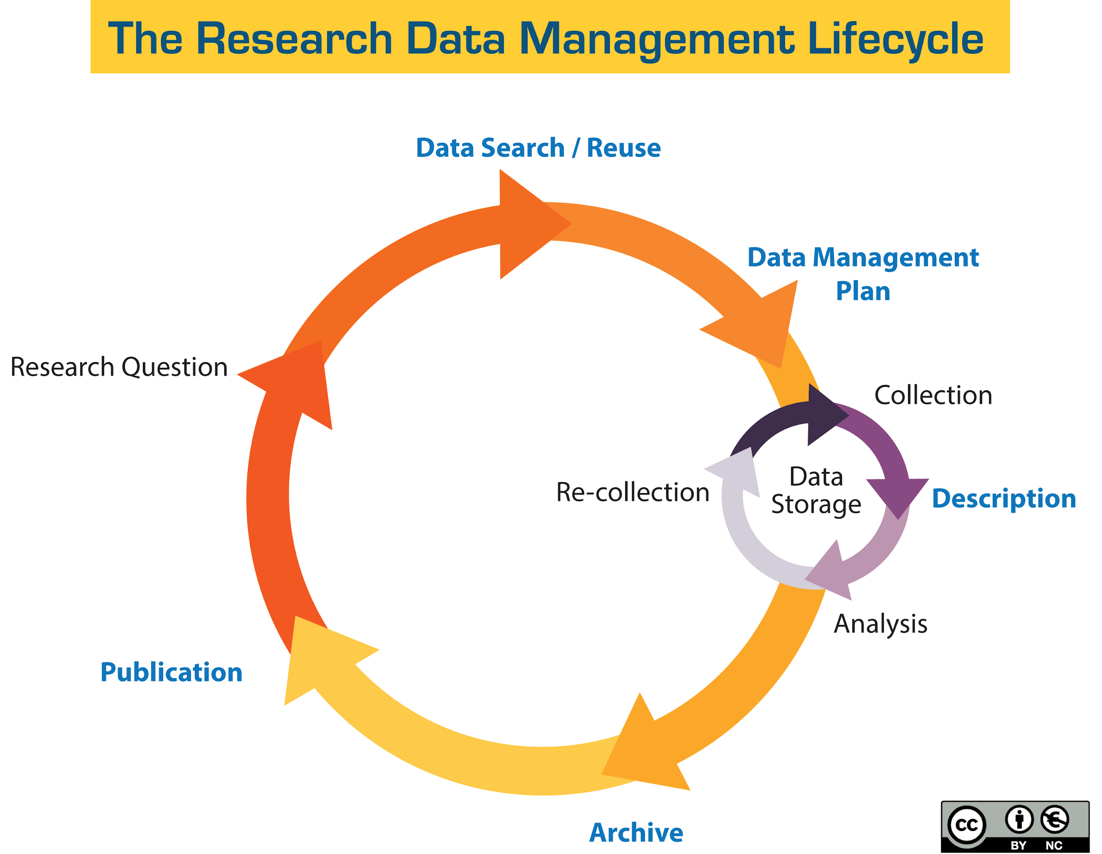
Problem
Research projects don’t always involve work practices that describe the data generated so that it meets the FAIR principles.
Solution
Describe the data as it’s being created using open standards and tools
use Describo
source: https://guides.library.ucsc.edu/datamanagement/
Describo goes here
Notes:
For research data to be *F*indable, and *I*interoperable and *R*eusable, it has to have metadata that makes it so - and this needs to be both human and machine readable so that finding aids can be built and people can search, or write programs to discover and use data. Also for research data to be distributed it has to be *packaged* into distributable objects - otherwise there is no digital object. This talk looks at one tool that implements the Research Object Crate standard that supports such FAIR packaging.
In an ideal data management lifecycle Describo slots into the Description section of the lifecycle.

Slide 3
What is Research Object Crate (RO-Crate)?
Lightweight approach to packaging research data with metadata
Community effort - 38 contributors from AU, EU and US.
Can aggregate files and/or any URI-addressable content, with contextual information to aid decisions about re-use. (Who What When Where Why How).
Uses Schema.org as the main ontology, with domain-specific extensions
Has human readable summaries of datasets
Sefton is an Editor of the specification: http://www.researchobject.org/ro-crate/
Notes:
RO-Crate grew out of work on packaging file-based data, but as it uses JSON-LD as a serialization for linked-data metadata it can also aggregate any URI-addressable resource, or if necessary describe physical objects. RO-Crates have a metadata file describing a research object, and optionally its content and useful context such as who created the objects, using what equipment, software and workflows, and how to reuse the data and under which license(s). The idea is that if a user finds a zip file on their hard drive, and opens it there is an HTML file within which explains the data enough for them to be able to reuse it.

Slide 4
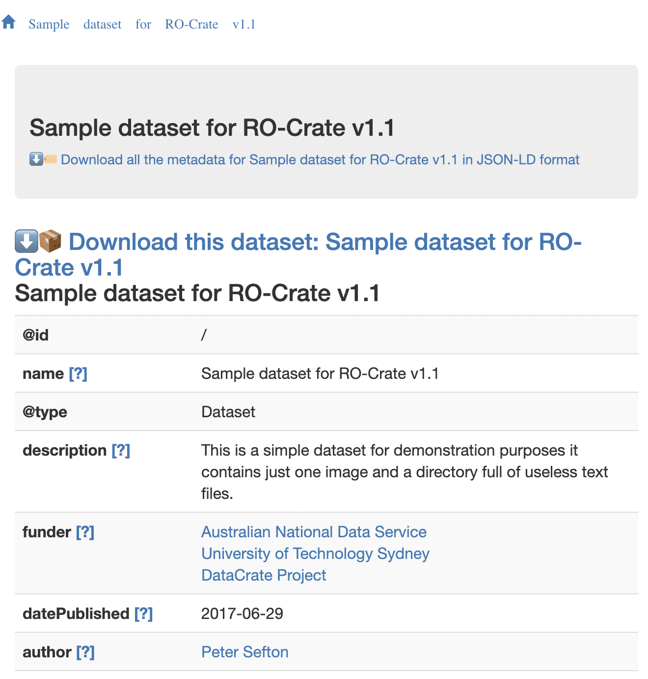
Notes:
RO-Crate can (and should) have a human-readable summary of the metadata in the data package (or on the a website or repository).

Slide 5
Who is using it?
Pacific and Regional Archive for Digital Sources in Endangered Cultures (PARADISEC). Demonstrator with > 16k items and > 500 collections exported as RO-Crates into OCFL @ http://mod.paradisec.org.au/
University of Technology Sydney data repository
Galaxy
WorkflowHub: https://about.workflowhub.eu/
CS3MESH4EOSC

Slide 6
Describo
Describo is a pair of tools for researchers and support staff to create spec-compliant RO-Crates w/:
  Linked data for high-precision unambiguous metadata
  Package level “who, what, where” metadata
  Individual file-level metadata including provenance
Describo exists as:
  a desktop tool (electron application) for all major platforms: https://uts-eresearch.github.io/describo/
  an online tool that integrates with Microsoft OneDrive: https://github.com/UTS-eResearch/describo-online
Describo was developed as a proof of concept in two short sprints in 2020 (Desktop ~ 3 months and Online ~ 2 months). Both are viable release candidates.
https://arkisto-platform.github.io/assets/docs/Describo-WhitePaper.pdf
Notes:
Describo exists as a desktop application and an online application. Both create spec compliant RO-Crates.
The desktop application is useful for describing filesystem based objects attached to the local machine including share drives and cloud drives like Dropbox.
The online application is designed for group / institutional level deployment and it supports describing content in Microsoft OneDrive. The Online version is multi user.

Slide 7
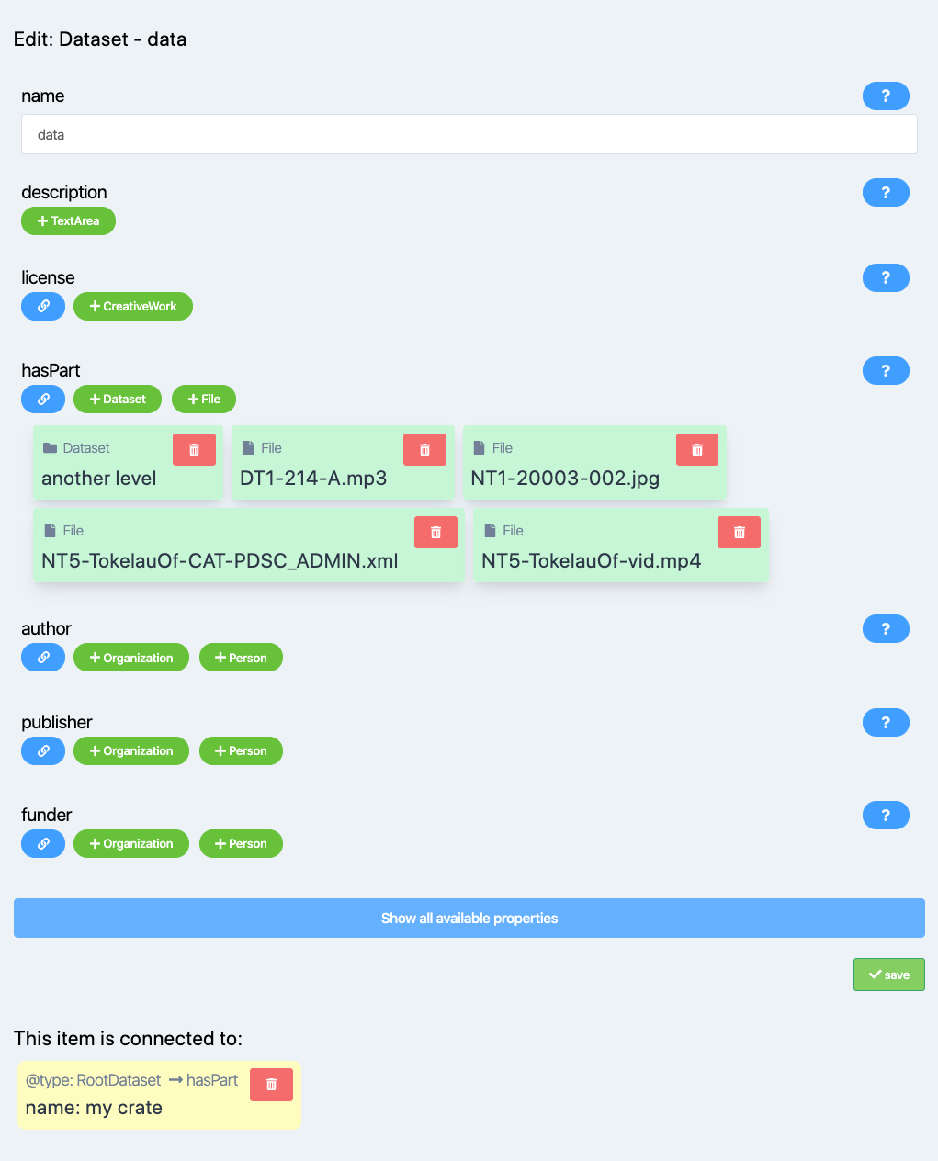
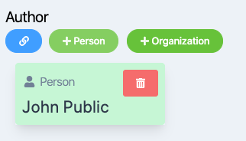
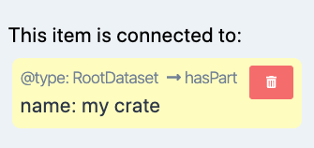
Describo Desktop - define and link entities
Notes:
The UI of describo enables the user to define and describe context entities like People, Places, Organizations and many others. Entities can be Interlinked.

Slide 8
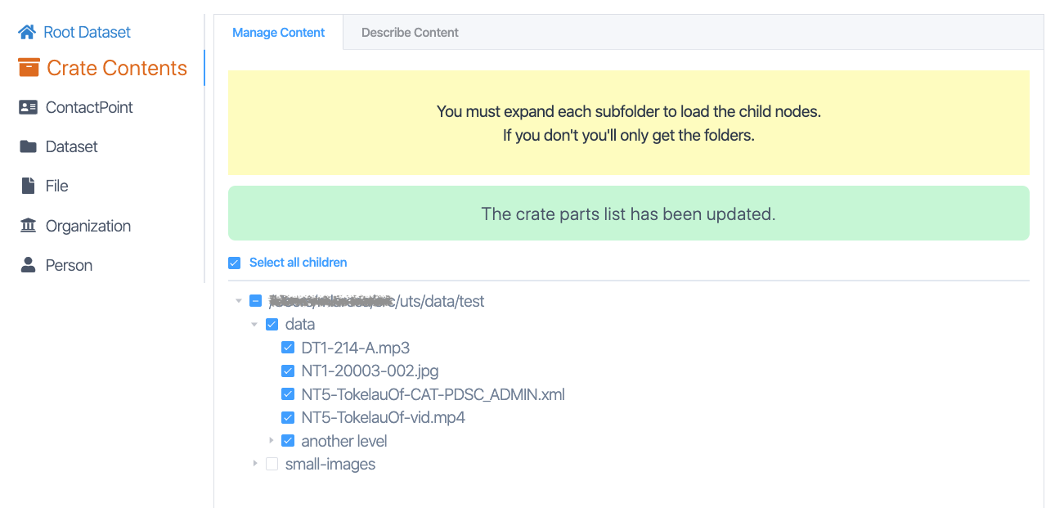
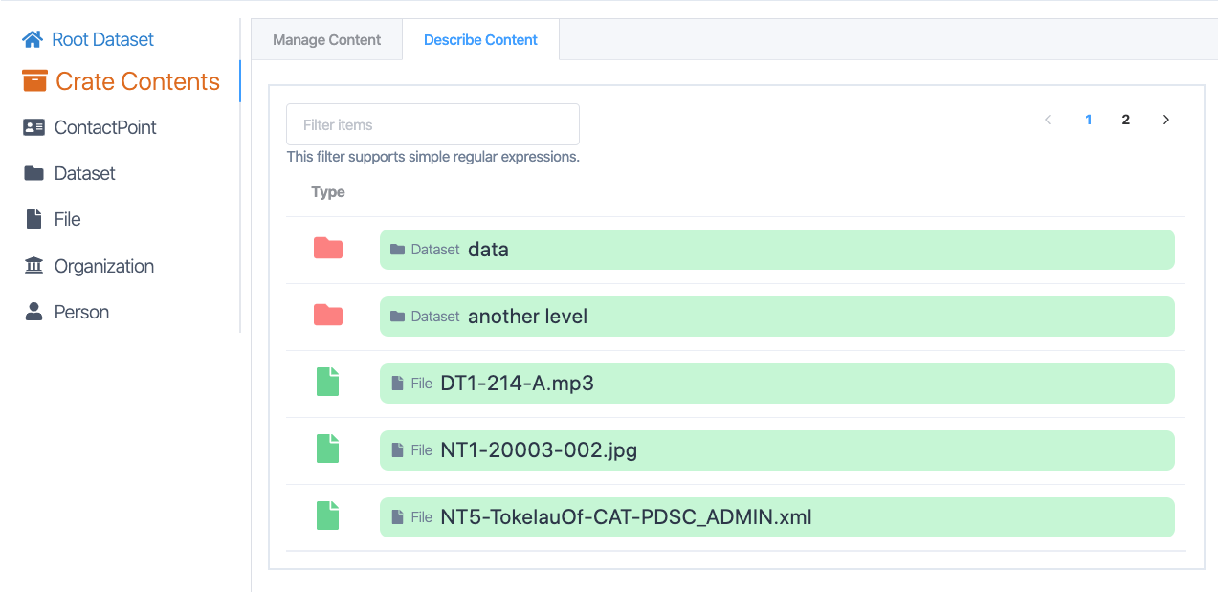
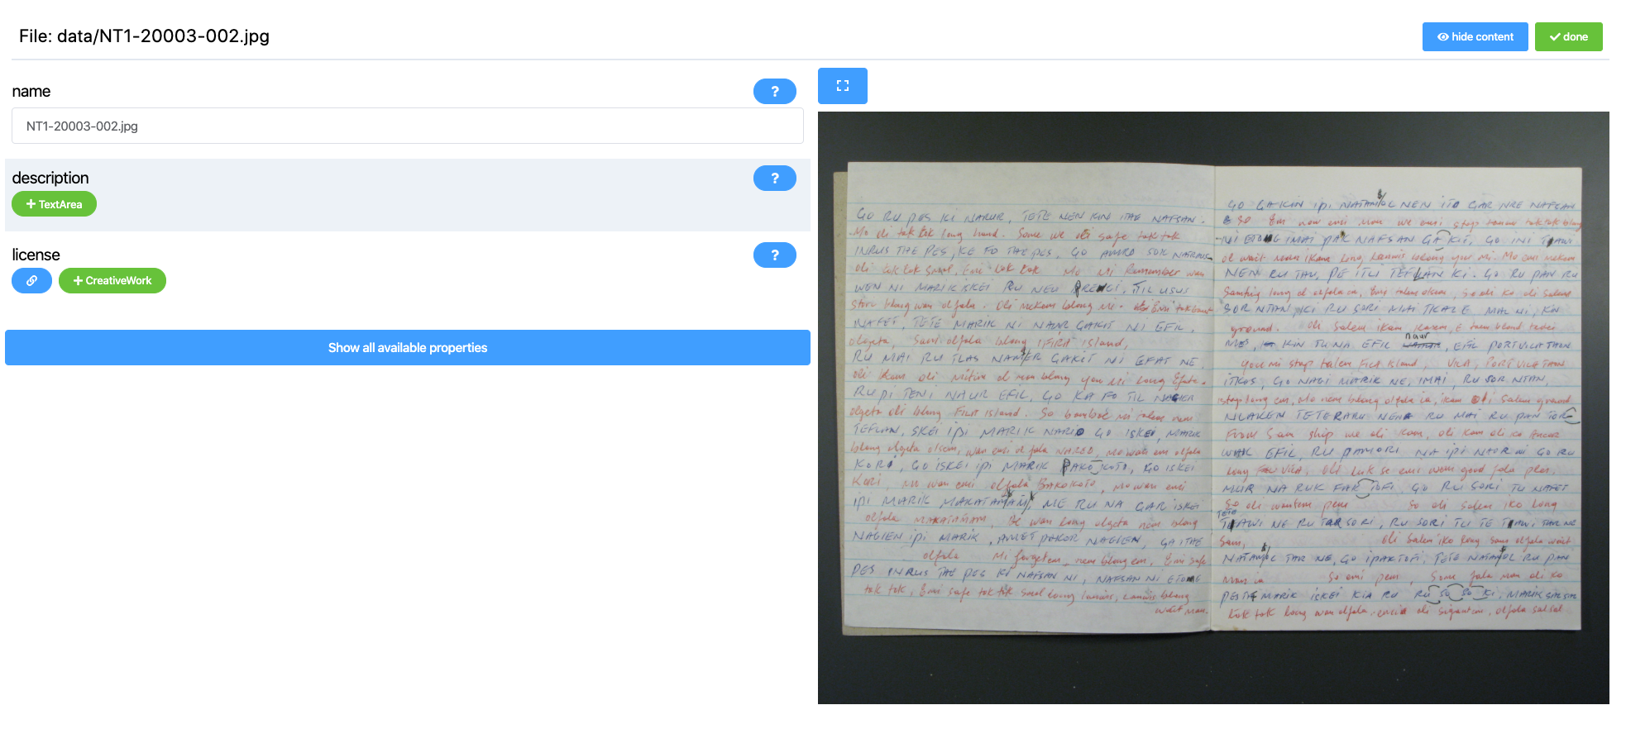
Describo Desktop - define and document data
Notes:
Describo allow the user to describe the content of the folder - ie image, audio and video content. Content previews are available whilst describing individual items.

Slide 9
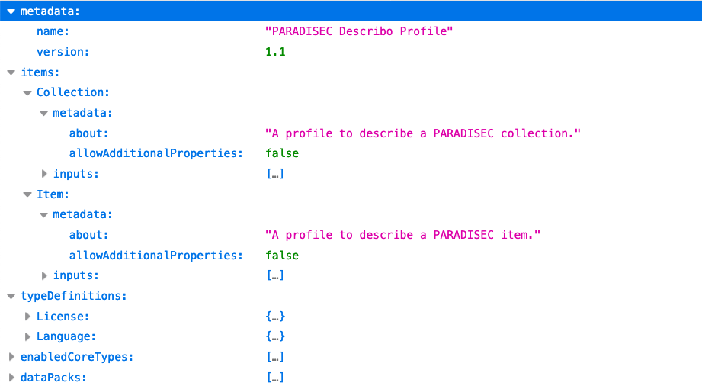
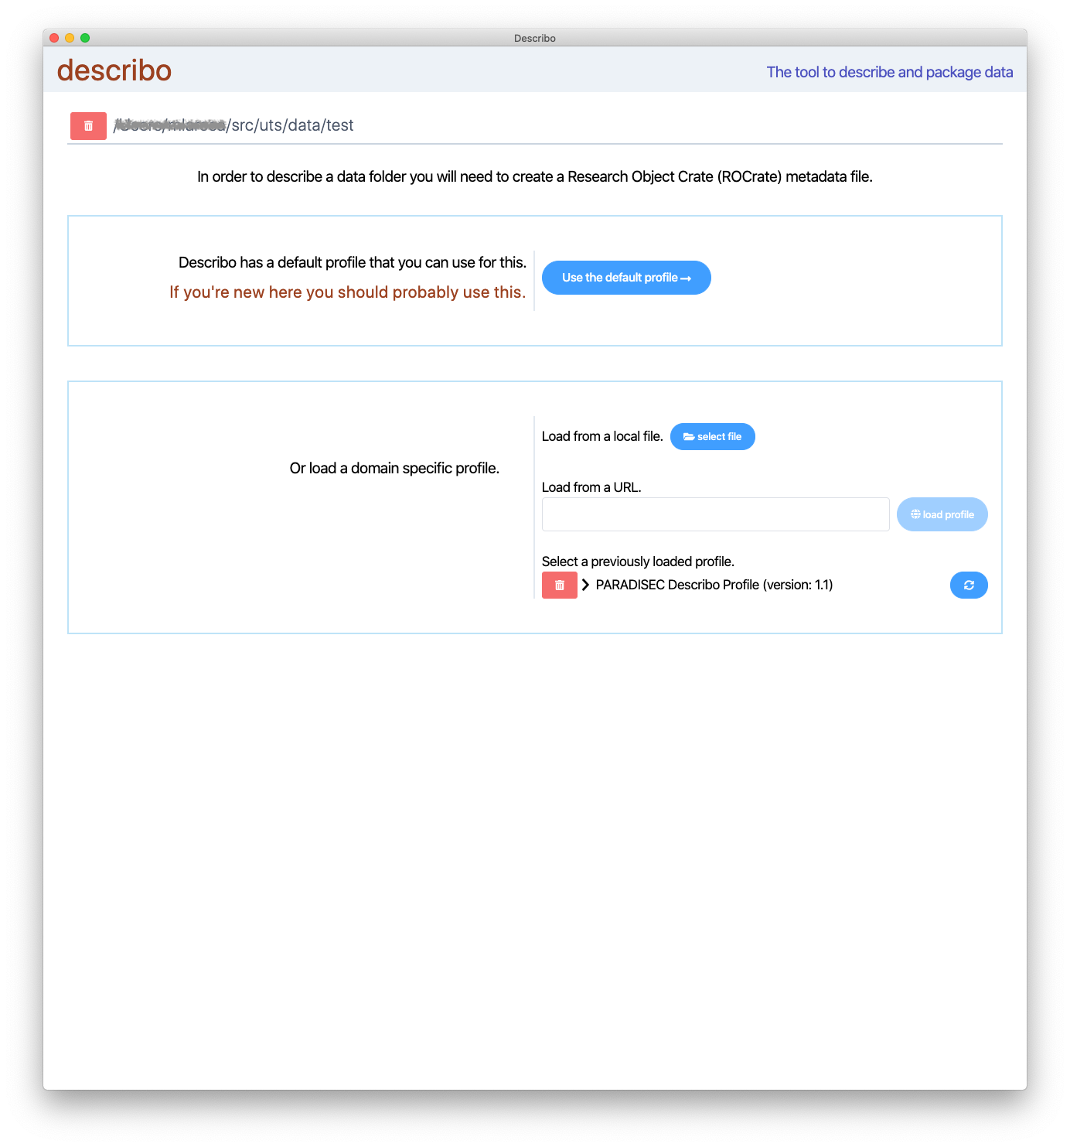
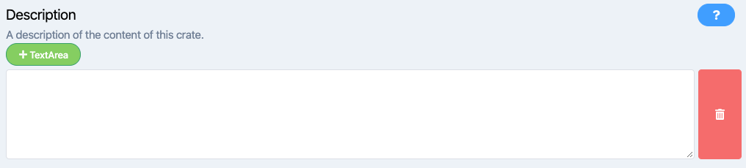
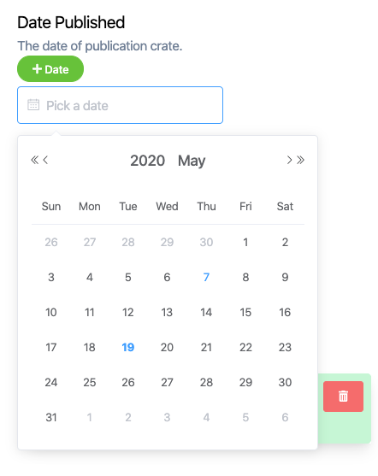
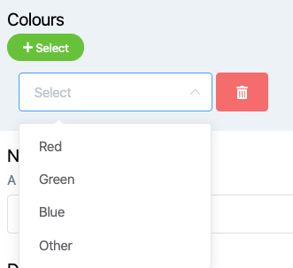
Describo Desktop - load custom data profiles
Notes:
Describo desktop supports loading custom profiles. This enables a community to define which entities / properties are relevant to them in order to guide the user when describing their data. The UI of describo is driven by the profile.

Slide 10
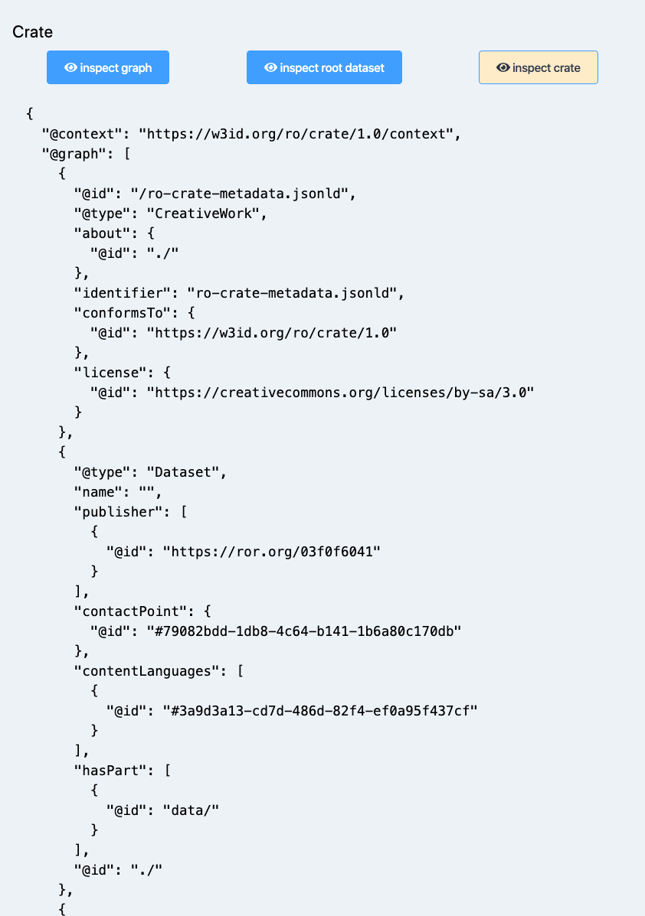
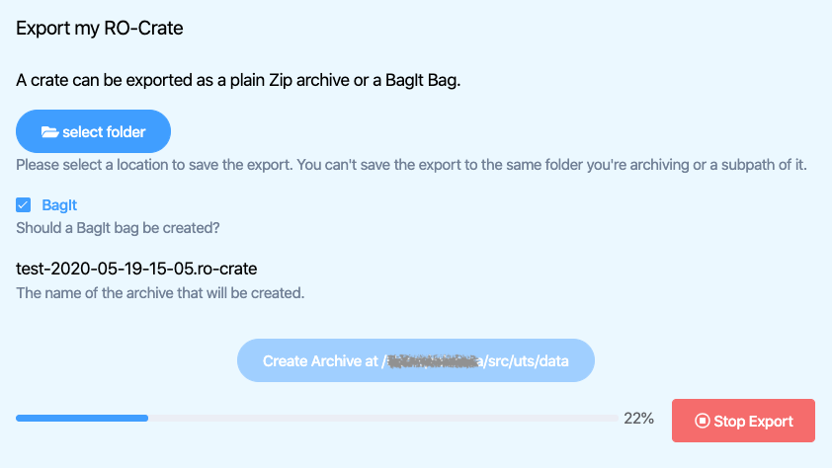
Describo Desktop - save / export
Notes:
Describo desktop can save and export described folders as plain zip files or bagit bags for upload to institutional repositories/archives.

Slide 11
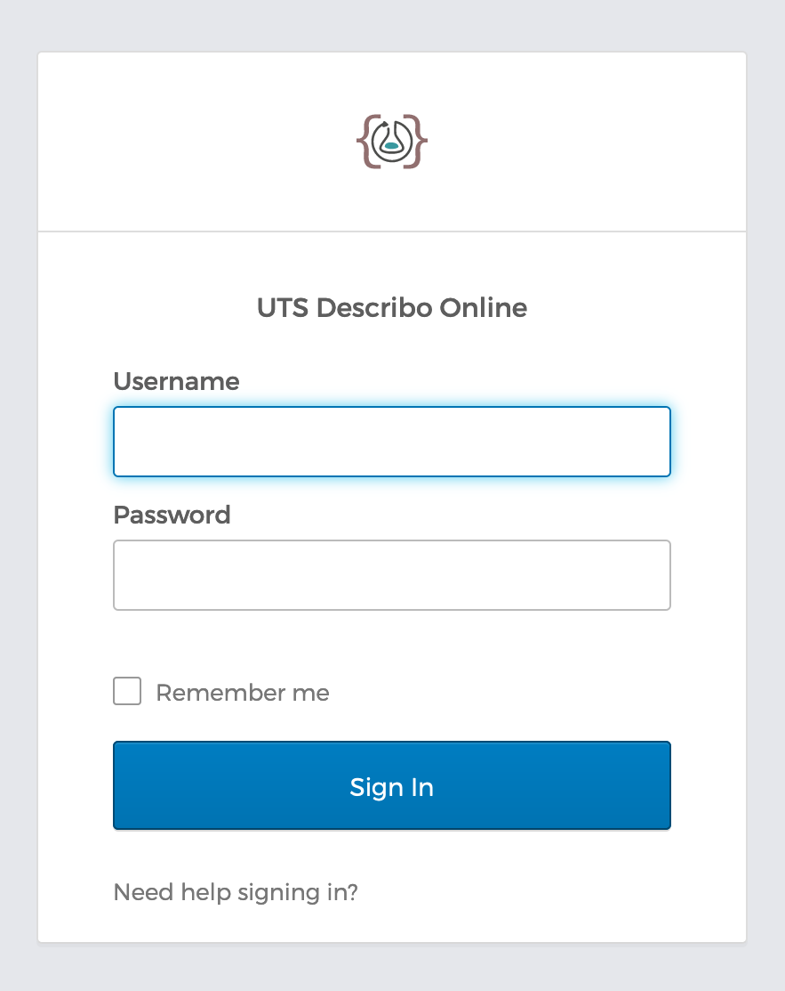
Describo Online - architecture: integrate or standalone service
Easily deployed via docker containers: UI, API and PostgreSQL database. Start one instance and scale to many users or start small instances for individual domains.
Architected for extensibility to other backends and data stores: S3, Dropbox, Google Drive, Openstack Swift, webdav, SFTP.
Operates on RO-Crate in database and synchronises back to target resource on change
Dynamically loads existing crates into DB and can associate crates on disk with in database entries to support multiple users operating on the data
User management and authentication
via okta.com (developer.okta.com) (free up to 1000 Monthly Active Users)
or integrate into your own application.
Notes:
Describo Online is targeted at the group / institutional deployment. It uses okta for authentication or it can be integrated into existing services by accepting delegated authentication.
Describo Online has been architected for extensibility to other back file sync and store applications such as OwnCloud and it supports multi user access by operating on the data in a database and then synchronising that back to the remote resource.

Slide 12
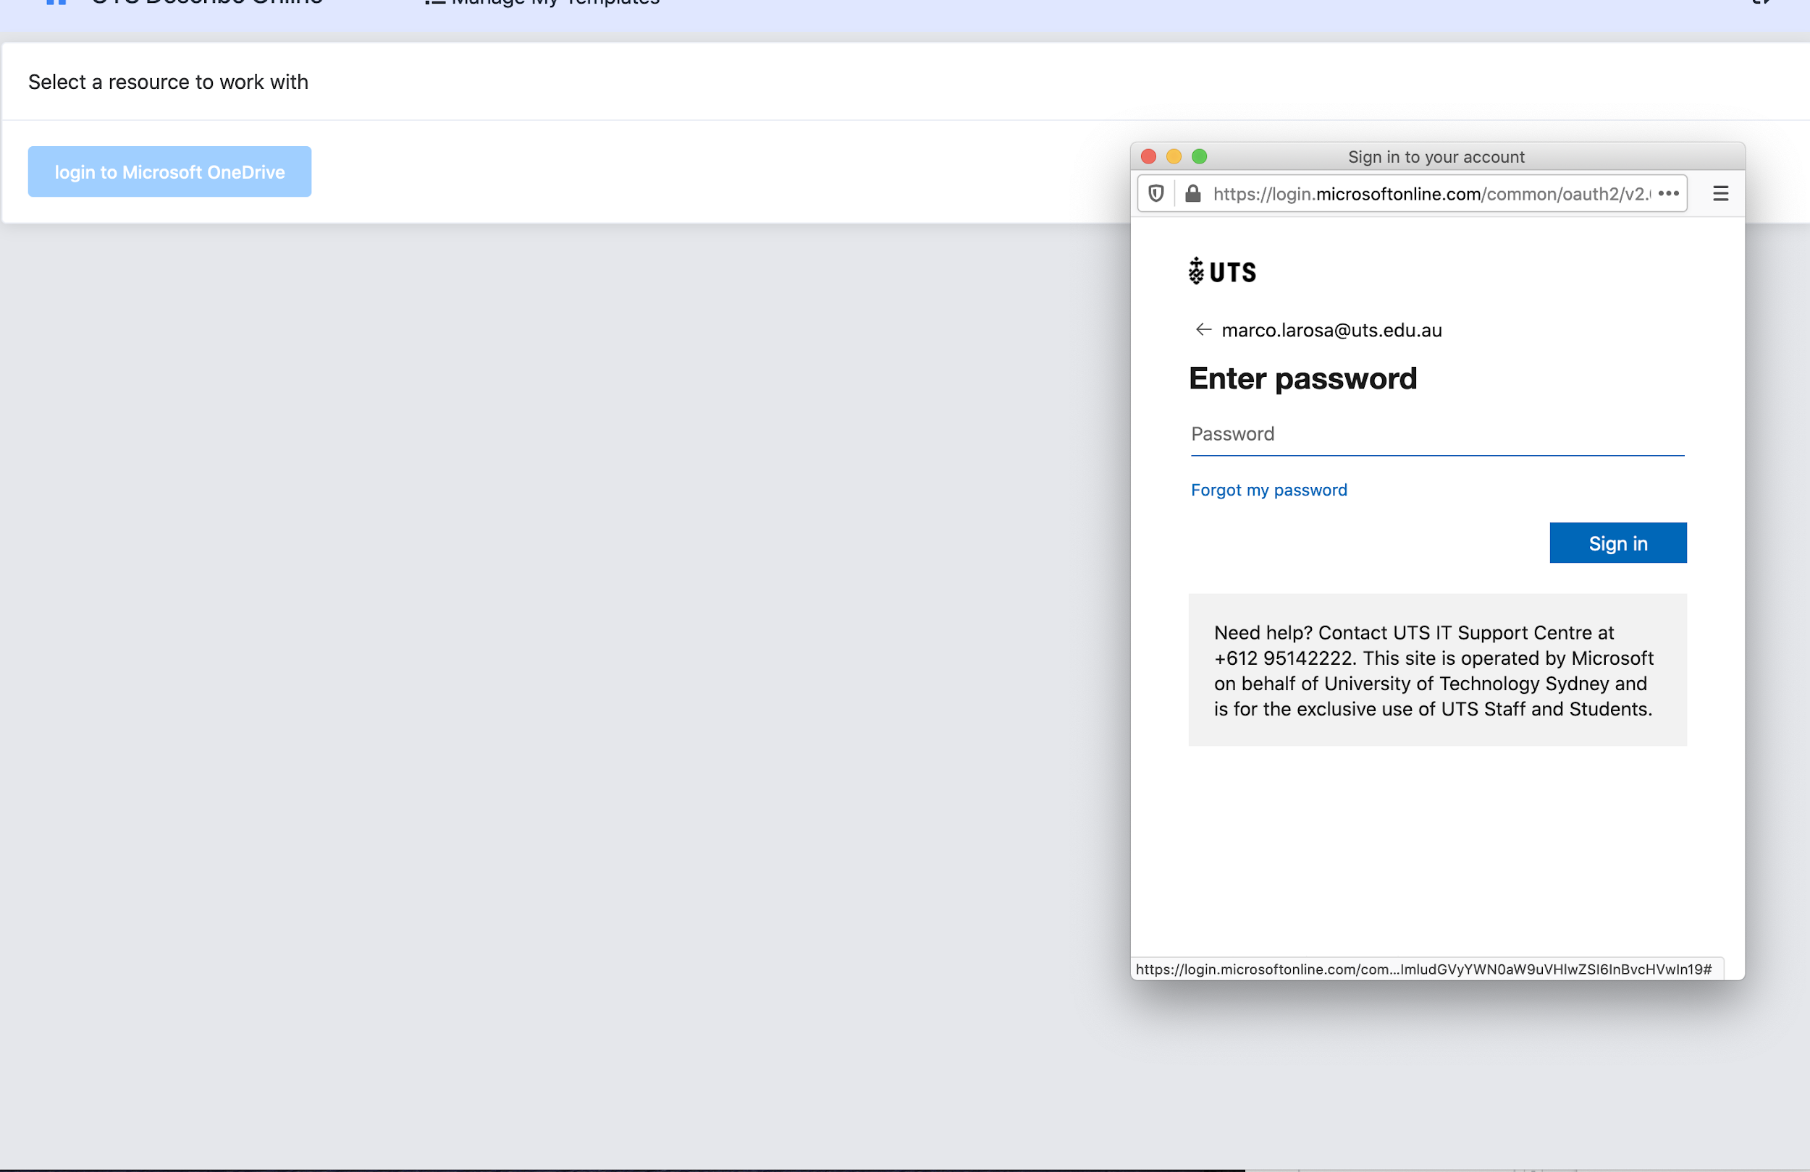
Describo Online - works with folders in Microsoft OneDrive
Notes:
Describo Online currently works with Microsoft OneDrive. This was a use case of UTS but the backend is extensible to other cloud resources via rclone.

Slide 13
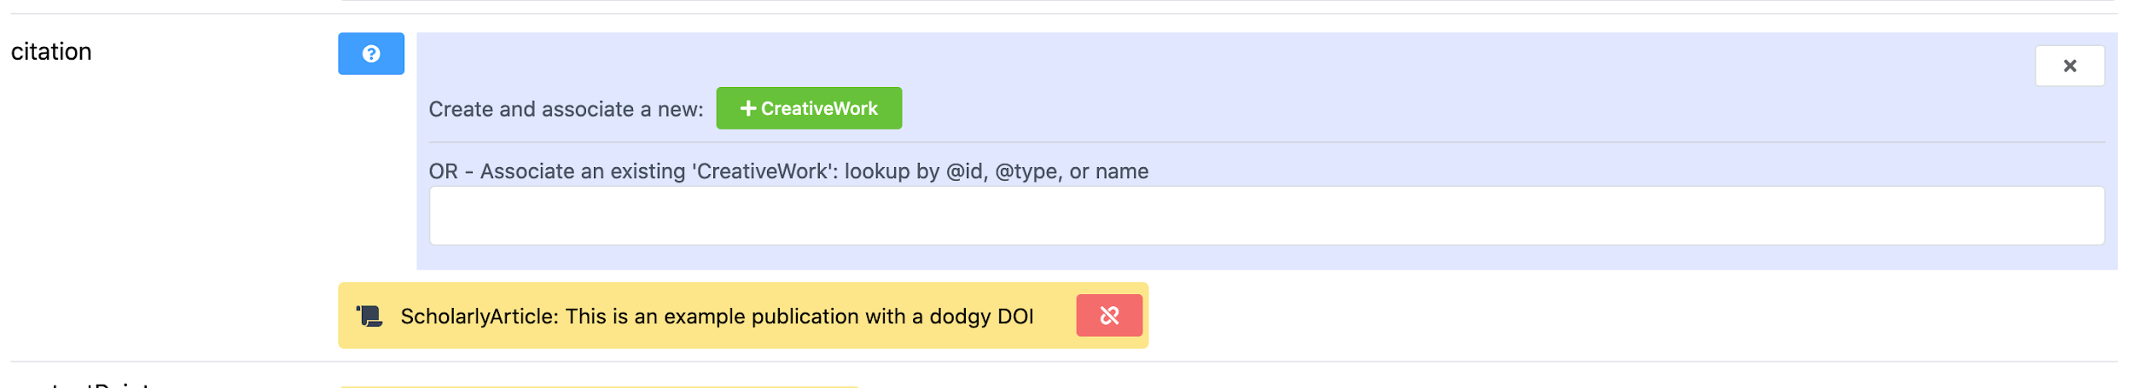
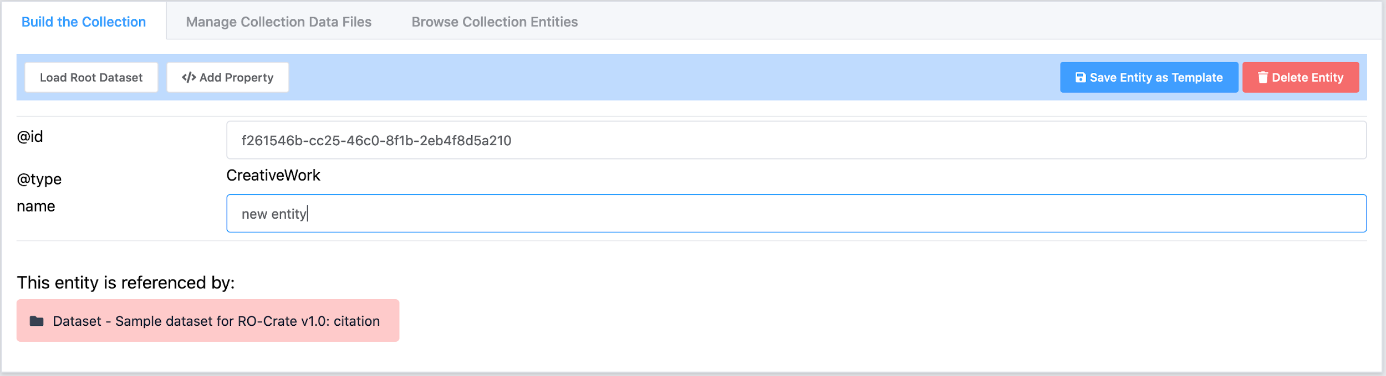
Describo Online - define and link entities
Notes:
Describo Online supports the full schema.org schema by default.

Slide 14
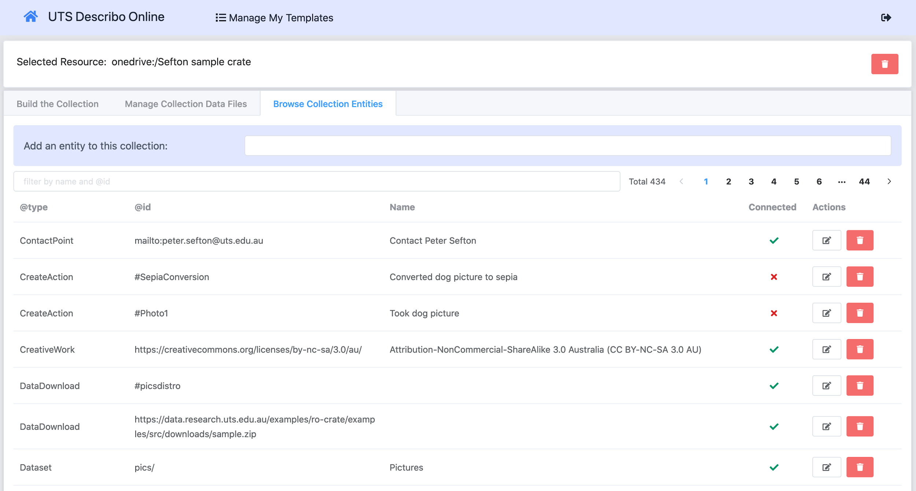
Describo Online - manage crate entities
Notes:
Describo Online makes it easy to find entities and update them.

Slide 15
Describo Online - MVP - next steps
Develop other backend integrations
Develop a UI for novice users - current UI = expert RO-Crate user
Develop a UI to manage cultural collections
Port capability to upload domain specific profiles from desktop
Describo Desktop - next steps
Port online entity rendering code from online - implementation cleaner than initial implementation in desktop
Port novice user and cultural collections UI from online
Port backend integrations from online
Notes:
Describo Desktop and Online have some difference. Future work will aim to bring the two more inline and ensure that all capabilities are supported in both environments.

Slide 16
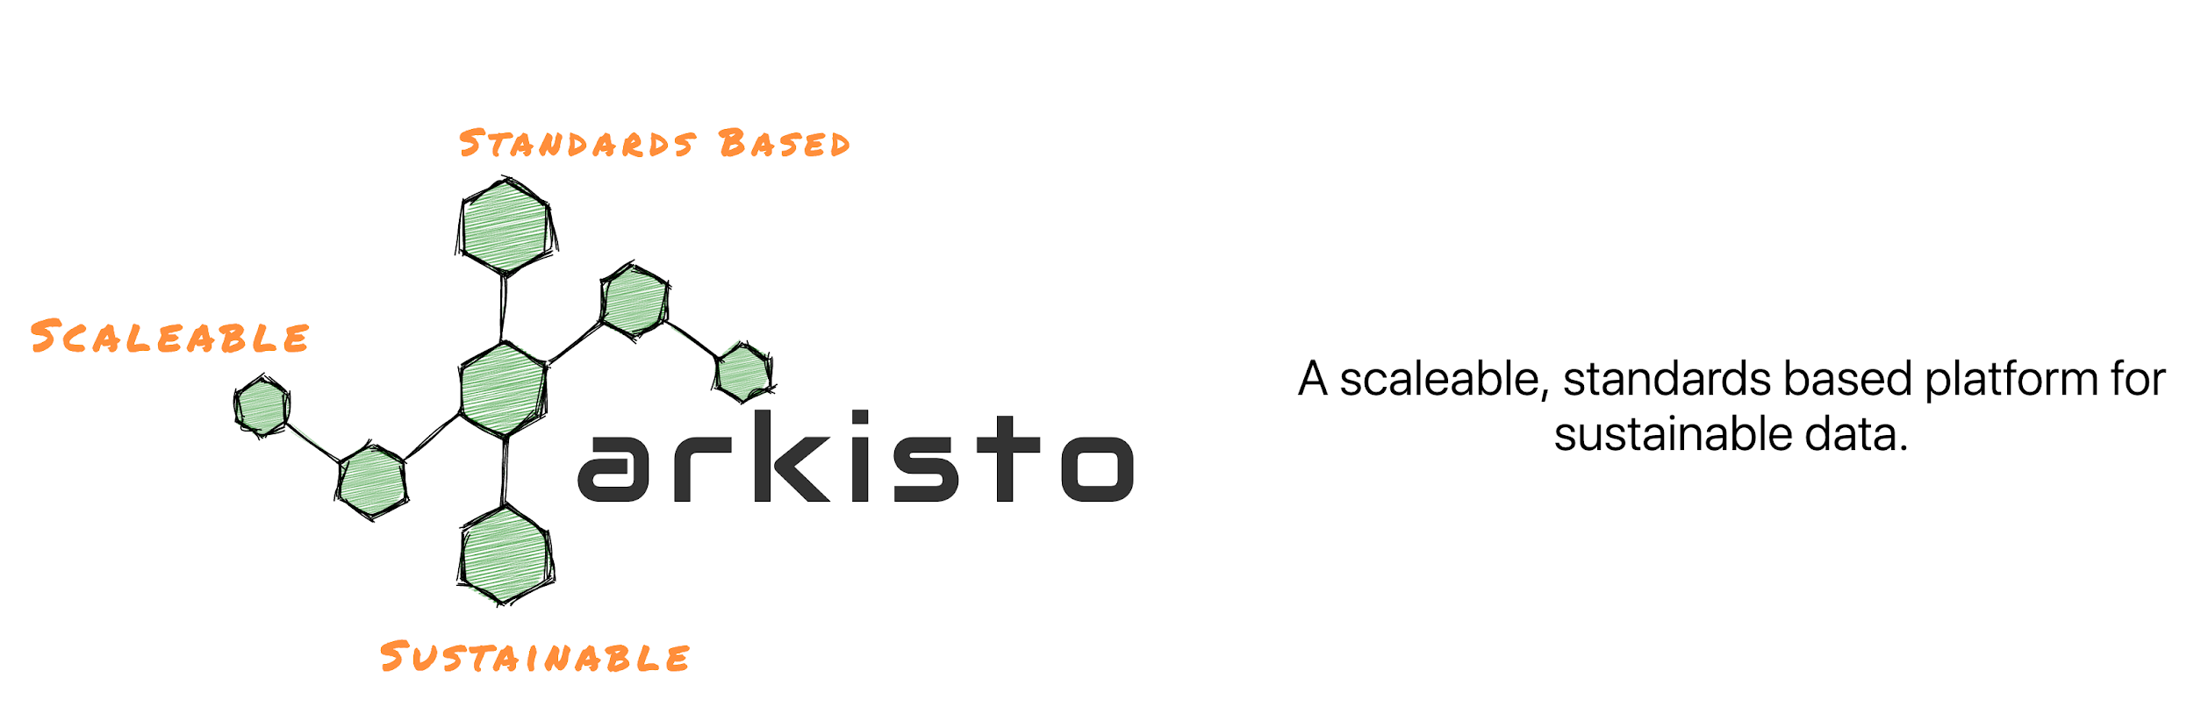
https://arkisto-platform.github.io/
Notes:
Find out more by visiting the Arkisto site where we also talk about repository patterns and use cases.

