Slide 1
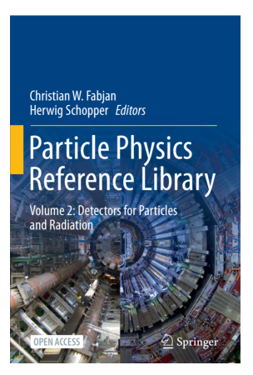
Particles Physics
Reference Library
Christian Fabjan
November 2020

Slide 2
Background
2011
Originally published in 2011, in Series «Landolt-Börnstein»
Detectors for Particles and Radiation
2020
Revised publication in 2020:
Open Access
Updated version
Updatable
Book; e-book; online
Two volumes: Principles and Methods
Systems and Applications

Slide 3
Acknowledgements
  C. Caron, Springer, initiated this initiative
  S. Myers, H. Schopper, CF were persuaded by «Open Access» publication
  Strongly supported by CERN Scientific Information Service (SIS) group:
  T. Basaglia and J. Vigen
  SIS arranged support from CERN (personnel, financial support)
  Most authors of the first issue, published in 2011, were available
  Generally, enthusiastic collaboration
  Magic word: Open Access
    Importance and added value universally appreciated

Slide 4
Special Thanks to:
  Springer support, Hidako Niko for :
    Interacting with authors
    Following the editing process, assisted by B. Kanaga Thara
    Interfacing to Springer lawyers dealing with legal issues (contracts, copy right,…):
    important, time consuming, puzzling, frivolous («no pornographic content»)
  Springer for making available 10 copies to the audience
  All the authors for their outstanding contributions, their friendly collaboration and for graciously considering my (sometimes extensive) editing suggestions

Slide 5
«Reference»
  Title suggested by C. Caron, Springer
  «Reference»: Tall order!
    Authoritative entry point to a subject
    The reader will decide, whether goal was achieved
  Facts
    Contributions by acknowledged experts in their respective fields
    Contributions at graduate textbook level
  Numbers
    21 chapters
    1078 pages (another advantage of online availability!)
    From fundamentals to systems
    Accelerator and non-accelerator based techniques
  Personal regret:
    one important section missing
    «Instrumentation for Applied Physics and Industrial Applications»
  You can ask me later, why…

Slide 6
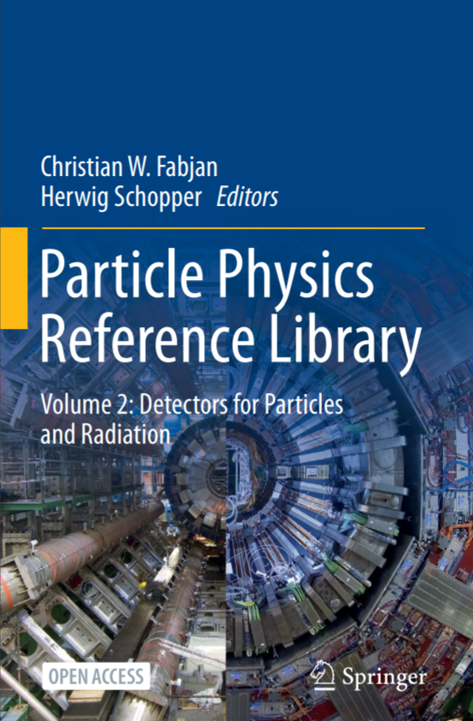
Result of the work
Open Access link
https://link.springer.com/book/10.1007%2F978-3-030-35318-6
Access the content anywhere, anytime
Use the full power of working online
Searches
References
During the past three months
more than 31 000 Downloads

Slide 7
Contents
The Interaction of Radiation with Matter: H. Bichsel, H. Schindler
Scintillation Detectors for Charged Particles and Photons: P. Lecoq
Gaseous Detectors: H. J. Hilke, W. Riegler
Solid State Detectors: G. Lutz, R. Klanner
Calorimetry: C. W. Fabjan, D. Fournier
Particle Identification: Time-of-Flight, Cherenkov and Transition Radiation Detectors: R. Forty, O. Ullaland
Neutrino Detectors: L. Camilleri
Nuclear Emulsions: A. Ariga, T. Ariga, G. De Lellis, A. Ereditato, K. Niwa
Signal Processing for Particle Detectors: V. Radeka
Detector Simulation: J. Apostolakis
Triggering and High-Level Data Selection: W. H. Smith

Slide 8
Contents
Pattern Recognition and Reconstruction: R. Frühwirth, E. Brondolin, A. Strandlie
Distributed Computing: M. Delfino
Statistical Issues in Particle Physics: L. Lyons
Integration of Detectors into a Large Experiment: Examples from ATLAS and CMS: D. Froidevaux
Neutrino Detectors Under Water and Ice: C. Spiering
Spaceborne Experiments: R Battiston
Cryogenic Detectors: K. Pretzl
Detectors in Medicine and Biology: P. Lecoq
Solid State Detectors for High Radiation Environments: G. Kramberger
Future Developments of Detectors: T. Behnke, K. Buesser, A. Mussgiller

Slide 9

Particle Physics Reference Library
Enjoy!

