Slide 1
Gantry Design for the Heavy-Ion Therapy Medical Application
Andris Ratkus, Toms Torims, Jānis Vilcāns,
Luca Piacentini
30.06.2021

Slide 2
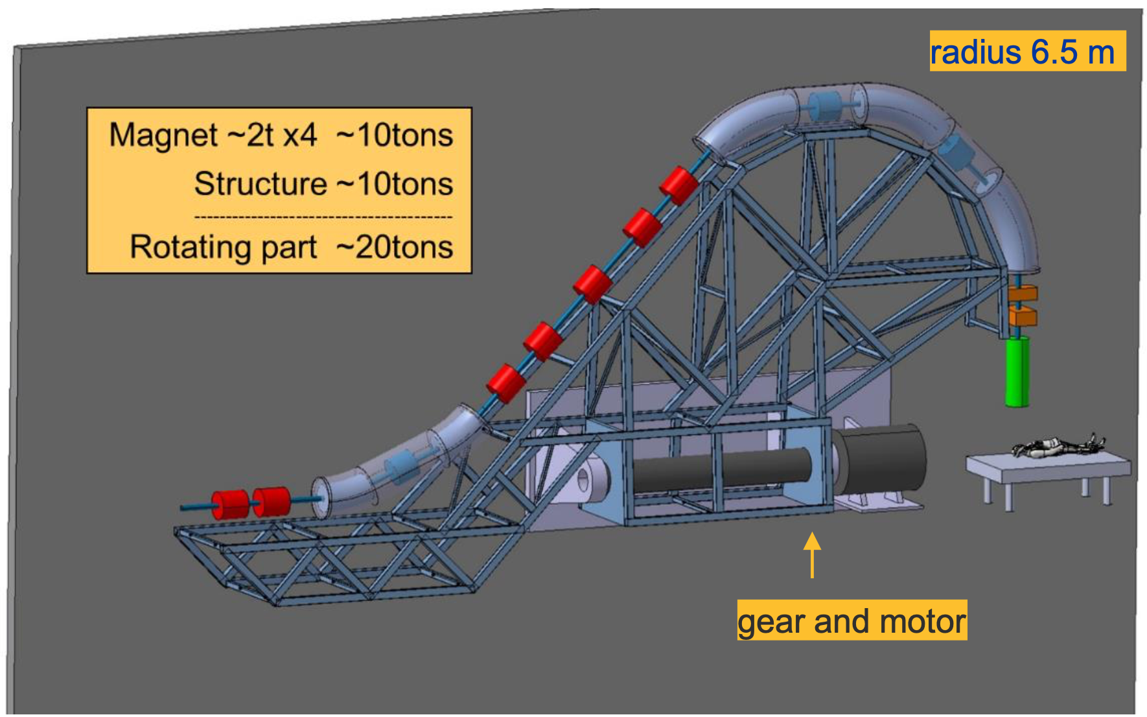



Gantry Mechanical Design
Gantry – Rotating beam line sending the beam to precise positions to the patient
CNAO: Marco Pullia
CERN team: Mechanical & Materials Engineering (MME) Diego Perini, Luca Dassa
RTU Team: Andris Ratkus,
Toms Torims, Jānis Vilcāns, Luca Piacentini

Slide 3


Fighting against Cancer
Cancer is the second leading cause of death globally
Globally, nearly 1 in 6 deaths is due to cancer (WHO)
Timeline: 4 year, started
1st of April 2021

Slide 4
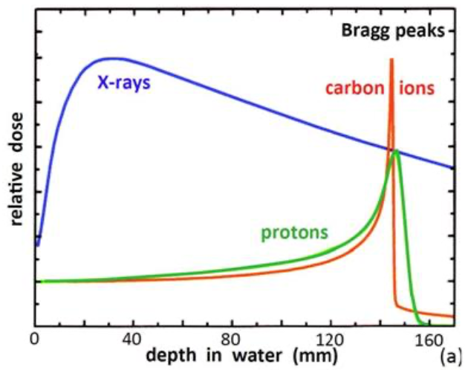
Why hadron therapy (proton or ions)
Different from X-rays or electrons, protons (and ions) deposit their energy at a given depth inside the tissues, minimising dose to the organs close to the tumour, sparing nearby organs.
Physical phenomena:
X-ray Radiation Therapy is improving as well
Proton therapy is mainly recommended for:
- Some specific tumours close to critical organs
- Niche therapy
Required energy for
full-body penetration:
230 MeV protons,
450 MeV/u C-ions.
Source: Maurizio Vretenar CERN

Slide 5
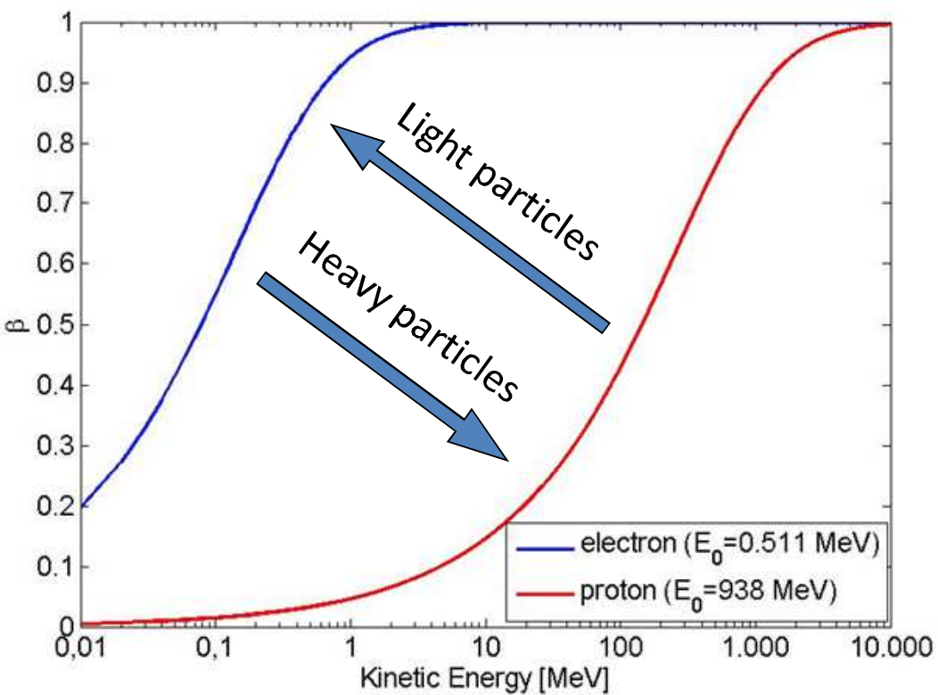

Circumstances to be taken into account
A proton is approx. 1800 times heavier than an electron.
Higher energy is needed to accelerate protons and Ions
Higher energy –
LARGER SIZE !!!
>10%
$\sim 3$ MeV
Source: David Alesini CAS

Slide 6
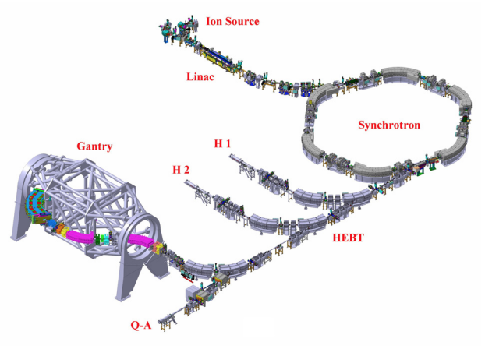
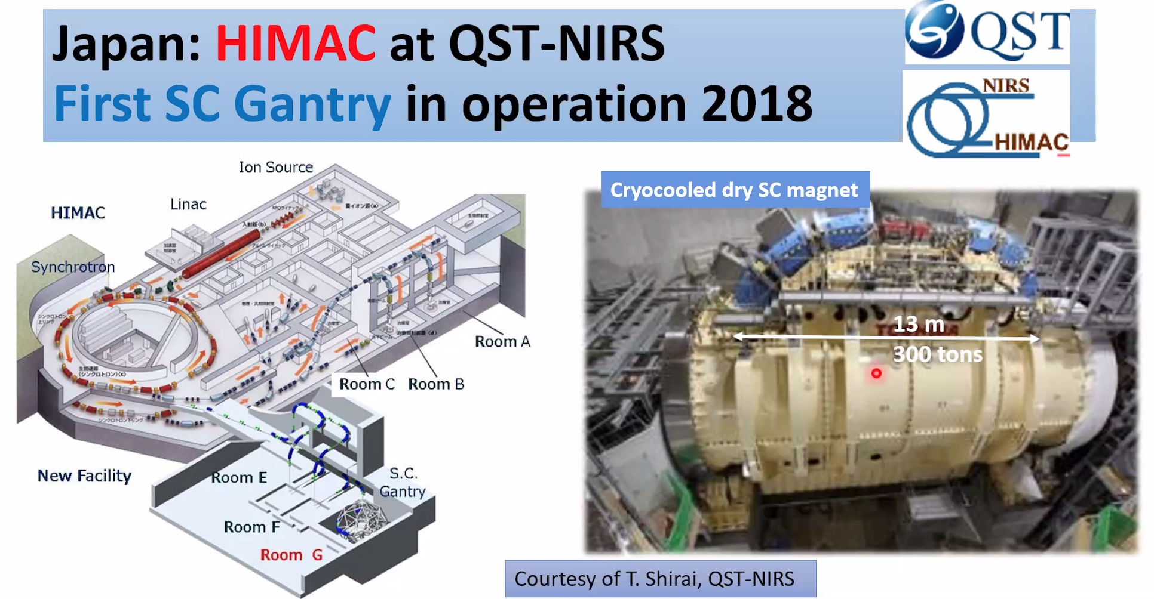


Existing facilities
The Heidelberg Ion Therapy Facility
gantry (RT magnets):
L=25 m, F = 13 m, 600 tons
Source: The Heidelberg
Ion Therapy Facility (HIT)

Slide 7
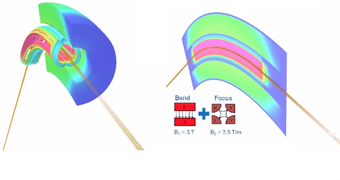
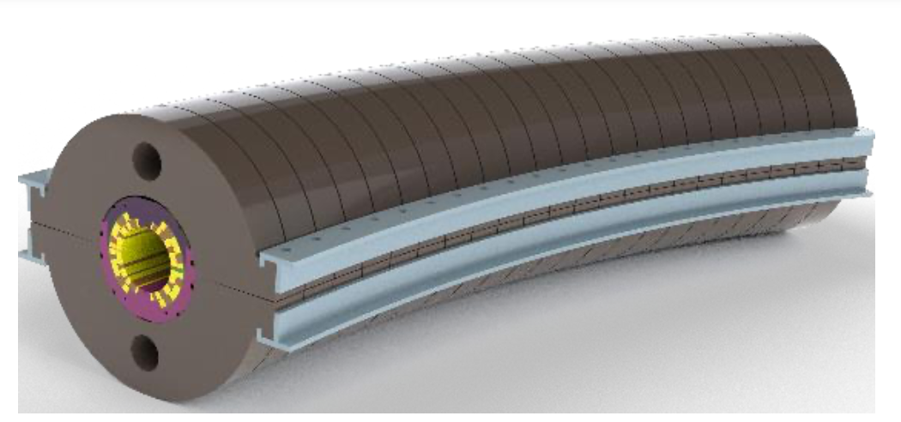
New generation of compact ion therapy accelerators
NIMMS–
Next Ion Medical Machine Study
by Elena Benedetto
WP 7 (One WP of 14 WP) Challenges:
New superconducting magnets
Optimised beam transport and instrumentation
Higher accelerating gradient
Lower costs
Weight lower than 100 tons and length below 16 metres
Source: Maurizio Vretenar CERN

Slide 8
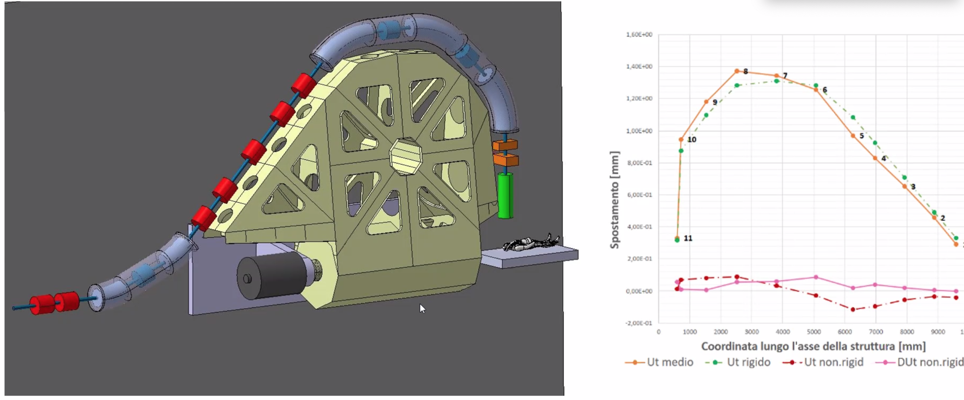
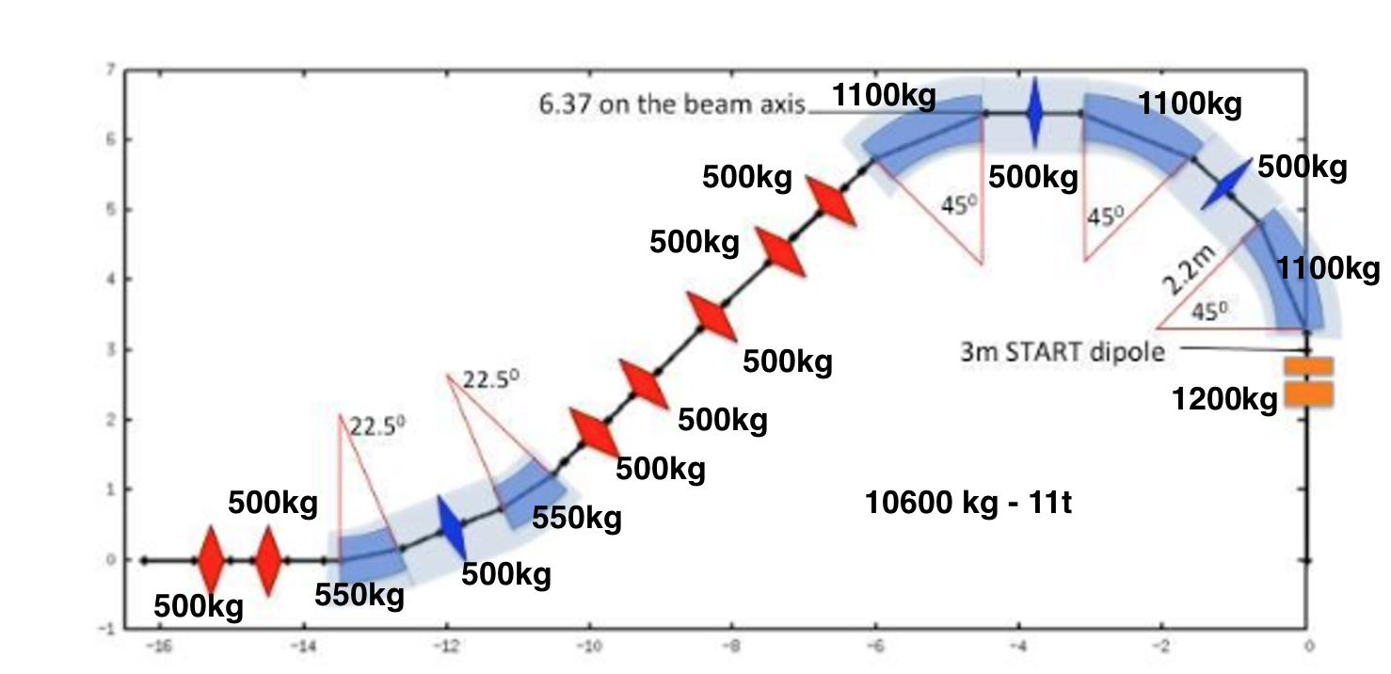
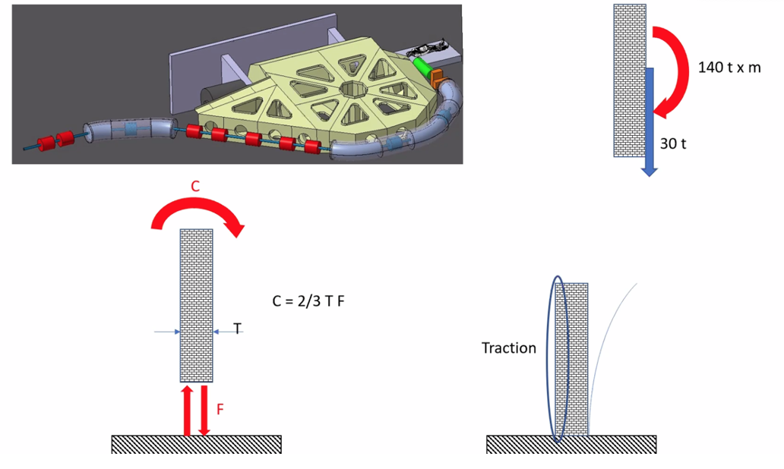

Assumptions/ calculation I
360º $⟶$ 220º to reduce dimensions
Remove drive from axis

Slide 9
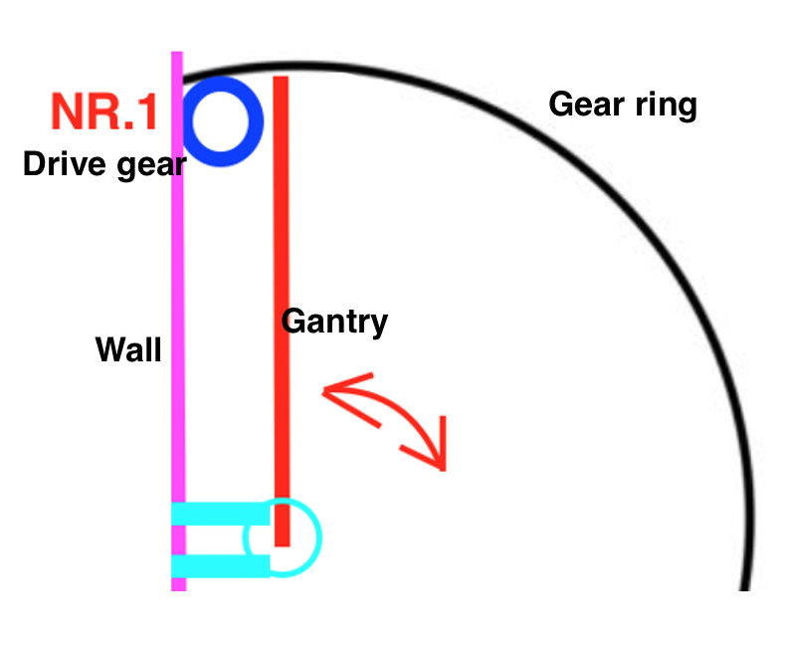
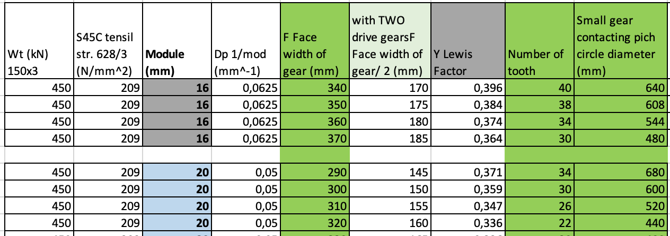
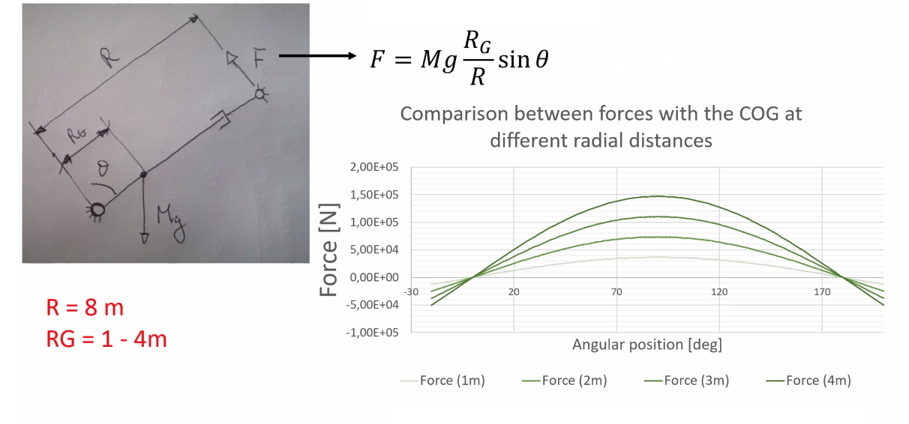
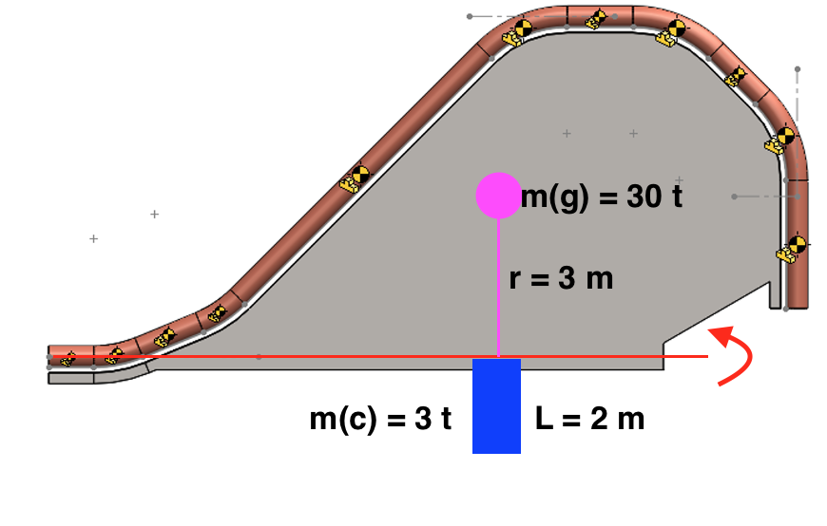
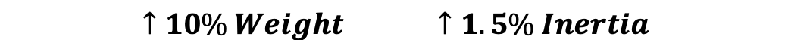
Assumptions/ calculation II
Gears
Inertia
Torques etc.

Slide 10
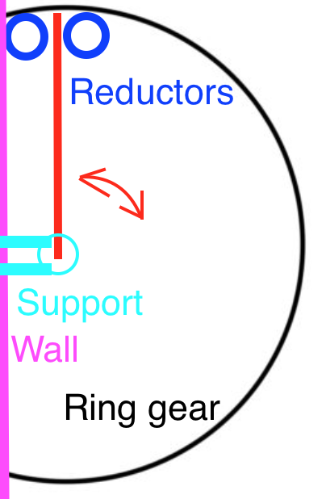



Assumptions/ calculation III
Gantry speeds:
Target speed – 1 rpm >> 30 sec.
1 rpm – average speed value with steps:
  “Soft start”
  ”Accelerating stage”
  “MAX speed”
  “Deaccelerating stage”
  “Positioning stage”
”MAX speed” > 1rpm

Slide 11
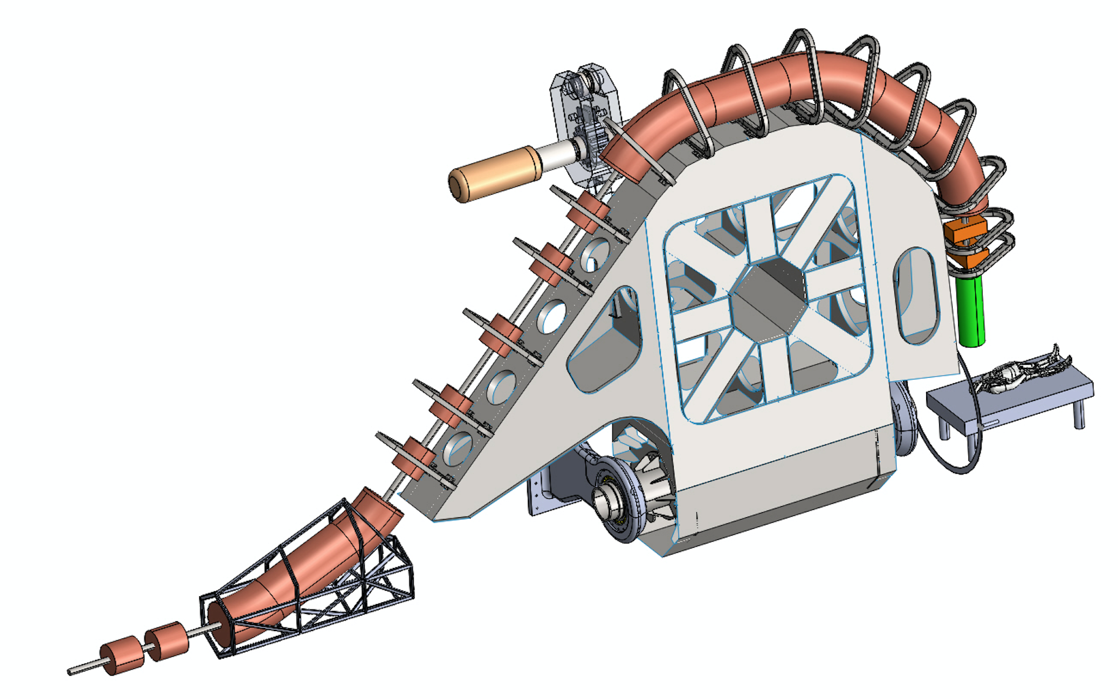
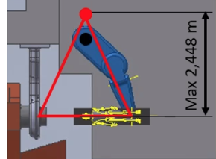
Iteration process

Slide 12
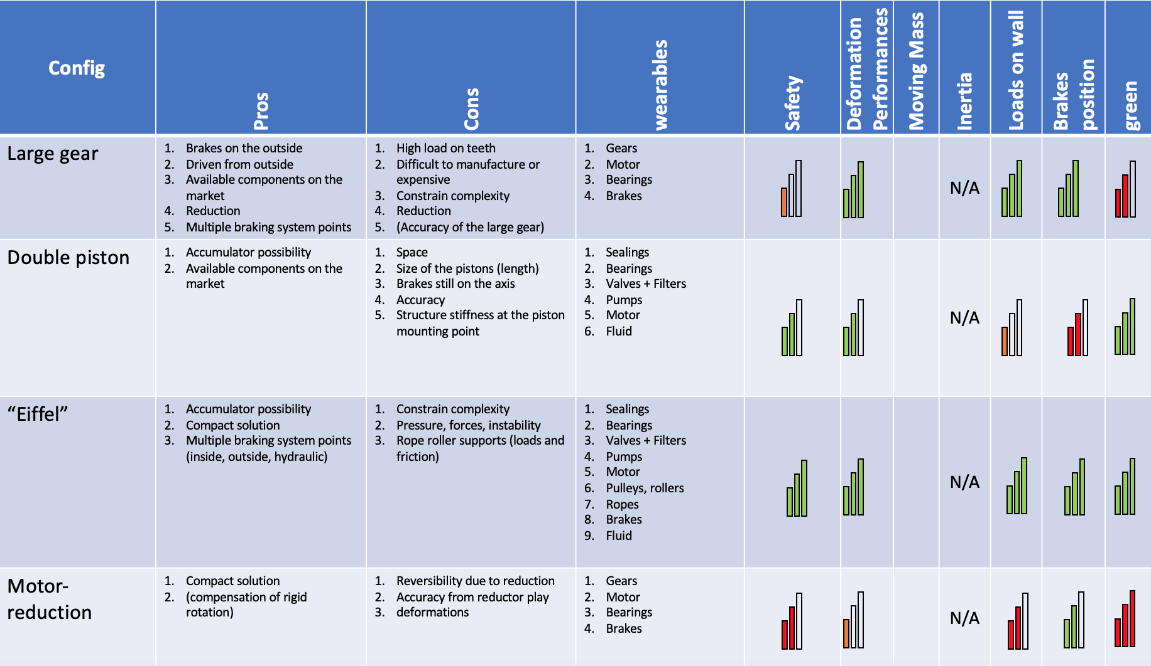
Evaluation of solutions
Solutions evaluation and Feasibility check should
be continued

Slide 13
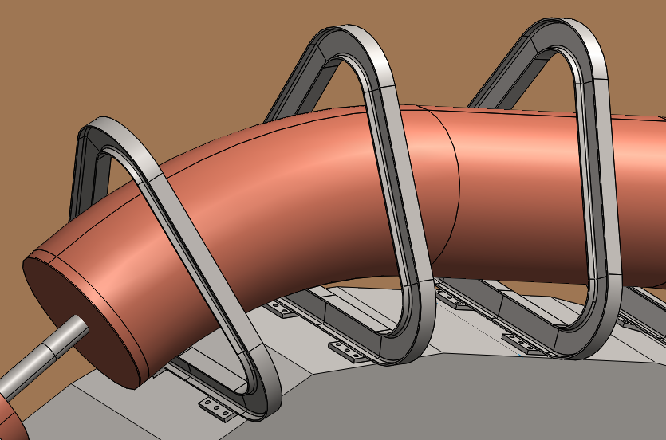
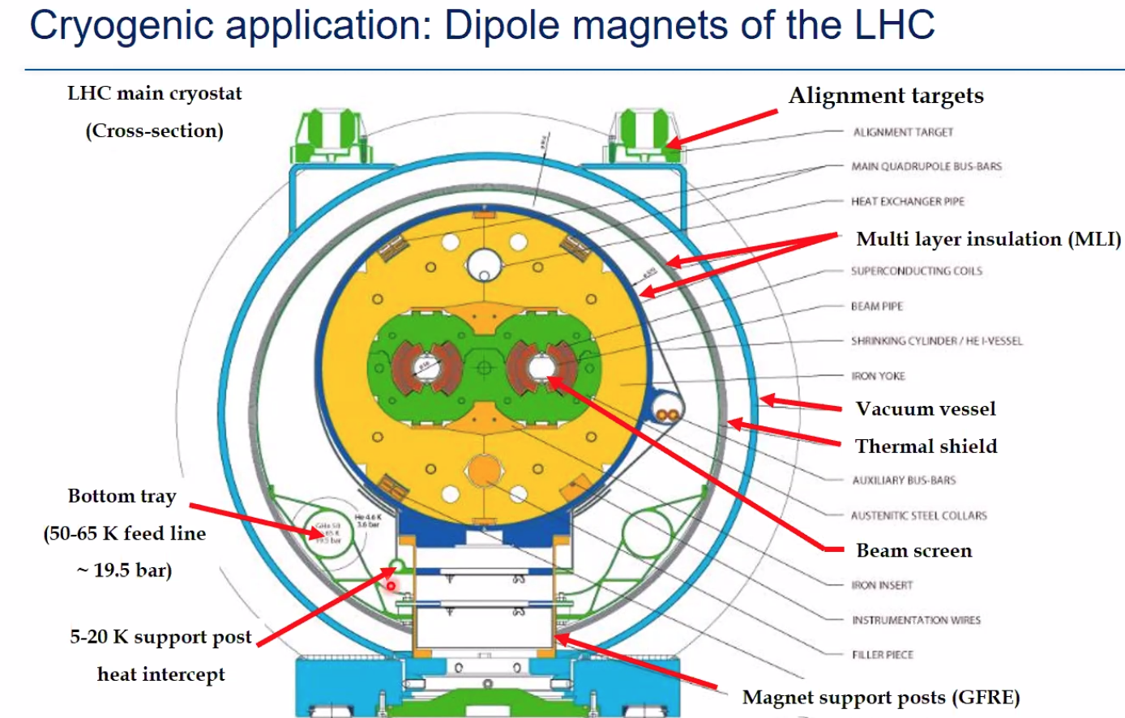
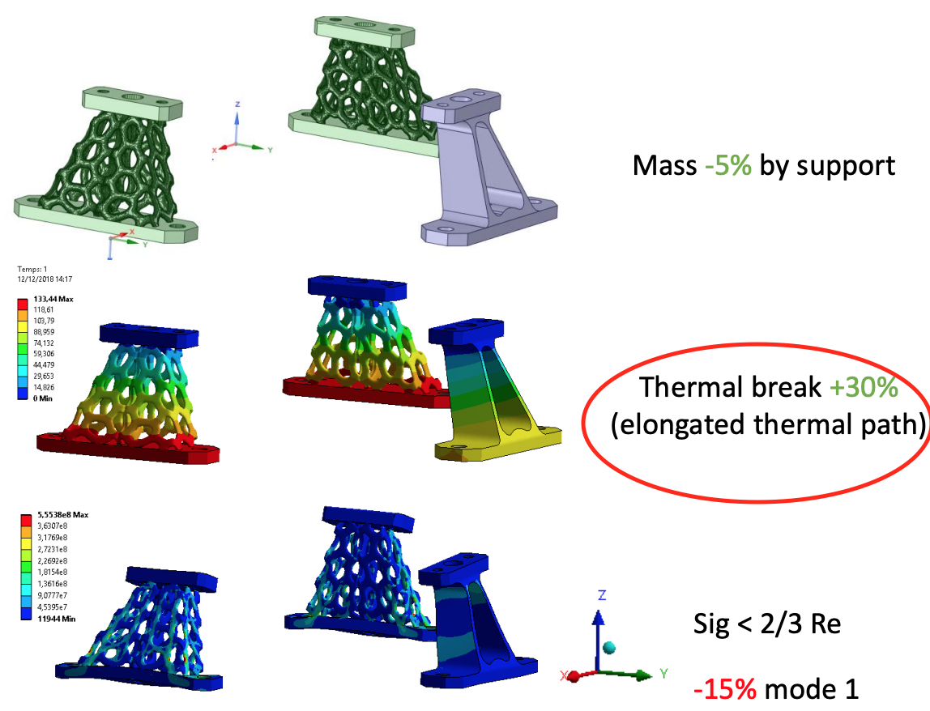
Future steps
The gantry design
Cryogenic – vacuum “tube” fix to to the gantry
Magnet fix in cryogenic “tube”
Source:Y. Jan (CERN)
Source: T. Koettig CERN TE/CRG

Slide 14
Team and PhD thesis
CERN: Mechanical & Materials Engineering (MME) Diego Perini, Luca Dassa
RTU: Toms Torims, Andris Ratkus and two PhD students Jānis Vilcāns, Luca Piacentini
Jānis Vilcāns
Development of the rotational (mobile) cryostat system for the superconducting magnets in the hadron therapy installations.
Luca Piacentini
Gantry design integration and development

Slide 15
Thanks

