Slide 1

The radiosensitizer potential of resveratrol on MDA-MB-231 breast cancer cell line
1st CERN Baltic Conference (CBC 2021)
Danguolė Laukaitienė¹, Aistė Savukaitytė¹, Agnė Bartnykaitė¹, Rasa Ugenskienė^{1,2}, Arturas Inčiūra³, Elona Juozaitytė³
¹Oncology Research Laboratory, Oncology Institute, Lithuanian University of Health Sciences, Kaunas, Lithuania
²Department of Genetics and Molecular Medicine, Lithuanian University of Health Sciences, Kaunas, Lithuania
³Oncology Institute, Lithuanian University of Health Sciences, Kaunas, Lithuania

Slide 2

Background
Breast cancer has posed a major threat to female health worldwide, and its morbidity shows an increasing trend every year.
So far radiation therapy has been applied in the treatment of breast cancer.
However, radioresistance and side effects have been limiting factors of this practice.
Therefore, studying phytochemicals that can enhance the radiation effect and, at the same time, protect normal cells is extremely relevant.

Slide 3

Background
One of these phytochemicals is RESVERATROL (RSV).
Resveratrol is a polyphenol produced by several plants, including grapes, red wine, berries and peanuts and is a phytoestrogen that possesses anti-oxidant, anti-inflammatory, cardioprotective, and anti-cancer properties.
Studies with this substance show its ability to inhibit the expression of cancer-specific genes, induce changes in the cell cycle, and activate apoptosis.

Slide 4
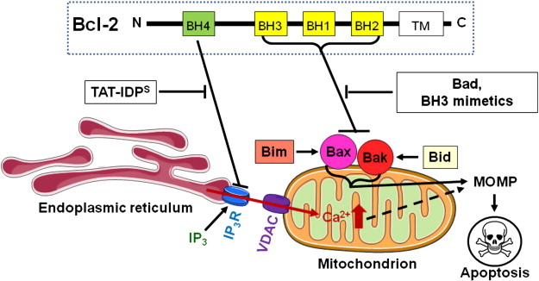
Background
BCL2 is the milestone of apoptosis-regulatory gene. It contributes to tumorigenesis by blocking programmed cell death and promoting cell survival.
The aberrant expression of BCL2 gene is strongly associated with resistance to chemotherapy and radiation.
The aim of the study was to investigate the in vitro effects of RSV on cellular radiosensitivity and the expression of anti-apoptotic gene BCL2.

Slide 5
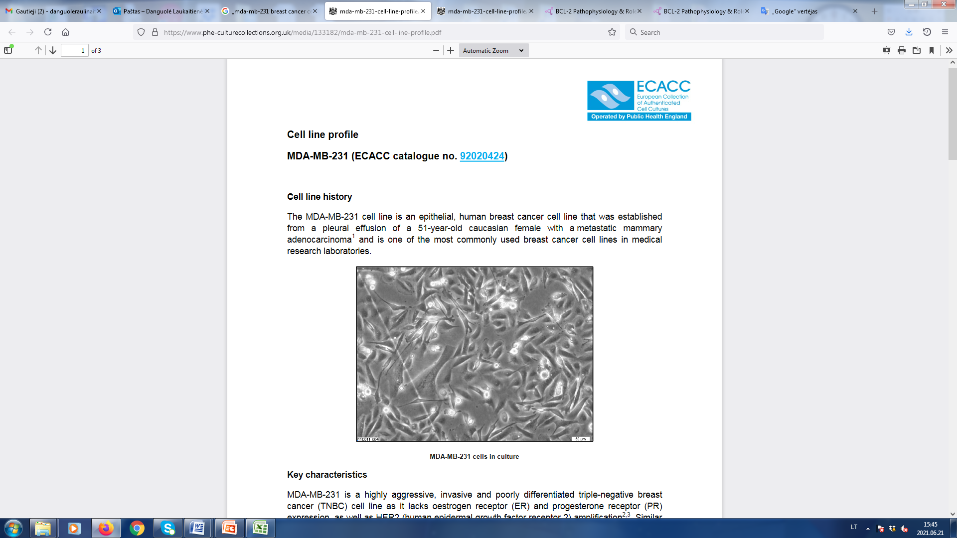
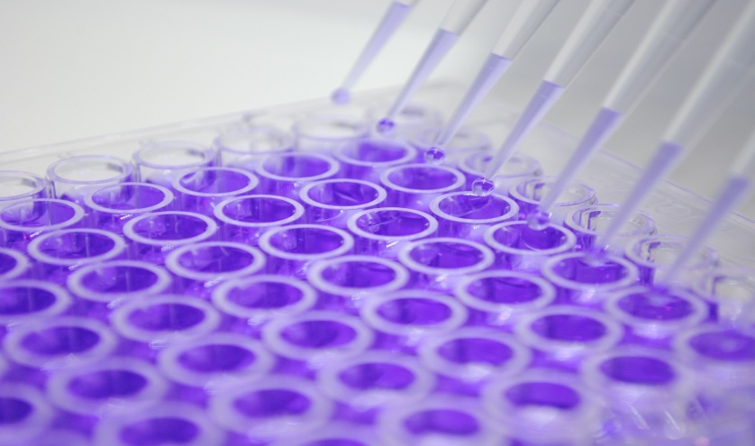
Methods
Cell culture
In this study the MDA-MB-231 breast cancer cell line has been used.
Cells were grown in DMEM medium supplemented with 10% FBS, 1% glutamine and 100 IU/ml penicillin-streptomycin solution at 37⁰C, humidified and filled with 5% CO2air conditions.
MDA-MB-231 is a highly aggressive, invasive and poorly differentiated triple-negative breast cancer (TNBC) cell line.
MTT assay
The anti-proliferative effect of resveratrol against MDA-MB-231 breast cancer cells was determined using the colorimetric MTT assay.

Slide 6
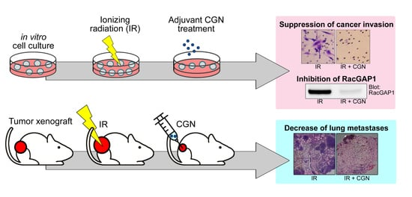
Methods
Irradiation (IR)
Cells were seeded into culture plates, incubated overnight and treated with resveratrol. After 24 h the media was removed and replaced with fresh resveratrol-free culture media.
Cell irradiations were performed with photon beams (X-rays) of 6 MV nominal energy and doses of 2 and 10 Gy, using a medical linear accelerator Clinac 2100C/D.
Ionizing radiation (IR)
Proliferation
in vitro
cells culture
RSV treatment
Apoptosis
overnight
24 h
Gene expression analysis

Slide 7
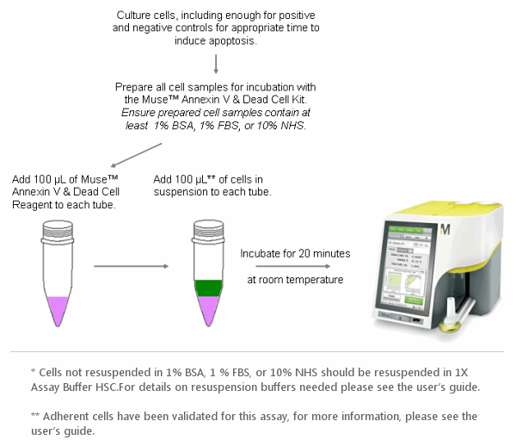
Methods
Apoptosis analysis. The assay was performed according to the instructions of Muse Annexin V & Dead Cell Kit on a Guava Muse Cell Analyzer.

Slide 8
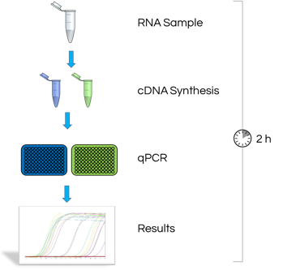
Methods
Gene expression analysis
The expression of BCl2 was determined by quantitative real-time PCR.
Total RNA was extracted using RNeasy Mini Kit.
One microgram of total RNA was reverse transcribed to cDNA using High Capacity cDNA Reverse Transcription Kit with RNase Inhibitor.

Slide 9
Results
We examined the effect of resveratrol on the viability of MDA-MB-231 breast cancer cell line.
The inhibition of cell viability significantly increased in response to resveratrol in a dose- and time-dependent manner.

Slide 10
Results
The radiosensitizing effect of resveratrol at different concentrations (25, 50, 80 µM) in 24 h cell culture irradiated at 0, 2, and 10 Gy were evaluated.
The combination of resveratrol and radiation (RSV+IR) treatment produced significantly greater antitumor effects on the breast cancer cells than either treatment alone.

Slide 11
Results
To determine whether the RSV-induced inhibition of breast cancer cells growth was due to cell apoptosis, MDA-MB-231 cells were stained with annexin V. Flow cytometry analysis showed that the apoptotic cell population increased in a dose-dependent manner.
The activation of apoptosis was also demonstrated by the combination of RSV+IR therapy. The percentage of cells undergoing apoptosis increased with radiation dose and resveratrol concentration.

Slide 12
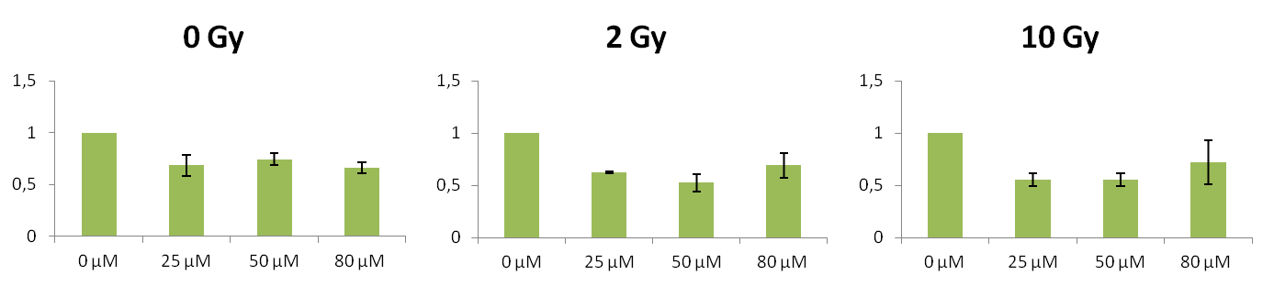
Results
The combination of RSV+IR treatment significantly reduced BCL2 gene expression than either treatment alone.

Slide 13
Conclusions
So, to conclude, our study results revealed that resveratrol is a potential radiosensitizer of MDA-MB-231 breast cancer cells.
We also demonstrated that the inhibitory effect of combination of RSV+IR cell growth was related to the induction of apoptosis and the expression reduction of anti-apoptotic gene BCL2.

Slide 14
Thanks for your attention!!!

Slide 15
The radiosensitizer potential of resveratrol on MDA-MB-231 breast cancer cell line
1st CERN Baltic Conference (CBC 2021)
Danguolė Laukaitienė¹, Aistė Savukaitytė¹, Agnė Bartnykaitė¹, Rasa Ugenskienė^{1,2}, Arturas Inčiūra³, Elona Juozaitytė³
¹Oncology Research Laboratory, Oncology Institute, Lithuanian University of Health Sciences, Kaunas, Lithuania
²Department of Genetics and Molecular Medicine, Lithuanian University of Health Sciences, Kaunas, Lithuania
³Oncology Institute, Lithuanian University of Health Sciences, Kaunas, Lithuania

