Slide 1

HEP-EX studies at NICPB
Mario Kadastik

Slide 2
History
Originally HEP group overall including theory, phenomenology and since ca 15 years experimental programs
Ca 5 years ago experiment group separately formed, concentrating on CMS analysis efforts
Lately have turned towards experiment development through trigger development projects

Slide 3
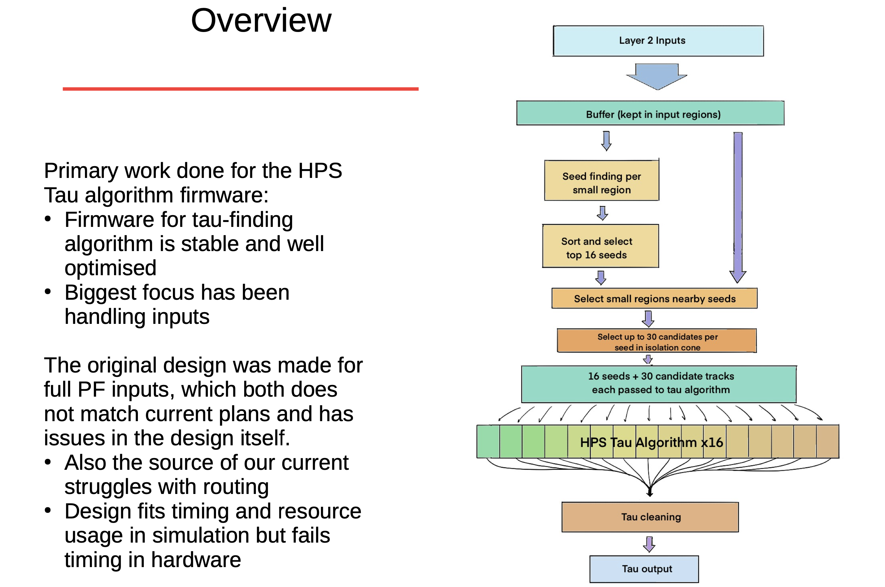
L1 trigger development
Work in progress

Slide 4
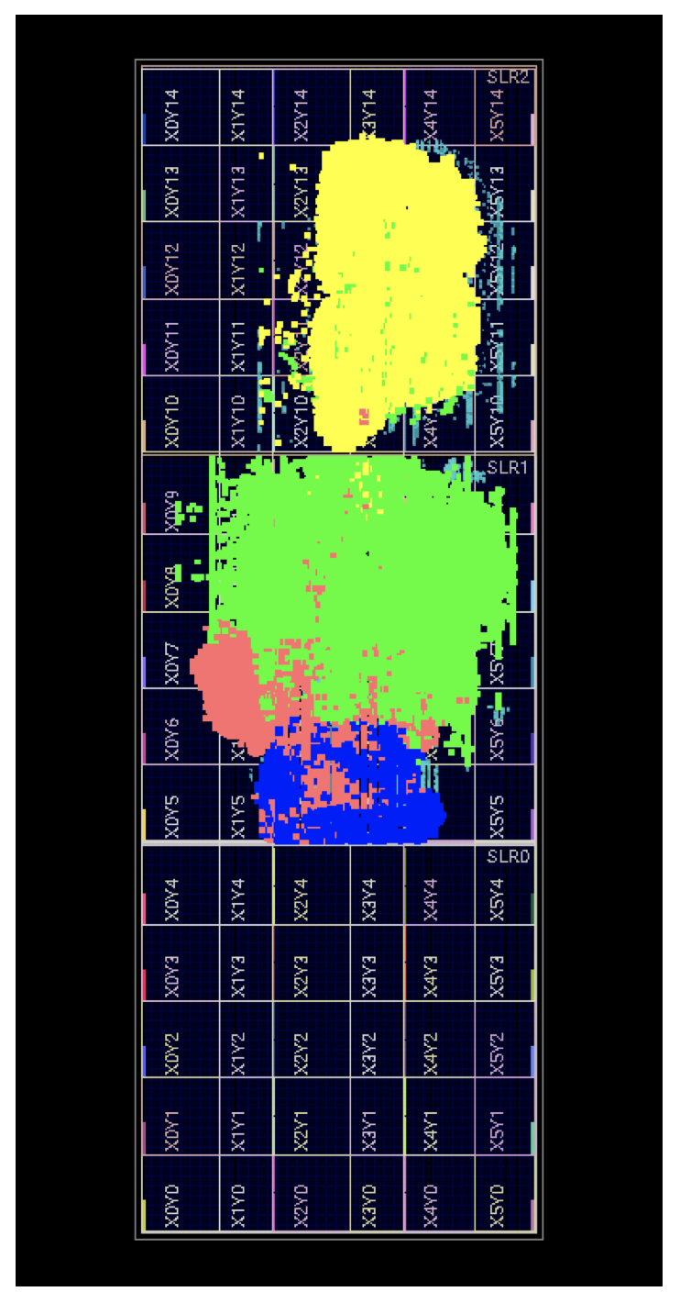
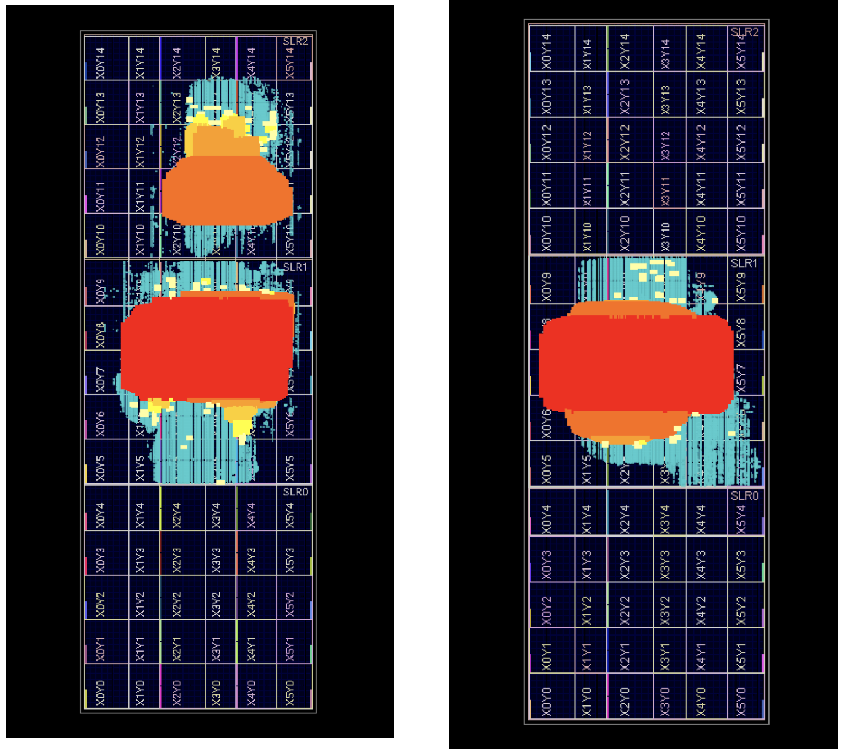
L1 trigger development
Firmware inputs and routing
Work in progress

Slide 5
L1 trigger development
Firmware for the HPS Tau algorithm itself is stable
  Fits both timing and resource usage easily
  Bitwise emulator for better validation in progress
Main work has been on algorithm inputs:
  Full PF preferable in offline algorithm, but not feasible in firmware due to routing complexity.
  Testing has been done to figure out where worst congestion is
  Reduced inputs likely the best option – currently exploring what our options are
Work in progress

Slide 6
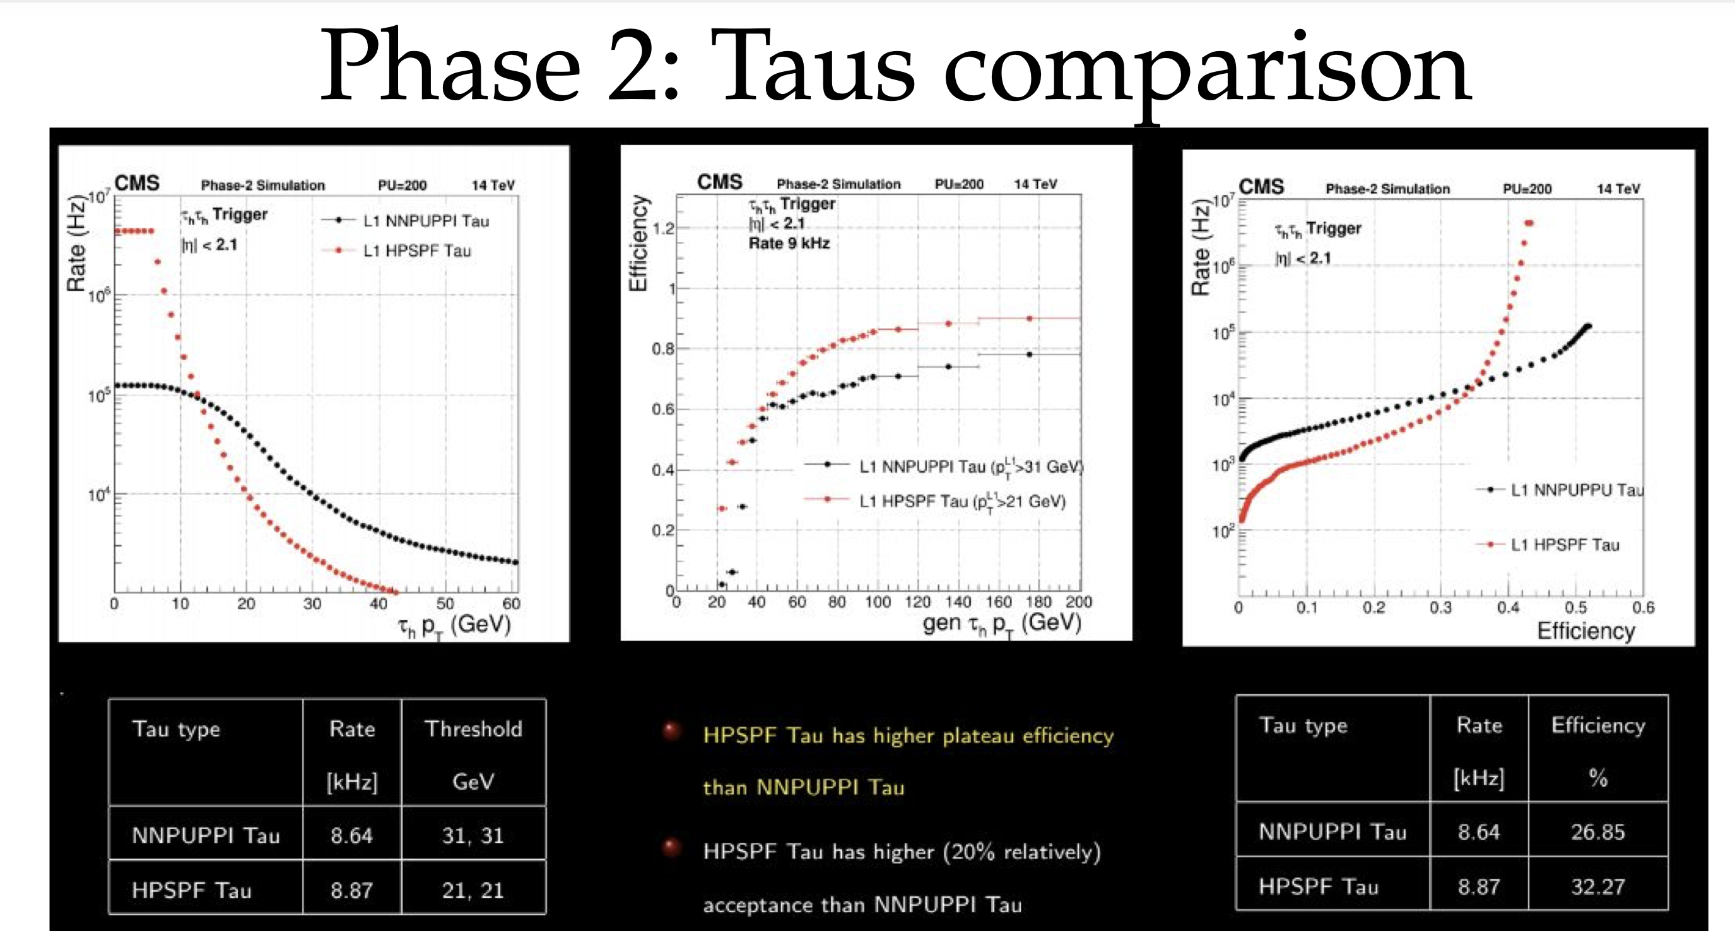
L1 taus
Work in progress

Slide 7
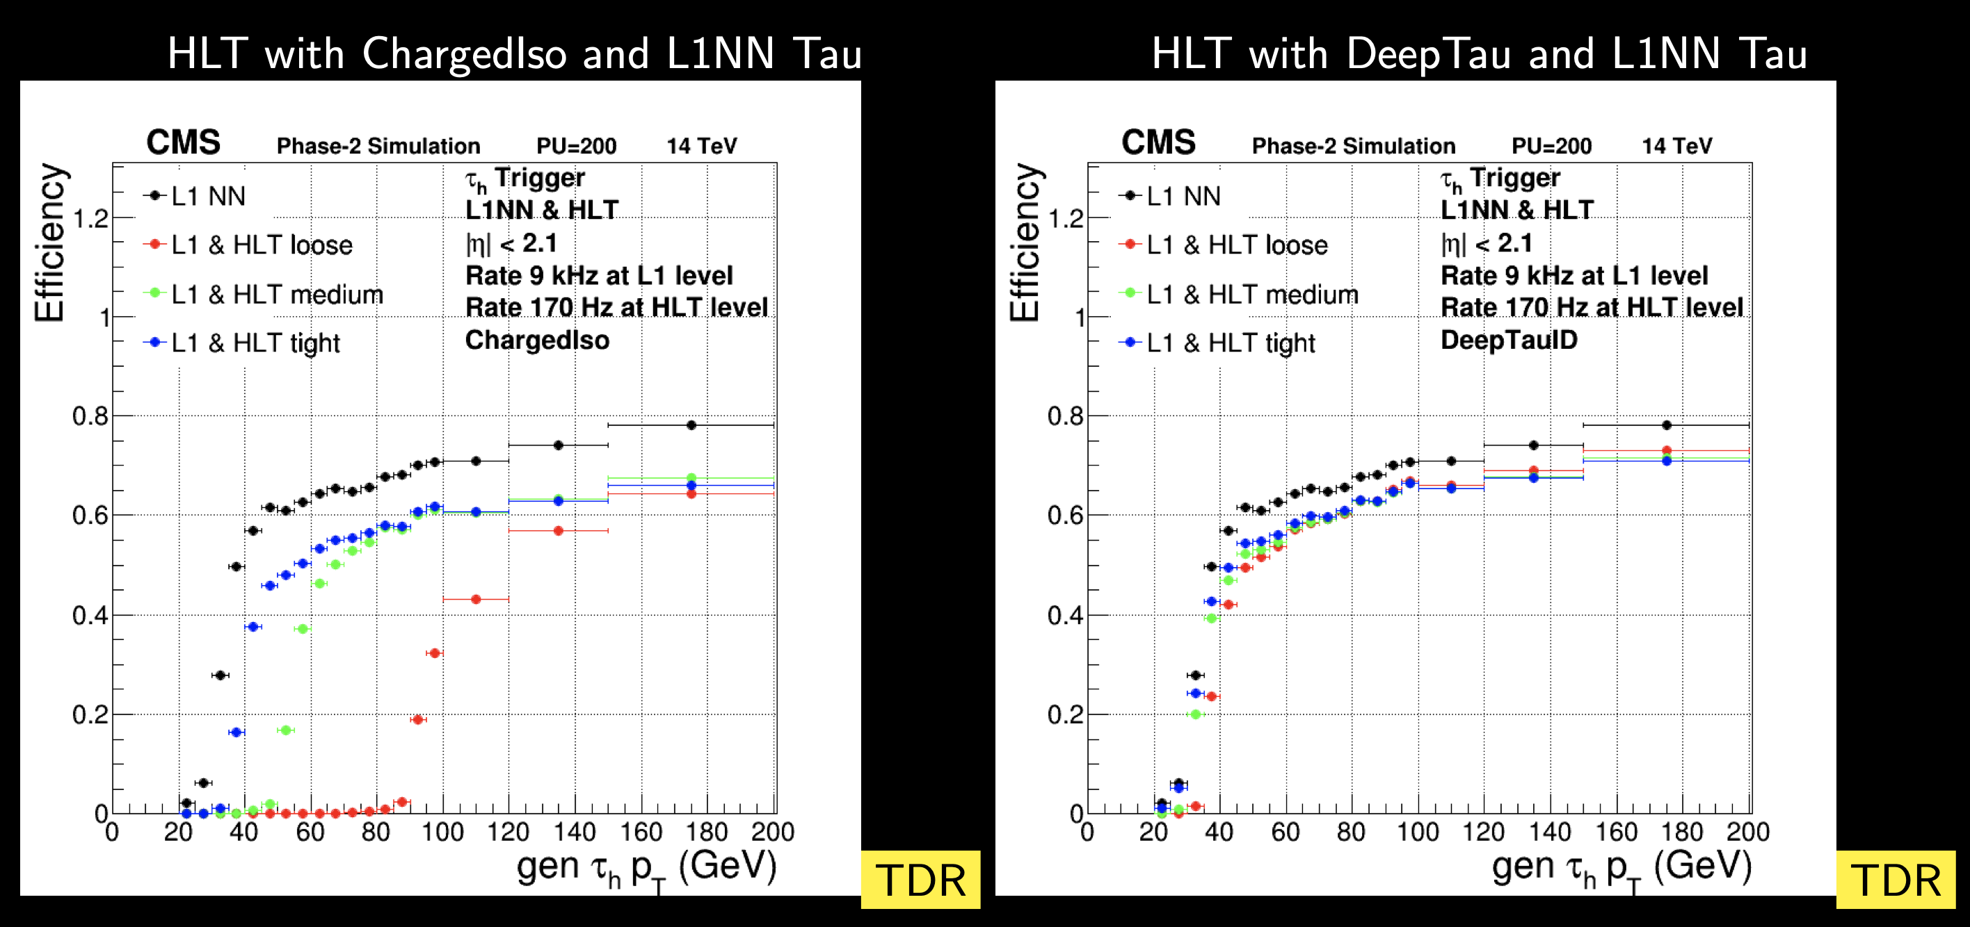
HLT taus
Work in progress
Using deep learning and neural nets we can get a faster turnon and higher efficiency

Slide 8
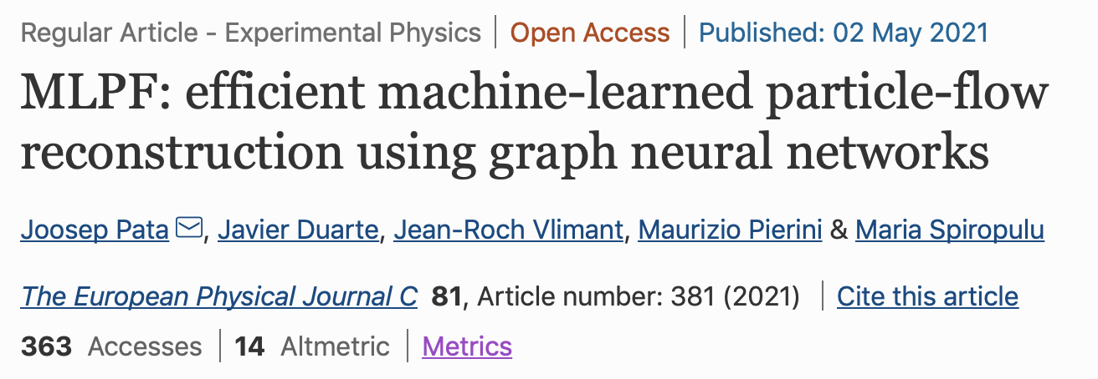
Graph based NN
Detector signals
Reconstructed particles

Slide 9
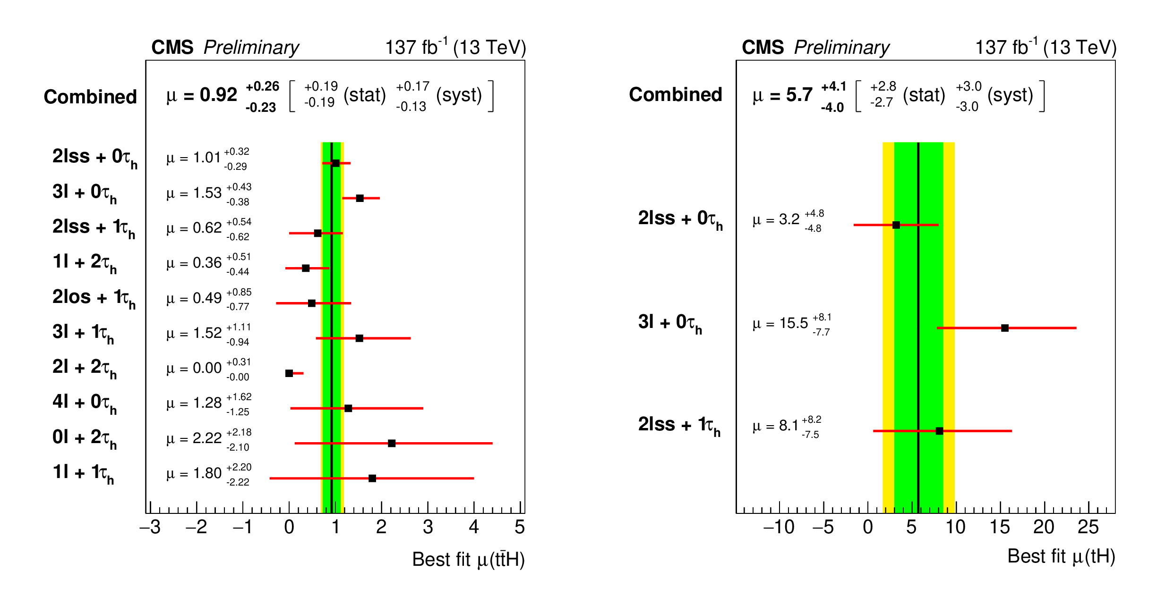
ttH analysis with taus

Slide 10
Summary
Group active in multiple projects, some complementary
Re-igniting active work with theorists for ”fun” projects in between long experimental analysis cycles
Transitioning closer to hardware to progress in field, cooperation active with TalTech

