Slide 1
The operation of LHC detectors
Trigger and DAQ
T.Camporesi,C. Clement,C.Garabatos Cuadrado,R. Jacobsson, L. Malgeri, T. Pauly
Acknowledgements: slides stolen and help from S. Cittolin, W. Smith, J. Varela, I. Mikulec, N. Ellis, T.Pauly. C.Garabatos, T.Pauly
All errors/omissions are mine.
Disclaimer: most of the material is from CMS…this is due to my inability to find the time to understand the essentials for the other experiments and does not imply a judgment on the merit of the implementations other than CMS

Slide 2
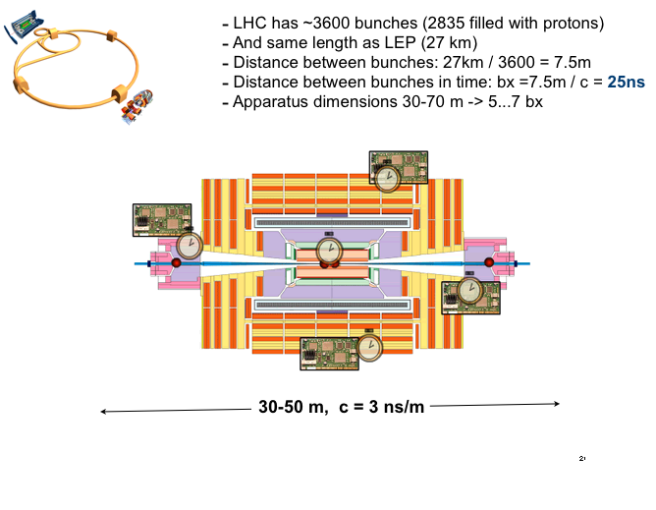
Space-time constraint

Slide 3
Digitization choices
Derandomizer
Signals (every 25 ns)
e.g. ATLAS EM calorimeter
(Digitizer)
Register
FED
BC clock
(every 25 ns)
(Digitizer)
Pipeline
e.g. CMS calorimeter
Multiplexer
e.g. CMS tracker

Slide 4
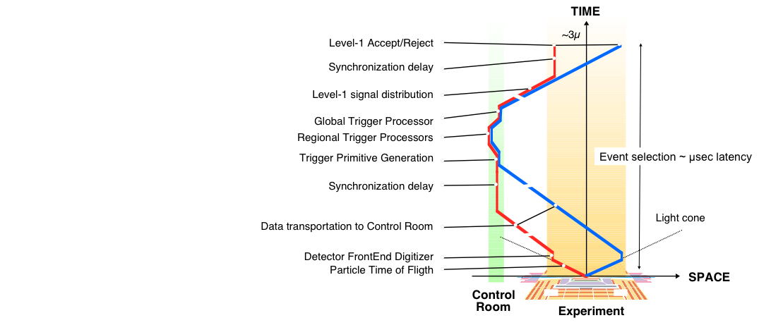
Timing and Trigger and Event kinematics

Slide 5
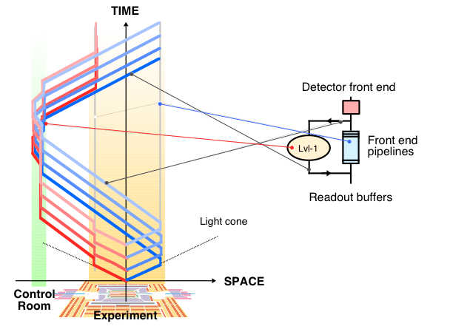
Pipeline: buy time for trigger

Slide 6
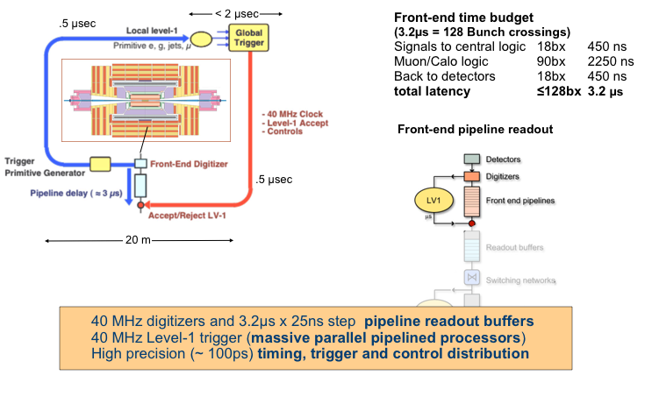
Pipeline in practice

Slide 7
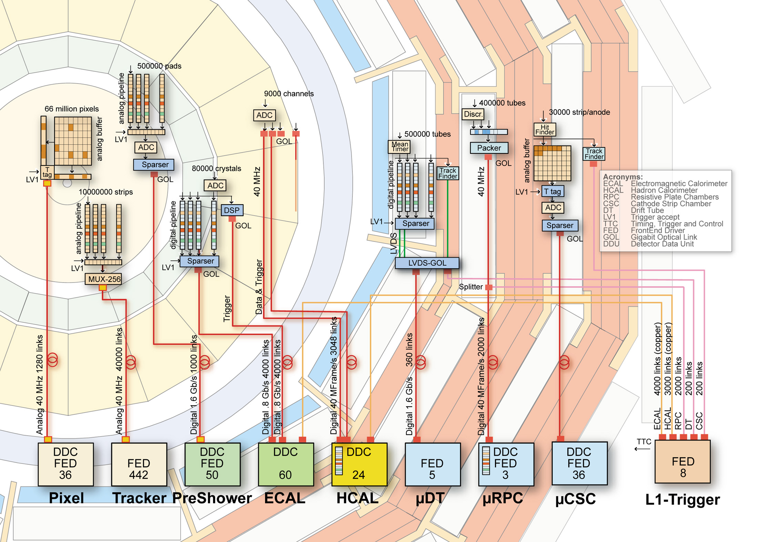
Front-ends to FE Drivers

Slide 8
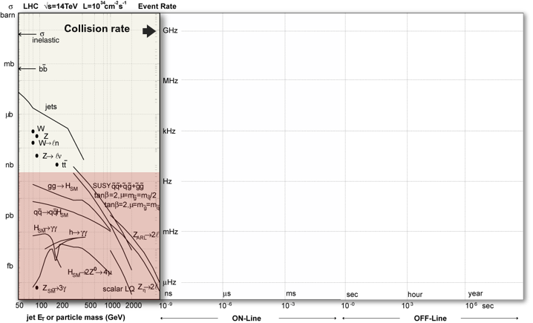
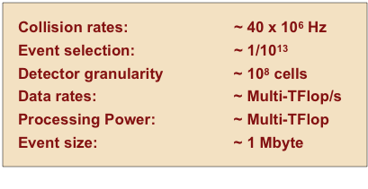
Trigger challenge

Slide 9
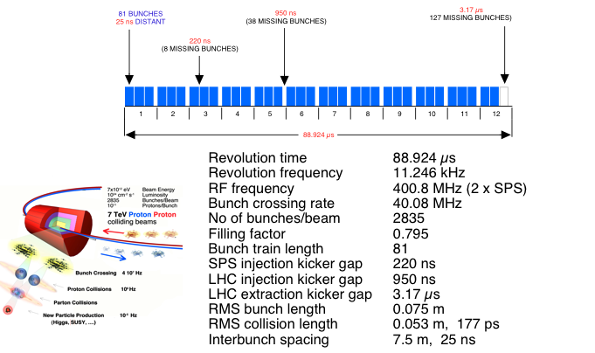
And things are not always simple

Slide 10
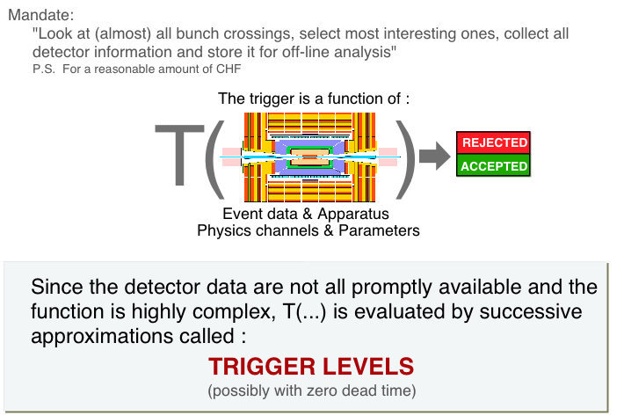
Trigger

Slide 11
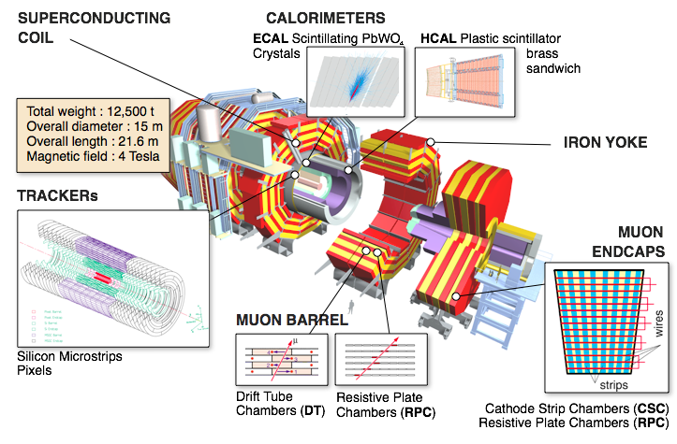
CMS detector

Slide 12
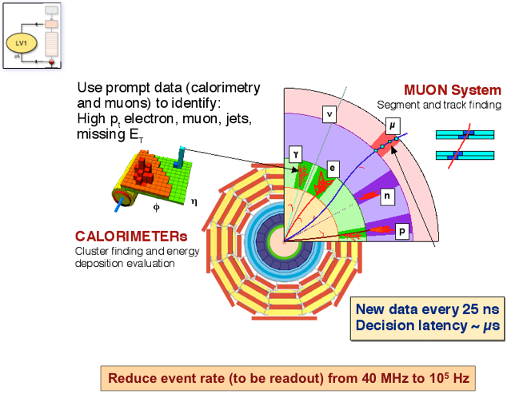
Level 1 trigger

Slide 13
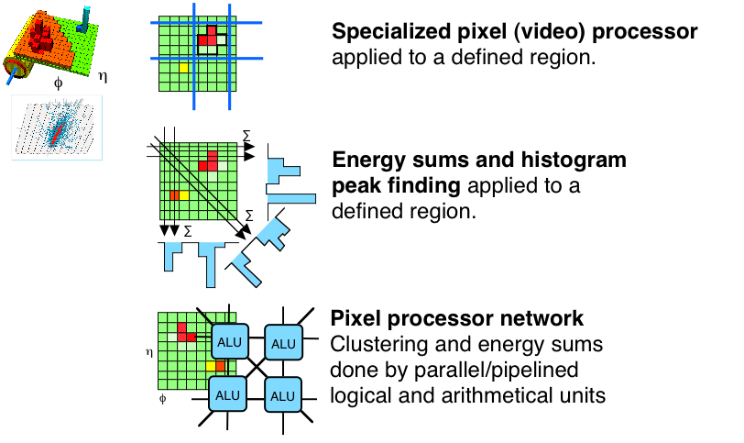
LV1 : calorimeter

Slide 14
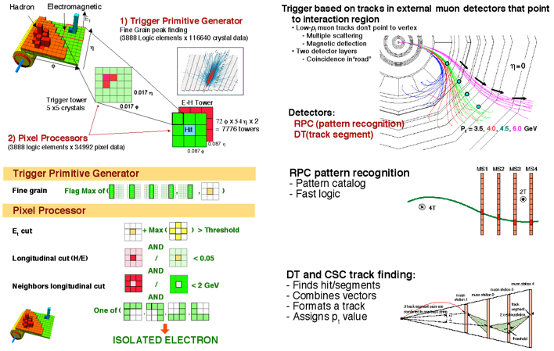
LV1: Massive parallel processing

Slide 15
How to go from 100KHz to 100Hz
The massive data rate after LVL1 poses problems even for network-based event building — different solutions are being adopted to address this, for example:
  In CMS, the event building is factorized into a number of slices each of which sees only a fraction of the rate
    Requires large total network bandwidth (⇒ cost), but avoids the need for a very large single network switch
  In ATLAS, the Region-of-Interest (RoI) mechanism is used with sequential selection to access the data only as required – only move data needed for LVL2 processing
    Reduces by a substantial factor the amount of data that need to be moved from the Readout Systems to the Processors
    Implies relatively complicated mechanisms to serve the data selectively to the LVL2 trigger processors ⇒ more complex software

Slide 16
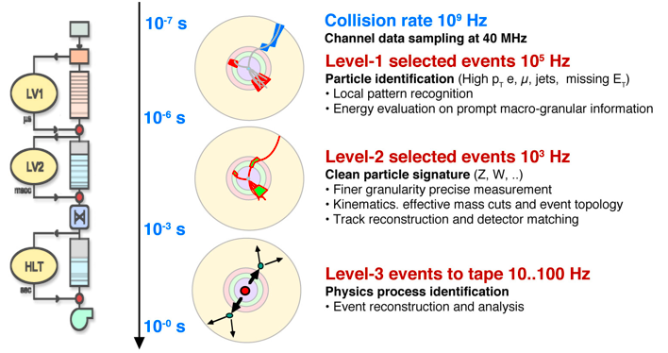
Multilevel trigger
PC farm
Atlas
Region of Interest: LV1 identifies the geographical location
of candidate objects. LV2 accesses data only form RoI.
Sequential selection: Data accessed initially only from a subset of subdetectors (e.g muons) and many events rej. w/o further access
PC farm

Slide 17
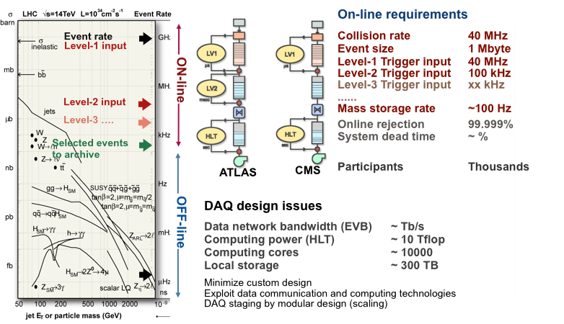
Data flow

Slide 18
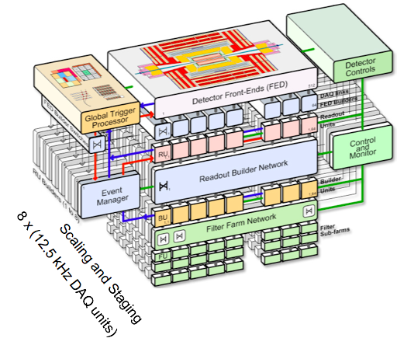
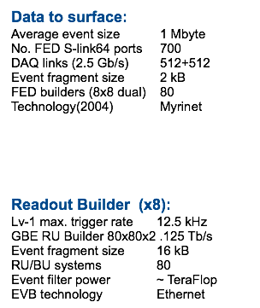
CMS DAQ

Slide 19
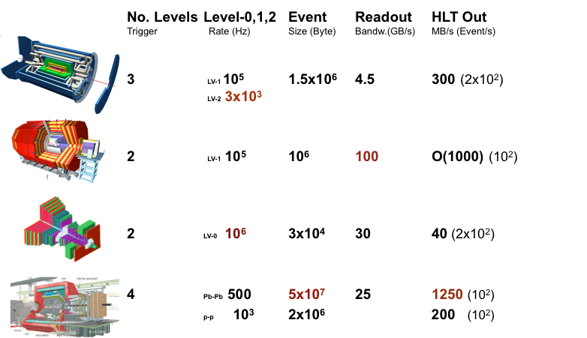
LHC experiment choices

Slide 20
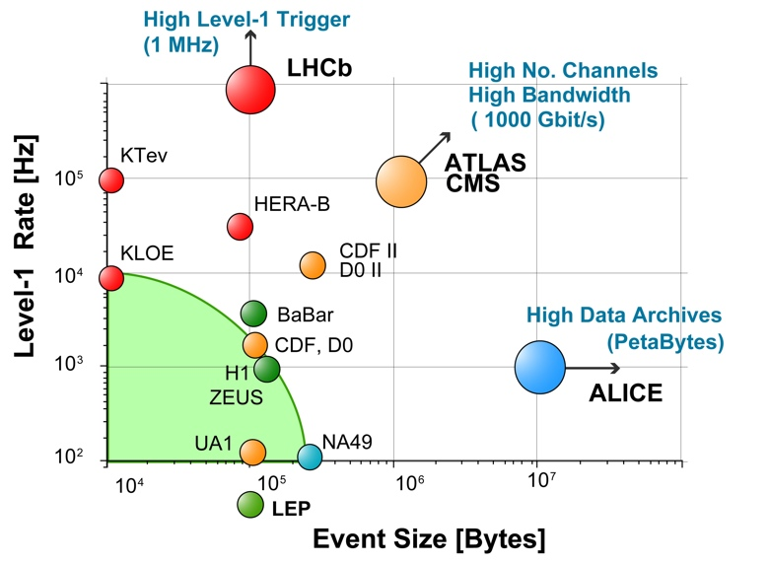
LHC DAQ/Trigger trends

Slide 21
Trigger: follow LHC
Glossary:
  Zero bias trigger: require just LHC bunches crossing (Beware: sometime Zero bias triggers are referred to triggers which are generated by RNDM trigger generators synched with a BX)
  Min bias trigger: minimal sign of interaction (typically some activity in fwd region)
The trigger menus (at all levels) follow the progress of LHC: this year expect to have to cover Luminosities ranging from 10²⁷Hz/cm² to 10³² Hz/cm²
Goals of the trigger:
  select interesting physics events (high P_{t} objects, missing energy…)
  Provide means to allow data driven efficiency studies
  Provide specific trigger to calibrate/align the detector
  Provide ‘artificial’ ( pulse, laser) calibration triggers

Slide 22
Ex: First level trigger in CMS
128 algorithm, 128 technical trigger
  Zero bias
  Min bias (very forward calorimeter, forward scintillators)
  Jets various thresholds (ECAL, HCAL)
  E-gamma various thresholds (ECAL)
  Muons various thresholds (Barrel DT,RPC and FWD CSC,RPC)
  E_{t} (HCAl, ECAL)
  Taus jets ( ECAL, HCAL)
  Multiplicity triggers Jets,Egamma, Muons (decreasing threshold with multiplicity
  + calibration & monitoring triggers
Prescales: presently at 1 as until number of bunch crossing below ~80KHz can afford to do selection only at HLT

Slide 23
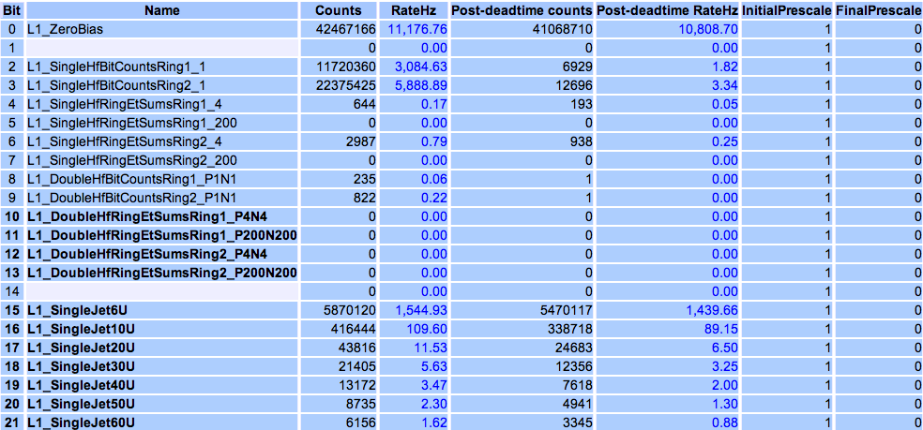
LV1 trigger menu (CMS 10²⁹ Hz/cm²)
Example with rates from fill with L = 2 10²⁹ Hz/cm²
Lower Jet E> 6 GeV
Lower “τ”
E> 10 GeV

Slide 24
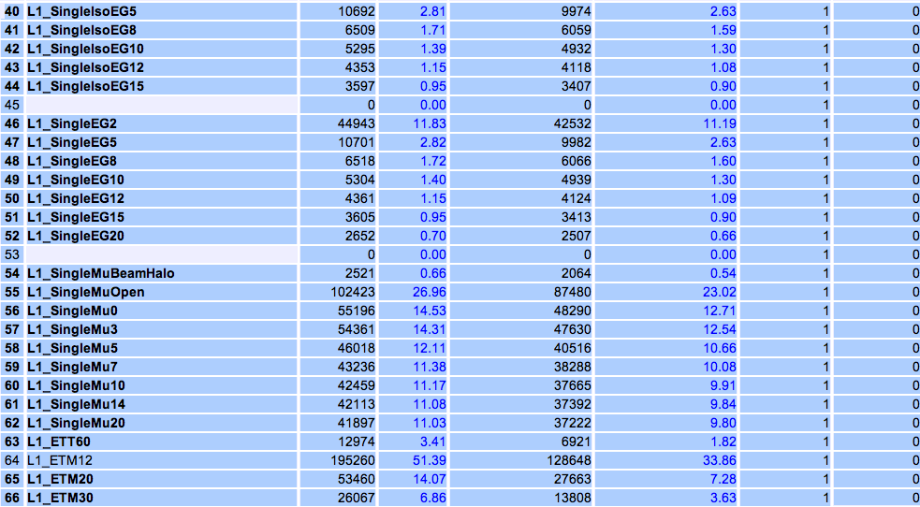
Continued
Lower eγ E> 2 GeV
Lower ΜE_{t} E>12GeV
Lower ΣE_{t} E> 20 GeV

Slide 25
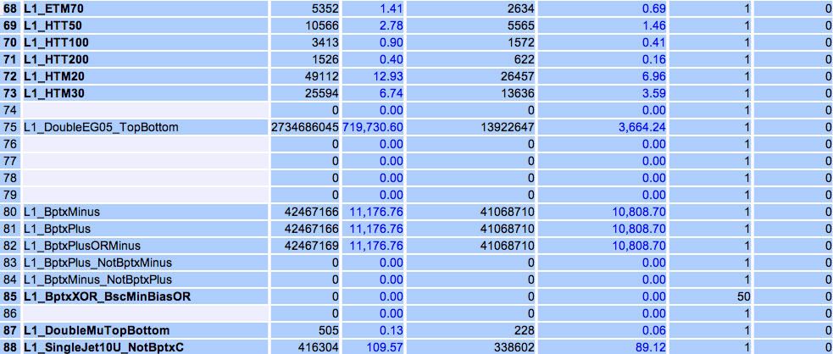
Continued
Lower ΣJetE_{t} E> 50 GeV
Lower ΜJetE_{t} E> 20 GeV

Slide 26
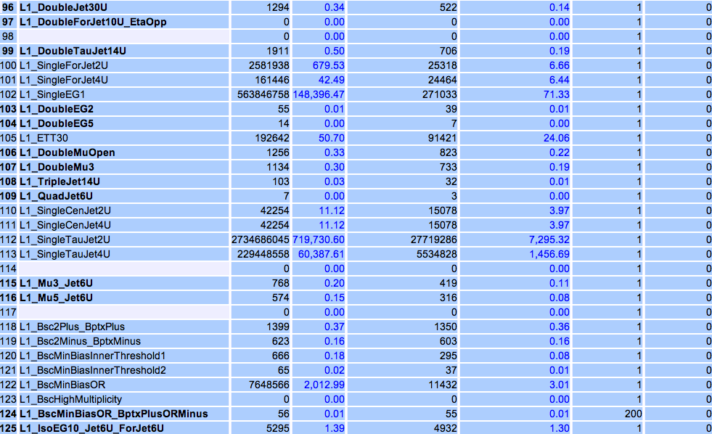
continued
Multiplicity or topology triggers

Slide 27
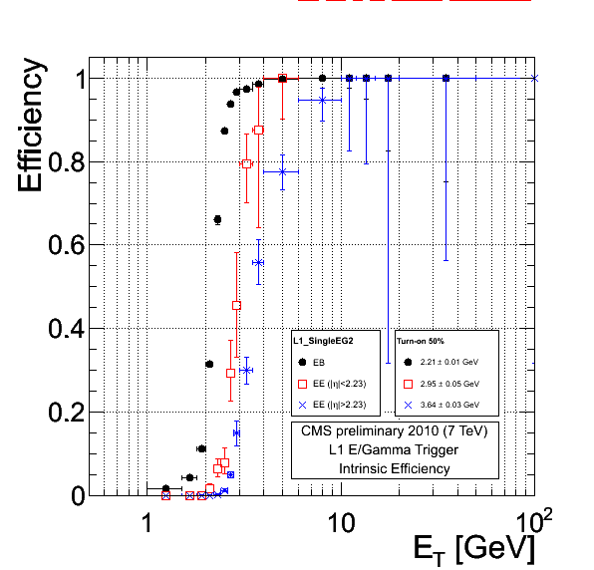
Example: Verification of trigger thresholds
Example
eγ>2 GeV
In edge region of η, topology of trigger tower becomes ‘scanty’

Slide 28
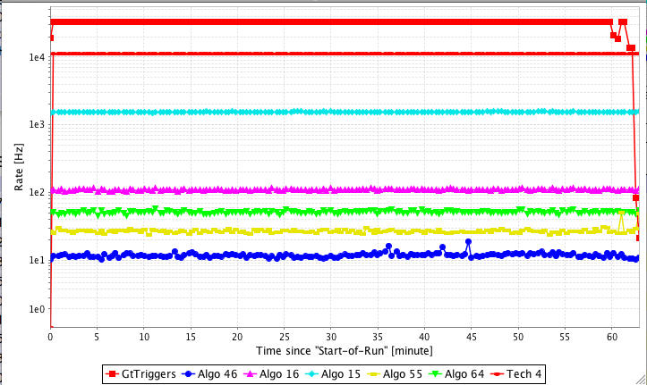
The same fill in a plot
33 KHz total rate Lv1
Total L1 rate
Zero bias
Jet> 6 GeV
Jet>10 GeV
Jet>10 GeV
Single μ open
Eγ> 2 GeV

Slide 29
HLT: CMS example
The CMS HLT process has a multitude of ‘Paths’ which process a given event depending on a seed which is defined by the L1 trigger bit which fired
The accepted events are tagged according to the Path to be placed in Primary datasets (see Luca’s presentation) to be used by the analysis community.
The primary datasets are presently :
eγ
jetME_{t}-τ
μ
minbias
eγ-monitor
jetME_{t}-τ-monitor
μ-monitor
Commissioning
Cosmics
Align-Calib
Physics
Monitoring

Slide 30
CMS HLT: a couple of PDs (4 10²⁹ Hz/cm²)
eγ
Path Name | L1 condition | L1 Prescale | HLT Prescale | HLT Rate [Hz]
HLT_Photon10_L1R | L1_SingleEG5 | 1 | 1 | 27.91+-0.09
HLT_Photon15_L1R | L1_SingleEG8 | 1 | 1 | 9.64+-0.05
HLT_Photon15_TrackIso_L1R | L1_SingleEG8 | 1 | 1 | 7.39+-0.05
HLT_Photon15_LooseEcalIso_L1R | L1_SingleEG8 | 1 | 1 | 7.37+-0.05
HLT_Photon20_L1R | L1_SingleEG8 | 1 | 1 | 4.91+-0.04
HLT_Photon30_L1R_8E29 | L1_SingleEG8 | 1 | 1 | 2.00+-0.02
HLT_DoublePhoton4_eeRes_L1R | L1_DoubleEG2 | 1 | 1 | 15.48+-0.07
HLT_DoublePhoton4_Jpsi_L1R | L1_DoubleEG2 | 1 | 1 | 5.09+-0.04
HLT_DoublePhoton4_Upsilon_L1R | L1_DoubleEG2 | 1 | 1 | 3.72+-0.03
HLT_DoublePhoton5_Jpsi_L1R | L1_SingleEG8 OR L1_DoubleEG5 | 1, 1 | 1 | 1.27+-0.02
HLT_DoublePhoton5_Upsilon_L1R | L1_SingleEG8 OR L1_DoubleEG5 | 1, 1 | 1 | 0.21+-0.01
HLT_DoublePhoton5_L1R | L1_DoubleEG5 | 1 | 1 | 4.88+-0.04
HLT_DoublePhoton10_L1R | L1_DoubleEG5 | 1 | 1 | 1.40+-0.02
HLT_Ele10_LW_L1R | L1_SingleEG5 | 1 | 1 | 8.44+-0.05
HLT_Ele10_LW_EleId_L1R | L1_SingleEG5 | 1 | 1 | 1.83+-0.02
HLT_Ele15_LW_L1R | L1_SingleEG8 | 1 | 1 | 2.61+-0.03
HLT_Ele15_SC10_LW_L1R | L1_SingleEG8 | 1 | 1 | 0.81+-0.02
HLT_Ele15_SiStrip_L1R | L1_SingleEG8 | 1 | 1 | 2.36+-0.03
HLT_Ele20_LW_L1R | L1_SingleEG8 | 1 | 1 | 1.19+-0.02
HLT_DoubleEle5_SW_L1R | L1_DoubleEG5 | 1 | 1 | 0.98+-0.02
Note: physics prescale =1
Commissioning primary dataset
Commissioning
Note: prescale tuned
Path Name | L1 condition | L1 Prescale | HLT Prescale | HLT Rate [Hz]
HLT_Activity_L1A | OpenL1_ZeroBias | 1, 1 | 30000 | 0.74+-0.02
HLT_Activity_PixelClusters | OpenL1_ZeroBias | 1, 1 | 20000 | 0.99+-0.02
HLT_Activity_DT | L1_BscMinBiasOR_BptxPlusORMinus | 1 | 3 | 8.26+-0.05
HLT_Activity_DT_Tuned | L1_BscMinBiasOR_BptxPlusORMinus | 1 | 1 | 4.06+-0.04
HLT_Activity_Ecal | NOT L1_SingleEG2 | 1 | 300 | 0.56+-0.01
HLT_Activity_EcalREM | NOT L1_SingleEG2 | 1 | 6000 | 1.55+-0.02
HLT_SelectEcalSpikes_L1R | L1_SingleEG2 | 1 | 40 | 1.40+-0.02
HLT_SelectEcalSpikesHighEt_L1R | L1_SingleEG5 | 1 | 20 | 1.27+-0.02
HLT_L1_BptxXOR_BscMinBiasOR | OpenL1_ZeroBias | 1, 1 | 40 | 4.30+-0.04
OpenHLT_Activity_Ecal_SC7 | L1_BscMinBiasOR_BptxPlusORMinus | 1 | 15 | 4.63+-1.04
OpenHLT_Activity_Ecal_SC15 | L1_BscMinBiasOR_BptxPlusORMinus | 1 | 1 | 12.28+-1.69

Slide 31
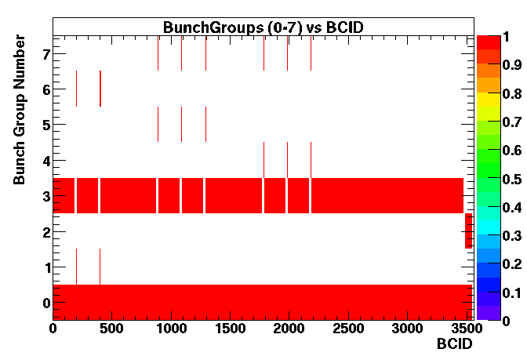
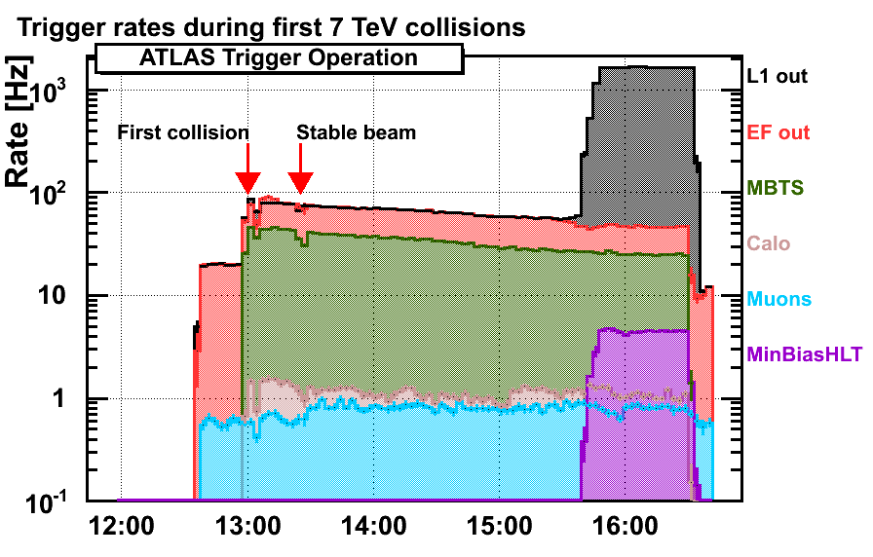
Some trigger examples: ATLAS
Trigger groups: keyed on LHC collision schedule
L1 and HLT accept rates (low lumi)
Unpaired
peak luminosity ~ 7e26Hz/cm²
Empty after paired
Unpaired beam 2
Unpaired beam 1
Lumi optimiz.
HLT accept
Empty
Min Bias
Trig Scint
Calibration requests in abort gap
Physics (paired bunches)
Technical bunch group
HLT in pass-through mode
Turn on HLT selection

Slide 32
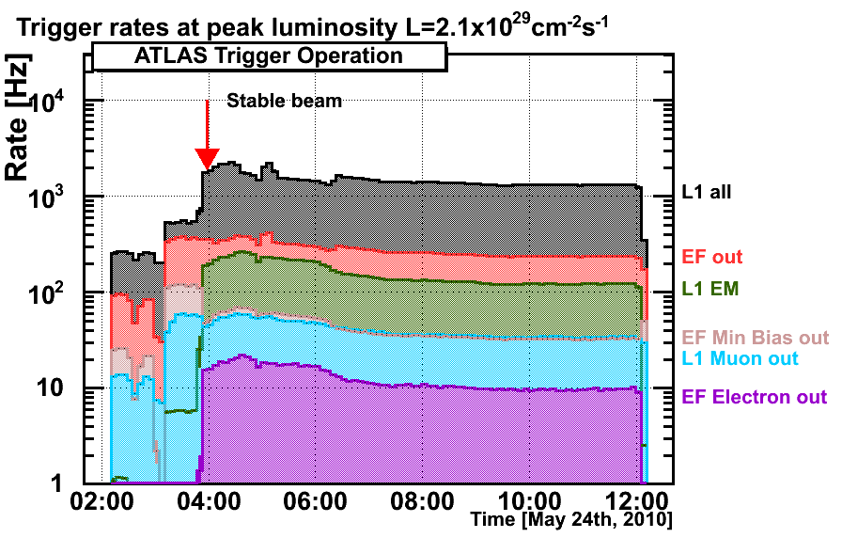
ATLAS: Higher lumi
Example of rate( monitored online)
HLT trigger menu tuned to keep output rate at ~200 Hz
eγ rejection enabled for the EM > 2,3 GeV.
high-rate LVL1 for MinBias are reduced
by the MinBias prescale .
"EF Electron out" shows an events rate selected by e3_loose
Only example streams are shown :their sum does not account for ”HLT accept".
Bumps and dips in "L1 out" and ”HLT Accept" correspond to time when prescale values were changed → change of prescale is synched with ‘luminosity’ section ( smallest unit of data collection selected by analysis community) and available in data payload!
HLT accept
HLT Min bias out

Slide 33
ALICE: Lv1
ALICE uses only LV1 at the present luminosities: triggers are grouped in clusters.
Readout detectors
Fast detectors
Cluster FAST
MB or RARE triggers
Cluster ALL
Fast detectors
Slow detectors
Muon arm
MB triggers
Cluster MUON
Muon arm
MUON triggers
Cluster CAL
TPC laser
TPC calibration
As luminosity increases, the a special duty cycle (“RARE time window) is introduced which for a certain percentage of time blocks MB triggers and opens the way to RARE triggers (high multiplicity, photons, muons, electrons, …) in any cluster. This is ~equivalent in practice to prescale the MB triggers

Slide 34
Buffer protection
Dataflow is a hierarchy of buffers
  front-ends in the cavern,
  back-ends in the underground counting room,
  online computer farms
Goal:
  prevent buffers from overflowing by throttling (blocking) the Level-1 trigger
  Level-1 triggers are lost, i.e. deadtime is introduced
Throttling the trigger has to take into account the latency of the signal propagations from the front end to the Central trigger hardware. This protection is implemented through a dedicated hardware network (TTS)
Various ways have been chosen have to implement the ‘busy’ to protect the chain of memory buffers on the data path.

Slide 35
Trigger throttling
Implemented taking into account that trigger can come spaced by 25 ns: each buffer ‘manager task’ knows how deep ( and occupied) his buffers are and when they reach a high water mark they assert a Warning to reduce/block the trigger in time. The signal is reset once the buffer gets below a low water mark.
This is ‘easy’ to implement at the level of backend buffers (data concentrators, farms) where large buffers and/or relatively short fibers are involved.
For the front ends where buffers are optimized, logic capability limited, and possibly with constraints on the number of BX which need to be read for a given trigger (and wanting to avoid overlapping readout windows) things are more complicated: the concept of protective deadtime is introduced

Slide 36

Protective deadtime
Example CMS: trigger rules (assumed in design of front ends) which allow enough time to all systems to propagate the Warnings to the Global trigger
  Not more than 1 Level 1 trigger in 3 BXs
  Not more than 2 Level 1 triggers in 25 BXs
  More rules implementable, but less critical
Example ATLAS: Leaky bucket algorithm (applied at Central trigger level) which models a front-end derandomizer ( in CMS the Tracker is the only subdetector which has similar emulation implemented in the Front end controller)
  2 parameters: buffer size and time it takes to ship 1 event to the backend
  leaky bucket: fill bucket with L1A. When the bucket is full, deadtime is applied. At the same time, the L1A are leaking out of the bucket at constant rate
Protective deadtime introduces negligible (<1%) deadtime in absence of ‘sick’ conditions
L1A
Example:
size=7 BC
rate=570 BC
Bucket
size
leak rate

Slide 37
Asynchronous throttling
In addition to the throttling logic trees which are embedded in the synchronous data flow, asynchronous throttling abilities are foreseen to allow processors at any level who detect a problem in the buffer processing ( e.g. problem of synchronization when comparing data payloads coming from different front-end drivers) to interact with Global trigger and force actions ( e,g. sending a Resync command to realign the pipelines)
Not yet activated/implemented….

Slide 38
Pileup
The best way to maximize istantaneous luminosity is to maximize the single bunch intensity ( L ~ I_{b}²), but that increases the average number of interactions per crossing:
e.g. with nominal LHC bunch currents (1.2 10¹¹ p/bunch) , nominal emittance one gets in average 2.2 (β*=3.5m), 3.7(β*=2m),14(β*=0.5 m) interaction per crossing

Slide 39
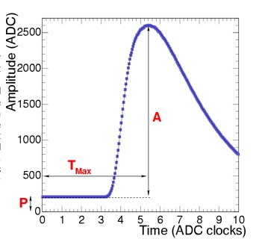
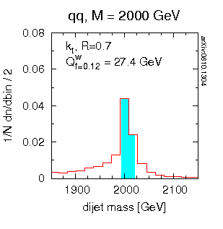
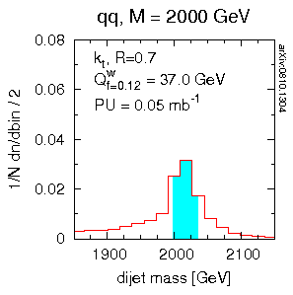
Pileup issues
Evidently It creates confusion! (even with single interaction we are struggling to simulate correctly the underlying event to any hard scattering)
Tracking: increased combinatorics
Effect on calorimetry depends strongly on the shaping time of the signals and on the interbunch distance: e.g. for CMS EM cal signal the pileup will worsen the baseline stability once we get to bunch spacings of 150 ns or lower (the fine granularity and low occupancy mitigate the issue!) .
It will worsen the jet energy resolution
Effect on Muons: negligible
(toy theoretical model )
No pileup
pileup
0.05 mb⁻¹/ev
(~3.5 int/ev)

Slide 40
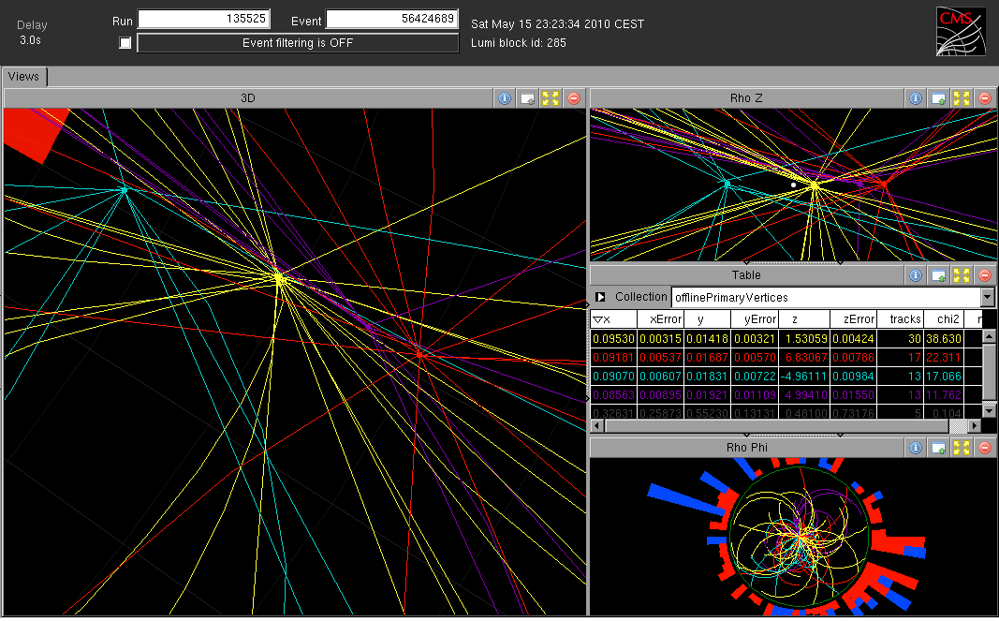
A recent event with 4 vertices

Slide 41
Pileup NOW
Issue mitigated by choice to stretch longitudinally the bunches
at 3.5 TeV, β*=3.5 m we have σ_{z}~8-12 cm
hence better chance of identifying separate vertices
Pileup now is ideal to ‘study’ pileup: is at the level 0.007 mb⁻¹/ev (1.5 interaction/ev) that means that in the same fill one will have a fair fraction of events with 0, 1,2,3,4 vertices
<# int/ev>=1.5

Slide 42
Pileup and luminosity
Le luminosity measurement amounts in practice to estimate the number of interactions per bunch crossing, typically by counting ‘triggers’ (either online or after offline analysis) satisfying certain topologies which aim to integrate large cross sections with the minimum possible acceptance bias.
The # of ‘triggers’ ( ideally a linear function of the luminosity) tend to be affected to some extent by the pileup probability.
The backgrounds as well tend to show some dependence from the pileup thus introducing further non linearity in the equations to extract the lumi
In general more ‘constraining’ triggers ( like requirement of opposite arms coincidence) tend to be more non-linear ( eventually saturating at very high pileups)
Ideally the perfect algorithm would be the one were the multiple vertices of the event are counted, but obviously in this case the measurement becomes more complicated (possibly less robust) as it requires understanding of the reconstruction resolutions, besides trigger efficiencies and more severe dependency on the size of the luminous region

Slide 43
Summary
The challenges that LHC poses to be able to capture the rare interesting events (reduction of rate of 10⁻¹³ needed) are met with a complex and sophisticated trigger, DAQ and data flow architecture
The gradual progression of luminosity of the machine ( 7 orders of magnitude from start to nominal) is allowing us to gradually commission and validate our approach

Slide 44
Backup slides

Slide 45
Luminosity measurement in CMS
Acknowledgments: Slides,plots and Help from D. Marlow, N. Adam, A. Hunt

Slide 46
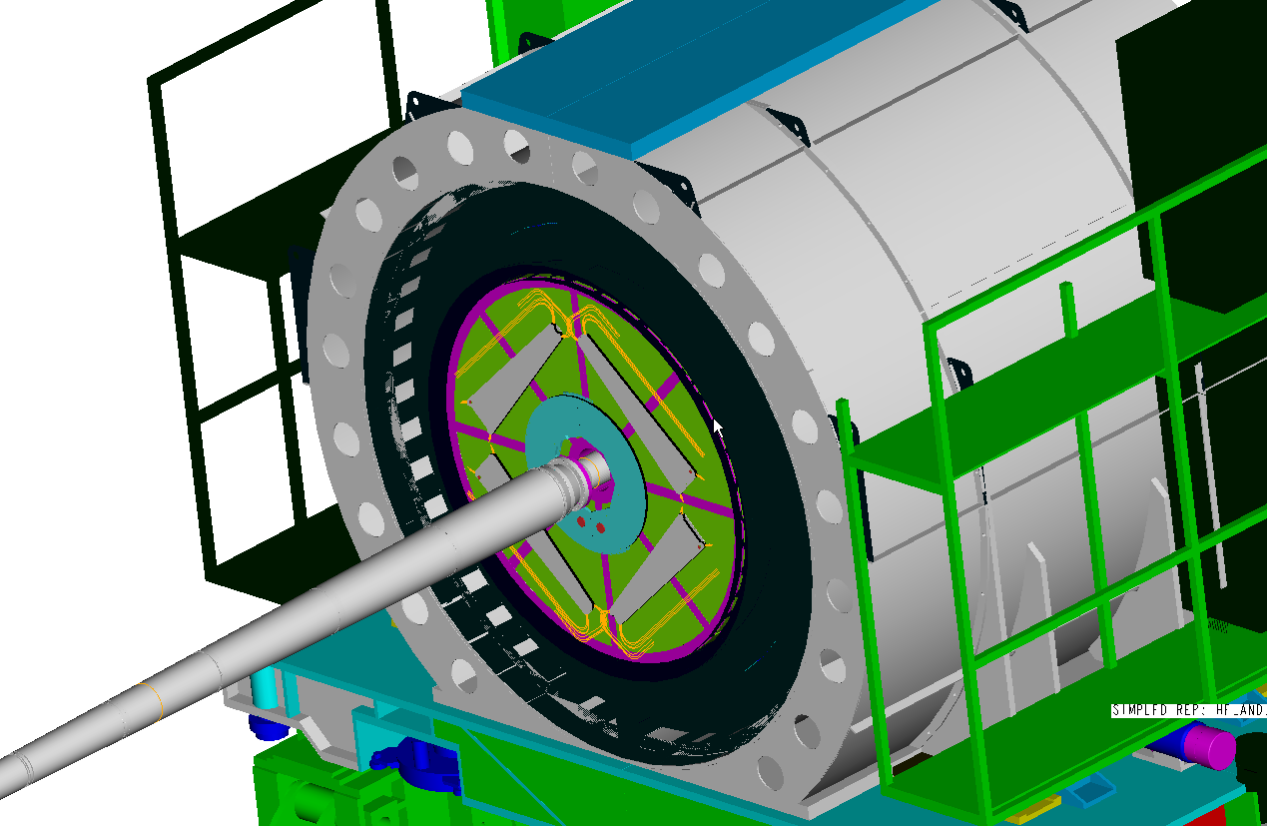
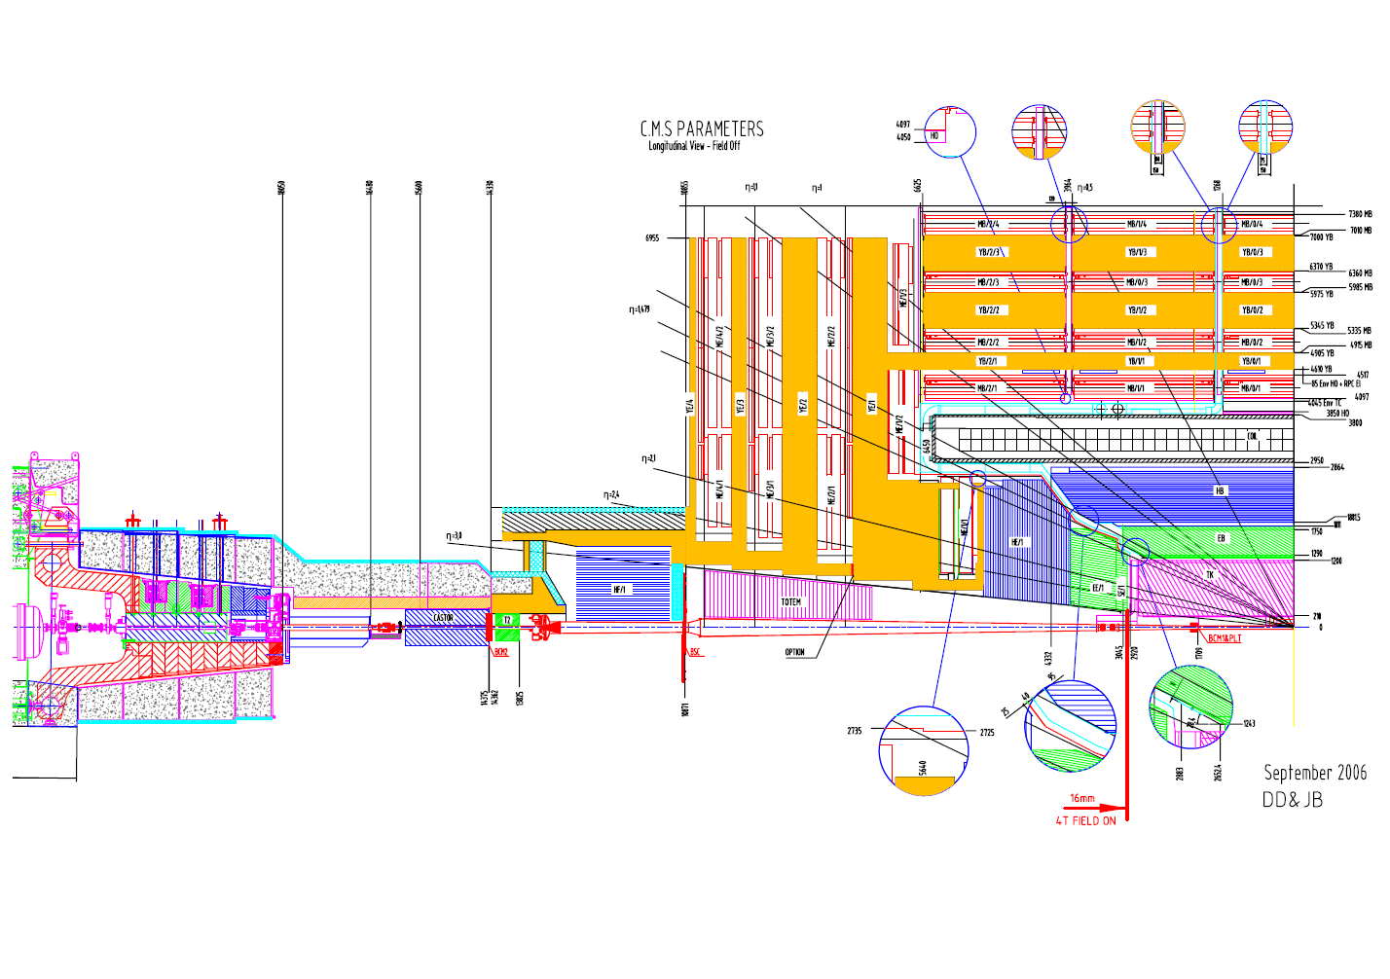
The CMS luminosity monitor
HF: forward calorimeter. Quartz fiber in steel matrix readout by PMTs

Slide 47
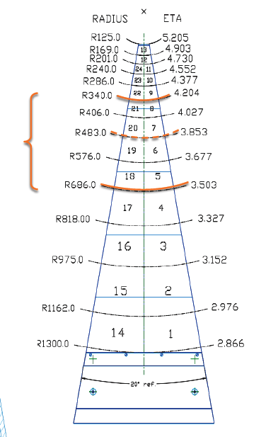
Online lumi using HF
Online Luminosity :
Use 4 rings between η 3.5 and 4.2
Two methods:
-Tower occupancy :2 x 2 rings
- E_{t} : summed over 4 rings

Slide 48
Occupancy method
This method used to date to define online lumi
μ=average # of interaction/crossing
σ= cross section
L=istantaneous luminosity
f=bx frequency
Hit= E_{t} > 125 MeV
f₀=frequency of 0 hits
P=probability of getting no hit (ranging 0.82 to 0.99)
ε<<1 : slope correction
due to noise (non linear with μ… but small until μ reaches > 100
Ν: offset correction
due to noise

Slide 49
E_{T} method
ν_{s} = average energy for a single interaction per bunch crossing
ν_{n} = noise equivalent energy ( evaluated from non colliding crossings)
Advantage: no threshold ( less dependency on variation of response of PMTs), no saturation at very high lumi

Slide 50
Luminosity offline
HF Offline
  Require ΣE_{T} > 1GeV in both HF+ and HF-
  Require |t| < 8ns in both HF+ and HF-
Vertex Counting Offline
  Require ≥ 1 vertex with |z| < 15cm
Monte Carlo Efficiency Estimate
Used from first fills to ‘define’ the online absolute lumi
σ_{Minbias} = 73.1 mb
Method | Efficiency | Eff. Cross-Section
HF | 63.4 % | 45.2 mb
Vertex | 73.4 % | 52.3 mb

Slide 51
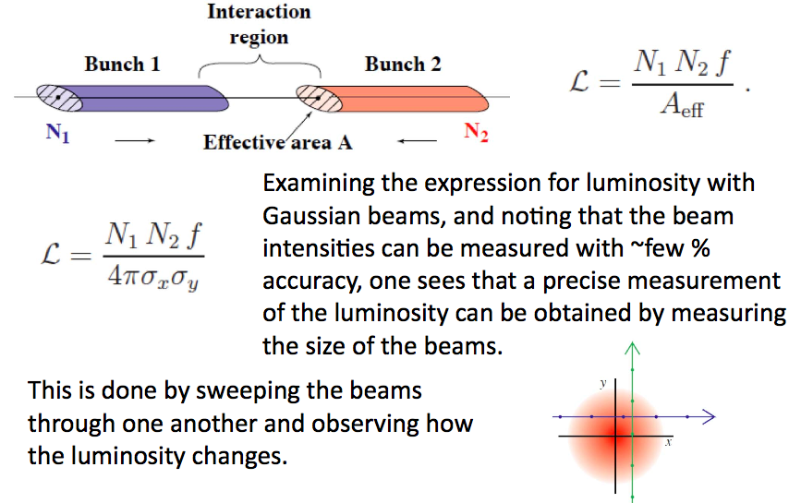
Absolute luminosity

Slide 52
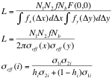
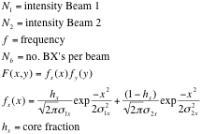

In practice
The separation scan method is used for absolute calibration at CMS. Have 25 points per scan, out to ~4.5σ_{beam}.
A double-Gaussian beam profile is needed to fit the beams observed in CMS. Significant luminosity in the tails of the distribution.
Luminosity at beam separation d is given by

Slide 53
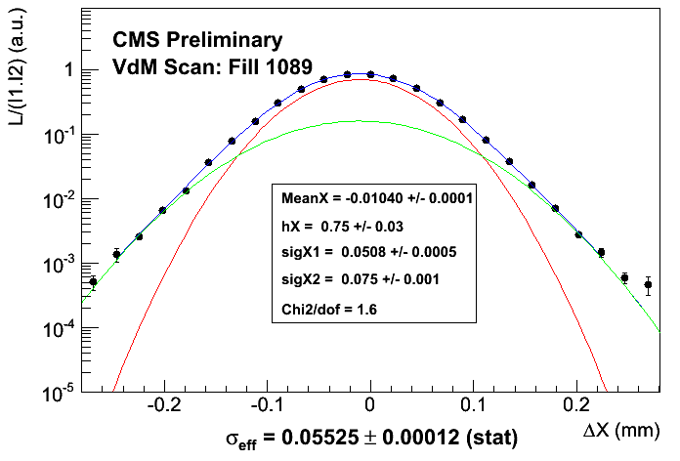
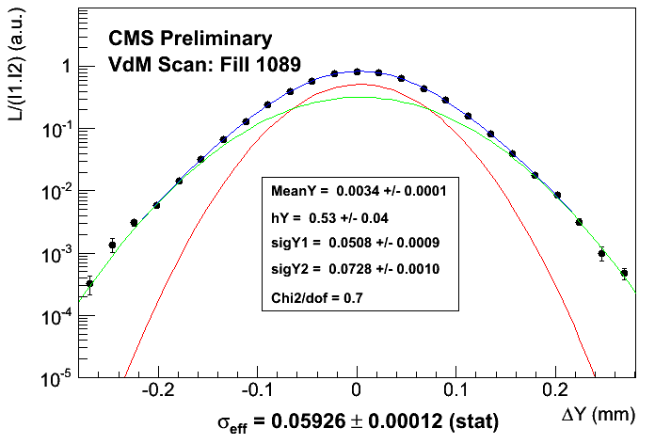
The actual scan
Scan X
Scan Y

