Slide 1

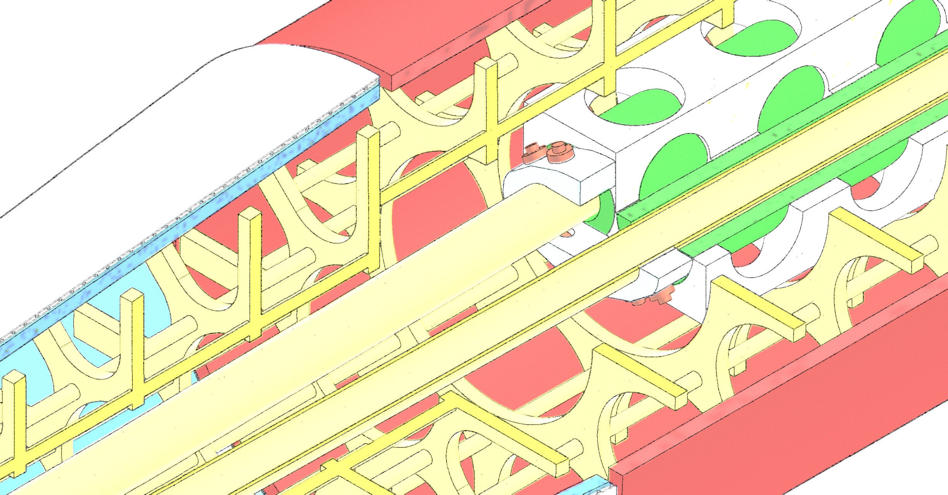

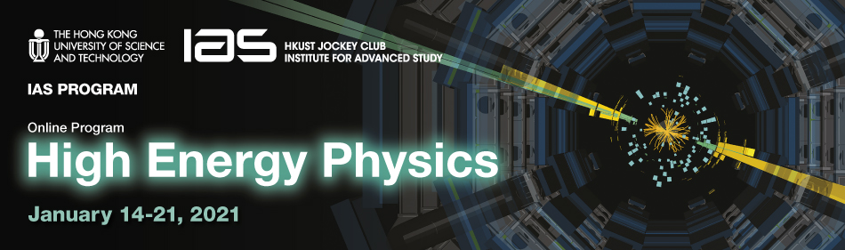
FCC-ee MDI SC Quadrupole Design and Prototyping Status
M. Koratzinos
IAS High Energy Physics conference,
21/1/2021
‘The Future Circular Collider Innovation Study (FCCIS) project has received funding from the European Union's Horizon 2020 research and innovation programme under grant No 951754.’

Slide 2
Acknowledgements
For the design: Glyn Kirby, Jeroen van Nugteren (author of Field)
Manufacturing: the CERN main workshop, Karol Scibor
Bits and pieces: the B927 boys, Pierre-Antoine Contat, Jacky Mazet
Winding and assembly: Herman ten Kate’s team in B180, Tim Mulder
Special tools manufacturing: the CMS workshop in P5, Maf Alidra
Warm testing: the B311 boys Carlo Petrone, Melvin Liebsch, Dmitry Akhmedyanov, Stefano Sorti
This work would not have been possible without the support of many people. I would like to especially thank Austin Ball, Katsunobu Oide, Frank Zimmermann, Guenther Dissertori, Michael Benedikt

Slide 3
Preamble
The main considerations when designing a final focus quadrupole system are:
L* value: this is the distance from the IP of the final focus quadrupole closest to the IP
  The smaller the value, the better the focusing of the beams
Beam pipe size
  The smaller the beam pipe, the easier it is to accommodate the quads, but beam heating increases and physical aperture decreases.
Quadrupole field strengths
  Are dictated by the optics and ultimately the luminosity performance. They need to be within the reach of technology and not induce too much synchrotron radiation

Slide 4
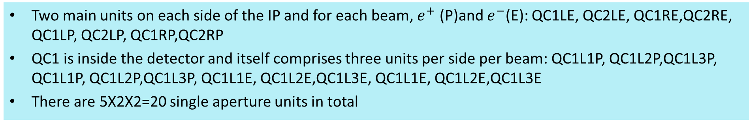
Final focus quadrupoles
Two main units on each side of the IP and for each beam, $e^{+}$ (P)and $e^{−}$(E): QC1LE, QC2LE, QC1RE,QC2RE, QC1LP, QC2LP, QC1RP,QC2RP
QC1 is inside the detector and itself comprises three units per side per beam: QC1L1P, QC1L2P,QC1L3P, QC1L1P, QC1L2P,QC1L3P, QC1L1E, QC1L2E,QC1L3E, QC1L1E, QC1L2E,QC1L3E
There are 5X2X2=20 single aperture units in total
From the FCC CDR update 13/12/2019, Katsunobu Oide
Optics design is such that E and P quads have the same strength
Maximum strength is 100T/m
The most difficult element is QC1L1, the closest to the beam and where the E and P quads are closer together
 | Start position (m) | Length (m) | B’ @Z (T/m) | B’ @W (T/m) | B’ @ H (T/m) | B’ @ tt (T/m)
QC2L2 | -8.44 | 1.25 | 25.05 | 43.82 | 61.30 | 69.50
QC2L1 | -7.11 | 1.25 | -0.18 | 0.00 | 7.32 | 56.85
QC1L3 | -5.56 | 1.25 | -19.35 | -34.38 | -53.08 | -99.98
QC1L2 | -4.23 | 1.25 | -18.57 | -32.94 | -53.07 | -99.98
QC1L1.1 | -2.9 | 0.7 | -40.95 | -70.00 | -99.71 | -95.39
QC1L1.2 | 2.2 | 0.7 | -40.95 | -70.00 | -99.71 | -95.39
QC1R2 | 2.98 | 1.25 | -25.44 | -37.25 | -51.94 | -100.00
QC1R3 | 4.31 | 1.25 | -19.54 | -39.51 | -53.65 | -91.87
QC2R1 | 5.86 | 1.25 | 14.64 | 16.85 | -2.65 | 37.19
QC2R2 | 7.19 | 1.25 | 19.50 | 44.32 | 67.52 | 94.43
The updated parameters are rather different for QC1L1: its length is now 70cm from 120cm

Slide 5
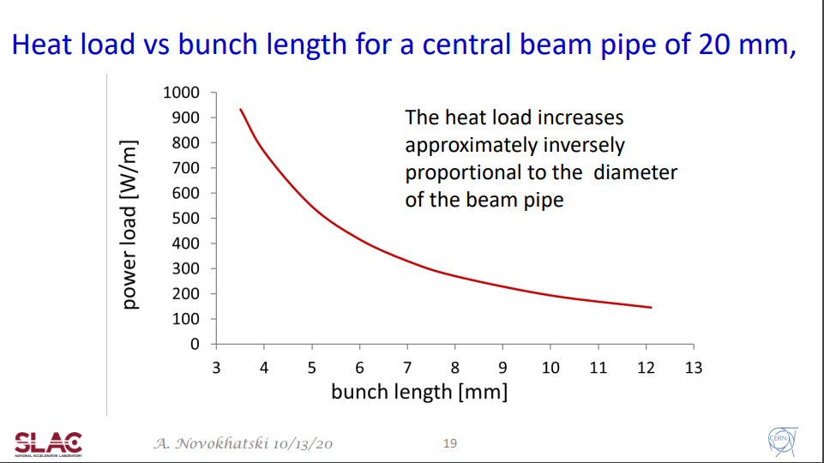
Beam pipe size
Since space is at a premium, the smaller the beam pipe the easier to accommodate the final focus quads and the easier to shield the E from the P type
The beam-stay-clear for FCC in the vicinity of the IP is ±12 mm
We have decided to have a beam pipe with inner radius of 15mm (b-s-c plus margin)
Beam resistive heating is inversely proportional to beam pipe diameter (important for the Z running)
FCC-ee @Z : ~100W/m for a beam pipe inner diameter of 30mm
[cf CEPC with a beam pipe inner diameter of 17mm and a bunch length of 9.6mm: ~200W/m for an equivalent beam current]
FCC-ee
➔FCC-ee approach: try and design the FF quads with the constrain of a beam pipe inner diameter of 30mm
S. Novokhatski

Slide 6
Choice of L*
(L* is the position of the front face of the final focus quadrupole. The shorter it is, the easier it is to focus the beams to a narrower spot.)
However, the final focus quad is only one of the main components that needs to fit in the proximity of the IP, inside the detector: the compensation system must also work, and this takes space
This system comprises:
  Empty space, to allow for the vertex detector and Luminosity counter
  A compensation solenoid to undo the twisting of the beam due to the detector solenoid
  A screening solenoid, as the final focus quadrupoles should reside ina field-free region
In the case of FCC, L* was chosen to be 2.2m which leads to excellent performance as published in our CDR and will be presented in IPAC2021.

Slide 7
The FCC-ee compensation scheme
Compensating solenoid
QC1L1
Luminometer
Screening solenoid
IP
Excellent performance: vertical emittance blow-up = 0.24pm for 2IPs at the Z for an L*=2.2 m.
Abstract submitted to IPAC 2021. Draft paper: arXiv:2101.05704 [physics.acc-ph]
Beam pipe

Slide 8
Choice of technology for QC1L1
The pivotal requirement for the design is the close proximity of the QC1L1 quads, only 66 mm at the front tip. Moreover, the two quads are at an angle
There should be no crosstalk between the quads, otherwise performance will be affected.
There is not enough space to shield the two quads using an iron yoke
All requirements are fulfilled with a CCT iron-free design

Slide 9
CCT accelerator magnets
A CCT (Canted Cosine Theta) is a type of accelerator magnet where the multipole mix is a local attribute of a magnet. (One can trivially design a magnet which is a dipole on one side and a quadrupole in the other.)
The QC1L1 magnets are NOT quadrupoles. They are quads minus the field due to the other aperture. But together they make two nearly perfect quadrupoles
Other important advantages of CCTs:
  Cheap to make – from the magnet design program to CAD to CNC machine with no manual interventions
  Easy to make – no pre-stress! Stress management is trivial in CCTs
  Fast to make – few steps, no expensive equipment
  Excellent field quality – please see further

Slide 10
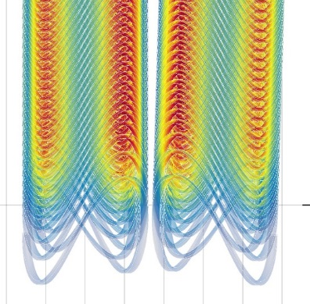
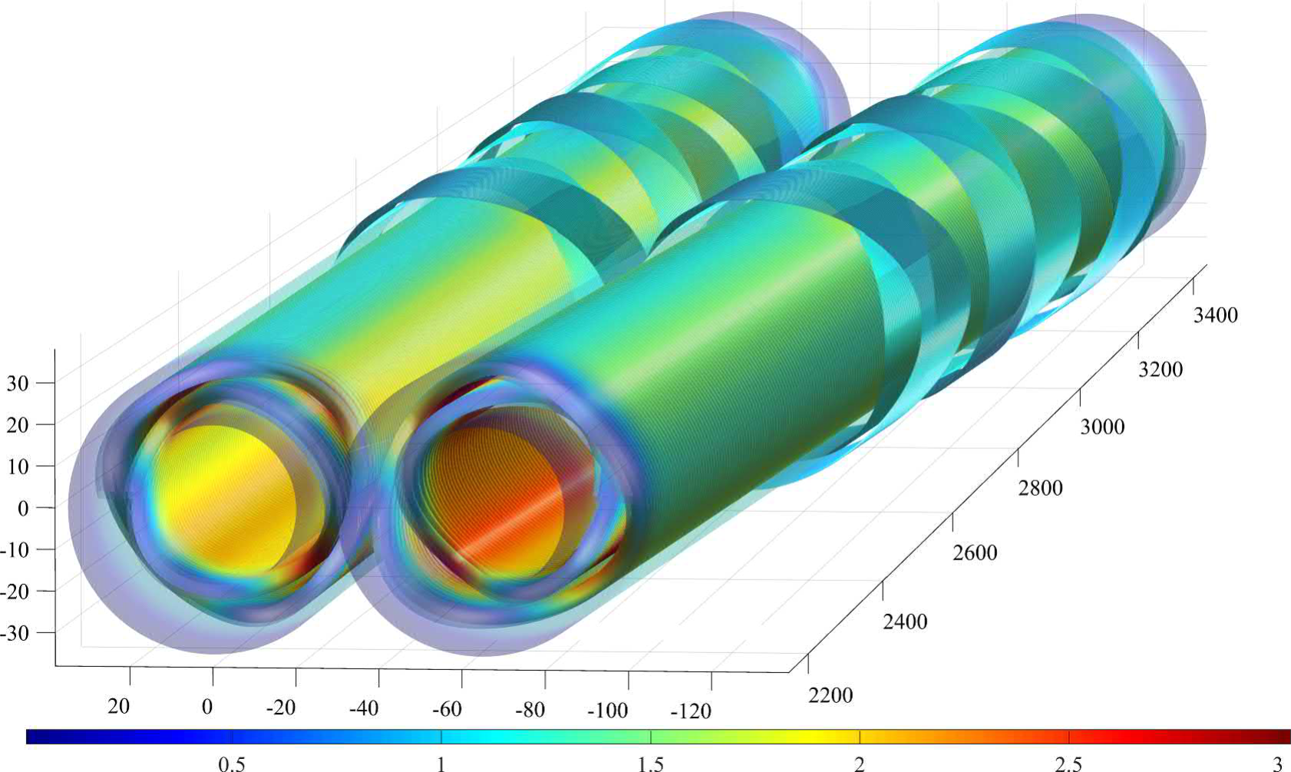
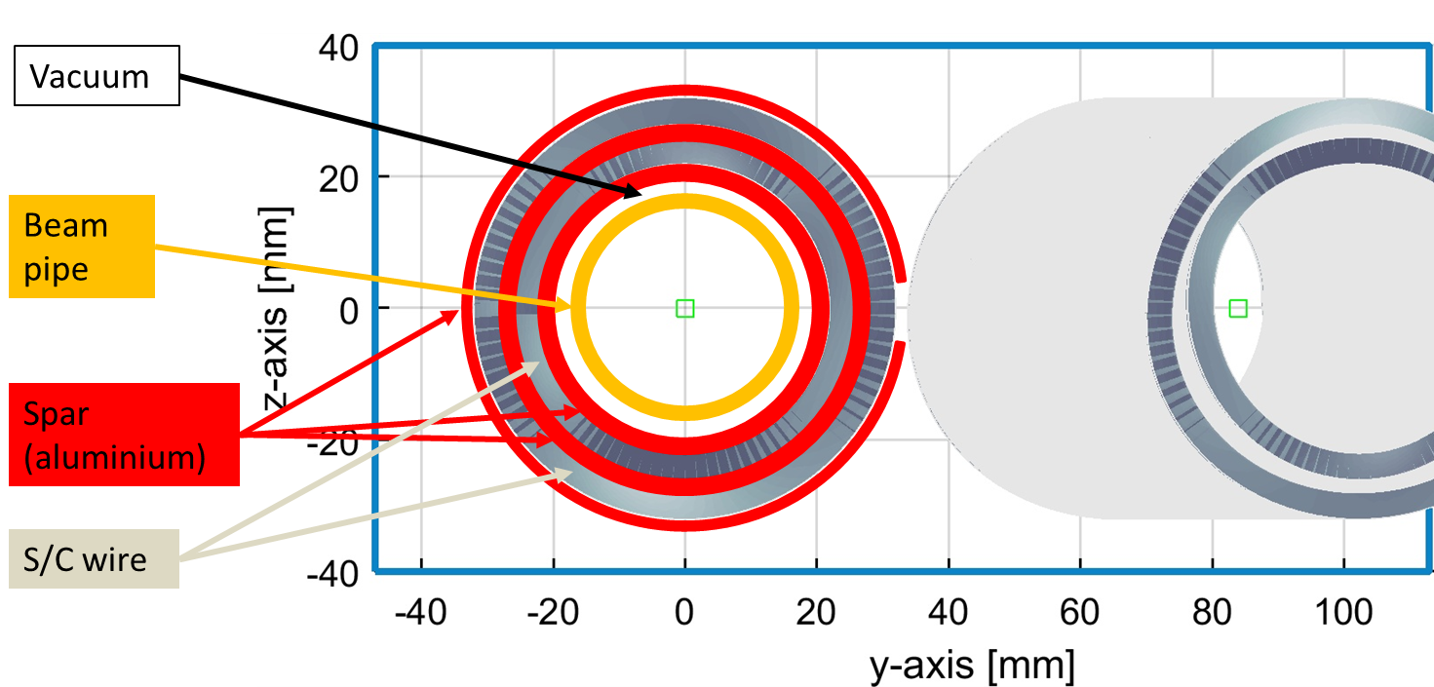
QC1L1
QC1L1 is the first and most demanding pair of quadrupoles of the final focus system of FCC-ee
Iron-free design
Inner bore: 40mm (diameter)
Fits outside the warm water-cooled beam pipe of inner diameter 30mm

Slide 11
Why prototype?
Although it works very well on paper, we need to test it in practice
The first prototype is a single aperture magnet. So how can we test the crosstalk performance?
The specific prototype employs a technique similar to the crosstalk compensation: edge correction
One end of the magnet is corrected for local multipoles, which are present on every accelerator magnet design
Exactly the same technique and tools are used for the crosstalk compensation of a double aperture design. ➔ If the edge correction works as expected, so will the crosstalk compensation

Slide 12
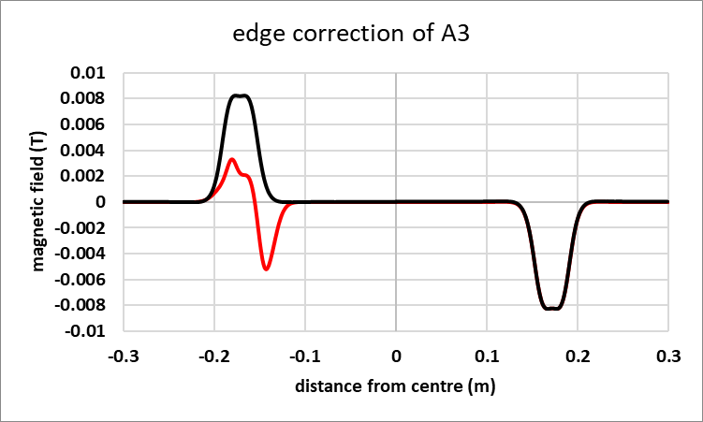
Local edge correction
By design, a CCT magnet has all integral multipoles vanish (with the exception of the main one).
However, the skew (A) components of the magnetic field compensate only because they have opposite signs at the entry and exit of the magnet.
QC1L1 sits in an area of rapidly-changing optics functions: the change of beam size between the entry and exit of the magnet is a factor of ~2. ➔ a local correction is needed
Example: correction of A3 component, one side only. In red: corrected; in black: uncorrected
M. Koratzinos et al.1709.08444 [physics.acc-ph]

Slide 13
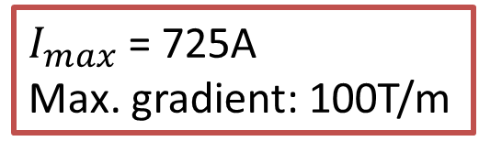
QC1L1 and the prototype
The first FCC-ee Final Focus prototype is a single-aperture version of QC1L1, with identical aperture (40mm) but one-third of the length (26% of the quadrupole strength).
It has asymmetric edges
QC1L1_electron
Prototype
QC1L1_positron
1200mm
$I_{max}$ = 725A
Max. gradient: 100T/m
400mm

Slide 14
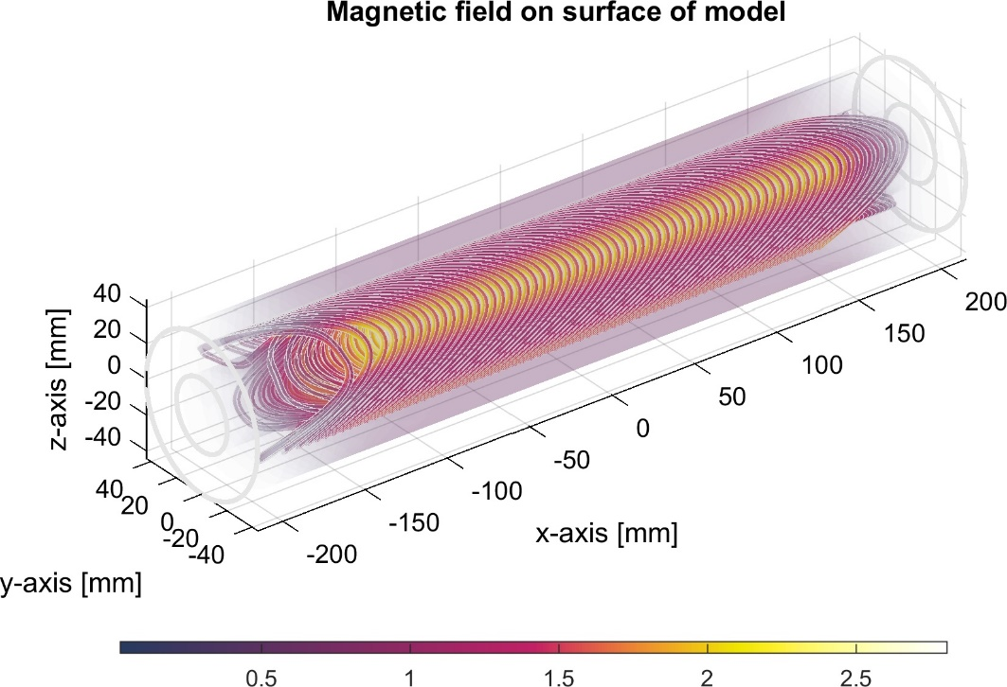
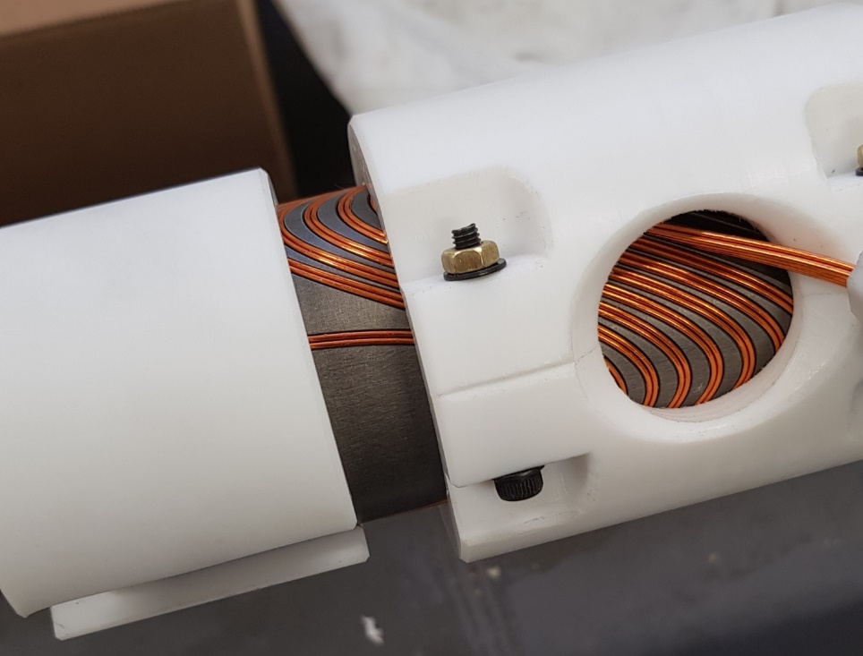
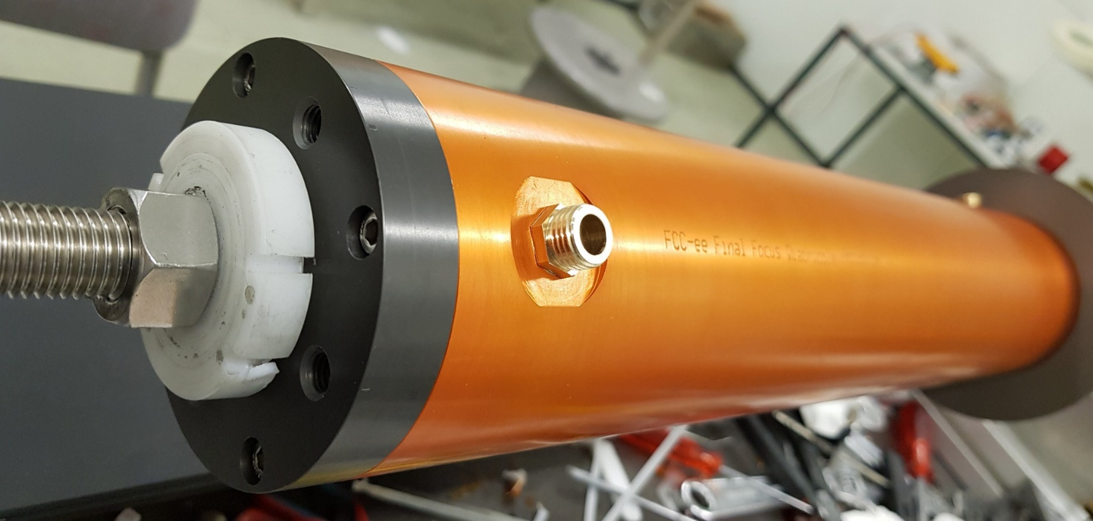
Design, manufacture and winding

Slide 15
Testing at warm
The first magnetic quality tests were performed at warm
A rotating coil arrangement was used:
  The magnet is powered with a current of 5 A (0.7% of maximum current) at room temperature
  We measure the magnetic flux as the coil is rotated.
  Each measurement is averaged over 100 revolutions
  Then the data is post-processed to calculate the first 15 multipoles.
  Then current is reversed and another (100-revolution) measurement is taken
  The final numbers are the average over the two polarities – This eliminates the contribution due to the earth’s magnetic field and any other static fields.
All measurements made at a radius of 10mm
Rotating coil length: 200mm (194mm active), width 35mm
The rotating coil can be moved to measure the (integrated) field at different areas of the magnet: the middle, the corrected side and the uncorrected side

Slide 16
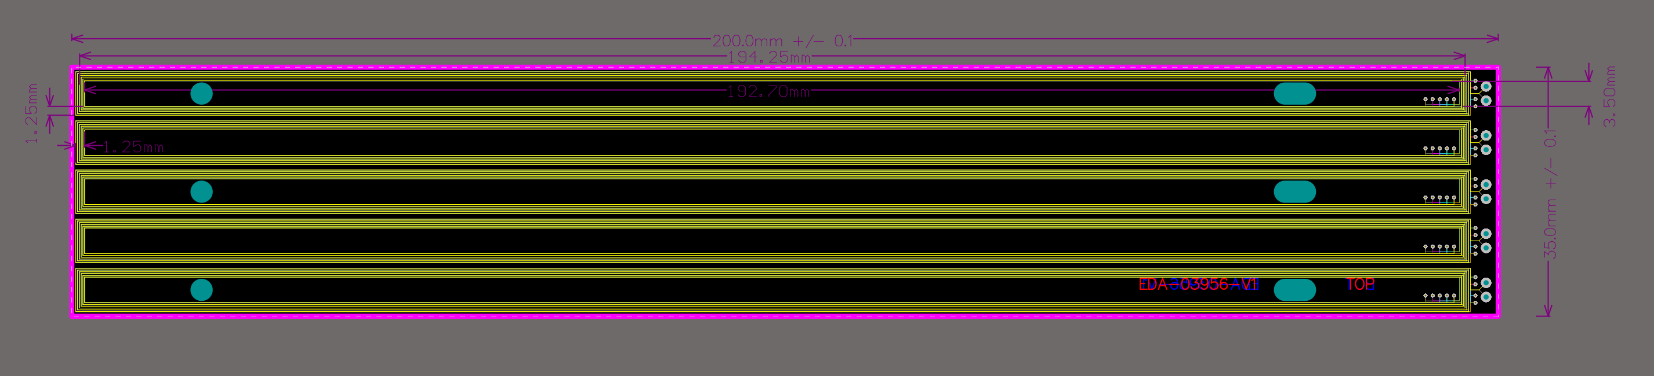
The rotating coil
Length is 200mm nominal, 194.25 mm active, width is 35mm, split in five individual coils
For the quadrupole magnet, the individual coils are combined in such a way, that the coil is immune to the B2 field component, which is the dominant one, to be able to see errors in higher multipoles
For the transfer function measurement, the coil is combined linearly

Slide 17
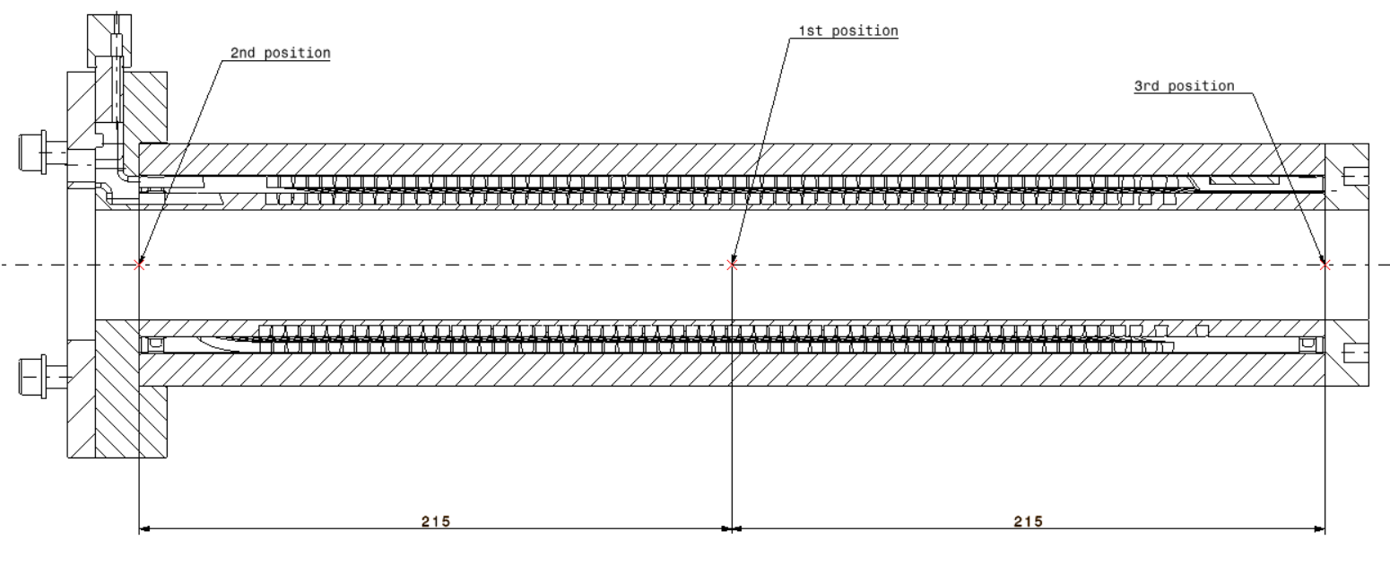
Testing arrangement
1st measurement:
Centre
Rotating probe
Three rotating coil measurements at the middle, at the uncorrected edge and at the corrected edge

Slide 18
Testing arrangement
2nd measurement:
Uncorrected side
Three rotating coil measurements at the middle, at the uncorrected edge and at the corrected edge

Slide 19
Testing arrangement
3rd measurement:
Corrected side
Three rotating coil measurements at the middle, at the uncorrected edge and at the corrected edge

Slide 20
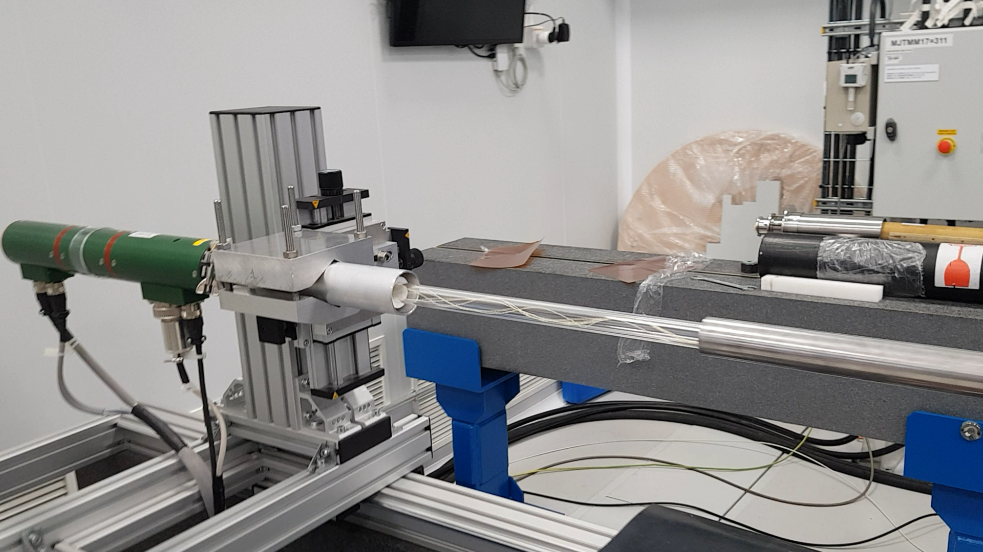
Measurement video

Slide 21
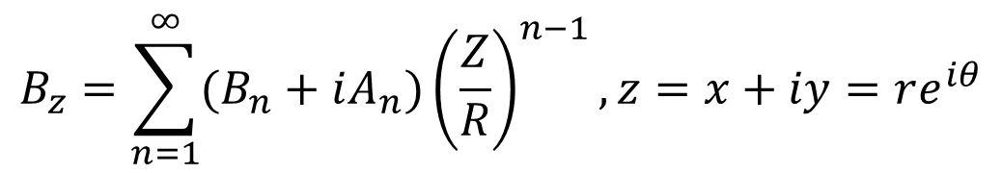
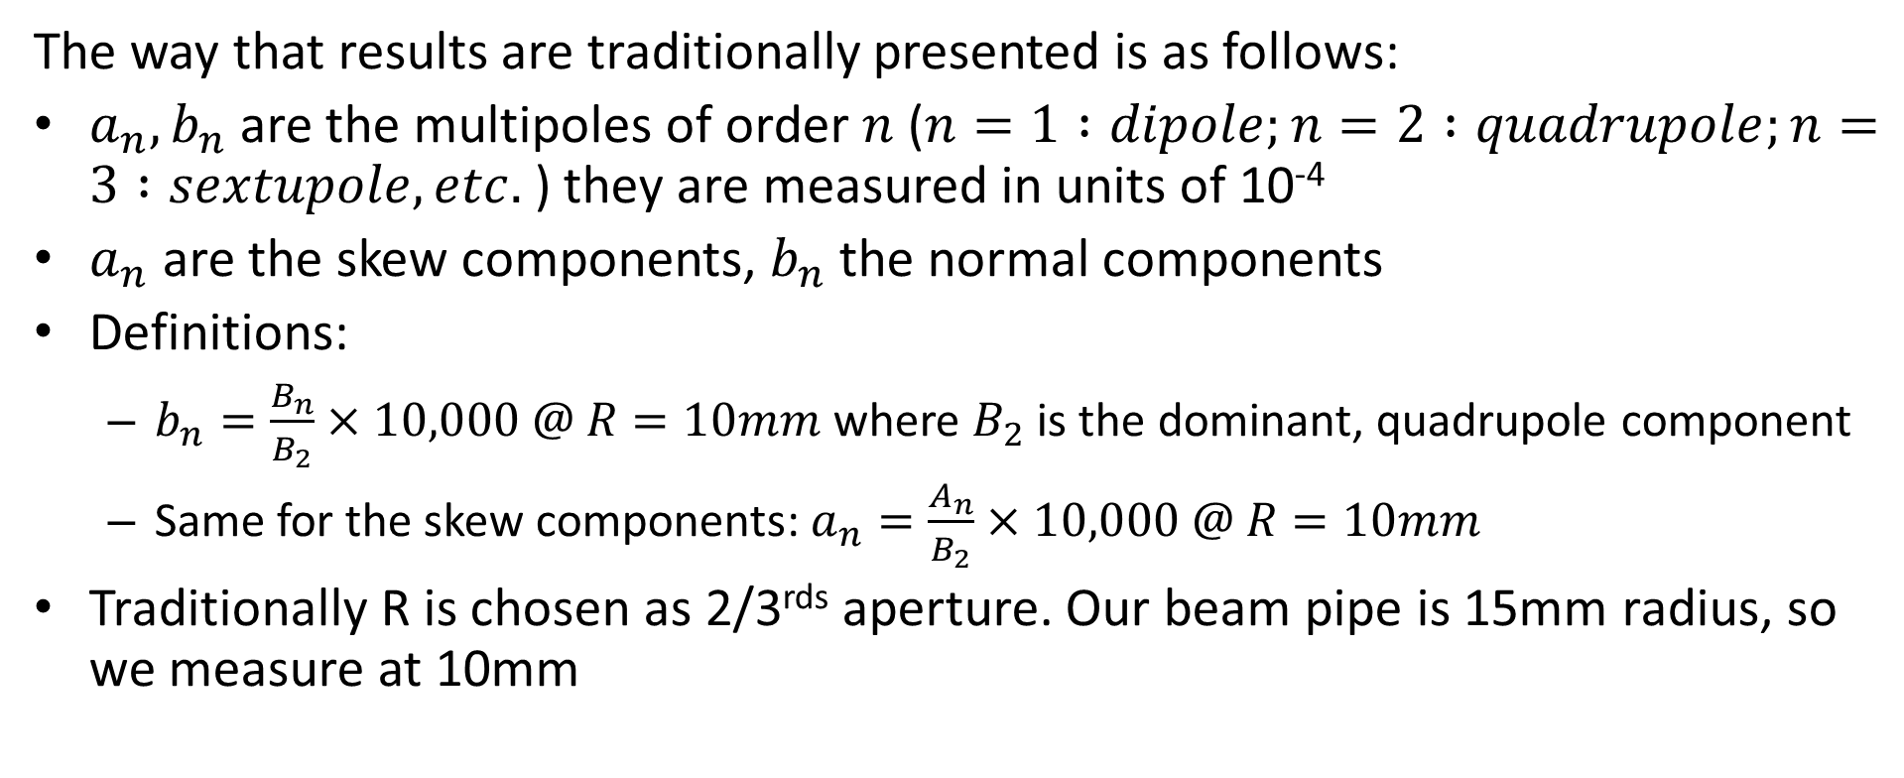
Nomenclature
$$B_{z}=\sum_{n=1}^{∞}{(B_{n}+iA_{n}){\left(\frac{Z}{R}\right)}^{n−1},z=x+iy=re^{iθ}}$$
Magnetic field of accelerator magnet:
The way that results are traditionally presented is as follows:
$a_{n},b_{n}$are the multipoles of order $n$ ($n=1 :dipole;n=2 :quadrupole;n=3 :sextupole, etc.$ ) they are measured in units of 10⁻⁴
$a_{n}$ are the skew components, $b_{n}$ the normal components
Definitions:
  $b_{n}=\frac{B_{n}}{B_{2}}×10,000 @ R=10mm$ where $B_{2}$is the dominant, quadrupole component
  Same for the skew components: $a_{n}=\frac{A_{n}}{B_{2}}×10,000 @ R=10mm$
Traditionally R is chosen as 2/3^{rds} aperture. Our beam pipe is 15mm radius, so we measure at 10mm

Slide 22
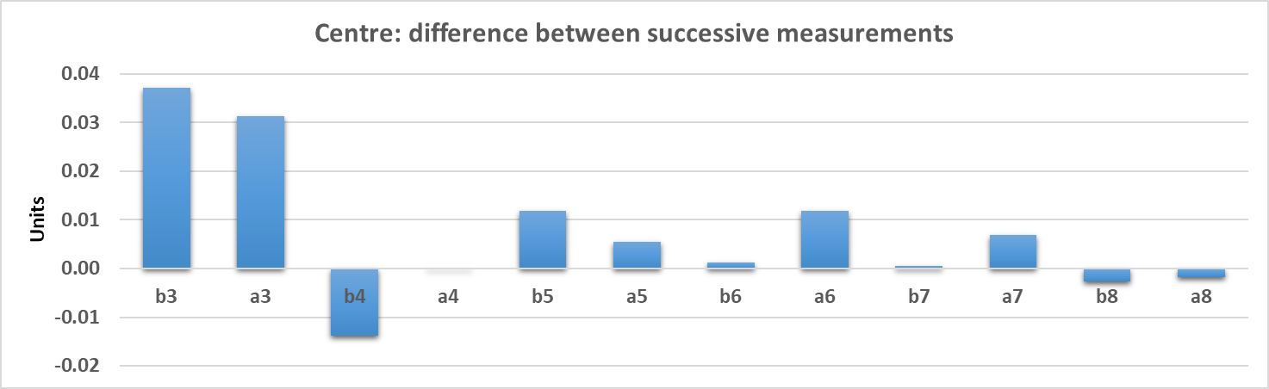
Repeatability of measurements
The first test is the (short-term) reproducibility of measurements: The plot shows two successive measurements. Repeatability is excellent, within 0.04 units or better
➔ The sensitivity of the method is at the ~0.02 unit level
preliminary
Carlo Petrone

Slide 23
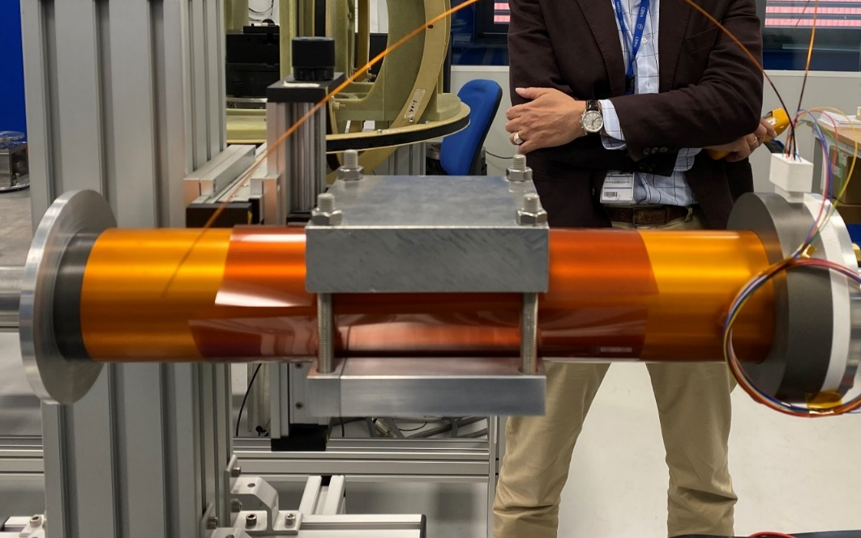
Centre measurement
We need to make sure that whatever we measure is due to the magnet and not its environment
Although the mechanical clamping of the magnet is with aluminium claws, we have also used stainless steel high-strength bolts
At this level of precision, we need to guard against these bolts distorting the field and therefore introducing multipoles
Do not forget that we are dealing with 10⁻⁵ effects

Slide 24
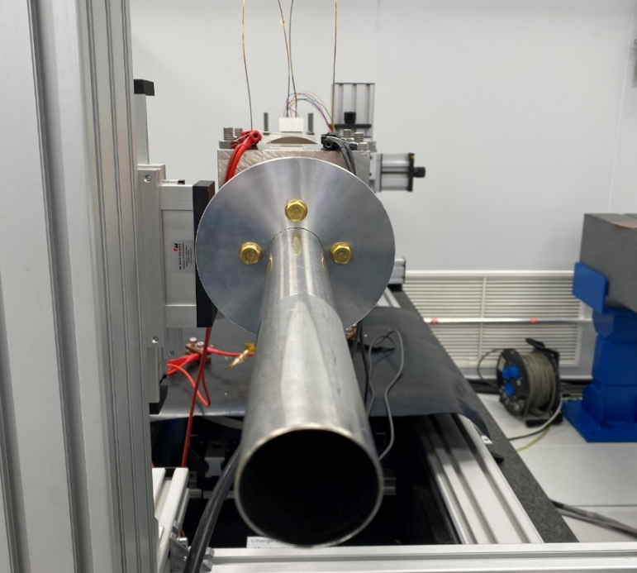
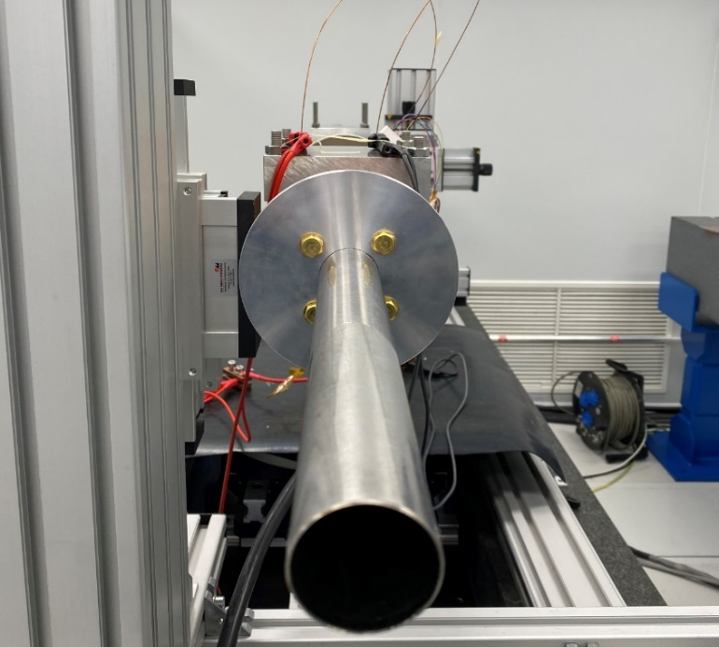
A strategy for measuring the pure magnet components
We decided to take two measurements: one with the magnet in its proper position and the second where the magnet is rotated by ~45 degrees. (suggested by Glyn Kirby, CERN)
The multipole errors due to the magnet should rotate with the magnet, but the errors due to the environment should not
We then have two measurements and two unknowns
Original position
rotated position
φ
In our case, φ was measured to be 41.87 degrees

Slide 25
Rotated/original measurements
 | b3 | a3 | b4 | a4 | b5 | a5 | b6 | a6 | b7 | a7 | b8 | a8
Original data (units) | -0.24 | 0.30 | 0.54 | 0.54 | -0.17 | -0.03 | 0.64 | -0.12 | 0.03 | -0.01 | 0.00 | -0.03
Rotated data (units) | 0.08 | 0.43 | 0.49 | 0.66 | -0.16 | -0.03 | 0.65 | -0.11 | 0.03 | 0.00 | 0.00 | -0.03
If a multipole component comes from the magnet and not from the environment, it is expected to change under this rotation.
Example:
Rotate by 42 degrees:
b3
magnet
b3
environment
42°×3=126°
total
a3
a3
Vector rotates by (rotation angle) × n

Slide 26
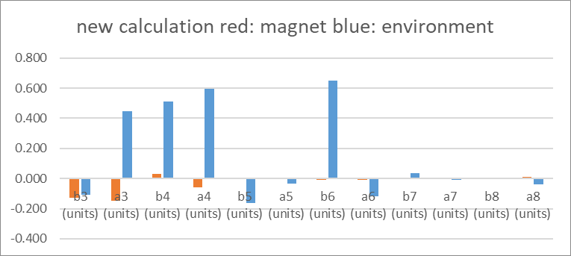
Results
preliminary
 | b3 | a3 | b4 | a4 | b5 | a5 | b6 | a6 | b7 | a7 | b8 | a8
Original data | -0.24 | 0.30 | 0.54 | 0.54 | -0.17 | -0.03 | 0.64 | -0.12 | 0.03 | -0.01 | 0.00 | -0.03
Rotated data | 0.08 | 0.43 | 0.49 | 0.66 | -0.16 | -0.03 | 0.65 | -0.11 | 0.03 | 0.00 | 0.00 | -0.03
Magnet component | -0.129 | -0.146 | 0.029 | -0.057 | -0.004 | 0.001 | -0.011 | -0.006 | -0.003 | 0.001 | 0.004 | 0.009
Environment component | -0.110 | 0.447 | 0.510 | 0.595 | -0.163 | -0.035 | 0.652 | -0.118 | 0.033 | -0.008 | -0.005 | -0.036
A big chunk of the measured multipoles can be attributed to the environment

Slide 27
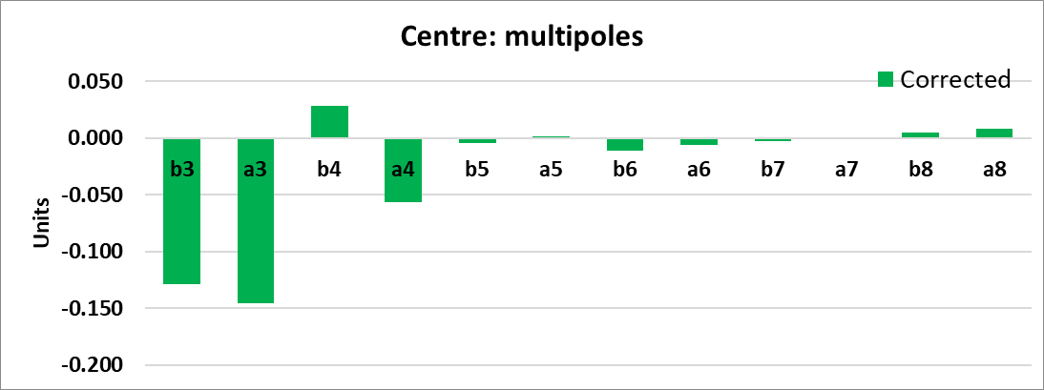
Results - centre
preliminary
All multipoles are below 0.15 units and only b3, a3 is above 0.10 units. (this is barely above the sensitivity of the method)

Slide 28
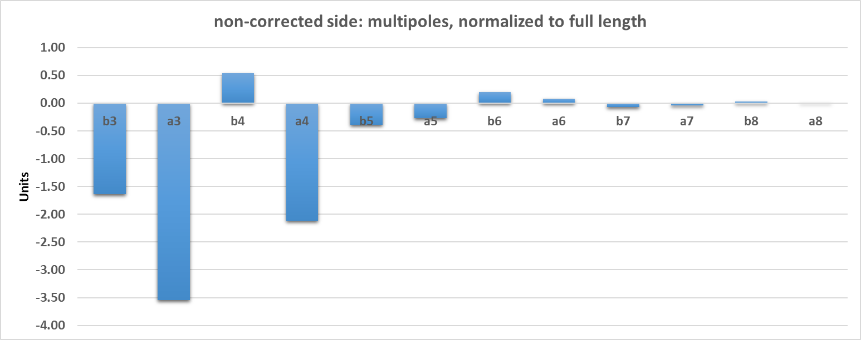
Field quality at the edge, without correction
@10mm radius
preliminary
For this measurement we do not have rotated data
Multipoles calculated up to B15, A15, but are all zero
Carlo Petrone
3.5 units in A3, 2 units in A4

Slide 29
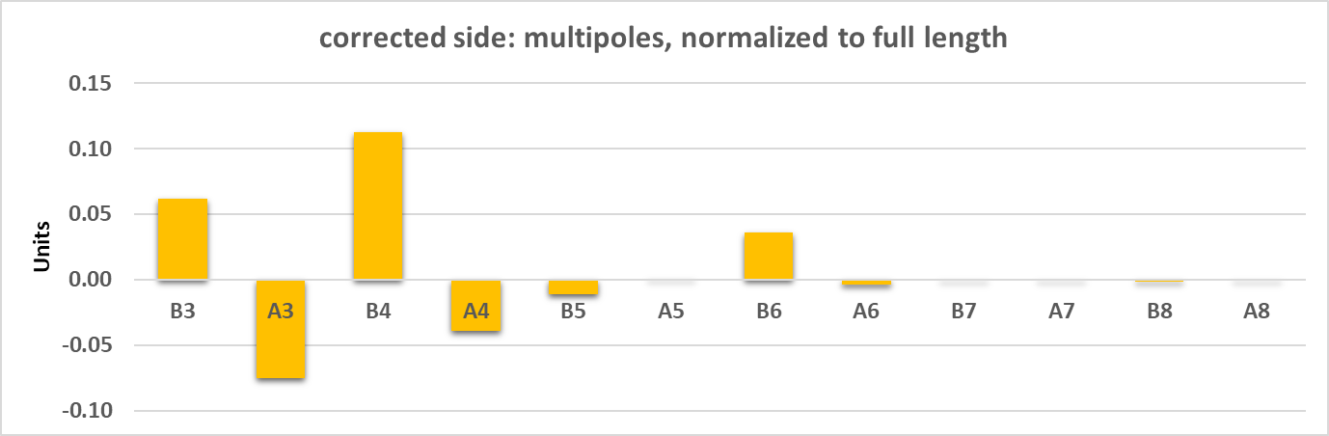
Field quality at the edge, with correction
@10mm radius
preliminary
For this measurement we do not have rotated data, real magnet errors might be smaller
Carlo Petrone
Multipoles calculated up to B15, A15, but are all zero
0.1 units maximum. An excellent result.

Slide 30
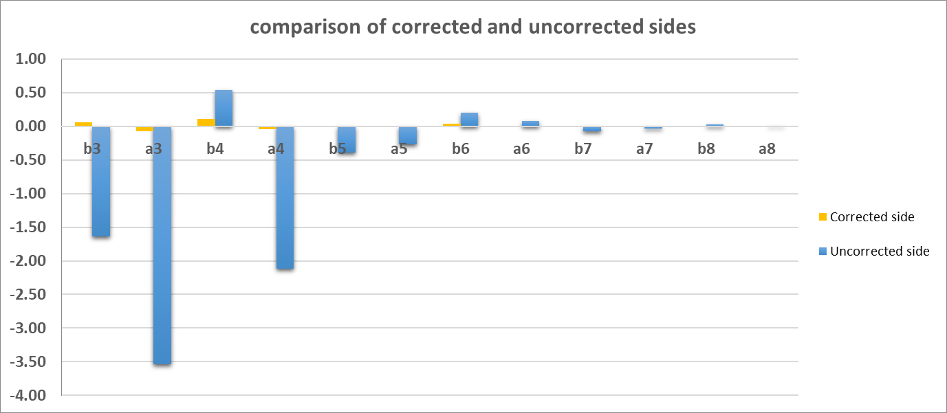
Field quality at the edge, comparison
preliminary
Corrected side has edge effects that are 0.1 units or less
For both plots, the normalization is to the full length of QC1L1 (1200mm)
Carlo Petrone
Edge correction really works!

Slide 31
Conclusions
The first FCC-ee final focus prototype has been designed, manufactured and the first tests at warm are available (results are preliminary).
Field quality is excellent.
All multipoles in the middle of the magnet are 0.15 units or less, approaching the accuracy of the method. These are real measurements, not simulation!
The novel technique of locally correcting each edge for edge effects is working beautifully → this gives us confidence that the crosstalk compensation will also work.
All multipoles of the corrected edge contribute 0.1 units or less. ➔ this is a “perfect edge” magnet.
The CCT technique is very well suited for the final focus quadrupoles of FCC-ee (and also CEPC…).

