Slide 1
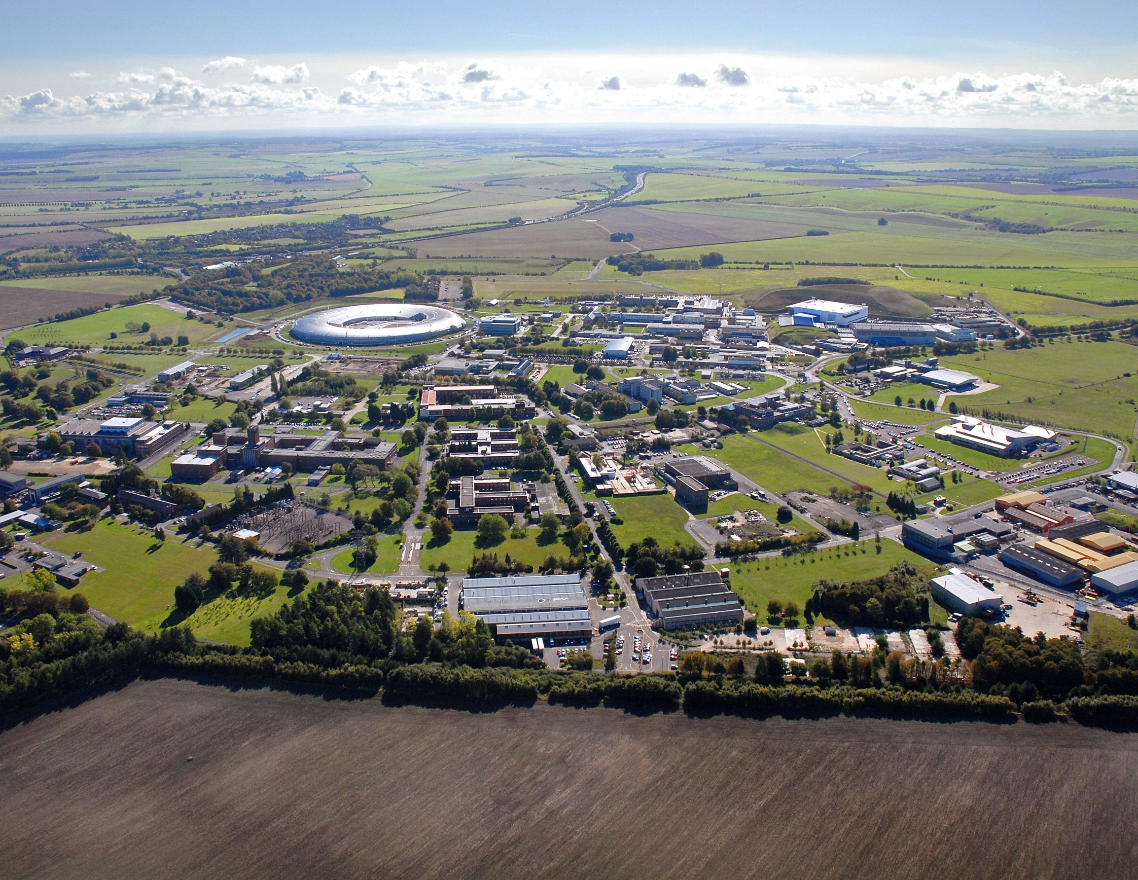
Synchrotron and neutron based diffraction and spectroscopic techniques
Lecture 2
ASP Online Series 2020
Andrew Harrison, Diamond Light Source

Slide 2
Relaxation after photoionisation ?
Photoionisation leaves a hole behind which is electronically unstable and is rapidly filled by relaxation of higher-energy electrons and the additional energy is carried away either by a secondary photoionisation event (Auger effect) or photons (X-ray fluorescence - XRF)
Auger Effect
XRF

Slide 3
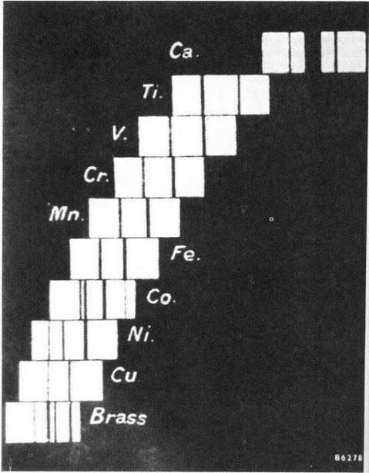
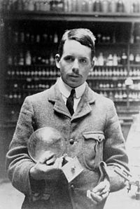
X-ray fluorescence (XRF)
XRF observed by Moseley who observed K transitions (relaxation into n=1 shell) and showed ν = c/λ = K(Z-1)² where K = 2.47 x 10¹⁵ Hz
Start and end states are quantised electronic states so (dipole) selection rules apply: Δl=±1, Δs=0, Δj =0, ±1 but j=0→ j=0 forbidden
For K series, lowest energy transitions are α lines (split by spin orbit coupling to α₁, α₂) then β lines etc…

Slide 4
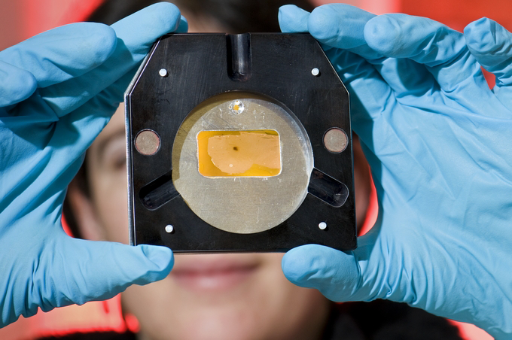
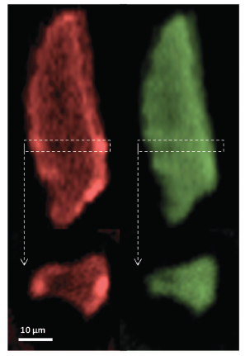
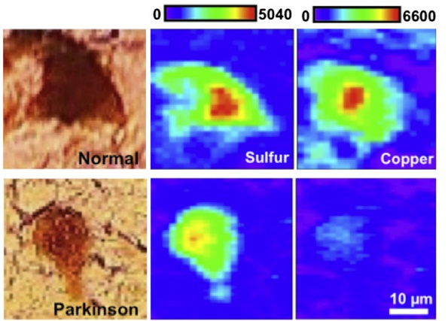
XRF – chemical mapping
XRF tomography on supported catalyst particles
Mo (green) and Pt (red)
Influence of elements on neurodegenerative disease

Slide 5
X-ray scattering
Notes:
Roentgen first ‘use’ of X-rays was to reveal the bones in his wife’s hand….

Slide 6
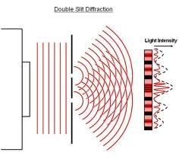
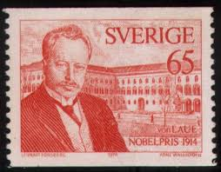
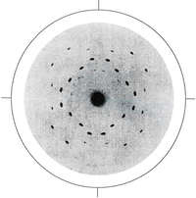
Scattering and diffraction
X-ray diffraction is the most incisive technique to determine atomic structure of crystalline materials. Synchrotrons allow the technique to be exploited particularly effectively.
Diffraction arises from the coherent interference between waves scattered by an array of objects whose spacing is comparable to wavelength (of the order of 1 Å). In X-ray diffraction the scattering is by the electrons around the atoms in the structure.

Slide 7

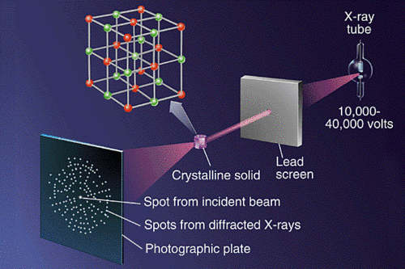
Scattering and diffraction
X-ray diffraction is the most incisive technique to determine atomic structure of crystalline materials. Synchrotrons allow the technique to be exploited particularly effectively.
Diffraction arises from the coherent interference between waves scattered by an array of objects whose spacing is comparable to wavelength (of the order of 1 Å). In X-ray diffraction the scattering is by the electrons around the atoms in the structure.

Slide 8
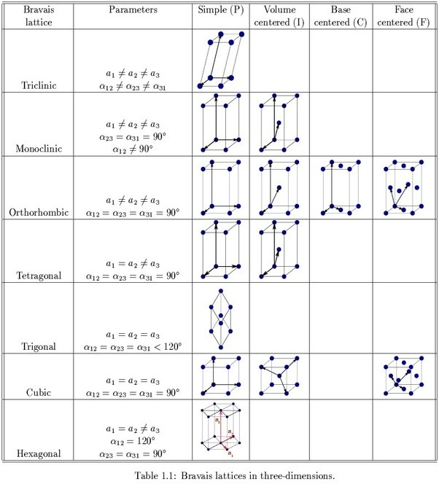
Diffraction – building blocks
Recall crystallography courses you may have taken
Scattering of X-rays from a crystal produces a set of Bragg spots (reflections) whose position is determined by the size and structure of the unit cell and whose intensity is determined by the (Fourier transform of) the distribution of electron density in the unit cell, the minimum repeat unit
The are 7 crystal systems which may be modified further by centring to produce the 14 distinct Bravais lattices.
Decorate the cell with atoms i whose position is defined by fractional co-ordinate (x_{i}, y_{i} , z_{i} )

Slide 9
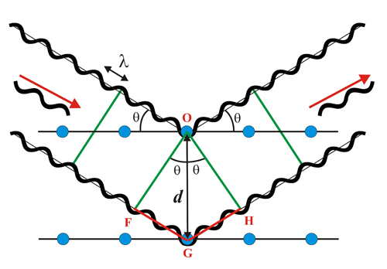
Diffraction - measurements
The position of a Bragg spot can be determined simply by considering diffraction to be the consequence of coherent scattering of X-rays of wavelength λ from identical planes of spacing d at angle θ using the Bragg equation: n λ = 2d sin θ
If the X-rays are monochromatic, the crystal has to be rotated so that the angle between the planes and the incident X-rays is θ.
If the beam is polychromatic, containing a band of wavelengths, Bragg condition may be met for an arbitrary crystal orientation for different values of λ for different planes at different values of θ - Laue diffraction – more complex but more information and can be unravelled with detectors that discriminate between energy and hence λ

Slide 10
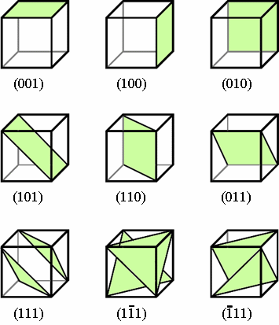
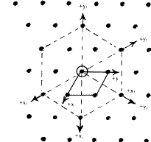
Defining and labelling planes
The planes are defined and labelled using the so-called Miller indices
A plane with Miller indices h, k and l makes intercepts a/h, b/k, c/l with the unit cell axes a, b and c. This is called the (hkl) plane. For crystals where a, b and c are perpendicular, 1/d² = h²/a² + k²/b² + l²/c²
An alternative representation that enables reflections to located rapidly is to define a lattice in reciprocal (Fourier) space where the co-ordinate system is such that a* is ⊥ to both b and c, of length 2π/a, etc. The line joining the origin to the point (hkl) in reciprocal space is perpendicular to the (hkl) plane and bisects the scattering angle 2θ
c
b
a

Slide 11
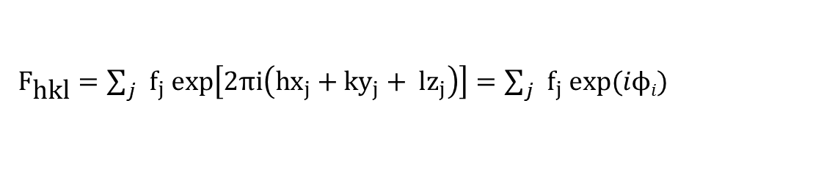
Scattering intensity
The amplitude of the scattering from the (hkl) plane is then proportional to the sum of the scattering f_{j} from every atom j in the unit cell, called the structure factor F_{hkl}:
Where exp(iφ_{j}) is the phase of the scattering from atom j.
We measure the intensity in diffraction experiment, This is proportional to the square of the amplitude so we lose the information about the phase and cannot solve the structure directly – the phase problem
.
${\text{F}}_{\text{hkl}}=\sum_{j}{f_{j} exp\left[2πi\left(hx_{j}+ky_{j}+ lz_{j}\right)\right]=\sum_{j}{f_{j} exp(iϕi) }}$

Slide 12
X-ray diffraction at synchrotrons
The same principles determining position and intensity of scattering still apply to synchrotron X-rays, but they bring advantages
Exceptionally bright – focus down to very small beams (< 1 μm) and look at very small samples or regions of samples – though care with radiation damage (biological samples fried in seconds)
Follow structural features in seconds, and in some cases fractions of a second – look at dynamics
More energetic synchrotron X-rays (100 KeV and more) can penetrate materials much more deeply than the lower energy radiation more typical of a laboratory-based instrument (typically ∼ 8 KeV).
Energy of synchrotron X-rays may be tuned through the absorption edge of an element in the sample, altering the nature of the scattering from such elements and enable the phase problem to be solved.
Coherence reveals small structural deformation in nm – 10’s nm regime, complementing EM techniques where samples are too thick for electron microscopy

Slide 13
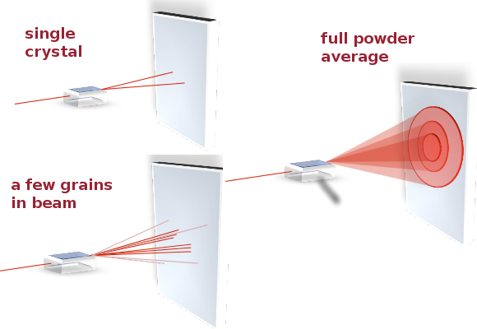
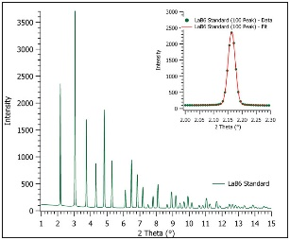
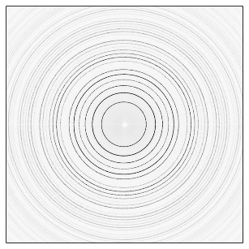
Powder diffraction
Scattering from randomly oriented crystallites leads to an average over all possible orientations and reduces sets of discreet spots to rings characterised by scattering angle θ_{hkl} (where the indices hkl have to be determined too).
Average over rings to produce powder diffraction pattern: I vs 2θ_{hkl}
nλ = 2d sinθ _{hkl} 1/d² = h²/a² + k²/b² + l²/c² for orthorhombic and intensity ∝ F_{hkl}²

Slide 14
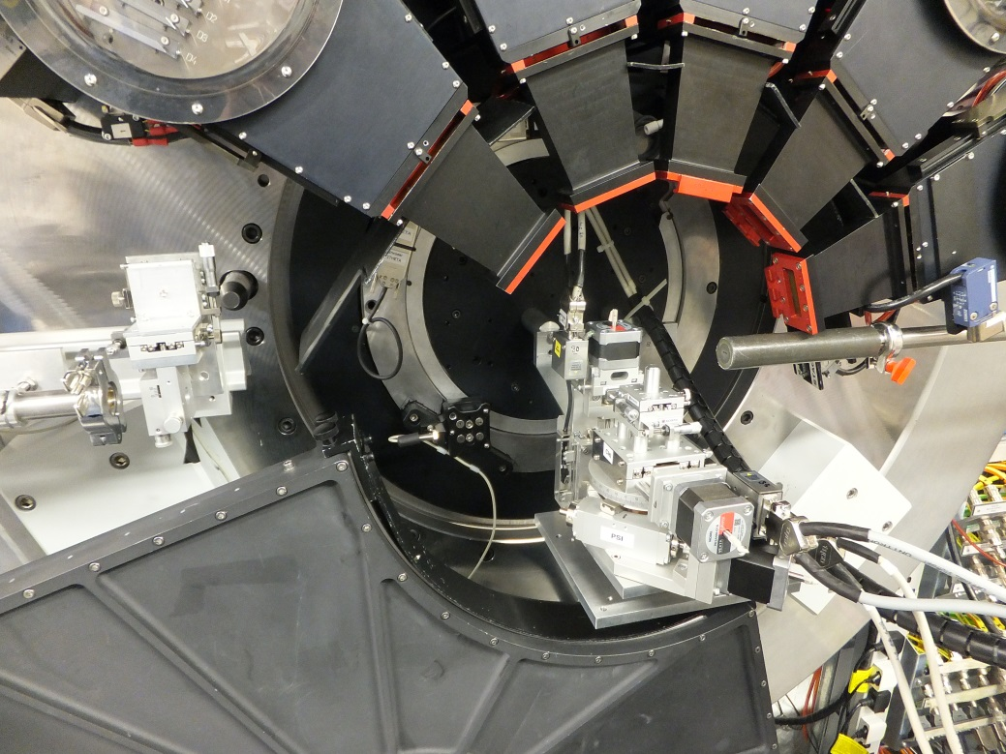
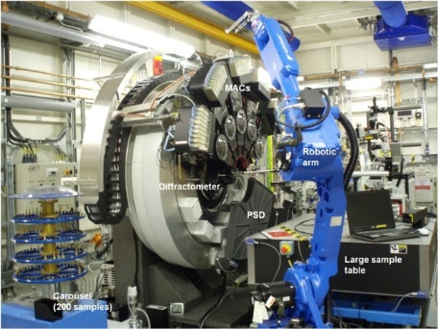
Powder diffraction
Applications (photos show powder diffractometer I11 @Diamond:
- Fingerprint or match with known material with very high spatial (d) resolution
Refine structure based on known structure (Rietveld process) until model predicts the observed powder pattern
Solve structure ab initio (rare)

Slide 15
Follow processes in operando
E.g. gel containing iron nitrate and gelatin heated under N₂ in a glass capillary in the X-ray beam. PSRD shows evolution of phases, identified against known samples – oxide then nitride then carbide (C from gelatine) forms
Schnepp et al, Chem. Mat. 27 (2015) 5094

Slide 16
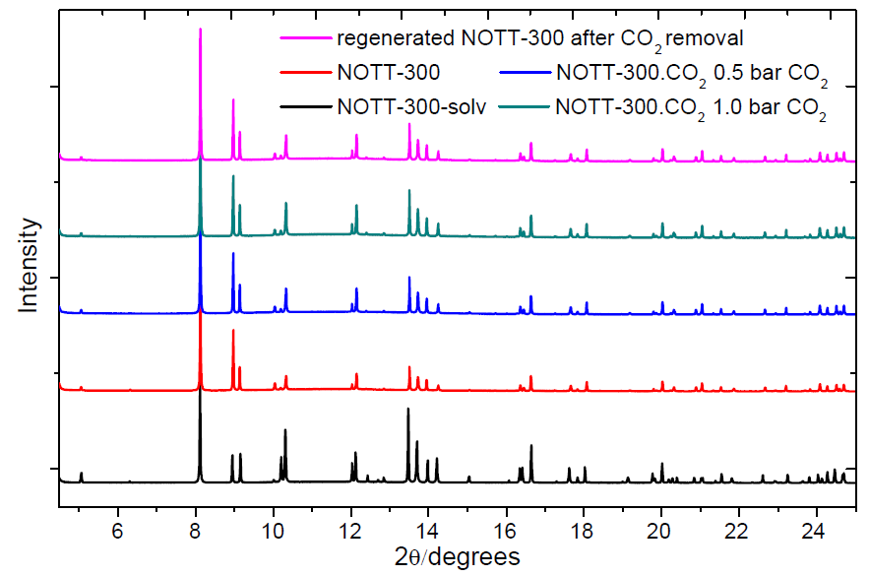
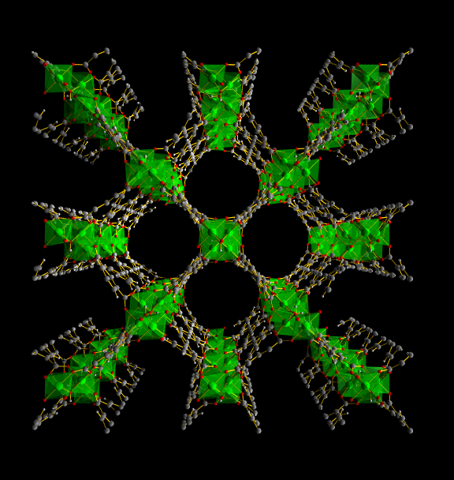
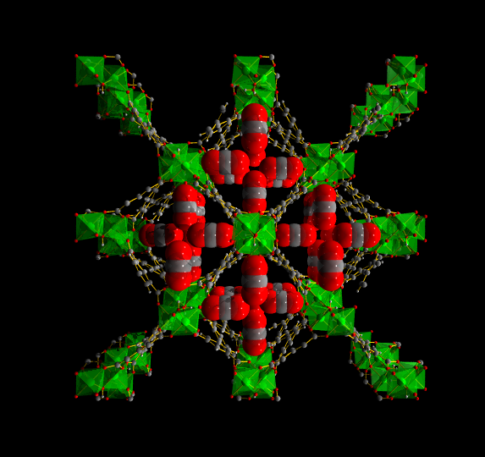
Follow processes in operando
e.g. follow insertion of gases such as CO₂ in porous materials such as MOFs in situ, refining structure to locate CO₂ and observe change in host material
In situ Powder Diffraction (CO₂)
S. Yang, M. Schroder et al (2012)

Slide 17
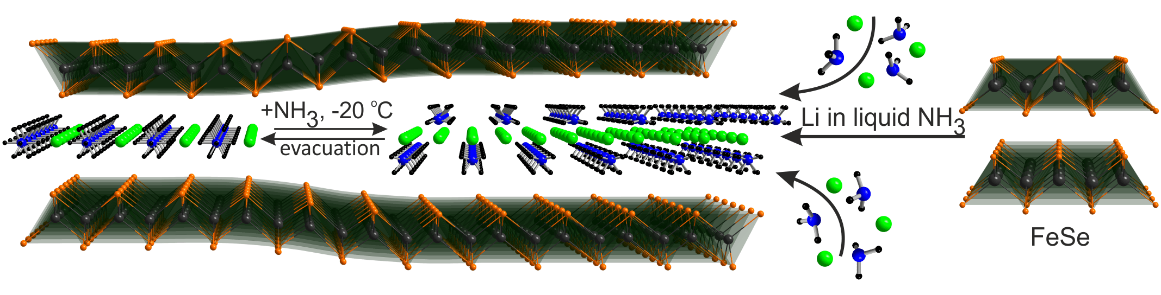
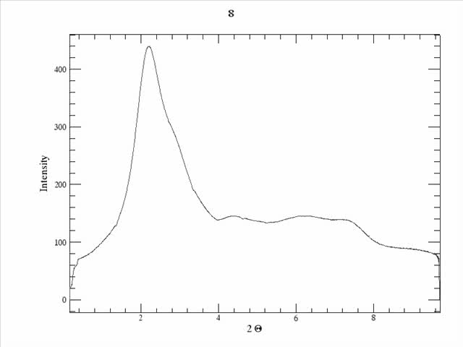
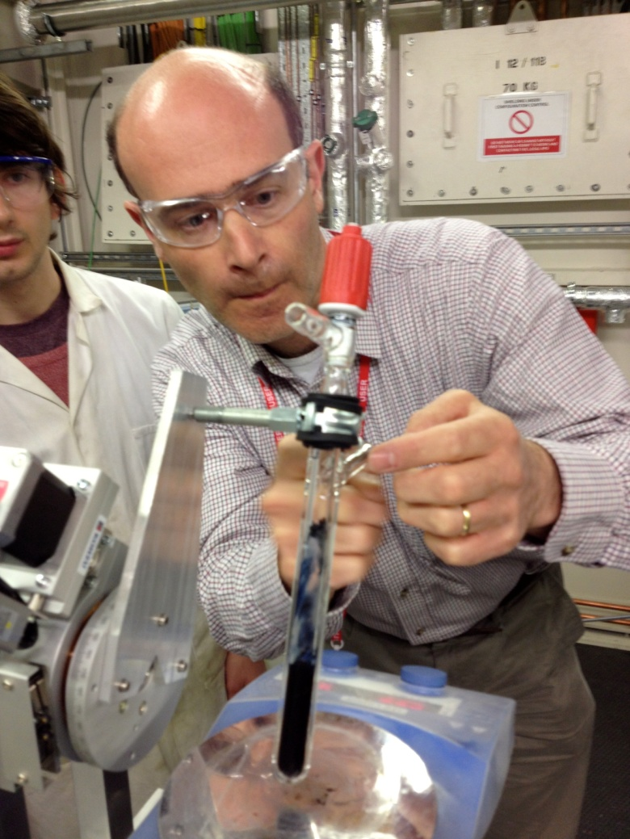
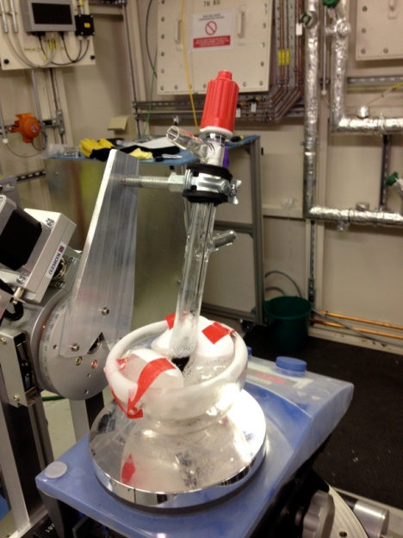
Watching chemical reactions
e.g. study the chemical reaction between a host, layered chalcogenide FeSe and Li in ammonia to produce new layered superconductor
Tc 44 K 39 K 9K
S. Sedlmaier, S. Cassidy, R. Morris, M. Drakopoulos, C. Reinhard, S. Moorhouse, D. O'Hare, P.Manuel, D. Khalyavin, and S. Clarke., J. Am. Chem. Soc. 2014 136, 630-633

Slide 18
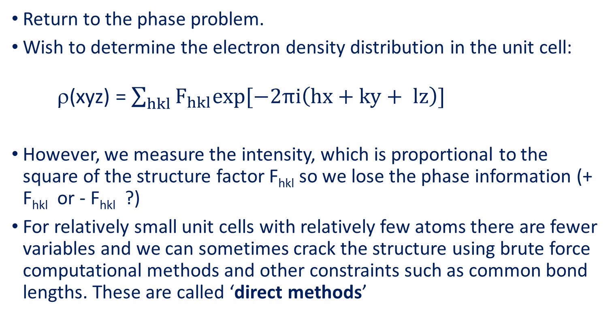
Single crystal diffraction
Return to the phase problem.
Wish to determine the electron density distribution in the unit cell:
ρ(xyz) = $\sum_{hkl}{F_{hkl}exp[−2πi\left(hx+ky+ lz\right)] }$
However, we measure the intensity, which is proportional to the square of the structure factor F_{hkl} so we lose the phase information (+ F_{hkl} or - F_{hkl} ?)
For relatively small unit cells with relatively few atoms there are fewer variables and we can sometimes crack the structure using brute force computational methods and other constraints such as common bond lengths. These are called ‘direct methods’

Slide 19
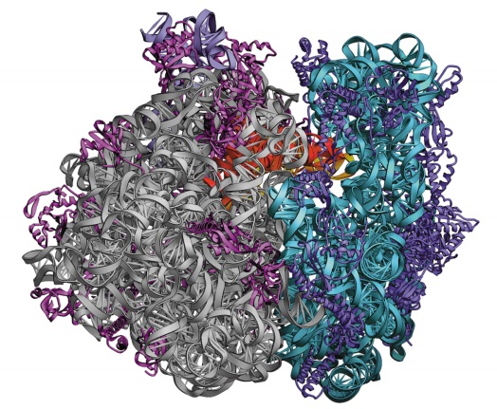


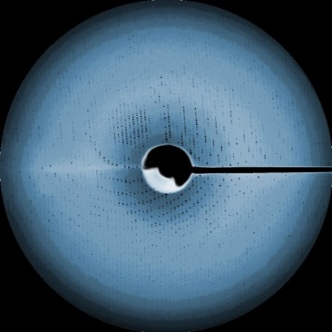
Failure of direct methods
Direct methods do not work for the large macromolecules that govern life and are implicated in disease and drug discovery and can contain 100’s of thousands of atoms – e.g. the work on the structure of the ribosome which was recognised by the award of the 2009 Nobel Prize in Chemistry to Ada Yonath, Venki Ramakrishnan and Thomas Steitz
Note that scattering from an individual atom ∝ Z² so heavy atoms can dominate scattering. If a natural atom such as S is substituted in the structure by Se this can help us determine the phase.

