Slide 1
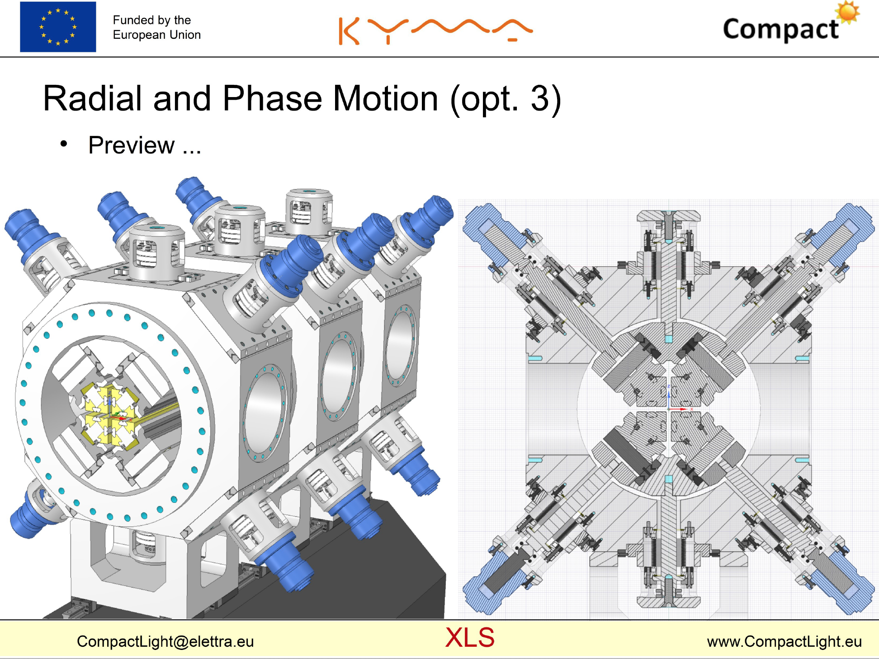
courtesy Tadej Milharcic

Slide 2
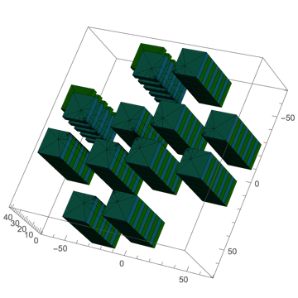
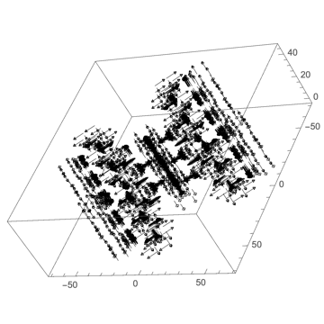
Force compensation for APPLE X
Model

Slide 3
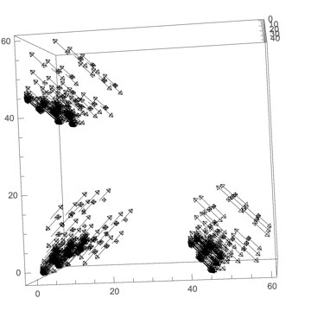
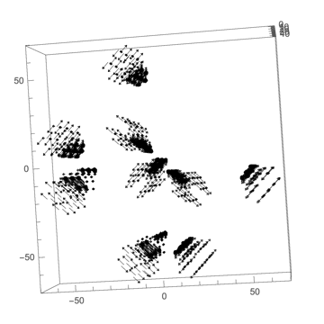
Force compensation for APPLE X

Slide 4
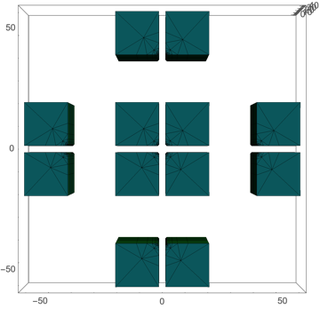
Force compensation for APPLE X
Forces on individual magnet rows
for short RADIA model
F [a.u.]
364!
F [a.u.]
force compensation magnets
-364!

Slide 5
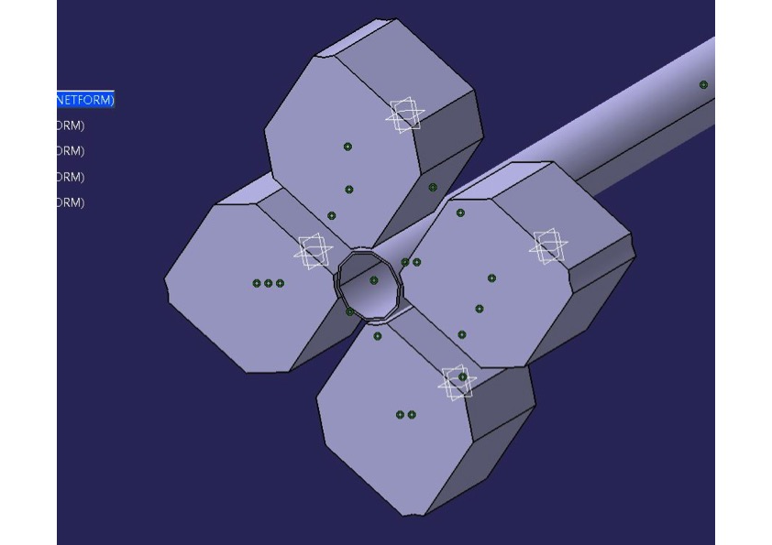
simplified magnet geometry
pro:
increased sorting freedom due to symmetry
simplified machining, reduced costs
con:
this model may too simple cause of missing form closure

Slide 6
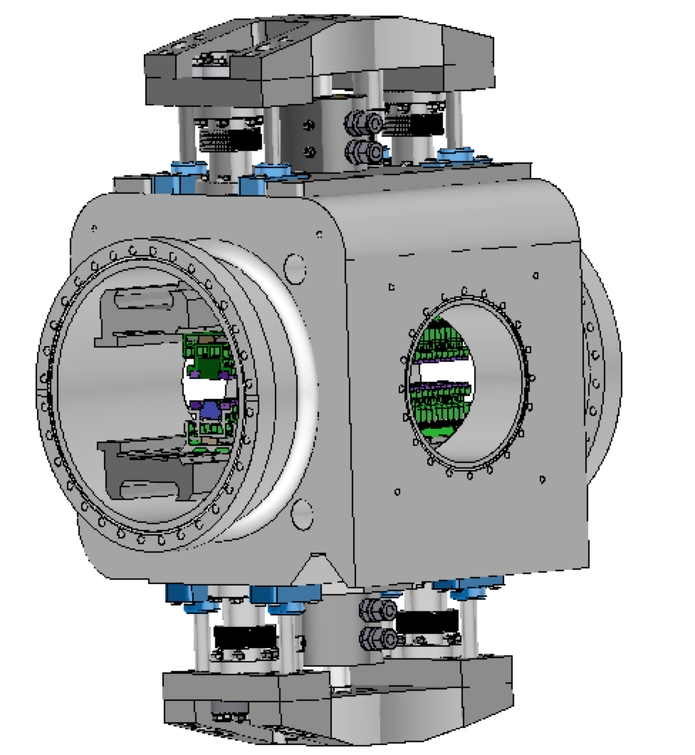
Prototype study for compact planar in-vacuum (CPMU) undulator for SLS2.0 at PSI
module length 504mm
vacuum chamber = support
hydraulic drive system
guiding like a die cutter

Slide 7
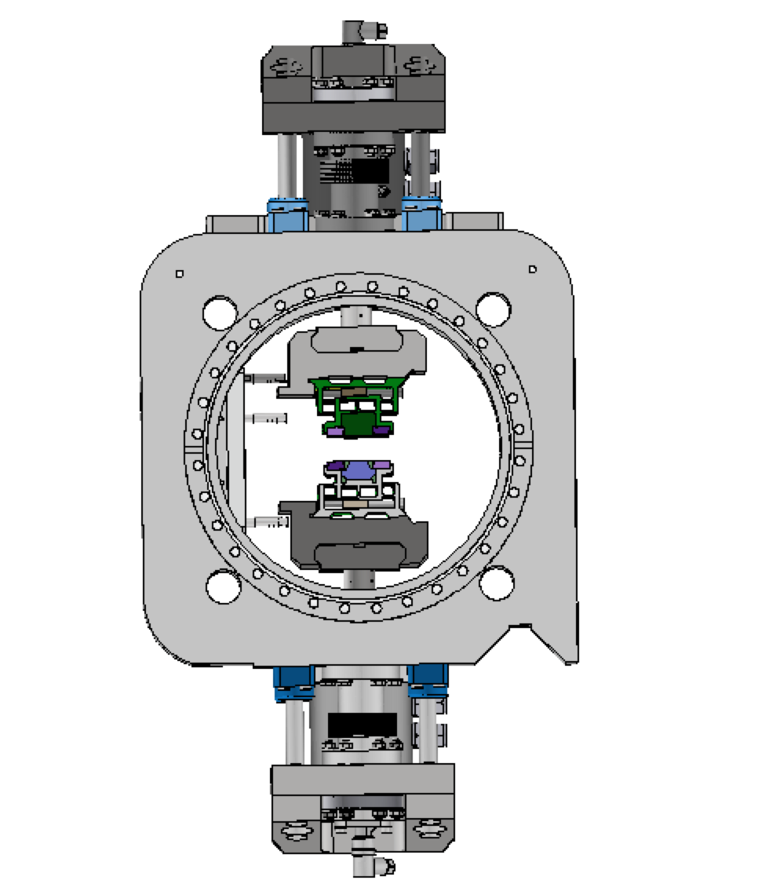

Slide 8

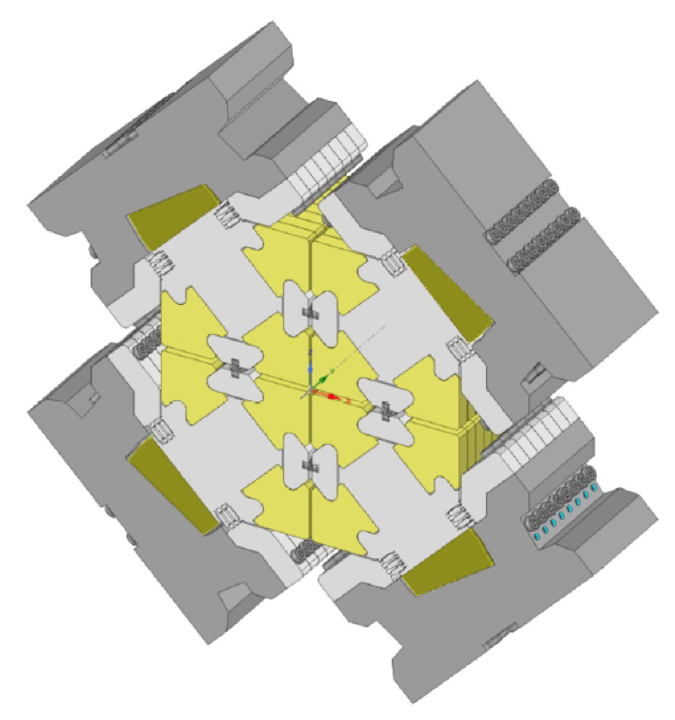
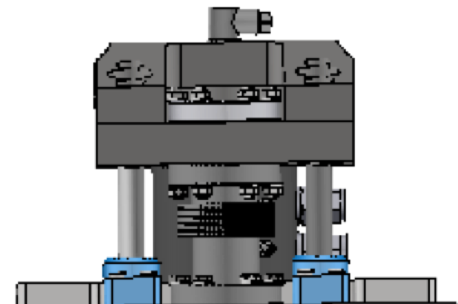

Slide 10
