Slide 1

Afterburner FEL performance
For 250 eV and 600 eV
SCU (Helical)
Kicker
APPLE
Hector Mauricio Castaneda Cortes

Slide 2
FEL performance of afterburner
Hector Mauricio Castaneda Cortes
Daresbury Laboratory
09/11/2020

Slide 3
Simulation parameters (650 eV)
Parameter | Value | Notes
Beam Energy | 1.45 GeV | (maximum value found by Neil, 1kHz repetition rate)
Sliced Energy Spread | 0.02%
Sliced emittance | 0.2 mm-mrad
Photon Energy | 250 eV
aw₀ | 2.42
Noise realisations | 20
Undulator period | 13 mm | (recommended by Neil)
Peak Current | 5 kA | Neil’s peak current (5.5 kA)
Bunch length | 4.85 µm | Cuarge = 75 pC

Slide 4
Simulation parameters (II)
Parameter | Value | Minimum (Deliverable 2.2) | Notes
Beam Energy | 2.36 GeV | 2.36 GeV | (maximum value found by Neil, 1kHz repetition rate)
Sliced Energy Spread | 0.04% | 0.04%
Sliced emittance | 0.2 mm-mrad | 0.2 mm-mrad
Photon Energy | 600 eV | 0.5 – 1 keV
Undulator type | SCU Nb₃Sn | Nb-Ti | Neil did his analysis initially with Nb₃Sn
aw₀ | 2.3893 | 0.62-1.32
Noise realisations | 20
Gap | Approx. 4.3 mm | 4.3 mm | (found by Neil)
Undulator period | 13 mm | 13 mm | (recommended by Neil)
Peak Current | 700 A | 650 A | Neil’s peak current (5.5 kA)
Bunch length | 32.12 µm | Total Charge 75 pC

Slide 5
SXR: Polarisation control via Afterburner (250 eV)
SCU (Helical)
APPLE
Decoupling
chicane
 | Only SCU (max B- helical) | Only APPLE (max B - planar) | SCU+AB (best- planar, max B)
Pulse energy (µJ) | 572.5 | 408.4 | 248 (43%, 60%)
B | 2.5×10³¹ | 7.4×10³⁰ | 1.32×10³¹ (52%, 1.78 times larger)
Length (m) | 4.03 | 6.59 | 5.628
To recover 64% pulse energy of SCU at maximum B (91% of APPLE at max. B) , the AB needs to have 1 section ( 372 µJ, 6.27×10³⁰)
Best scenario: SCU with 1 section and AB with 1.5 sections
SCU (Helical)
Kicker
APPLE

Slide 6
SXR: Polarisation control via Afterburner (650 eV)
SCU (Helical)
APPLE
Decoupling
chicane
 | Only SCU (max B- helical) | Only APPLE (max B - planar) | SCU+AB (best- planar, max B)
Pulse energy (µJ) | 191 | 73 | 91.478 (47%, 80%)
B | 3.6×10³⁰ | 5.7×10²⁹ | 1.86×10³⁰ (50%, 3.7 times larger)
Length (m) | 9.9 | 20.59 | 16
A SCU with 3 sections will provide a larger pulse energy than the APPLE at highest B (even with an AB with one section, pulse energy = 102 uJ)
SCU (Helical)
Kicker
APPLE
APPLE highest peak brilliance around 20.59 m. Pulse Energy at highest brilliance: 73 µJ.
Best scenario: SCU with 3 sections and 2 sections (total length around 16 m). Pulse energy of 91 µJ (1.28 times the pulse energy of the APPLE at highest peak brilliance)

Slide 7
Summary

Slide 8
Summary (250 eV, 5kA)
Best scenario: SCU with two segments and 1.5 sections (43% the highest brightness of the SCU ). For larger SCUs, the electrons enter into the afterburner after saturation, so they are overbunched.
Pulse energy of the APPLE undulator at maximum peak brilliance recovered for an afterburner with more than 2 segments (around 92% the pulse energy of SCU at highest brightness
Maximum peak brilliance within the afterburner (SCU with one segment) around 6.2 ×10³¹ for afterburners with 2.5 segments
Best scenario shorter than length of maximum B for the APPLE planar undulator (14% shorter)

Slide 9
Summary (650 eV, 700A)
Best scenario: SCU with 3 segments. For larger SCUs, the electrons enter into the Afterburner after saturation, so they are overbunched.
Pulse energy of the APPLE undulator at maximum peak brilliance recovered for an afterburner with more than 2 segments. For a SCU with one segment and one afterburner segment, the pulse energy obtained at the end of such afterburner is around 25% of the pulse energy of the APPLE undulator at peak brilliance
The SCU with 3 sections will have a pulse energy larger than the pulse energy at highest brightness for the APPLE at z = 20 m and around 1.5 times the brightness of the SCU at highest B
Best scenario shorter than length of maximum B for the APPLE planar undulator (20% shorter)

Slide 11
Extra-slides
Results of after-burner (250 eV and 650 eV)

Slide 12
SXR: Polarisation control via Afterburner (250 eV)
SCU (Helical)
APPLE
Decoupling
chicane
Pulse energy (µJ) | AB (1 sect) | AB (2 sect) | AB (3 sect) | AB (4 sect) | AB (5 sect)
SCU(1 sect) | 84 | 372 | 313 | 340 | 297
SCU(2 sect) | 4 | 6 | 10.65 | 15 | 18
SCU(3 sect) | 1.19 | 1.47 | 1.75 | 1.90 | 2.03
SCU max B length = 4.03 m and max B energy = 572 µJ
APPLE max B length = 6.59 m and max B energy = 408 µJ
Best scenario: SCU with 1 section and AB with 2 sections Pulse energy of 372 µJ
SCU (Helical)
Kicker
APPLE

Slide 13
SXR: Polarisation control via Afterburner (250 eV)
SCU (Helical)
APPLE
Decoupling
chicane
B(×10²⁹) | AB (1 sect) | AB (2 sect) | AB (3 sect) | AB (4 sect) | AB (5 sect)
SCU(1 sect) | 13.173 | 62.2 | 9.14 | 1.26 | 3.48
SCU(2 sect) | 0.14 | 0.12 | 0.0793 | 0.0793 | 0.13
SCU(3 sect) | 0.027 | 0.006 | 0.004 | 0.003 | 0.002
SCU max B length = 4.03 m and B = 2.25×10³¹
APPLE max B length = 6.59 m and B = 7.4×10³⁰
Best scenario: SCU with 1 sections and AB with 2 section. Peak Brilliance of 6.2×10³⁰
SCU (Helical)
Kicker
APPLE

Slide 14
SXR: Polarisation control via Afterburner (650 eV)
SCU (Helical)
APPLE
Decoupling
chicane
Pulse energy (µJ) | AB (1 sect) | AB (2 sect) | AB (3 sect) | AB (4 sect) | AB (5 sect)
SCU(2 sect) | 1.6 | 19 | 59.88 | 74 | 87
SCU(3 sect) | 102 | 130 | 149 | 160 | 167
SCU(4 sect) | 59 | 71 | 79 | 85 | 89
SCU max B length = 9.02 m and max B energy = 191 µJ
APPLE max B length = 20.35 m and max B energy = 73 µJ
SCU (Helical)
Kicker
APPLE
APPLE highest peak brilliance around 20 m. Pulse Energy at highest brilliance: 73 µJ.
Best scenario: SCU with 3 sections and 2 sections (total length around 16 m). Pulse energy of 102 µJ

Slide 15
SXR: Polarisation control via Afterburner (650 eV)
SCU (Helical)
APPLE
Decoupling
chicane
B(×10²⁹) | AB (1 sect) | AB (2 sect) | AB (3 sect) | AB (4 sect) | AB (5 sect)
SCU(2 sect) | 0.08 | 0.348 | 1.02 | 0.535 | 0.48
SCU(3 sect) | 5.8 | 2 | 0.93 | 0.65 | 0.48
SCU(4 sect) | 2.29 | 0.5 | 0.3 | 0.15 | 0.14
SCU max B length = 9.02 m and max B = 3.6×10³⁰
APPLE max B length = 20.35 m and max B = 5.6×10²⁹
SCU (Helical)
Kicker
APPLE
APPLE Highest peak brilliance at 20 m. Highest peak brilliance 5.6×10²⁹
Best scenario: SCU with 3 sections and 2 sections (total length around 16 m). Peak Brilliance of 2×10²⁹ (21% of peak brilliance of the APPLE)

Slide 16
Afterburner performance
(250 eV, 5 kA)

Slide 17
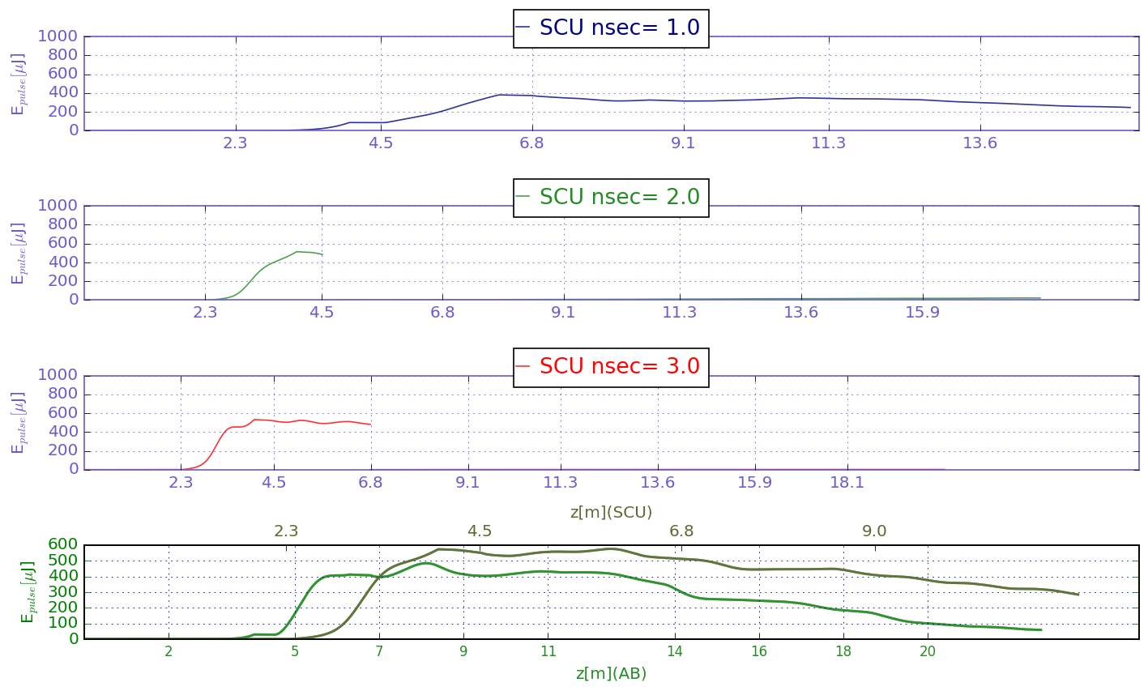
Pulse energies
Only for the 1st scenario (SCU with one segment), the maximum pulse energy is achieved within the afterburner.
Maximum pulse energy around 400 µJ for afterburners with 2.75 segments

Slide 18
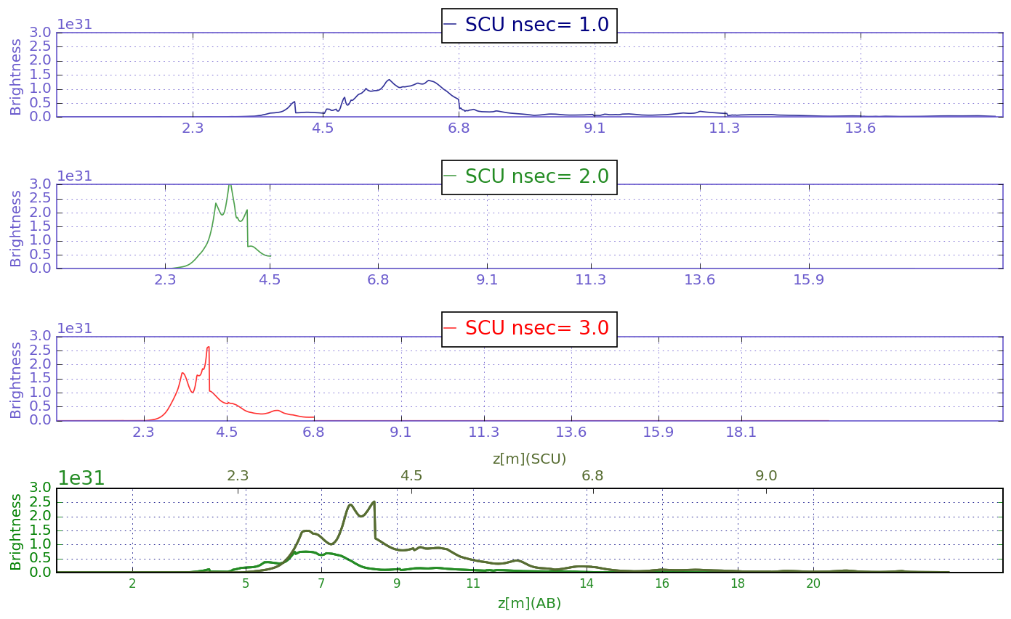
Peak brilliance
Only for the 1st scenario (SCU with one segment), the peak brilliance is achieved within the afterburner.
Maximum peak brilliance around 1.5 ×10³¹ for afterburners with 2.5 segments

Slide 19
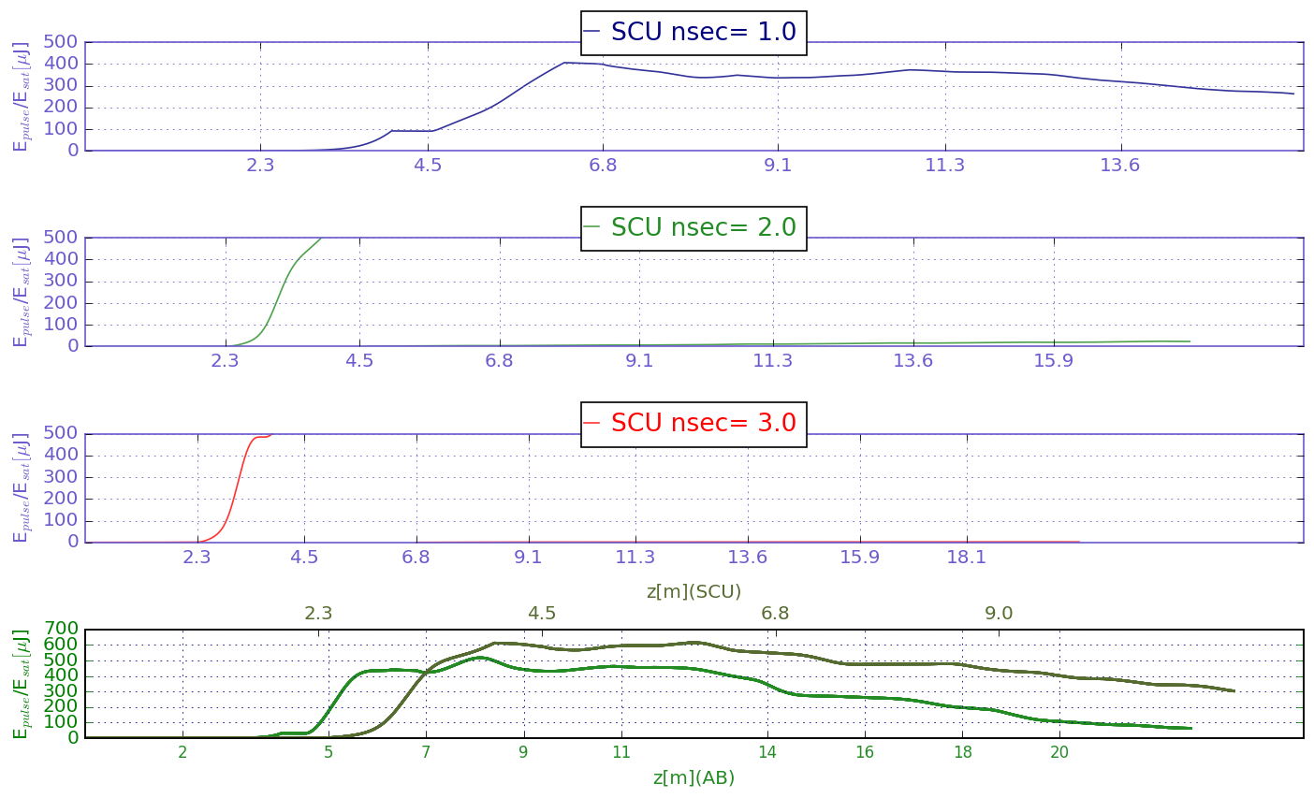
Comparison with pulse energy of APPLE at maximum brightness
For the optimum scenario, the pulse energy of the APPLE at maximum peak brilliance is recovered for an afterburner with 2 segments

Slide 20
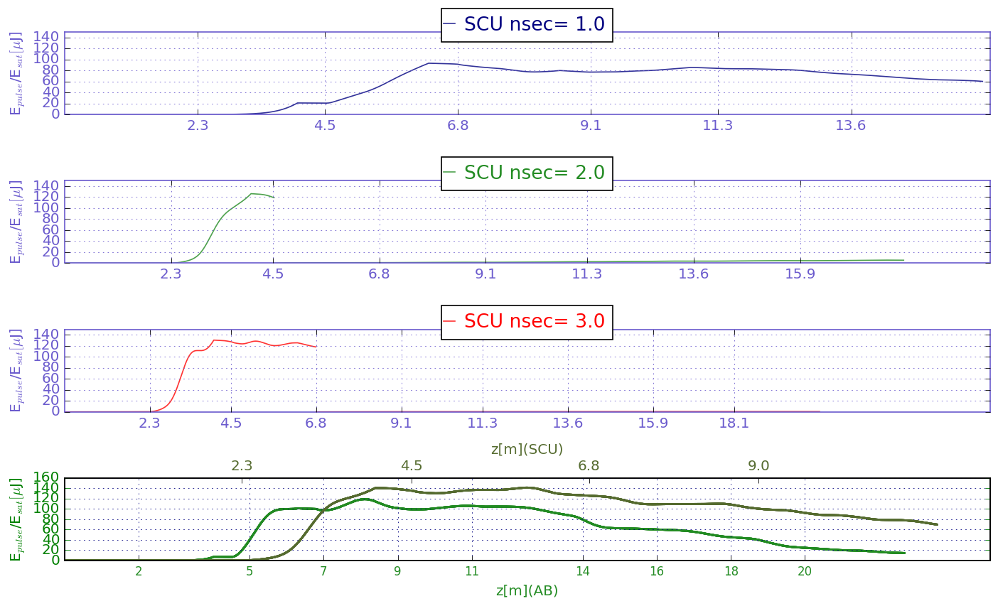
Comparison with pulse energy of SCU at maximum brightness

Slide 21
Afterburner performance
(600 eV, 700 A)

Slide 22
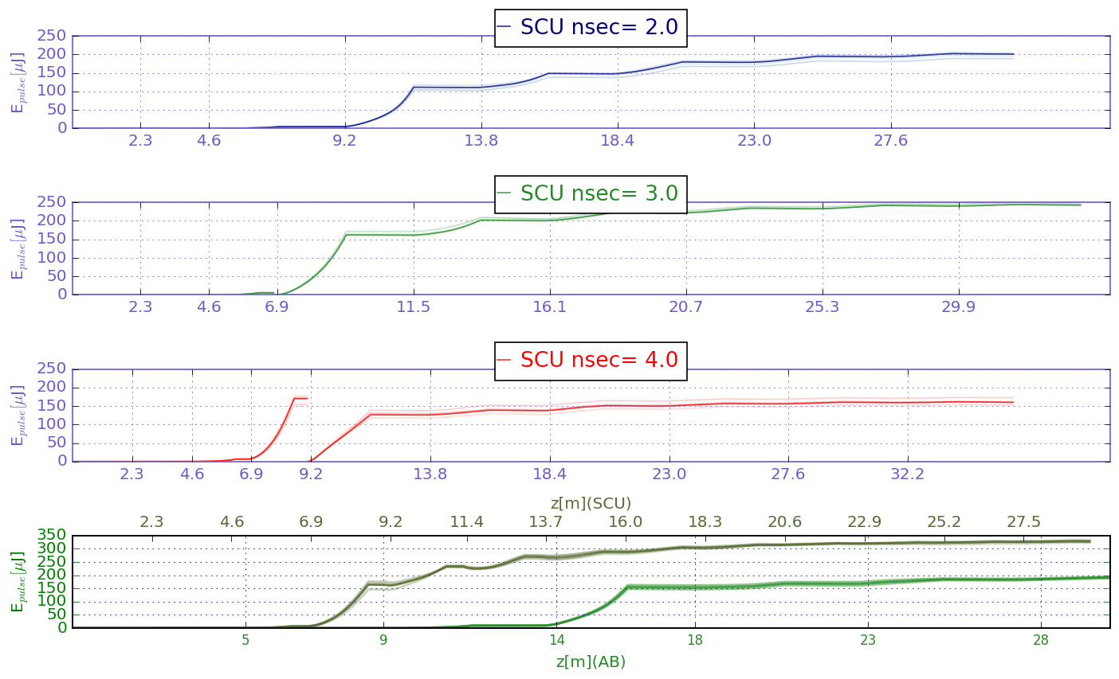
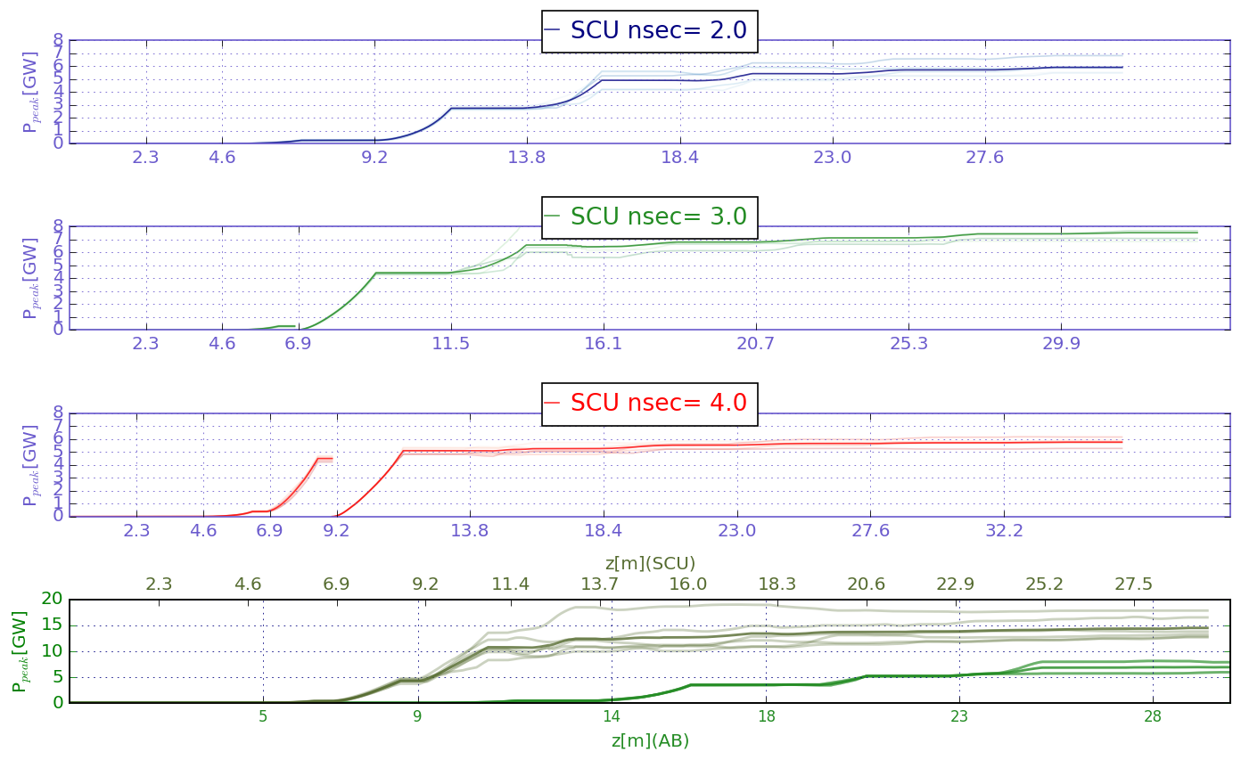

Pulse energy and maximum peak power over all slices
Pulse Energy (highest brightness):
SCU (around 9.9 m) ≈191 µJ
APPLE (around 20 m) ≈ 73 µJ
Best scenario SCU with 3 sections (2 sections AB have around the pulse Energy of the SCU at highest B)

Slide 23
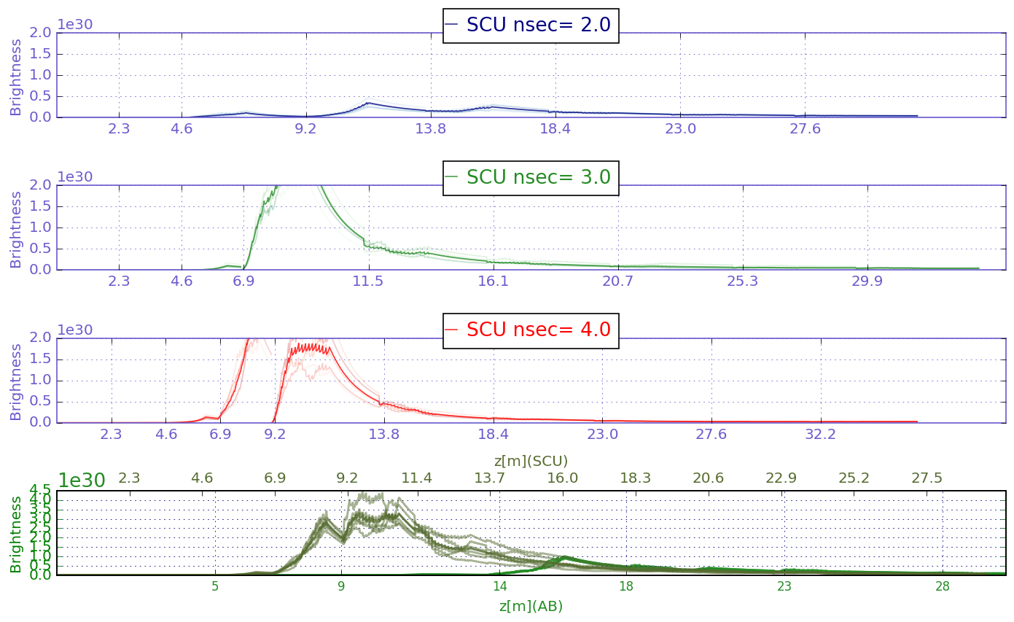
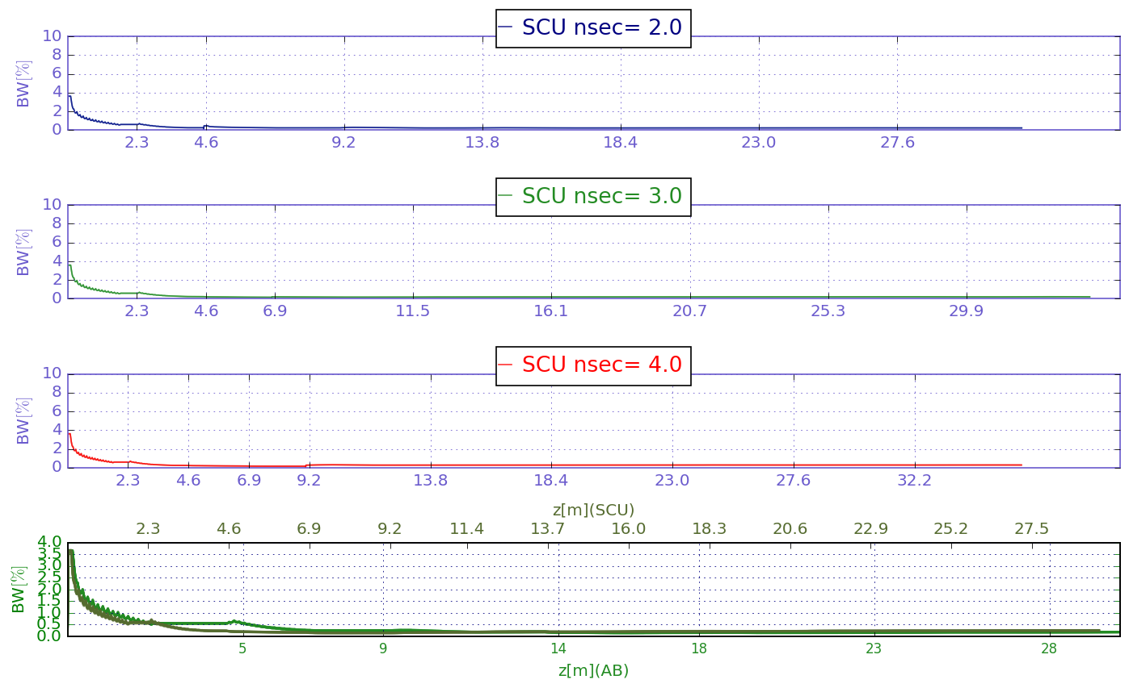
Brightness and Bandwidth
z (highest brightness):
SCU (around 9.9 m) ≈3.6×10³⁰
APPLE (around 20 m) ≈ 5.6×10²⁹
Best scenario SCU with 3 sections. Smaller B afterwards

Slide 24
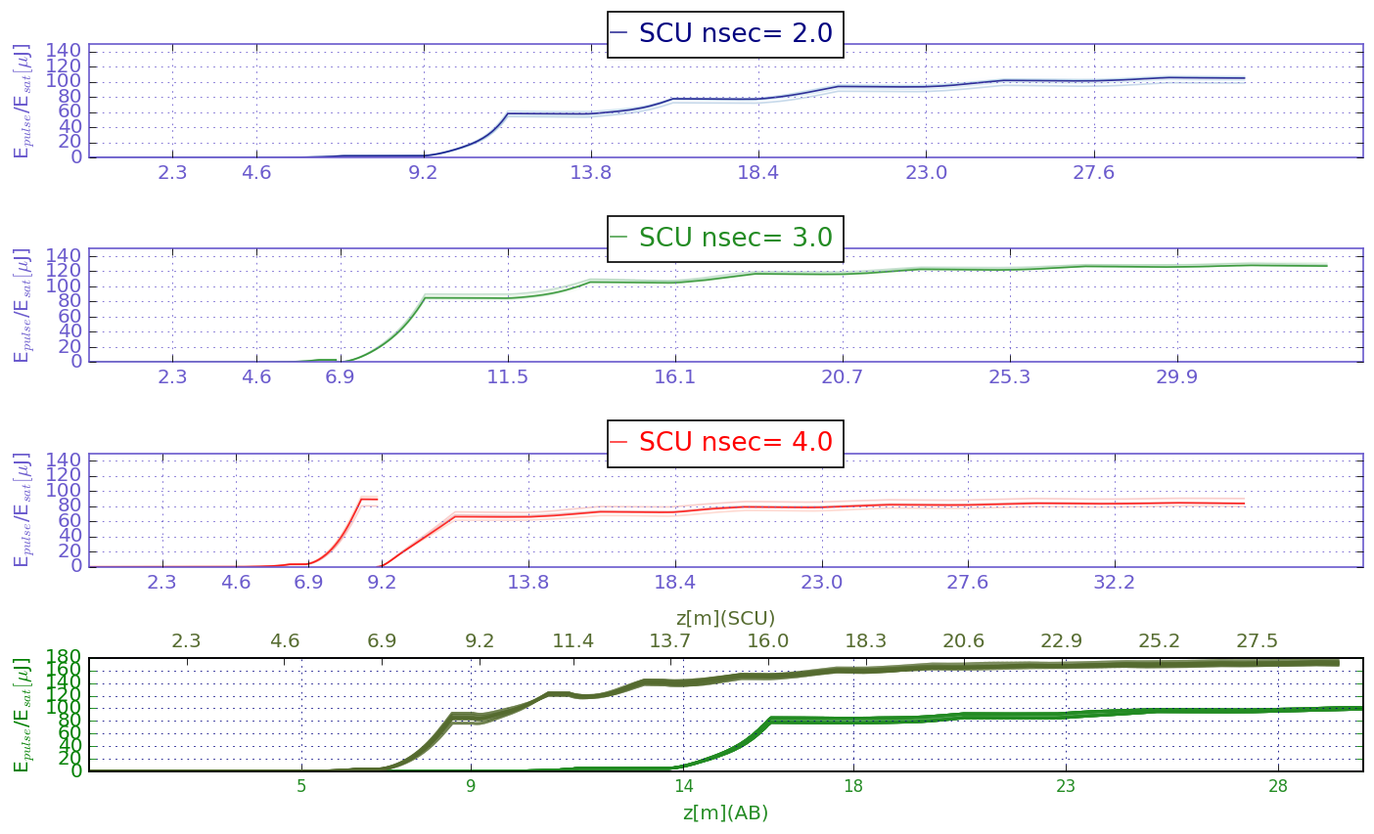
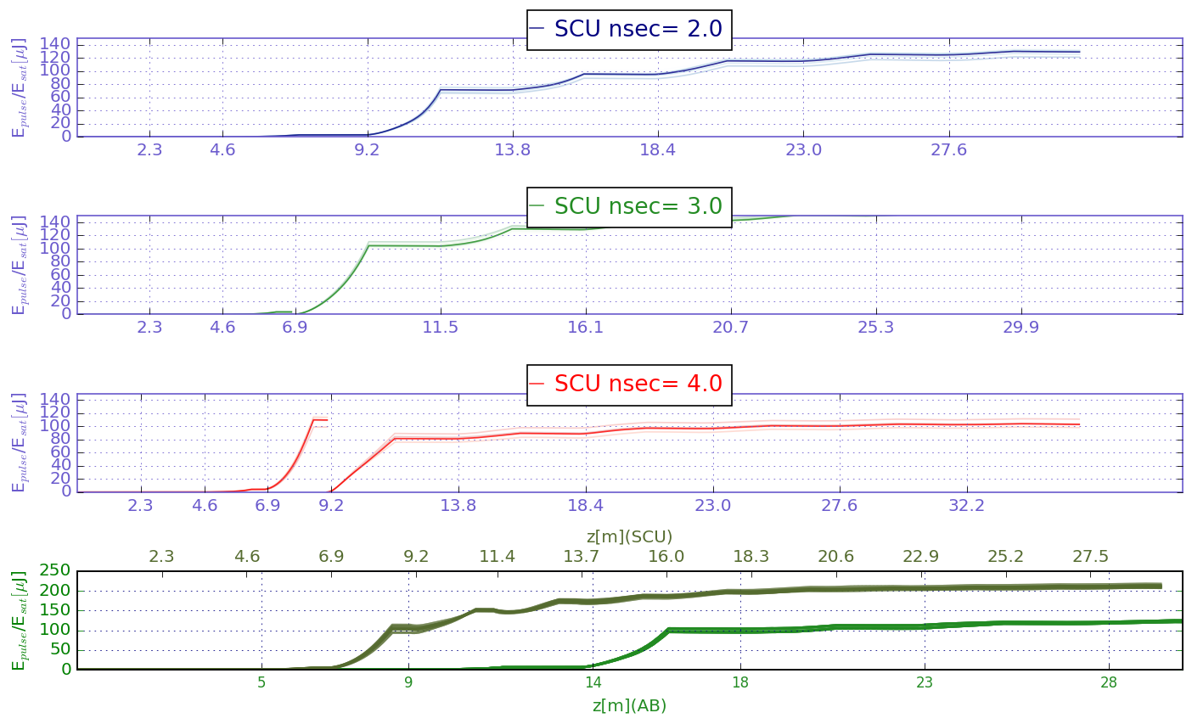
Comparison with pulse energy at highest brightness (SCU, left and APPLE, right)
The SCU with 2 sections can recover the pulse energy of the SCU at highest B at the end of an AB with 2.5 segments.
The SCU with 3 sections will have a pulse energy larger than the pulse energy at highest brightness for the APPLE at z = 16 m and around 1.5 times the brightness of the SCU at highest B

Slide 25
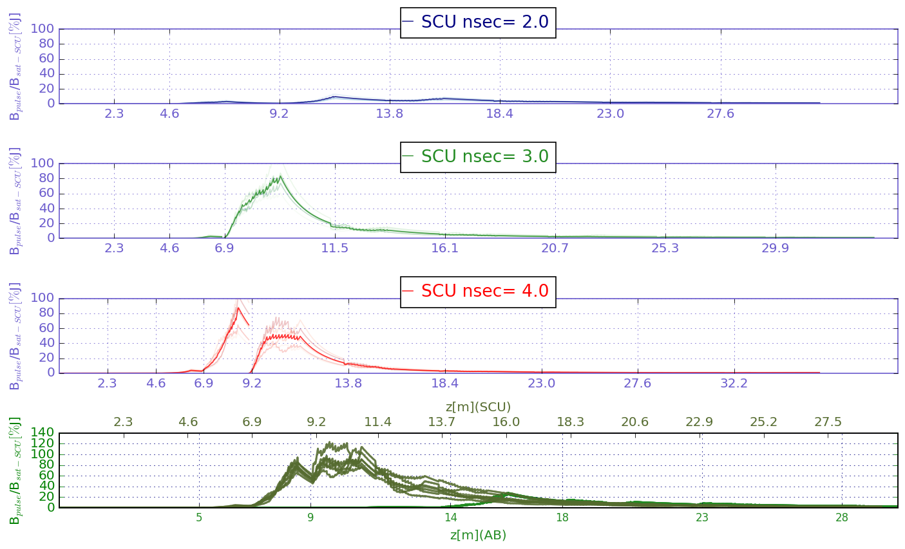
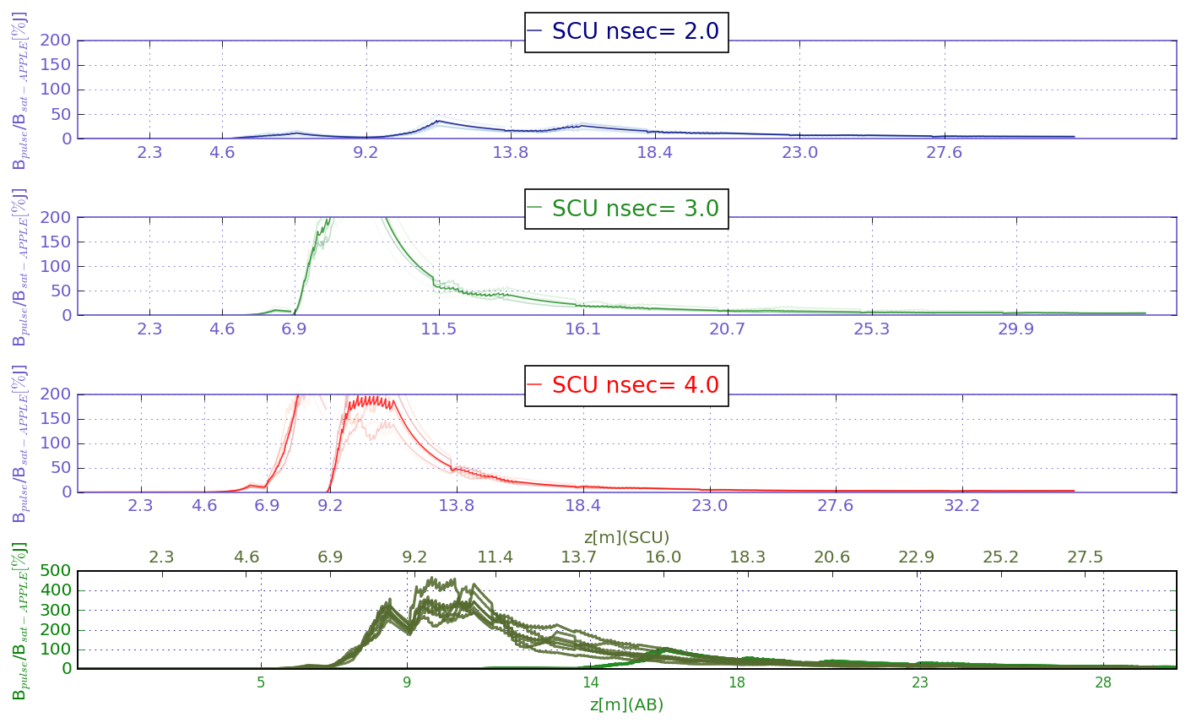
Comparison with Brightness at highest brightness (SCU, left and APPLE, right)
Brightness for best scenario around 20% of the highest brightness for the SCU.

