Slide 1
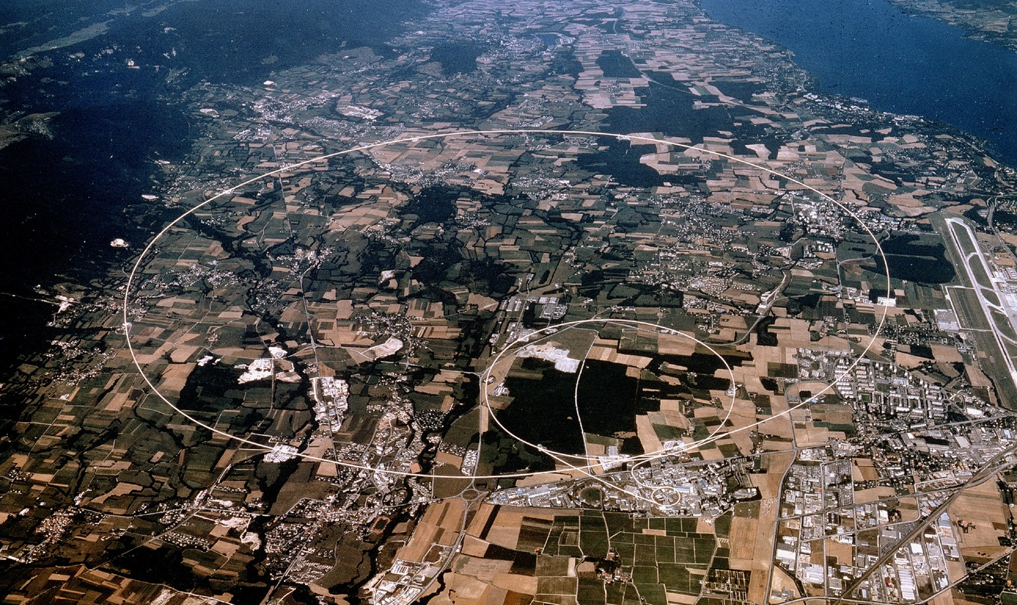


Radiation Protection at CERN
Helmut Vincke
CERN, HSE-RP
ESIPAP
26/1/2021
Notes:
1

Slide 2
Content
CERN – Accelerators, our main source of radiation
Most important quantities used in Radiation Protection
Radiation Fields occurring at High Energy Accelerators
A few words about cosmic radiation
Radiation Protection carried out at CERN
Radiation detectors used in mixed radiation fields

Slide 3
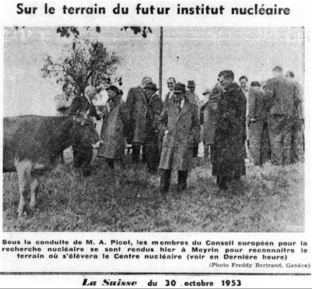
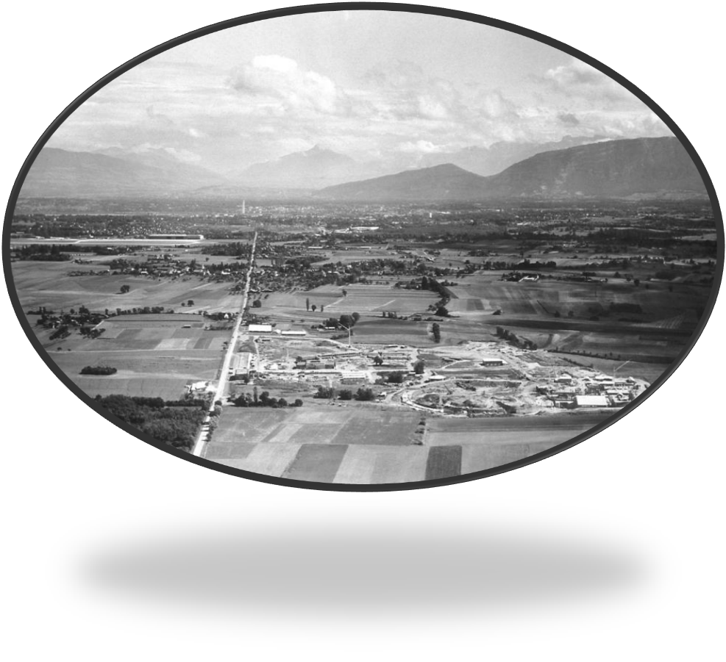
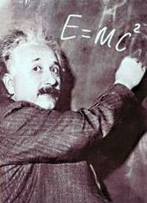
CERN - CONSEIL EUROPÉEN POUR LA RECHERCHE NUCLÉAIRE
1954:
Created by 12 European States
First European Organisation
Focus on nuclear physics (“nucleaire”)
Today: Particle Physics

Slide 4
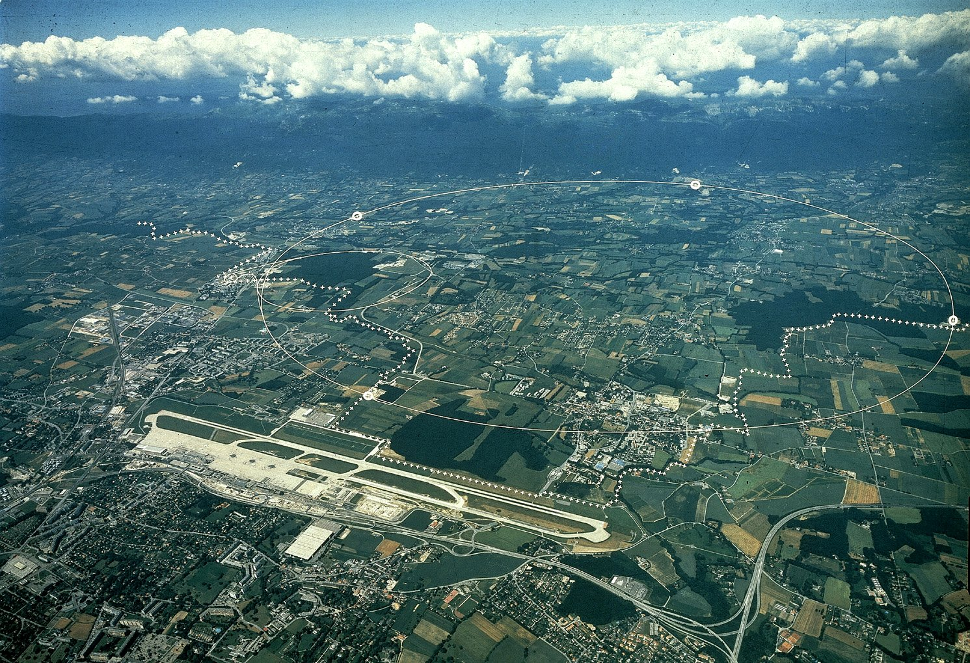
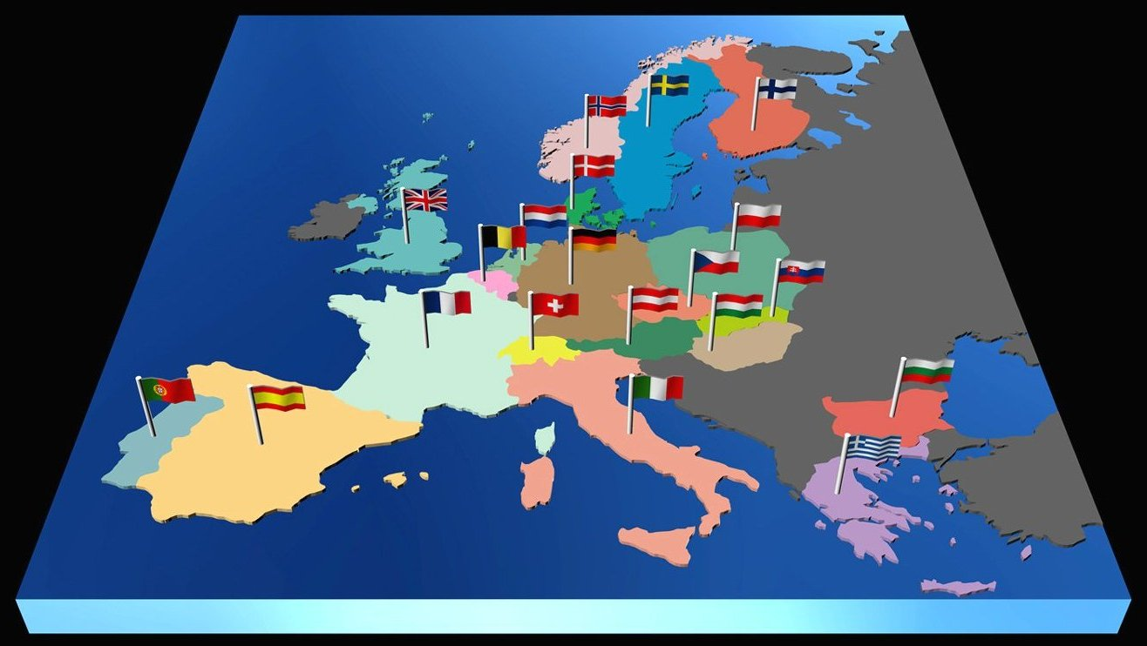

~ 2400 staff
~ 800 other paid personnel
> 11000 registered users from ~ 100 countries
~ 3500 registered contractors
Intergovernmental Organization
LHC
Meyrin
Prévessin
SPS
PS
CNGS
23 Member States: Austria, Belgium, Bulgaria, the Czech Republic, Denmark, Finland, France, Germany, Greece, Hungary, Israel, Italy, Netherlands, Norway, Poland, Portugal, Rumania, Serbia Slovakia, Spain, Sweden, Switzerland and the United Kingdom.
7 Observers to Council: Japan, the Russian Federation, the United States of America, the European Union, JINR and UNESCO
Notes:
Exploration of a new energy frontier - Proton-proton collisions at E_{CM} = 14 TeV
Start-up of the Large Hadron Collider (LHC), one of the largest and truly global scientific projects ever, is the most exciting turning point in particle physics.
Full membership to be confirmed very soon : Romania
Group of candidates for membership: Israel, Cyprus, Serbia, Slovenia, Turkey.
CERN was founded 1954: 12 European States
Geographical enlargement going on at present
Non-Member States with co-operation agreements
Algeria - Argentina - Armenia - Australia - Azerbaijan - Belarus - Bolivia - Brazil - Canada - Chile - China - Colombia - Croatia - Cyprus - Ecuador - Egypt - Estonia - Former Yugoslav Republic of Macedonia (FYROM) - Georgia - Iceland - Iran - Jordan - Korea - Lithuania - Malta - Mexico - Montenegro - Morocco - New Zealand - Pakistan - Peru - Saudi Arabia - Serbia - Slovenia - South Africa - Ukraine - United Arab Emirates - Vietnam
Other Non-Member States with Scientific Contacts at CERN
China (Taipei) - Cuba - Ghana - Ireland - Latvia - Lebanon - Madagascar - Malaysia - Mozambique - Palestinian Authority - Philippines - Qatar - Rwanda - Singapore - Sri Lanka - Thailand - Tunisia - Uzbekistan - Venezuela

Slide 5
CERN’s main accelerator chain

Slide 6
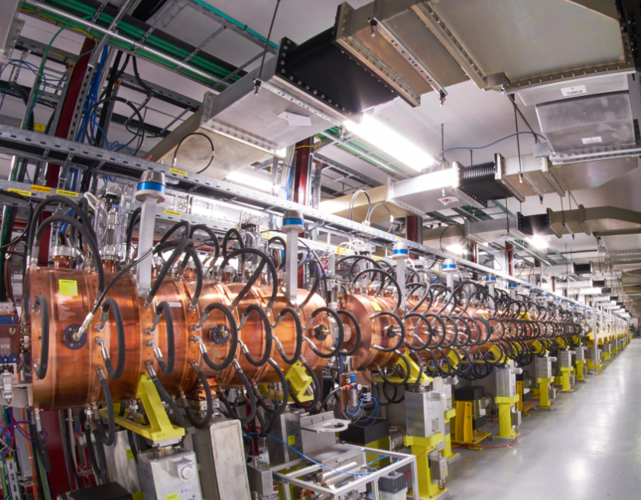
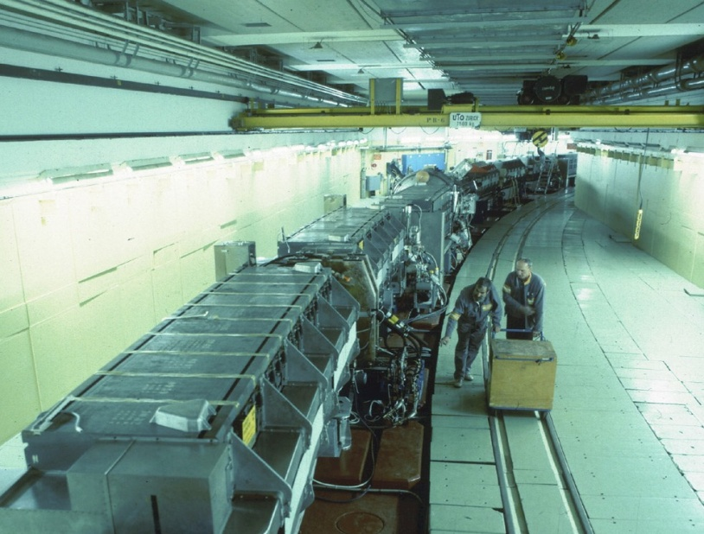
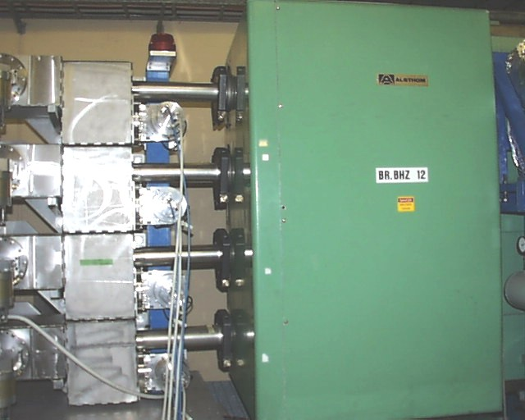
Main accelerator chain at CERN
(low-energy part)
Booster (2.0 GeV)
Proton Synchrotron (26 GeV/c)
LINAC (160 MeV)
200 m

Slide 7
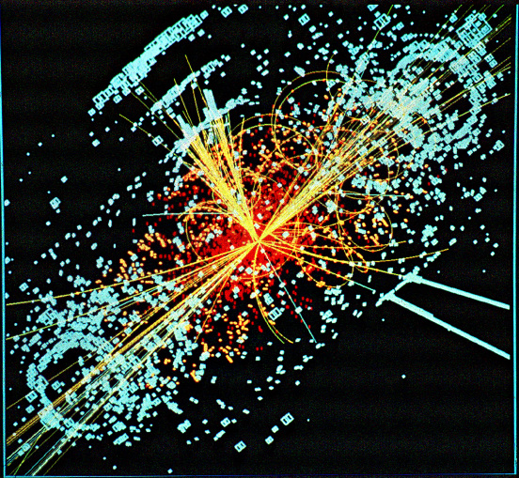
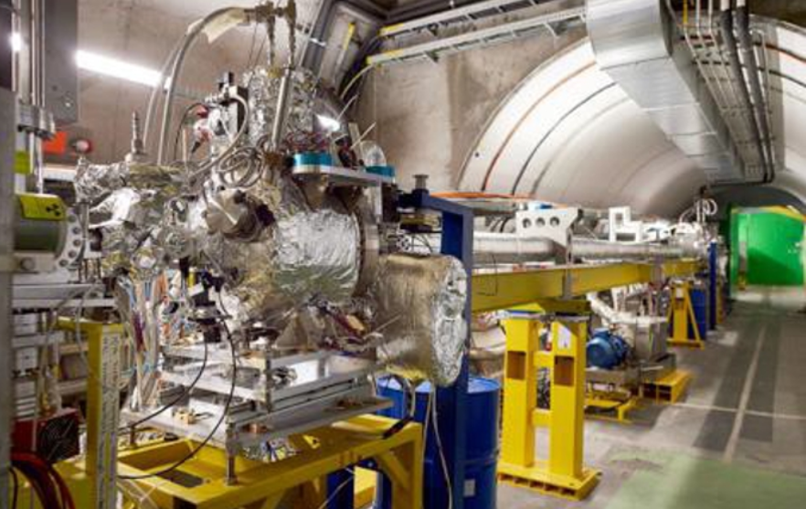
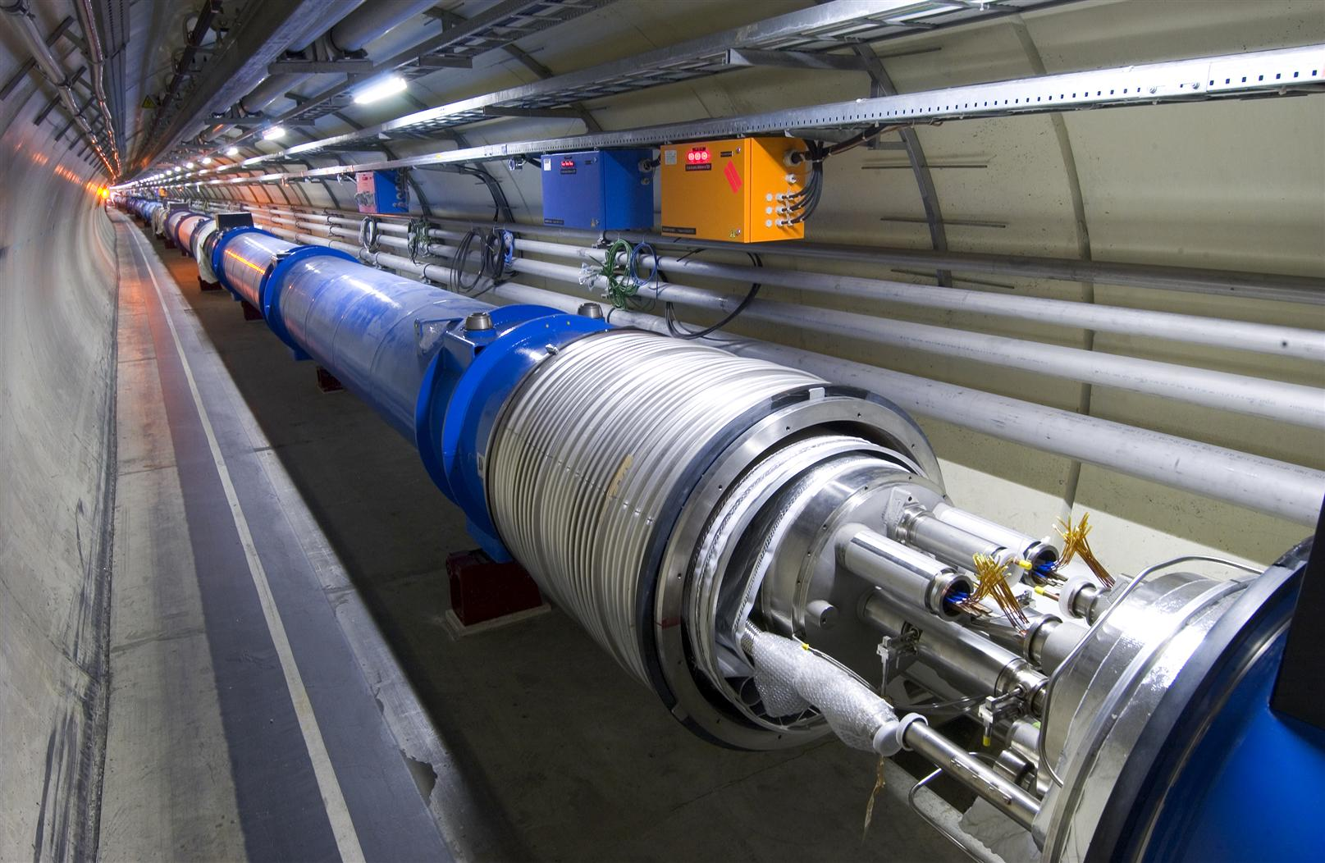
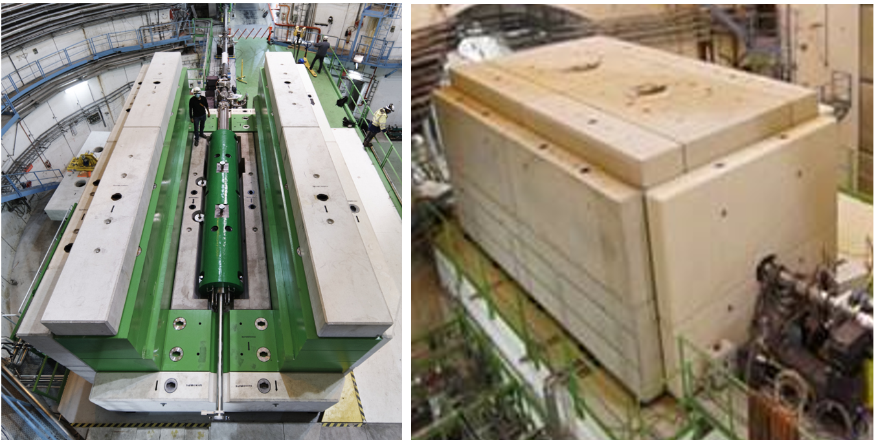
Accelerators at CERN
(high-energy part)
LHC (2 x 7 TeV)
SPS
Circumference: 7 km
Intensity per filling of the ring: 6E13 protons
SPS beam
FT
Fixed target experiments
Super Proton Synchrotron
(450 GeV/c)
LHC
AWAKE
CNGS
1 km

Slide 8

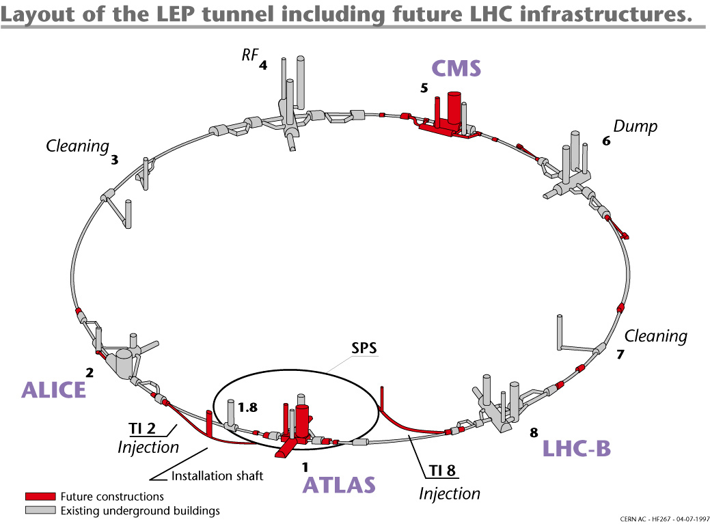
Large Hadron Collider (LHC)
Particle type: Protons
Beam energy: 7 TeV
Number of stored particles: 2×4·10¹⁴
Stored energy: ~ 2×450 MJ
Mass at rest:
~ 1 ng
Mass in laboratory system: ~10 μg

Slide 9
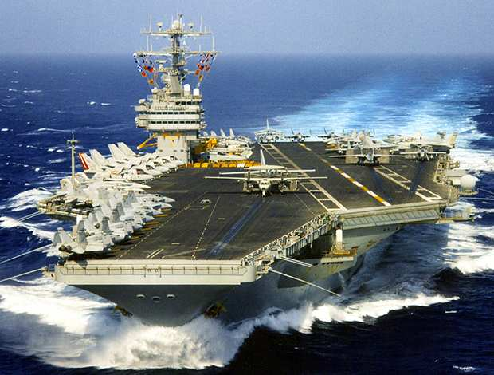
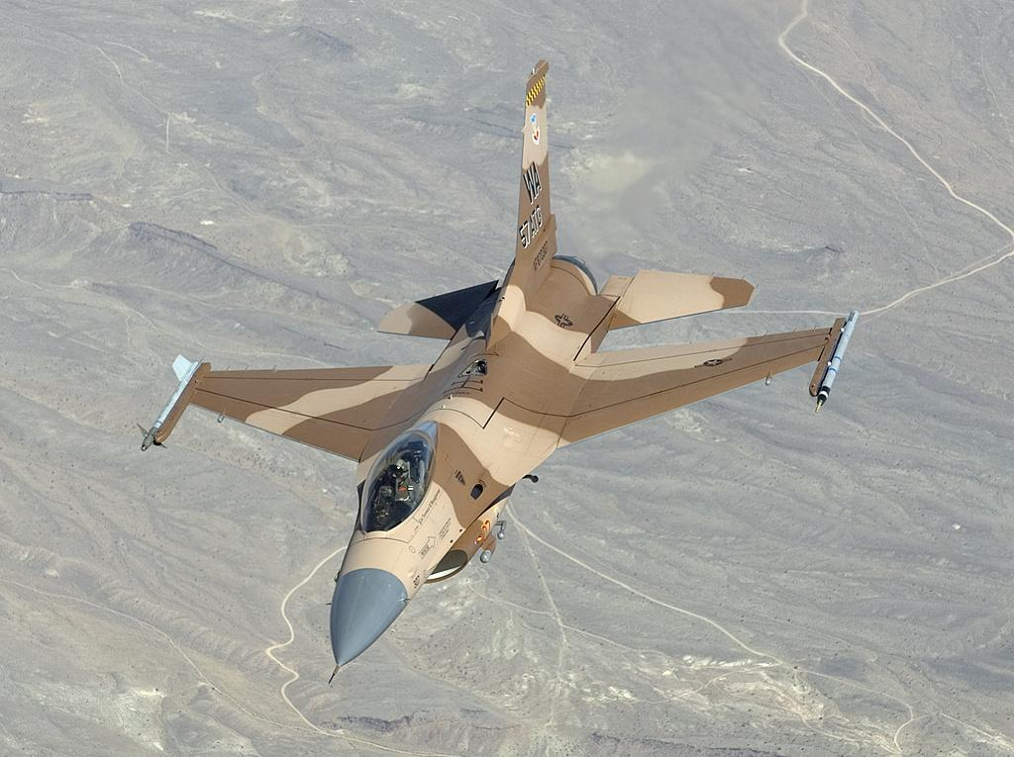
The same amount of energy as in one LHC beam is stored in:
An F16 airplane at supersonic speed (mach 1)
In an aircraft carrier at a speed of 12 km/h
Notes:
11 GJ stored in magnets

Slide 10
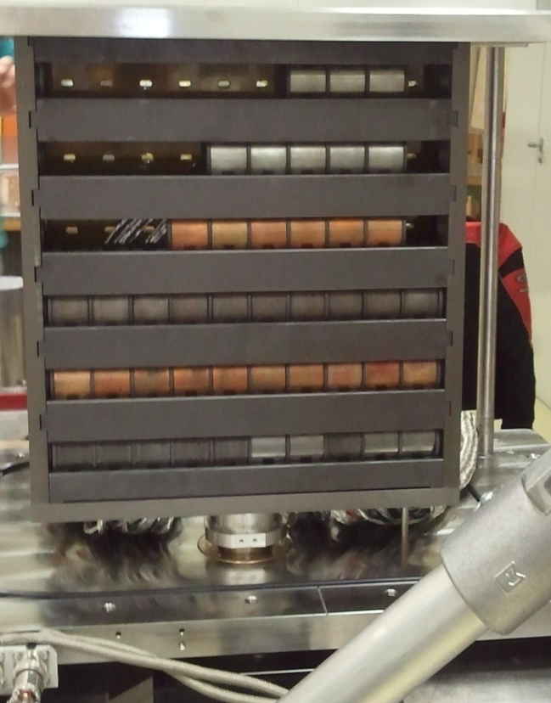
CERN operates powerfull (and dangerous) beams: full impact of a typical high-energy beam on tungsten (~ 0.16 % of the LHC beam energy)
Beam energy 440 GeV/c (SPS beam momentum)
1.08×10¹³ protons on tungsten alloy (Inermet 180)
Beam impact within ~ 8 us
Question: How will the three 3 cm long tungsten alloy blocks digest the beam impact?
By courtesy of A. Bertarelli

Slide 11
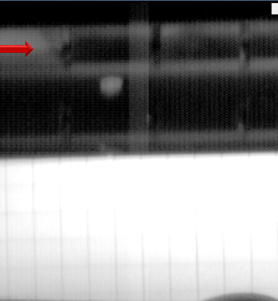
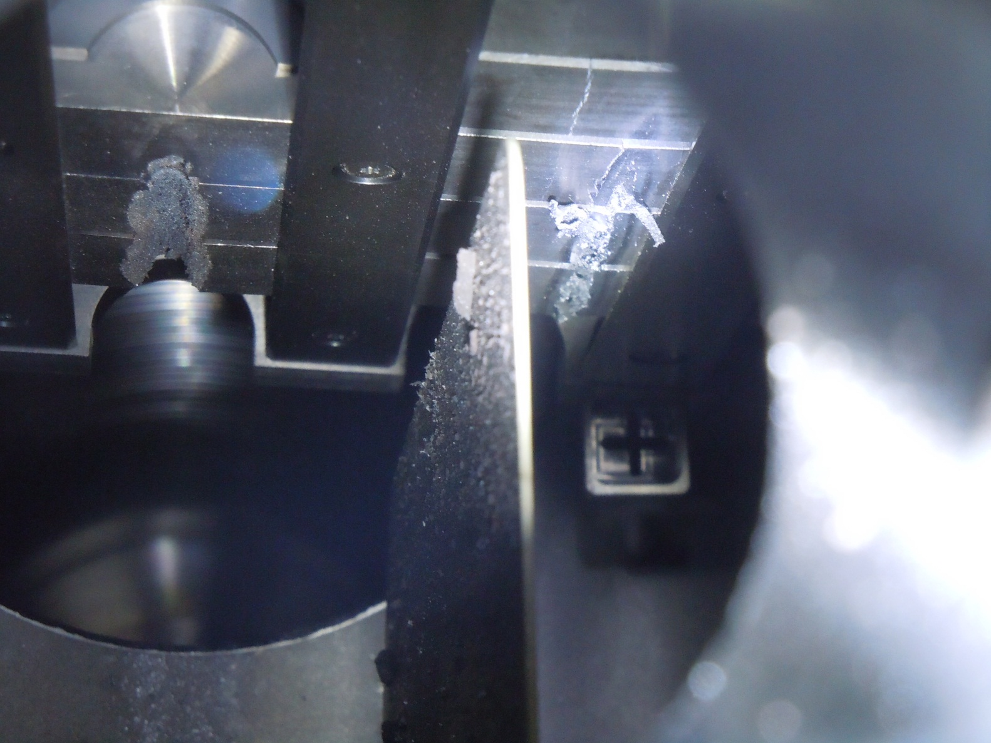
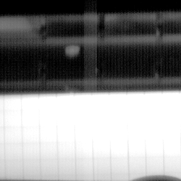
High speed camera catching the beam impact
Beam
Beam
~10.5 mm
Details: Bertarelli et al., An experiment to test advanced materials impacted by intense proton pulses at CERN HiRadMat facility, Nucl. Instr. Meth. B (2013) http://dx.doi.org/10.1016/j.nimb.2013.05.007

Slide 12
Most important quantities used in Radiation Protection

Slide 13


Absorbed dose
refers to the energy deposited (not released) in matter.
It reflects the sum of the energies dE_{dep} deposited by incident particles in a sample of matter, divided by the mass dm of the sample.
$$D=\frac{dE_{dep}}{dm}$$
dm
Unit: J/kg = Gray (Gy)

Slide 14
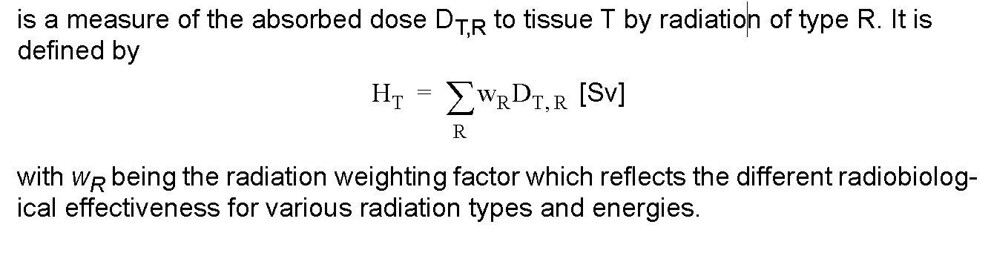
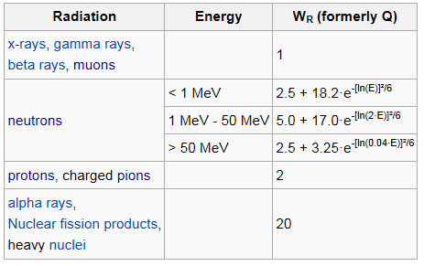
Equivalent dose in an organ or tissue, H_{T}
Unit: Sievert (Sv)
ICRP publication 103
The radiation weighting factor (especially for neutrons) has been revised over time and remains controversial

Slide 15
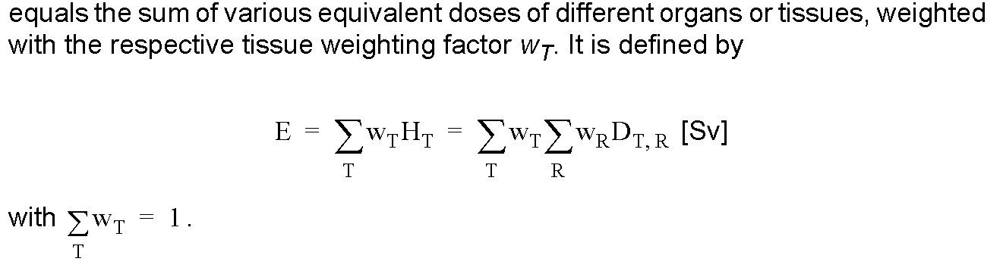
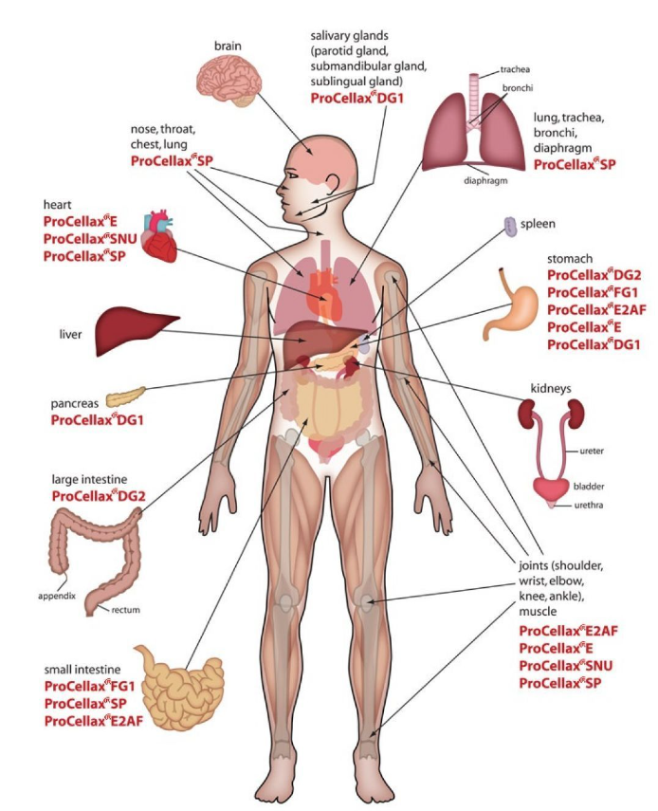
Effective dose, E
Unit: Sievert (Sv)
Different organs show different sensitivity to equivalent dose deposited
Organ | Tissue weighting factor |  | Organ | Tissue weighting factor
Gonads | 0.08 |  | Esophagus | 0.04
Red Bone Marrow | 0.12 |  | Thyroid | 0.04
Colon | 0.12 |  | Skin | 0.01
Lung | 0.12 |  | Bone surface | 0.01
Stomach | 0.12 |  | Salivary glands | 0.01
Breasts | 0.12 |  | Brain | 0.01
Bladder | 0.04 |  | Remainder of body | 0.12
Liver | 0.04

Slide 16
Ambient-dose-equivalent, H*(10)
denotes the operational dose quantity used for area monitoring of penetrating radiation. Such a quantity is required since the effective dose is not directly measurable (different weighting factors for organs and particles). The H*(10) quantity is measured via the ICRU sphere:
ICRU sphere: A sphere of 30 cm diameter made of tissue equivalent material with a density of 1 g/cm³ and a mass composition of 76.2% oxygen, 11.1% carbon, 10.1% hydrogen and 2.6% nitrogen
Dose equivalent in this point (10 mm inside the sphere)
30 cm
Unit: Sievert (Sv)
Ambient dose equivalent is a conservative measure for effective dose.

Slide 17
Radiation Fields around High Energy Accelerators
Contents
Introduction
Impact of ionizing radiation in accelerators
Dose to people, shielding
  Radiation fields lateral to beam impact points
  Radiation fields downstream of beam impact points

Slide 18
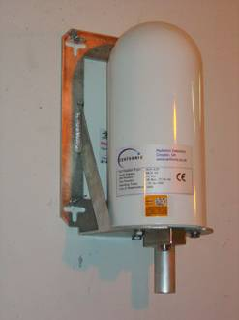
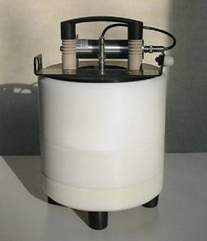
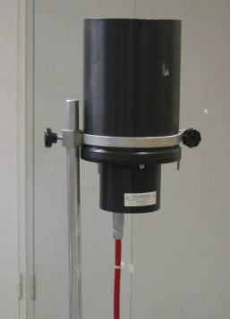
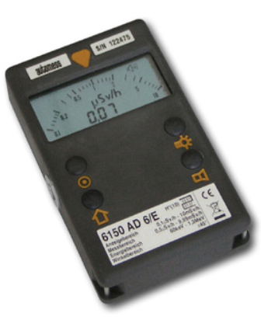
Radiation Fields around High Energy Accelerators
Prompt ionizing radiation – beam on
Whole particle zoo with E up to initial beam energy
High pressure ionization chamber
REM counter
Ionizing Radiation due to induced radioactivity – beam off
α, β-, γ-radiation,
Main γ energies: < 2.76 MeV
Air filled ionizat-ion chamber
Handheld devices

Slide 19
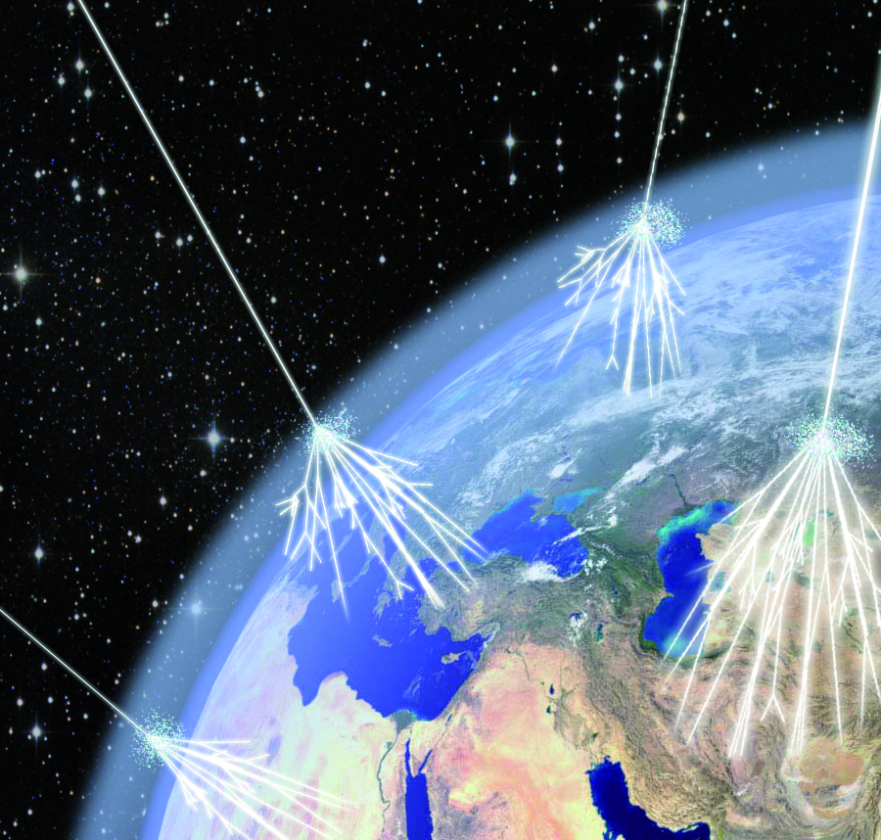
Prompt Ionising Radiation
Highest particle energy measured: 3.2×10²⁰ eV
up to 7 TeV
Hadron accelerator
Cosmos
Particle impact creates high-energy mixed radiation fields

Slide 20
Prompt Ionizing Radiation in Accelerators
Ionizing radiation in accelerators is produced by any beam impacts of high energy particles ➔ secondary radiation
Impact of very energetic particles produce particle showers
Next slides show the production of ionizing radiation by ONE hadron (120 GeV/c ) on copper Target

Slide 21
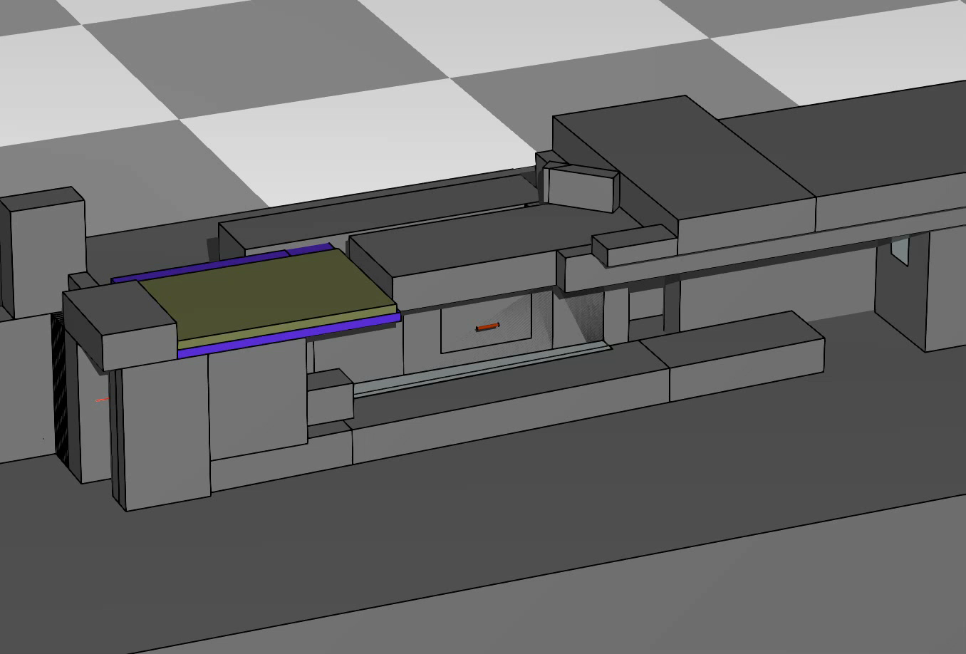
What happens when a 120 GeV proton impacts?
Hadronic cascade
Proton
Neutron
Pion+
Pion-
Electron
Positron
Photon

Slide 22
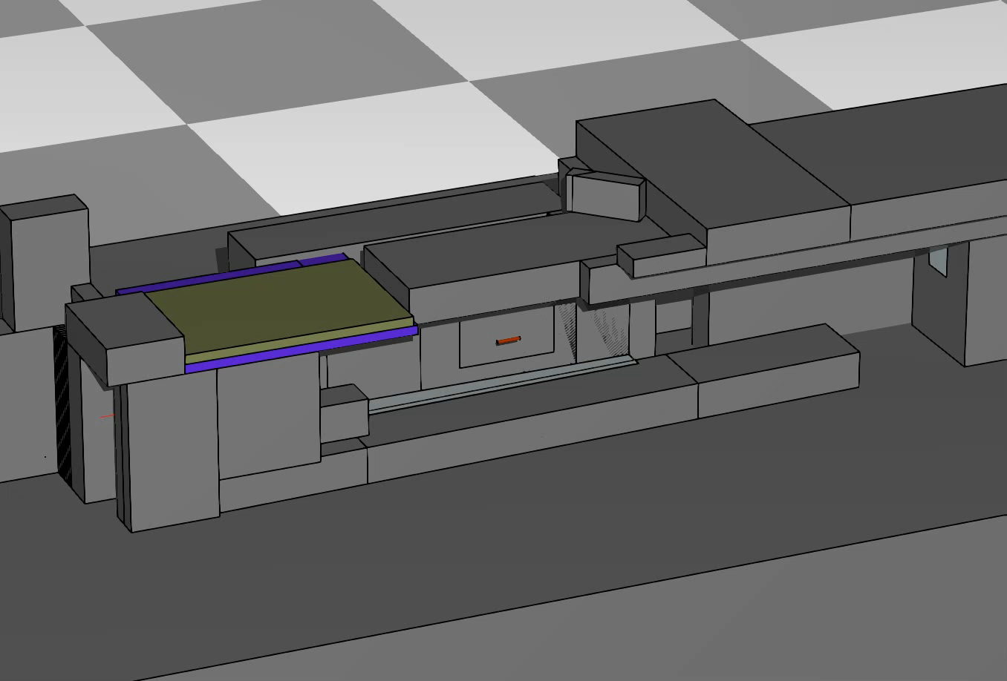
What happens when a 120 GeV proton impacts?
Full cascade
Proton
Neutron
Pion+
Pion-
Electron
Positron
Photon

Slide 23
Ionizing particles on matter: Impact and consequences
Focused energy deposition in material ➔ heat development, shockwaves➔ destruction of materials
  Radiation triggered failure of electronics
  Dose to people
  Aging of organic materials like insulations
  Activation of material

Slide 24
Radiation impact
Relation between absorbed dose and damage caused by radiation
Gy
Problems with
electronics
equipment occur
Annual dose limit (Sv) for radiation workers in Switzerland
Problems with cable insulation occur
Problems with magnet coil insulation occur
LD 50/30

Slide 25
Dose to people

Slide 26
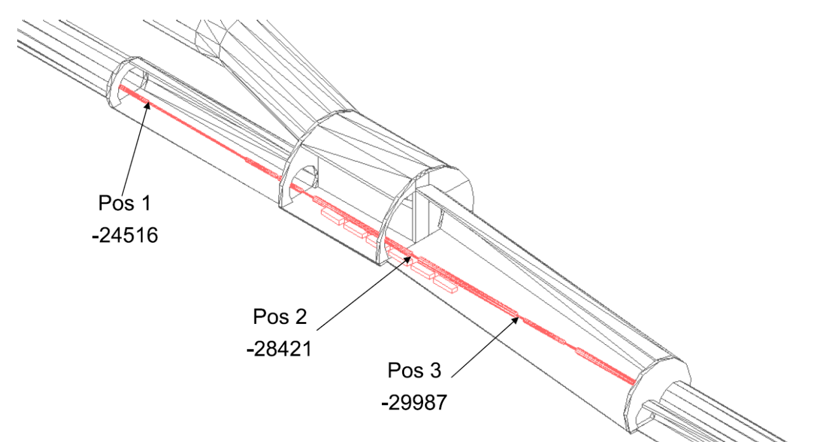
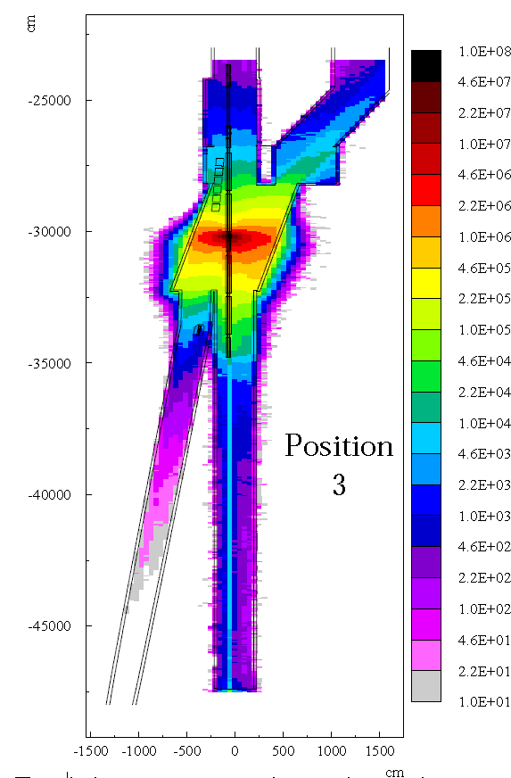
Example of full beam loss (7 TeV) in the LHC
Dose caused by a full beam loss (4E14 protons@7TeV) reaches levels of tens of thousands of Sv close to the loss point.
➔ strong shielding required to significantly reduce dose
mSv/full beam loss

Slide 27
Main aspects of radiation field attenuation in accelerator environments
Lateral to beam impact point
Downstream to beam impact point

Slide 28
Radiation lateral to the beam impact point

Slide 29
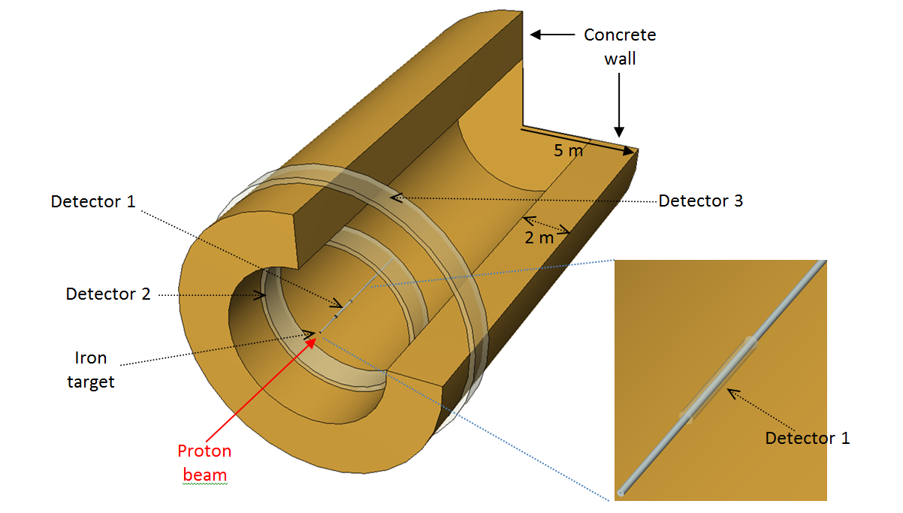
Lateral Shielding Configuration: Simulation to calculate radiation propagation through a lateral shielding wall
One quarter clipped for viewing the inner structure of geometry
A 450 GeV proton beam is sent onto a 5 m long target with a diameter of 5 cm.
Target is surrounded by particle detectors to evaluate the particles’ spectra

Slide 30
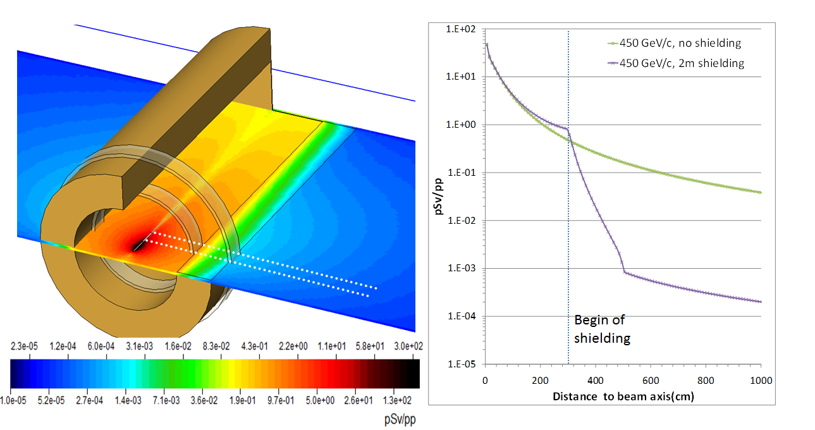

Dose analysis
Point source/line of sight model
Source
Buildup
r₁
d
r₀
Point of interest
Attenuation
~e^{-d/λ}
$$H\sim \frac{1}{r^{2}}$$
Shielding
H_{π/2 …} source term (at 1 m) for quantity of interest (e.g. effective dose)
r= r₀+d+r₁ in m
λ… hadronic interaction length

Slide 31
Typical particle fluence spectra at areas
located behind lateral thick concrete shielding
Dose contributors
86% n 7 % p 4% π 3% γ

Slide 32
Radiation downstream to the beam impact point

Slide 33
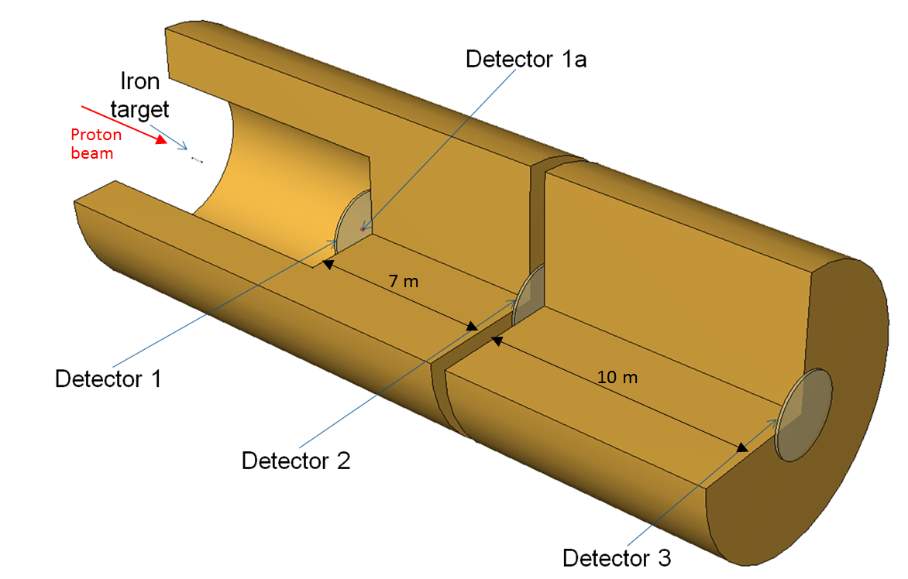
Radiaton fields occurring downstream of an impact point of an high-energy proton beam
450 GeV proton beam on 50 cm long copper target
2m

Slide 34
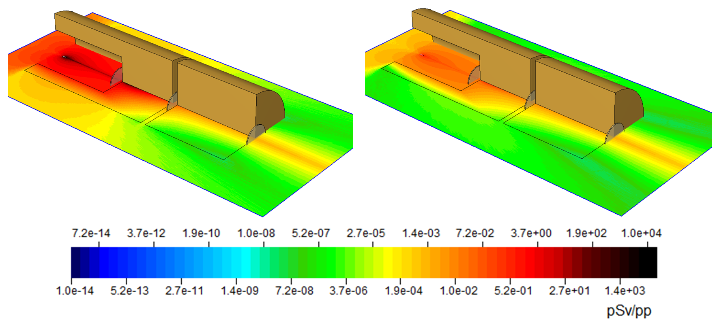
Dose simulation results
Dose of all particles
Dose by muons only
Muons strongly dominate the dose seen downstream the heavy shielding

Slide 35

Spectral analysis of the fluence seen in detector 1 and detector 3.
Strong domination of muons downstream the shielding
Particles at this locations can be traced back to muon interactions
High-energy muons lose ~1 GeV when traveling through 1.8 m of concrete or 70 cm of iron.
➔ To shield all muons a shielding of hundreds of m of iron is required.
450 GeV
Detector 1
Detector 3

Slide 36
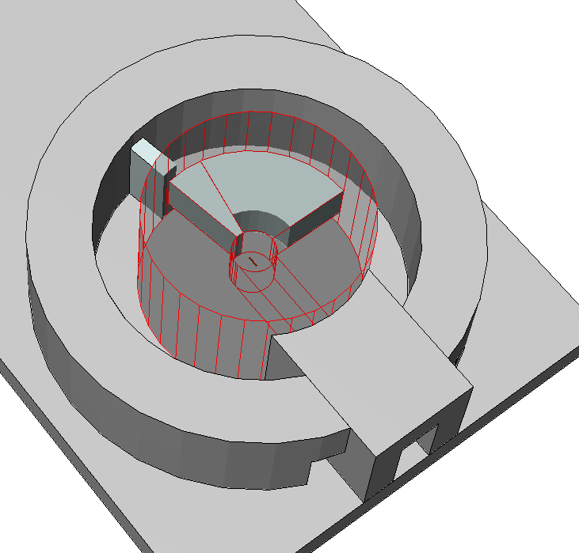
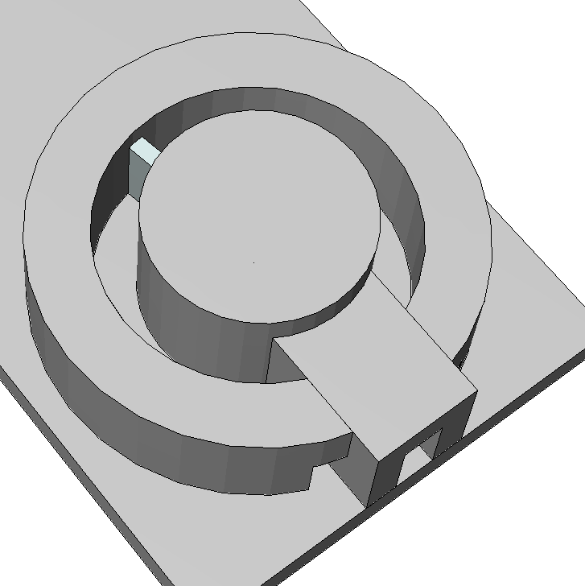
Demonstrating the muon problem by Conceptual design of an irradiation facility
Concrete shielding
2.8 m
Iron shielding and dump
4 m
2 m
Courtesy of E. Feldbaumer

Slide 37
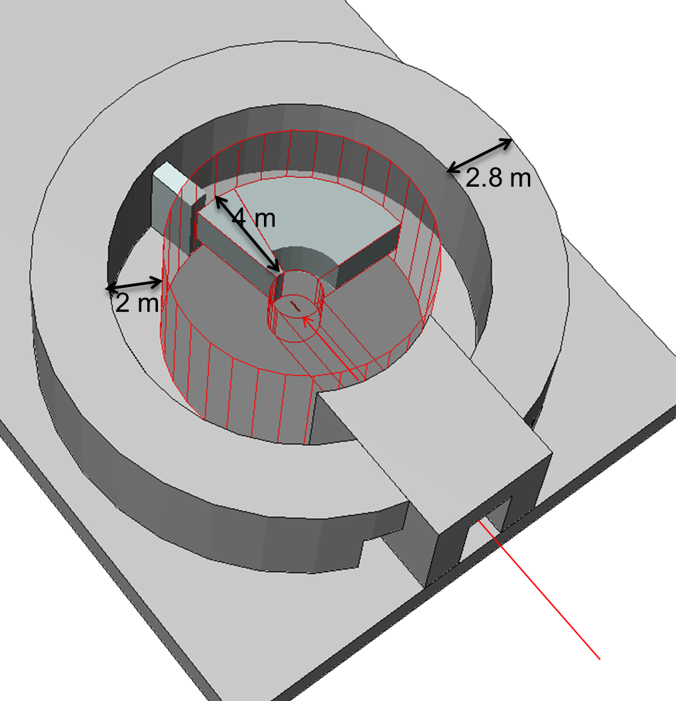
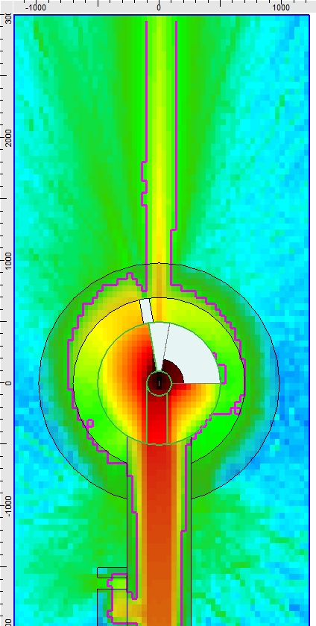
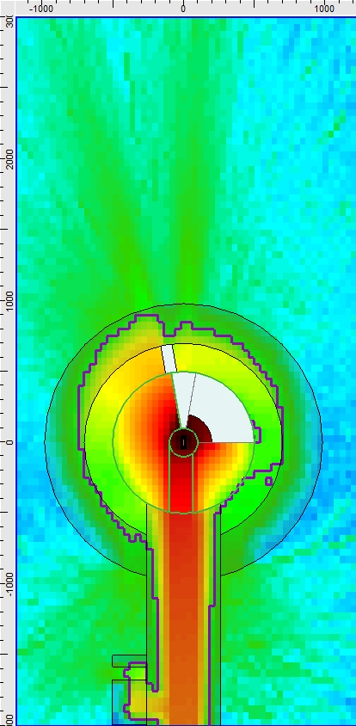
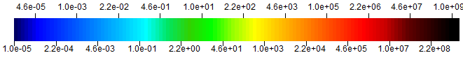
Dose rate mapping at beam height
Comparison: 450 GeV/c vs 24 GeV/c
Example to show the muon dominance downstream of thick shielding construction in high-energy facilities
450 GeV/c
24 GeV/c
10¹⁰ particles/spill
10¹¹ particles/spill
Contours:
15 µSv/h
15 µSv/h
µSv/h
Courtesy of E. Feldbaumer

Slide 38
Spectra behind experimental setup consisting of a 50 cm copper target + 2 m of air + 4 m of iron dump
Courtesy of E. Feldbaumer

Slide 39
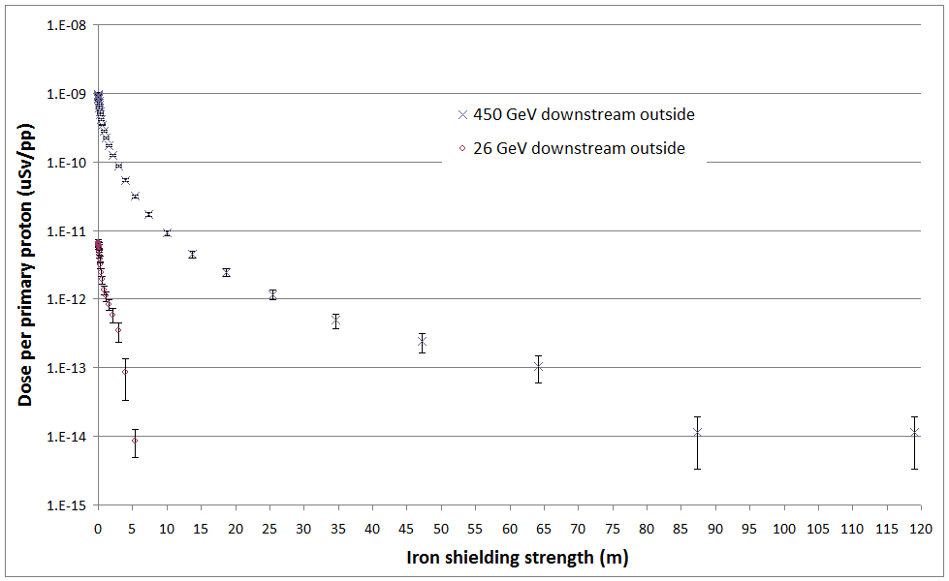
Rough estimates for the muon dose as a function of shielding strength (collimated beam assumed)
The given shielding strength does not include the 4 m of iron between the target and the reference point.
Concrete shielding strength = Iron strength*2.6
Assuming a beam intensity of 1E11 p/s we would need the following amount of shielding to remain below 2.5 uSv/h (non designated area) a locations downstream the dump
~ 100 m of additional iron for 450 GeV/c
~ 5 m of additional iron for 24 GeV/c

Slide 40
Cosmic radiation environment

Slide 41
Contents:
Basic introduction to cosmic radiation fields
Interesting phenomena at high energies
Radiation Protection aspects in space

Slide 42
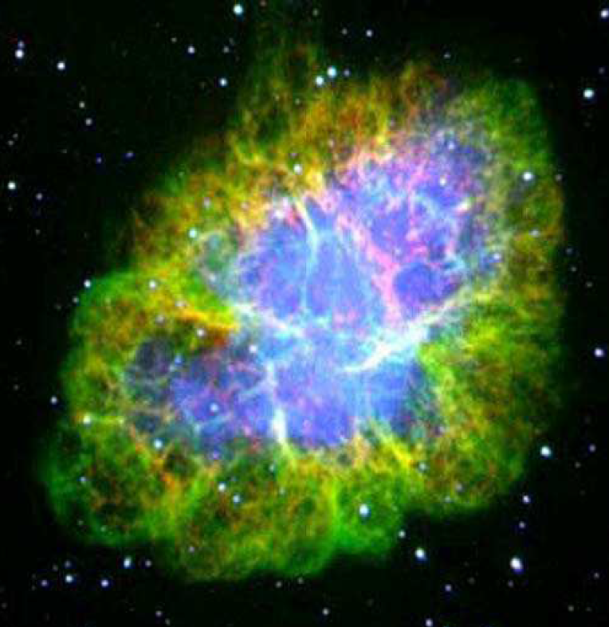
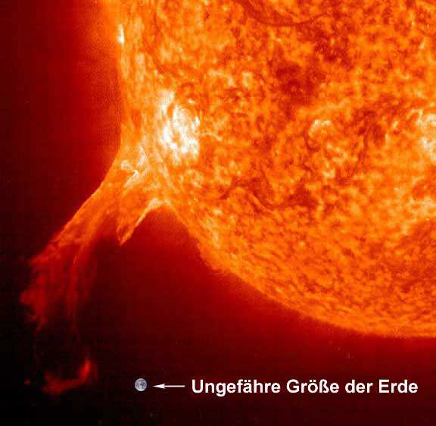
Classification of cosmic (ionizing) radiation
Solar Cosmic Radiation (SCR)
Galactic Cosmic Radiation (GCR)
high-energy particles coming from the sun
consist of protons, electrons and ions with energies ranging from a few tens of keV to GeV
Two main processes of their production:
  solar-flares
  shock waves caused by coronal mass ejections.
Particles which originate from sources outside of the solar system, distributed throughout our Milky Way galaxy and beyond.

Slide 43
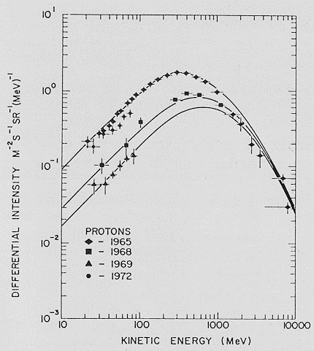
Properties of Galactic Cosmic Radiation
Composition: 2% electrons and 98% nuclei
Proton spectra observed during various years (1965: solar minimum, 1969: solar maximum)
Composition of nuclei:
87% protons 12 % α-particles 1% heavy nuclei
Almost no anti-matter detected
Spectrum:
Main part of the GCR particles have an energy below 10 GeV
Interaction with solar magnetic field modulate the particle’s energy
➔ GCR fluence up to 10 GeV shows a dependence on the solar activity
There is a high-energy component of the GCR spectrum, reaching energies higher than 10²⁰ eV.
Fisk (1979): Mechanisms for energetic particle acceleration in the solar wind

Slide 44
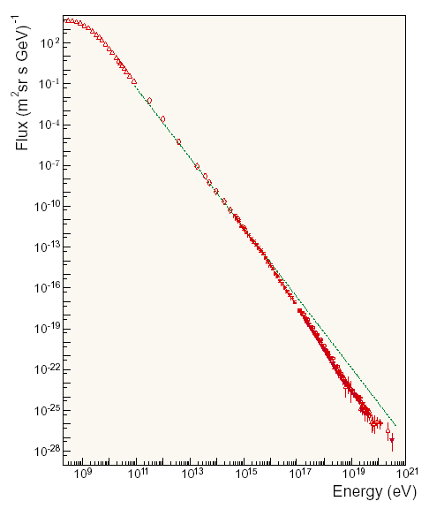
A BIRD'S EYE VIEW OF THE ALL-PARTICLE CR SPECTRUM
In the high energy region the particle “flux” can be described by:
Modulated by solar activity
All nuclei
1 particle per m²×second
F ~ E^{-α}
with
α= 2.7 for E < 3×10¹⁵ eV
and
α= 3 for E > 3×10¹⁵ eV
ballons & satellites |
| EAS experiments
Knee
1 particle per m²×year
Highest energy measured: 3.2×10²⁰ eV (Fly’s Eye detector)
2nd knee
1 particle per km²×year
Ankle
Foot (?)
Fingers (?)
Expected GZK cutoff
Picture taken from http://hep.fi.infn.it/PAMELA/naumov/Eng/UHECR/UHECR.html

Slide 45







Interesting effects at such high energies
(assuming particle was a proton)
Energy of particle : 3.2×10²⁰ eV = 51 J
Kinetic energy of a golf ball (170 km/h)
we calculate Lorentz factor γ:
= 3.4×10¹¹
From
Time dilatation: t= t₀×γ
1 second for the proton are 10773 years for us!!!
For the proton the earth appears as a disk with a
maximum thickness of 39 micro m.
Length contraction:
$$l=\frac{l_{0}}{γ}$$

Slide 46


Relativistic Doppler Effect
High energy particles are subject to Doppler Effect, changing the frequency of photons.
Considering a head-on collision between a proton and a photon, the frequency of the photon is seen as:
$$f=f_{0}\sqrt{\frac{1+β}{1−β}}$$
With: β=v/c … β (3.2×10²⁰ eV)= (1 - 4.8×10⁻²⁴)
Typical energy of microwave photon: 1.1×10⁻³ eV.
$$E=E_{0}\sqrt{\frac{1+β}{1−β}}=1.1×{10}^{−3}×6.4×{10}^{11}=7.04×{10}^{8}eV$$
Proton should interact with microwave photons producing pions.
This calculation coincides with the Greisen–Zatsepin–Kuzmin limit (GZK limit), defining a theoretical upper limit (6E19 eV) for the energy of cosmic rays coming from sources beyond ~ 50 MParsec.
However, we observe such particles, although no sources for such high-energy particles can be pinpointed within this radius. These observations remain an unsolved riddle.

Slide 47



Dose to space- and aircraft crews
Ambient-dose-equivalent rates as a function of standard barometric altitude
(at 2 GV vertical geomagnetic cut-off rigidity and mid solar cycle, calculated by S. Rollet, taken from Oxford University Press et al. Journal of the ICRU 2010;10:17-21)

Slide 48



Dose exposure during a space trip to Mars
In space crafts only limited shielding power for the protection of the crew can be provided.
During a one way trip to Mars, the dose received by the crew is estimated to (330 ± 6) mSv, resulting in a dose of 660 mSv for a round trip. Exposure during Mars (no magnetic field protection) is not included in this calculation.
These results are based on measurements carried out in the Mars Science Laboratory spacecraft*.
Real dose during flight depends also strongly on the sun activity
*Science 31 May 2013: Vol. 340 no. 6136 pp. 1080-1084, DOI: 10.1126/science.1235989

Slide 49
  Aging of organic materials like insulations

Slide 50

Examples for radiation damage
Resin used for magnet coil insulation
D (Gy)
0 5x10⁶ 10⁷ 2.5x10⁷ 5x10⁷
Notes:
La dosimétrie à haute dose
Les points de mesures
Le long de accélérateur
La fréquence des mesures
Les ancienne répartition de dose des années passer

Slide 51



Radiation damage on cable insulations

Slide 52

Radiation damage is mainly caused by braking hydrogen bridge bounds in molecules
Radiation resistance of cable materials
In radiation facilities insulation material shall be chosen according to the radiation level in the area.
In the last millennium many radiation hardness tests were carried out and documented at CERN.
Material catalogues from the past are available and should be used

Slide 53
Induced radioactivity in and around (high-energy) particle accelerators

Slide 54
Contents:
Introduction to radioactivity and isotope decay
Activation in accelerators
Calculation procedures to forecast activation in accelerators
Examples of activation at high-energy accelerators

Slide 55
Radioactivity

Slide 56


What is radioactivity?
Spontaneous emission of radiation from unstable nuclei. The consequence of most of the radioactivity reactions are combined with the change of the emitting nucleus into another kind of nucleus.
Modes of radioactive decay
α−decay: Emission of an alpha particle, a part of the nucleus consiting of 2 protons and 2 neutrons. ➔ A_{new}= A_{old}-4 and Z_{new}=Z_{old}-2
U-235
Th-231
α
Example:
β⁻−decay: A neutron in the nucleus is transformed into a proton via the emission of an electron and an anti-electron neutrino. ➔ A_{new}= A_{old} and Z_{new}=Z_{old}+1
Example:

Slide 57


Modes of radioactive decay
β⁺−decay: A proton in the nucleus is transformed into a neutron via the emission of a positron and an electron-neutrino ➔ A_{new}= A_{old} and Z_{new}=Z_{old}-1
Example:
Electron capture: An electron from the atomic orbit is captured by a proton resulting to the transformation into a neutron. ➔ A_{new}= A_{old} and Z_{new}=Z_{old}-1
Example:
Alternative decay of C-11
γ-decay: In a gamma decay a nucleus changes from a higher energetic state to a lower energetic state by emitting a high-energy photon (gamma particle). The composition of the nucleus remains unchanged.
All decay pictures taken from Jefferrson lab web page

Slide 58

Radiation types emitted by radioactivity
Radioactivity results in the emission of α, β⁺, β⁻ and γ radiation.
How can we shield these particles?
Sheet of paper
Several mm of aluminium
Heavy shielding
How dangerours are such particles when being incorporated?
The risk caused by α-radiation is highest when being incorporated and decaying inside the body.

Slide 59





Radioactive decay
Decay of a radioactive material per time unit (activity) as a function of time:
$A=−\frac{dN}{dt} \sim N$
Proportionality factor is called decay constant (λ) and it defines the probability of the deacy per time unit
$A=−\frac{dN}{dt}=λ∙N$
N... Number of radioactive isotopes
A ... Activity, decay per time unit
λ… Decay constant, defining the speed of decay
$\frac{dN}{N}=−λ∙dt$
With N(t=0) = N₀
$$N(t)={N_{0}∙e}^{−λ∙t}$$
λ
$$A(t)={A_{0}∙e}^{−λ∙t}$$
Unit: Bq: 1 Bq = 1 decay per second

Slide 60

General production-decay chains
A decay of an isotope can result in a chain (even several chains) of decays
Uranium-Radium decay chain
P_{U-238}
P_{Th-234}
Each possible chain in this tree can be described by coupled differential equations
P_{Po-210}
P_{ra-226}
P_{Rn-222}
P_{Po-218}
P_{Pb-214}
Beside production via decay some or even all isotopes can be produced by external production processes. E.g.: activation of materials in accelerators.

Slide 61







Mathematical expression of one production-decay chain (Bateman equation)
System of coupled differential equations
$$\frac{dN_{1}}{dt}=P_{1}−λ_{1}∙N_{1}$$
$$\frac{dN_{2}}{dt}=P_{2}+{{(b}_{1,2}∙λ}_{1}∙N_{1})−λ_{2}∙N_{2}$$
…
…
$$\frac{dN_{i}}{dt}=P_{i}+{{(b}_{i−1,i}∙λ}_{i−1}∙N_{i−1})−λ_{i}∙N_{i}$$
…
…
$$\frac{dN_{n}}{dt}=P_{n}+{{(b}_{n−1,n}∙λ}_{n−1}∙N_{n−1})−λ_{n}∙N_{n}$$
N_{n} … Number of isotope n
P_{n} … Production rate of isotope n
λ_{n …} Decay constant of isotope n
b_{n} … Branching ratio from isotope n-1 into n
…
…
$$\frac{dN_{m}}{dt}=P_{m}+{{(b}_{m−1,m}∙λ}_{m−1}∙N_{m−1})−λ_{m}∙N_{m}$$
$(ℒ$)
Solving by Laplace transformation of system of differential equations

Slide 62

Laplace transformation to find solutions for complicated
radioactive decay problems
It transforms a function being dependent from t into a new function F being dependent from s
Laplace transformation of system of differential equations ➔ system of linear algebraic equations

Slide 63



Mathematical expression of one production-decay chain (Bateman equation)
Laplace transformed equations = system of linear equations, to be solved in the Laplace domain as a function of s.
N_{n} … number of isotope n
P_{n} … production rate of isotope n
λ_{n …} decay constant of isotope n
b_{n} … branching ratio from isotope n-1 into n
F_{n} (s) … Laplace transformed of
N_{n}(t)
$$s∙F_{1} \left(s\right)−N_{1}(t=0) =\frac{P_{1}}{s}−λ_{1}∙F_{1}(s)$$
…
…
$$s∙F_{n} \left(s\right)−N_{n}(t=0) =\frac{P_{n}}{s}+{b_{n−1,n}∙λ}_{n−1}∙F_{n−1}(s)−λ_{n}∙F_{n}(s)$$
…
…
$$s∙F_{m} \left(s\right)−N_{m}(t=0) =\frac{P_{m}}{s}+{b_{m−1,m}∙λ}_{m−1}∙F_{m−1}(s)−λ_{m}∙F_{m}(s)$$
$ℒ^{−1}(F_{n}\left(s\right)$)
Inverse Laplace transformation of F_{n} (s) N_{n}(t)
Decay term
Production term
$$N_{n}\left(t\right)=\sum_{i=1}^{n}{\left[\left(\prod_{j=i}^{n−1}{{λ_{j}b}_{j,j+1}}\right)\sum_{j=i}^{n}{\left(\frac{N_{i}^{0}e^{−λ_{j}t}}{\prod_{\begin{aligned}p=i \\ p≠j\end{aligned}}^{n}{λ_{p}−λ_{j}}}+\frac{P_{i}(1−e^{−λ_{j}t})}{λ_{j}\prod_{\begin{aligned}p=i \\ p≠j\end{aligned}}^{n}{λ_{p}−λ_{j}}}\right)}\right]}$$
To obtain the final result for a given isotope the contributions of the various chains have to be summed up.

Slide 64
Activation:
Radioactivity production in accelerators

Slide 65
First questions about activation
What is activation?
Activation can be described as the imposed change of nuclear composition of given isotopes resulting in the production of radioactivity.
Impact of activation:
Accelerators: due to beam operation’s losses, accelerator and environment will become radioactive ➔ dose to personnel and environment.
What can be done to reduce activation?
Reduce beam losses
Reduce activation prone material

Slide 66
Which production mechanisms of activation occur at high-energy accelerators?
At high-energy accelerators primary particles interact with matter. The primary particle itself or secondary particles interacting with nuclei can produce radioactive isotopes. Main production channels of activation at high-energy accelerators are:
  Spallation processes, (n,2n), (n,p), (n,alpha), ..
  Particle capture (mainly neutrons)
  (γ,n)-reactions (important for electron accelerators)

Slide 67
Questions about activation III/III
Why is activation important for high-energy accelerators?
Environment
Tunnel and accelerator
Air activation
Water activation
Soil activation
Material activation of beam line, tunnel and shielding components
Required information to classify activation:
  Specific activity: classification of material between radioactive and non-radioactive material
  Dose rate around the activated components

Slide 68
Parameters responsible for production of radioactivity in a given material sample at high-energy accelerators
Beam type and energy
Material around loss point
Location of sample in given radiation environment
Composition of material sample
Beam intensity
Irradiation history
Cooling time
Radionuclide production in sample per lost proton
Evolution of radioactivity as a function of time

Slide 69


Physics principles of radio nuclide production per lost proton
Beam on target situation:
Target
Sample positions
Shielding
Chemical composition
Material | Wt-%
Fe | 65.0
Cr | 15.0
Ni | 14.0
Mo | 5.0
Co | 1.0
Total production of radio-nuclide i per lost proton
Total track length of particle type k through volume of interest as a function of energy (E)
Atomic density of isotope j in the given volume
Energy (E) and particle type dependent production cross section to produce nuclide i from isotope j

Slide 70

Activation as a function of beam operation time and cooling time
N_{i}… Number of isotopes i
λ… decay constant of nuclide i
P_{i}… production rate of isotope i per proton
I … proton intensity
A_{i}… Activity of isotope i after t_{irr} and t_{cool}
t_{irr}… irradiation time
t_{cool}… cooling time
Build-up and decay
A_{i,max} ≤ P_{i} ∙ I
90% of A_{i,max} are obtained after ~ 3.32∙t_{1/2}
99% of A_{i,max} are obtained after ~ 6.64∙t_{1/2}

Slide 71
Calculation procedures to forecast activation and dose rates in high-energy accelerators
Analytic method
Full Monte Carlo calculation

Slide 72
Analytic methods
}
Analytical estimate of activation
Required input parameters:
  Track length spectra for all relevant particle types, Λ_{k}(E)
  Cross sections for radio nuclide production σ_{i,j,k}
  Irradiation and cooling history
Pro:
Fast activation result if input parameters are available
Cons:
Track length of various particles fields are required (very often Monte Carlo results)
Only rough dose rate estimate without self shielding effects

Slide 73
Full Monte Carlo calculation of activation
Input required:
3D geometry description
Beam energy and intensity
Irradiation history and cooling time(s)
Procedure inside code:
1) Simulation of particle cascade and isotope production around beam impact point
2) Radiation emerging from radio-isotopes are further transported to calculate dose rate in the surroundings of activated material

Slide 74
Applications for FLUKA activation simulations

Slide 75
Applications at the Large Hadron Collider (LHC)
Particle type: Protons
Beam energy: 7 TeV
Number of stored particles: 2×4·10¹⁴

Slide 76

CMS detector
Collision point
21 m
7.5 m
Parameters of CMS detector:
Length: 21 m
Diameter: 15 m,
Mass: 12500 t
Operational parameters:
Two counter rotating beams @ 7 TeV
Luminosity: 10³⁴ cm⁻² s⁻¹
➔10⁹ proton-proton collisions/s

Slide 77
Residual dose rates to be expected after beam operation
Residual dose rate expected after 1st year of operation:
180 days of operation +
6 cooling times: 1 h, 1d, 1w, 1m, 4m

Slide 78


180 days of irradiation, 10⁹ pp/s, 1h of cooling

Slide 79

180 days of irradiation, 10⁹ pp/s, 1d of cooling

Slide 80

180 days of irradiation, 10⁹ pp/s, 1w of cooling

Slide 81

180 days of irradiation, 10⁹ pp/s, 1m of cooling

Slide 82

180 days of irradiation, 10⁹ pp/s, 4m of cooling

Slide 83
Radiation Protection at CERN

Slide 84
Contents
Mandate
Radiation Protection Regulations
Dose limits and objectives
Dosimetry, Operational Radiation Protection and Radiation Monitoring
Radioactive waste: treatment and elimination
ALARA at CERN

Slide 85










Radiation Protection at CERN:
Mandate
Monitoring
Riskanalysis
Authorization
Controls
Legislation
Radioactive Waste
Safety Code F

Slide 86

Some Key Figures…
Radiation Areas and Radioactive Laboratories:
~ 45 km accelerator tunnel
Class A,B and C laboratories
RIB facility ISOLDE
Spallation source n-TOF
~ 50 - 60 access points
~ 160 experiments
~ 11000 radiation workers
Many new projects

Slide 87
Radiation Protection Regulation
General Principles of Radiation Protection
Justification
any exposure of persons to ionizing radiation has to be justified
2) Limitation
the personal doses have to be kept below the legal limits
3) Optimization
the personal doses and collective doses have to be kept as low as reasonable achievable (ALARA)

Slide 88
CERN’s Radiation Protection Regulation
CERN is an intergovernmental organization and not bound to any national law* - but
IAEA Basic Safety Standards
Guideline 96/29 Euratom laying down the basic standards for protecting public and workers against the risk of ionising radiation
*) CERN’s relation with its two Host States is defined in conventions between the parties
CERN Safety Code F (Radiation Protection Ordinance) and underlying safety instructions, guidelines, etc.
Taken from B. Lorenz, WKK Symposium April 2008 and modified

Slide 89





Tripartite Agreement
RATIFICATION OF THE TRIPARTITE AGREEMENT ON SAFETY AND RADIATION PROTECTION
(September 2011)

Slide 90
History of Radiation Protection
M. Curie
ICRP 103
Source: Los Alamos Science
Nr. 23, 1995, p. 116

Slide 91
Dose Limits
 | Dose limits for 12 months consecutive (mSv)
 | Non-occupationally exposed persons | Occupationally exposed persons
 |  | B | A
EURATOM | < 1 | < 6 | < 20
Germany/France | < 1 | < 6 | < 20
CERN | < 1 | < 6 | < 20
Switzerland | < 1 | < 20

Slide 92
CERN’s Dose Objectives
Category | Dose/Year
Reference group of Public | < 10 uSv
Non-professionally exposed personnel | < 100 uSv
Professionally exposed personnel | < 6 mSv

Slide 93
Dosimetry, Operational Radiation Protection and Radiation Monitoring

Slide 94

Individual Dosimetry
Dose interval (mSv) | Persons concerned | Persons concerned | Persons concerned | Persons concerned | Persons concerned | Persons concerned | Persons concerned | Persons concerned | Persons concerned | Persons concerned | Persons concerned
years | 2009 | 2010 | 2011 | 2012 | 2013 | 2014 | 2015 | 2016 | 2017 | 2018 | Jan- Nov 2019]
0.0 | 5042 | 5418 | 5315 | 6002 | 6273 | 7616 | 8704 | 8788 | 9034 | 9824 | 7246
0.1-0.9 | 1219 | 1514 | 1984 | 2030 | 2188 | 1816 | 1108 | 1003 | 1110 | 1260 | 1400
1.0-1.9 | 39 | 31 | 31 | 29 | 82 | 133 | 2 | 11 | 3 | 10 | 10
2.0-2.9 | 13 | 6 | 7 | 0 | 3 | 14 | 0 | 0 | 0 | 0 | 0
3.0-3.9 | 2 | 0 | 0 | 0 | 0 | 1 | 0 | 0 | 0 | 0 | 0
4.0-4.9 | 0 | 0 | 0 | 0 | 0 | 0 | 0 | 0 | 0 | 0 | 0
5.0-5.9 | 0 | 0 | 0 | 0 | 0 | 0 | 0 | 0 | 0 | 0 | 0
> 6.0 | 0 | 0 | 0 | 0 | 0 | 0 | 0 | 0 | 0 | 0 | 0
SUM PERS | 6315 | 6969 | 7337 | 8061 | 8546 | 9580 | 9814 | 9802 | 10147 | 11094 | 8656
0.0 – 0.1
0.1 – 1.0
1.0 – 2.0
2.0 – 3.0
3.0 – 4.0
4.0 – 5.0
5.0 – 6.0
> 6.0
Up to 11000 monitored persons per year
98 - 99% of individual doses < 1 mSv

Slide 95

Collective Personal Dose Equivalent
Summary over 25 years
From 2015 onwards: low dose could be measured more precisely

Slide 96





Operational Radiation Protection
From design
1 hour
1 week
1 month
to reality
Notes:
HiRADMat
Ramses materials
-yellow inside facility
- Red ventilation outlet

Slide 97


Radiation Monitoring
with
location ID
Monitor
Controller
Tap box
Radiation
Monitor
Direct
hardware
connection
with
ID + local
database
Basic Area
Controller
Display
Control box
Radiation
Display

Slide 98


Instrumentation
Start up of LHC – Seen by neutron monitors in USA15
30 nSv/h
10 nSv/h
Hourly values

Slide 99










Area classification: LHC - 2010

Slide 100



LHC - 2011

Slide 101


LHC - 2012
Point 4
Point 5
Point 6
Point 3
Expectation the LS1
LHC tunnel mostly classified as Supervised Radiation Area
Few areas might be classified as Simple Controlled Radiation Area
Collimation and dump areas will be classified as Limited Stay Area
Point 2
Point 1
Point 8
Point 7

Slide 102

LHC during LS1

Slide 103





Radioactive waste: treatment and elimination
Waste received
Analyzed
Conditioned
Eliminated to final repository

Slide 104


ALARA at CERN
ALARA procedure – 3 Levels:
  I Optimisation
  II Optimisation, documentation
  III Optimisation, documentation,
  ALARA Committee
Includes risk analysis

Slide 105
ALARA
Mock-up training
Procedures
Approval by “stakeholders” – radiation protection incl.
Lessons learned

Slide 106
ALARA example 1:
SPS-LSS1 cabling and dump shielding wall design
(ALARA III)

Slide 107








Cable exchange campaign in SPS-LSS1
The LSS1 area is the most radioactive zone in the SPS
Any work has to be fully optimized allowing to reduce dose to personnel to a bare minimum
Removal of highly radioactive equipment prior the 22 weeks lasting cable exchange campaign
➔ average dose rate in the LSS1+ area was reduced by a factor of 3.2
➔ dose reduction of several tens of mSv
Remote handling with robots
Special equipment allowing for dose optimization
Optimized cable removal and cutting
Cables combs replacing cable ties
Remote cable pulling machine

Slide 108





SPS beam dump shielding
The former shielding located beside the TIDV dump caused significant problems due to its high activation and contamination levels.
In the SPS-CSAP a working group (chaired by RP) was founded to replace this shielding wall by a new design.
Final shielding design, being the optimized choice in material, dimensions and installation position
Ten options were studied in order to optimize the new wall with respect to:
  Dose-to-cable reduction
  Residual dose rate during beam-off periods
  Reduction of radioactive waste
  Transport handling issues
  Compatibility with other equipment
  Allowing cable maintenance or exchange without removing the wall
  Compatibility with cable routing plans
  …
FLUKA
geometry
Dose rate after 1 week of cooling

Slide 109
ALARA example 2:
Dismantling of former SPS target area

Slide 110


Job and Dose Planning
For all working steps i, the time_{i} required and the given dose rate_{i} need to be assessed beforehand.
$Total dose=\sum_{i}{{Dose rate}_{i}×{Time}_{i}}$
Dose rates based on measurements and simulations
Example: Work in a former SPS target area

Slide 111



Removal of highly radioactive blocks being located in a former SPS target area

Slide 112
ALARA example 3:
Repair work of CNGS horn and reflector

Slide 113



CNGS Horn und Reflector Repair
level II
optimisation and documentation
1.6 mSv collective dose
Shielded cabin
Mobile lead shield
Notes:
Rupture of ceramic insulator brazed to Ti flanges
(no brazing, only under compression)
all water outlets and inlets for both horn and reflector (improved geometry)

Slide 114
Radiation detector systems used to measure mixed radiation fields at workplaces

Slide 115
Goal of this chapter
We will introduce the RAMSES system using three different radiation detector types which are mainly used as fixed detector systems at CERN
We will learn about their main fields of application in terms of radiation fields.

Slide 116
Monitoring system RAMSES
(RAdiation Monitoring System for Environment and Safety)
CERN Networks
(Ethernet)
Internet
RP Data Base
long term storage
Configuration and
Supervision
Manager
LHC point
(local Network)
RP User
Interface
Remote User
Interface
RP User
Interface
with
location ID
Monitor
Controller
Tap box
Radiation
Monitor
Direct
hardware
connection
Termination
with
ID + local
database
Basic Area
Controller
Display
Control box
Radiation
Display
Termination
Conceptual proposal
Monitor
Controller
Network-based
Area Controller

Slide 117
Typical radiation detectors used at CERN for high-energy particle fields
High pressure ionization chamber
REM counter
Air filled ionization chamber

Slide 118
IG5 monitor (high pressure ionization chamber)
Used mainly in accessible areas during machine operation
Comes in two flavours
H-filled type: Calibrated to neutron sources
Ar-filled type: Calibrated to photon sources

Slide 119


IG5 - Design
Properties
2 types (Ar or H filled)
5,2 l active volume
pressurized at 20 bar
1200 V high-voltage
electrodes
Dimensions
diameter – 18.33 cm
height – 45.6 cm
active medium
electronics
board
Notes:
Electronics = 60% epoxy resin, 35% silicon, 2.5% copper, 2.5% carbon

Slide 120
Characteristics of IG5 chamber responses (Ar versus H)
IG5 argon type
10 times stronger sensitivity to charged particles and photons when being compared to H-type
➔Detector response in mixed fields is strongly triggered by charged particles (e.g. muons) and photons
IG5 hydrogen type
Strong sensitivity to neutrons at energies relevant behind thick shielding.
Reduced sensitivity to charged particles compared to the Ar type➔ total detector response in a neutron dominated field is dominated by neutron triggered counts

Slide 121
Locations of IG5 chambers in our accelerator environment
IG5 Argon type
IG5 hydrogen type
To be used at locations where the dose is dominated by photons or charged particles:
Close to gamma sources (e.g.: ion exchanges of cooling water)
Behind massive beam dumps or shielding downstream high-energy beam loss points (muons dominating dose)
To be used at locations where the dose is dominated by neutrons:
Behind lateral shielding (e.g.: LHC experiments)
upstream of beam loss points
at the end of mazes
Target or loss point
Target or loss point
beam
IG5-Ar
Shielding
beam
dump
IG5-H

Slide 122

REM counters adapted to high-energy neutron fields (WENDI2 detector)
To be used in neutron dominated areas (beam-on)

Slide 123

Reminder to our typical radiation fields behind lateral shielding in accelerators
Target or loss point
Majority of dose originates from neutrons in the energy range of a few hundred of keV to a few hundred of MeV
beam
Shielding
Radiation Detector
Detector is sensitive to neutrons only!!!

Slide 124

Neutron detector used at CERN:
FHT 762 Wendi-2
Wide Energy Neutron Detector (Thermo)
Borated rubber
PE cylinder
He-3 counter
W-layer
Reference: Olsher et al, Health Physics, 79(2): 170ff, 2000
This instrument is sensitive up to high neutron-energies but blind to all other particles.
Equivalent instruments exist also from other companies

Slide 125

PMI detector (ionization chamber)
PE wall (4mm) / inside graphite coated
15.8 cm
Wall composition: C-H₂
Active volume
Filling gas: air atmospheric pressure
Anode: PE / graphite coated
21.5 cm
Active volume: 3l
28.5 cm
Working voltage: ~460 V
Main installation place: radioactive equipment inside accelerator tunnel.
Various connectors

Slide 126

Use of PMI monitors in RAMSES
Main use: remote readout of monitors prior machine intervention when beam is off. ➔ Monitor measures residual dose rate (ambient dose equivalent) coming from activated material in Sv/h.
Secondary use: remote readout of monitors during machine operation. ➔ Monitor measures prompt dose rate (in Gy/h!!! not Sv/h) of the cascade originating from lost particles. The measured value can be interpreted as dose rate in air within an accuracy of 20%.

Slide 127
Summary of
“Radiation detector systems used to measure mixed radiation fields at workplaces”
The IG5 chambers are used mainly to monitor accessible areas during beam-on There are two types available:
  The hydrogen type is used mainly behind lateral shielding during beam-on
  The argon type is used mainly to monitor dose behind dumps or close to gamma sources (e.g.: ion exchangers)
REM counters provide a clear discrimination to other particles than neutrons ➔ measuring only the neutron component of a radiation field
The PMI (sometimes called IAM) detector is used to measure residual ambient dose equivalent rate (Sv) during “beam-off”. During beam-on it provides a very good indication for the dose in air (Gy) caused by the given mixed radiation fields

Slide 128
Merci Beaucoup !
Notes:
128

Slide 129
Monte-Carlo simulations as a tool for detector response evaluation

Slide 130
Motivation
High-energy hadron accelerator – LHC, SPS ...
High-energy mixed radiation fields
Radiation detectors must be characterized for these fields
Measured detector counts ⬅➔desired quantity (Sv, Gy)

Slide 131
Detector response evaluation with Monte Carlo simulation tools
Simulation of irradiation situation + simulation response of detector
Simulation provides knowledge of particle fields and the response of the chamber to this radiation field
Field calibration factor
The following question remains: Does the simulation also reflect the reality?
Comparison between simulation and measurement = Benchmarking of simulation

Slide 132

Benchmark experiments in the CERF radiation field to test reliability of Monte Carlo program FLUKA
Two ionization chamber types were irradiated with secondary particles produced in high-energy hadronic interactions (like beam loss in accelerator)
PMI chambers: exposed to high-energy particles occurring close to a target
IG5 chambers: exposed to the same radiation field, however attenuated by 80 cm of concrete.
What is CERF?
An irradiation facility at CERN providing high-energy mixed radiation fields
IG5: High pressure ionization chamber
Concrete shielding
How? ➔ A mixed hadron beam
(in this setup 120 GeV/c) is intercepted by a copper target ➔ high-energy mixed radiation field produced by EM and hadronic cascades
PMI: Air filled
ionization
chamber
Hadron beam
Copper target
1 m

Slide 133




Detector benchmarking at the CERF facility:
Copper target irradiated with a mixed hadron beam at 120 GeV/c
~0.02 Gy/h
~10 Gy/h
~ 2 Gy/h
Hadron beam
Dose rate at 1E8 protons/spill

Slide 134
Simulation picture of the PMI chamber
PE wall (4mm) / inside graphite coated
15.8 cm
Wall composition: C-H₂
Active volume
Filling gas: air atmospheric pressure
Anode: PE / graphite coated
21.5 cm
28.5 cm
Connector to cathode
Active volume: 3l
Working voltage: ~460 V
Connector to anode
Connector plug for power supply and signal outlet

Slide 135
IG5 - Geometry
Properties
2 types (Ar or H filled)
5,2 l active volume
pressurized at 20 bar
1200 V high-voltage
electrodes
Dimensions
diameter – 18.33 cm
height – 45.6 cm
active medium
electronics
board
Notes:
Electronics = 60% epoxy resin, 35% silicon, 2.5% copper, 2.5% carbon

Slide 136
Way 1 (indirect approach)
2 ways to calculate detector response
Used to calculate IG5 response
A) Calculate detector fluence response [C cm²]
B) Calculate particle fluence spectra [cm⁻²]
C) Combination of A and B
Simulated counting rate of detector

Slide 137
A) Simulation of Response Fuctions
Circular parallel beam
Energy deposition in active volume
Calculate number of ion pairs created
Charge created within active volume
Conversion factors
Response R_{Φ} [C cm²]
Response R_{Ka} [C/Gy], R_{H*10} [C/Sv]
Notes:
Parallel beam from circular disk, covers the whole chamber

Slide 138
Response to var. particles (R_{Φ} for Ar)

Slide 139

B) Calculation of fluence in the range of the measurement positions
CT4
CT6/T10
CS2
CS-50U
Hadron beam

Slide 140
B) Particle fluence at detector position (CT6/T10)

Slide 141
C) Combination of A and B
x
Charge leads to counting rate of detector

Slide 142
Convolution between fluence and response functions (CT6/T10)
Total contribution to response (Ar)
Neutron | Proton | π | γ
(30 ± 1)% | (24 ± 3)% | (11 ± 1)% | (35 ± 4)%
Total contribution to response (H)
Neutron | Proton | π | γ
(59 ± 3)% | (17 ± 2)% | (4 ± 1)% | (20 ± 2)%

Slide 143
Ratio between simulation and experiment
Notes:
CS2 – No additional shielding!! -> less response from calculation!!
CT4: The ratio is expected to be above 1 because the spectra calculated for the simple geometry do not match position T4 but a position directly above the target (T8/T12). The we'd expect more low energy neutrons and thus the comparision has to be done keeping this in mind!

Slide 144

Experimental set-up in the CERF target area
Pos 1
Pos 2
Pos 3
Pos 4
Pos 5
Pos 6
Beam parameters:
Momentum:
120 GeV/c
Intensity:
9*10⁷ hadrons/ SPS extraction (16.8 s with 4.8 s continuous beam)
Hadron beam
Cu target
Beam composition:
60.7 % π⁺
34.8 % protons
4.5 % K⁺

Slide 145
Way 2 (direct approach)
Used to calculate PMI response
FLUKA calculation of the whole particle cascade in the experimental setup
Within this simulation calculation of energy deposition in active volume of chamber
“Energy to ion⁺/e⁻” conversion factor leads to number of produced ion⁺/e⁻ pairs.
Conversion of number of ion⁺/e⁻ pairs into pC.
One pC corresponds with one PMI counts.

Slide 146

Analysis of the fluence reaching the various detector positions
Particle fluence at detector position 2
Pos 6
Pos 5
Pos 4
Pos 3
Pos 2
Pos 1
beam

Slide 147
Particle fluence at detector position 4
Pos 6
Pos 5
Pos 4
Pos 3
Pos 2
Pos 1
beam

Slide 148
Particle fluence at detector position 6
Pos 6
Pos 5
Pos 4
Pos 3
Pos 2
Pos 1
beam

Slide 149
Simulation result of the counting rate
Pos 6
Pos 5
Pos 4
Pos 3
Pos 2
Pos 1
beam

Slide 150
Influence of the different particle types (%) to the final counting rate of the detectors at the various positions

Slide 151
Comparison between simulation and measurement results
 | Simulation Counts/ prim. part. *10⁻⁶ | Simulation error *10⁻⁶ | Measurement Counts/ prim. part. *10⁻⁶ | Measurement error *10⁻⁶ | Simulation/ Measurement | Error
Pos 1 | 5,63 | ± 0,12 | 5,64 | ± 0,56 | 0.998 | ± 0.102
Pos 2 | 16,06 | ± 0,44 | 15,58 | ± 1,56 | 1.031 | ± 0.107
Pos 3 | 67,46 | ± 0,73 | 67,25 | ± 6,93 | 1.003 | ± 0.104
Pos 4 | 85,33 | ± 0,64 | 79,00 | ± 8,67 | 1.080 | ± 0.119
Pos 5 | 96,20 | ± 1,26 | 89,39 | ± 9,47 | 1.076 | ± 0.115
Pos 6 | 108,31 | ± 0,82 | 115,74 | ± 17,99 | 0.936 | ± 0.146

Slide 152
Summary of MC based calibration
FLUKA benchmarking experiments were performed at CERF
Very good agreement between simulation and measurement results in the radiation field occuring at the CERF facility.
The results prove that:
  FLUKA calculates mixed high-energy radiation fields correctly.
  FLUKA calculates detector response of ionisation chambers correctly.
FLUKA can be used to calculate a suitable field calibration factors for high-energy radiation fields occuring at CERN

Slide 153
Backup slides

Slide 154
ActiWiz
Nuclide inventory optimization in accelerators

Slide 155


Motivation for optimization of nuclear inventories of materials placed in accelerators
Beside other material properties also the radiological consequences of the implementation of a material have to be considered
Level of activation depends on the type of the material
Choosing materials with low radiological impact results in several benefits
Safety benefit
Lower dose rates and committed doses
Operational benefit
Reduced downtime due to faster access
Less restrictions for manipulation & access
End of life-cycle benefit
Smaller amount and less critical radioactive waste
Smaller financial burden

Slide 156


Strategy to develop a tool allowing an optimization of nuclear inventories
Categorization of radiation environments
Development of ActiWiz –
code assessing radiation risks,
dominant nuclides etc., for arbitrary materials
Radiological hazard catalogue for materials

Slide 157



Categorization of the radiation environments
FLUKA calculations of typical hadronic particle spectra (p, n, π⁺, π⁻) in CERN’s accelerators
LHC
SPS
2400 single Monte Carlo simulations
→ 157.000 nuclide inventories (10 GB of data)
Linac 4 + Booster
PS
Used as base for the ActiWiz program
160 MeV (Linac4), 1.4 GeV (Booster), 14 GeV/c (PS), 400 GeV/c (SPS), 7 TeV (LHC)

Slide 158


ActiWiz – program interface
Evaluate radiological hazard for arbitrary materials with a few mouse clicks
1.) Select energy / location / irradiation times
2.) Define material composition based on 69 chemical elements
* Many thanks to R. Froeschl for providing activation data on Zinc

Slide 159

Main output of ActiWiz: Material categorization
Radiological hazard assessment of material allowing for radiological comparison of materials
Operational
Waste
Aluminum 5083
Copper CUZnO5
Steel 316Ti

Slide 160

Secondary output of ActiWiz: RP quantities
Example
For a given irradiation scenario we obtain:
Information about ambient dose equivalent rate for various materials as a function of cooling time

Slide 161
Some relevant units for radiation protection and radiation physics

Slide 162
Quantities discussed
Flux
Fluence
Fluence rate or Flux density
Differential fluence
Current
Kerma
Absorbed dose
Equivalent dose
Effective dose
Ambient dose equivalent
Cross section
Surface density
Activity
Particle momentum versus particle energy
The description of these quantities are taken from the relevant ICRU and ICRP reports

Slide 163

FLUX (g: Fluß)
N … number of particles
t … time
$$\dot{N}=\frac{dN}{dt}$$
No surface through which particles traverse is considered

Slide 164





Fluence (Flußdichte)
$$φ=\frac{dN}{dα}$$
N …. Number of particles incident on a sphere of cross-sectional area dα
α ... Cross section of an infinitesimal sphere surrounding point of interest
$φ=\frac{dl}{dV}$
l … track length of particles traversing the infinitesimal sphere of volume dV
More general for macroscopic bodies: average fluence in a given body
$$φ=\frac{N}{α}=\frac{N}{r^{2}π}=\frac{N}{\frac{4}{3}r^{3}π}∙\frac{4}{3}r=\frac{N}{V}\overline{l}=\frac{\sum{l}}{V}$$
$φ=\frac{\sum{l}}{V}$
For a sphere:
l … average cord length of a sphere
Fluence is a quantity that is proportional to effects such as induced activity, dose, radiation damage. The longer the integrated track length of particles through matter the higher the number of interactions inside the body

Slide 165

Average fluence on a surface
For a given surface with a infinitesimal thickness of dt the following can be concluded:
$dl=\frac{dt}{\cos{(Θ)}}$
$φ=\frac{\sum{dl}}{dV}=\frac{\sum{dt}}{\cos\left(Θ\right)∙A∙dt}$ = $\frac{Ndt}{\cos\left(Θ\right)∙A∙dt}$ = $\frac{N}{A}\frac{1}{\cos\left(Θ\right)}$
Considering a constant Θ
Quantity called current
Θ
dt

Slide 166

Differential fluence
$$φ_{E}=\frac{dφ}{dE}$$
Fluence per energy occurring in the energy interval [E, E+dE]

Slide 167

Different ways to display differential fluence
$φ_{E}=\frac{dφ}{d(ln\frac{E}{E_{0}})}$ = $E∙\frac{dφ}{dE}$
$$φ_{E}=\frac{dφ}{dE}$$
Lethargy plots
Reflects better the real amount of particles around a given energy

Slide 168


$φ_{E}\frac{dφ}{d(ln\frac{E}{E_{0}})}$
Derivation
$$E∙\frac{dφ}{dE}$$
From
to

Slide 169

Current
Particles (N) crossing a given surface (A)
No weighting with cos(Θ)
Pure counting of particles through a surface
$$C=\frac{N}{A}$$

Slide 170

Fluence rate or Flux density
$\dot{Φ}=\frac{dΦ}{dt}=$ $\frac{∂N}{∂α∂t}$
Φ … Fluence
N … number of particles
t … time

Slide 171

Kerma (K)
is the abbreviation of kinetic energy released in matter. It reflects the sum of the initial kinetic energies dE_{tr} of charged particles that are liberated by uncharged particles in a sample of matter, divided by the mass dm.
$$K=\frac{dE_{tr}}{dm}$$
Unit: J/kg = Gray (Gy)
Kerma must not be mixed up with Absorbed dose, having the same unit (Gy).

Slide 172

Absorbed dose
refers to the energy deposited (not released) in matter.
It reflects the sum of the energies dE_{dep} deposited by incident particles in a sample of matter, divided by the mass dm of the sample.
$$D=\frac{dE_{dep}}{dm}$$
Unit: J/kg = Gray (Gy)

Slide 173
Equivalent dose in an organ or tissue, H_{T}
Unit: Sievert (Sv)
ICRP publication 103
The radiation weighting factor (especially for neutrons) has been revised over time and remains controversial

Slide 174
Effective dose, E
Unit: Sievert (Sv)
Different organs show different sensitivity to equivalent dose deposited
Organ | Tissue weigthing factor |  | Organ | Tissue weigthing factor
Gonads | 0.08 |  | Oesophagus | 0.04
Red Bone Marrow | 0.12 |  | Thyroid | 0.04
Colon | 0.12 |  | Skin | 0.01
Lung | 0.12 |  | Bone surface | 0.01
Stomach | 0.12 |  | Salivary glands | 0.01
Breasts | 0.12 |  | Brain | 0.01
Bladder | 0.04 |  | Remainder of body | 0.12
Liver | 0.04

Slide 175
Ambient-dose-equivalent, H*(10)
denotes the operational dose quantity used for area monitoring of penetrating radiation. Such a quantity is required since the effective dose is not directly measurable (different weighting factors for organs and particles). The H*(10) quantity is measured via the ICRU sphere:
ICRU sphere: A sphere of 30 cm diameter made of tissue equivalent material with a density of 1 g/cm³ and a mass composition of 76.2% oxygen, 11.1% carbon, 10.1% hydrogen and 2.6% nitrogen
Dose equivalent in this point (10 mm inside the sphere)
30 cm
Unit: Sievert (Sv)
Ambient dose equivalent is a conservative measure for effective dose.

Slide 176

Cross section
The cross section (σ) of a target entity, for a particular interaction produced by incident particles is defined as:
$$σ=\frac{P}{φ}$$
Using the definition of the fluence applying the track length allows to use each target shape and size
P … probability of interaction occurring in a given volume
Φ fluence through the given volume
Unit of the cross section is m². A special unit for the cross section used is barn, which is defined by:
1 barn= 10⁻²⁸ m²= 10⁻²⁴ cm²

Slide 177


Surface density (Flaechendichte)
Mass per unit area:
Explanation: Mass along a straight line starting at a given surface normalized to the size of the surface
l
A
$ρ_{A}=\frac{m}{A}$ =$\int{ρ∙dl}$ = $ρ$ $∙l$
ρ_{Α} … surface density
ρ … density
If ρ = const.
Unit: kg/m²

Slide 178

Activity
Decays of a radioactive material per time unit
$A=\frac{dN}{dt}$
Unit: Bq: ➔ 1 Bq = 1 decay per second

Slide 179



Particle momentum versus particle energy
E … total energy
p … momentum
m… mass of particle
m₀… mass of particle at rest
v… velocity of particle
c… speed of light in vacuum
$E^{2}= {m_{0}^{}}_{}^{2}c^{2}$+$p^{2}c^{2}$
$E^{2}= {m_{0}^{}}_{}^{2}$+$p^{2}$
E in GeV
m in GeV
p in GeV/c
Don’t forget considering mass:
E_{kin}= E – Energy equivalent of particle

