Slide 1

LHC PM Analysis for Machine Protection
M.Zerlauth for the LHC Post Mortem Team

Slide 2
LHC PM and Machine Protection
LHC Post Mortem is not an active machine protection system
Nevertheless if is meant to support machine protection by helping the operations crews and experts in understanding the machine performance and beam dump events and answer fundamental questions:
What happened? (ie the initiating event / event sequence leading to dump/incident)
Did the protection systems perform as expected?
+ assist in trend analysis, statistics of machine performance, …
During past 2 years considerable joint effort of BE-CO, TE-MPE, BE-OP and EN-ICE to
  consolidate and prepare PM hardware infrastructure for LHC operation
  Develop a generic and open PM analysis framework (including event building layer and GUI framework)
  Implement a first series of analysis modules and data viewers for analysis of global PM events
First version operational for 2009 run, full ONLINE/OFFLINE server architecture since start of 2010 run

Slide 3
PM Server Architecture
GUI
PMA server
PMA
Scheduler
runs
Modules
triggers
Modules
uses
Libraries
(references,
DB Access
Logging)
triggers
reads writes
Database
Event
Builder
PM Data
Manager
browses
notifies
LHC
Logging
PM Data
files
Data
Collection
PM buffers
Courtesy of V.Baggiolini
Notes:
3

Slide 4
PM Server Architecture
Very good dependability of redundant data collection and storage infrastructure
  No record of a ‘lost’ PM file (if actually sent by FE), able to swallow ‘busy’ days with >50 PM1 events (each PM1 event = 1 GB of data to be stored and analyzed)
  Data volume growing 10 faster than initially estimated (launched upgrade campaign of disk space)
Flexible layer of event building, allowing identification of different events which will trigger subsequent analysis configuration (Global, Powering, XPOC, IQC, QPS Snapshots, …)
Performing analysis framework (moved to dedicated proliant cs-ccr-pm3), allowing analysis of PM1 data set in ~ 20 seconds
Due to good record of performance and synergies of requirements, PM infrastructure and analysis/GUI framework is also used for LBDS XPOC, IQC and POWERING analysis (latter still in DEV)
No major problems with ONLINE servers (mainly used in CCC), although monitoring and (expert-)recovery tools exist at any level in case of e.g. ‘missed’ or incorrectly built events, etc…

Slide 5
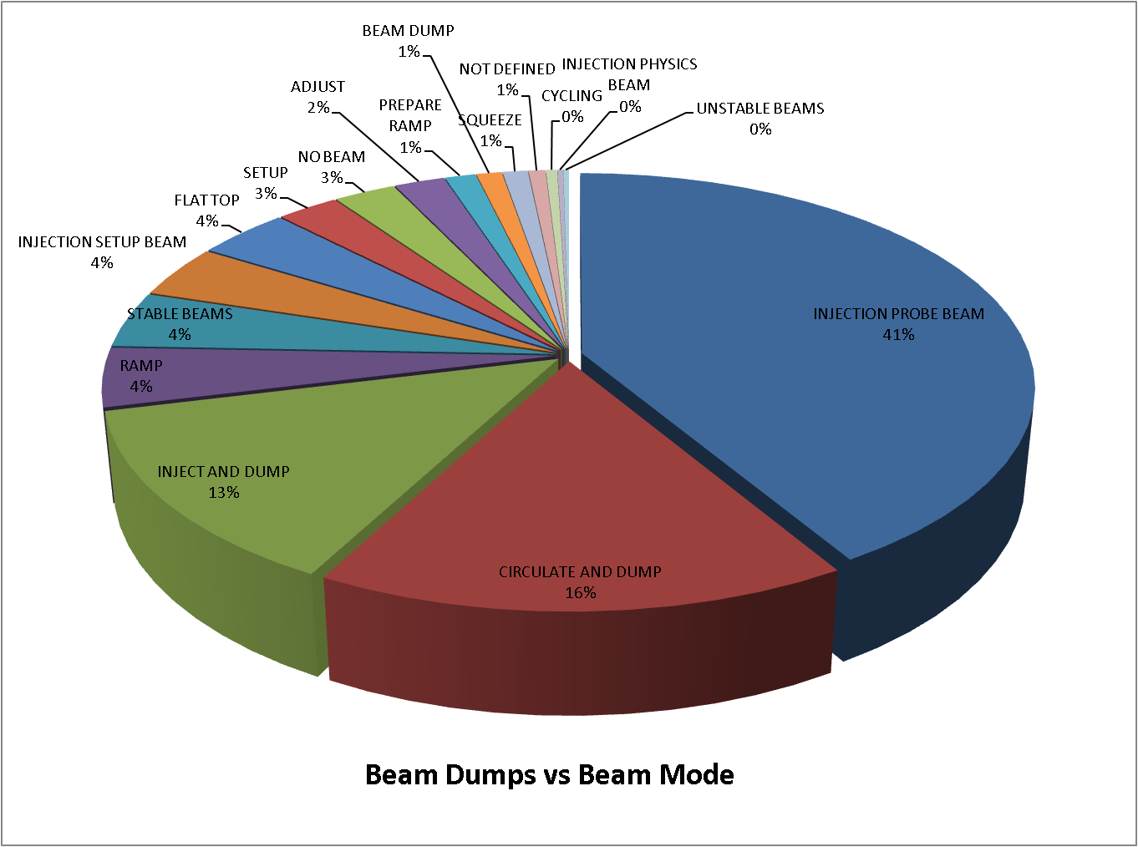
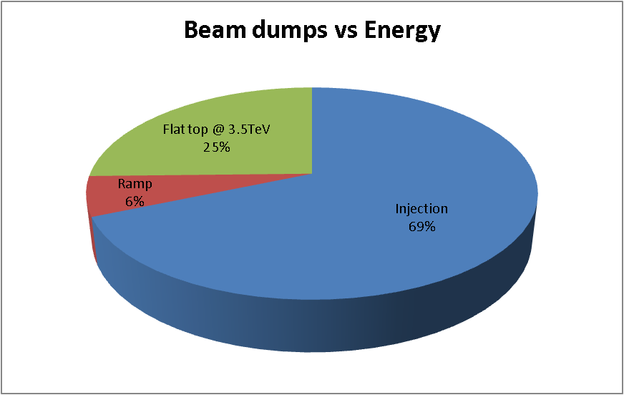
A bit of statistics…

Slide 6
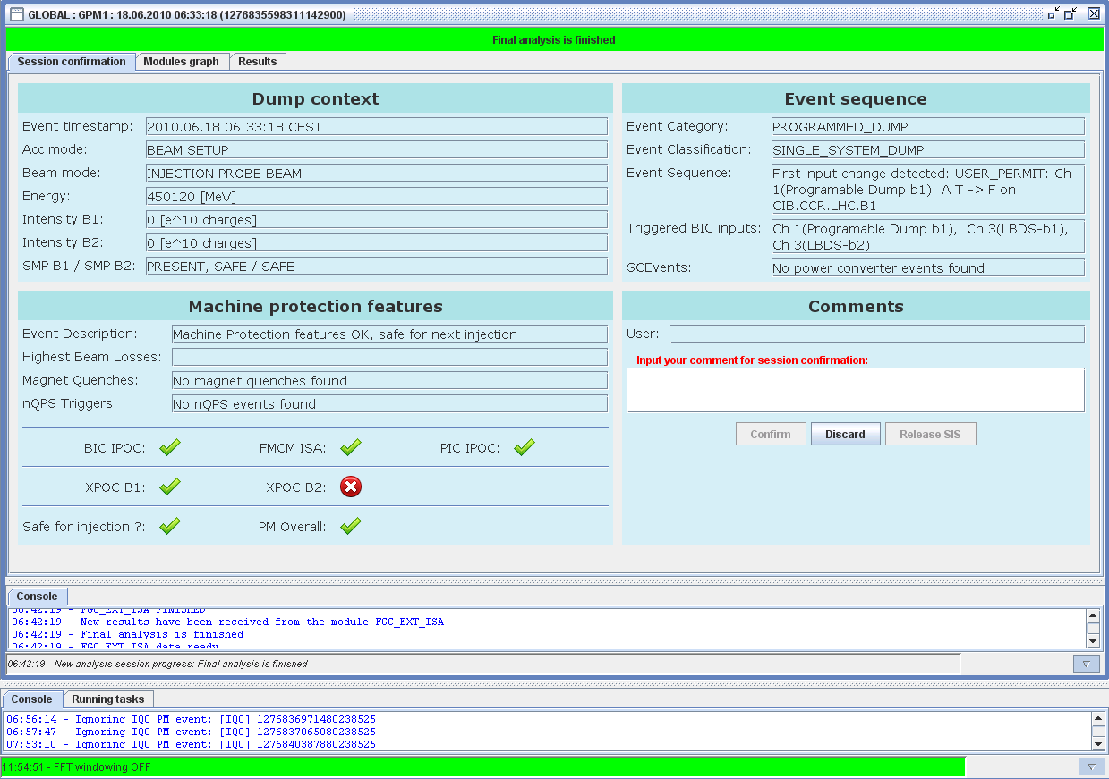
Analysis of global events…

Slide 7
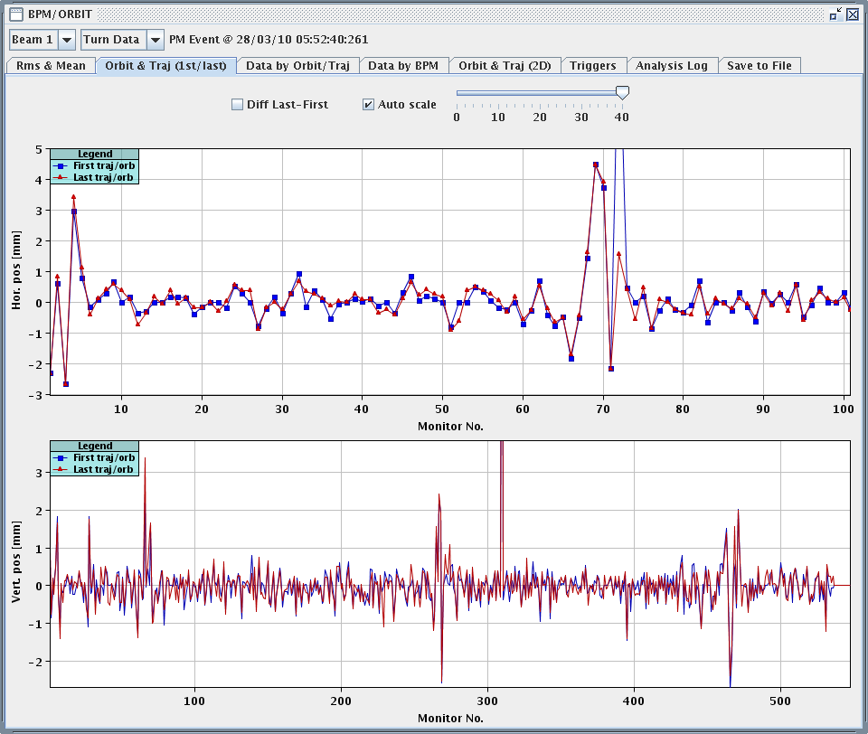
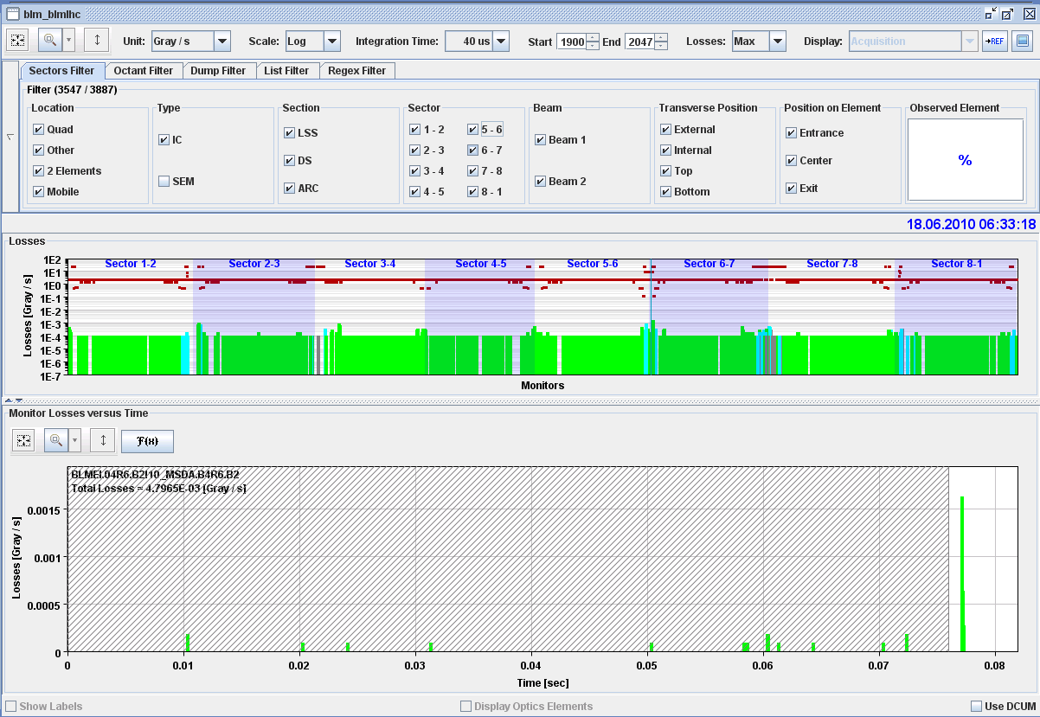
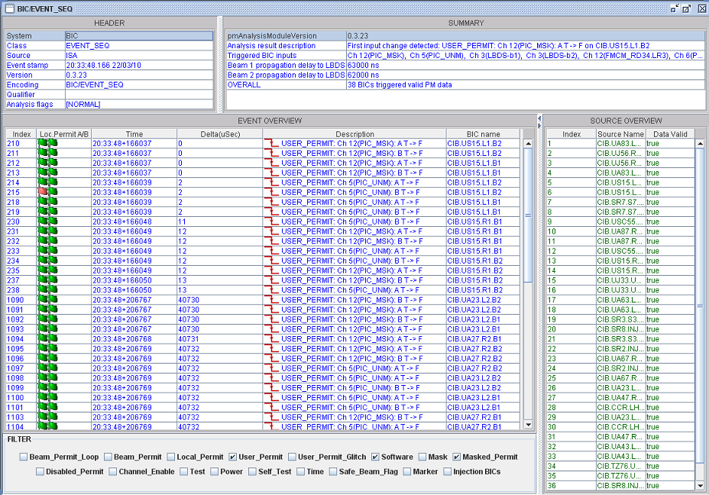
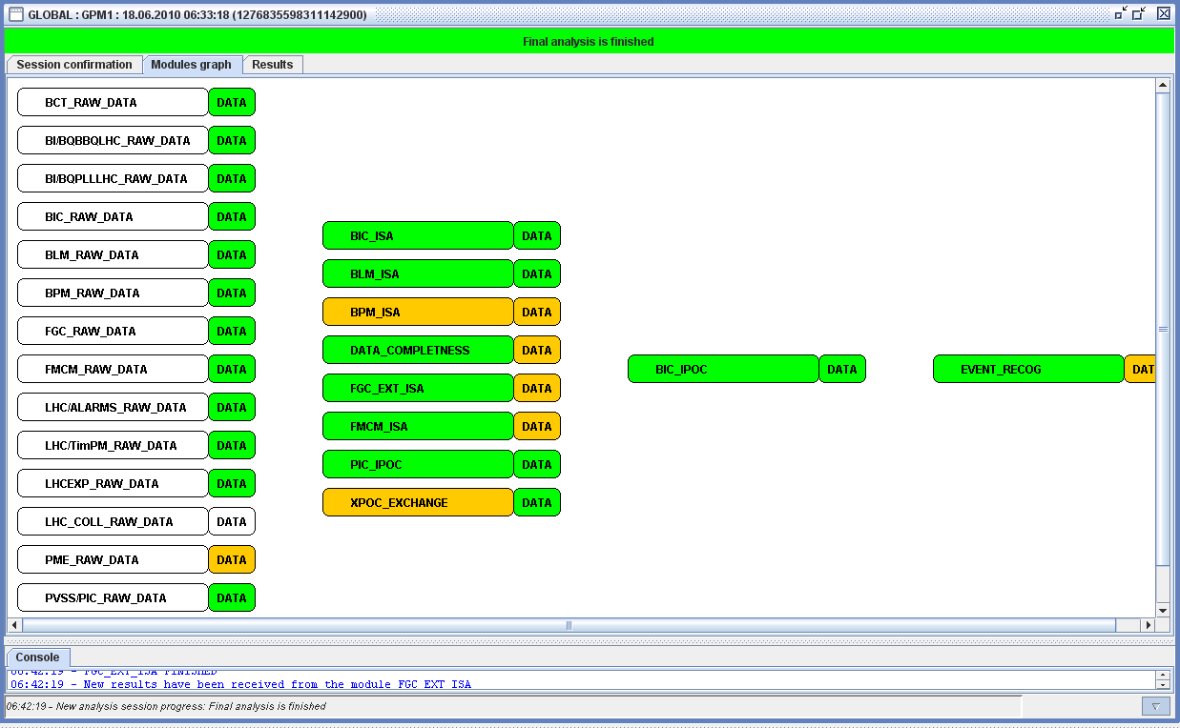
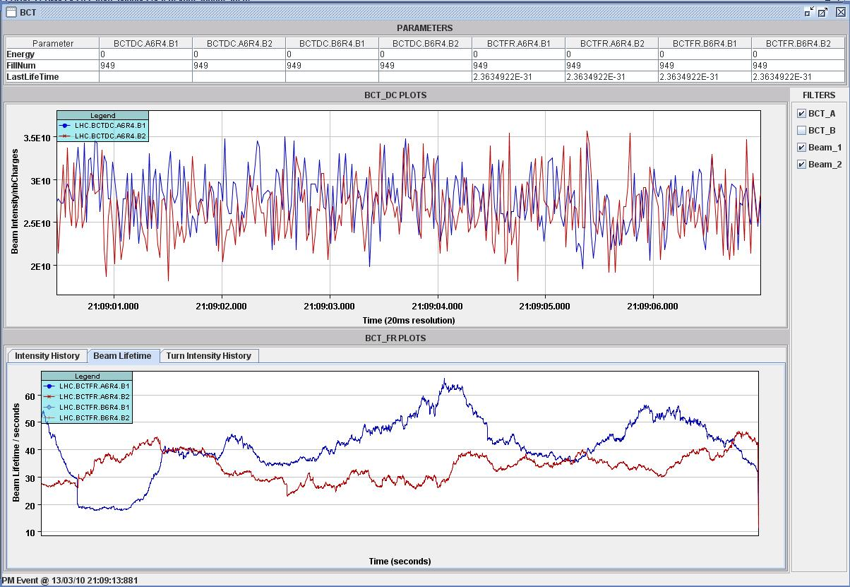
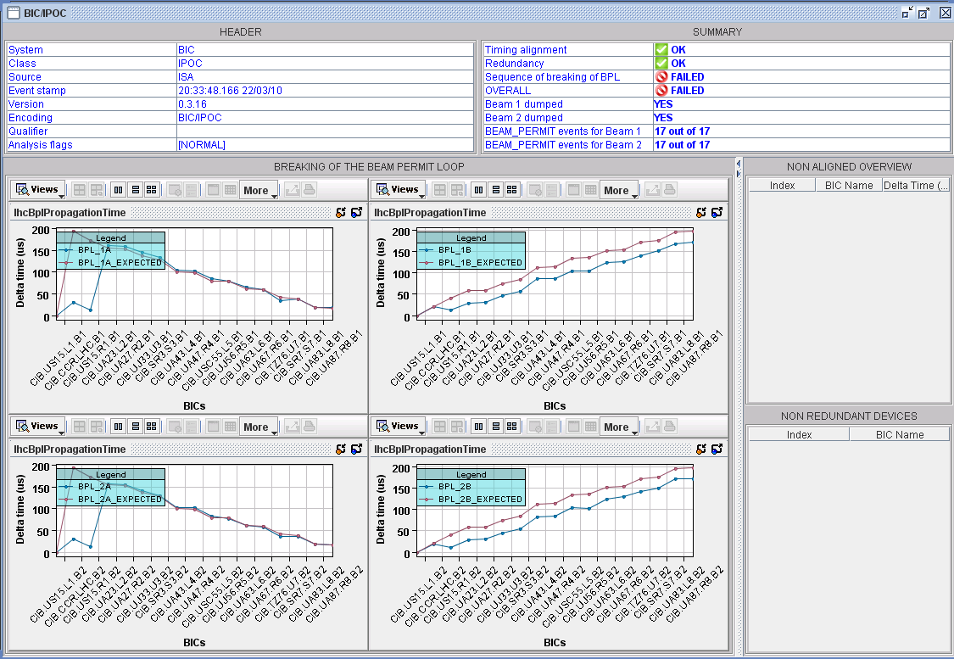
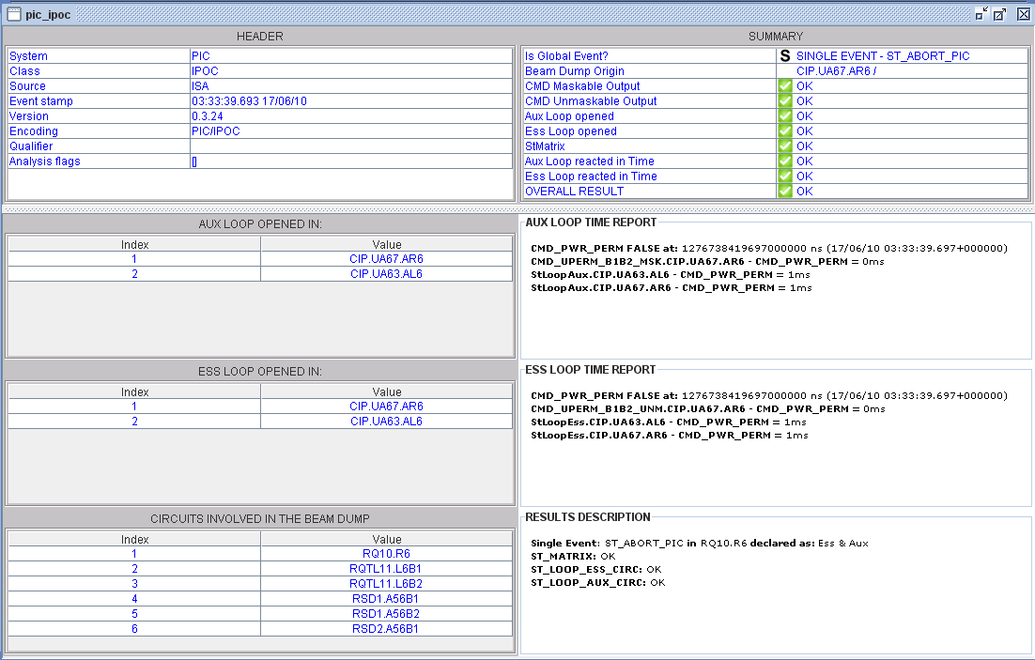
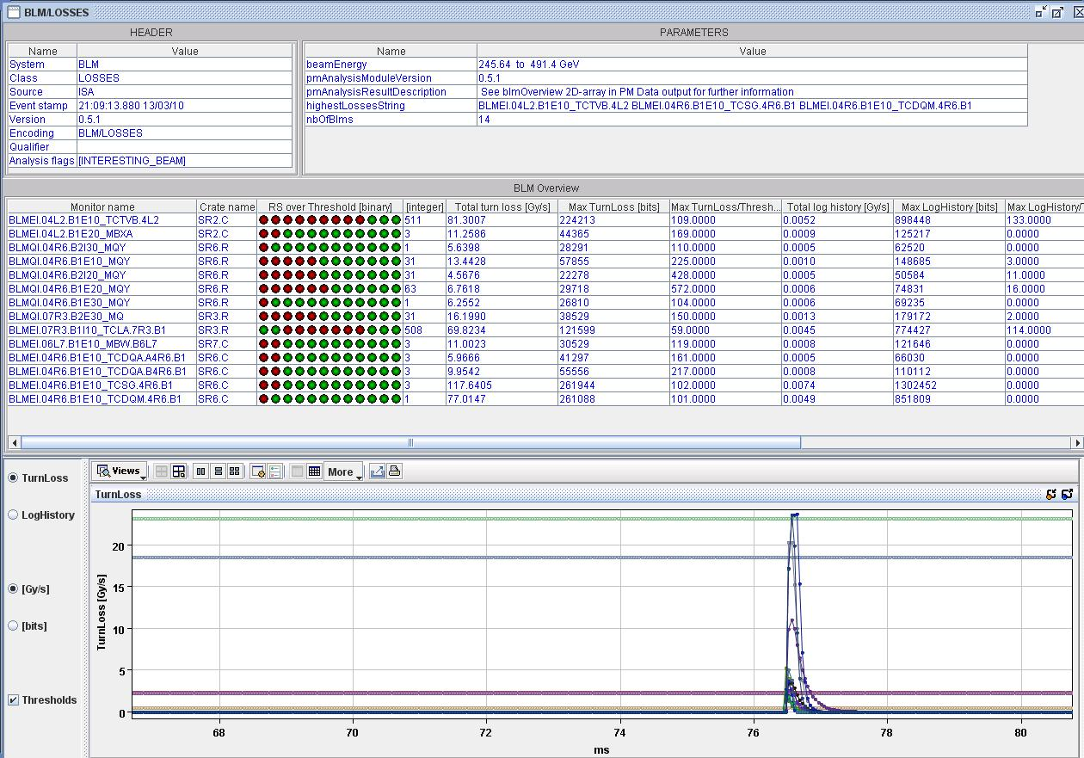
Analysis of global events…

Slide 8
PM Server Architecture
First set of most relevant analysis modules (and related panels) exist and start to be more widely used
Analysis modules mostly provided by system experts/operators,… which assures efficient development (code re-usage) and long-term maintenance
Much more can (and will have to) be done still, currently in work
  PM raw data from RF
  BBQ and collimator analysis modules (Anthony and Eric)
  Improved FGC_ext + dedicated GUI panel to allow easier identification of current changes in circuits (e.g. feedback,…)
  Powering analysis as part of global events
Current tools allow for reasonably efficient analysis and understanding of beam dump events
  Identification of initiating event / event sequence works reliably
  nevertheless the input and comment of EIC/operations is vital for the (later) understanding of events (ie what was done @ time of dump?)
Notes:
8

Slide 9
LHC PM and Machine Protection
PM should determine whether it is safe or not to re-inject and proceed
Overall PM Result used for SIS interlock, which currently verifies
  BIC IPOC (Sequence and timing of BPLs, user and beam permit redundancy, timing alignment of controllers, missing data from BIS)
  PIC IPOC (Triggering of MSK/UNM BIS channels and redundant CPLD path, propagation delays of beam dump requests, identification of global events)
  FMCM ISA (Threshold consistency, trigger delay for self-triggered events)
  Possible Circuit Quenches in any of the sc circuits which will require detailed analysis
  Overall result of LBDS XPOC (to be included in next release)
Even for this (small) amount of checks a reliable automated decision has proven difficult (endless amount of possible use- and failure cases)
  still rely on help of EICs/operations to take ultimate decision to go on
Can to better and probably need to be more rigorous on this (input from MPP/operations appreciated)
  Experts need to be informed if existing IPOC modules and/or OVERALL result fails
  What additional checks should be added in OVERALL result for > intensities ?
  Should PM SIS channel become unmaskable?

Slide 10
Masking of SIS Interlock…
Generation of a PM1 event and subsequent data-collection + analysis currently impose a ‘dead-time’ of ~ 10 minutes (SIS interlock will be FALSE)
  Note: Analysis only takes ~ 20 seconds, but long data collection of up to 8 minutes in QPS/FGC requires this timeout before finalizing event
To nevertheless provide asap a first result, concept of preliminary and final analysis has been introduced
  Preliminary event and analysis results are produced ~ 1 minute after dump
  Final analysis is launched after data collection timeout of 8 minutes
  Final confirmation and unlatch of SIS only possible with final results
Not an issue for normal operational cycle, but slowing down (re-)injection when beams are lost/dumped with a subsequent PM1 event
  SIS interlock is often masked (and several unconfirmed sessions accumulated) during injection process
Risk to forget to unmask and to overlook early warnings of possible issues
Proposal: Could allow unlatching of SIS already with preliminary results (which will include all data but for QPS/FGC_self which anyway would not go unnoticed)?

Slide 11
Other related developments for 2010 and ongoing work
Implement 1st version of automated POWERING event analysis
  Dedicated analysis server (as global, XPOC, IQC)
  Fully automated process to support MP3/operations and assure deterministic analysis of all powering events (also outside of beam operation)
  Recovery of HWC modules through LV interface
  Super-locking of circuits in case of major problems
  First DEV version up and running, first operational version for July-Aug
Additional granularity for classification of dumps and improved operator comments (based on suggestion of Jorg/Matteo)
  Extend/add in confirmation panel a number of pre-defined drop down selections for event types, dump origins, standard checks, etc..)
  Will allow for more refined and powerful follow-up and statistics (will try to provide some web-based tools for standard statistics
More versatile data viewer - PM shopping basket

Slide 12

The PM shopping basket – a generic data viewer
Shopping basket will allow to assemble and visualize any collection of any data item across the PM framework
  Collection of data from all data levels, ie raw data, event data and analysis result data
  Will allow correlation of e.g. circuit related data with beam lifetimes, orbit movements, in a single plot
  Will allow trend analysis/correlation of different events (e.g. compare orbits evolution of two different events)
  1st version for PM data only, but generic design to include e.g. DB data, online acquisitions,…
Data collection is done via
  dedicated ‘data picker component’ (to allow free selection across events)
  Drag & Drop (also across GUI components)
  centrally stored user-defined templates (‘Logging-like’)
Needs some additional work/help from BI colleagues to introduce possibility of calculation/reconstruction of absolute time relations also in beam related data

Slide 13

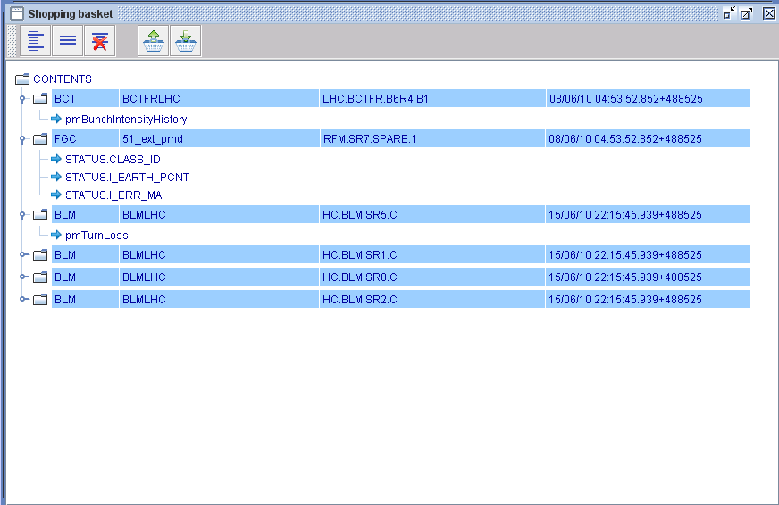
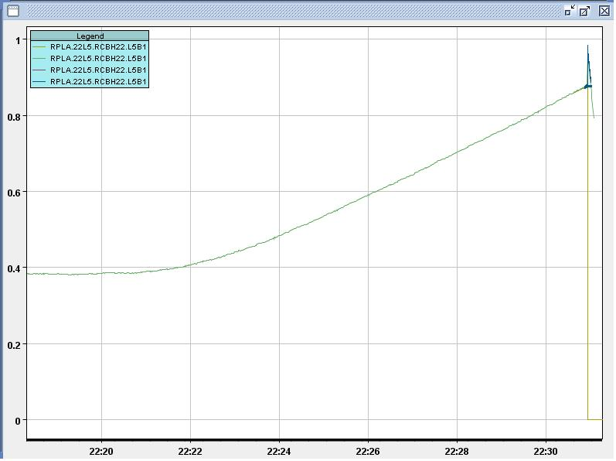
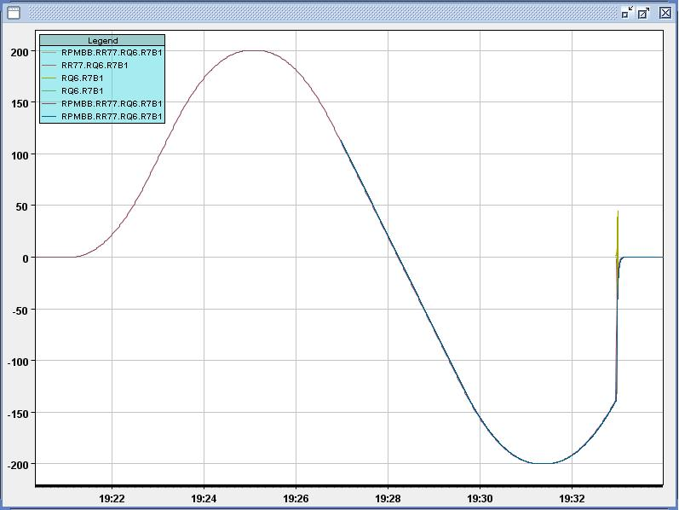
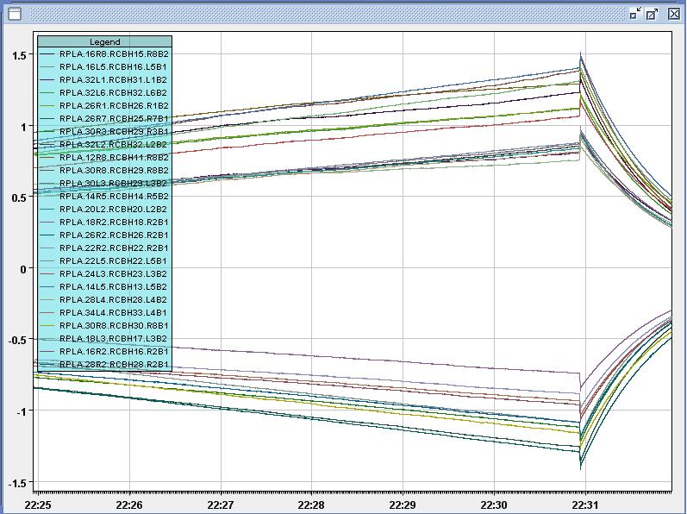
The PM shopping basket – a generic data viewer

Slide 14
Conclusions
Infrastructure and framework well established, no major issues left
  Development environments for additional JAVA and LV modules provided
Basic analysis configuration available, still a lot can/has to be done, ie
  few analysis modules still missing
  better correlation, visualization and manipulation of data cross systems and events
  Improved classification / documentation of dumps
What needs to be added/sorted out for higher intensities
  Quality/Dependability of PM data (few issues left with BCT, BBQ,…)
  No masking of PM result, but follow-up module warnings/failures with experts (LBDS-XPOC like)
    Should we allow unlatching with preliminary result?
  Additional (automated checks) to support OP, or short check-list for main systems
  Systematic (offline) follow-up of possible issues

Slide 15


