Slide 1
Dump protection
W. Bartmann, C. Boucly, C. Bracco, E. Carlier,
B. Goddard, M. Meddahi, S. Redaelli, J. Uythoven
MPS Review 17-June 2010

Slide 2
Outline
TCDQ Performance
  hw/sw issues
  asynch dumps at 450 GeV and 3.5 TeV
  orbit tolerance
TCDQ leakage simulated with SixTrack
Abort gap cleaning

Slide 3
TCDQ hw/sw issues
TCDQ movement problems:
  SW trigger problems, lost communication between FESA and PLC, fixed
  SW trigger failed in coll application after CPU update at the low level, fixed
  sequencer task problem, (e.g. sending TCDQ to position where it already is), management of states to be improved, at the next long shutdown (2010/2011) – requires a full recheck of the system after code modification!
  applying angle settings out of tolerance possible – will be modified in low level SW, the compatibility with mid- and high level SW needs to be reviewed in general
settings in LSA only low level for the moment (no nsigma deployment)
TCDQ will be damaged by impact of full intensity 25 ns beam at 7 TeV – rebuild in 2012 shutdown - ongoing

Slide 4
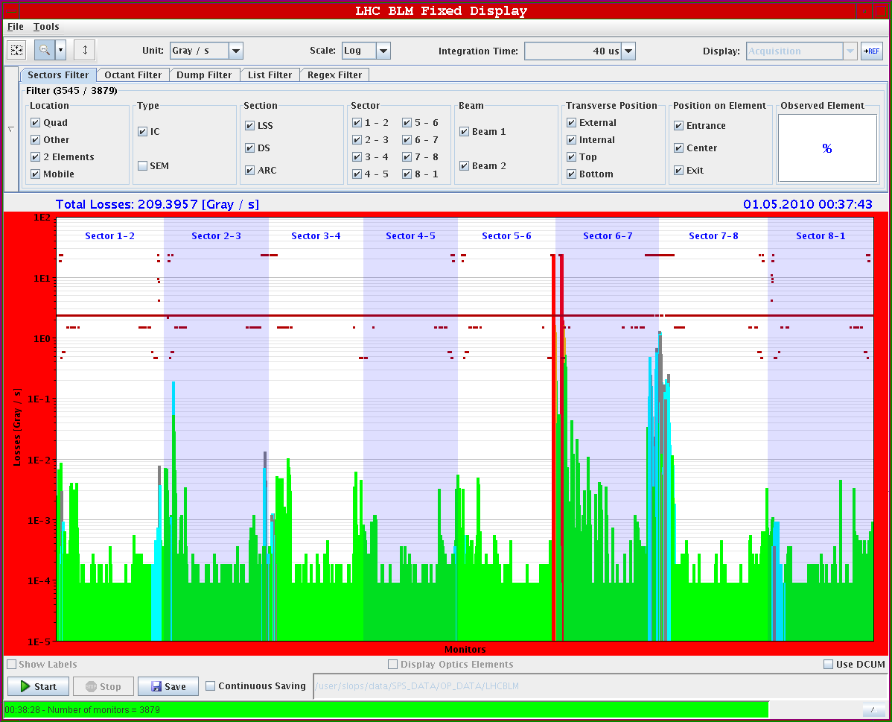
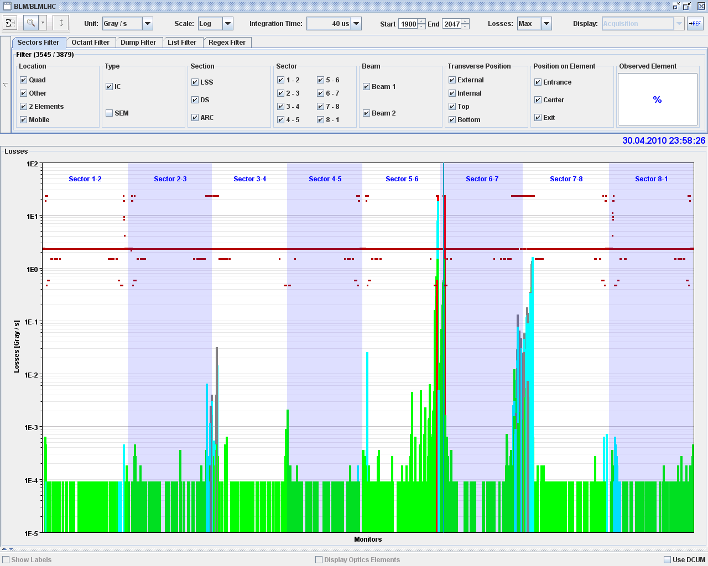
Debunched dumps at 450 GeV, 1e11
B1
B2
→ Losses as expected
→ a small spike on the TCLIB R2 (inj.prot. in for this test to see the losses on these objects)
→ big saturation of BLMs in P6
→ Losses in P6, P7, P3 and very small amount (3e-6 Gy) on TCTH.4R5
→ no beam seen by B2 abort gap monitor
Asynch Dump at 450 GeV, 1e11 looks OK

Slide 5
Debunched dumps at 3.5 TeV
4 separate tests made to date
  1x 3.5 TeV unsqueezed
  2x 3.5 TeV squeezed, low intensity, centered
  1x 3.5 TeV squeezed, higher intensity, offset
Assumptions
  36/120 of abort gap population impacts TCDQ
  Uniform abort gap population (pending deeper analysis!)
  1e12 p+/Gy response for BLMs at TCTs and, TCSG, TCDS
  Measured response at TCDQ: 1 – 5 e11 p+/Gy

Slide 6
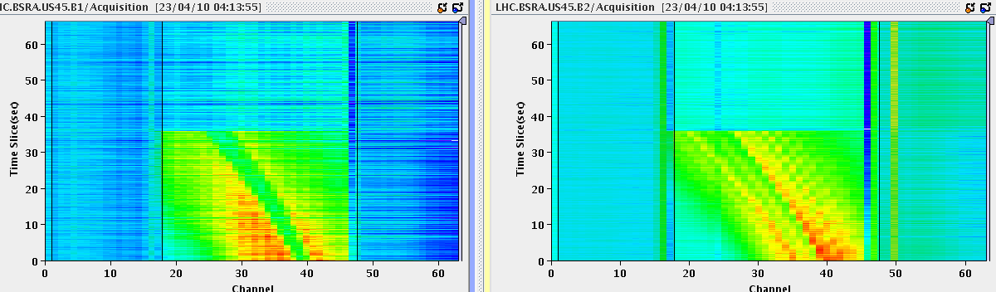
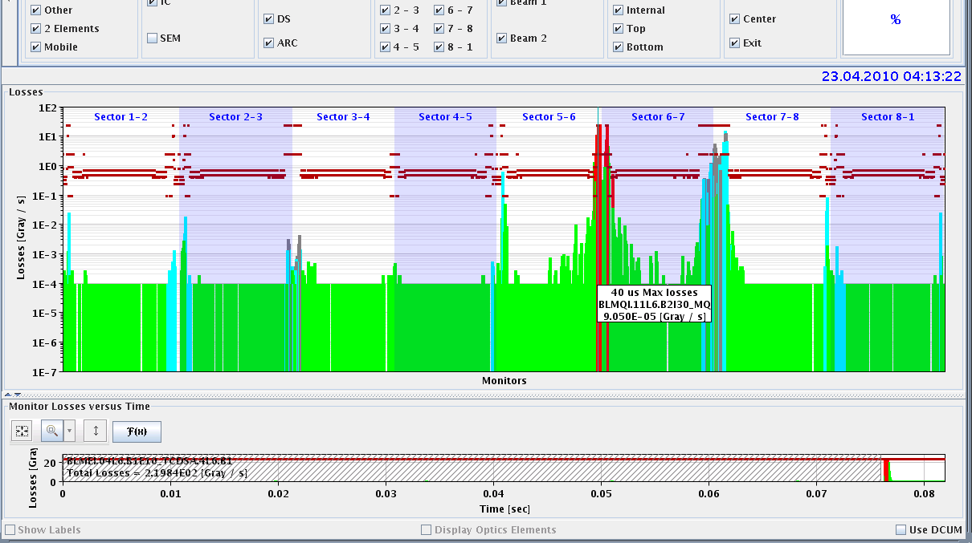
Debunched dumps at 3.5 TeV squeezed,
1σ offset
1.6e10 in 2b in B1, 1.7e10 in 2b in B2,
90 s debunching, 1 σ offset
Measured ~4e9 in abort gap at moment of dump
IR6 saturated
IR7 15Gy/s
TCTH.4R5.B2 0.6 Gy/s, 2e7 p+
Leakage from TCDQ ~2e-2 from BLMs (but saturated). Using abort gap population gives ~2e-3

Slide 7
Some other considerations
Other observations
  About 4-6e7 p+/m – ‘limit’ for abort gap at 7 TeV defined as 1e6 p+/m, for Q4 quench
  No quench of Q4 (factor 10 above BLM threshold)
  Structure on BSRA signal – what is this??
  Analysis of various unsaturated BLM data and comparing signals gives estimates of between 0.03% and 0.3% leakage to P5.TCT – comparable to the other estimates
  Cross-calibration of losses “v.difficult” because of BLM saturation at 40 us – should be better now with filters, to be tested
  p+ on TCT calculated from assumed 1e12 p+/Gy scaling – to measure!
  Main contribution to leakage probably from only a few σ impact parameter on TCDQ system – confirmed by simulations - increases leakage figure!
  Abort gap population and distribution known more accurately when BSRA not saturated
Actions, analysis ongoing to improve some of these unknowns – needs supporting measurements

Slide 8
Orbit tolerance at TCDQ
Retraction of TCT wrt TCDQ:
Contribution | [σ]
orbit measurement error at TCDQ | 0.7
orbit change at TCDQ (SIS interlocked) | 2.5-3.0
TCDQ setting up error | 1.0
dynamic beta beat | 0.5
TCT setting up error | 0.5
total | 5.2 - 5.7
Agreement to 5σ retraction TCT-TCDQ

Slide 9
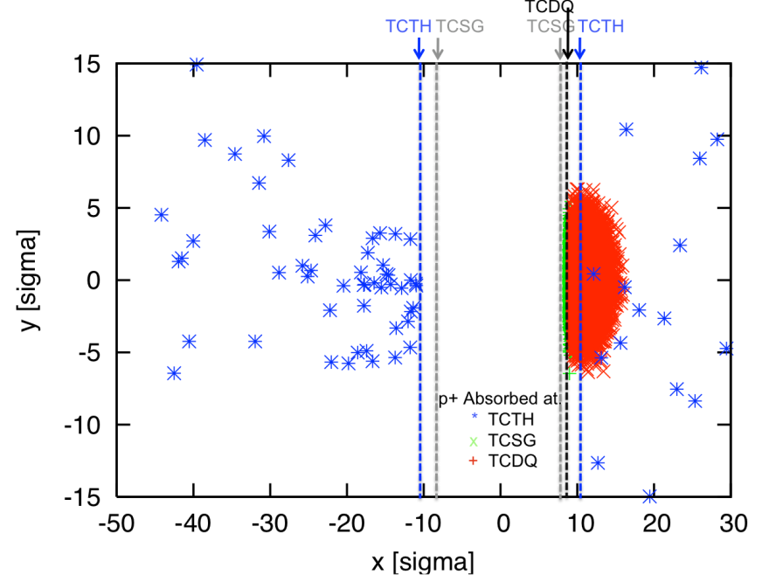
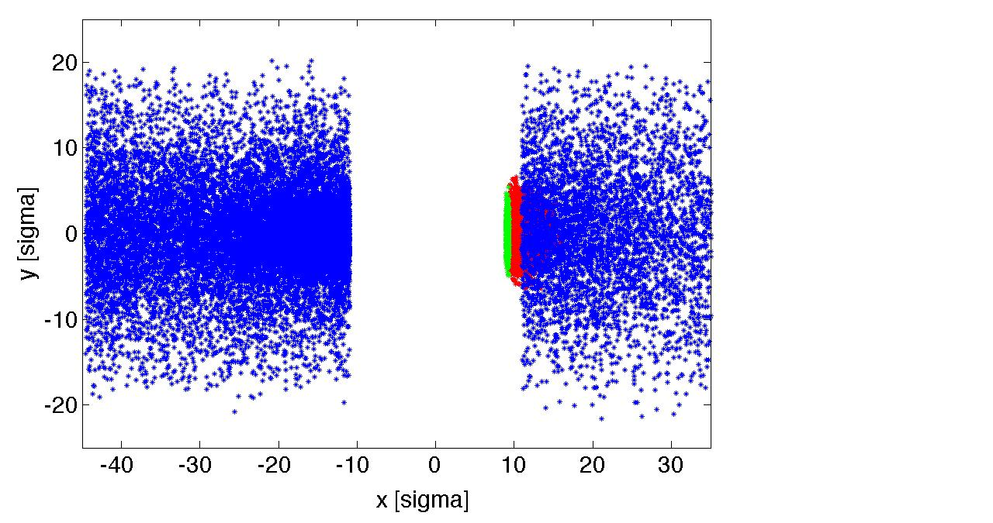
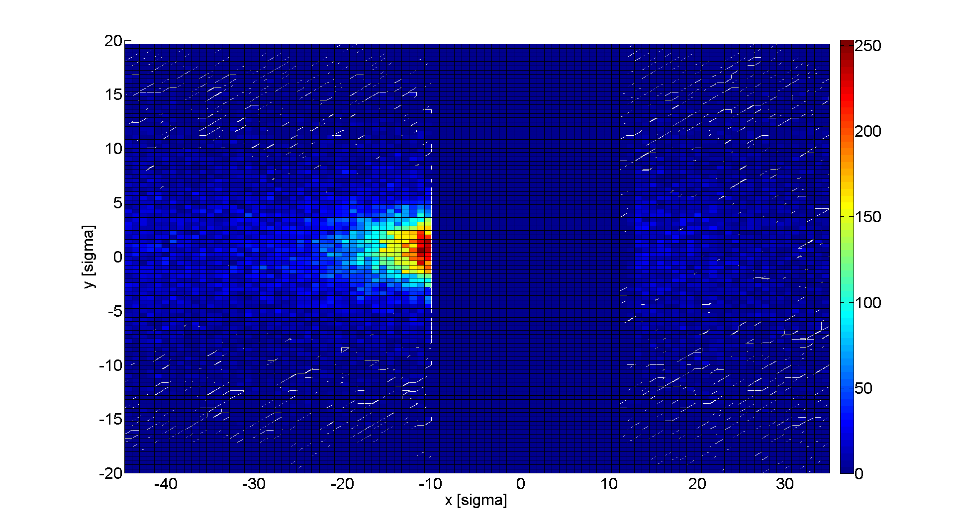
Leakage from dump protection – SixTrack simulations
All losses come from p+ scattered through TCSG which fills acceptance with scattered primaries
Total p+ on TCTH is 0.3% of single bunch (8% impacting TCSG in this simulation) or 3.4×10⁸ p+
Peak p+ density is about 0.016% of single bunch (equivalent to 2.5×10⁶ p+ with nominal e_{xy})
Consistent with expectations - full bunch on TCSG would be attenuated by ×10, and have ×180 emittance increase
p+ / σ² on TCTH (for 8.5e6 p+ initial)

Slide 10
Loss Map for Beam 2, 3.5 TeV, 2m β* in IP5
From SixTrack simulations:
# particles lost in Δs
Δs = 10 cm @ magnets
Δs = 1 m @ collimators (jaw length)
Tot_{abs} = 8’463’489
Local cleaning inefficiency: η =
Δs × Tot_{abs}
Collimators
Cold Magnets
Warm Magnets
1 bunch case
TCDQ +TCSG
Collimator | N [p+] | % Tot_{abs}
TCDQ | 7’639’643 | 90
TCSG | 697’298 | 8
TCTH | 22’186 | 0.3
TCTV | 875 | 0.01
120
Beam2
TCTH+TCTV
Statistical error = 1/√N ➔ max = 0.03
Nominal bunch (1.1E11 p+):
3.3E8 p+ on TCT
Only primary protons losses.

Slide 11
Loss Map for Beam 2, 3.5 TeV, 2m β* in IP5
From Measurements during asynchronous beam dump (23/04/2010):
BLM at TCDQ and TCSG saturated for 40 μs and 80 μs integration time!
TCDQ +TCSG
100
TCTH+TCTV
At least a factor of 100 between losses in point 6 and TCT in point 5.
It seems to be consistent with simulations (not worse).
Filters added at BLM in point 6 ➔ repeat measure.
1.3 s integration time
Showers included

Slide 12
Loss Map for Beam 2, 3.5 TeV, 2m β* in IP5
From Measurements during asynchronous beam dump (23/04/2010):
zoom
MQY4
MQY5
Warm losses are on drift or BI (mainly BPM)
1.3 s integration time
Showers included

Slide 13
Loss Map for Beam 2, 3.5 TeV, 2m β* in IP5
From Measurements during asynchronous beam dump (23/04/2010):
Warm losses are on drift or BI (mainly BPM)
zoom
MQY4
MQML5
1.3 s integration time
Showers included

Slide 14
Outcome of simulations
Asynchronous beam dump simulations for a single bunch (worst case) at 3.5 TeV (2m β* in point 5) have been performed with SixTrack for beam 2.
Simulations show that losses at the TCT come from particles scattered at the TCSG, no losses of primary protons are observed
Simulations allow to visualize the distribution of particles absorbed at the TCT: peak density equivalent of 0.016% of full bunch with nominal emittance
An asynchronous beam dump test has been performed for the same case (3.5 TeV, 2m β* in point 5) and losses (from PM) have been analyzed.
BLM at the collimators in point 6 saturated (40-80 μs):
  Difficult to quantify the ratio between losses in point 6 and point 5 (at the TCT)
  Data at 1.3s show that measurements are consistent (not worse) than simulations
  Filters applied at the TCDQ → new measurements needed for benchmarking

Slide 15
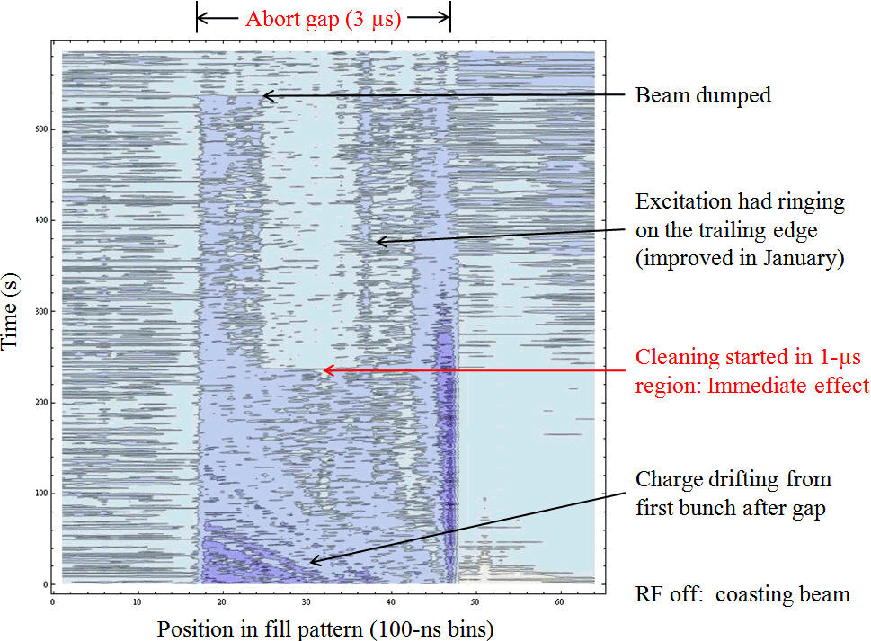
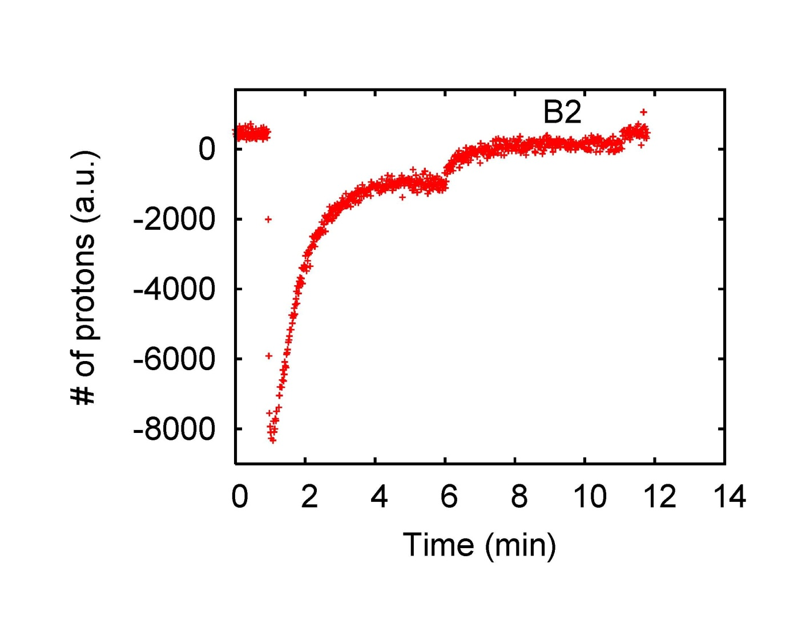
AGC: Results from cleaning test
(E. Gianfelice-Wendt, W. Höfle, T. Lefevre, ...)
Cleaning test of a costing beam done, on 16-17 Dec.’09
4 bunches of 2.5e10 protons
RF switched off
After 5 minutes, started cleaning using swept frequency around Q_{v}
cleaning starts
gap population
equilibrium
RF off

Slide 16
Summary – TCDQ Performance
Estimated 1e-4 leakage from TCDQ system unsqueezed, and around 2-4e-3 leakage squeezed.
  Based on this, full sweep can let maybe 0.1 bunches through to TCT. However, almost certainly seeing scattering from TCSG/TCDQ and not ‘primary’ p+ (yet)
Cannot yet conclude on effect of 1 s offset – not hugely different from beam centered
Analysis to refine with abort gap population data
BLM saturation in P6 - filters are installed
Response measured for TCDQ – to be done for TCT and TCSG6

Slide 17
Summary – SixTrack Simulations
Asynchronous beam dump simulated with SixTrack for a single bunch at 3.5 TeV
Losses at the TCT come only from scattered particles at the TCSG - no losses of primary protons
Peak density equivalent of 0.016% of full bunch with nominal emittance
Simulations compared to measurement:
  Data at 1.3s show that measurements are consistent (not worse) than simulations
  Filters applied at the TCDQ BLMs → new measurements needed for benchmarking

Slide 18
Summary – Abort Gap Cleaning
First AGC tests in Dec 09 with encouraging results
In the 2009-2010 LHC shutdown, modifications on the damper system to improve the shape of the pulse
Calibration of damper kicks to compare simulations with measurements
The effect of all modifications has still to be demonstrated with beam
NOT ready to include the abort gap population info to SIS
  Abort gap monitoring almost operational
  Need to define interlock level for abort gap population

Slide 19
What is still to do for high bunch intensity stable beams?
LBDS MPS checks:
  Beam excursion interlock window
  TCSG/TCDQ settings cross-check with TCP scan
  Normal dumps from extreme orbit positions
  Checks of asynch dumps at 450 GeV with high bunch intensity, from extreme orbit positions
  Dumps with maximum energy offset AND maximum orbit excursion (H plane only)
  Verification of abort gap keeper settings and protection (only after all fine synch adjustments)
Dump protection validation at 3.5 TeV and 3.5 m β*
  TCDQ hierarchy checks and settings checks
  TCSG/TCDQ settings cross-check with TCP sigma scan (2 h)
  Asynchronous dump tests with beam on- and off-axis (3 ramps)
Abort gap cleaning tests – tbc when needed

