Slide 1
ERAM detector production
T2K Micromegas PRR 12/11/20
Rui De Oliveira on behalf of the CERN MPT workshop

Slide 2
Outline
ERAM production
Production tests
Documents
Planning

Slide 3
ERAM production
PCB production
DLC mapping and selection
DLC foil gluing
Bulk Micromegas
Connectors Assembly
Detector Finish

Slide 4
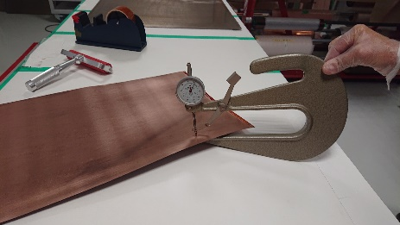
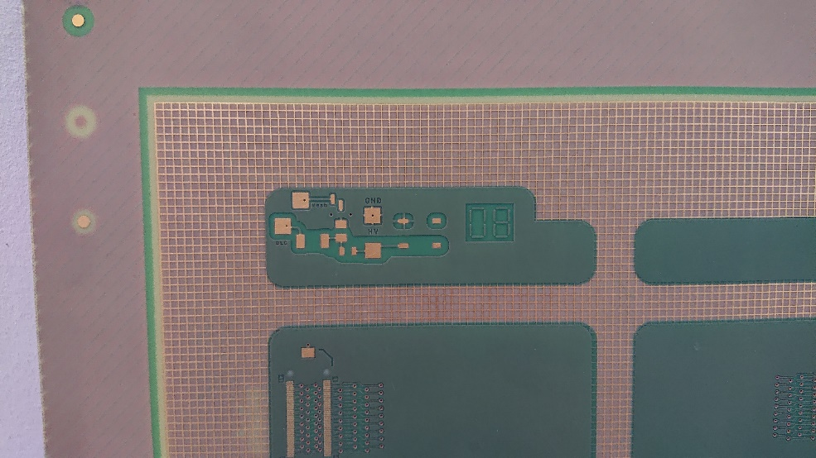
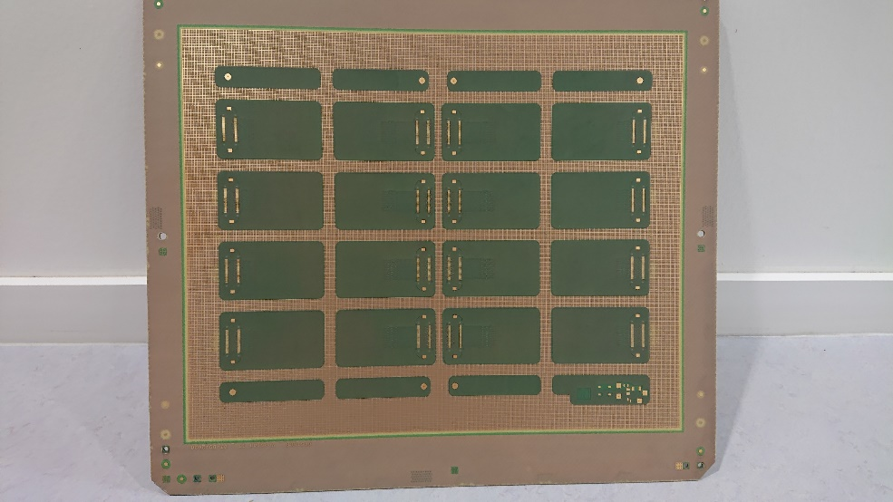
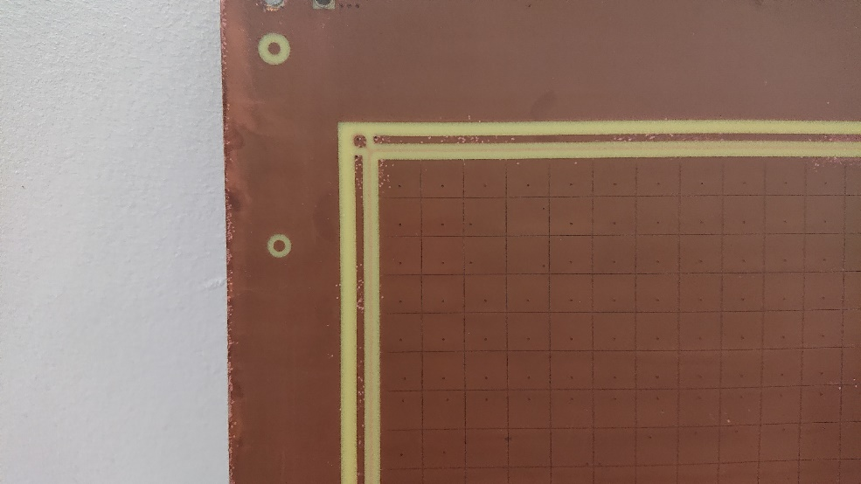
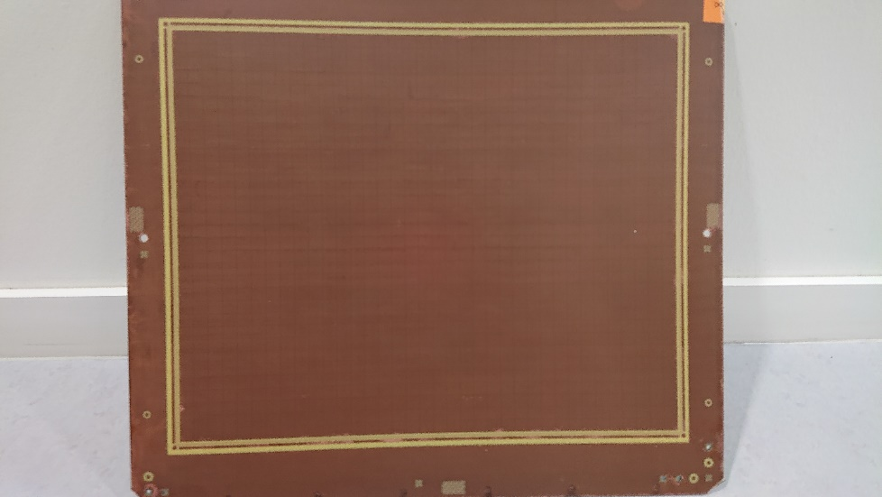
PCB production
Stack-up
-6 Layers
-4 layers core with PTH
-2 outer layers with blind holes
-Solder mask Bottom
-NI/AU plating Bottom
-Inter-pad epoxy filling on Top
-Brown oxide Top
-Final outer size 419.9 x 339.9
-Thickness: 2.4mm
-Copper layers 35um
-Minimum hole dia: 0.5mm
-0.12mm line/space mini
-Base material Halogen free
-UL 94V-0
-TG : 150 deg
-TD: 288 deg → 35 min
-IPC–A-600 Class 3
BOT detail
BOT
TOP detail
TOP

Slide 5
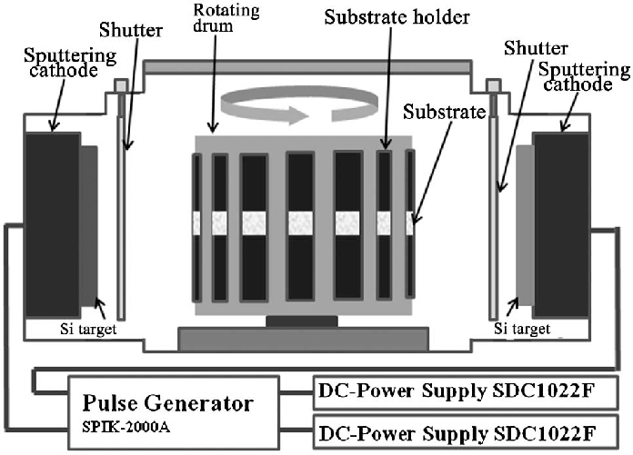
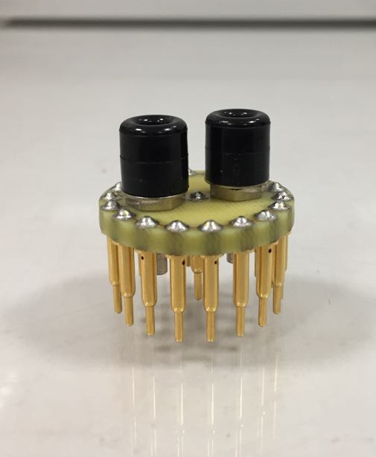
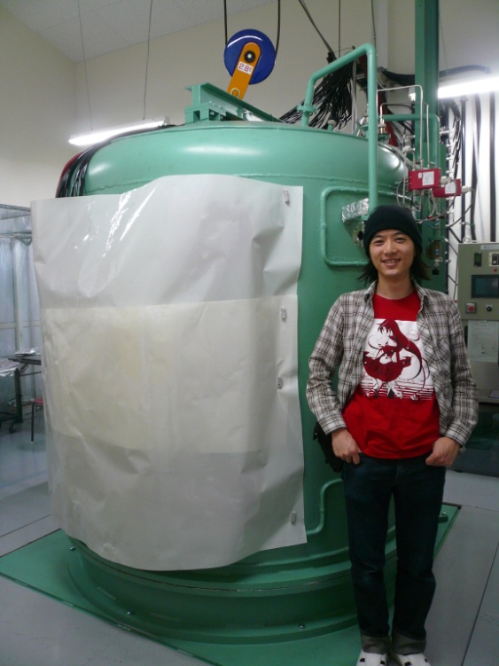
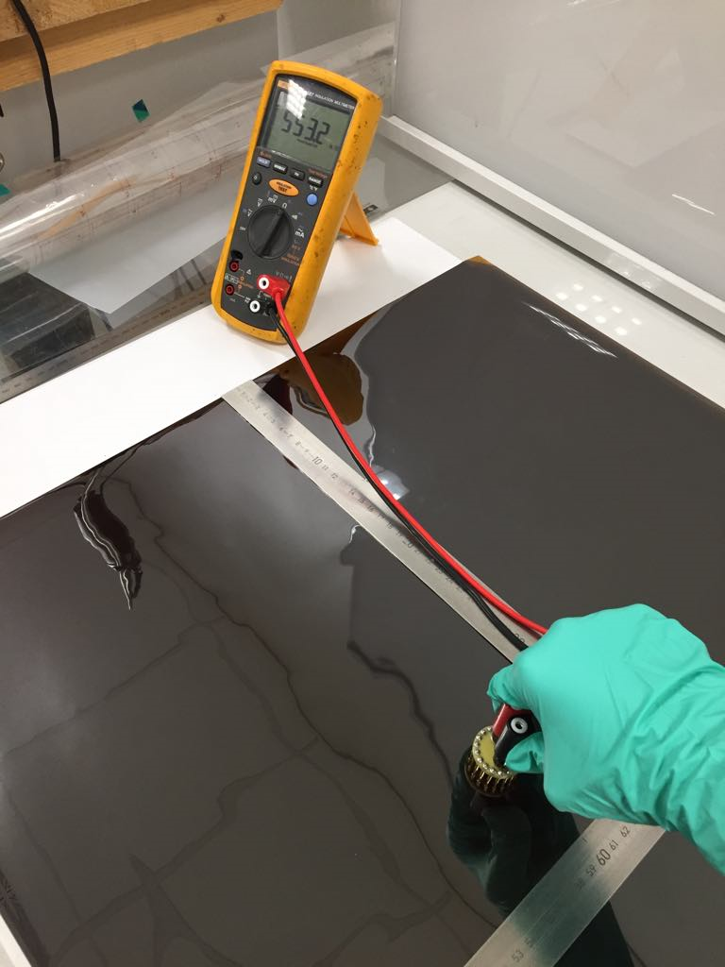
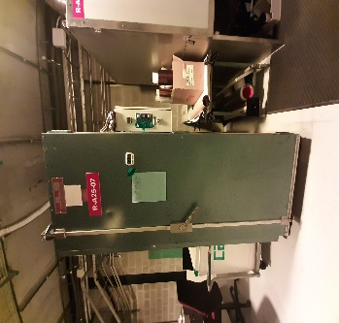
DLC mapping & selection
DLC deposition
-APICAL-NP PI
-REPIC (Japan)
-4m2/batch
-8 weeks for 7 foils
-10Weeks for 70 foils
-Target 500K +/-150K
DLC test
-Ohms/square
DLC thermal tuning
In air divide by :
  2.1 at 160deg
  2.3 at 190deg
  2.7 at 220deg
  2.5 at 250deg
In Vacuum
  1.8 at 180deg
Final DLC mapping
-Target 200K +/-60K

Slide 6
570 k to 1270 k → center value 920K

Slide 7
330 k to 550 k → center value 440 k → value divided by 2.09

Slide 8
270 k to 550 k → center value 410 k → value divided by 2.3

Slide 9
230 k to 440 k → center value 335 k → value divided by 2.7

Slide 10
250 k to 500 k → center value 375k → value divided by 2.5

Slide 11
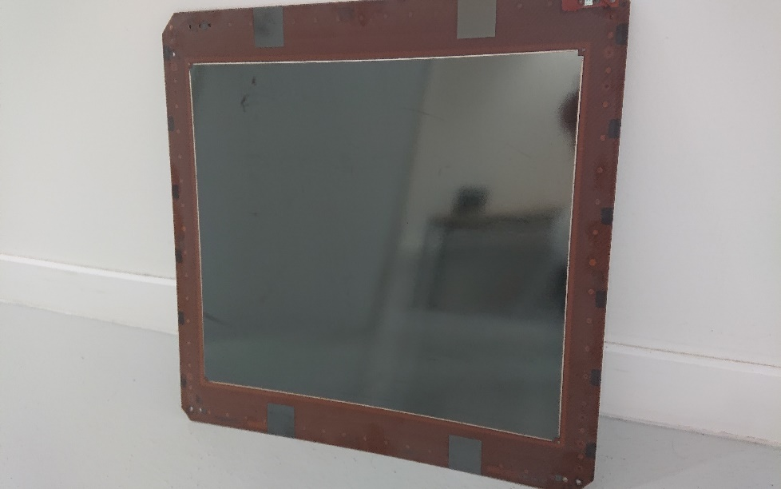
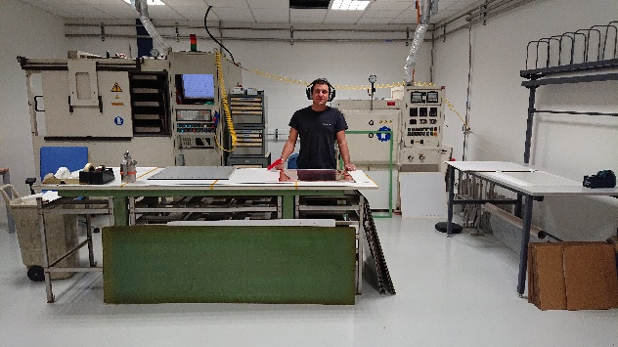
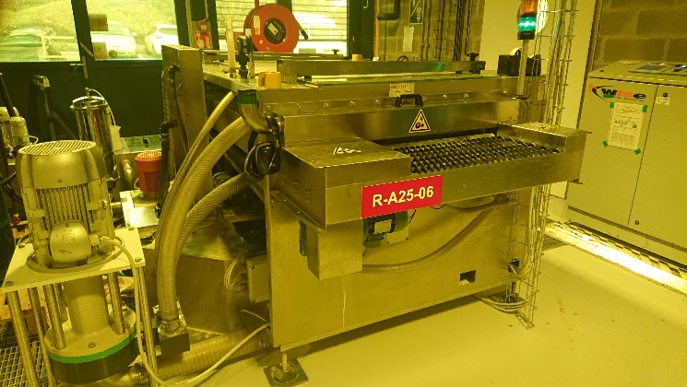
DLC foil gluing
Silver glue
DLC
PI 50um
Preg 150um
PCB 2.4mm
1/Select DLC foil
2/Glue the foil with 150um Preg
3/Create active area image on DLC with resist
4/Pattern DLC with Jet scrubbing
5/DLC active area mapping after pressing
6/CNC drilling to access Cu Anode electrode in PCB
7/DLC to Cu connection, printed with silver paste (ESL)
-4 DLC squares are patterned for later controls
Isostatic press
Jet scrubbing

Slide 12
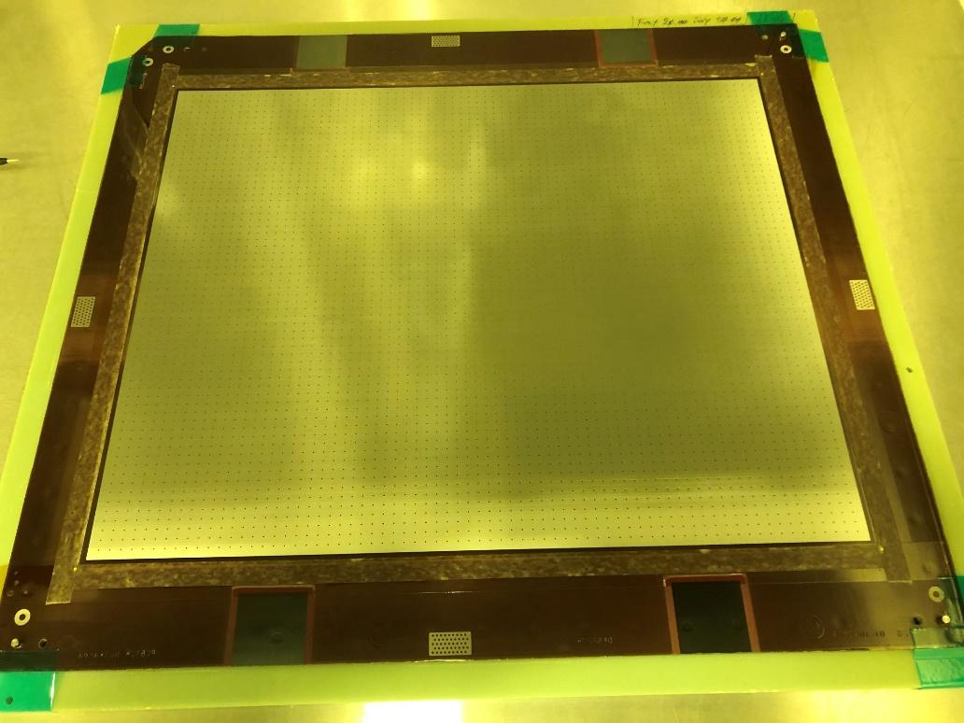
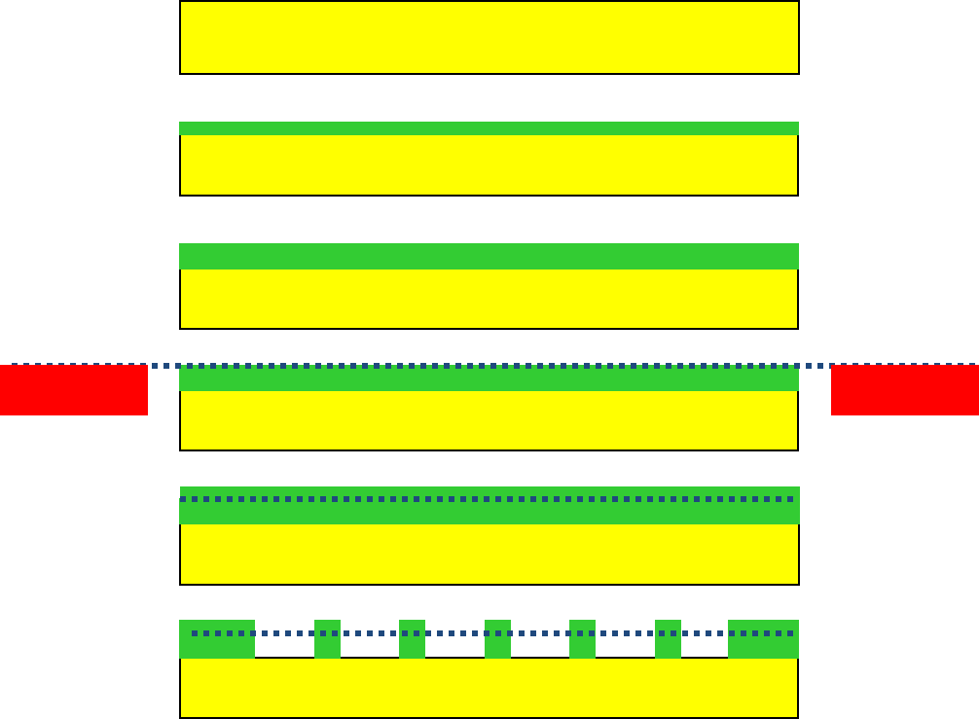
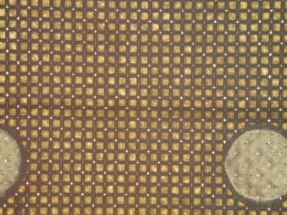
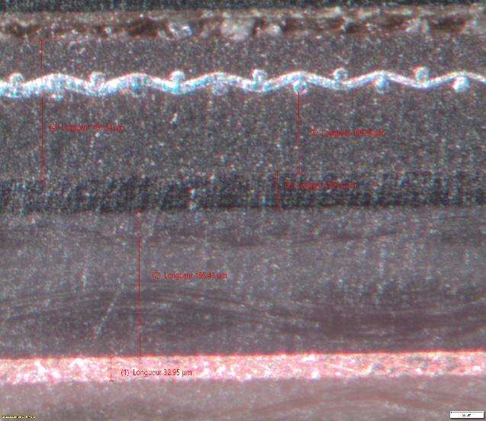
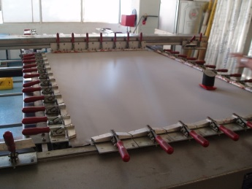
BULK Micromegas
1/Select PCB with DLC
2/64um PC1025 lamination
3/64um PC1025 lamination
4/Mesh on frame deposition
5/64um PC1025 lamination
6/UV Exposure
7/Development
8/160 deg curing
9/Cross section control
10/mesh Silver connections
11/Detector cleaning
12/protect with 0.5mm Glass epoxy
13/Electrical test at HV max
  900V in Air @ 20% RH max
  Max leakage current : 20nA
  +/-2nA fluctuation
14/DLC control on 4 squares
-DUPONT PC 1025 coverlay
-BOPP Meshes 45/18
-SERITEC stretching
1
2
3
4
5
Total BULK
A-gap
6/7
PI
Preg
Pads

Slide 13
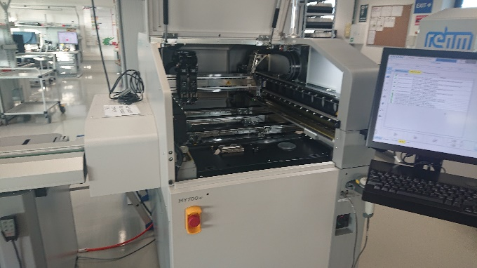
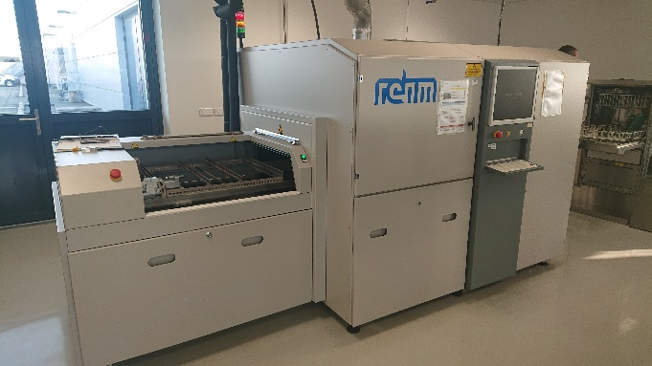
Connector Assembly
1/Check protection cover
2/Solder paste inkjet deposition
3/Connector deposition → manual
4/Vapor Phase Reflow
Solder paste inkjet printer
Vapor phase reflow oven

Slide 14
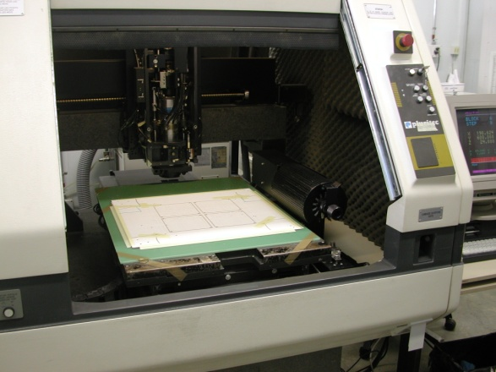
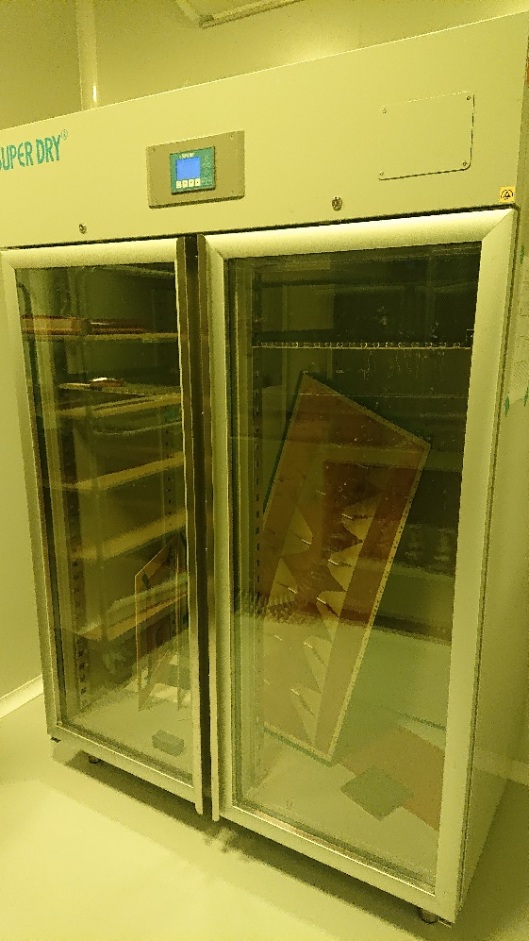
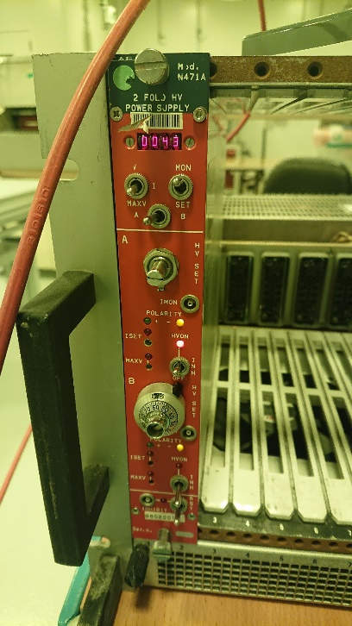
Detector Finishing
1/Soldering cover removal
2/Detector cleaning
3/Electrical test at HV max in dry cabinet
  900V in Air @ 20% RH max
  Max leakage current : 20nA
  +/-2nA fluctuation
4/DLC control on 4 squares
5/Final Glass Epoxy cover sticking
6/CNC milling
7/Board size measurement
8/Detector packing/delivery
CNC milling
V/I test
Dry cabinet

Slide 15
Shared documents
Description folder
  Gerber , drilling , milling files
  Stack up
  Material specification
Production Flow Chart documents for each batch
  PCB
  DLC gluing
  BULK
Test report document
  For each board

Slide 16
Test report document
for each board
Board thickness and size
DLC Foil reception mapping
DLC Foil mapping after thermal treatment
Detector active area mapping after DLC foil pressing
DLC measurement on test patterns after BULK processing
DLC measurement on test patterns after connector soldering
HV test before soldering
  900V in Air @ 20% RH max
  Max leakage current : 10nA
  +/-2nA fluctuation
New HV test before delivery

Slide 17
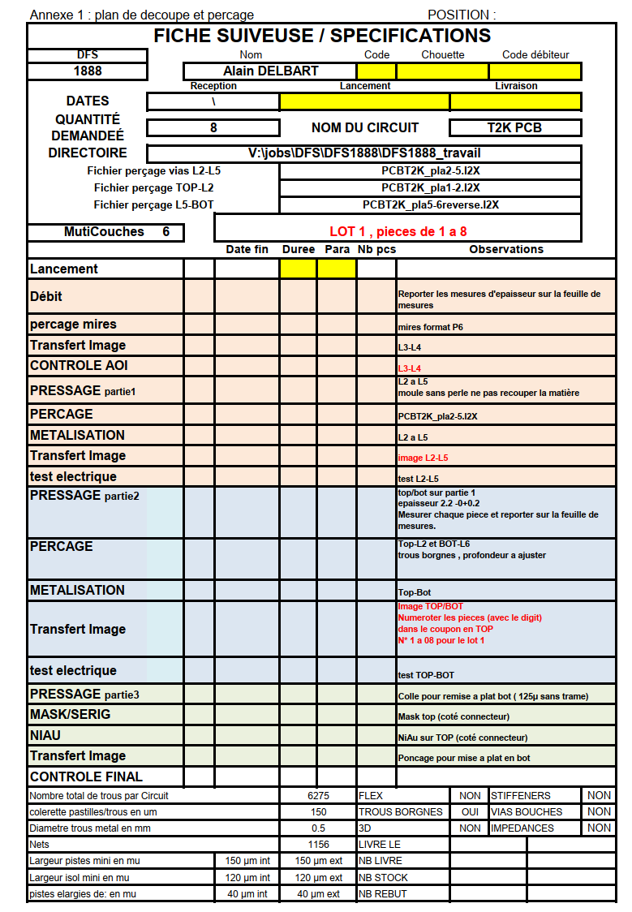
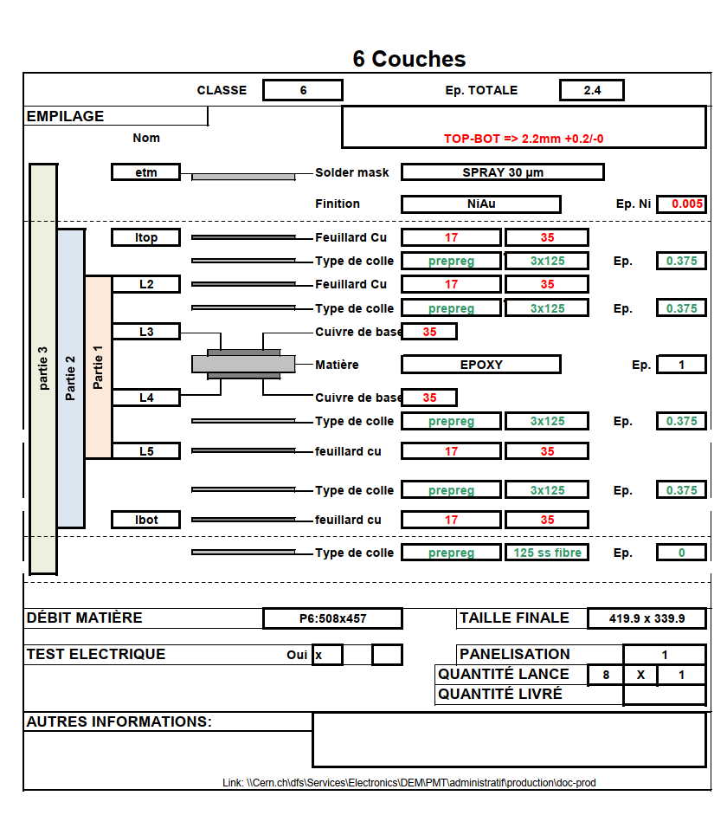
PCB flow chart & stack up

Slide 18
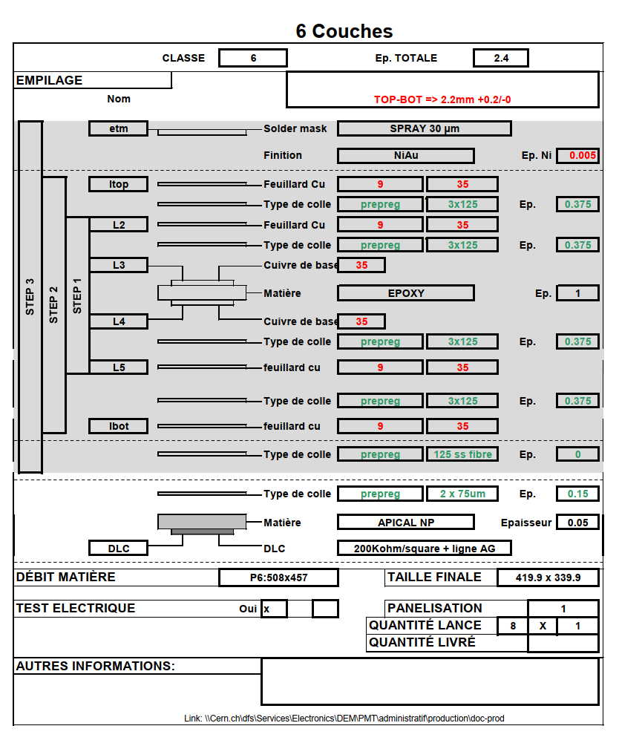
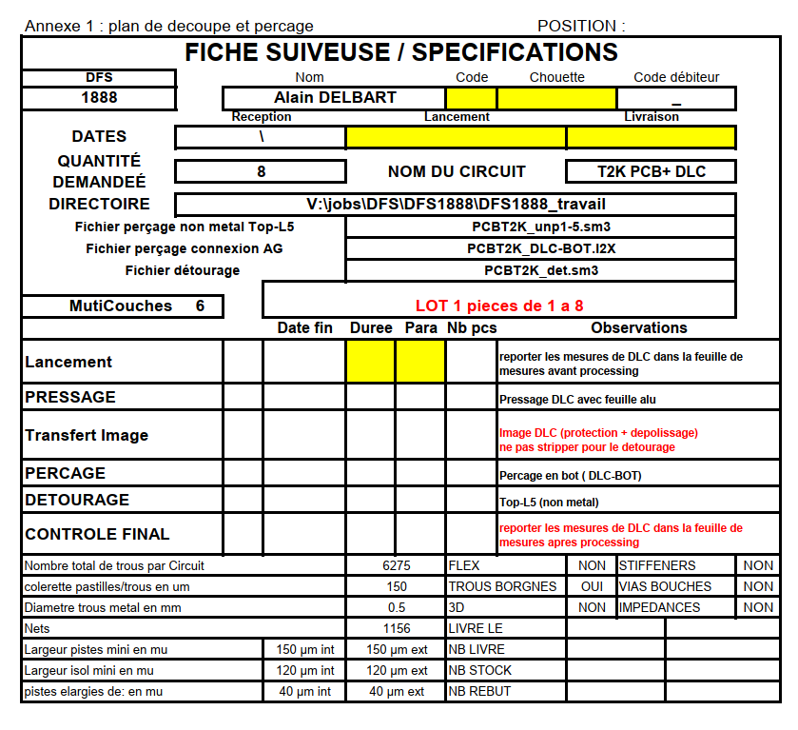
PCB + DLC flow chart & stack up

Slide 19
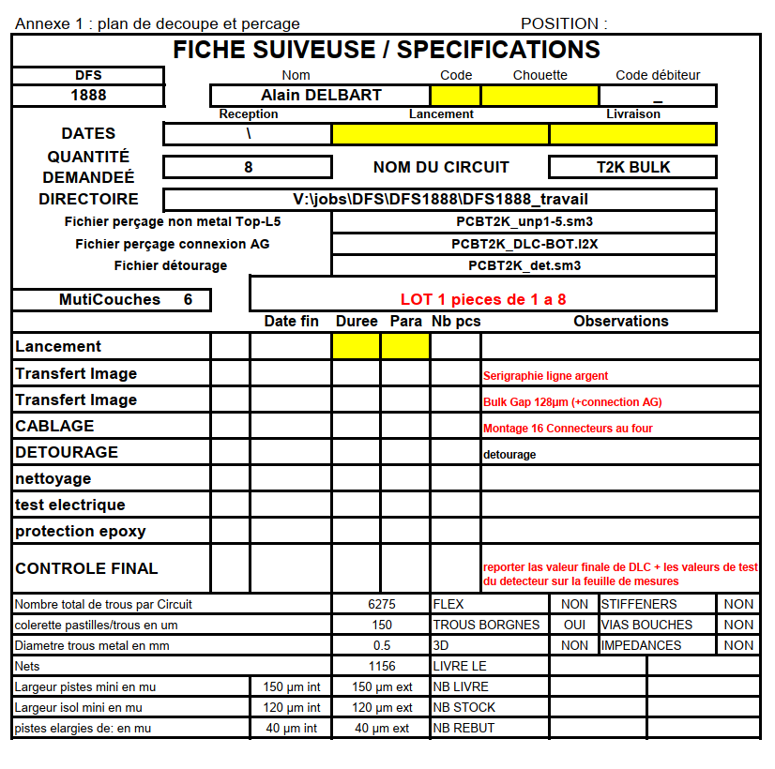
BULK flow chart

Slide 20
Planning
PCB production → 4 weeks for 8 PCBs
DLC production → 8 weeks for 4m2 or 12 weeks for 40m2
DLC mapping and selection → 2 weeks for 8 foils
DLC foil gluing → 2 weeks for 8 detectors
Mesh stretching → 2 weeks for 10 frames
Bulk Micromegas → 1 detector /week
Connectors Assembly → 8 detectors /week
Detector Finish → 1 detector /week
All these steps can be done in parallel
Resources:
  2 staffs + 4 FSUs + Bsputter + Seritec
  Raw Materials
    Apical Np in rolls easy to procure and we have some stock
    Glass epoxy for PCB easy to procure and we have some stock
    Mesh easy to procure and we have some stock
    Frames for mesh 6 on stock
    Photoimageable coverlay all the quantity needed on stock
    Protection covers easy to procure at CERN store

Slide 21
Thank you for your attention Questions ?

