Slide 1
Simulation results of the design iteration
J. A. García Matos, F. Toral.
12th November 2020

Slide 2
Outline
Introduction
Model Description
  Geometry & Materials
  Boundary conditions
  Contacts
Torque load definition
Model checks
Results of Present ID VS Shorter ID
Results of Present ID using 20 GPa VS 15 GPa cables
Work in progress
Conclusions

Slide 3
Introduction
As solution to improve MCBXFB performance shorter ID coils have been proposed.
The goals of the ongoing simulations are:
  Understand why the inner dipole coil heads are the cause of the majority of quenches.
  Evaluate if shorter ID coils could improve performance.

Slide 4
Outline
Introduction
Model Description
  Geometry & Materials
  Boundary conditions
  Contacts
Torque load definition
Model checks
Results of Present ID VS Shorter ID
Results of Present ID using 20 GPa VS 15 GPa cables
Work in progress
Conclusions

Slide 5

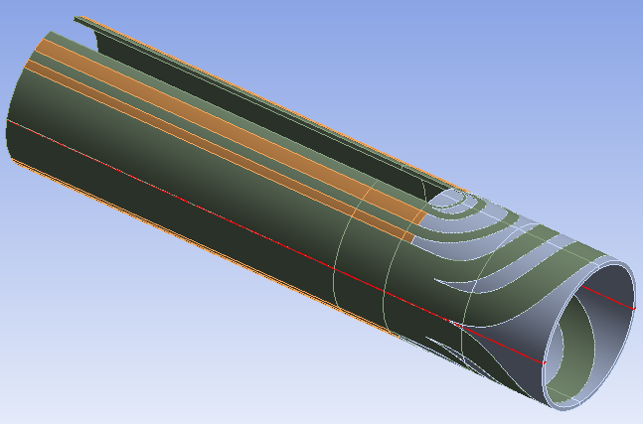
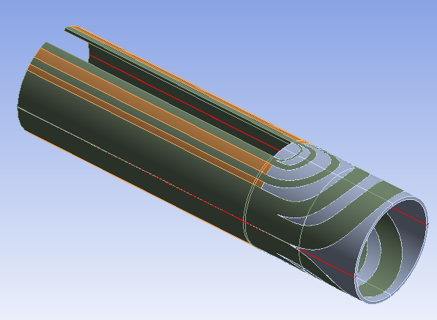
Geometry & materials
Only ID inner layer has been modelled for the sake of simplicity.
Real endspacers geometry was used to generate the corresponding coils and wedges by solid Boolean operations.
Full 4 quadrant model is used to assure precision. Several half symmetry application options have been tested and discarded by the moment.
Model is divided azimuthally in quadrants and in 4 sections along Z direction to ease torque load application:
  Fasten straight section (SS)
  Loose part of the straight section (Cantilever SS)
  Head beginning
  Head end
Isotropic materials used:
  Cables: 20 Gpa
  Wedges: 130 Gpa
  Endspacers: 193 Gpa
  Midplane Kapton: 2.5 Gpa
Only difference between present ID and shorter ID geometry is the Cantilever SS length

Slide 6
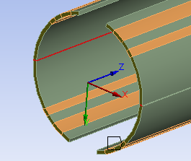
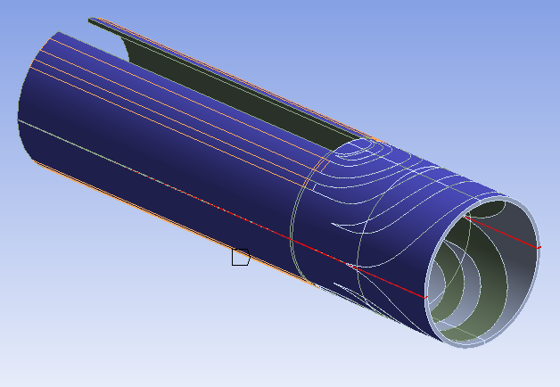
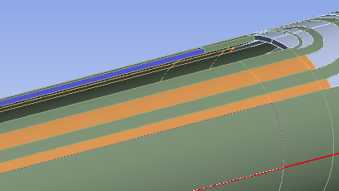
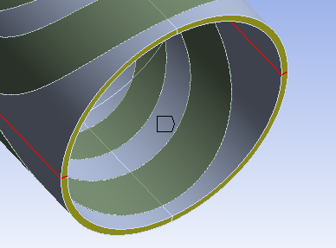
Boundary contitions
Mid-dipole displacement along Z = 0 | Radial displacement of outer face = 0
Half dipole symmetry | Collaring restriction
SS poles fixed at Q1 and Q3 | Σ Z Rot Dipole endface = 0
Torque locking provided by the collars | Fixed end (it can move along Z but not rotate)

Slide 7
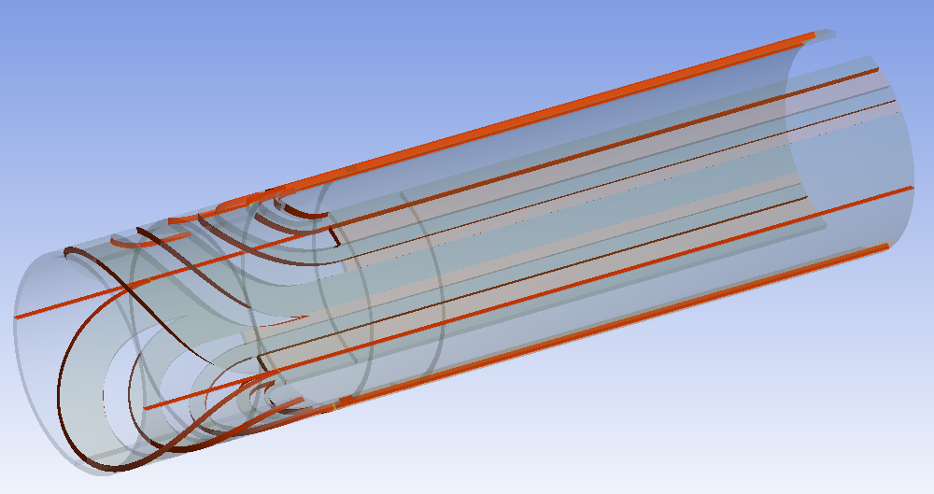
Contacts
Define between the different bodies: wedges, cables, endpacers and midplane kapton.
Same body interfaces share topology.
All the contacts are considered bonded as a first approximation to the problem.

Slide 8
Outline
Introduction
Model Description
  Geometry & Materials
  Boundary conditions
  Contacts
Torque load definition
Model checks
Results of Present ID VS Shorter ID
Results of Present ID using 20 GPa VS 15 GPa cables
Work in progress
Conclusions

Slide 9
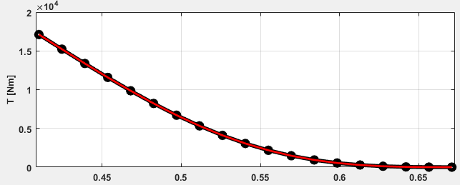
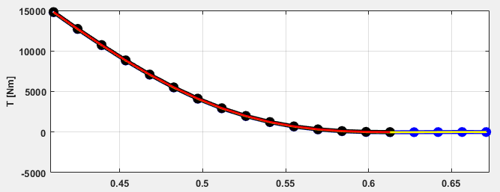
Torque load distribution along Z
410
Straight Section
EM Torque is the only load applied to the model (Room temperature is considered)
1st assumption: Coil cables suffer a torque profile like the one obtained at the magnet axis.
This torque profile is simplified by a polyline so constant torque can be applied at the different dipole sections along Z direction
Present ID
M_{SS} = 137 kNm/m
Shorter ID
M_{SS} = 151 kNm/m
410

Slide 10
Torque load distribution along Z
410
473
570
671
Straight Section
Cant. SS
Head beg.
Head end
EM Torque is the only load applied to the model (Room temperature is considered)
1st assumption: Coil cables suffer a torque profile like the one obtained at the magnet axis.
This torque profile is simplified by a polyline so constant torque can be applied at the different dipole sections along Z direction
Present ID
M_{SS} = 137 kNm/m
Shorter ID
M_{SS} = 151 kNm/m
Head beg.
Head end
410
413
511
612
Cant. SS

Slide 11
Torque load distribution along Z
410
473
570
671
Straight Section
Cant. SS
Head beg.
Head end
EM Torque is the only load applied to the model (Room temperature is considered)
1st assumption: Coil cables suffer a torque profile like the one obtained at the magnet axis.
This torque profile is simplified by a polyline so constant torque can be applied at the different dipole sections along Z direction
Present ID
M_{SS} = 137 kNm/m
Shorter ID
M_{SS} = 151 kNm/m
Head beg.
Head end
410
413
511
612
Cant. SS

Slide 12
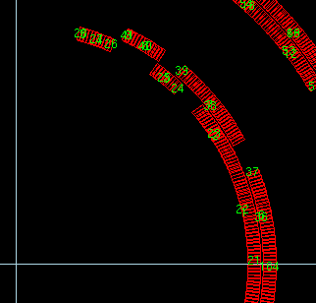
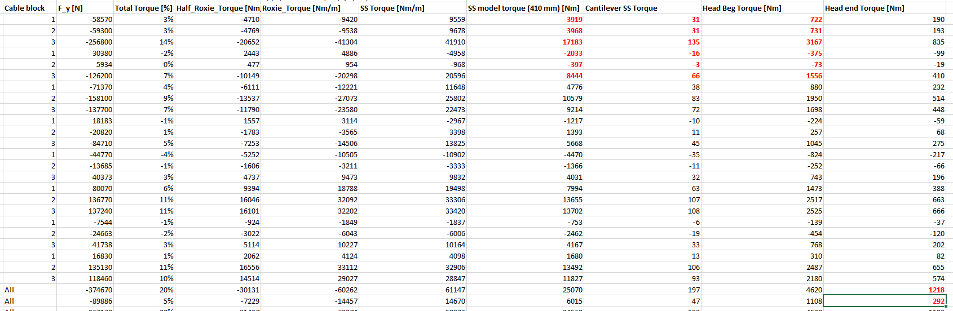
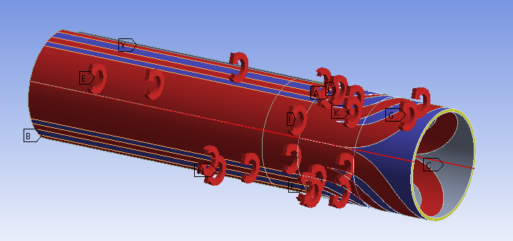
Azimuthal torque load distribution
2nd assumption: Torque distributes among the coil cable blocks as in a 2D Roxie simulation.
Torque load is proportionally computed for each coil block and sector and then applied in the model.

Slide 13
Outline
Introduction
Model Description
  Geometry & Materials
  Boundary conditions
  Contacts
Torque load definition
Model checks
Results of Present ID VS Shorter ID
Results of Present ID using 20 GPa VS 15 GPa cables
Work in progress
Conclusions

Slide 14
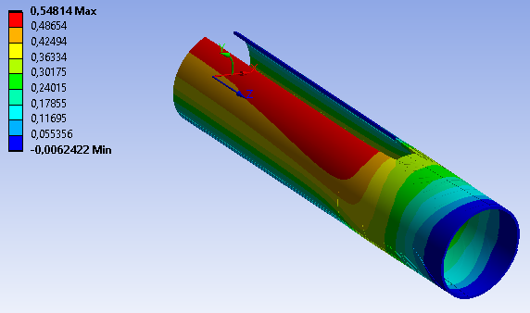
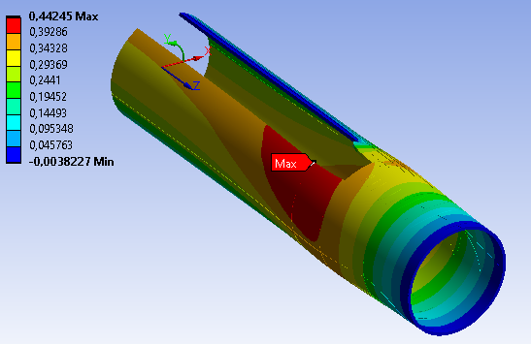
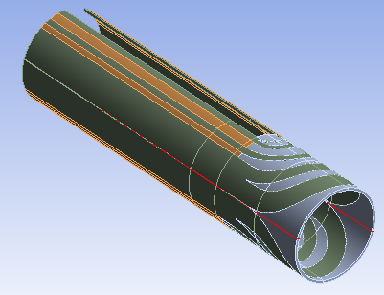
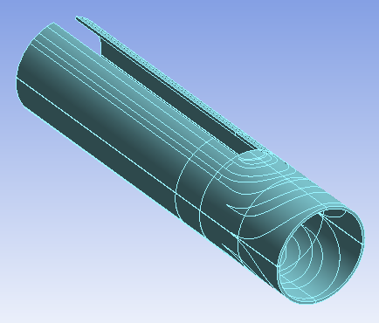
Smeared-out dipole (35 Gpa)
Smeared out results for a 35 GPa dipole are not far from the ones obtained with real materials.

Slide 15
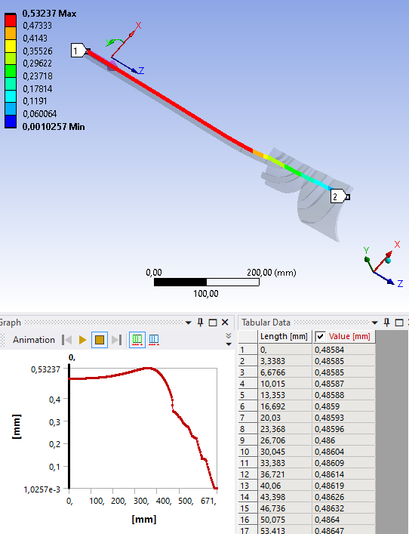
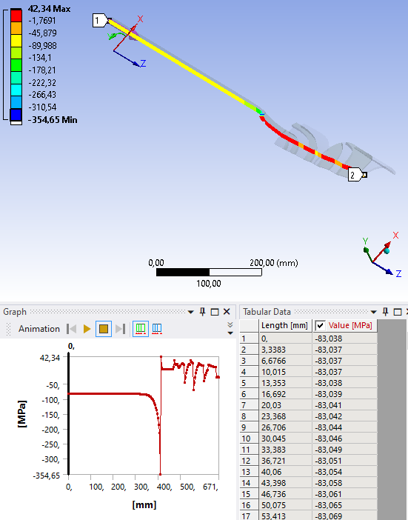
Stress at locked pole and displacement in the free one
Coherent with the arc length and smeared out straight section of 30 GPa
Free pole displacement
Locked pole azimuthal stress

Slide 16
Outline
Introduction
Model Description
  Geometry & Materials
  Boundary conditions
  Contacts
Torque load definition
Model checks
Results of Present ID VS Shorter ID
Results of Present ID using 20 GPa VS 15 GPa cables
Work in progress
Conclusions
All displacements have been graphically multiplied x40

Slide 17
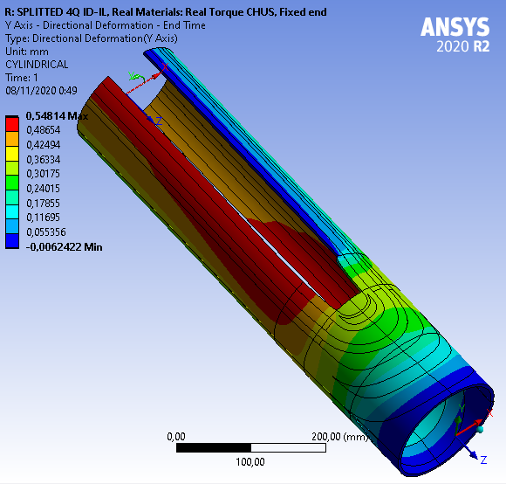
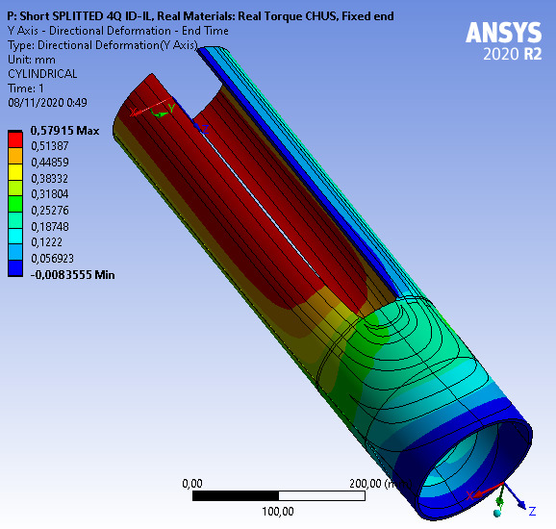
Azimuthal deformation
Present ID-IL
Shorter ID-IL

Slide 18
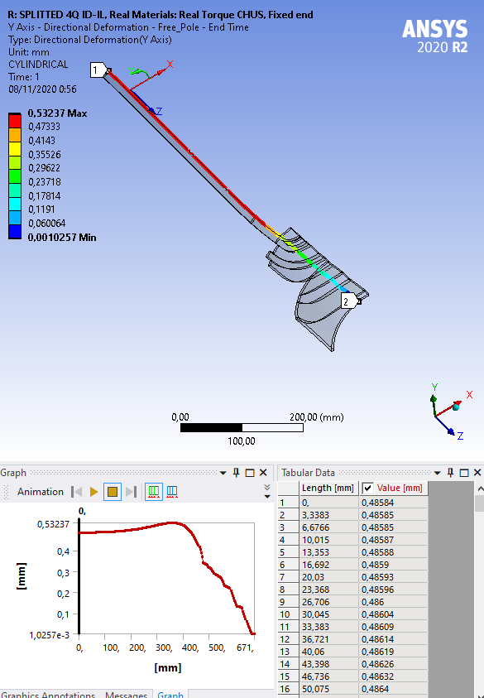
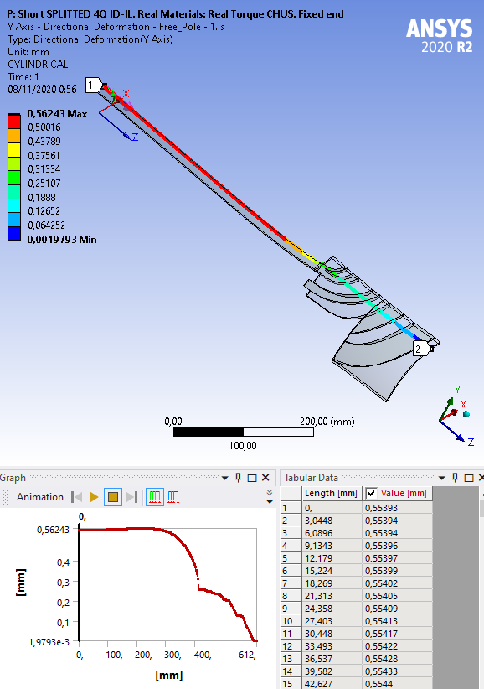
Path along Free pole: Azimuthal displacement
Present ID-IL
Shorter ID-IL

Slide 19
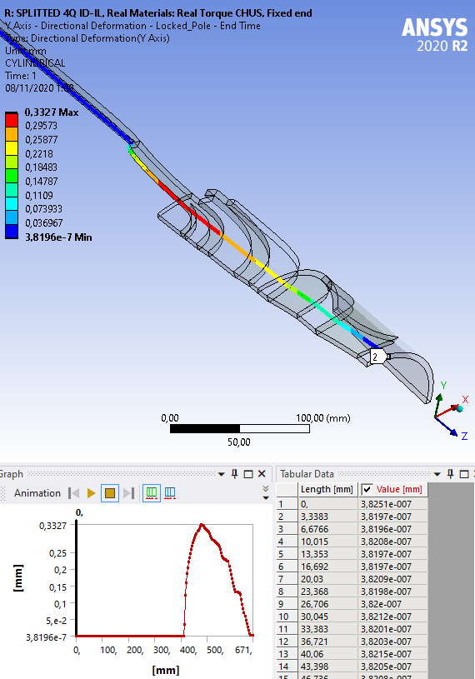
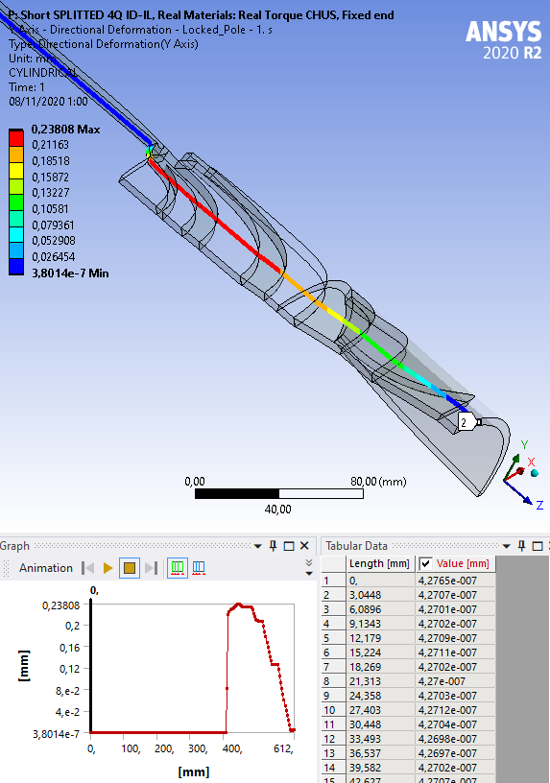
Path along Locked pole: Azimuthal displacement
Present ID-IL
Shorter ID-IL

Slide 20
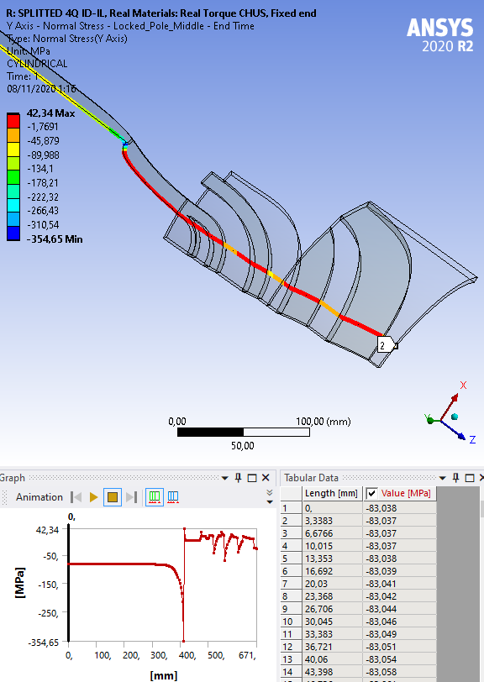
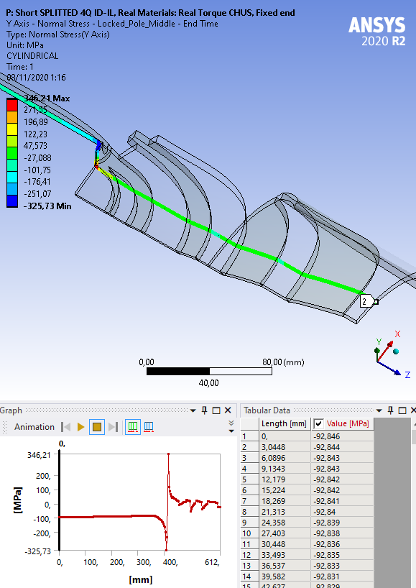
Path along Locked pole: Azimuthal Stress
Present ID-IL
Shorter ID-IL

Slide 21
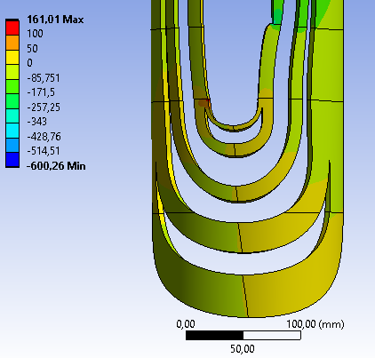
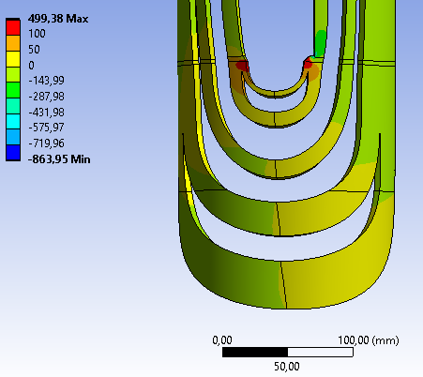
Cables: Azimuthal Stress
Present ID-IL
Shorter ID-IL

Slide 22
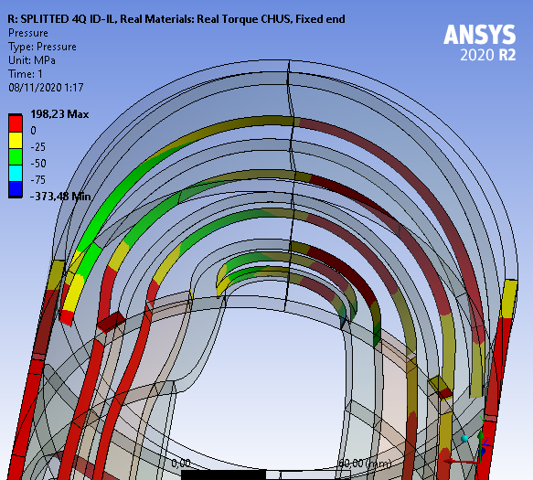
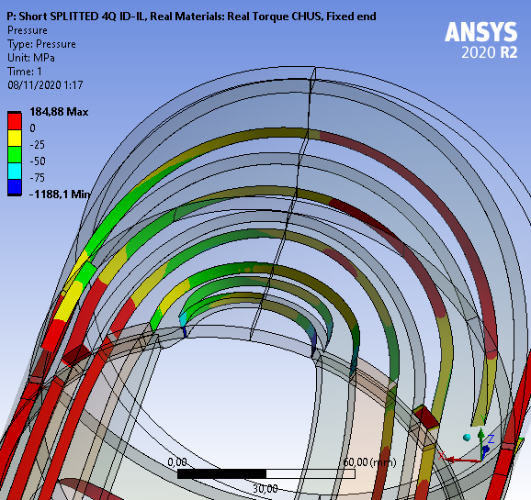
Contacts: Pressure
Present ID-IL
Shorter ID-IL

Slide 23
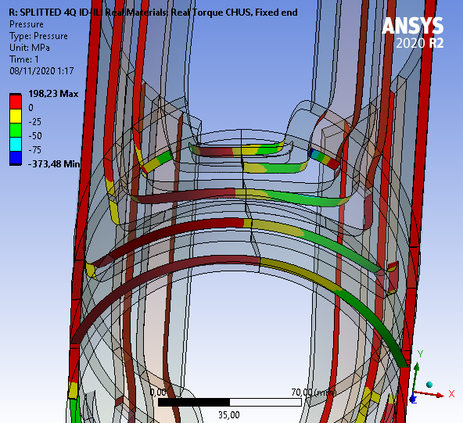
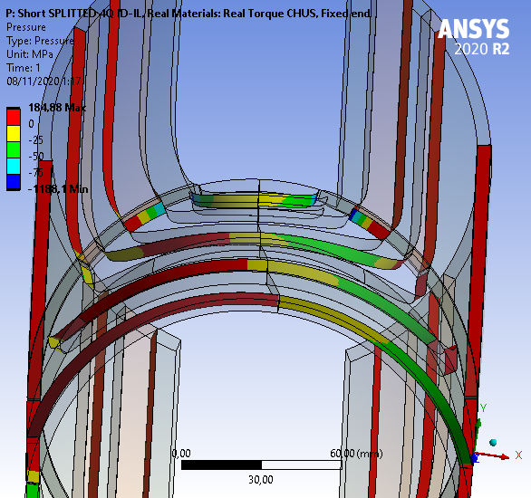
Contacts: Pressure
Present ID-IL
Shorter ID-IL

Slide 24
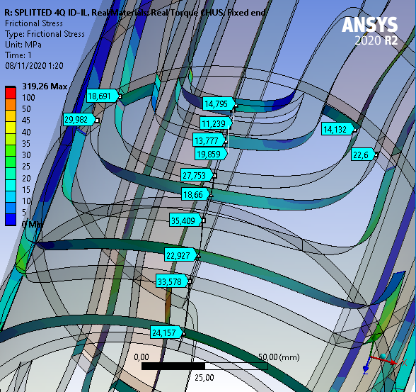
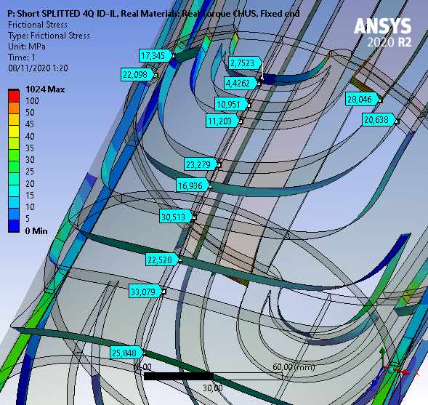
Contacts: Frictional Stress (Mid-coil)
Present ID-IL
Shorter ID-IL

Slide 25
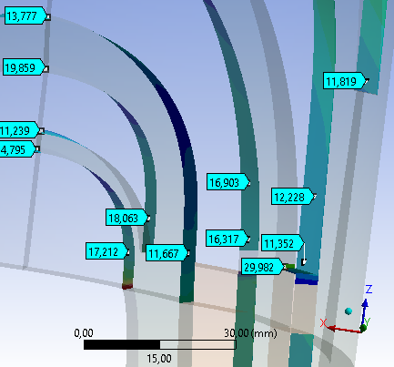
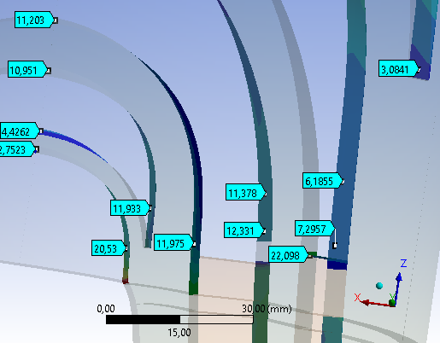
Contacts: Frictional Stress (Endspacers tips)
Present ID-IL
Shorter ID-IL

Slide 26
Outline
Introduction
Model Description
  Geometry & Materials
  Boundary conditions
  Contacts
Torque load definition
Model checks
Results of Present ID VS Shorter ID
Results of Present ID using 20 GPa VS 15 GPa cables
Work in progress
Conclusions
All displacements have been graphically multiplied x40

Slide 27
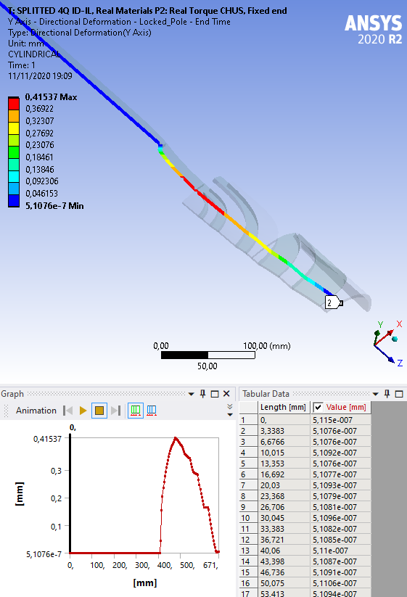
Path along Locked pole: Azimuthal displacement
Present ID-IL (P1, 20 GPa)
Present ID-IL (P2, 15 GPa)

Slide 28
Outline
Introduction
Model Description
  Geometry & Materials
  Boundary conditions
  Contacts
Torque load definition
Model checks
Results of Present ID VS Shorter ID
Results of Present ID using 20 GPa VS 15 GPa cables
Work in progress
Conclusions

Slide 29
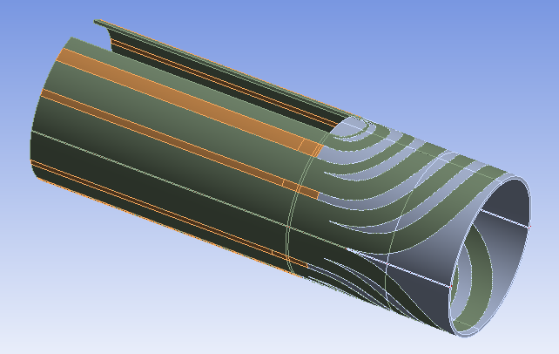
Work in progress
Outer Dipole Inner Layer model.
  Goal: Compare displacements and stress between both dipole heads.

Slide 30
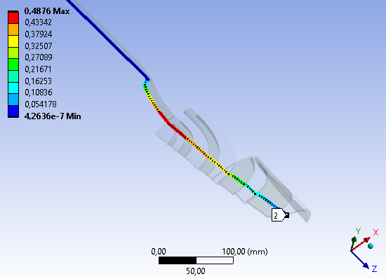
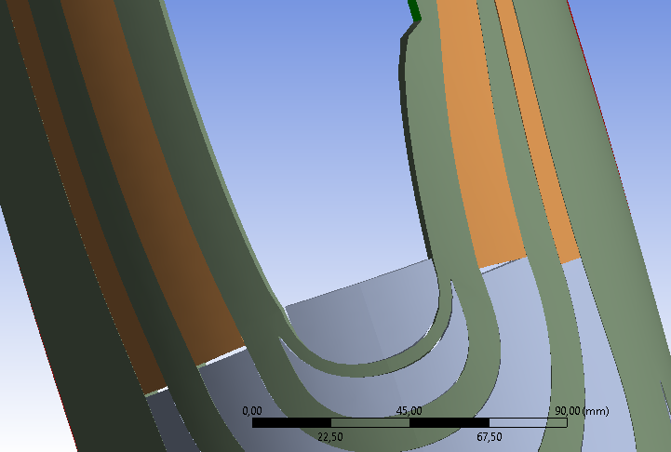
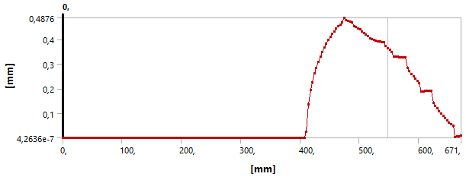
Work in progress
Outer Dipole Inner Layer model.
  Goal: Compare displacements and stress between both dipole heads.
Assessment of changes in the model:
  Frictionless contact at midplane Kapton while coupling Z displacements at dipole endface.
  Frictionless contacts at wedges/endspacer interfaces.
  Include pole preload.
Endspacers detaching from wedges cause maximum azimuthal displacement to increase from 0.33 to 0.48 !!

Slide 31
Outline
Introduction
Model Description
  Geometry & Materials
  Boundary conditions
  Contacts
Torque load definition
Model checks
Results of Present ID VS Shorter ID
Results of Present ID using 20 GPa VS 15 GPa cables
Work in progress
Conclusions

Slide 32
Conclusions
4Q ID-IL model has been developed in order to understand ID coil heads behavior under EM torsion.
First result seems coherent compared with analytic computations.
Using this model, azimuthal displacements and frictional stress, specially at endspacers tips are lower for a shorter version of the dipole.
Further analysis is necessary to evaluate model behavior, boundary conditions and contact definitions in order to know if the model results are trustworthy.

Slide 33
Thank you

Slide 34
Back-up slides

Slide 35
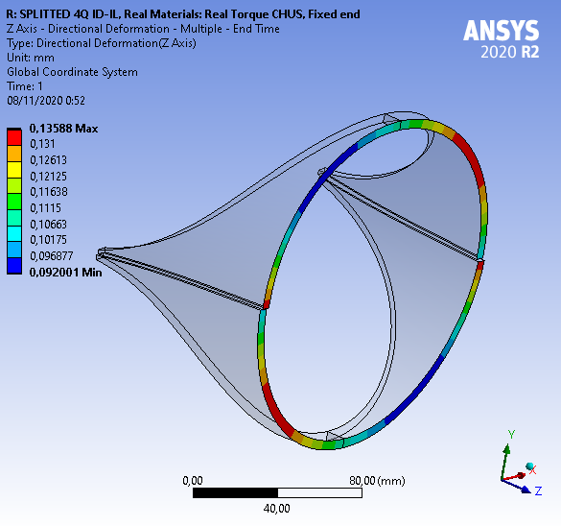
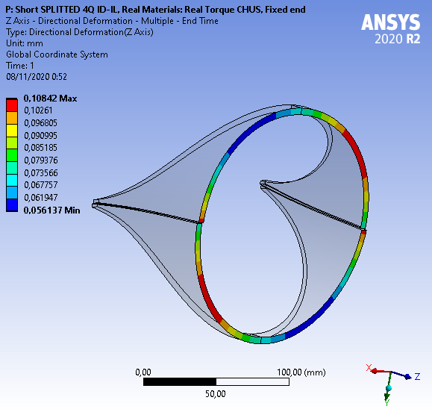
Z Displacement of saddle endspacers
Present ID-IL
Shorter ID-IL

Slide 36
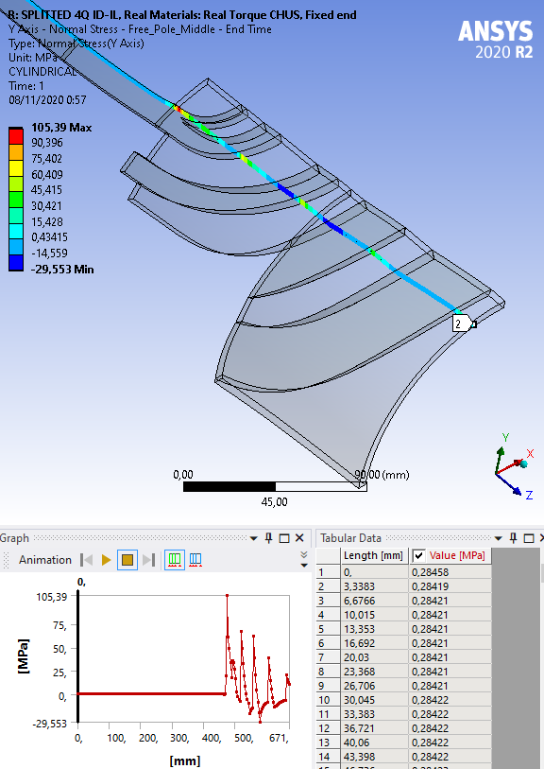
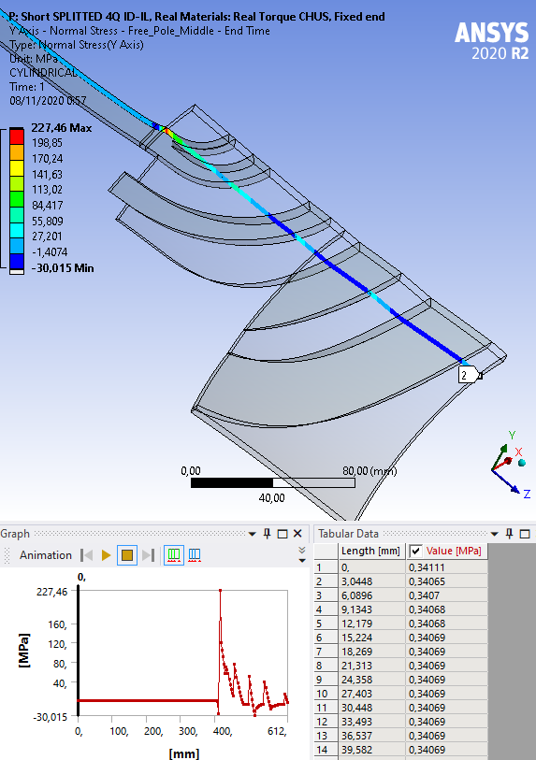
Path along Free pole: Azimuthal stress
Present ID-IL
Shorter ID-IL

Slide 37
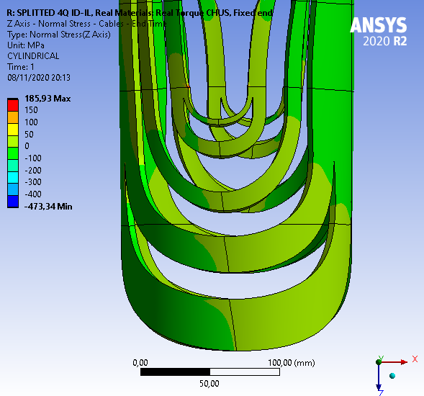
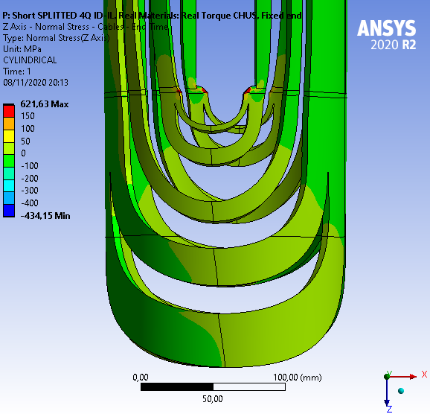
Cables: Z stress
Present ID-IL
Shorter ID-IL

Slide 38
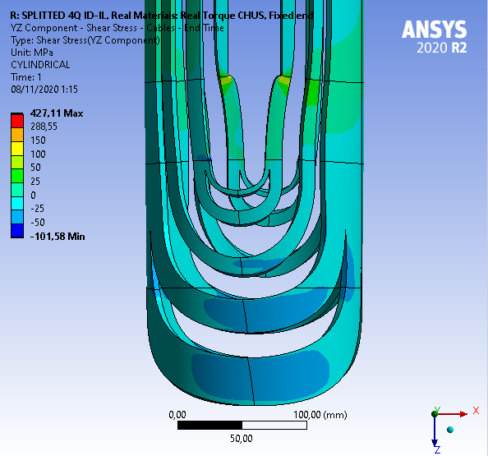
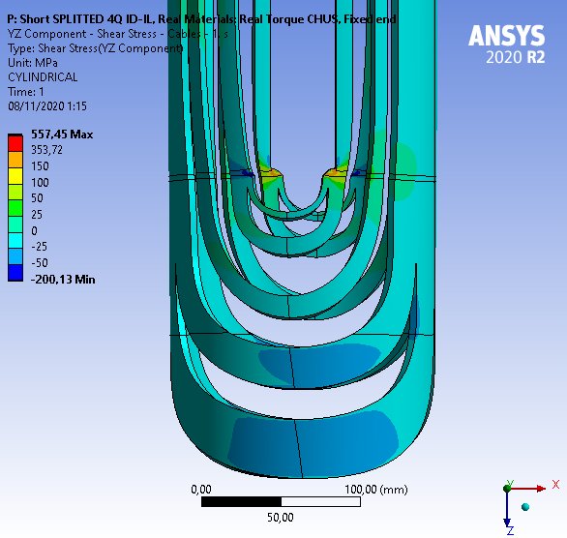
Cables: YZ Shear stress
Present ID-IL
Shorter ID-IL

Slide 39
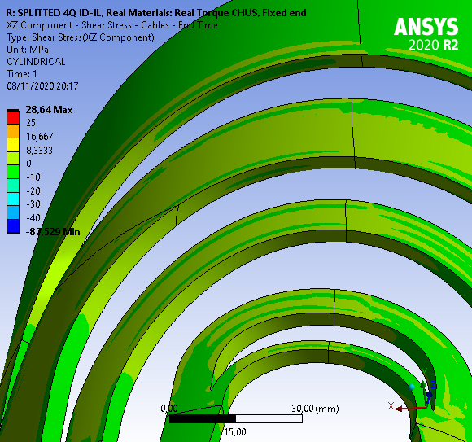

Cables: XZ Shear strees
Present ID-IL
Shorter ID-IL

Slide 40


Contacts: Frictional Stress (Gradient)
Present ID-IL
Shorter ID-IL

