Slide 1

Test results of MCBXFBP2a
Salvador Ferradás, Jerome Feuvrier, Jean-Luc Guyon, Franco Mangiarotti, Juan Carlos Pérez, Guillaume Pichon, Gerard Willering
Test plan: EDMS #2414418
WP3 Meeting – 12 November 2020
https://indico.cern.ch/event/973841/

Slide 2
Contents
HV Tests
Protection scheme
Cooldown & Warm-up
Cold powering
Conclusions

Slide 3
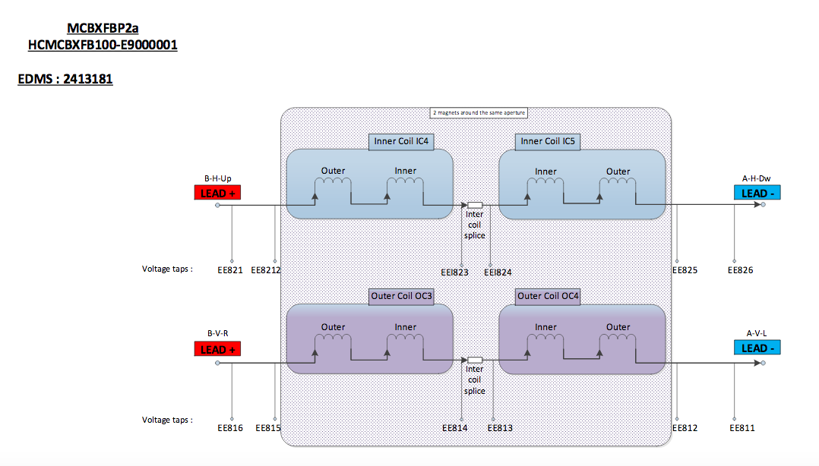
Electrical insulation test (I/III)
@Reception
SM18 Hall
293 K, Air
@Cryostat
Cluster D
293 K, Air
CD1 Before test
@Cryostat
Cluster D
1.9 K, He
CD1 Before test
Circuit | V [kV] | Time [s] | Resistance [GΩ]
Inner – GND | 2 | 60 | 140
Outer – GND | 2 | 60 | 104
Circuit | V [kV] | Time [s] | Resistance [GΩ]
Inner – GND | 2 | 60 | 19
Outer – GND | 2 | 60 | 16
Circuit | V [kV] | Time [s] | Resistance [GΩ]
Inner – GND | 2 | 60 | 5.7
Outer – GND | 2 | 60 | 17
MIT515
Voltage: 5 kV (+4%, -0%, ±10 V nominal test voltage at 1 GΩ load (0°C to 30°C)
Current: ±5% ±0.2 nA at all voltages (20 °C) [1].
[1] MIT515; 5 kV d.c. Insulation Resistance Testers; https://us.megger.com/5-kv-insulation-resistance-tester-mit525#technical

Slide 4
Electrical insulation test (II/III)
@Cryostat
Cluster D
1.9 K, He
CD1 After test
@Cryostat
Cluster D
4.5 K, He
CD2 Before test
@Cryostat
Cluster D
4.5 K, He
CD2 After test
Circuit | V [kV] | Time [s] | Resistance [GΩ]
Inner – GND | 2 | 60 | 54
Outer – GND | 2 | 60 | 12
Circuit | V [kV] | Time [s] | Resistance [GΩ]
Inner – GND | 1 | 60 | 31
Outer – GND | 1 | 60 | 6.9
Circuit | V [kV] | Time [s] | Resistance [GΩ]
Inner – GND | 1 | 60 | 29
Outer – GND | 1 | 60 | 14
MIT515
Voltage: 5 kV (+4%, -0%, ±10 V nominal test voltage at 1 GΩ load (0°C to 30°C)
Current: ±5% ±0.2 nA at all voltages (20 °C) [1].
[1] MIT515; 5 kV d.c. Insulation Resistance Testers; https://us.megger.com/5-kv-insulation-resistance-tester-mit525#technical

Slide 5
Electrical insulation test (III/III)
@Cryostat
Cluster D
4.5 K, He
CD3 Before test
@Cryostat
Cluster D
4.5 K, He
CD3 After test
Circuit | V [kV] | Time [s] | Resistance [GΩ]
Inner – GND | 1 | 60 | 40
Outer – GND | 1 | 60 | 11
Circuit | V [kV] | Time [s] | Resistance [GΩ]
Inner – GND | 1 | 60 | 25
Outer – GND | 1 | 60 | 21
MIT515
Voltage: 5 kV (+4%, -0%, ±10 V nominal test voltage at 1 GΩ load (0°C to 30°C)
Current: ±5% ±0.2 nA at all voltages (20 °C) [1].
[1] MIT515; 5 kV d.c. Insulation Resistance Testers; https://us.megger.com/5-kv-insulation-resistance-tester-mit525#technical

Slide 6
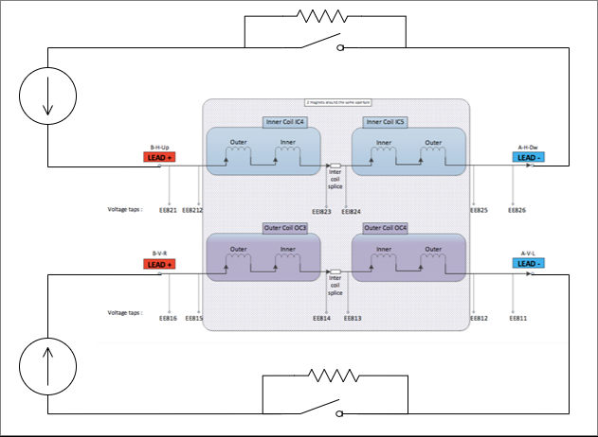
Protection scheme
EE: 150 mΩ
2 kA PC 1
2 kA PC 2
EE: 150 mΩ

Slide 7
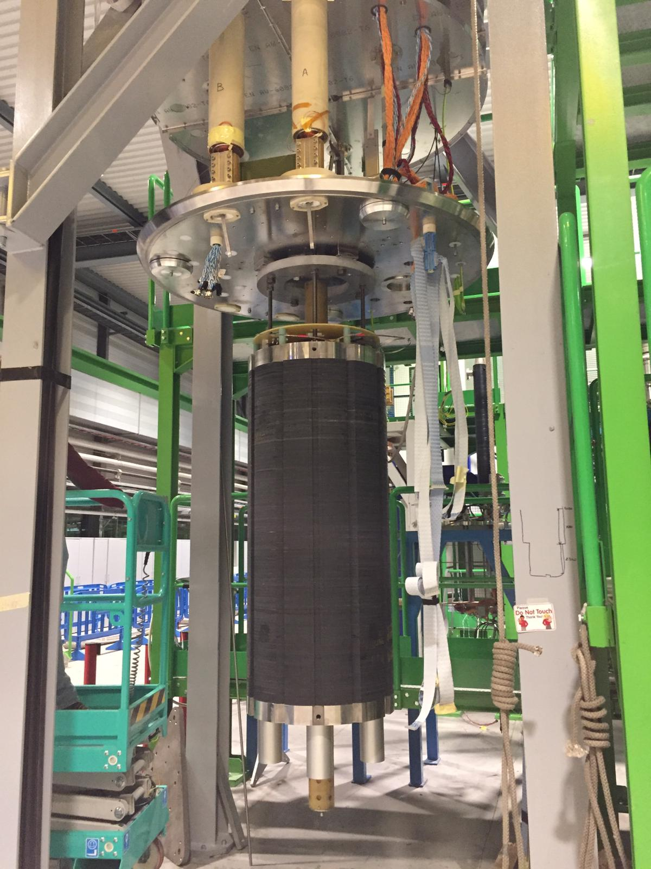

Cooldown 1
Warmup 1
Max allowed ∆T = 100 K
Max allowed ∆T = 100 K
Up A
Up
Middle
Down A
Down
Anomalous behavior of the sensors in the valve distribution box
Disclaimer: Approximate sensor positioning

Slide 8
Cooldown 2
Warmup 2

Slide 9
Cooldown 3
Warmup 3

Slide 10
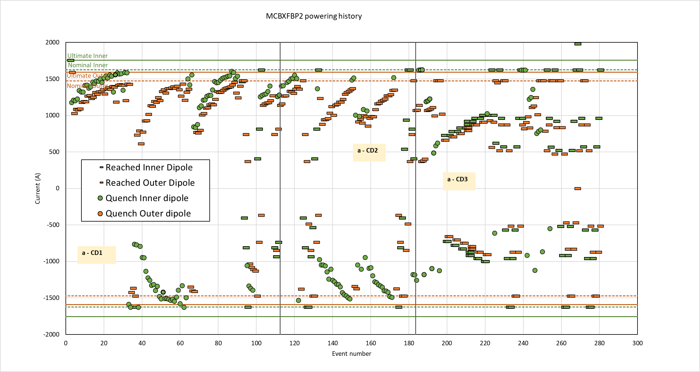
Summary of events, for completeness
A
B
C
D
E
F
G
H
I
J
K
MCBXFBP2a:
Reached ultimate in both circuits standalone
Reached 1980 A Inner circuit stand alone
280 Events
Reached nominal + torque
Reached 97% of -nominal torque
 | Training quenches
 | IC4 | IC5 | OC3
 | 91 | 83 | 4
Total | 177

Slide 11
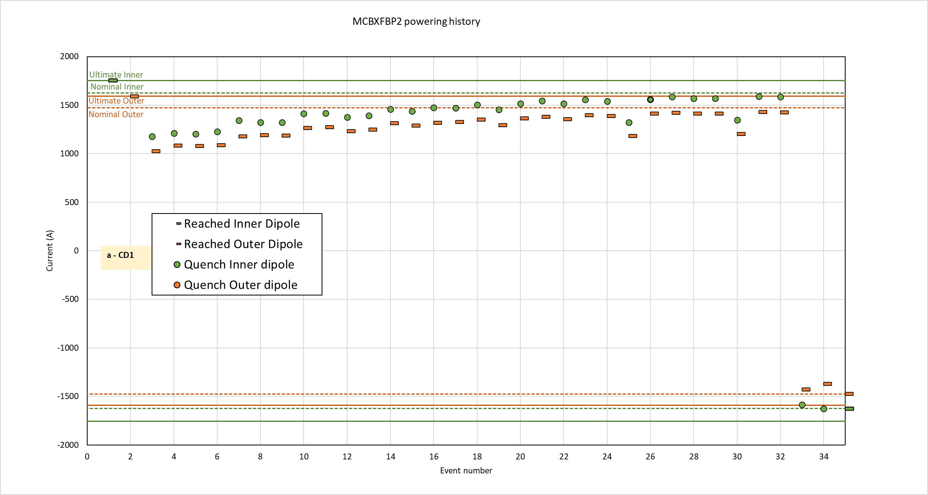
A. Training Q1 (from event 0)
MCBXFBP2a:
32 quenches to nominal
 | Training quenches
 | IC4 | IC5 | OC3
 | 20 | 11 | 1

Slide 12
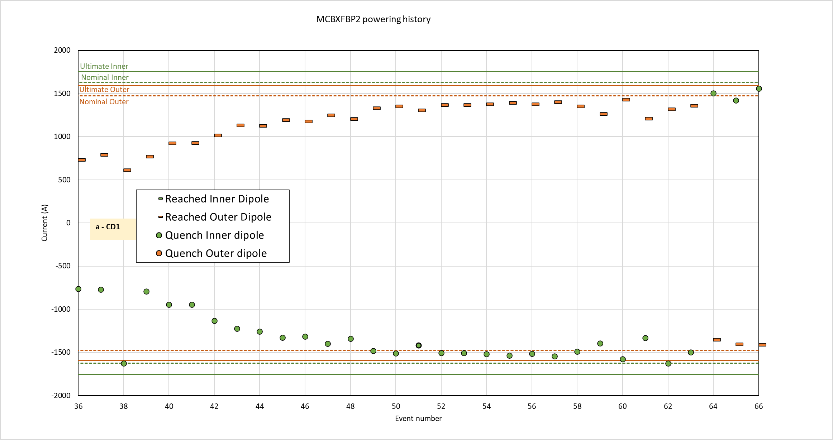
B. Training Q2 right after
MCBXFBP2a:
31 quenches
First quench at 23% of nominal torque
Reached 94% of nominal torque in event #60
 | Training quenches
 | IC4 | IC5 | OC3
 | 11 | 18 | 2

Slide 13
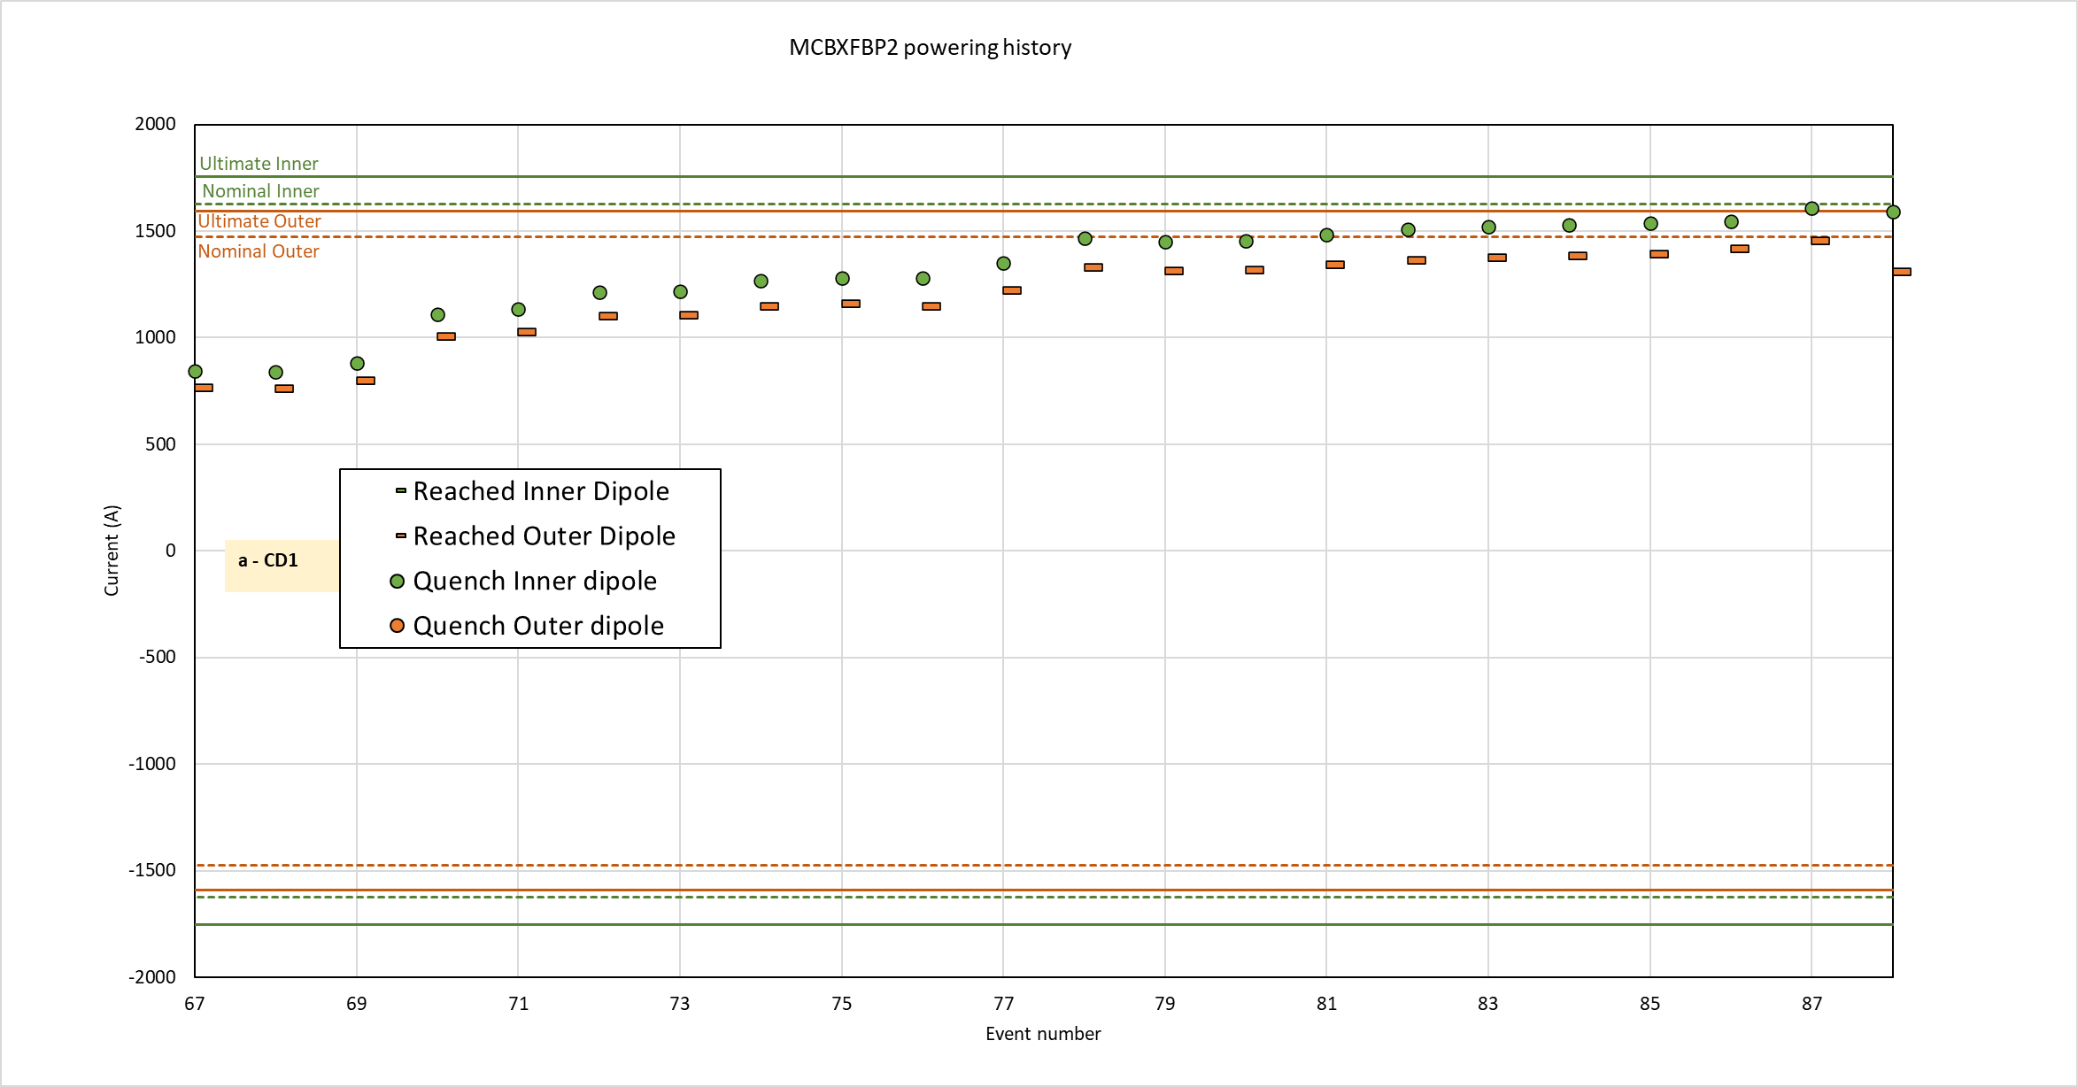
C. Training Q1 again right after
MCBXFBP2a:
22 quenches
First quench at 27% of nominal torque
Reached 97% of nominal torque in event #87
 | Training quenches
 | IC4 | IC5 | OC3
 | 12 | 10 | 0

Slide 14
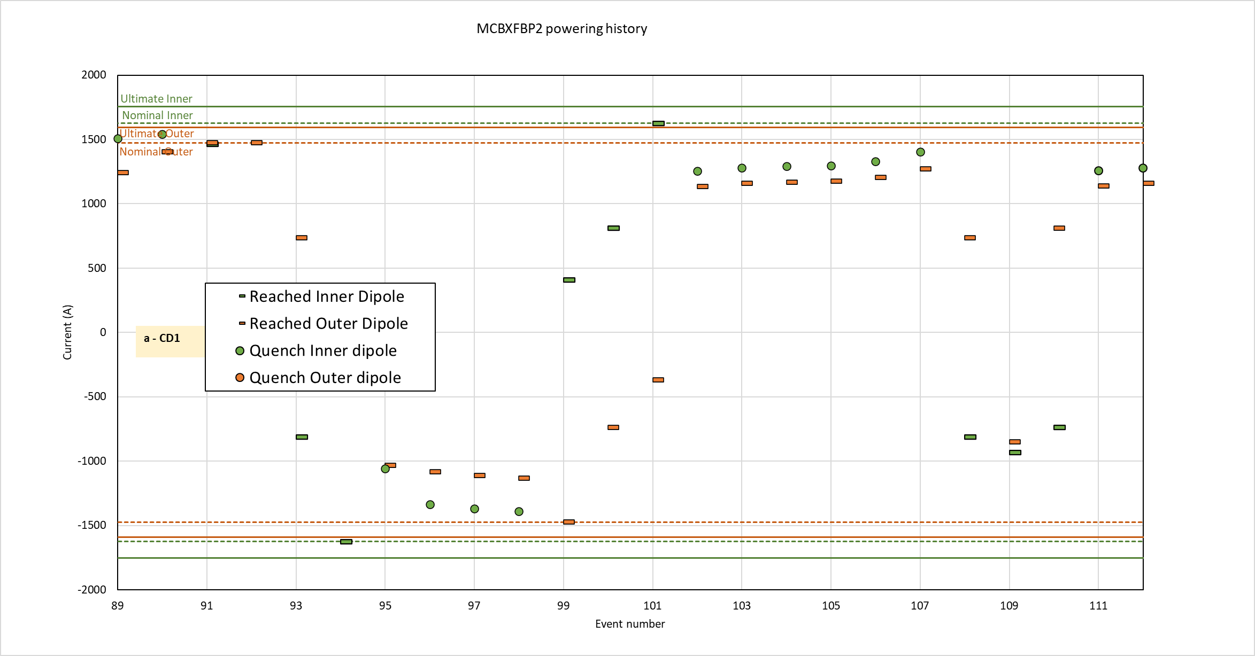
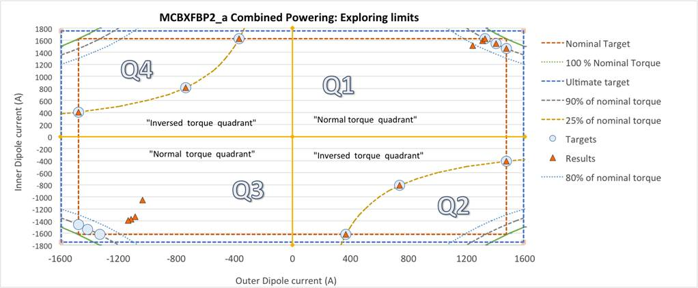
D. Quench free cycle before thermal cycle I/II
MCBXFBP2a:
Up to 90% of nominal torque in the first and third quadrant
  The magnet quenched twice before reaching the 90% target in Q1
  Quenched at 45% in Q3 after inversing the torque in Q2. Three more quenches were performed before moving to Q4. Target was not reached.
  A last ramp in Q1 (not shown in the plot bottom right) was performed after the last ramp in Q4 and the magnet quenched at 60% of nominal torque.
Up to 25% of nominal torque in the second and fourth quadrant
  Reached without quench in Q2 and Q3.

Slide 15
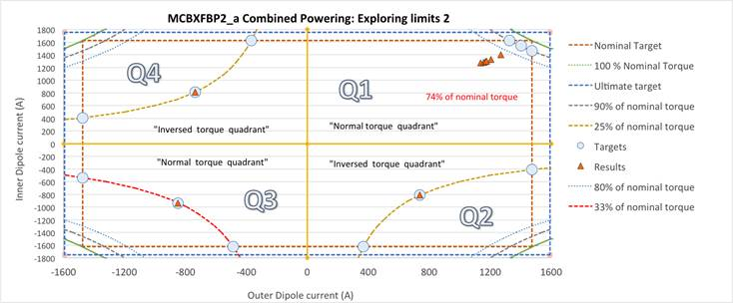
D. Quench free cycle before thermal cycle II/II
MCBXFBP2a:
1. The magnet was retrained up to 74% of nominal torque in Q1 (last event was at 60%), it took 5 more quenches
2. Reached 25% of nominal torque in quadrant 2 without quench
3. Reached 33% of nominal torque in quadrant 3 without quench
4. Reached 25% of nominal torque in quadrant 4 without quench
5. Ramp to quench in Q1, reaching 60% of nominal torque (not shown in the plot bottom right)

Slide 16
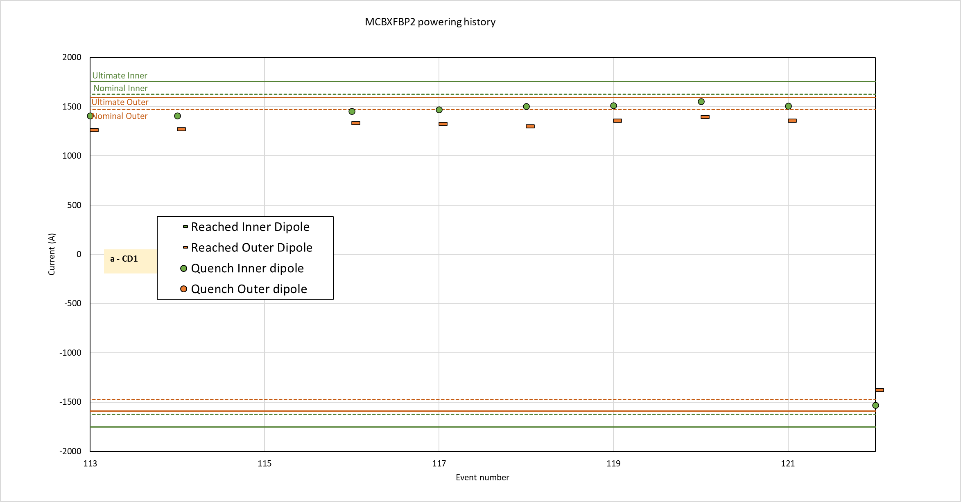
E. Training verification in Q1 after TC
CD 2
MCBXFBP2a:
Last quench in Q1 before TC at 61% of nominal torque
First quench at 75% of nominal torque
7 quenches until 90% of nominal after TC (9 in total in this test due to a bit of detraining in the last two)
Reached 90% of nominal torque in event #120
 | Training quenches
 | IC4 | IC5 | OC3
 | 6 | 3 | 0
CD 2

Slide 17
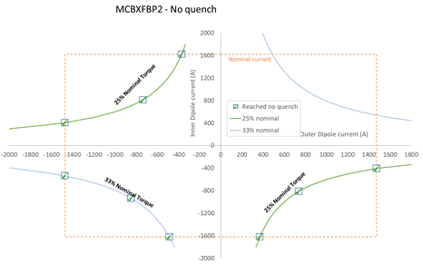
F. Quench free cycle after th cycle
MCBXFBP2a:
Verified the quench free region. 3 ramps in quadrant 2, 3 and 4, coming from training in Q1
OK 25% inversed torque
OK 33% direct torque
CD 2

Slide 18
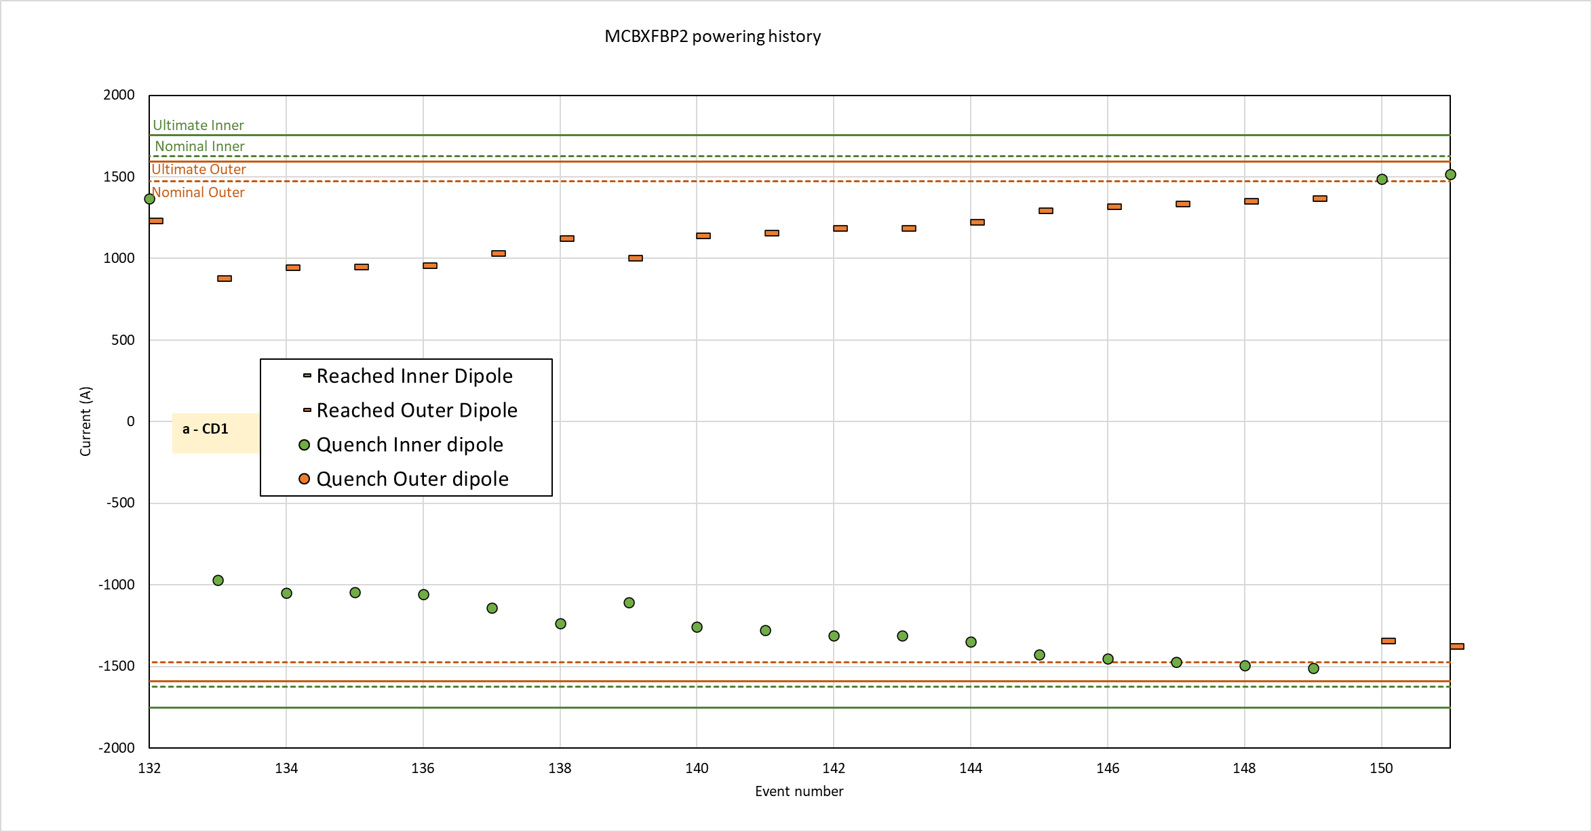
G. Training Q2 after TC
CD 2
MCBXFBP2a:
Quench in Q1 right after the quench free cycle
First quench at 35%
19 quenches until 87% of nominal torque
Reached 87% of nominal torque in event #151
 | Training quenches
 | IC4 | IC5 | OC3
 | 8 | 11 | 0
CD 2

Slide 19
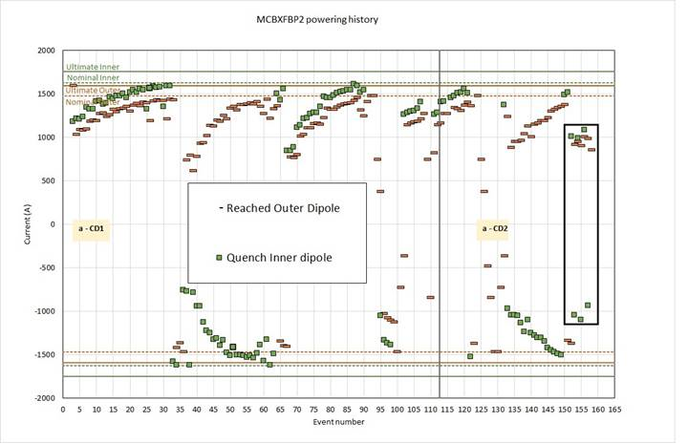
H. Alternating torque sense
CD 2
MCBXFBP2a:
8 quenches
Those quenches happened between:
• 33% and 45% of nominal torque, average 41%
• 58% and 68% of nominal field, average 64%

Slide 20
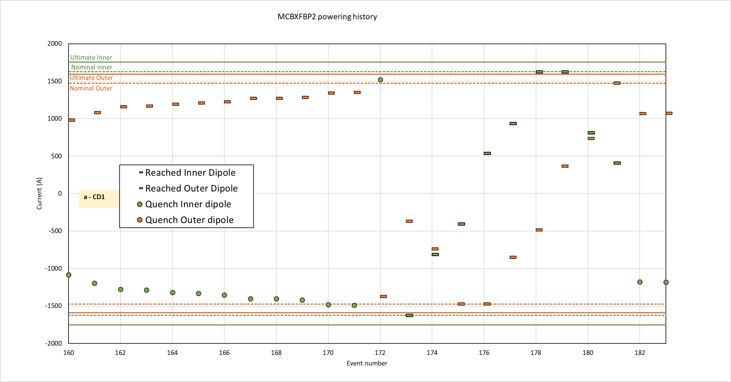
I. Re-train in Q2, quench free at 33% and circular cycle (I/II)
CD 2
MCBXFBP2a:
Coming from a quench in Q1
Re trained Q2 in 13 quenches from 44% to 85% of nominal torque and then verified in Q4
CD 2

Slide 21
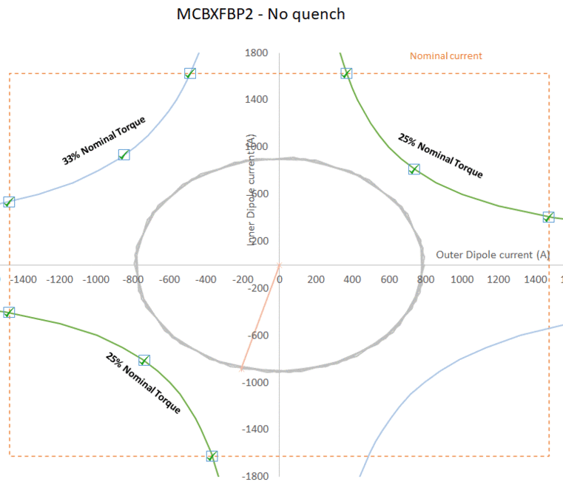
I. Re-train in Q2, quench free at 33% and circular cycle (II/II)
CD 2
MCBXFBP2a:
Coming from a quench in Q1
Re trained Q2 in 13 quenches from 44% to 85% of nominal torque and then verified in Q4
The circular cycle is not shown in the events plot
Quench in Q1 to reset after the training (event 172) before the quench free cycle
Quench free cycle targeting 33% of nominal torque (57% of nominal field) in Q4 and 25% of torque (50% of field) in Q1 and Q3.
A ramp to quench was performed in the diagonal after the cycle again in Q2 reaching 52% of nominal torque (72% of nominal field).

Slide 22
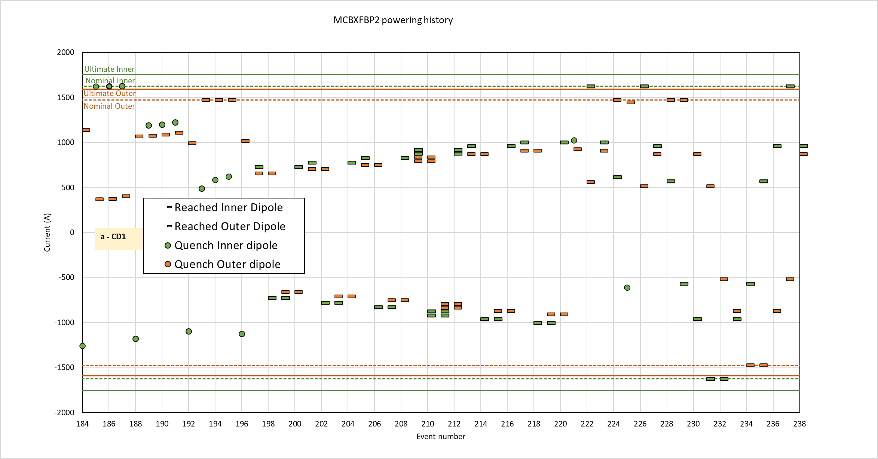
J. Verification of the powering sequence and more quench free cycles (I/III)
CD 3
MCBXFBP2a:
A third cooldown was requested
The magnet quenched twice in Q2 just before this cycle. This might explain the low quench current of the ramps in Q1
Ramp to quench in Q2: 60% of nominal torque
Ramp Inner in Q1 to nominal current and then outer until quench (3 cycles): 25,25,27 % of nominal torque
Ramp to quench in Q2: 52% of nominal torque
Ramp both magnets in diagonal until quench in Q1(3 cycles): 54,54,57 % of nominal torque
Ramp to quench in Q2 45% of nominal torque
Ramp Outer in Q1 until nominal and the inner until quench (3 cycles) 30, 36, 38 % of nominal torque
Ramp to quench in Q2 47 % of nominal torque
CD 3

Slide 23
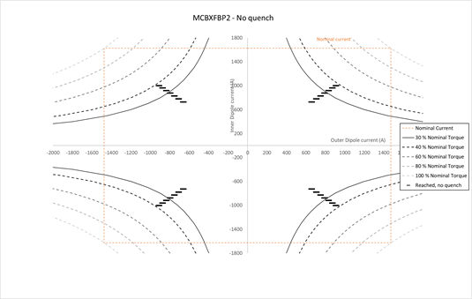
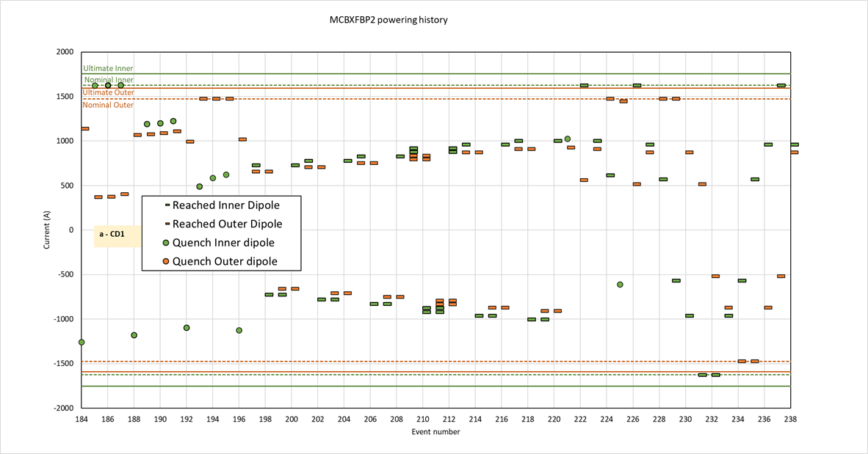
J. Verification of the powering sequence and more quench free cycles (II/III)
CD 3
MCBXFBP2a:
  Quench free cycle of 4 points (diagonals) 20, 23, 26, 29, 32, 35, 38% of nominal torque
  Quench when attempting 41%
CD 3

Slide 24
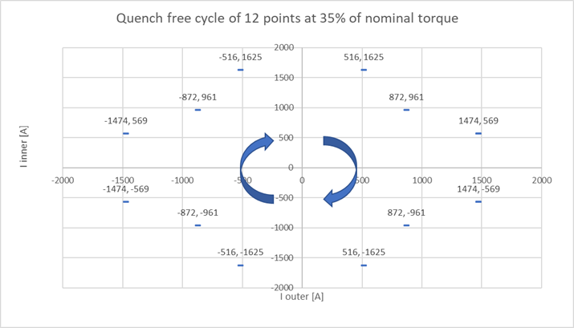
J. Verification of the powering sequence and more quench free cycles (III/III)
CD 3
MCBXFBP2a:
  Quench free cycle of 4 points (diagonals) 20, 23, 26, 29, 32, 35, 38% of nominal torque
  Quench when attempting 41%
  Quench free cycle attempt of 12 points at 38%, quench.
  Quench free cycle of 12 points at 35% OK

Slide 25
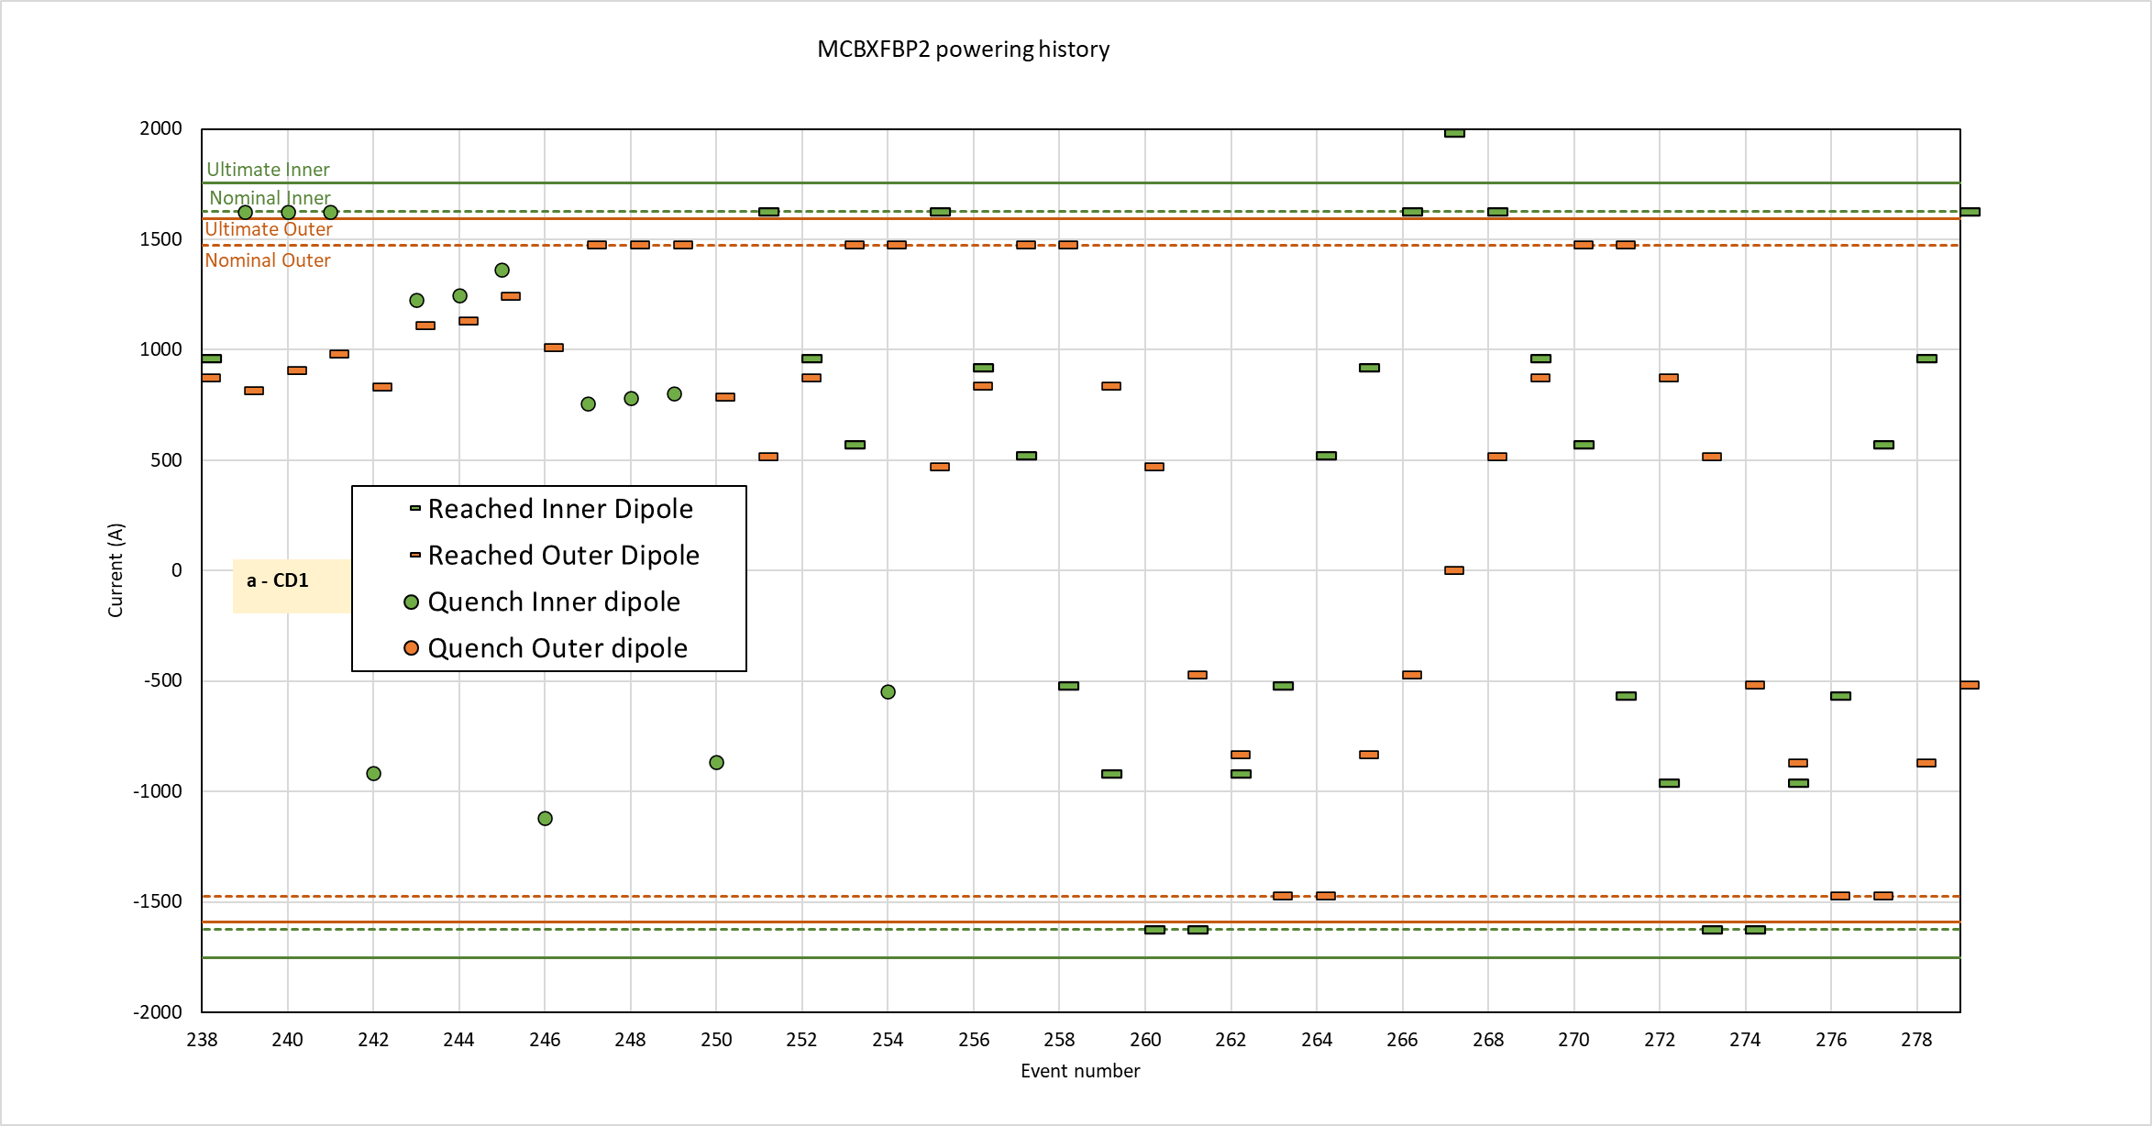
K. Second verification of the powering sequence and more quench free cycles (I/II)
CD 3
MCBXFBP2a:
Ramp to Q1 to 35% of nominal torque (event 238)
Ramp Inner in Q1 to nominal current and then outer until quench (3 cycles): 55, 61, 66 % of nominal torque
Ramp to quench in Q2: 31% of nominal torque
Ramp both magnets in diagonal until quench in Q1(3 cycles): 56, 58, 70 % of nominal torque
Ramp to quench in Q2 47% of nominal torque
Ramp Outer in Q1 until nominal and the inner until quench (3 cycles) 46, 48, 49 % of nominal torque
Ramp to quench in Q2 28 % of nominal torque
CD 3

Slide 26
K. Second verification of the powering sequence and more quench free cycles (II/II)
CD 3
MCBXFBP2a:
1. Attempted the 12 point quench free cycle at 35% of nominal torque (quench, event 254)
2. Successfully performed a 12 point quench free cycle at 32 % of nominal torque
3. Ramped Inner circuit alone to test stability at high current (event 267)
4. Successfully performed a 12 point quench free cycle at 35 % of nominal torque
CD 3

Slide 27
Conclusions
MCBXFBP2a:
Good margin in standalone configuration
  No quench inner nor outer
  Reached 1980 A in the inner circuit
33 quenches from new to nominal
~ 20 quenches from ~ nominal in one torque sense to ~ nominal in the other, when the magnet was already trained
Perfect memory after thermal cycle
Quench free region:
  Q1/Q3: ~35% of nominal torque Q2/Q4: ~35% of nominal torque
Ongoing: vibration analysis of the voltage signals

