Slide 1


Results from test 23
15th WP15 Meeting
Presenter
Dmitry Tikhonov
Early stage researcher
Helmholtz-Zentrum Berlin
dmitry.tikhonov@helmholtz-berlin.de
+49-30-8062-12922
EASITrain – European Advanced Superconductivity Innovation and Training. This Marie Sklodowska-Curie Action (MSCA) Innovative Training Networks (ITN) has received funding from the European Union’s H2020 Framework Programme under Grant Agreement no. 764879

Slide 2
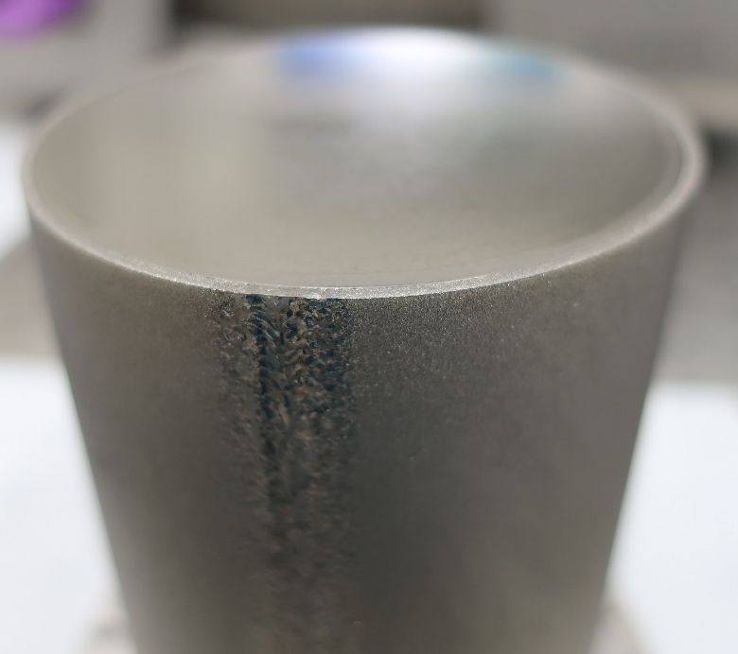
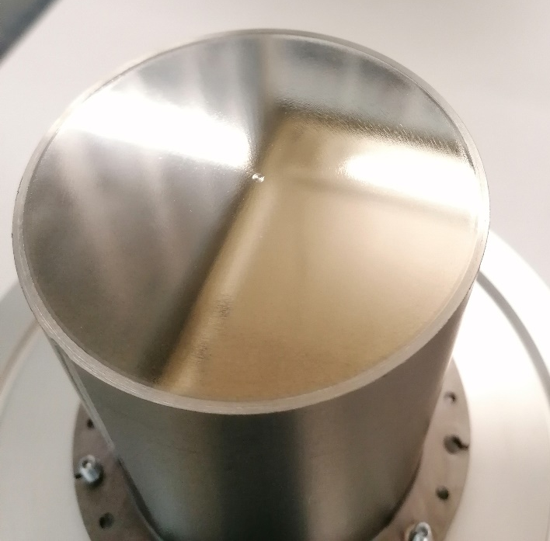
Testing sample
B-4.9 | B-3.7
Full HiPMS | DCMS
Chemical ‘polishing’ before coating | (BCP), exposed to air before SIS
Nb-AlN-NbN 4um-8nm-180nm | Nb-AlN-NbN 4um-35nm-200nm

Slide 3
Last SIS results
Low Rres ~40 nOhm
No non-monotonic
Good Rs vs B quality

Slide 4
Last SIS results
Low Rres ~40 nOhm
No non-monotonic
Good Rs vs B quality

Slide 5
BCS part
Low Rres ~40 nOhm
No non-monotonic
Good Rs vs B quality
BCS is lower

Slide 6
Last SIS results

Slide 7
Last SIS results
Nb-AlN-NbN
4um-35nm-200nm
Nb-AlN-NbTiN
bulk-15nm-75nm
J-Lab
Nb-AlN-NbN
4um-8nm-200nm

Slide 8
Second test of 3.7
Second test of B-3.7:
Peaks appear but changed
Reheating cavity up to 20 K and sample did not help
1st cooldown
2nd cooldown

Slide 9
IDEAS and explanations
Ideas:
Peaks appear due to thermal properties of the insulator layer
Flux trapping effects?
Effects bc. exposed to air?
Effects of the sample edges quality?

Slide 10
Last SIS results
Nb ~ 9.3 K
Reference
NbN >20K???
Tc NbN <17.2

Slide 11

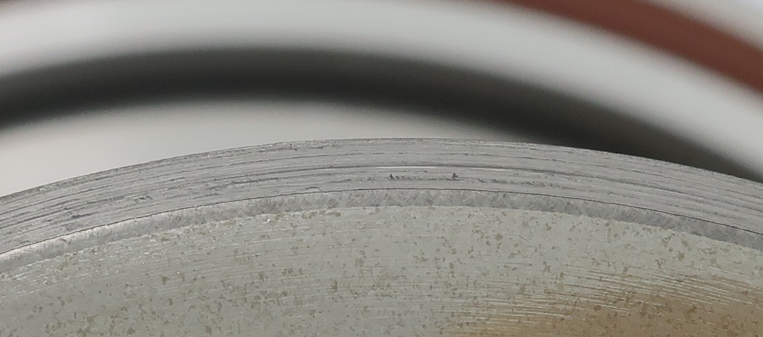
Difference
B 4.9 SIS with EP
Full EP sample:
No “Q-switches”
Lower Rres
Better performance at 1.3 GHz
“Other samples”

Slide 12
Last SIS results
Low Rres ~40 nOhm
No non-monotonic
Good Rs vs B quality

Slide 13
Last SIS results
Still high losses at Q3

Slide 14
Conclusions?
Non-monotonic effect
        Effect of thickness, make the thickness 20-25 nm?
        No exposure to air after each layer is the reason?
        Flux trapping?
        2. Chemical ‘polishing’ of the whole sample should be implemented in the procedure
 | Rres | Mx field | Tc
400 MHz | ~40 nOhm | ~35 mT | ??
800 MHz | ~140 nOhm | ~35 mT | ??

Slide 15
Conclusions?
 | Location, film
B-2 | CERN, Nb thick film
B-3 | HZB, SIS (siegen 35 nm)
B-4 | HZB, SIS (Siegen)
B-5 | RTU, Nb

Slide 16
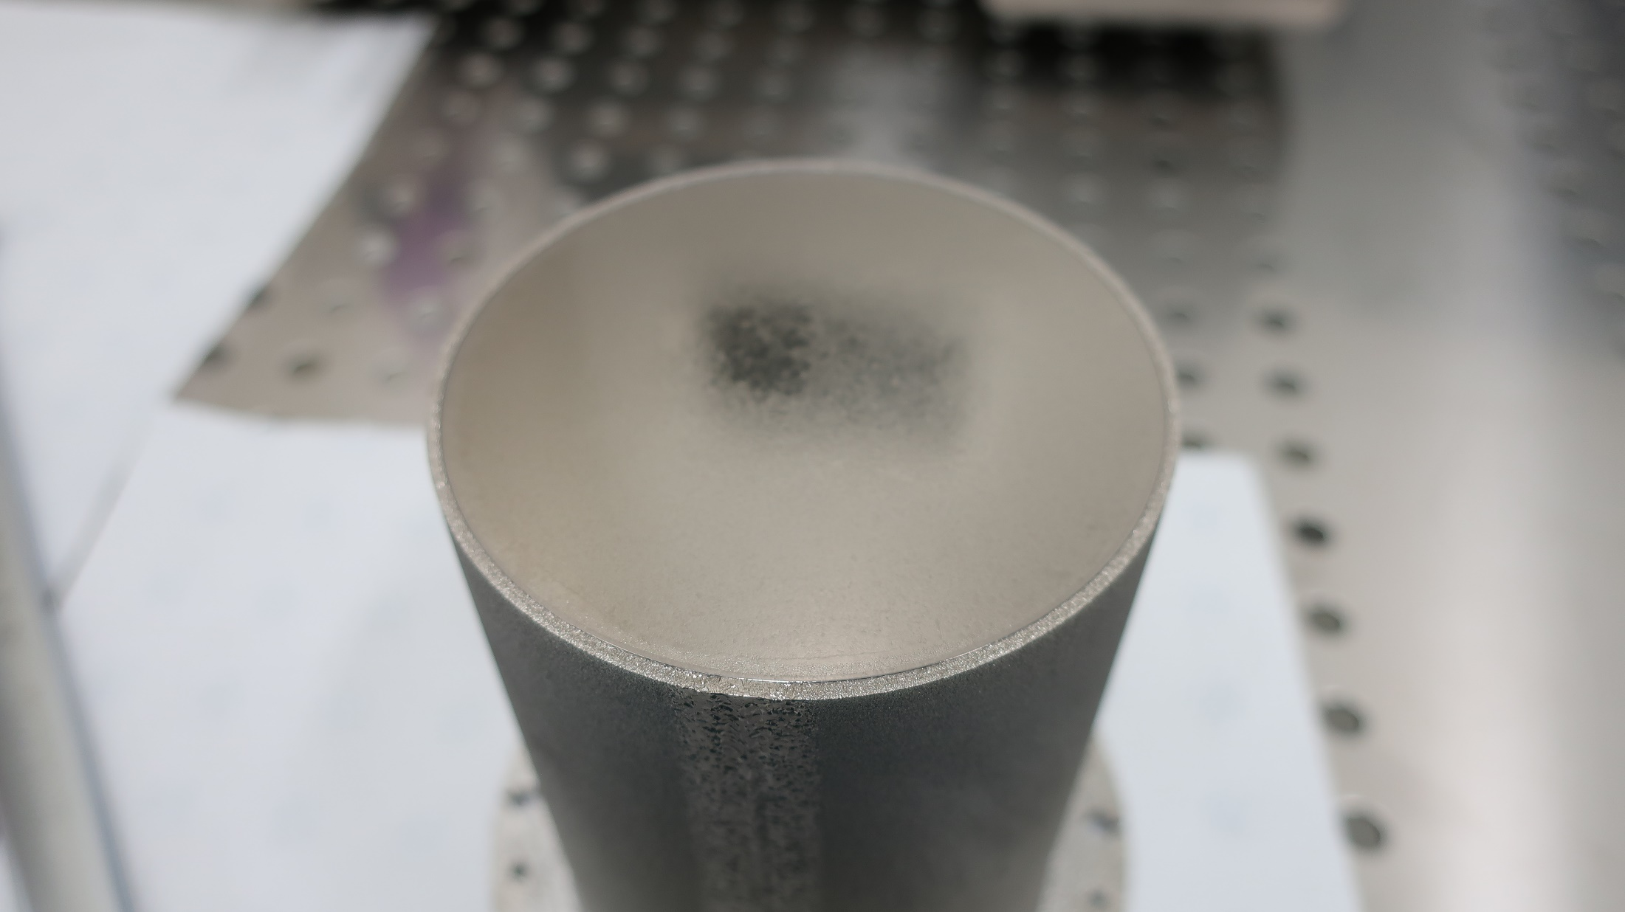
Last SIS results

Slide 17
Last SIS results

Slide 18
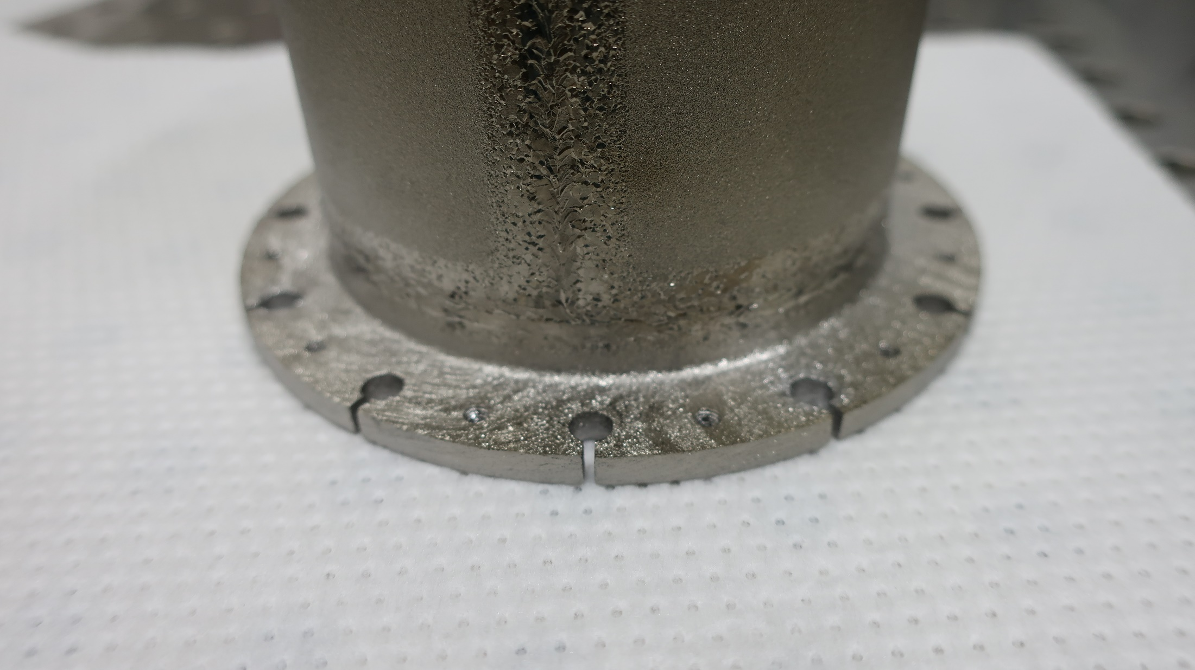
Last SIS results

