Slide 1
BI LHC Planning for LS2
Global LHC LS2 Planning
https://espace.cern.ch/en-dep-mef-lpc/LS2/Global%20Schedules/Forms/AllItems.aspx
BI Planning

Slide 2
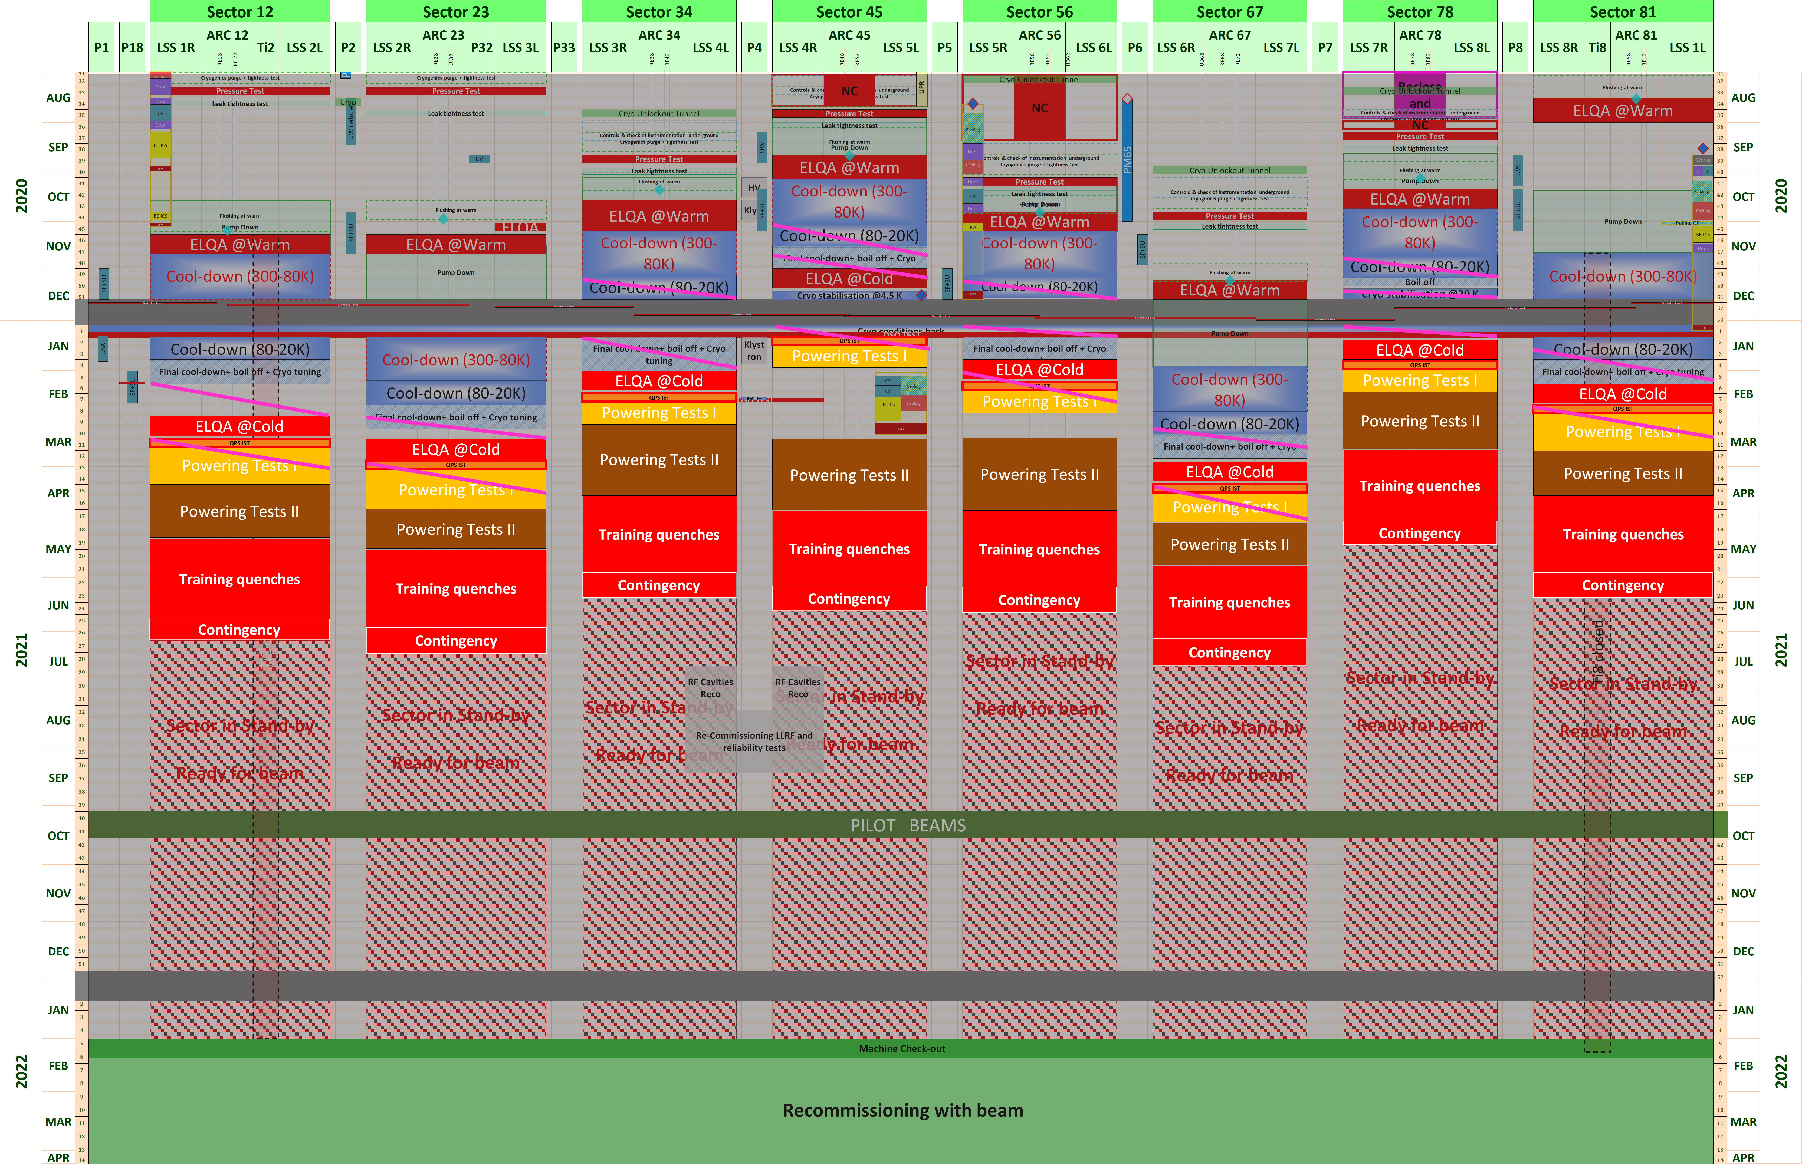
In-work Global planning LHC-LS2 V3.1
Annual Maintenance

Slide 3
Up-date of main activities with VSC implication
BPM.11L3.B2. Finally, replaced faulty internal cryogenic cable and the cryostat flange
BSRT mirror LSS4L possible replacement end 2021

Slide 4
Other activities
BLM: Following smoothly the planning
BPM maintenance
BTV maintenance
BRAN maintenance
Others?

Slide 5
Activities 2021
Handover for EN-ACE to BE-OP in February 2021
When does BI want to do what in 2021 after February?
  Do we need access for instrument calibration for the pilot beams?
  For all activities between February 2021 and October 2021 check with Jörg Wenninger and Matteo Solfaroli and EN-ACE, please keep me in the loop
  Need to make a list on our side as a starting point. Any inputs?
Annual Maintenance starts after pilot beams

Slide 6
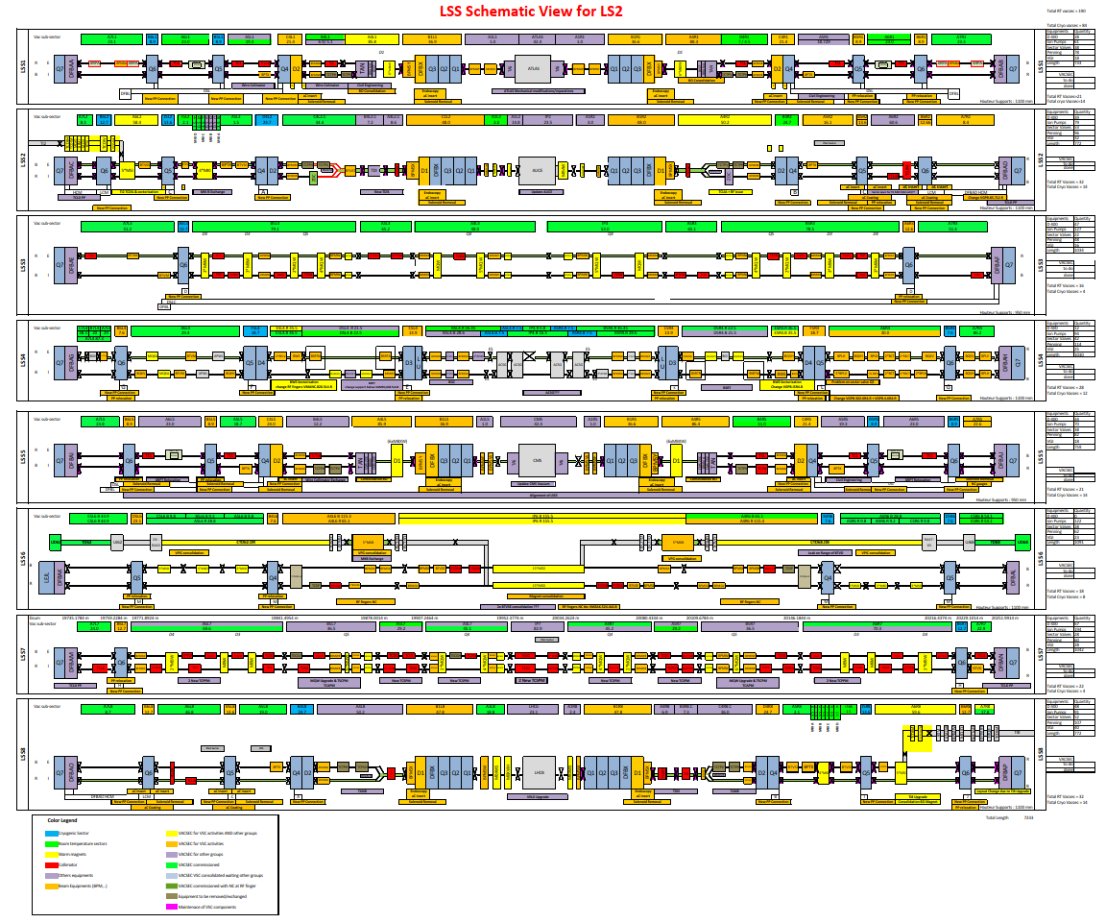
Latest Vacuum Schematic
If you cannot read that: Check Indico https://indico.cern.ch/event/857131/

