Slide 2
L4 Status
13 Nov 2020

Slide 3
General news/schedule
As from FOM
Quite some investigation on RF phases drift
Next 2 weeks only beam to main dump, bo beam to LBE
After: 1 week last setups → connection to PSB Dec 7th
TS stop (with access possible) : 4-6 January

Slide 4
BI MDs
ToF tests (next Tuesday): CCDTL1 @ nominal, downstream cavities at minimum power (as during phasing) → scan phase of low power cavities → monitor any change in ToF
SIS (to be scheduled) to shorten pulse while grids/scanners IN
  Systematic studies to check it works → no long pulsed go through wires

Slide 5
Outstanding issues

Slide 6
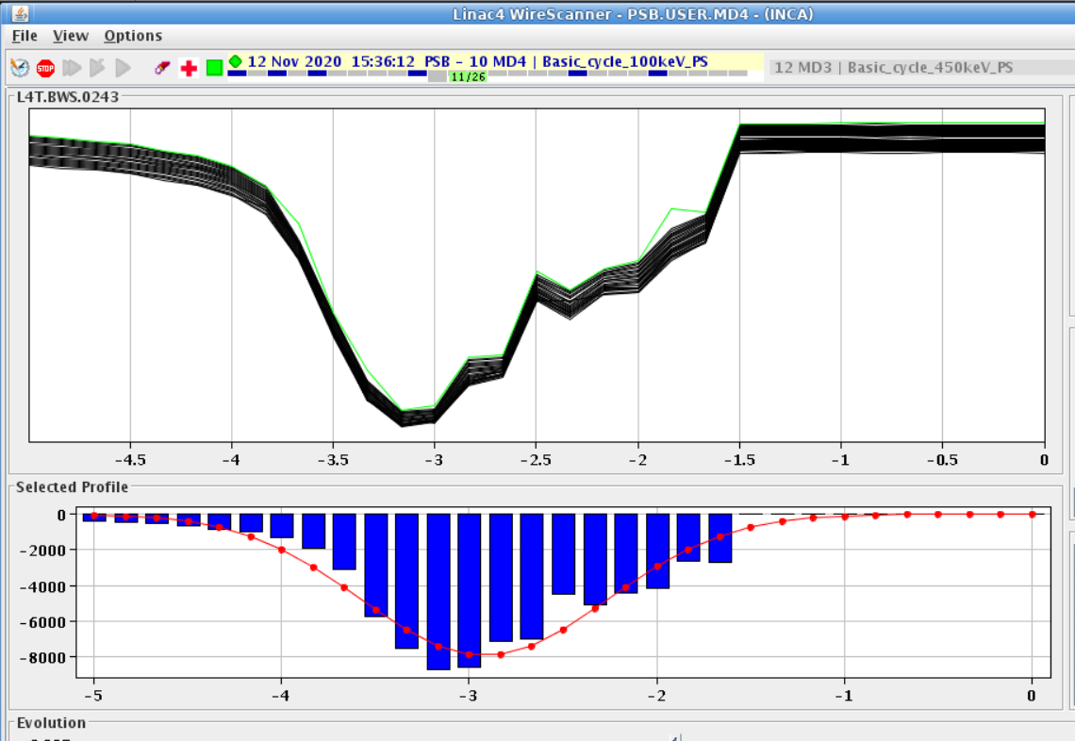
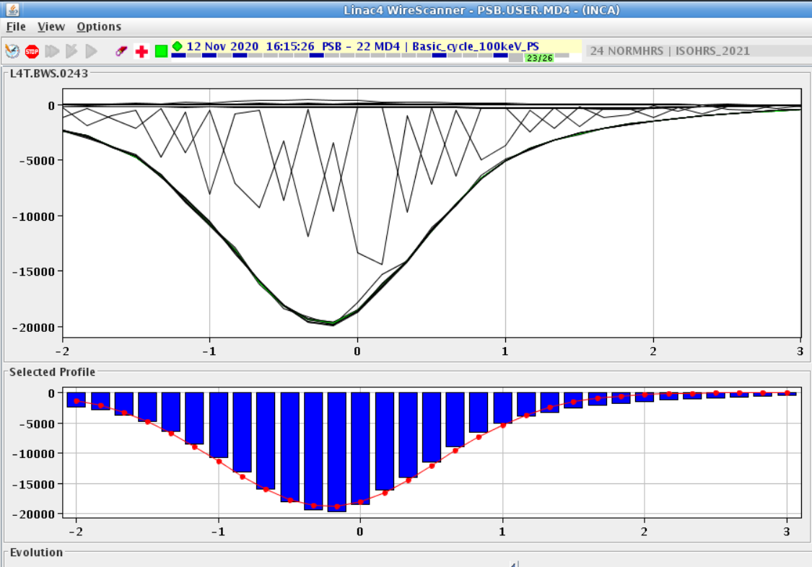
L4T.BWS.0243 H
Distorted signal when L4T trajectory == nominal
Signal OK when displace beam (→ not nominal trajectory but toward nominal 0 of scanner…)
Obstacle upstream? Loose wire moving with fork?

Slide 7
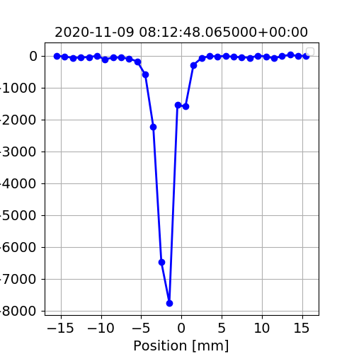
L4T-L4Z-LBE grids
Again hint of overheated wires
L4T.0223 H
L4T.0243 H
LBE 0025 V
… some others being checked, including inter-tanks

Slide 8
Plan
Access possible sometimes in the next two weeks (no beam to SWY, only possible to L4 dump)
  Spares: 2 scanner, xx grids available
  See with OP and VSC opportunity to open vacuum at least in tank L4T.0243
Would profit to:
  Try swapping 1 laser EM fiber with spare
  Check L4T-L4Z bias voltage status (two ggrids make the HV power supply trip)
  Change BSM1 EM (Jocelyn for January, same VSC sector as L4T grids)

