Slide 1
Cherenkov and Transition Radiation Detectors
_{Christian Joram}
_{CERN}
Acknowledgement: I make use of a lot of material provided by
Peter Krizan, JSI, Ljubljana (Cherenkov)
Christoph Rembser, CERN (Transition Radiation)
Thanks!

Slide 2
Outline
Cherenkov radiation
Short introduction to photodetectors
Cherenkov detectors
Transition radiation
Transition radiation detectors

Slide 3
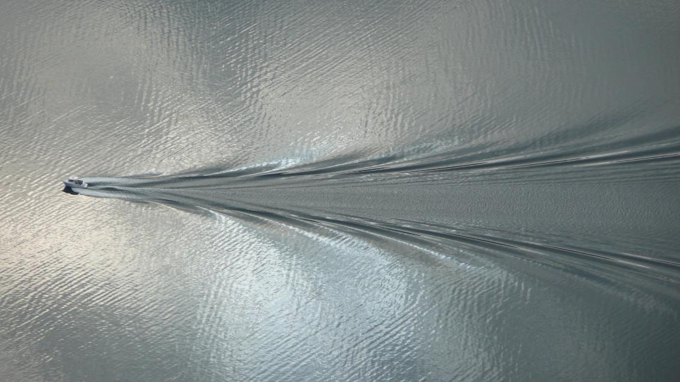

Cherenkov Radiation
A charged particle, moving through a medium at a speed which is larger than the speed of light in the medium, produces Cherenkov light.
Classical analogue: fast boat on water
θ
$$cosθ=\frac{v_{wave}}{v_{boat}}$$

Slide 4
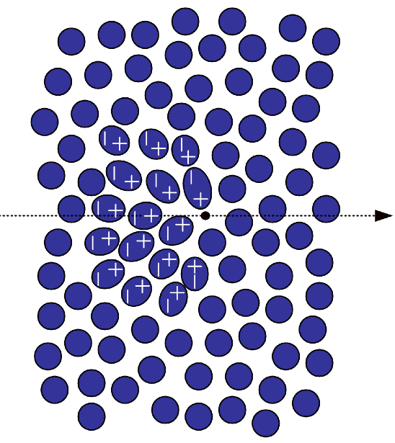
… back to Cherenkov radiation
The dielectric medium is polarized by the passing particle.
A coherent wave front forms if
“the radiator”
(n = refr. index)
v_{wave} = c/n
d·tanθ
d
θ_{C}
Cherenkov
cone
v_{particle} = βc
radiator of
limited thickness
Cherenkov
threshold
‘saturated’ angle (β=1)

Slide 5

Number of emitted photons per unit length and unit wavelength/energy interval
dN/dλ
UV cut-off
λ
dN/dΕ
Ε
0
UV cut-off
Cherenkov effect is a weak light source.
There are only a few tens or hundreds of photons produced per cm.

Slide 6
Cherenkov detectors
Energy loss by Cherenkov radiation small compared to ionization (≈0.1%)
Cherenkov effect is a very weak light source
→ need highly sensitive photodetectors
Number of detected photo electrons
ΔE = E₂ - E₁ is the width of the sensitive range of the photodetector (photomultiplier, photosensitive gas detector...)
N₀ is also called figure of merit ( ~ performance of the photodetector)
Example: for a detector with
and a Cherenkov angle of
one expects photo electrons

Slide 7
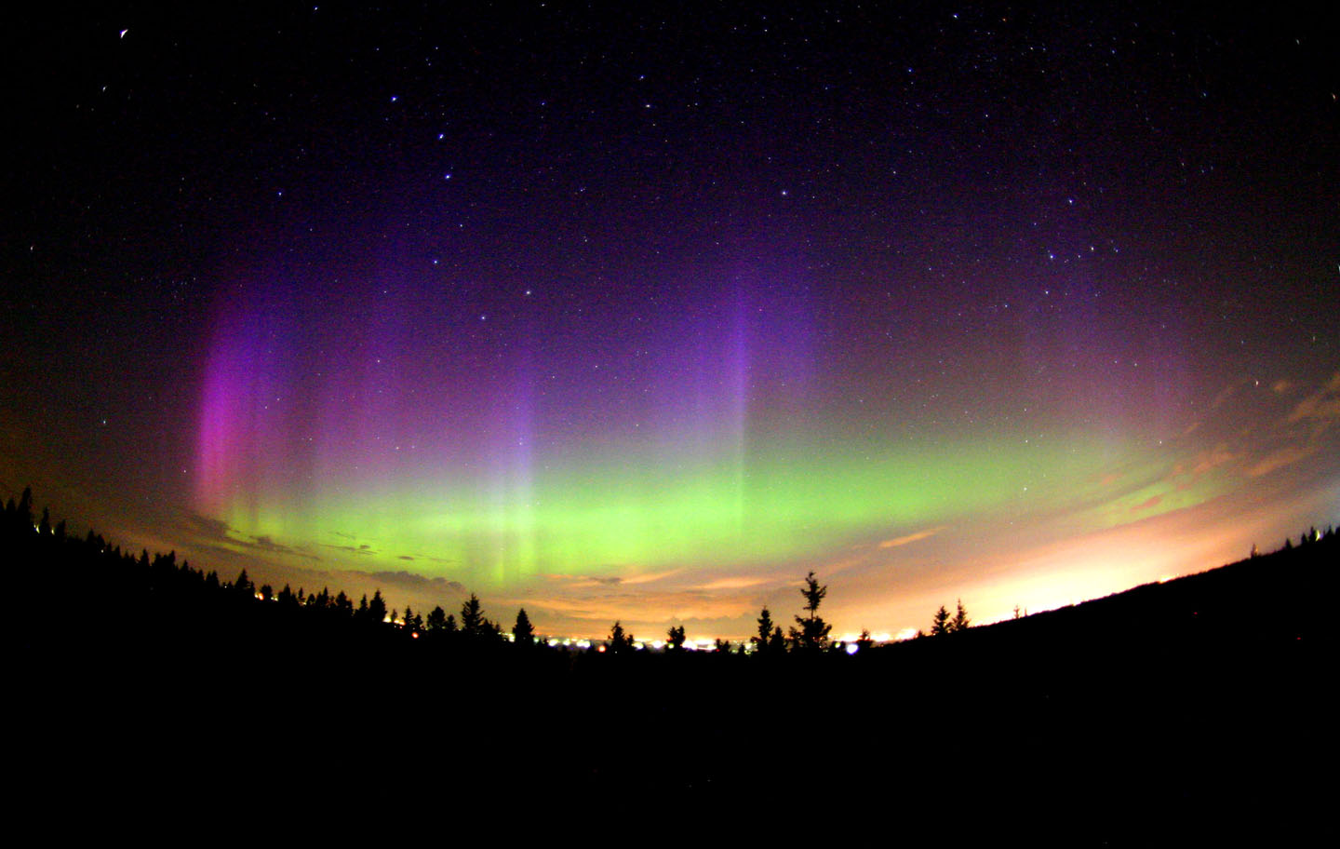
Photodetection
(Detection of light in the optical and UV domain)

Slide 8
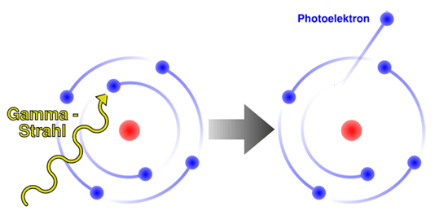
Basics of photon detection
Purpose:
Convert light into detectable electronic signal
(we are not covering photographic emulsions!)
Principle:
Use photoelectric effect to ‘convert’ photons (γ) to photoelectrons (pe)
Details depend on the type of the photosensitive material (see below).
Photon detection involves often materials like K, Na, Rb, Cs (alkali metals) . They have the smallest electronegativity → highest tendency to release electrons.

Slide 9
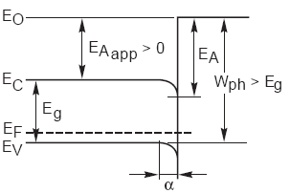
Basics of photodetection
Many solid photosensitive materials are semiconductors …
but photoeffect can also be observed from gases and liquids.
P [W]
photodet
semiconductor →← vacuum
e⁻
Internal photoeffect
E_{A} = electron
affinity
I [A]
E_{γ}
h
(Photonis)
External photoeffect
N_{γ}
Internal photoeffect: E_{γ} > E_{g}
External photoeffect: E_{γ} > E_{g +} E_{A}
photodet
N_{pe}

Slide 10
Basics of photon detection
Requirements on photodetectors
High sensitivity, usually expressed as: quantum efficiency
or radiant sensitivity S (mA/W), with
QE can be >100% (for high energetic photons) !
Good Linearity: Output signal ∼ light intensity, over a large dynamic range (critical e.g. in calorimetry (energy measurement).
Fast Time response: Signal is produced instantaneously (within ns), low jitter (<ns), no afterpulses
Low intrinsic noise. A noise-free detector doesn’t exist. Thermally created photoelectrons represent the lower limit for the noise rate ∼ A_{o}T²exp(-eW_{ph} /kT). In many detector types, noise is dominated by other sources.
+ many more (size, fill factor, radiation hardness, cost, tolerance/immunity to B-fields…)

Slide 11
Frequently used photosensitive materials / photocathodes
begin of arrow indicates threshold
Ultra Violet (UV)
Visible
Infra Red
(IR)
Si
(1100 nm)
TMAE,
CsI
Bialkali
K₂CsSb
GaAs
Multialkali
NaKCsSb
TEA
12.3 4.9 3.1 2.24 1.76 1.45 E [eV]
100 250 400 550 700 850 λ [nm]
Remember :
E[eV] ≅ 1239/λ[nm]
NaF, MgF₂, LiF, CaF₂
borosilicate glass
normal
window glass
quartz
Almost all photosensitive materials are very reactive (alkali metals). Operation only in vacuum or extremely clean gas.
Exception: Silicon, CsI.
Cut-off limits of window materials

Slide 12
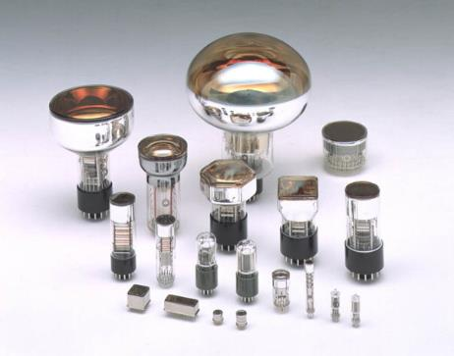
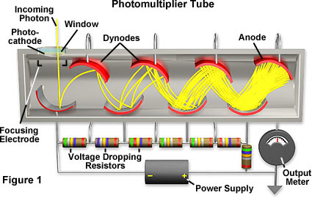
Photo-multiplier tubes (PMT’s)
Basic principle:
Photo-emission from photo-cathode
Secondary emission from N dynodes:
dynode gain g ≈ 3-50 (function of
incoming electron energy E);
total gain M:
Example:
10 dynodes with g = 4
M = 4¹⁰ ≈ 10⁶
Very sensitive to magnetic
fields, even to earth magnetic
field (30-60 μT = 0.3-0.6 Gauss).
→ Shielding required (mu-metal).
(Hamamatsu)
http://micro.magnet.fsu.edu/
pe
(http://micro.magnet.fsu.edu)

Slide 13

Latest generation of high performance photocathodes
QE Comparison of semitransparent bialkali QE
Example Data for
UBA : R7600-200
SBA : R7600-100
STD : R7600
50
Ultra Bialkali available only for small metal channel dynode tubes
UBA:43%
x1.6
40
30
SBA:35%
x1.3
Super Bialkali available for a couple of standard tubes up to 5”.
Quantum Efficiency [%]
STD:26%
20
10
0
200
300
400
500
600
700
Wavelength [nm]

Slide 14
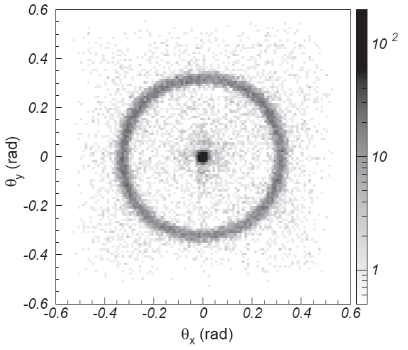
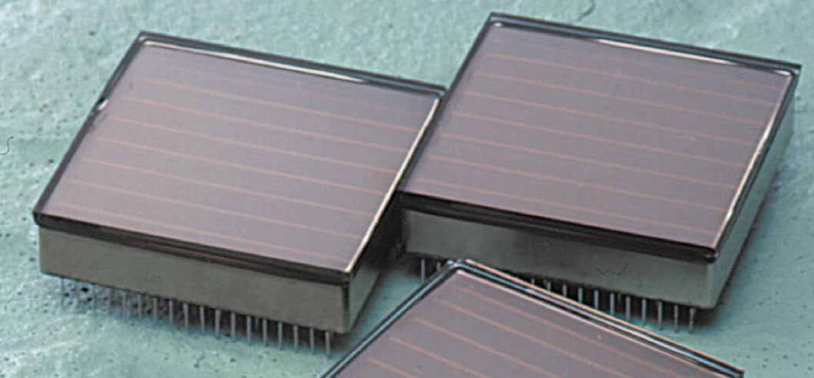
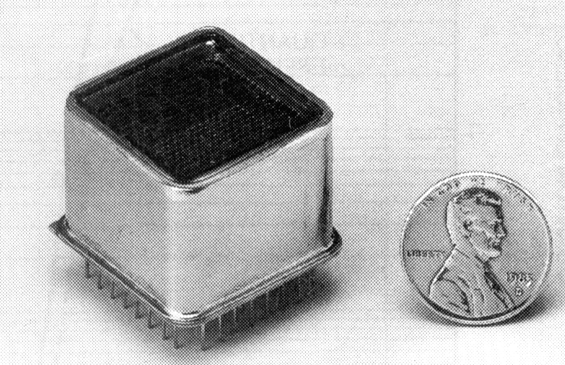
Multi-anode and flat-panel PMT’s
Multi-anode PMT (Hamamatsu)
Up to 8 × 8 channels (2 × 2 mm² each);
Size: 28 × 28 mm²;
Bialkali PC: QE ≈ 25 - 45% @ λ_{max} = 400 nm;
Gain ≈ 3 10⁵;
Gain uniformity typ. 1 : 2.5;
Cross-talk typ. 2%
Flat-panel (Hamamatsu H8500):
8 x 8 channels (5.8 x 5.8 mm2 each)
Excellent surface coverage (89%)
(Hamamatsu)
Cherenkov rings from
3 GeV/c π– through aerogel
50 mm
(Hamamatsu)
(T. Matsumoto et al., NIMA 521 (2004) 367)

Slide 15

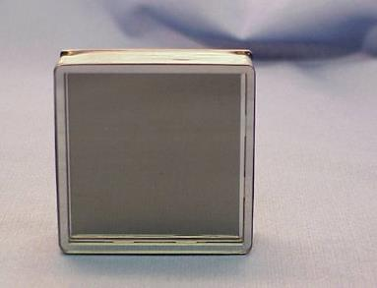
Micro Channel Plate (MCP) based PMTs
Window/Faceplate
Photocathode
photon
Typical secondary yield is 2
For 40:1 L:D there are typically 10 strikes (2¹⁰ ~ 10³ gain per single plate)
Pore sizes range from <10 to 25 μm.
Small distances → small TTS and good immunity to B-field
Photoelectron
ΔV ~ 200V
Dual MCP
ΔV~ 2000V
Gain ~ 10⁶
MCP-OUT Pulse
ΔV ~ 200V
Anode
MCPs are usually based on glass disks, with lots of aligned pores.
The surface of the pores are metal coated.
Gain stage and detection are decoupled → lots of potential and freedom for MA-PMTs: Anode can be easily segmented in application specific way.
Available with up to 1024 (32 x 32) channels (1.6 x 1.6 mm²)
50 mm
Dual MCP
Ceramic Insulators
Anode & Pins

Slide 16
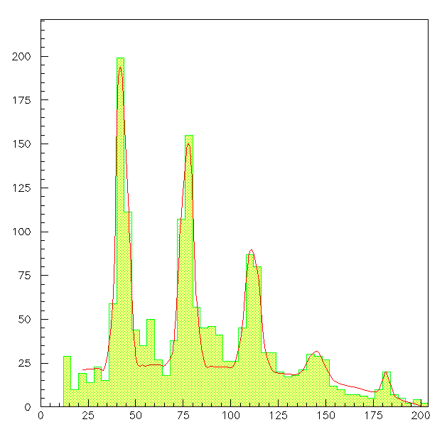
Hybrid Photon Detectors (HPD’s)
Basic principle:
Combination of vacuum photon detectors and solid-state technology;
Optical window, (semitransparent) photo-cathode;
Electron optics (optional: demagnification)
Charge Gain: achieved in one step by energy dissipation of keV pe’s in solid-state detector anode;
1 p.e.
pulse height signals of
1 Si pad
HV_{HPD} = 26 kV
➔ low gain fluctuations;
_{e-h}
2 p.e.
W_{Si} = 3.6 eV
Energy loss eV_{th} in (thin) ohmic contact
3 p.e.
Pedestal cut
ΔV = 20 kV
→ M ~ 5000
4 p.e.
5 p.e.
F = Fano factor
F_{Si} ~ 0.1
pulse height (ADC counts)

Slide 17
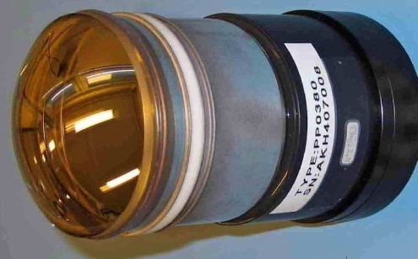
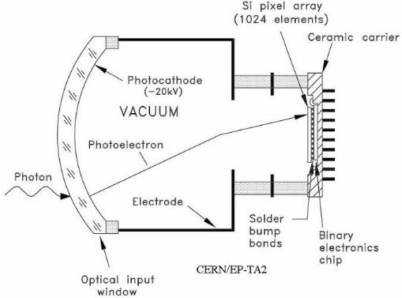
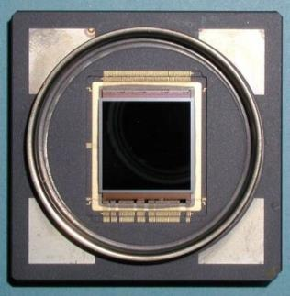
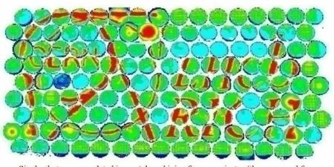
Pixel-HPD’s for LHCb RICH detectors
50mm
72mm ∅ active
Cross-focused electron optics
pixel array sensor bump-bonded to binary electronic chip, developed at CERN
8192 pixels of 50 × 400 μm.
specially developed high T° bump-bonding;
Flip-chip assembly, tube encapsulation (multi-alkali PC) performed in industry (VTT, Photonis/DEP)
T. Gys, NIM A 567 (2006) 176-179
Pixel-HPD anode
During commissioning: illumination of 144 tubes by beamer. In total : 484 tubes.

Slide 18
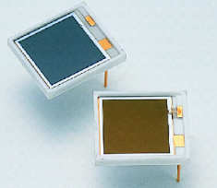
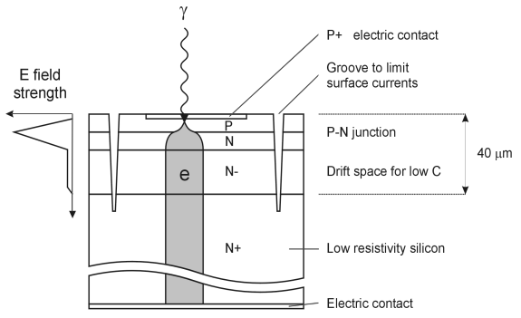
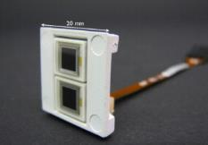
Solid-state photon detectors
(Si) – Photodiodes (PIN diode)
P(I)N type
p layer very thin (<1 μm), as visible light is rapidly absorbed by silicon
High QE (80% @ λ ≈ 700nm)
Gain = 1
Avalanche photodiode (APD)
High reverse bias voltage: typ. few 100 V
Special doping profile → high internal field (>10⁵ V/cm) → e and h avalanche multiplication
Avalanche must stop due to statistical fluctuations.
Gain: typ. O(100)
Rel. high gain fluctuations (excess noise from the avalanche). CMS ECAL APD: ENF = 2 @G=50.
Very high sensitivity on temp. and bias voltage ΔG = 3.1%/V and -2.4 %/K
p⁺ i(n) n⁺
h e
γ
Hamamatsu S8148.
(140.000 pieces used in CMS barrel ECAL).

Slide 19
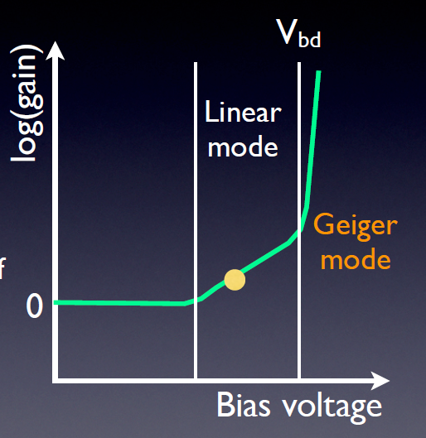
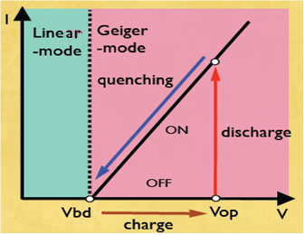
Solid-state … Geiger mode Avalanche Photodiode (G-APD)
How to obtain higher gain (= single photon detection) without suffering from excessive noise ?
Operate APD cell in Geiger mode (= full discharge),
however with (passive) quenching.
Photon conversion + avalanche short-circuits the diode.
J. Haba, RICH2007
J. Haba, RICH2007
J. Haba, RICH2007

Slide 20
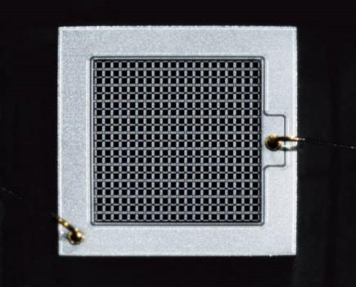
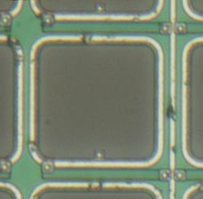
Multi pixel G-APD, called G-APD, MPPC, SiPM, …
1mm
100 – several 1000 pix / mm²
GM-APD
Bias bus
Only part of surface is photosensitive!
Quench
resistor
Sizes up to 6×6 mm² now standard.
−V_{bias}
Quench
resistor
1 γ
…
γ
γ
2 γ
…
20 x 20 pix
3 γ
GM-APD
Q
Q
2Q
Musienko @PD07
Quasi-analog detector allows photon counting with a clearly quantized signal

Slide 21



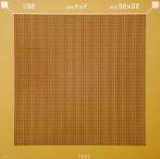
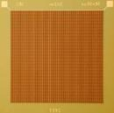




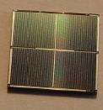
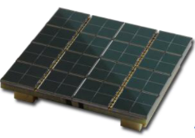

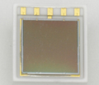
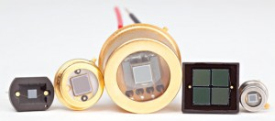
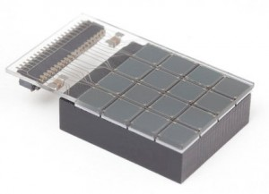
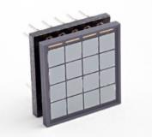
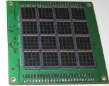
SiPM designs (just examples)
Hamamatsu HPK (http://jp.hamamatsu.com/)
25x25µm², 50x50µm², 100x100µm² pixel size
FBK-IRST
50x50µm² pixel size
4x4mm²
3x3mm²
1x1mm²
2x2mm²
1x1mm²
3x3mm²
Arrays
4x4mm²
2x2 channels
3x3 cm²
8x8 channels
1x4mm²
1x4 channels
6x6 mm²
2x2 channels
SensL (http://sensl.com/)
20x20µm², 35x35µm², 50x50µm², 100x100µm² pixel size
3.16x3.16mm²
4x4 channels
3.16x3.16mm²
4x4 channels
6 x 6 cm²
16x16 channels

Slide 22

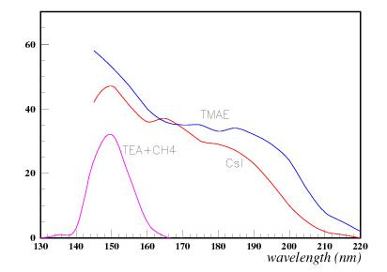
Gaseous Photodetectors
Principle:
Ionize photosensitive molecules, admixed to the counter gas: TMAE (λ_{abs} = O(cm), TEA (λ_{abs} = O(mm).
release photoelectron from a solid photocathode (CsI, bialkali...). λ_{abs} = 0.
In both cases free photoelectrons create Townsend avalanches → Gain
TPC-like
← few cm →
long drift
e.g. CH₄ + TMAE
e.g. CH₄ + TEA
TEA, TMAE, CsI work only in deep UV region.
← few mm →
The dream: Bialkali works in visible domain, however requires VERY clean gases.
Long term operation in a real detector not yet demonstrated.
Quantum efficiency
Cut-off of quartz windows
← few mm →
Thin CsI coating
on cathode pads
Challenges: How to achieve high gain (10⁵) ? How to control ion feedback and light emission from avalanche? How to purify gas and keep it clean? How to control aging ?

Slide 23
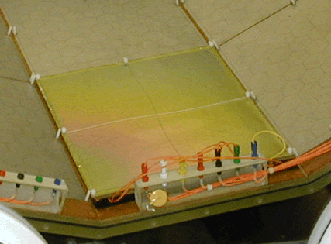
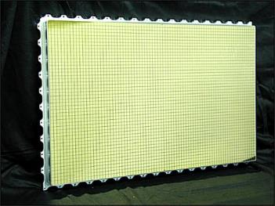
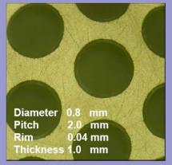
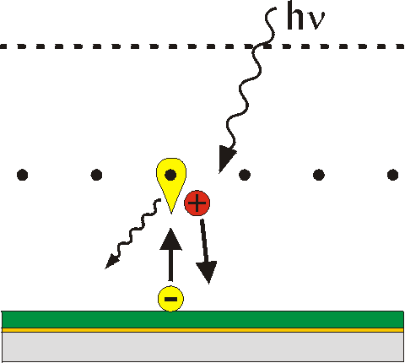
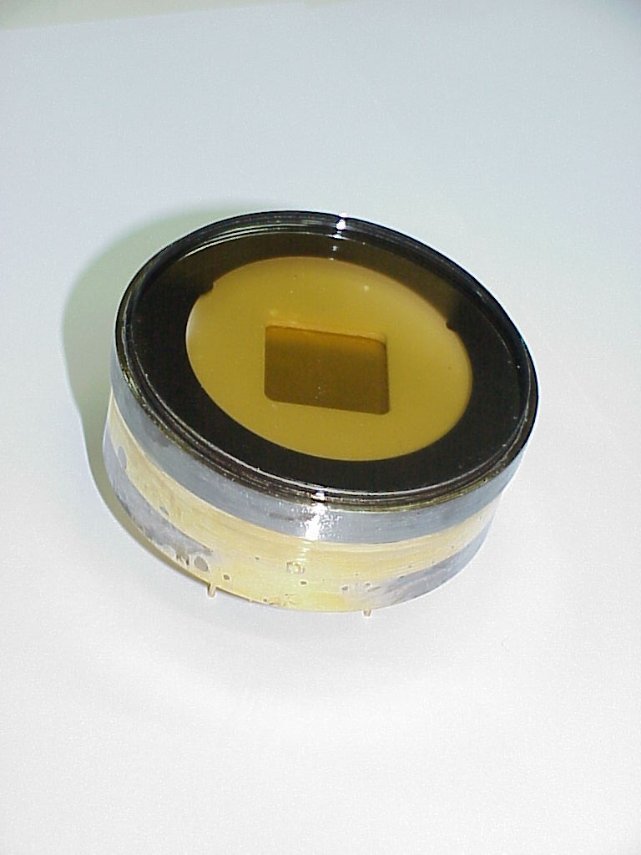
Gaseous photodetectors: A few implementations...
Proven technology:
Cherenkov detectors in ALICE, HADES, COMPASS,
J-LAB…. Many m² of CsI photocathodes
Micro Pattern Structures
(GEM) + CsI
HBD (RICH) of PHENIX.
R&D:
Thick GEM structures
Visible PC (bialkali)
Sealed gaseous devices
CsI
HV
Sealed gaseous photodetector with bialkali PC. (Weizmann Inst., Israel)
photocathode
CsI on readout pads
CsI on multi-GEM structure

Slide 24
Cherenkov detectors
Cherenkov detectors can exploit ...
N_{ph}(β) → Threshold detector. Do not measure θ_{C}
θ(β) → Ring Imaging Cherenkov detectors “RICH”
→ Detection of Internally reflected Cherenkov light “DIRC”.
Knowing both the speed β = v/c and the momentum p of the particle allows to derive the mass of the particle and hence identify it (e.g. π, K, p, d,…).
Particle ID.
Prompt emission of Cherenkov light (different from scintillation) plus angular information → very fast timing detectors. TOP, TORCH
1
2
Measure θ_{C}
3

Slide 25
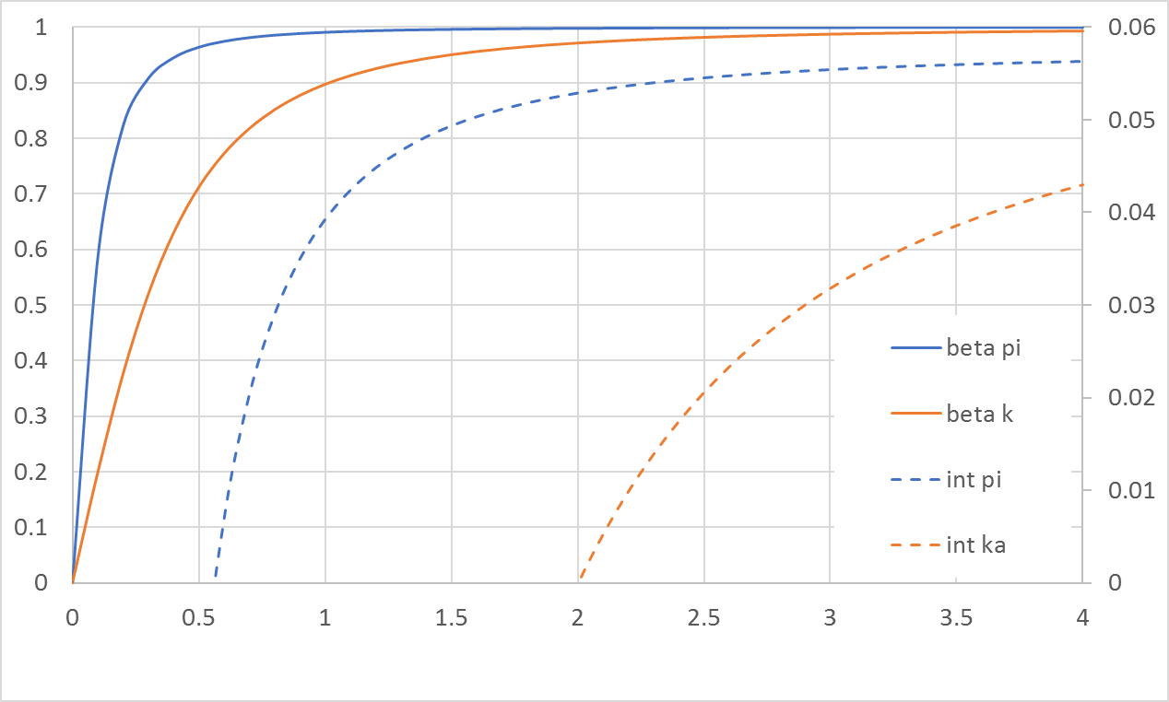
Cherenkov detectors
Threshold Cherenkov detectors
β(π)
β(k)
radiator with
n = 1.03, β_{thr} = 0.97
Often used in secondary beamlines (e.g. CERN PS, SPS) to tagg particle type
π threshold
k threshold
Dipole magnets select momentum,
e.g. 2 GeV/c
mirror
momentum (GeV/c)
Beam
π and k
radiator medium
n = 1.03
PM
Principle of a simple in-beam threshold Cherenkov counter

Slide 26
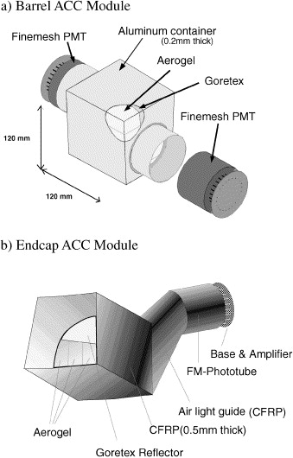
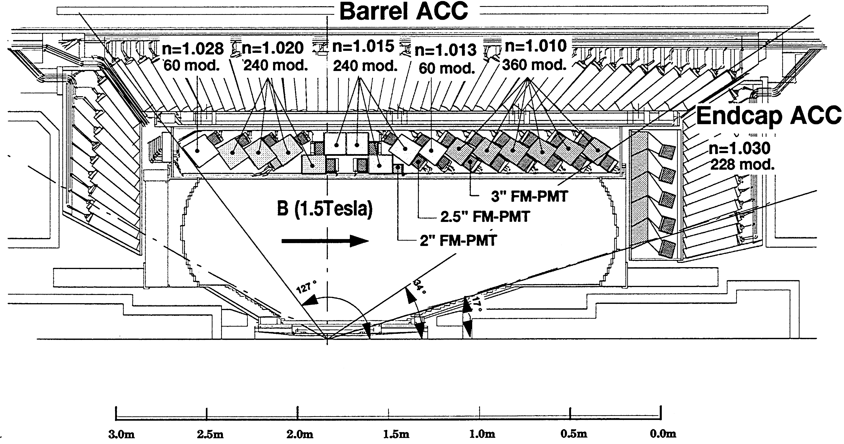
Cherenkov detectors
BELLE threshold aerogel counters
Almost 1200 independent detector modules in total.
6 different aerogels.
π/K separation up to 3.5 GeV/c

Slide 27
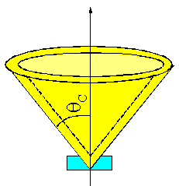
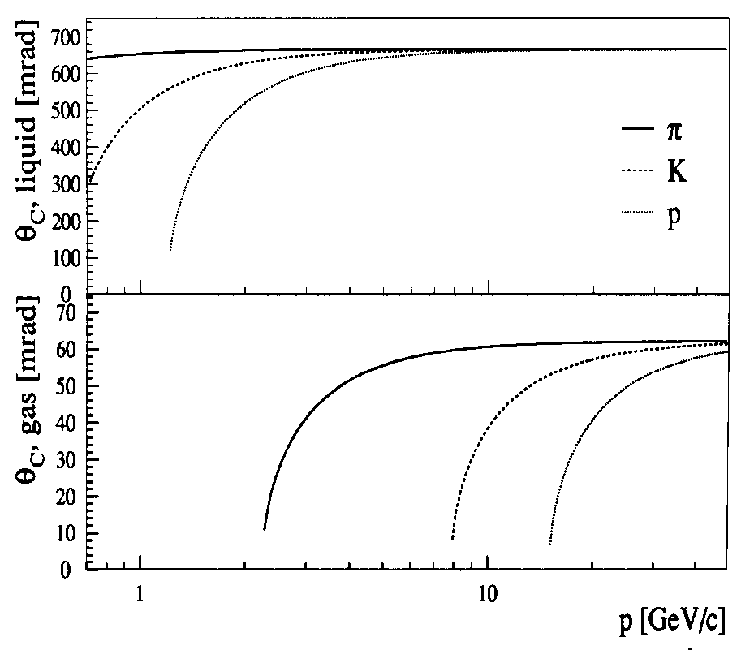
Ring Imaging Cherenkov detectors (RICH)
RICH detectors determine θ_{C} by intersecting the Cherenkov cone
with a photosensitive plane
→ requires large area photosensitive detectors, e.g.
wire chambers with photosensitive detector gas
PMT arrays
.
.
.
.
.
.
.
.
.
.
.
(J. Seguinot, T. Ypsilantis,
NIM 142 (1977) 377)
DELPHI
n = 1.28
C₆F₁₄ liquid
π/K
π/K/p
K/p
n = 1.0018
C₅F₁₂ gas
→
π/h
π/K/p
K/p
Detect N_{p.e.} photons (photoelectrons) →
minimize
→ maximize N_{p.e.}

Slide 28
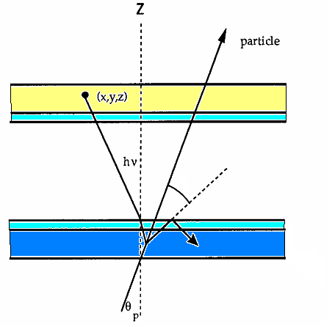
Ring Imaging Cherenkov detectors (RICH)
Reconstruction and resolution of Cherenkov angle
Determination of θ_{C} requires:
space point of the detected photon (x,y,z)
  photodetector granularity (σ_{x}, σ_{y}), depth of interaction (σ_{z})
emission point (x_{e},y_{e},z_{e})
  keep radiator thin
  or use focusing mirror
particle direction θ_{p}, φ_{p}
  RICH requires
  good tracker
detector
window
θ_{C}
window
radiator
(x_{e},y_{e},z_{e})
the chromatic error - an ‘irreducible’ error
θ_{C}
n_{rad} = n(Ε)
σ_{E} is related to the sensitivity range of the photodetector ΔE
ΔE ↑ → N_{pe} ↑ good σ_{E} ↑ bad ΔE ↓ → N_{pe} ↓ bad σ_{E} ↓ good

Slide 29
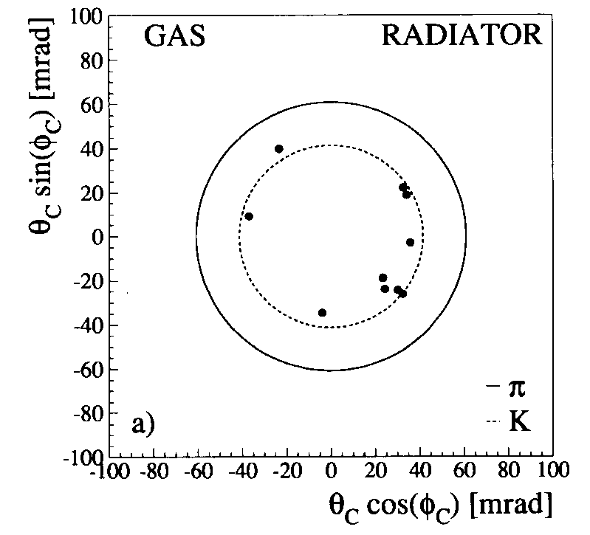
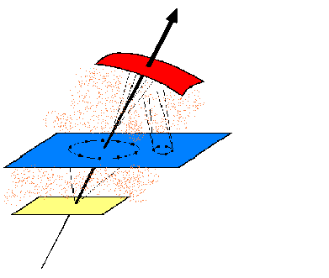
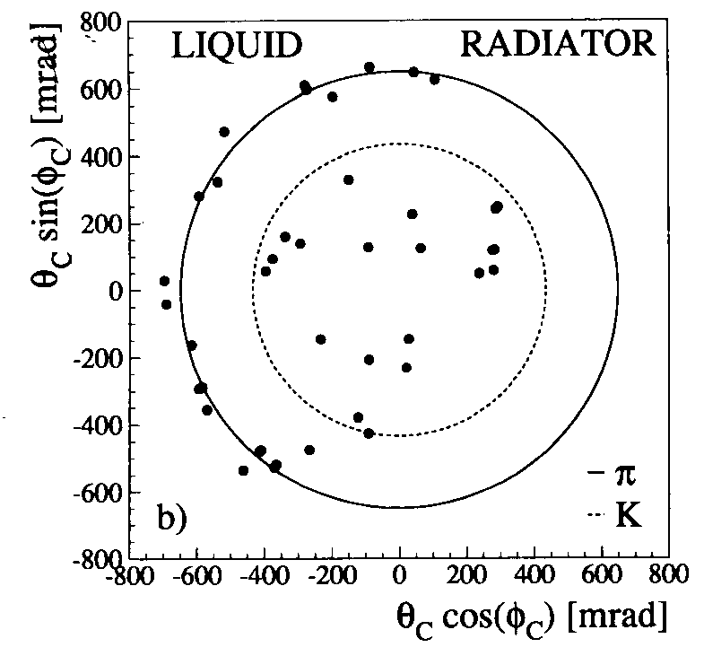
Ring Imaging Cherenkov detectors (RICH)
DELPHI and SLD:
A RICH with two radiators and a common photodetector plane
covers a large momentum range.
π/K/p separation 0.7 - 45 GeV/c:
spherical mirror
C₅F₁₂ (40 cm, gas)
C₄F₁₀ (50 cm, gas)
(W. Adam et al. NIM A 371 (1996) 240)
Generation 1
TPC-like Photodetector
TMAE-based
‘slow’
C₆F₁₄ (1 cm, liquid)
Two particles from a hadronic jet (Z-decay) in the DELPHI gas and liquid radiator.
Circles show hypotheses for π and K

Slide 30
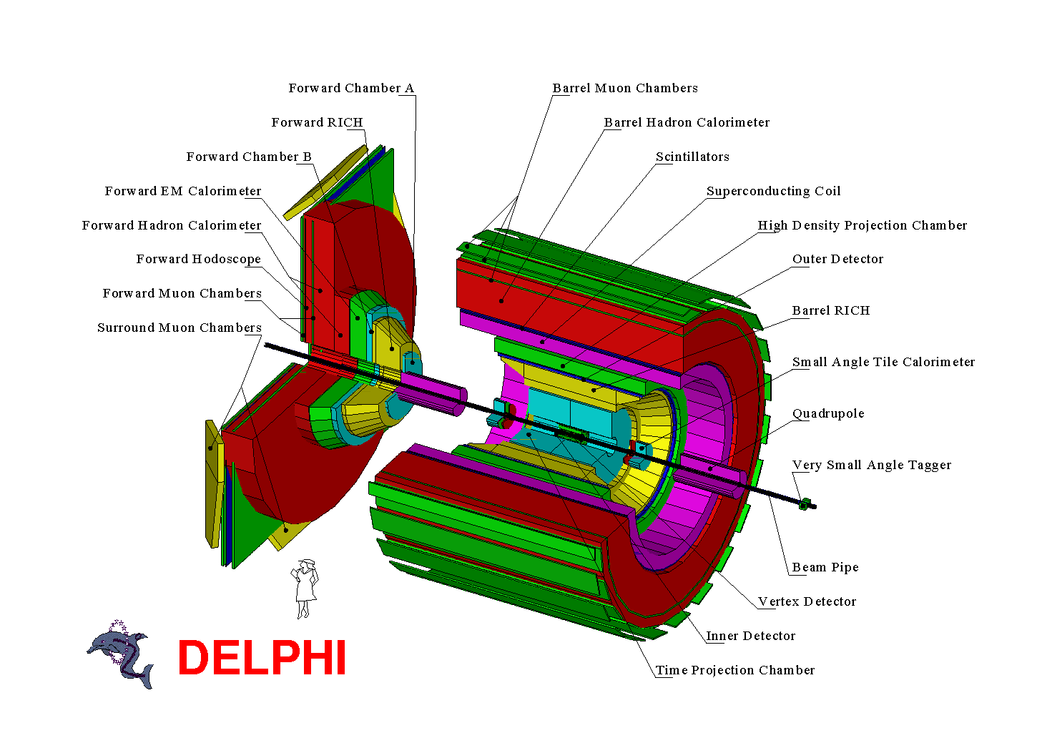

Slide 31
The RICH detectors are sandwiched between tracking detectors which provide precise particle track extrapolation

Slide 32
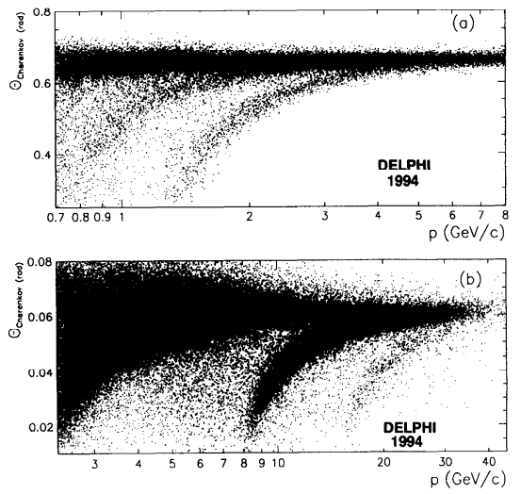
The DELPHI RICHes were complex and delicate, and required 24/24h care, 365 days a year. It took years to make them work and perform.
Working in the VUV posed strict requirements on purity of all liquids and gases.
The windows were made of quartz. The whole detector was kept at 1030 mbar, 40°C the whole year.
Materials were attacked by C_{x}F_{y} fluids. Leaks between radiator systems, shorts in the TPC drift field and many more things had to be taken care of.
π
Κ
p
π
Κ
But it finally worked!
p

Slide 33
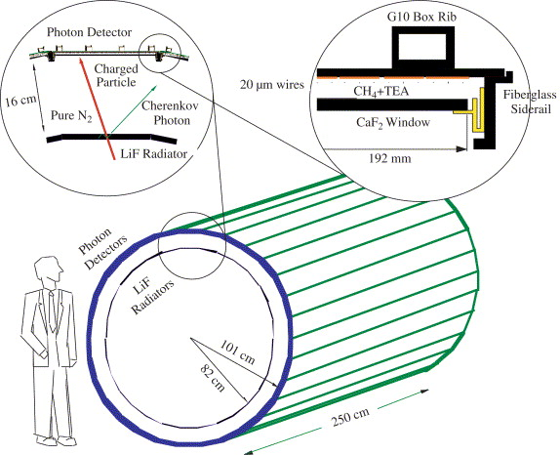

Fast RICH detectors
QE (%)
Generation 1.5
CLEO RICH @ CESR, Cornell
ALICE RICH @ LHC
M. Artuso et al.
https://doi.org/10.1016/j.nima.2005.07.056

Slide 34



ALICE RICH = HMPID
The largest scale (11 m²) application of CsI photo-cathodes in HEP!
Six photo-cathodes per module
CsI photo-cathode is segmented in 0.8x0.84 cm pads

Slide 35

The LHCb RICH counters
Generation 2
250 mrad
10 mrad
Vertex
reconstruction:
VELO
Trigger:
Muon Chambers
Calorimeters
Tracker
PID:
RICHes
Calorimeters
Muon Chambers
Kinematics:
Magnet
Tracker
Calorimeters

Slide 36



2 RICH detectors in LHCb
photodetectors (HPD)
RICH 2
flat mirror
spherical mirror
RICH 1
aerogel
radiator
L(C₄F₁₀) ~ 85 cm
radiator C₄F₁₀ aerogel
θ_{C} 3.03° 13.8°
n 1.0014 1.03
p_{thresh} (π) 2.6 0.6 GeV/c
N_{p.e.} 31 6.8
σ_{θ} 1.29 2.19 mrad
p (3σ) 56 13.5 GeV/c
radiator CF₄
θ_{C} 1.8°
n 1.0005
p_{thresh} (π) 4.4 GeV/c
N_{p.e.} 23
σ_{θ} 0.6 mrad
p (3σ) 98.5 GeV/c

Slide 37


2 RICH detectors in LHCb
RICH 2
photodetector plane
beam test in 2004 with 6 HPDs

Slide 38
2 RICH detectors in LHCb
Beam test results with C₄F₁₀ radiator gas (autumn 2004).
Single pion (10 GeV/c)
Superimposed events (100 k pions, 10 GeV/c)

Slide 39

Performance of LHCb RICHes
Single event
RICH 1
RICH 2

Slide 40



LHCb Upgrade (under way, LS2)
RICH2
RO plane
New photon detectors: MaPMTs Hamamatsu R13743 (H12700) and R13742 (R11265)
New electronics working at 40 MHz readout rate
New optics layout for RICH 1 (no aerogel)
8x8
6 mm
8x8
2.9 mm
RICH 1

Slide 41


Future LHCb Upgrade (LS4!!)
Generation 3?
Provide PID at p-p luminosity of 10³⁴ in the forward region
Aim to use SiPM (cryo-cooled?) photodetectors
Need ultralight mirrors (in active region)
Incremental improvements in:
  Improve Cherenkov angle resolution
    More photons in the green → lower chromatic error
  Reduced event complexity with timing
  Enhanced number of photons
New optics
New optics

Slide 42


SiPM as photosensor for a RICH counter ?
Improve the signal to noise ratio:
Reduce the noise by a narrow (<10ns) time window (Cherenkov light is prompt!)
Increase the number of signal hits per single sensor by using light collectors
Reduce the noise even further by cooling the SiPMs
E.g. light collector with reflective walls or plastic light guide
SiPM
PCB

Slide 43



Photon detector with SiPMs and light guides
SiPMs: array of 8x8 SMD mount Hamamatsu S10362-11-100P with 0.3mm protective layer
64 SiPMs
20mm
module was moved to 9 positions to cover the ring area. Save $$$ !
Korpar et al., NIM A594 (2008) 13; NIM A613 (2010) 195

Slide 44



DIRC @BaBar: Detection of Internally Reflected Cherenkov light
Use the internally reflected C-light, which would normally be lost!
During propagation: angle of Cherenkov light is conserved, except of left/right and up/down ambiguities

Slide 45



DIRC @ BaBar
BaBar spectrometer at PEP-II
e⁺
Only radiator is in active volume of detector. Photodetectors & electronics do not disturb!
Support tube (Al)
e⁻
Quartz Barbox
Compensating coil
Assembly flange
Standoff box

Slide 46


DIRC performance
Lots of photons!
Excellent π/K separation
NIM A553 (2005) 317

Slide 47



Belle II Cherenkov detectors
Endcap PID: Aerogel RICH (ARICH)
200mm
Barrel PID: Time of Propagation Counter (TOP)
Cherenkov photon
Quartz radiator
Aerogel radiator
Focusing mirror
Small expansion block
Hamamatsu MCP-PMT (measure t, x and y)
n~1.05
Hamamatsu HAPD
+ new ASIC
mirror
Aerogel radiator
Hamamatsu HAPD + readout
200

Slide 48

Time of propagation (TOP) counter
quartz radiator
Photon detector
Similar to the DIRC, Cherenkov ring imaging with precise time measurement.
Reconstruct Cherenkov angle from two photon hit coordinates and the time of propagation of the photon
Photon detector (MCP-PMT)‏, pixels of ~5 x 5 mm², very fast multi-GHz sampling electronics
    Excellent time resolution ~ 40 ps
    Single photon sensitivity at 1.5 T

Slide 49


TOP ‘image’ reconstruction
Pattern in the coordinate-time space (‘ring’) of a pion and kaon hitting a quartz bar
Time distribution of signals recorded by one of the PMT channels (slice in x): different for π and K (~shifted in time)
simulation
simulation
Patterns for π and K
The name of the game: analytic expressions for the 2D likelihood functions →M. Starič et al., NIMA A595 (2008) 252-255

Slide 50

TOP first events
The early BELLE II data demonstrates that the TOP principle is working

Slide 51



TORCH
A special type of Time-of-Propagation counter, part of a future LHCb upgrade.
Aim for π,k,p separation, 2-10 GeV/c.
At 10 GeV/c: Δt of π-k = 35 ps
Can be achieved with 30 photons and 70 ps resolution for single photons.
TORCH area 5 x 6 m²
18 module system
11 MCPs per module
CERN-LHCC-2017-003
Just radiator in active volume

Slide 52


TORCH principle
→ x
Cyl. mirror
θ_{x}
θ_{z}
Particle impact point known → θ_{x} can be derived from measurement of coordinate x on segmented MCP photodetector.
Cylindrical mirrored surface maps the photon angle θ_{z} to a y’ position
C-angle known
Photon arrival time can be corrected for time of propagation
Photek, custom development (64 x 64 pixels)
Precise TOF information

Slide 53

TORCH test beam results
Test-beam campaigns (2017 & 2018):
Single-photon time resolutions around 80 – 100 ps have been achieved
Photon yields are measured to be within∼10% and∼30% of simulation, respectively
https://doi.org/10.1016/j.nima.2020.163671
Expected performance (simulation)

Slide 54

Particle ID by Transition radiation
(there is an excellent review article by B. Dolgoshein (NIM A 326 (1993) 434))
Transition Radiation was predicted by Ginzburg and Franck in 1946
TR is electromagnetic radiation, emitted when a charged particle traverses a medium with a discontinuous refractive index, e.g. the boundaries between vacuum and a dielectric layer.
medium
vacuum
A (too) simple picture
electron
A correct relativistic treatment shows that…
(G. Garibian, Sov. Phys. JETP63 (1958) 1079)
Radiated energy per medium/vacuum boundary
Lorentz boost
only high energetic e± emit TR of detectable intensity.
→ particle ID
$$γ=\frac{1}{\sqrt{1−β^{2}}}$$

Slide 55

Particle ID by Transition radiation
Number of emitted photons / boundary is small
  → Need many transitions → build a stack of many thin foils with gas gaps
Emission spectrum of TR = f(material, γ)
Typical energy:
Simulated emission spectrum
of a CH₂ foil stack
→ photons in the keV range
X-rays are emitted with a sharp
maximum at small angles
→ TR stay close to track
Particle must traverse a minimum distance, the so-called formation zone Z_{f}, in order to efficiently emit TR.
Z_{f} depends on the material (ω_{p}), TR frequency (ω) and on γ.
Z_{f} (air) ~ mm, Z_{f} (CH₂) ~ 20 μm → important consequences for design of TR radiator.

Slide 56

Particle ID by Transition radiation
TR Radiators:
stacks of thin foils made out of CH₂ (polyethylene), C₅H₄O₂ (Mylar)
hydrocarbon foam and fiber materials
Low Z material preferred to keep re-absorption small (∝Z⁵)
R D R D R D R D
alternating arrangement of radiators stacks and detectors → minimizes reabsorption
TR X-ray detectors:
Detector should be sensitive for 3 ≤ E_{γ} ≤ 30 keV.
Mainly used: Gas detectors: MWPC,
        drift chamber, straw tubes…
Detector gas: σ_{photo effect} ∝ Z⁵
→ gas with high Z required, e.g. Xenon (Z=54)
Very Schematic!
Pulse height
(1 cm Xe)
dE/dx
≈200 e⁻
TR (10 keV)
≈500 e⁻
Intrinsic problem: detector “sees”
TR and dE/dx
Discrimination
by threshold
Q

Slide 57


Particle ID by Transition radiation
The ATLAS Transition Radiation Tracker (TRT)
~300’000 straw tubes (d = 4mm)
Every straw is a mini drift tube. Measure drift time of electrons to anode wire
680 cm
anode wire
Active gas is Xe/CO₂/O₂ (70/27/3) operated at ~2x10⁴ gas gain;
drift time ~ 40ns ( fast!)

Slide 58


Basic principle
radiator
(foam or fibres)
straw diameter = 4mm
traversing particle
sensor (straw tube)
wire thickness = 30µm
Spectrum of the energy deposit in a straw tube
with radiator in front
data test beam 20GeV electrons
Signal in straw is superposition of dE/dx and TR
without radiator in front

Slide 59
Special challenges at the LHC
Very high occupancy: up to 30% of straws receive a signal in a bunch crossing;
Very high counting rate: up to 20 MHz/straw
Short bunch crossing interval: 25 ns
High spatial resolution needed ⇒ many measurement points (35/track);
Radiation environment: ~10 MRad and 10¹⁴ n/cm² year;
Fast and chemically passive straw gas: otherwise ageing!
Chemically resistant straw materials: operating straw acts like an electrochemical reactor
Minimum amount of material ( in radiation lengths)
Extremely precise and robust mechanical structure of ~100µm/few m =~10⁻⁵;
Temperature stable: cooling required.
radiator
(foam or fibres)

Slide 60




The sensor - a straw
  straws in an end-cap wheel
Cathode foil
  layers of a straw wall
Anode
wire
New for ATLAS: stiff straw, supported by carbon fibre strips, allows self supporting structures, thus reduced material inside the detector; Length: 144 cm in barrel, 39 cm in end-cap.

Slide 61







The radiator
Polypropylene foils
Optimal TR threshold (~6.5 keV)
Regular foils (TRT end-caps)
~probability to produce detectable TR photon
Fibers (TRT barrel)
Foam (TRT barrel)
easy to build structures!
Polypropylene fibres
Choice of Radiator materials: ensure balance between TR-performance and simple construction.
Carbon foam
What was new about these foams?
No impurities from other material, always present in other type of foams
Polypropylene foam

Slide 62

TRT barrel module production
empty barrel module
inserting the straws
connecting the wires
inserting the radiator
connecting the straw walls
test with radioactive source
module shell half filled with radiator material
stringing straw wires
mounting electronics & cooling

Slide 63





From modules to a complete barrel detector
inserting modules
Barrel support structure
Filled barrel support structure
TRT Barrel detector (with semi conductor detector inserted)
insertion into ATLAS

Slide 64






TRT end-cap wheel production
assembly of a basic element, a wheel with 4 straw layers/planes
Installation of straws
(tests leak tightness)
Transfer of wheel…
…to string wires
Fixating and connecting wires
(tests wire tension & HV)
Sealing of wheel
(tests leak tightness & HV)
Final acceptance tests
(test wire centricity etc.)

Slide 65

A TRT event display

Slide 66




Example: tests for radiation hardness of TRT wires
Mandatory in high radiation environments: test of all materials
Check ratio of height of signal amplitude for
test straw (radiated) and
monitor straw (not radiated)
“bad” materials
“good” materials

Slide 67


ATLAS TRT: bad surprise during assembly (2)
Original TRT gas mixture (70% Xe, 20% CF₄, 10% CO₂)
was destroying the detector (2002)
glass wire joints of barrel TRT “melting” with radiation 0.3-04 C/cm, less than 1 year nominal LHC operation
Reason: hydrofluoric acid HF
Within one year, a new mixture was developed: 70% Xe, 27% CO₂, 3% O₂
O₂ very unusual, strong quencher (“eats” electrons)
only works for TRT as straws have small diameter (we are very lucky! … for once)

Slide 68




ATLAS TRT: bad surprise during operation
Cracks in outlet pipes of active gas developed in 2012
gas losses: 150l/day instead of <0.5l/day up to 2011;
reason: aggressive ozone produced when active gas mixture is radiated, ozone attacks plastic gas pipes (although plastic material has been validated - but material seem to have changed properties when being heated and bent....)
no chance to fix leaks
TRT pipes
cracks
Difficult to access!!!
For effected region, switched to Argon based gas mixture in the straws.
Reduce PID performance.

Slide 69






TRT Performance - Tracking
in 2016: already suffering from broken gas pipes
⇒ detector partially operated
with Argon mixture
low occupancy (number of collisions per bunch crossing <𝝻> low)
high occupancy (number of collisions per bunch crossing <𝝻> high, i.e. Heavy Ion Collisions)
Xenon
Argon
increasing occupancy

Slide 70



TRT Performance - Particle Identification
TR turn ON curve: HL probability VS gamma factor
Event with an electron (yellow track):
hits with high signal (=TR, passing a high level HL threshold) are indicated in red
10 GeV μ vs 10 GeV e
Typical Figure of Merit for a TR detector:

Slide 71



ALICE TRD
CERN-EP-2017-222
Time Expansion Chamber with Xe/CO₂ gas (85%-15%)
7.36 m
7.34 m
TRD
fibre/foam sandwich
TPC

Slide 72


ALICE TRD performance
Pulse height vs drift time
integ. charge method
charge + t_{D} method
TMQ = Truncated mean of charge
L-Q = Likelihood on charge
L-QX = 2D Likelihood on charge and x-coord.

Slide 73
11 take home messages
Cherenkov radiation is produced by a charged particle traversing a dielectric medium at a speed v ≥ c/n (threshold).
Weak light source, visible and UV.
Light intensity increases like sin²θ = 1 - (n²β²)⁻¹ → saturated angle at β ≈ 1
Detection of C-light requires low-noise single photon sensitive photodetectors.
Main applications are PID (π/k) by threshold, Ring Imaging or Time Of Propagation counters (incl. TORCH).
Transition radiation is produced by a charged particle at the edge of a dielectric medium.
Intensity scales with Lorentz boost γ. In HEP experiments, only e± reach high enough γ values (> 1000)
Extremely weak light source, X-ray, O(10keV)
Need many transitions → foil stacks, foams
Detection by gas detector (drift chamber / tubes) operated with high-Z gas (Xe)
Main application is tracking with e ± enhancement.

Slide 74
BACK-UP
MATERIAL

Slide 75
Propagating waves
A stationary boat bobbing up and down on a lake, producing waves

Slide 76
Now the boat starts to move, but slower than the waves
No coherent wavefront is formed

Slide 77
Next the boat moves faster than the waves
A coherent wavefront is formed

Slide 78
Finally the boat moves even faster
θ
The angle of the coherent wavefront changes with the speed
cos θ = v_{wave} / v_{boat}

Slide 79

Reminder: Interaction of charged particles
Detection of charged particles
Particles can only be detected if they deposit energy in matter.
How do they lose energy in matter ?
Discrete collisions with the atomic electrons of the absorber material.
e
W.W.M. Allison, J.H. Cobb,
Ann. Rev. Nucl. Part. Sci. 1980. 30: 253-98
-
$$E=hω$$
If are in the right range ⇨ ionization.

Slide 80

Interaction of charged particles
Optical behaviour of medium is characterized by the complex dielectric constant ε
Refractive index
Absorption parameter
$$E=hω$$
eV O(10) eV keV
Instead of ionizing an atom or exciting the matter, under certain conditions the photon can also escape from the medium.
⇨ Emission of Cherenkov and Transition radiation.
This emission of real photons contributes also to the energy loss.

Slide 81
… more interactions of charged particles
A photon in a medium has to follow the dispersion relation
θ
e
Assuming soft collisions + energy and momentum conservation → emission of real photons:
-
… solve for ω
schematically !
Emission of photons if
A particle emits real photons in a dielectric medium if its speed v = β⋅c
is greater than the speed of light in the medium c/n. ➔ Cherenkov radiation.

Slide 82

Estimate the energy loss by Cherenkov radiation in quartz
Private exercise
n_{quartz} ≈ 1.46
→ sin²θ = 1 - cos²θ = 1 - 1/n²= 0.53
λ_{min} = 160 nm → E_{max} ≈ 1234 / λ ≈ 7.7 eV
λ_{max} ≈ 3 μm = 3000 nm → E_{min} ≈ 0
ΔE = 7.7 eV
<E_{γ}> = ΔE/2 = 3.85 eV
Cherenkov effect is a weak but very useful light source.

Slide 83
Photodetection in HEP
The classical domains of application
Calorimetry
  Readout of organic and inorganic scintillators, lead glass, scint. or quartz fibres → Blue/VIS, usually 10s – 10000s of photons
Particle Identification
  Detection of Cherenkov light →UV/blue, single photons
  Time Of Flight → Usually readout of organic scintillators (not competitive at high momenta) or Cherenkov radiators
Tracking
  Readout of scintillating fibres → blue/VIS, few photons

Slide 84




Gain fluctuations of PMT’s
Mainly determined by the fluctuations of the number of secondary electrons m_{i} emitted from the dynodes;
Poisson distribution:
Standard deviation:
⇒ fluctuations dominated by 1st dynode gain m₁ = δ₁
GaP(Cs) dynodes E_{A}<0
SE coefficient δ
(Photonis)
Energy E
CuBe dynodes E_{A}>0
1 pe
1 pe
SE coefficient δ
Counts
Counts
2 pe
3 pe
(Photonis)
Pedestal noise
(Photonis)
(H. Houtermanns,
NIM 112 (1973) 121)
Electron energy
Pulse height
Pulse height

Slide 85

Light absorption in Silicon
At large λ, temperature effects become important
(http://pdg.ge.infn.it/~) deg/ccd.html

Slide 86

Multi pixel G-APD = G-APD, MPPC, SiPM, …
You cannot get "something for nothing”
G-APD show dark noise rate in the O(100 kHz – MHz / mm²) range.
The gain is temperature dependent O(<5% /°K)
The signal linearity is limited
The price is (still too) high
~10 producers are now in the market. Continuous improvement in technology and performance.
Uozumi@VCI2007
Hamamatsu catalog

Slide 87


Barrel RICH
2 × 6 parabolic mirrors
1 of 2×12 sectors
2 drift tubes + 2 MWPC
(= 1 bitube)
gas: 75% CH₄ + 25% C₂H₆, TMAE @ 28°C
2 liquid radiator
1 cm C₆F₁₄,
quartz windows
p = 985 mbar
gas radiator volume
1 single vessel
ca. 40 cm C₅F₁₂
p = 1030 mbar

Slide 88


Forward RICH
1 of 2×12 sectors
gas radiator volume
2 half vessels / side
ca. 50 cm C₄F₁₀
p = atm.
T_{vessel} ≈ 30°C, unregulated.
3 liquid radiator trays
1 cm C₆F_{14,}
quartz windows
p = atm.
5 spherical mirrors
2 drift boxes + 2 MWPC’s
gas: C₂H₆ + TMAE (24ºC)
α_{L} ≈ 50°

Slide 89



Separation of kaons and pions
Pions vs kaons in TOP:
different patterns in the time vs PMT impact point coordinate
Pions vs kaons:
Expected PID efficiency and misidentification probability.

Slide 90

Hybrid Photon Detectors (HPD’s)
10-inches (25.4 cm)
1 p.e.
pulse height signals of
1 Si pad
HV_{HPD} = 26 kV
2 p.e.
3 p.e.
Pedestal cut
4 p.e.
5 p.e.
pulse height (ADC counts)
10-inch prototype HPD (CERN)
for Air Shower Telescope CLUE.
Photon counting. Continuum due to electron back scattering.

Slide 91


CERN CsI deposition plant
Thickness
monitor
CsI photocathode produced with a well defined, several step procedure, with CsI vacuum deposition and subsequent heat conditioning.
CsI doesn’t like water !!!
→ Assembly of cathode and wire chamber in a glove box.
pcb substrate
PC
protective box
4 CsI sources
+ shutters
Remote controlled
enclosure box

Slide 92



Next step: use arrays of SiPMs
Example: Hamamatsu MPPC S11834-3388DF
8x8 SiPM array, with 5x5 mm² SiPM channels
Active area 3x3 mm²
+ array of quartz light collectors
E. Tahirović et al., NIM A787 (2015) 203

Slide 93
Digital SiPM
Digital SiPM (Philips): instead of an analog sum of signals from all cells of a single SiPM, use on board electronics for a digital sum + time stamp
→ A.Y. Barnyakov et al., NIM A732 (2013) 352

Slide 94
Particle ID by Transition radiation
(there is an excellent review article by B. Dolgoshein (NIM A 326 (1993) 434))
Transition Radiation was predicted by Ginzburg and Franck in 1946
TR is electromagnetic radiation emitted when a charged particle traverses a medium with a discontinuous refractive index, e.g. the boundaries between vacuum and a dielectric layer.
medium
vacuum
A (too) simple picture
electron
A correct relativistic treatment shows that…
(G. Garibian, Sov. Phys. JETP63 (1958) 1079)
Radiated energy per medium/vacuum boundary
only high energetic e± emit TR of detectable intensity.
→ particle ID

Slide 95


TRT Performance - Particle Identification
TR turn ON curve: HL probability VS gamma factor
event with an electron (yellow track)
hits with high signal (=TR, passing a high level HL threshold) are indicated in red
HL hit probability for electrons 4 times higher than for minimum ionising particles (muons)

Slide 96

Particle ID by Transition radiation
Rejection Power : R_{π/e} = ε_{π}/ε_{e} (90%)
one order of magnitude in Rejection Power is gained when the TRD length is increased by ~ 20 cm

