Slide 1
HL-LHC WP04 – RFD UHV PIMS Assembly tooling - DRAFT 25/11/2020
Teddy Capelli on behalf of the WP4 collaboration

Slide 2
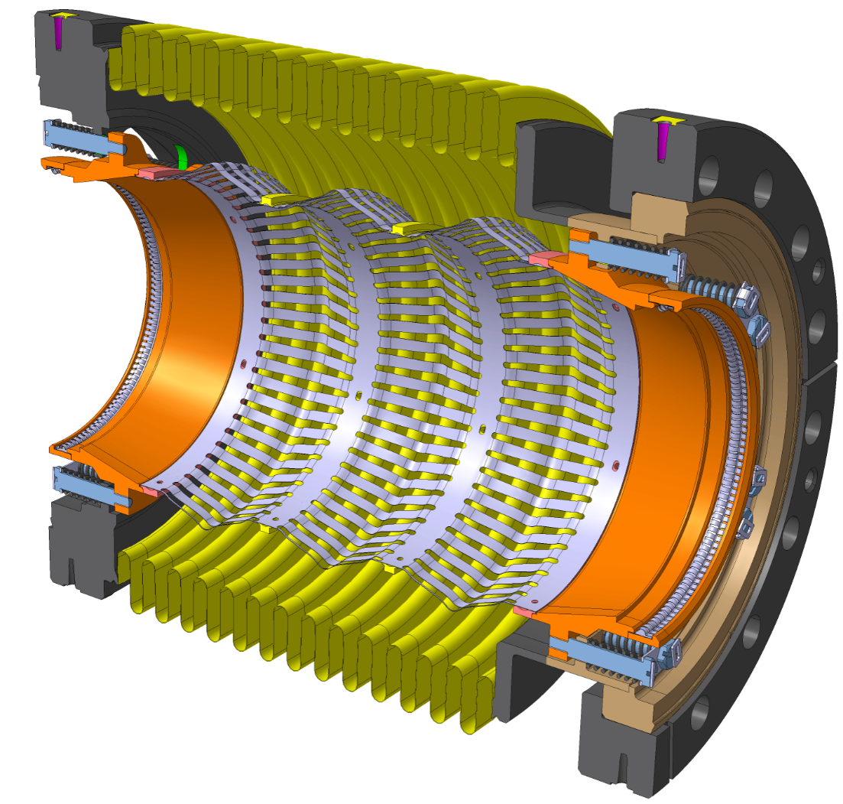
Example of assembly for the inter beam screen Plug In Module
Detail drawing of the final assembly : LHCVBMCI0015
Most complicated of the 6 PIMS (Internal aperture reduced at the extremities)

Slide 3
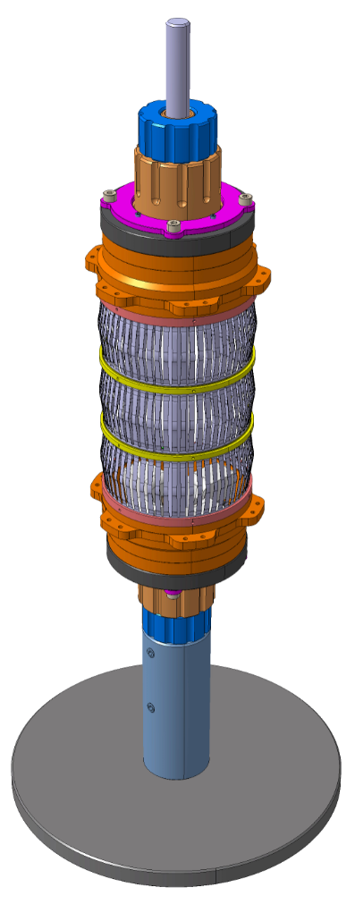
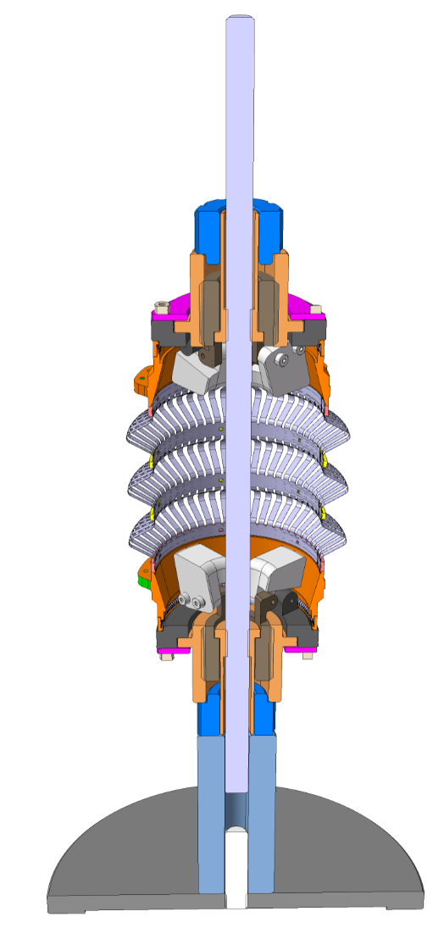
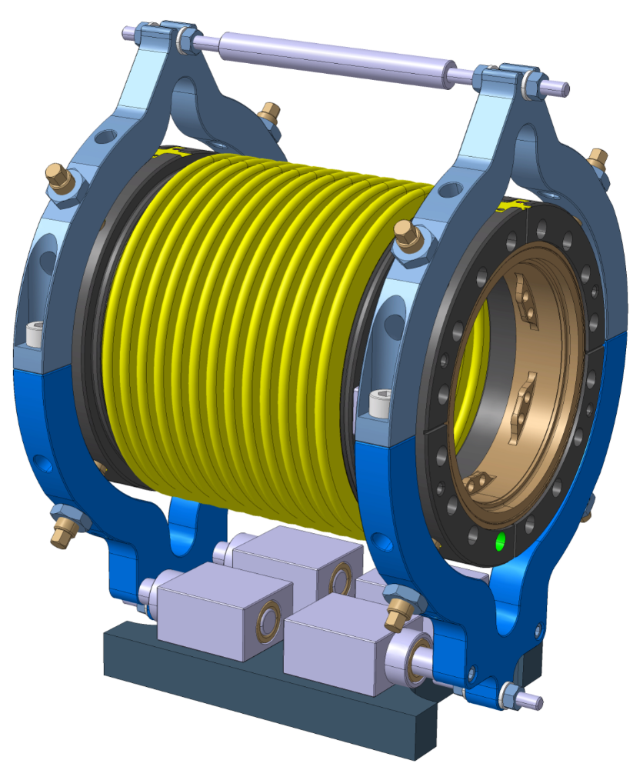
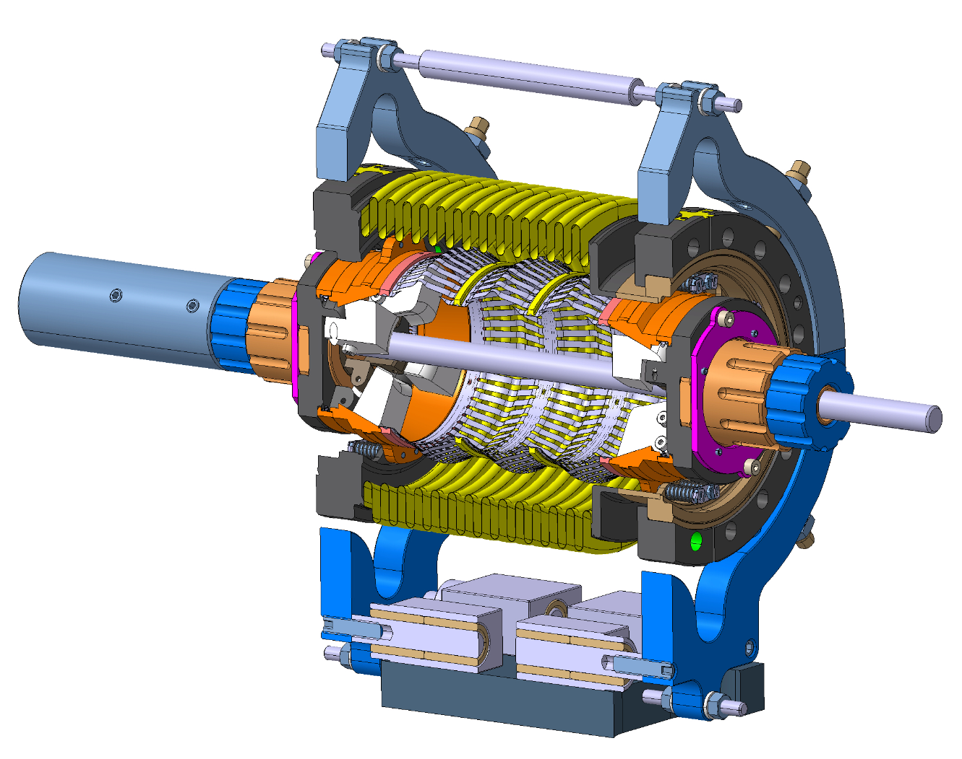
Tooling needed
Two separate tooling are neede for the assembly
The final tooling may be used for transport (TBC)
Tooling 1 :
Function : internal bellows support & extention
Tooling 2 :
Function : -External bellows support & extension
-PIMs assembly support
-Most of components are also used for cavity string assembly in clean room

Slide 4
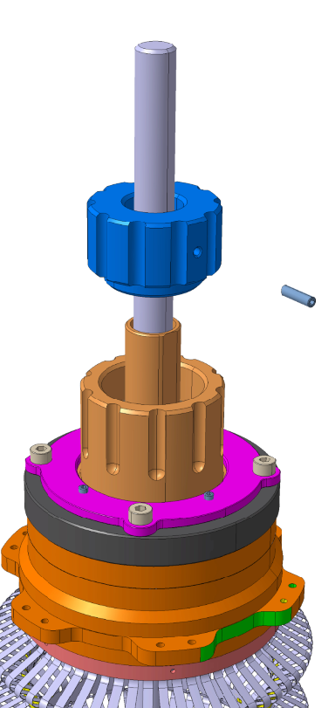
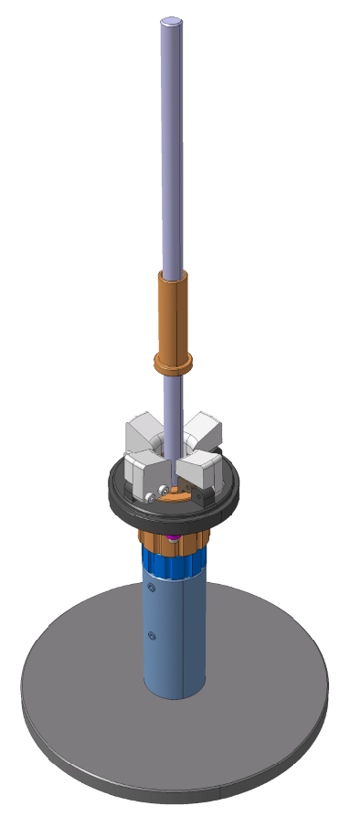
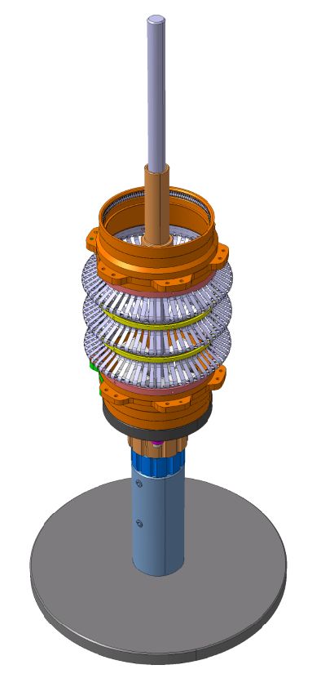
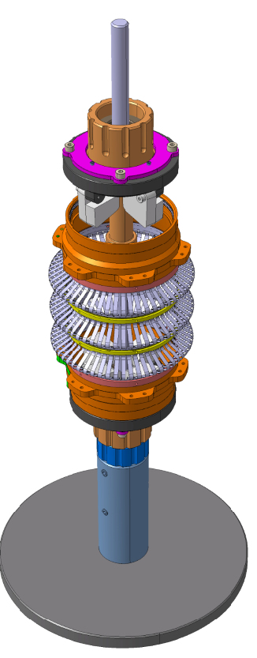
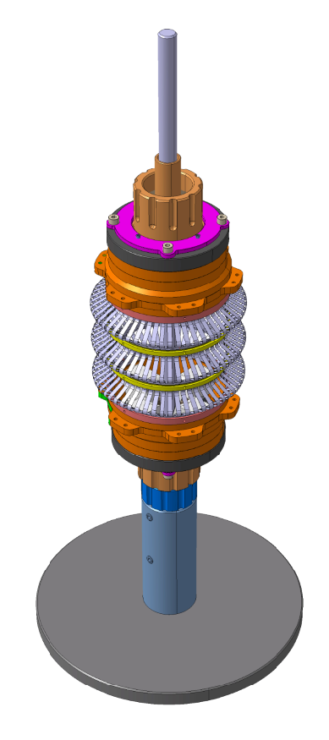
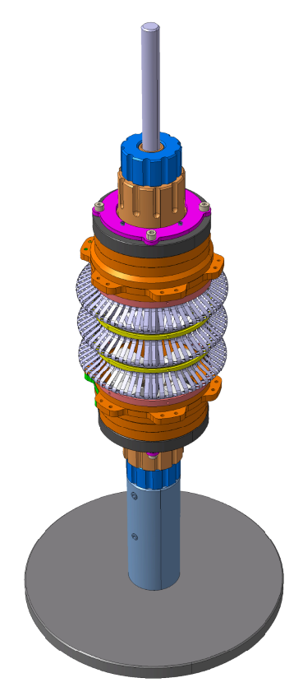
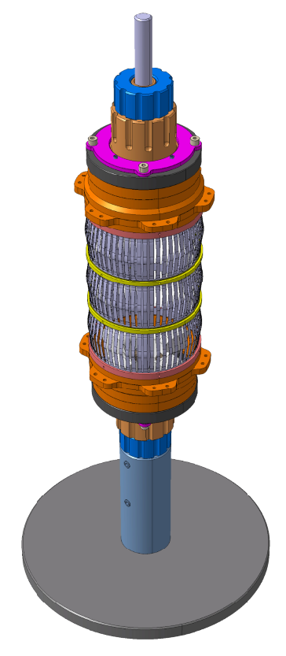
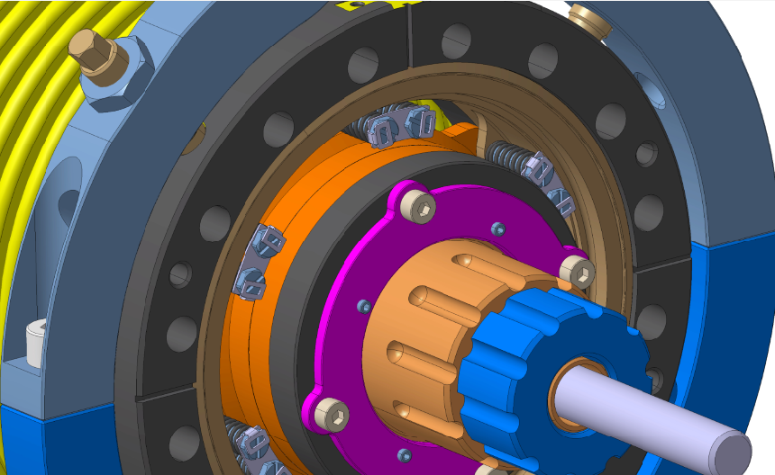
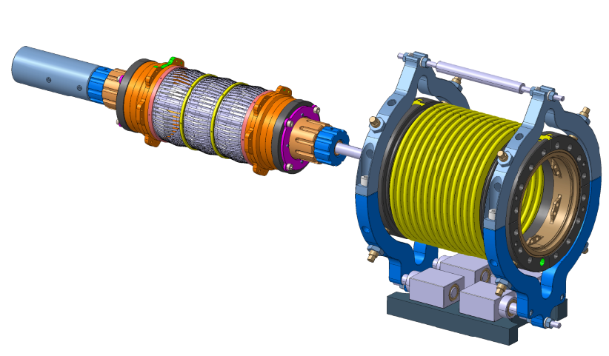
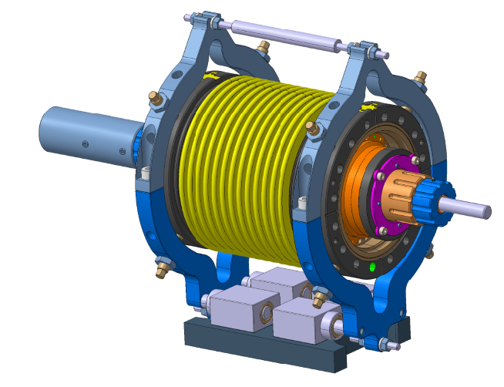
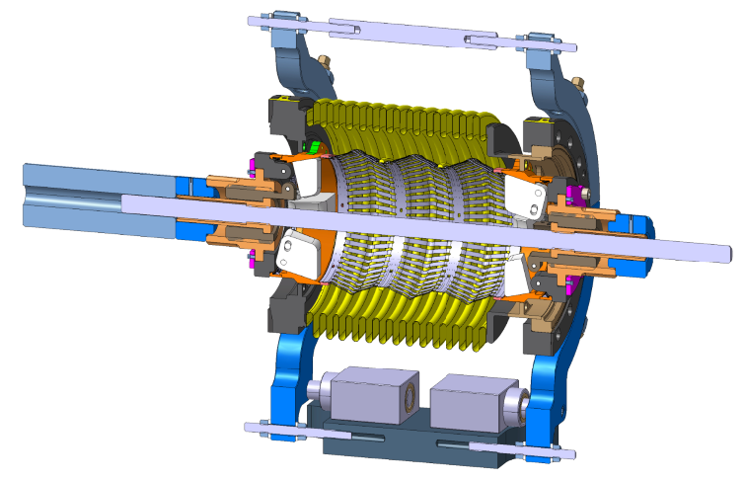
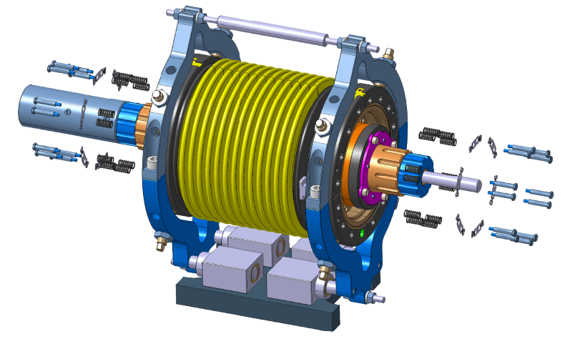
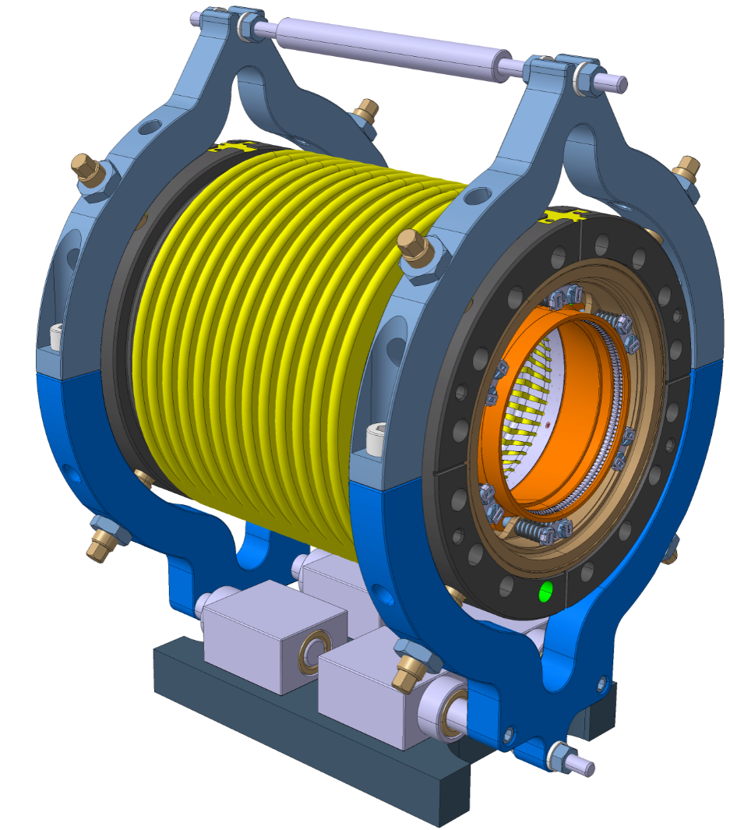
Sequence

Slide 5
End

