Slide 1
L4 Spare RFQ Project - WP06
Slim RF Window Integration
Suitbert Ramberger
25 November 2020

Slide 2
Introduction
Big and slim windows
Available spares
RFQ integration – the big window
RFQ integration – the slim window
Detailed mechanical simulations by Jorge
Principal mechanical deformation
Potential remedies
Next steps
Discussion

Slide 3
Big and slim windows
The big and the slim windows and how it came all about:
Originally two Thales RF windows have been purchased.
The prototype structures were all tested with this type of window.
One window was integrated with the RFQ with the required support structure.
The window is broadband (like the WR2100 waveguides).
The window was relatively expensive, so Eric was asked if this could not be done in-house.
Eric understood that it can be narrowband around the operational frequency of 352.2 MHz.
And it can be made much slimmer and therefore cheaper!
He took care of the RF and mechanical design, and of the manufacturing of >25 windows.
There are 2 spares left but for using it on the RFQ it would make sense to relaunch production.

Slide 4
Available spares
The current situation:
There are one big and two slim spare windows available.
For using the slim window on the RFQ, it would make sense to relaunch the production.
  The two spare windows are convex and require re-machining.
  We need one on the spare RFQ2 and one on each spare coupler (PIMS and CCDTL types).
  It would be good to have one for exchange on RFQ1 and RFQ3
The idea is to produce another 4, – 2 for the spare RFQ project and 2 as Linac4 spares.

Slide 5
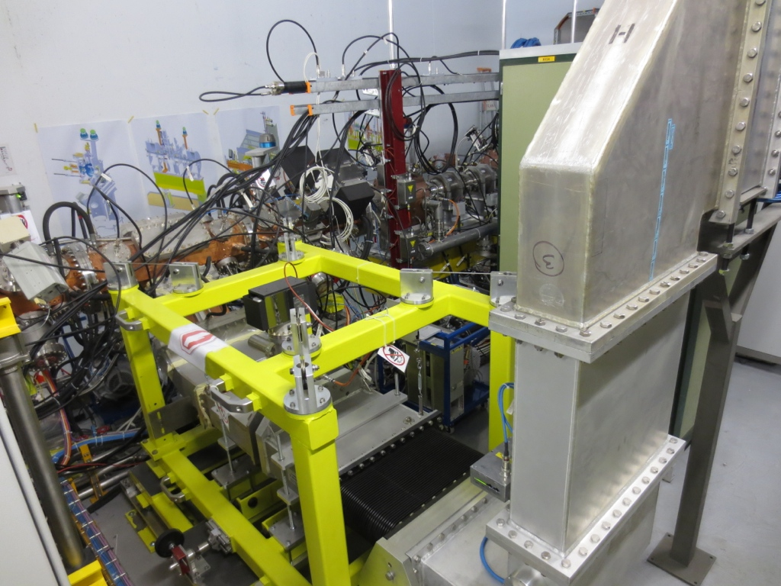
RFQ integration – the big window
The big window is suspended on a structure
The structure reduces forces on the RFQ
But:
Requires considerable space
RFQ cannot be moved with the window
For realignment, vacuum to be broken

Slide 6
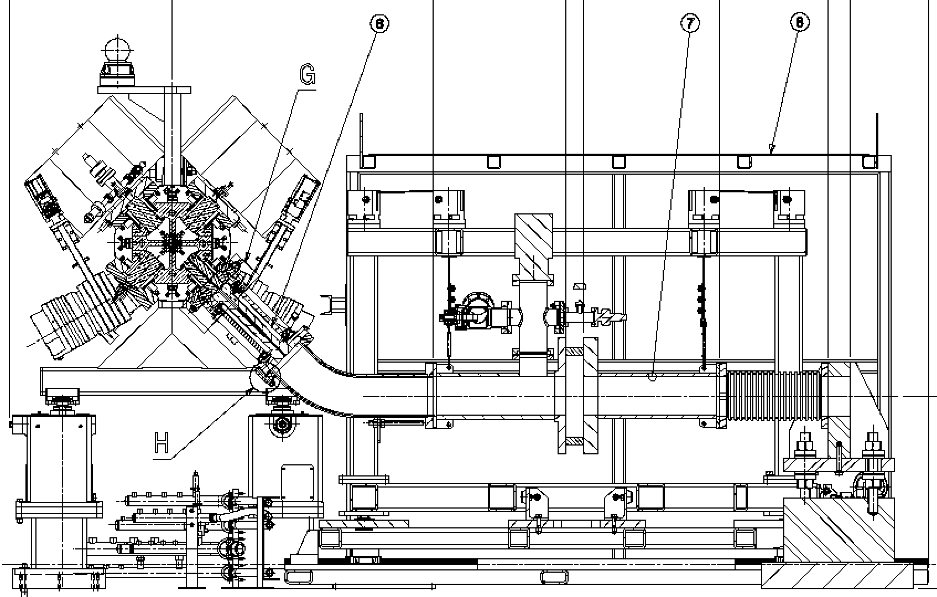
RFQ integration – the big window

Slide 7
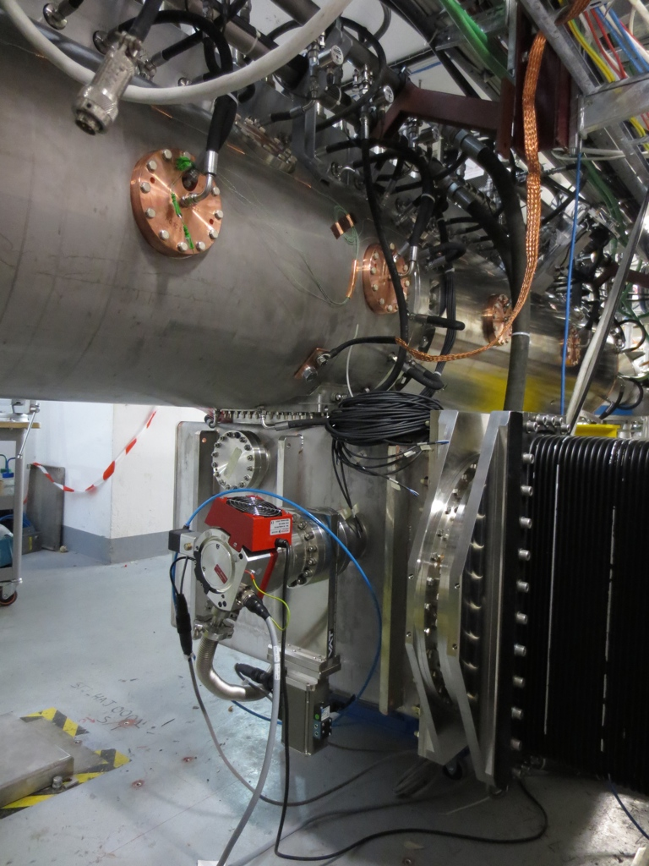
RFQ integration – the slim window
Integration slim RF window improves situation of RFQ:
No need for a bulky broadband RF window and support.
Realignment (within tight limits) w/o breaking the vacuum.
RFQ can be stored and transported with RF window.
Installation and conditioning will be faster.

Slide 8
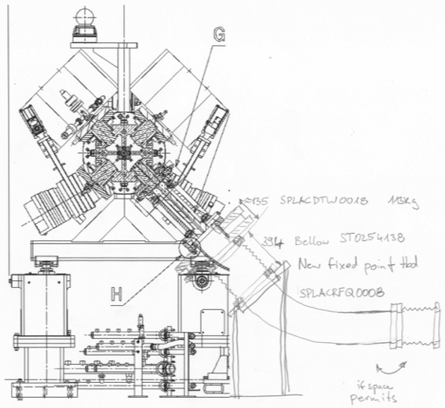
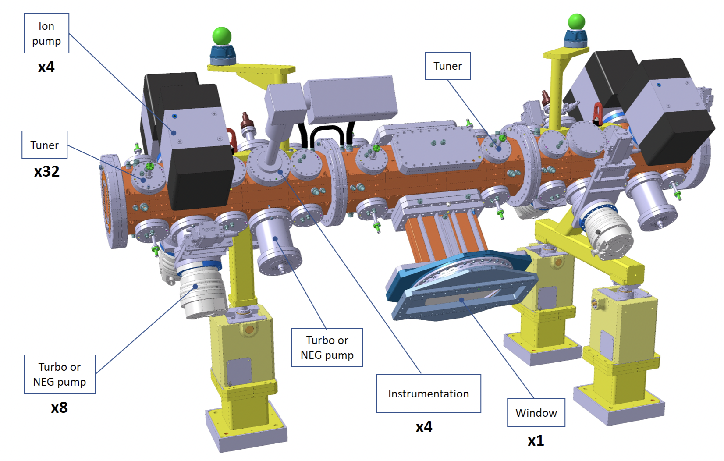
RFQ integration – the slim window

Slide 9
Detailed mechanical simulation results
Jorge Guardia Valenzuela

Slide 10
Principal mechanical deformation
The mechanical structure of the RFQ is weakened by the RF openings
After realignment of the deformed RFQ, 3 principal types of deformation remain:
Deformation of the quadrupolar shape in the center with changes of up to 6µm between vanes
A sag along the structure with a sharp change from -20µm/m to +20µm/m in the center
A torsion varying all along the RFQ within 0.3mrad with a variation in the center of 0.6mrad/m
Can this be accepted and maybe partly compensated by:
RF tuning of the RFQ?
Beam dynamics design?

Slide 11
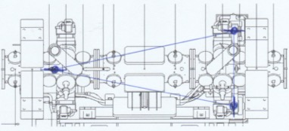
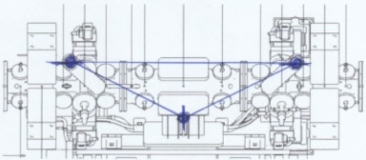
Potential remedies
The preference would be not to apply any mechanical modifications
To keep the design as is (which is already in production with the RFQ2)
To be able to apply the same solution also on RFQ1 when required / possible.
Potential remedies:
A mechanically stiffer redesign – for RFQ3.
Stiffeners between waveguide flanges
Weight equilibration (e.g. vacuum pump on other side)
A different distribution of supports

Slide 12
Next steps
The next steps need to follow rapidly as the production of RF windows takes about a year
One window needs to be ready well before the tuning phase 09/2021
Beam dynamics evaluation – if any
RF evaluation – if any
Decision to be taken (end of 12/2020)
Launch of slim RF window production – if decided
Mechanical integration and design of new supports
Supports production
RF window reception
RFQ assembly with RF window

