Slide 1
L4 Spare RFQ Project - WP06 - Slim RF Window Integration:
Mechanical simulations
Jorge Guardia-Valenzuela (EN-MME-EDS)
With contributions from B. Riffaud, F. Carra, S. Ramberger
25-Nov-2020
https://indico.cern.ch/event/974220/

Slide 2
Outline
Loading and boundary conditions
Assumptions
Mesh
Numerical results
Conclusions
Backup slides: previous symmetric calculations with simplified supports

Slide 3
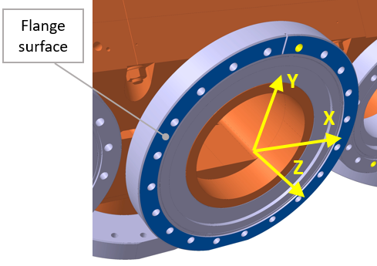
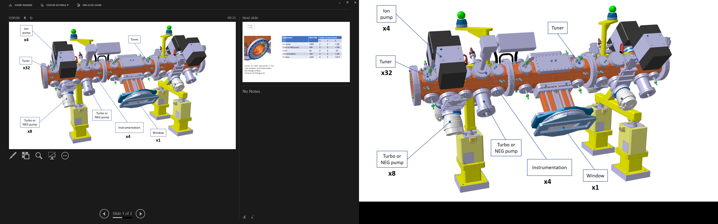
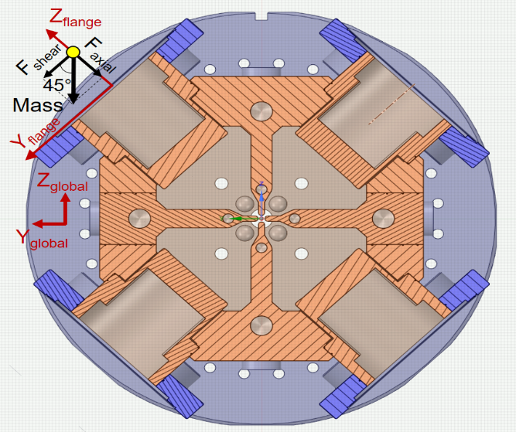
Component description
Z
X
Y
Local flange coordinate system:
X_global=X_local
Loads on flanges taken into account in all studied load cases
Component | Mass (N) | Centre of mass (mm) (flange coord. system) |  |  | Axial Force (N) | Shear Force (N) | Moment (Nm)
 |  | X | Y | Z | +/- Z (local) | +/- Y (local) | +/- X (global)
Ion pump | 1490 | 0 | 0 | + 195 | 1053.6 | 1053.6 | 205.5
Turbo or NEG pump | 340 | 0 | 0 | + 195 | 240.4 | 240.4 | 46.9
Tuner | 65 | 0 | 0 | - 20 | 46.0 | 46.0 | 0.9
Instrumentation | 100 | 0 | 0 | + 100 | 70.7 | 70.7 | 7.1

Slide 4
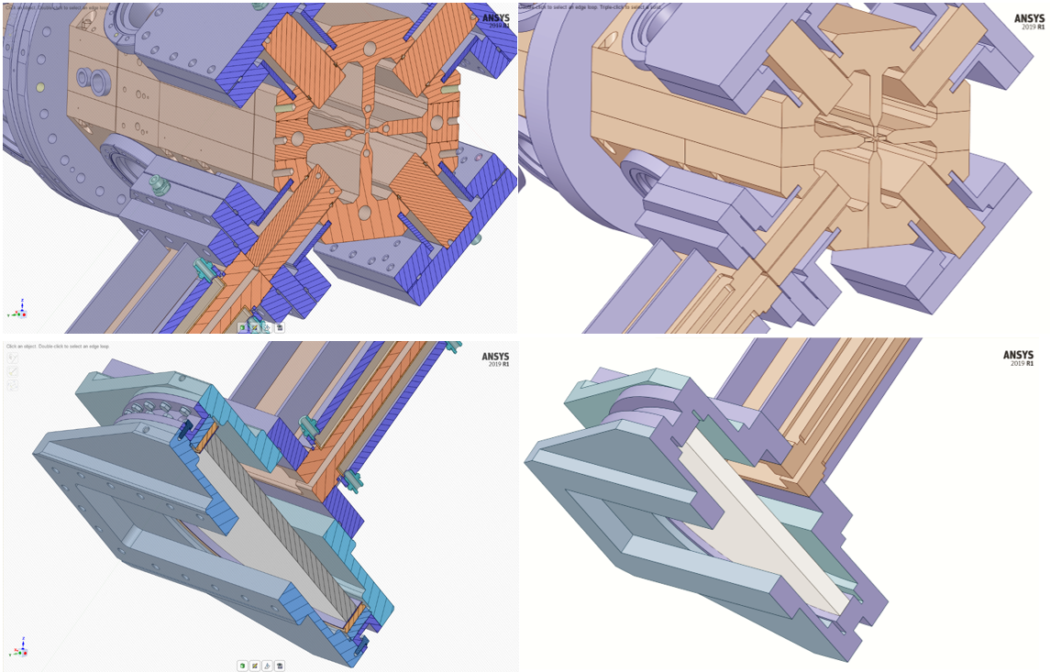
Geometry simplifications
Design Calculated model

Slide 5
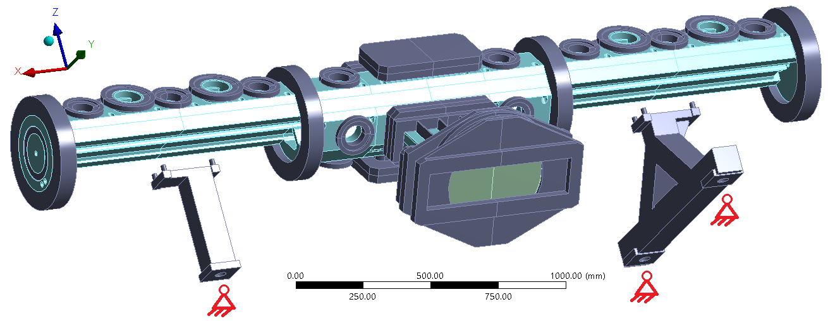
Supports
• Steel supports are included in the calculation, considering fixed frictionless spherical joints at the bottom (image below).
• Besides, calculations with fixed contact plate & symmetry were previously done (see backup slides).
Supports:
Spherical joints allow free rotation in all 3 axes, but displacement = 0.
Rigidity of the supports taken into account.
Connection with RFQ through the 4 pins per support (bonded contact).

Slide 6
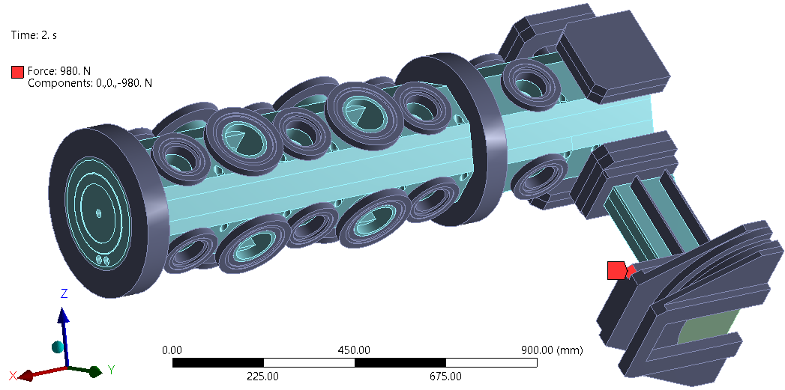
Load cases studied
• Self-weight (without RF window)
• Self-weight (complete model)
• Self-weight + 1 accidental person load on one side of the window (100 kg).
• Previous, after unloading the person load.
(Person load is actually applied where it is shown here, on the waveguide flange)

Slide 7
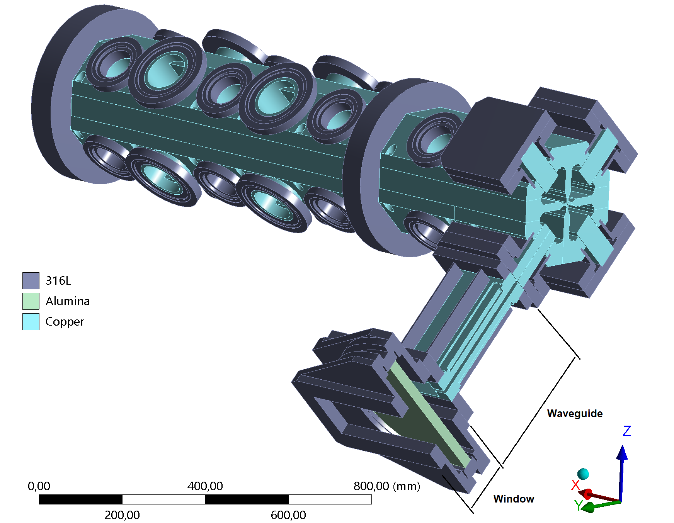
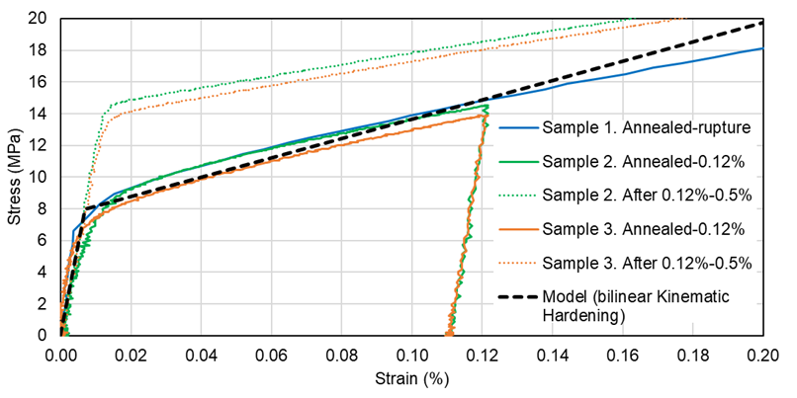
Assumptions
Linear elastic / elastoplastic assumptions;
Static structural calculation;
Small displacements assumption;
All contacts are perfectly bonded;
Material properties at room temperature:
- OFE Cu (annealed): elastoplastic model
- All steel parts: linear elastic, E=195 GPa (316L)
- Alumina: linear elastic (only its density is relevant)
Material | Density (kg/m³) | Poisson’s ratio (-) | Elastic modulus (GPa) | Yield stress Rp0.2 (MPa) | Tensile strength _{Rm} (MPa) | Ref
OFE Copper (Annealed) | 8890 | 0.3 | 115 | 8 | 240 | [7]
SS 316L | 7950 | 0.26 | 195 | 190 | 490 | [8][9]
Alumina | 4000 | 0.21 | 72 | 470 | 540 | [10][11]
Tensile tests on OFE Cu samples https://edms.cern.ch/document/1451106
The model fits well the experimental data of the annealed material (no previous cold working), up strains of around 0.2% (2000 μm/m).
- Yield strength: 8 MPa
- Tangent modulus 6.17 GPa

Slide 8
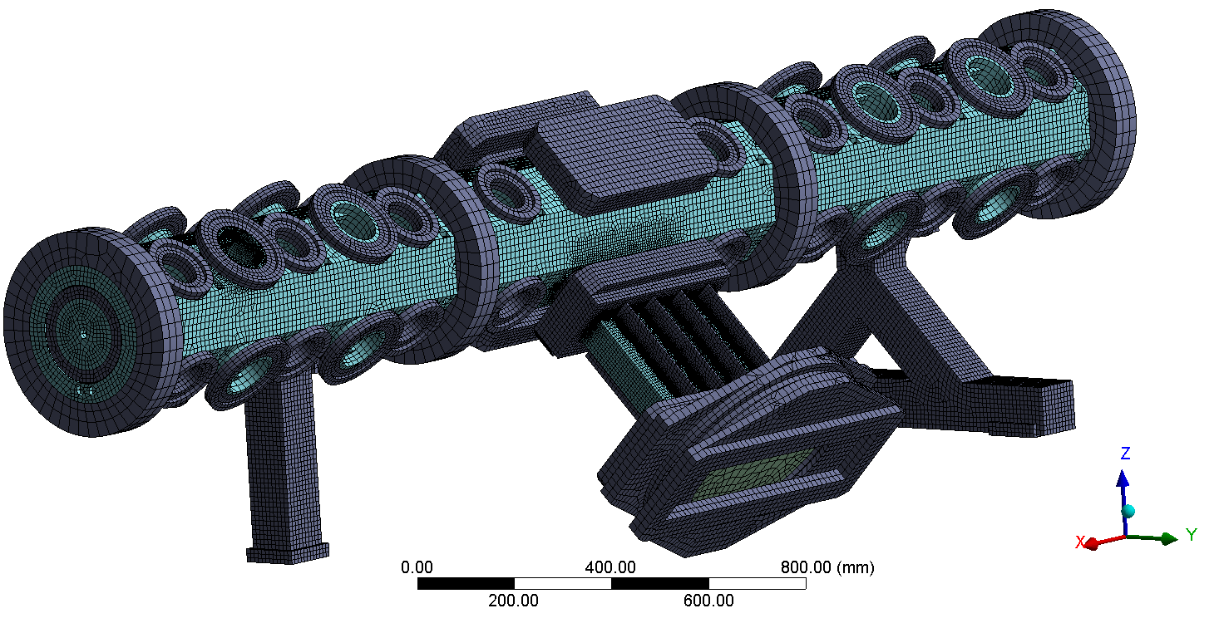
Mesh
Element size between 50 and 0.5 mm
≈ 1 million elements
≈ 800k nodes

Slide 9
Results

Slide 10
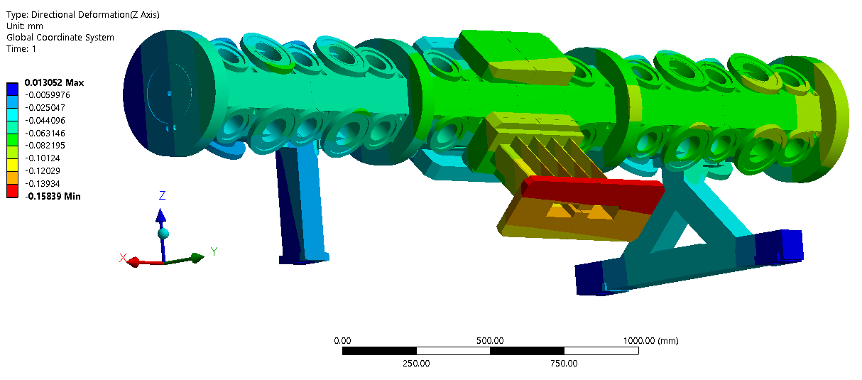
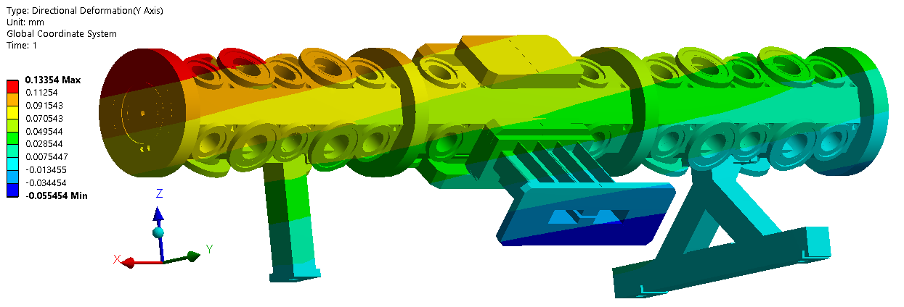
Only Waveguide case: deformations

Slide 11
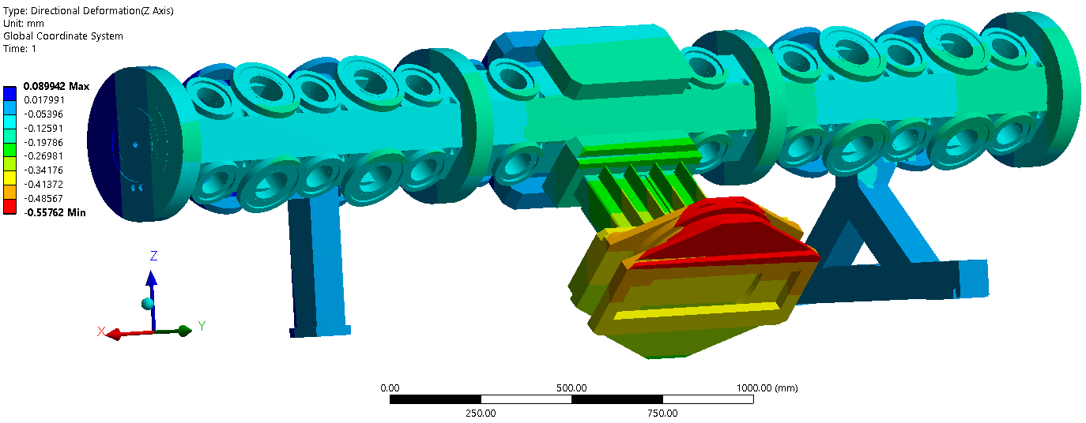
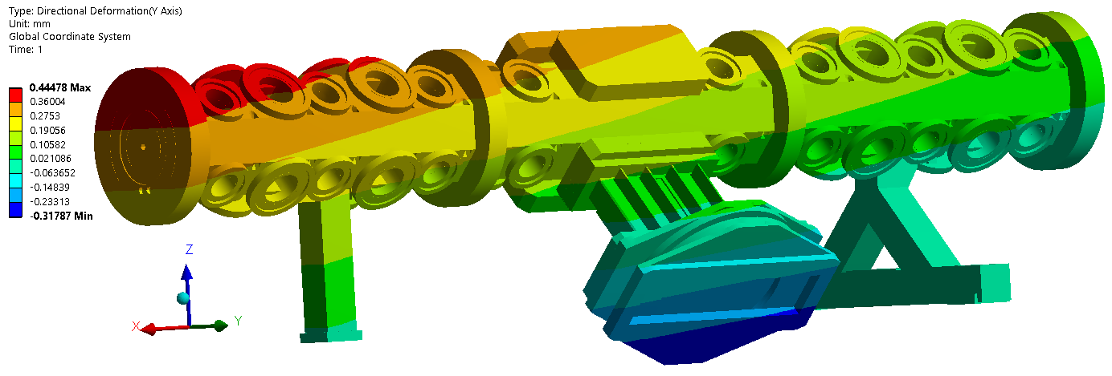
WG+window case: deformations

Slide 12
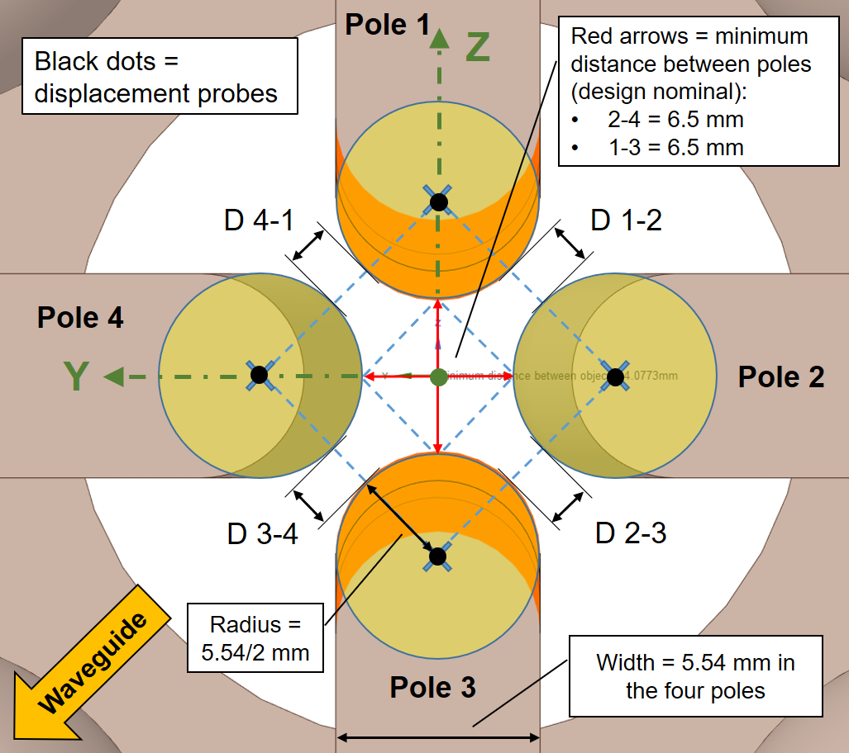
Deformation of the vanes
Pole displacements at the symmetry plane, and separation between them
Units: µm
Pole | No window, No WG |  | WG added |  | Window added |  | Load of a person |  | Unload person
 | Dir. Y | Dir. Z | Dir. Y | Dir. Z | Dir. Y | Dir. Z | Dir. Y | Dir. Z | Dir. Y | Dir. Z
1 (Top) |  |  | 56.2 | -50.7 | 186.9 | -58.7 | 298.0 | -65.1 | 189.9 | -59.1
2 (Behind) |  |  | 55.3 | -50.1 | 183.7 | -55.3 | 292.8 | -59.5 | 186.7 | -55.6
3 (Bottom) |  |  | 53.6 | -49.8 | 177.6 | -55.1 | 283.0 | -59.3 | 180.5 | -55.5
4 (Window) |  |  | 56.4 | -53.6 | 187.6 | -66.9 | 299.2 | -77.9 | 190.6 | -67.4
Distance change poles 1-3 |  |  | 1 (6.501 mm) |  | 4 (6.504 mm) |  | 6 (6.506 mm) |  | 4 (6.504 mm)
Distance change poles 2-4 |  |  | -1 (6.499 mm) |  | -4 (6.496 mm) |  | -6 (6.494 mm) |  | -4 (6.496 mm)
Distance change poles 1-2 |  |  | 0 (2.974 mm) |  | 0 (2.973 mm) |  | 0 (2.973 mm) |  | 0 (2.973 mm)
Distance change poles 2-3 |  |  | -1 (2.972 mm) |  | -4 (2.969 mm) |  | -7 (2.967 mm) |  | -4 (2.969 mm)
Distance change poles 3-4 |  |  | -1 (2.973 mm) |  | -1 (2.972 mm) |  | -2 (2.972 mm) |  | -1 (2.972 mm)
Distance change poles 4-1 |  |  | 2 (2.976 mm) |  | 6 (2.980 mm) |  | 10 (2.983 mm) |  | 6 (2.98 mm)
Person load does not plastically deform the vanes

Slide 13
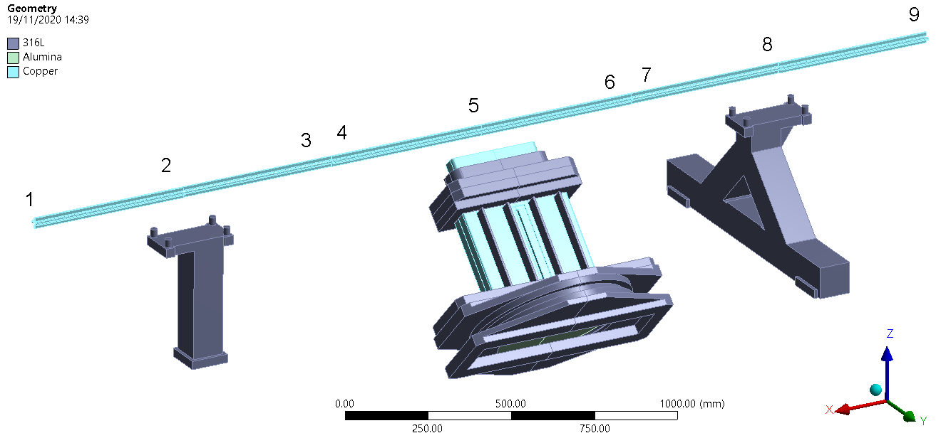
Alignment (centre of the 4 vanes)
Cross-section | X coord. (mm)
1 | 1528.091
2 | 1020.57
3 | 513.0499
4 | 512.95
5 | 0
6 | -512.95
7 | -513.05
8 | -1018.27
9 | -1523.48
Horizontal axis in next slide plots

Slide 14
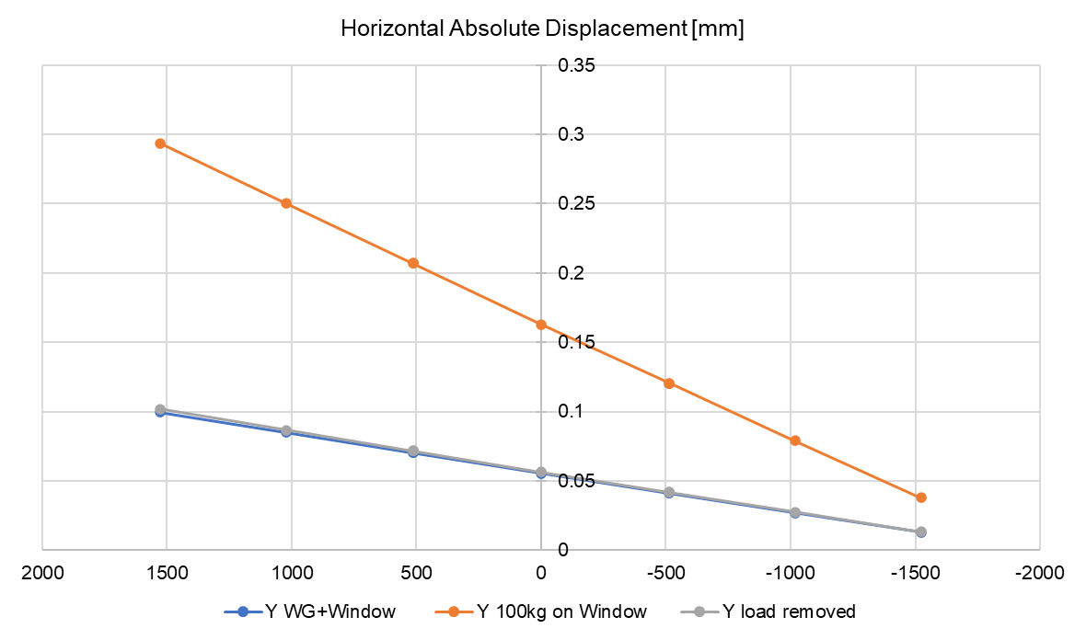
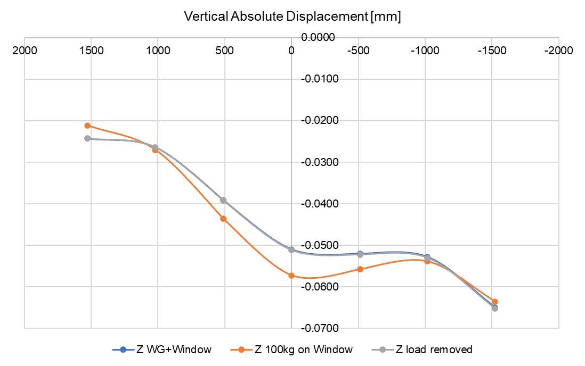
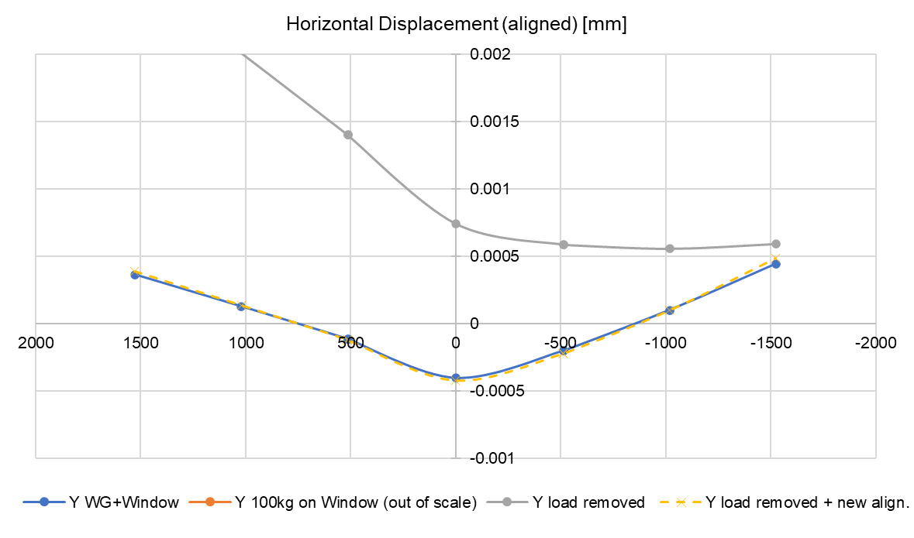
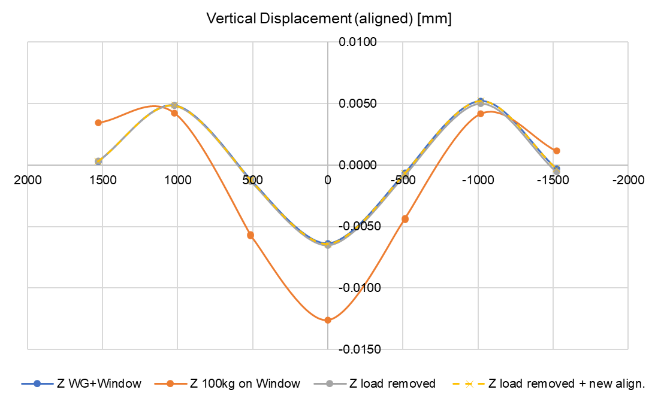
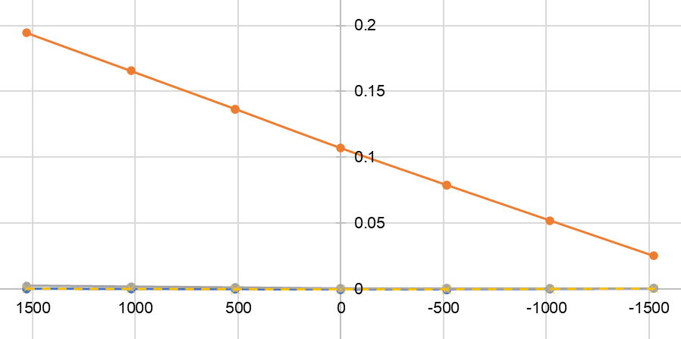
Alignment (centre of the 4 vanes): only WG case
Y axis
Z axis
+0.4 µm
+5.2 µm
-0.4 µm
-6.4 µm
Maximum |deviation|: 6.4 µm

Slide 15
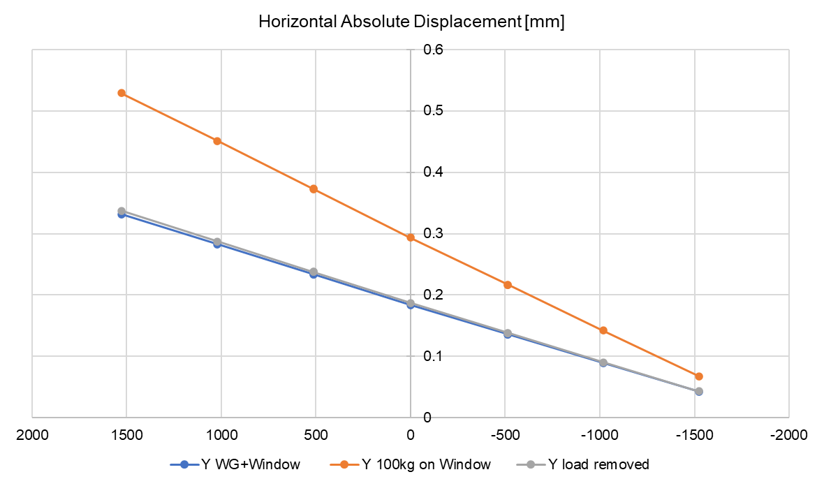
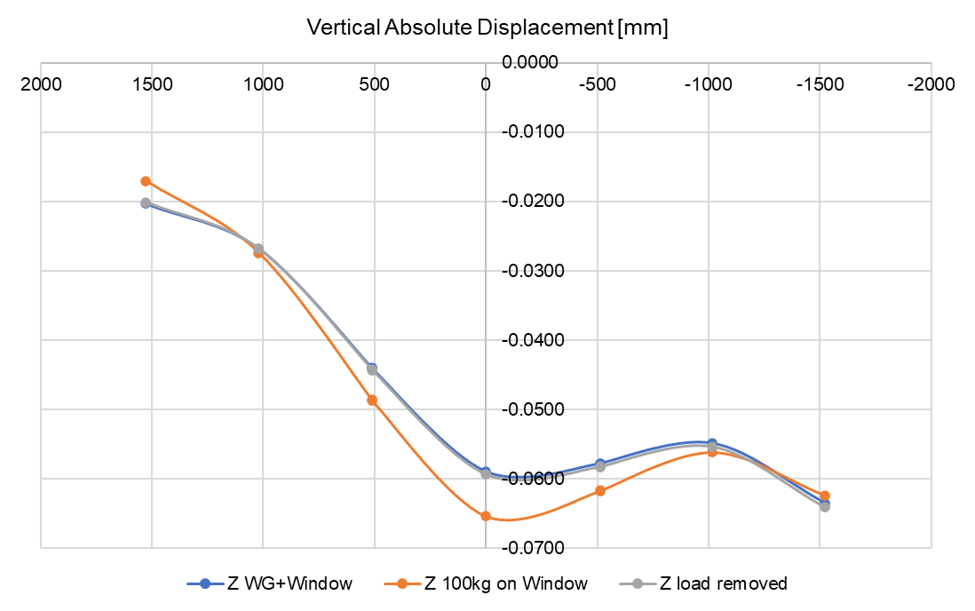
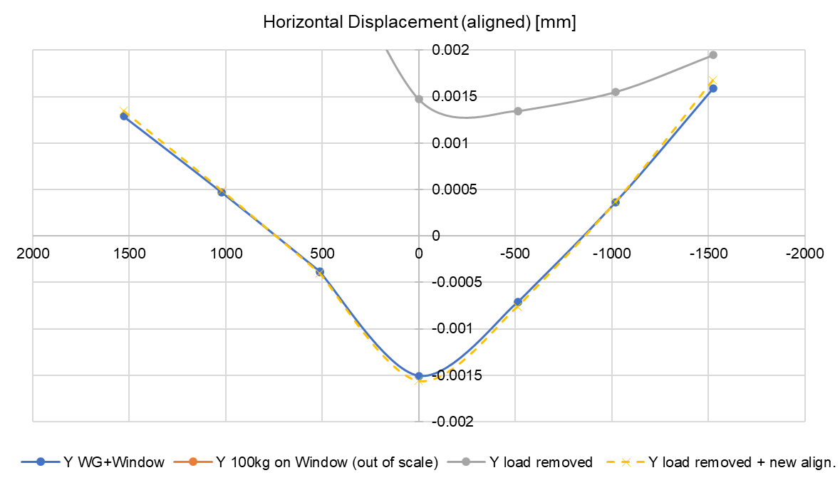
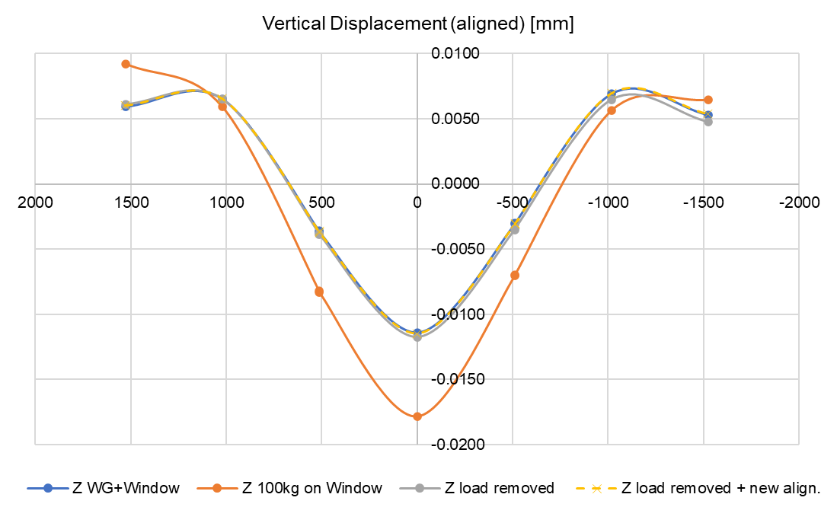
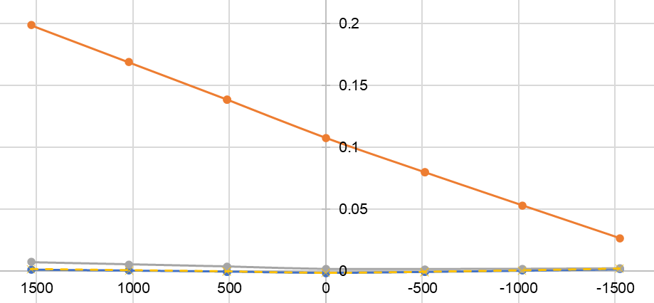
Alignment (centre of the 4 vanes): WG + window case
Y axis
Z axis
+1.7 µm
+7 µm
-1.6 µm
-12 µm
Maximum |deviation|: 12 µm

Slide 16
Conclusions
Stresses slightly higher than the elastic limit of annealed OFE copper (>8 MPa) are found in several areas, so locally plastically-deformed material is likely to occur.
  An accidental load of 100 kg on the window leads to further plastic deformation, mainly at the flange brazed area. However there is no relevant plastic def. at the RF vanes.
Deformations at the RF vanes close to the waveguide can be limited by adding stiffeners to the steel flanges that are brazed to the RFQ. To be studied if necessary.
  Worst area: Distance between poles 4-1 increases 6 µm when RF window is added. With stiffeners it increases only 1-2 µm.
Deformations of the RF vanes due to the rotation of the single-support can be corrected by the beam-alignment, reducing the maximum deviation to 12 µm.
Report will be available here: https://edms.cern.ch/document/2418061

Slide 17
Thank you for your attention!

Slide 18
Backup slides

Slide 19
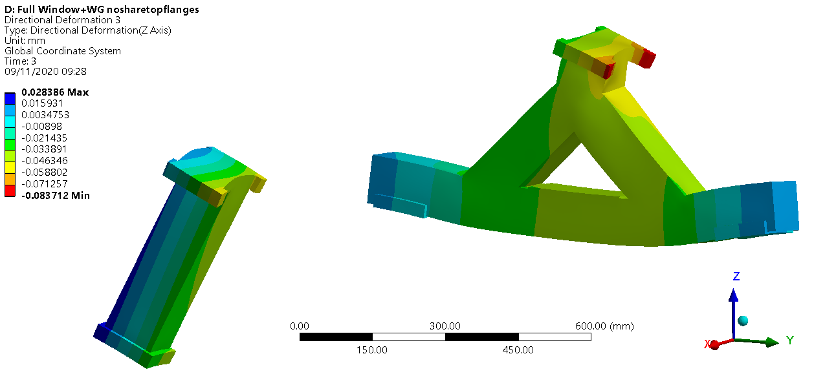
Supports: Single vs double
(Deformation magnified x1000 in the visual representation)
Waveguide + window case, without accidental 100 kg load

Slide 20
Symmetric calculations with simplified supports (fixed on RFQ surface)
These results are comparable to the ones shown before (including steel supports), except for the rotation due to the single support. Relative deformations between vanes and stresses are almost identical.
Minor differences are explained due to the small angle change of gravity acceleration for the loads:

Slide 21
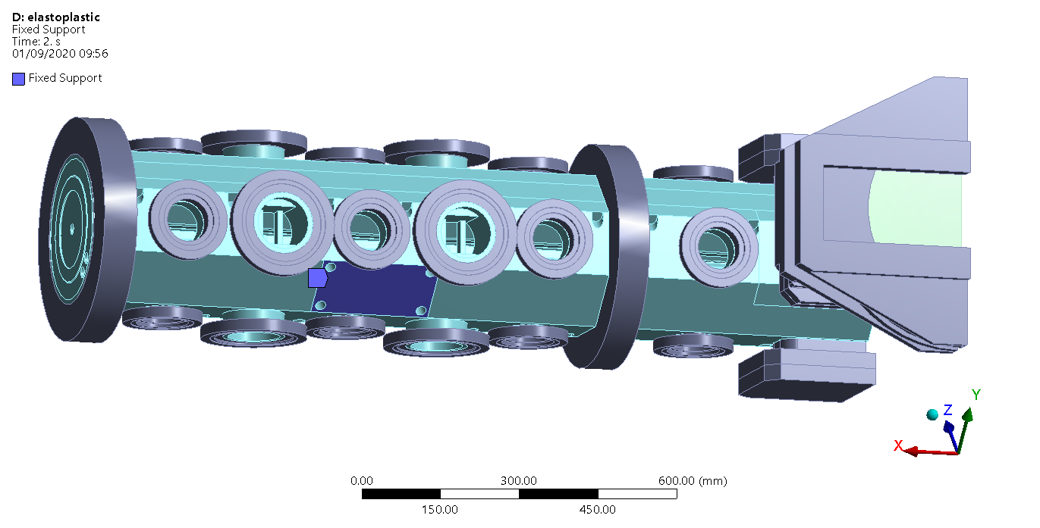
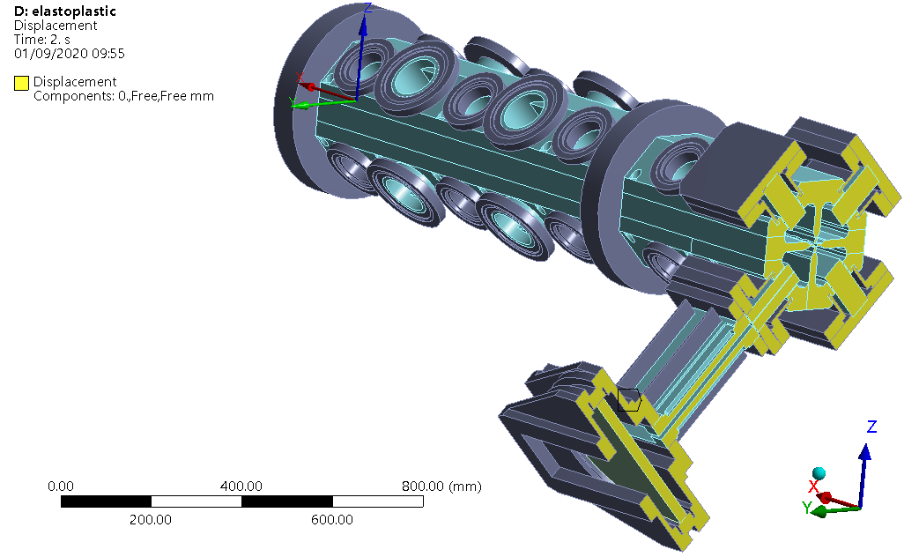
Fixed support calculations (with symmetry)
Boundary conditions

Slide 22
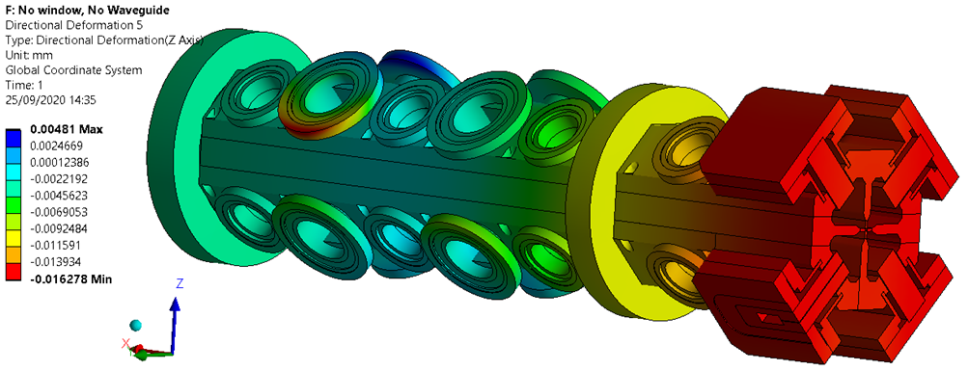
No Waveguide, No Window case
Vertical (Z) deformation
There is only one area with stresses slightly above the yield limit: the ion pump flange (9.0 MPa). Minor plasticised elements are found (strains up to 260 µm/m).
This load does not vary including the WG or window.
Deformation at the symmetry plane constant ≈15 µm in –Z, see table afterwards.

Slide 23
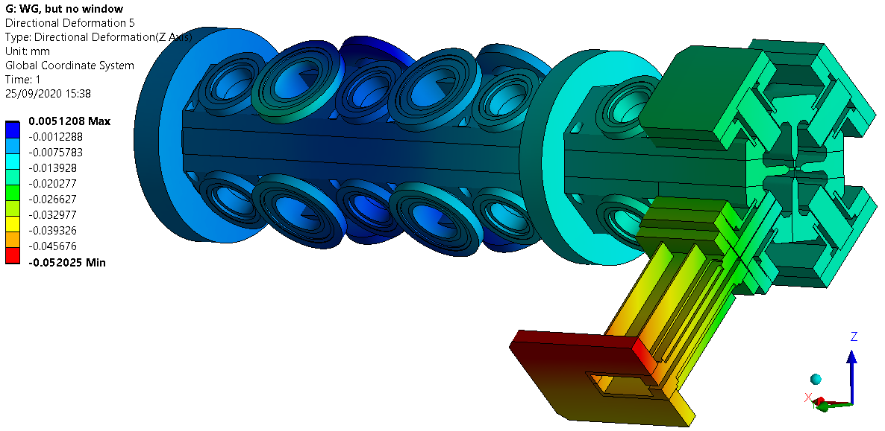
Effect of the waveguide (current situation)
Vertical (Z) deformation

Slide 24
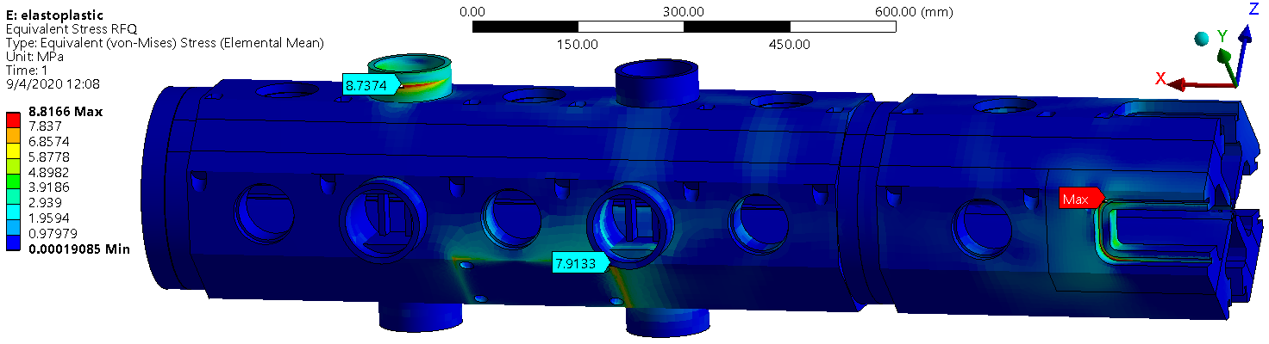
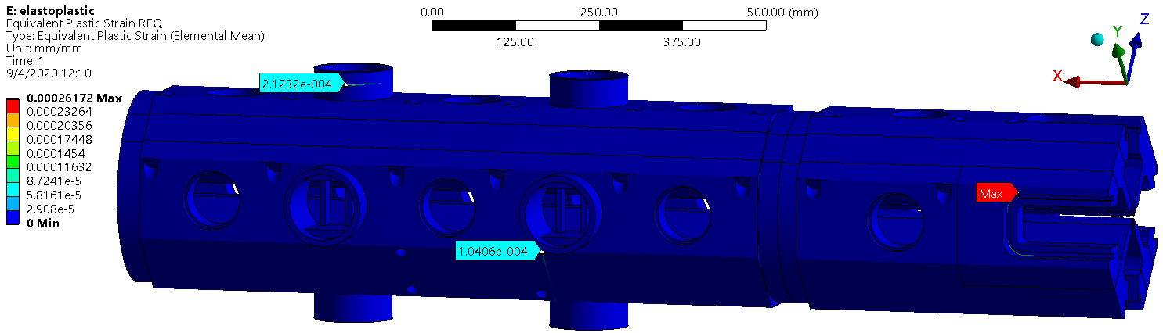
Effect of the RF window + waveguide

Slide 25
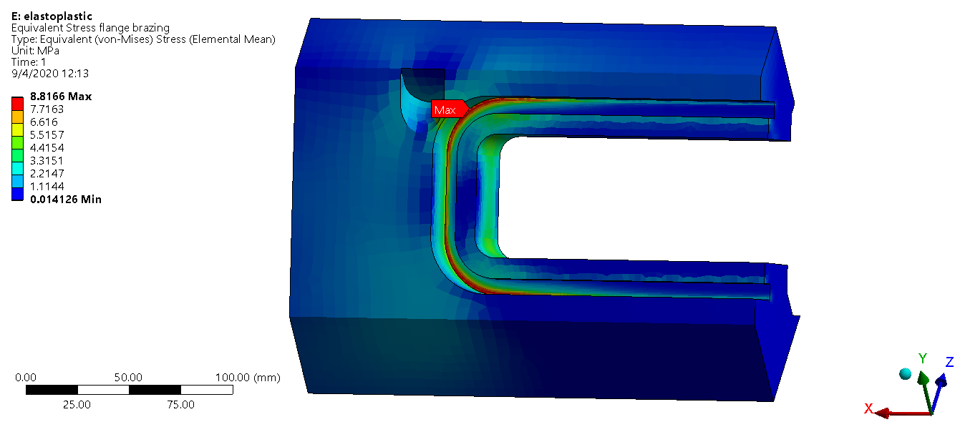
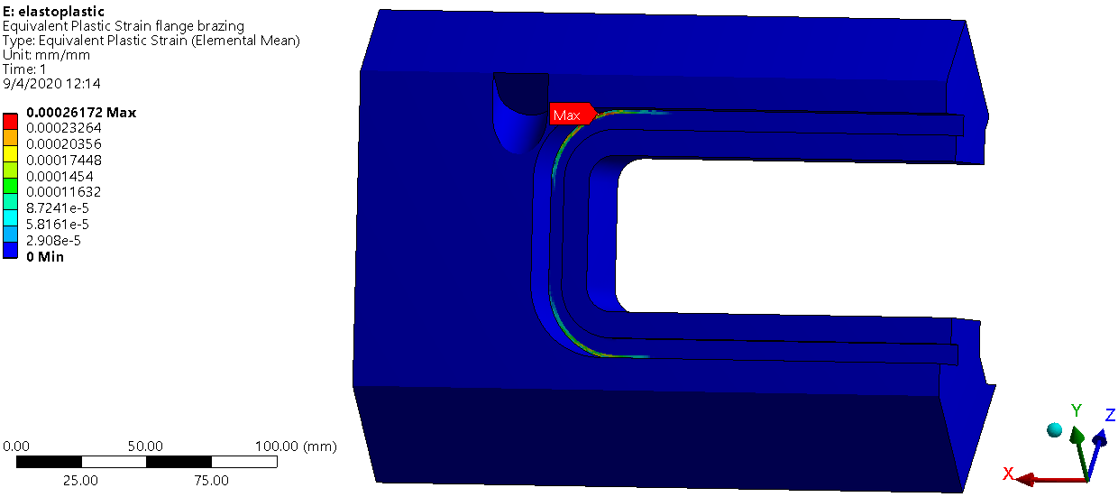
Effect of the RF window + waveguide

Slide 26
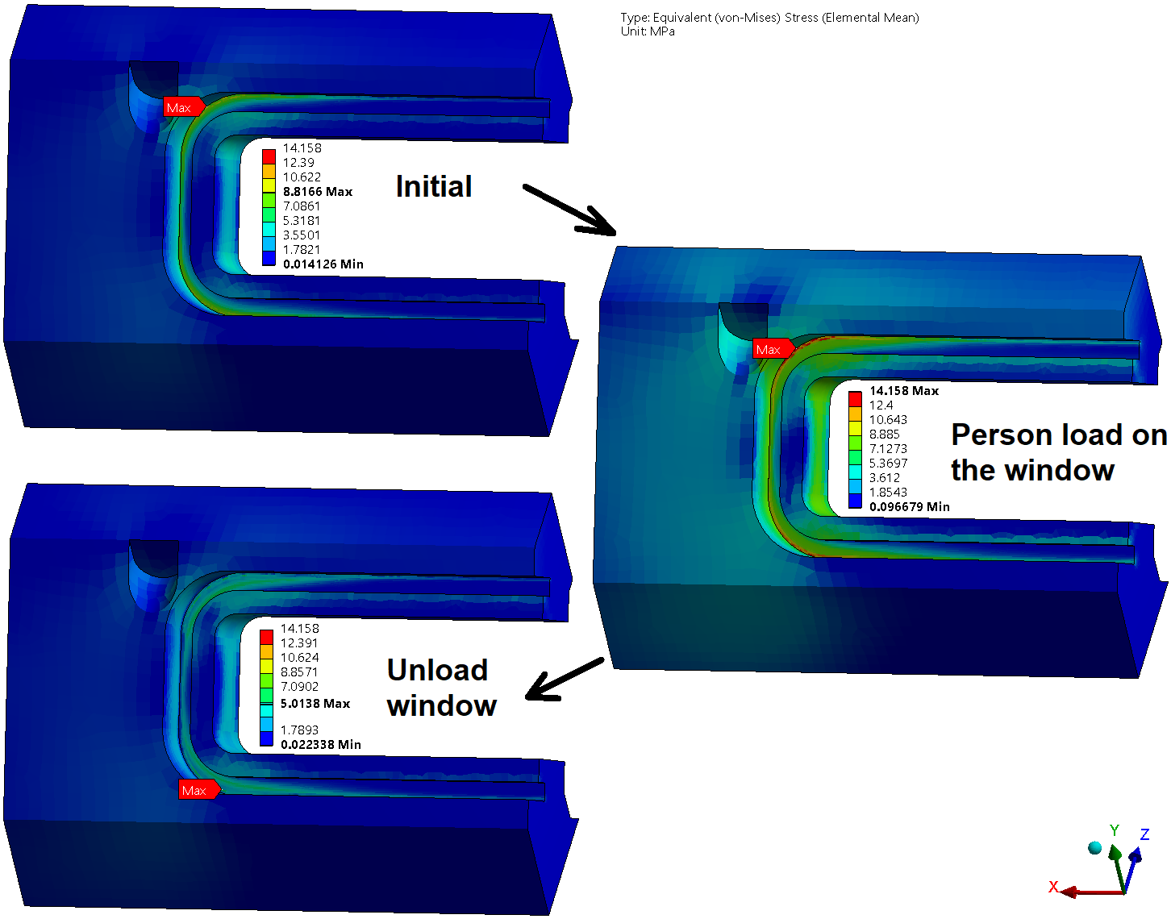
Effect of the RF window + waveguide
Stress distribution progress due to the accidental 100 kg load on the window
Peak ~9 MPa
Peak ~14 MPa
The plastically deformed surfaces (after the person load) lead to more evenly distributed stresses (that is why the peak stress decreases).
Peak ~5 MPa

Slide 27
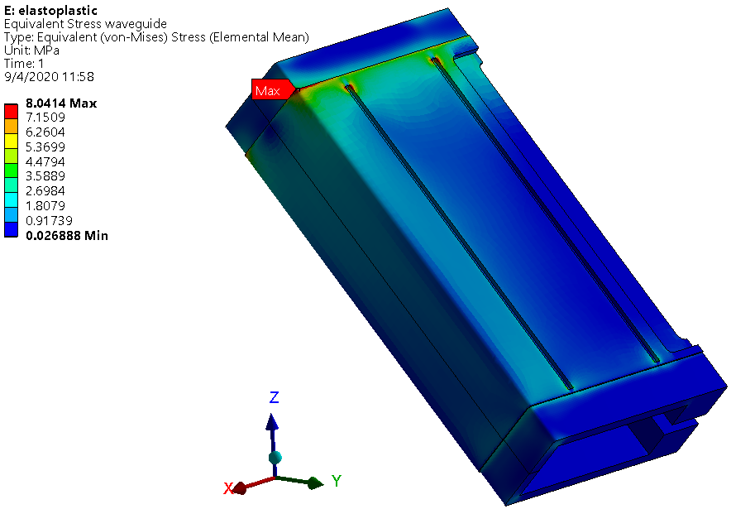
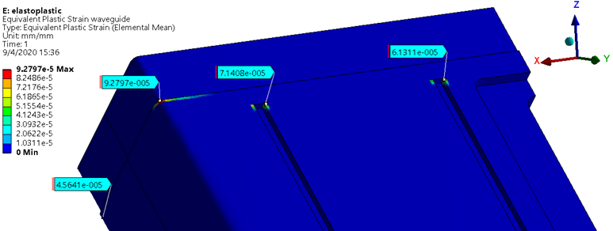
Effect of the RF window + waveguide

Slide 28

Deformation of the vanes
Pole displacements at the symmetry plane, and separation between them
Units: µm
Pole | No window, No WG |  | WG added |  | Window added |  | Load of a person |  | Unload person
 | Dir. Y | Dir. Z | Dir. Y | Dir. Z | Dir. Y | Dir. Z | Dir. Y | Dir. Z | Dir. Y | Dir. Z
1 (Top) | 0 | -14.6 | 0.6 | -16.7 | 1.9 | -20.2 | 4.2 | -26.1 | 2 | -20.4
2 (Behind) | 0 | -15.3 | 0.5 | -17 | 1.6 | -19.9 | 3.4 | -24.5 | 1.6 | -20
3 (Bottom) | 0 | -14.7 | -0.3 | -15.7 | -1.7 | -16.5 | -4.5 | -17.5 | -2 | -16.4
4 (Window) | 0 | -15.3 | 1.7 | -18.8 | 5.8 | -26 | 12.9 | -38.4 | 6.1 | -26.6
Distance change poles 1-3 | 0 (4.061 mm) |  | 1 (4.062 mm) |  | 4 (4.065 mm) |  | 10 (4.071 mm) |  | 5 (4.066 mm)
Distance change poles 2-4 | 0 (4.077 mm) |  | -1 (4.076 mm) |  | -4 (4.074 mm) |  | -9 (4.069 mm) |  | -4 (4.073 mm)
Distance change poles 1-2 | 0 (1.255 mm) |  | 0 (1.255 mm) |  | 0 (1.255 mm) |  | -1 (1.254 mm) |  | 0 (1.255 mm)
Distance change poles 2-3 | 0 (1.255 mm) |  | -1 (1.253 mm) |  | -5 (1.250 mm) |  | -11 (1.244 mm) |  | -5 (1.250 mm)
Distance change poles 3-4 | 0 (1.255 mm) |  | -1 (1.254 mm) |  | -1 (1.253 mm) |  | -2 (1.252 mm) |  | -1 (1.253 mm)
Distance change poles 4-1 | 0 (1.255 mm) |  | 2 (1.257 mm) |  | 7 (1.262 mm) |  | 15 (1.270 mm) |  | 7 (1.262 mm)
Person load does not plastically deform the vanes

Slide 29
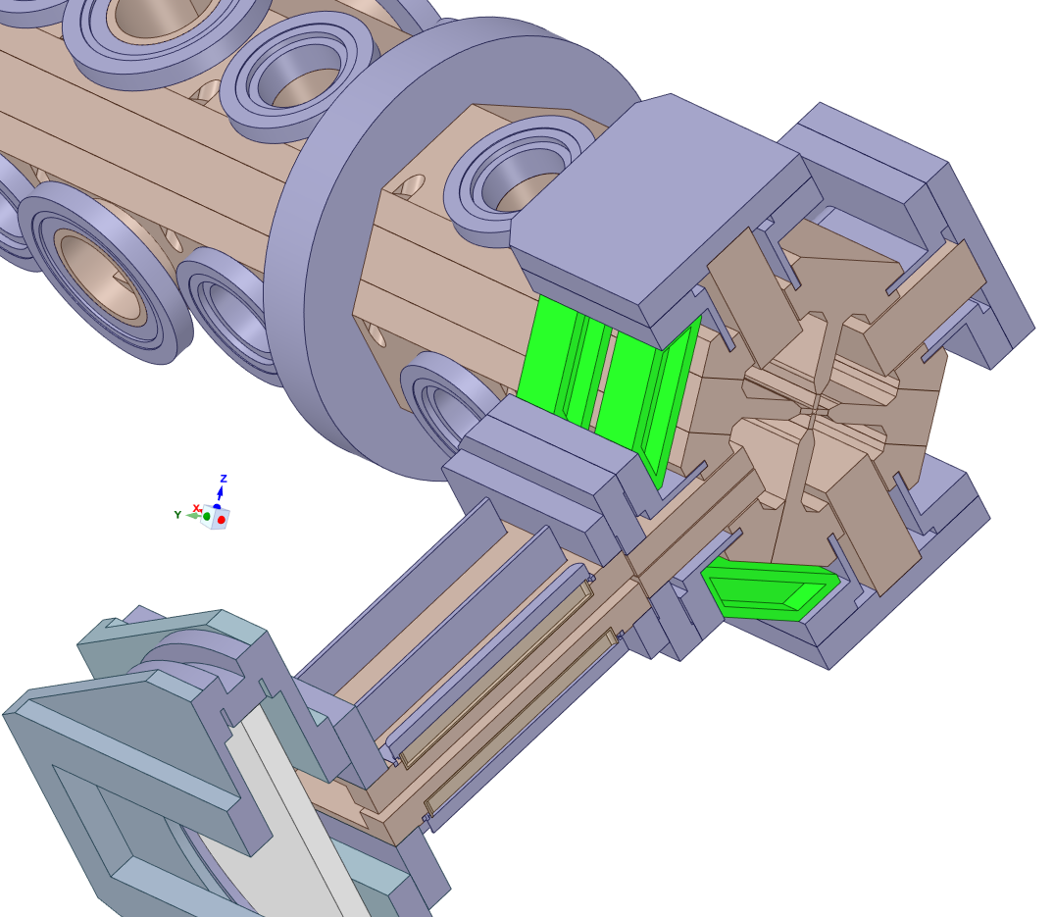
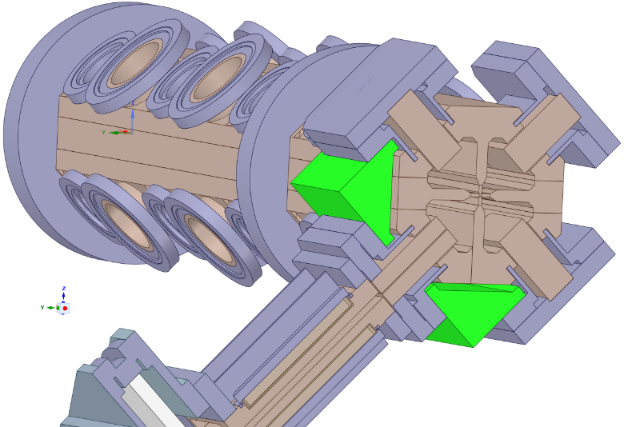
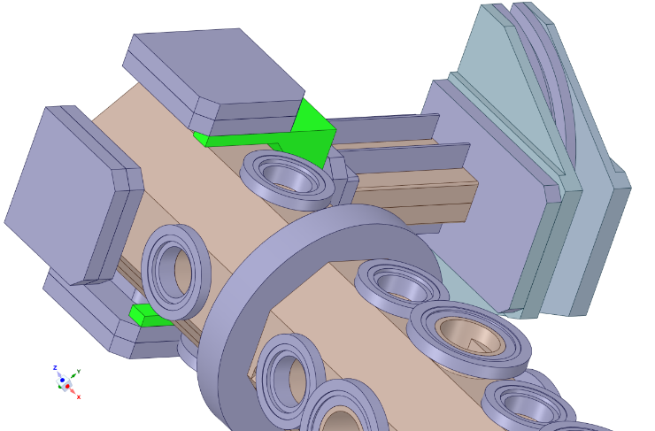
How to limit deformation?
→ Reinforce the flange so that the moment is distributed over adjacent flanges. The stiffeners must be rigid to bending moment for optimal results.
This is just a concept check, integration to be checked.
They can slide into place, and could be produced by milling a 50x50mm square bar, or welding 10mm thick plates. Total weight in steel (8 pieces)= 14.4 kg
Huge reinforcements:
Maximum possible material volume that fits between the flanges.
Total weight in steel 65 kg
Optimal reinforcement v2
 |  | Separation change | No window, no WG | WG added | Window added | Load of a person | Unload person
No reinforcement |  | Change 1-2 | 0.000 | 0.000 | 0.000 | -0.001 | 0.000 | mm
 |  | Change 2-3 | 0.000 | -0.001 | -0.005 | -0.011 | -0.005 | mm
 |  | Change 3-4 | 0.000 | -0.001 | -0.001 | -0.002 | -0.001 | mm
 |  | Change 4-1 | 0.000 | 0.002 | 0.007 | 0.015 | 0.007 | mm
Optimal reinforcement v2 |  | Change 1-2 | 0.000 |  | 0.000 | 0.000 | 0.000 | mm
 |  | Change 2-3 | 0.000 |  | -0.001 | -0.002 | -0.001 | mm
 |  | Change 3-4 | 0.000 |  | -0.001 | -0.001 | -0.001 | mm
 |  | Change 4-1 | 0.000 |  | 0.002 | 0.005 | 0.002 | mm
Optimal reinforcement v2 |  | Change 1-2 | 0.000 |  | 0.000 | 0.000 | 0.000 | mm
 |  | Change 2-3 | 0.000 |  | -0.001 | -0.002 | -0.001 | mm
 |  | Change 3-4 | 0.000 |  | -0.001 | -0.001 | -0.001 | mm
 |  | Change 4-1 | 0.000 |  | 0.002 | 0.005 | 0.002 | mm
Huge reinforcement |  | Change 1-2 | 0.000 |  | 0.000 | 0.000 | 0.000 | mm
 |  | Change 2-3 | 0.000 |  | -0.001 | -0.001 | -0.001 | mm
 |  | Change 3-4 | 0.000 |  | -0.001 | -0.001 | -0.001 | mm
 |  | Change 4-1 | 0.000 |  | 0.002 | 0.004 | 0.002 | mm

Slide 30
Deformation of the vanes: 2D plot
2D representation of the deformation probes
(displacements are multiplied by 100 to be able to see the difference in the plot)

Slide 31
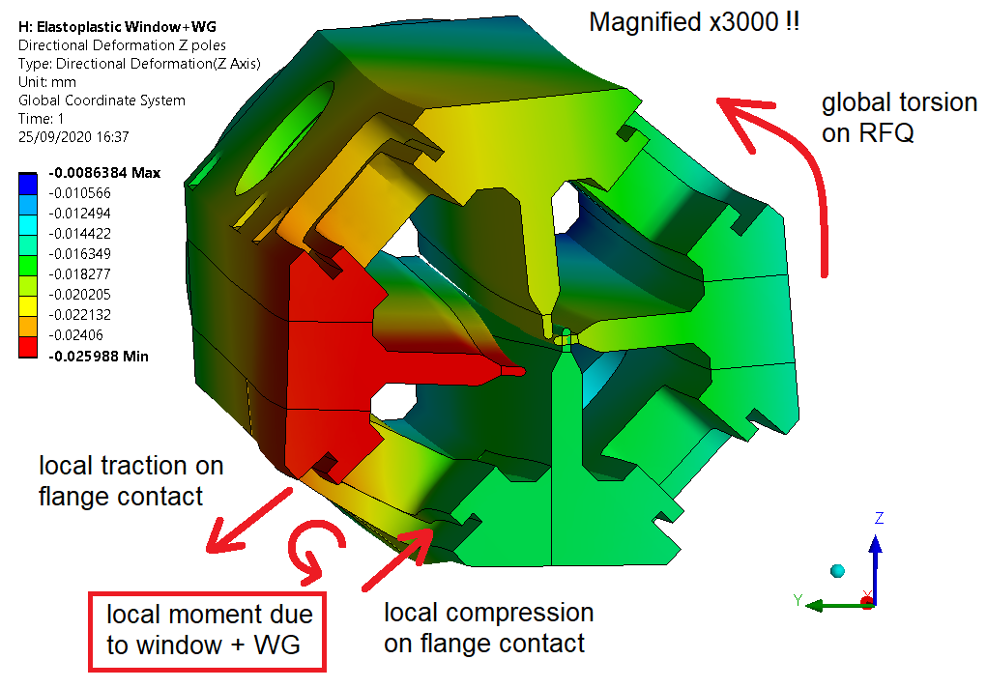
Why the vanes deform in this way?

Slide 32
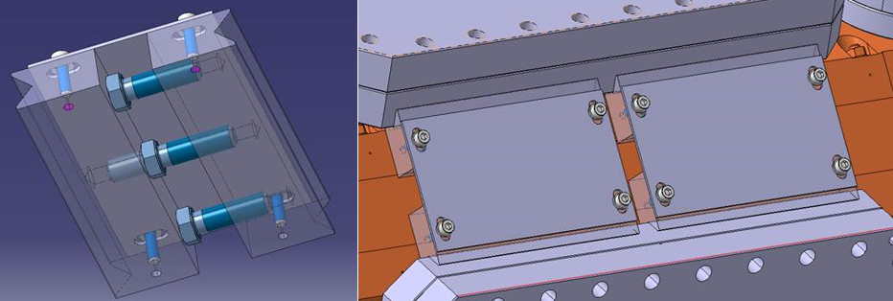
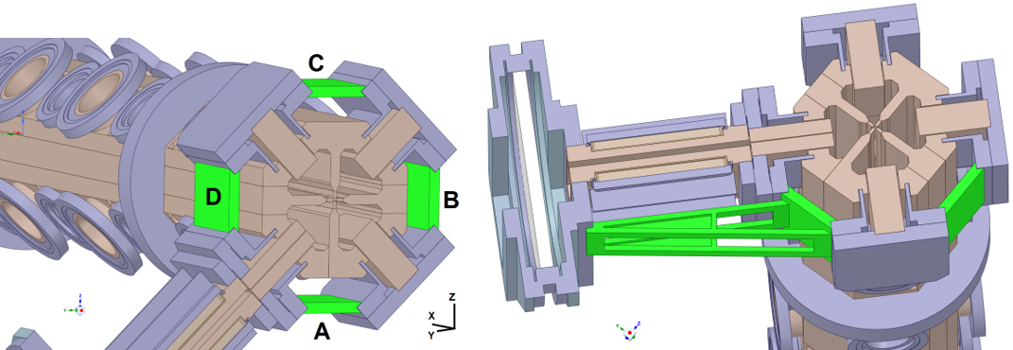
Other reinforcement concepts
Design of compression stiffeners between flanges. Compatible with current RFQ (V. Maire, B. Riffaud).
Model
Other concept

Slide 33
Results: comparison table
 | Reinforcement | RFQ max flange stress [MPa] | RFQ max flange plastic strain [µm/m] | Waveguide Max stress [MPa] | Waveguide Max plastic strain [µm/m] | RF window max Z deformation [mm]
Window added | No | 8.9 | 270 | 8.1 | 100 | -0.210
 | 1 (A) | 7.2 | 20 | 8.2 | 120 | -0.140
 | 2 (A+B) | 6.7 | 0 | 8.2 | 120 | -0.135
 | 4 (A+B+C+D) | 3.9 - 5.5* | 0 – 0* | 8.3 | 130 | -0.118
 | 2 (A+B) + beam | 6.5 | 0 | 6.7 | 10 | -0.082
Load of a person (100kg) | No | 14.2 | 1200 | 10.4 | 500 | -0.467
 | 1 (A) | 8.9 | 280 | 10.7 | 560 | -0.307
 | 2 (A+B) | 8.5 | 200 | 10.8 | 560 | -0.300
 | 4 (A+B+C+D) | 5.8 - 7.8* | 0 – 30* | 10.9 | 600 | -0.258
 | 2 (A+B) + beam | 8.4 | 20 | 8.6 | 190 | -0.162
Unload person | No | 5.0 | 1150 | 4.8 | 480 | -0.222 (p=12 µm)
 | 1 (A) | 4.7 | 280 | 5.0 | 530 | -0.144 (p=4 µm)
 | 2 (A+B) | 4.6 | 200 | 5.0 | 540 | -0.139 (p=4 µm)
 | 4 (A+B+C+D) | 3.9 - 4.5* | 0 - 30* | 5.0 | 570 | -0.122 (p=4 µm)
 | 2 (A+B) + beam | 4.6 | 20 | 4.3 | 190 | -0.082 (p=0 µm)
Values with symbol * come from the flange just above the one of the waveguide (one of the stiffeners is under traction and pulls it downwards). Note that the contacts between stiffeners and flanges are assumed as perfectly bonded; this is not realistic for the stiffener D which is under traction stress (and possibly also for C).
p= plastic deformation

