Slide 2
Individual System Tests of MPE systems in LHC post LS2
12-11-2020
  M. Zerlauth, Z. Charifoulline for TE/MPE

Slide 3
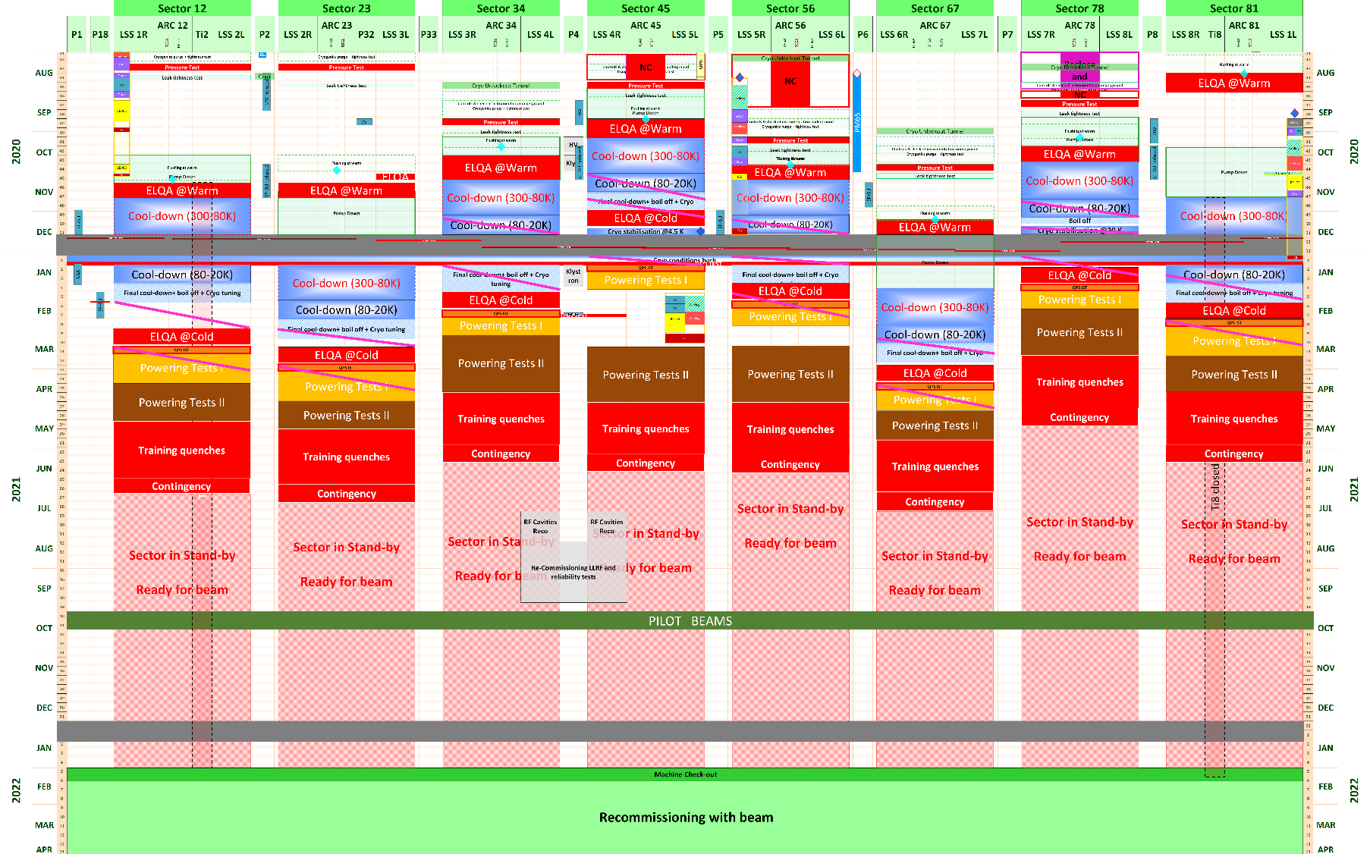
NEW V 3.1 – INWORK Without 11T
This version will be updated following the results of the discussions held on 23/10 with the Experiments
LHC-LS2, EN-ACE-OSS
3

Slide 4
resource loaded planning V3.0 (obsolete)
S45 and S81 QDS
IST and DQHDS and
cool-down preparations in S56
QDS IST @ warm
cool-down preparations
IST and DQHDS
remaining sectors
IST and DQHDS
S67
cool-down
preparations in S67

Slide 5
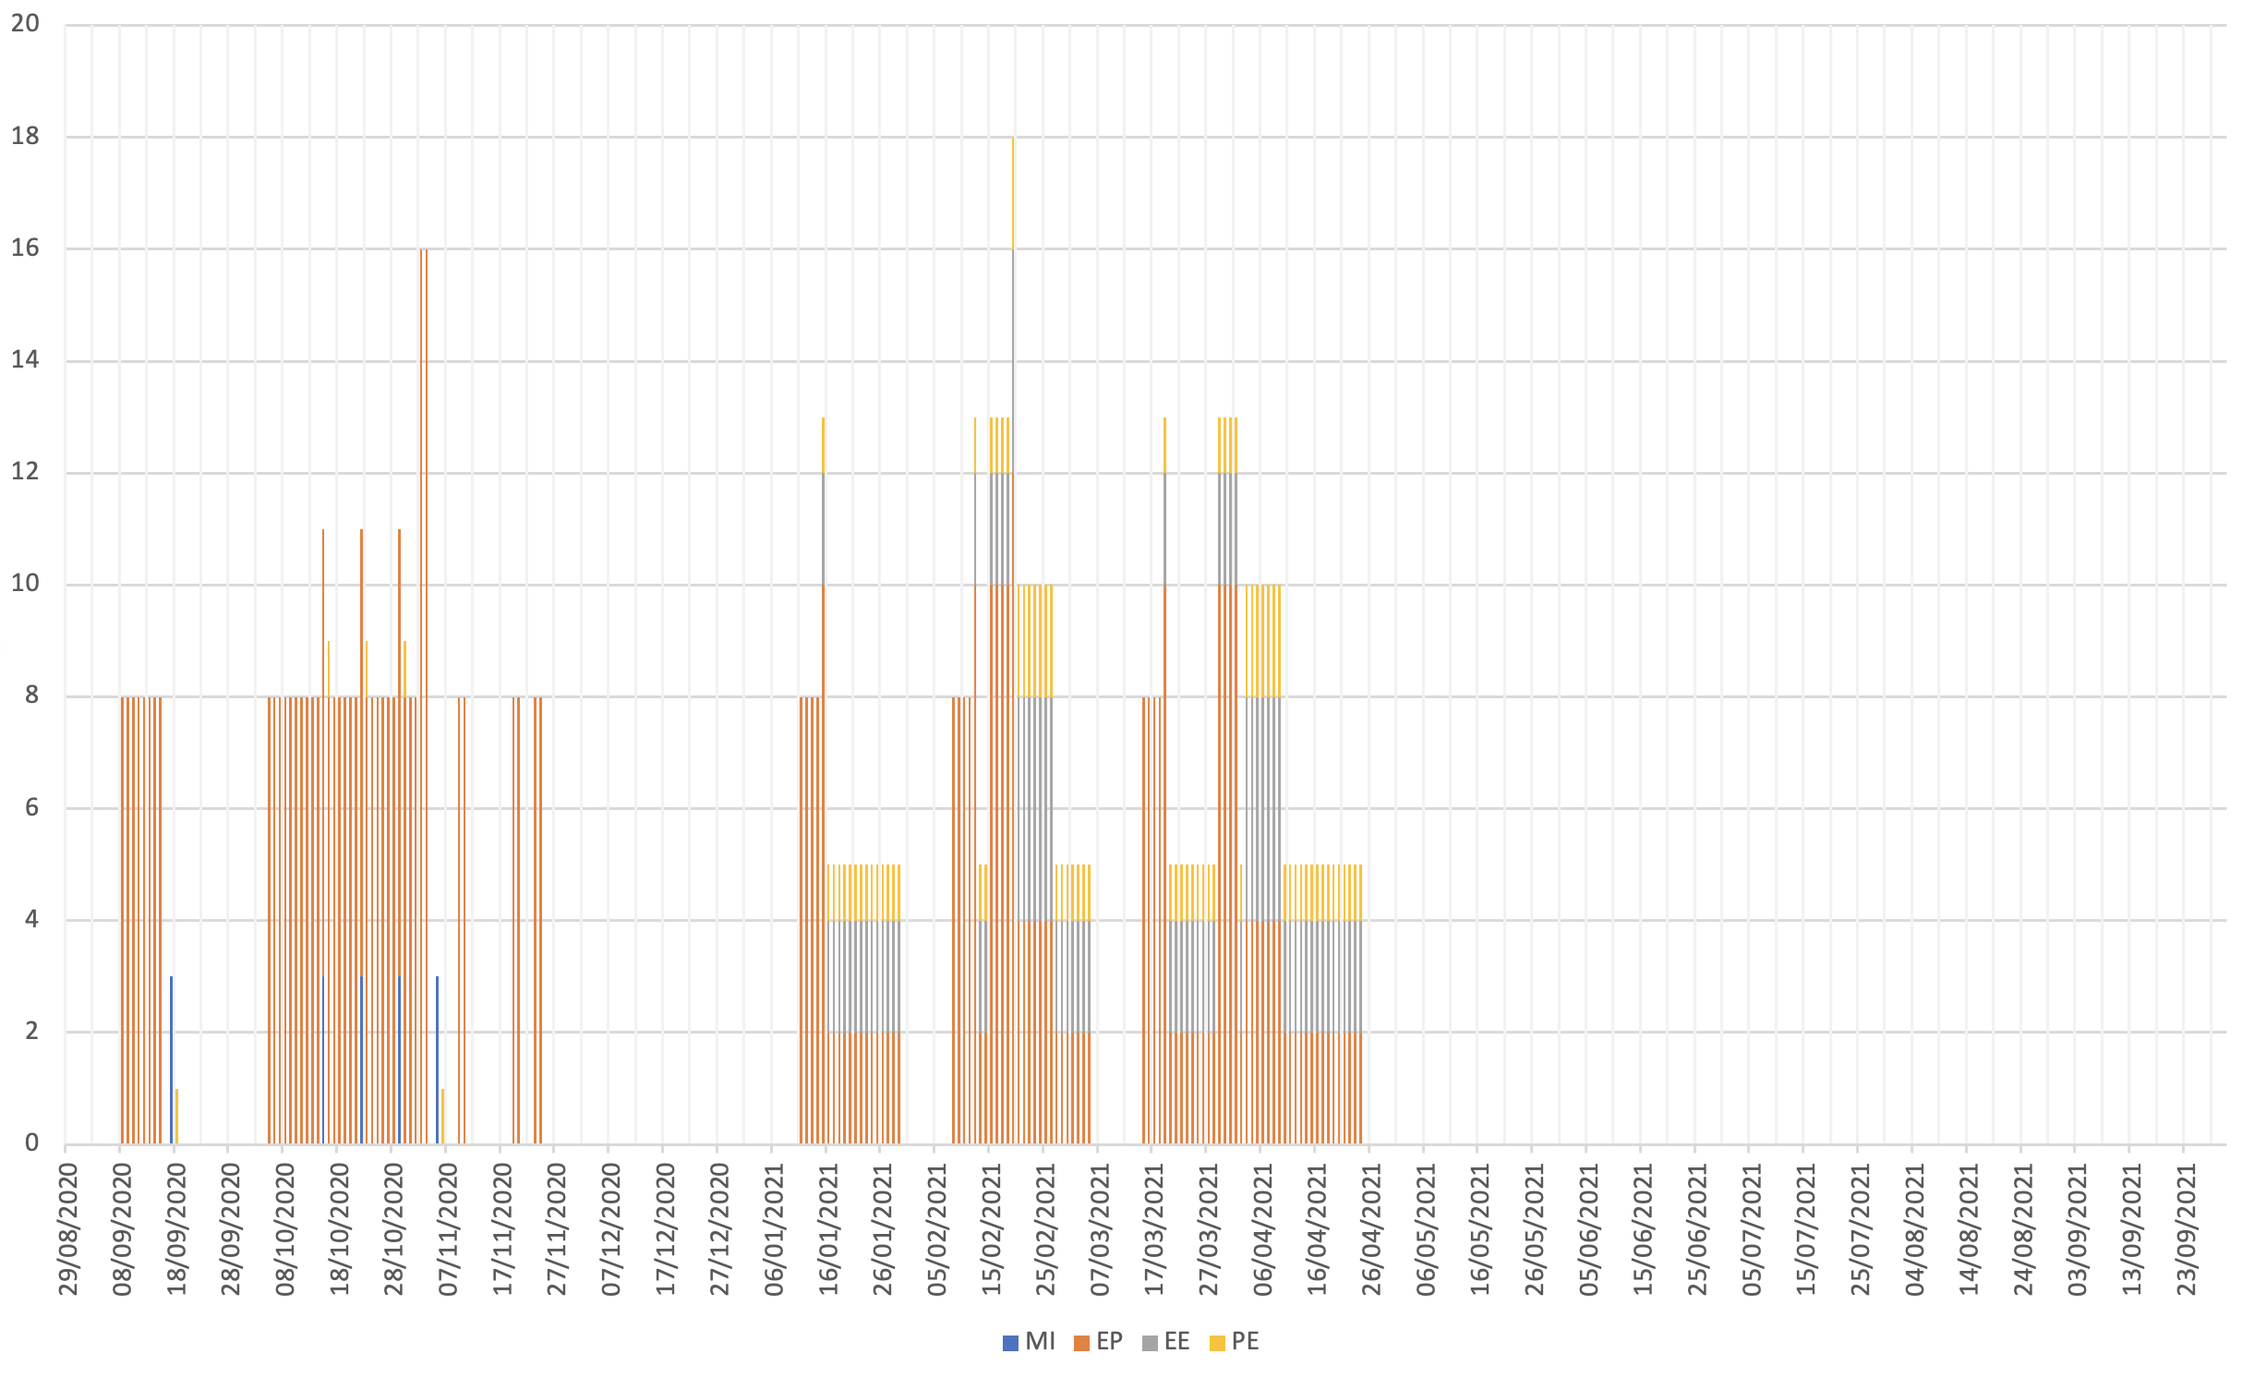
resource loaded planning V3.1
S45 and S78 QDS
IST and DQHDS and
cool-down preparations in S67
QDS IST @ warm
cool-down preparations
IST and DQHDS
S34, S56, S81
QDS IST and DQHDS
S12, S23 and S67
TODAY

Slide 6
Many thanks for your attention!
Questions?

Slide 7
MPE Individual System Tests
@ warm (before start of cool-down)
  QPS preparation (field team in tunnel)
  Interlock system upgrades and IST (WIC and PIC)
  Current lead Heating System (new system in radiation areas)
  ELQA @ warm (no co-activity)
  Final visual instrumentation inspection before cooldown
@ cold
  600A Energy Extraction IST
  ELQA @ cold (no co-activity)
  QPS IST and DQHDS heater firing campaign (limited / no co-activity)
  Signal integrity checks as part of first low current powering

