Slide 1
The new sign only IST steps in AccTesting planning
IST.QDS_FIELD
QPS signature
IST.QDS_REMOTE
QPS signature
IST.QPS
IST.QHD_LOW1
IST.QHD_LOW2
QPS & MP3 signature
IST.QHD_NOMINAL
IST.QDS_INTEGRITY
QPS signature
13kA
IST.EE_1
IST.EE
IST.EE_2
EE signature
IST.EE_3
IST.CL_HS
ELQA signature

Slide 2
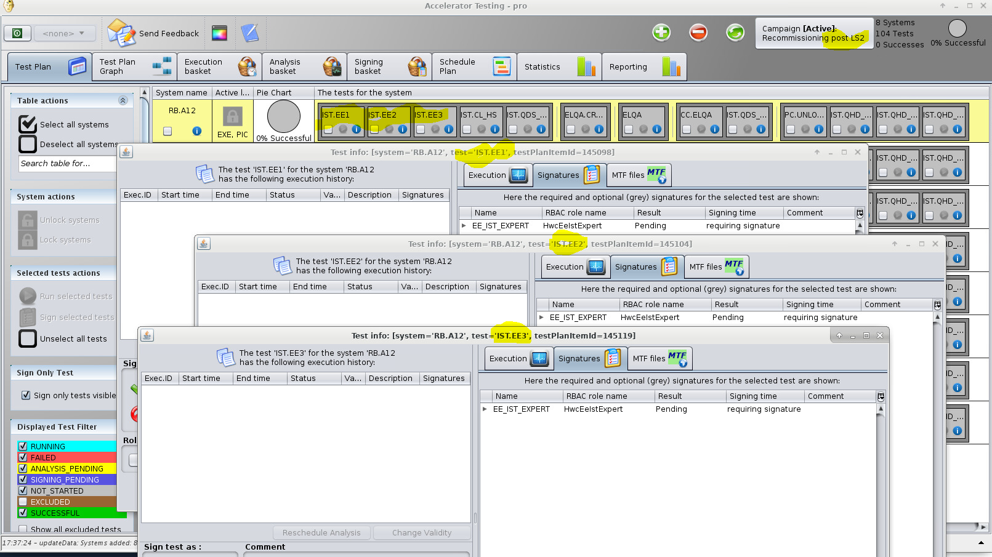
IST.EE_1/2/3

Slide 3
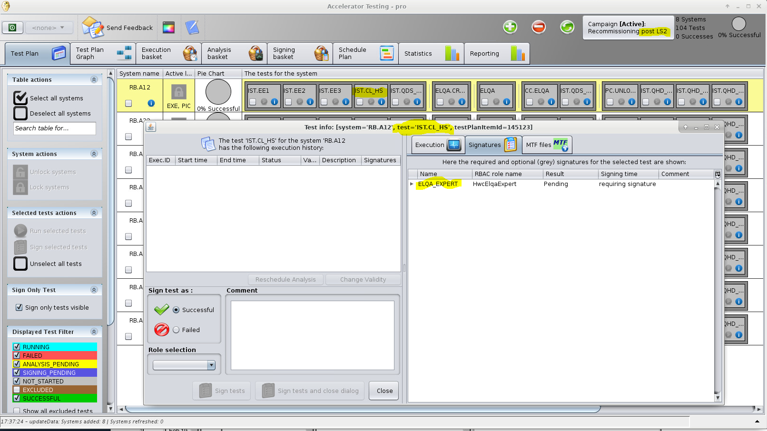
IST.CL_HS

Slide 4

IST.QDS_FIELD

Slide 5
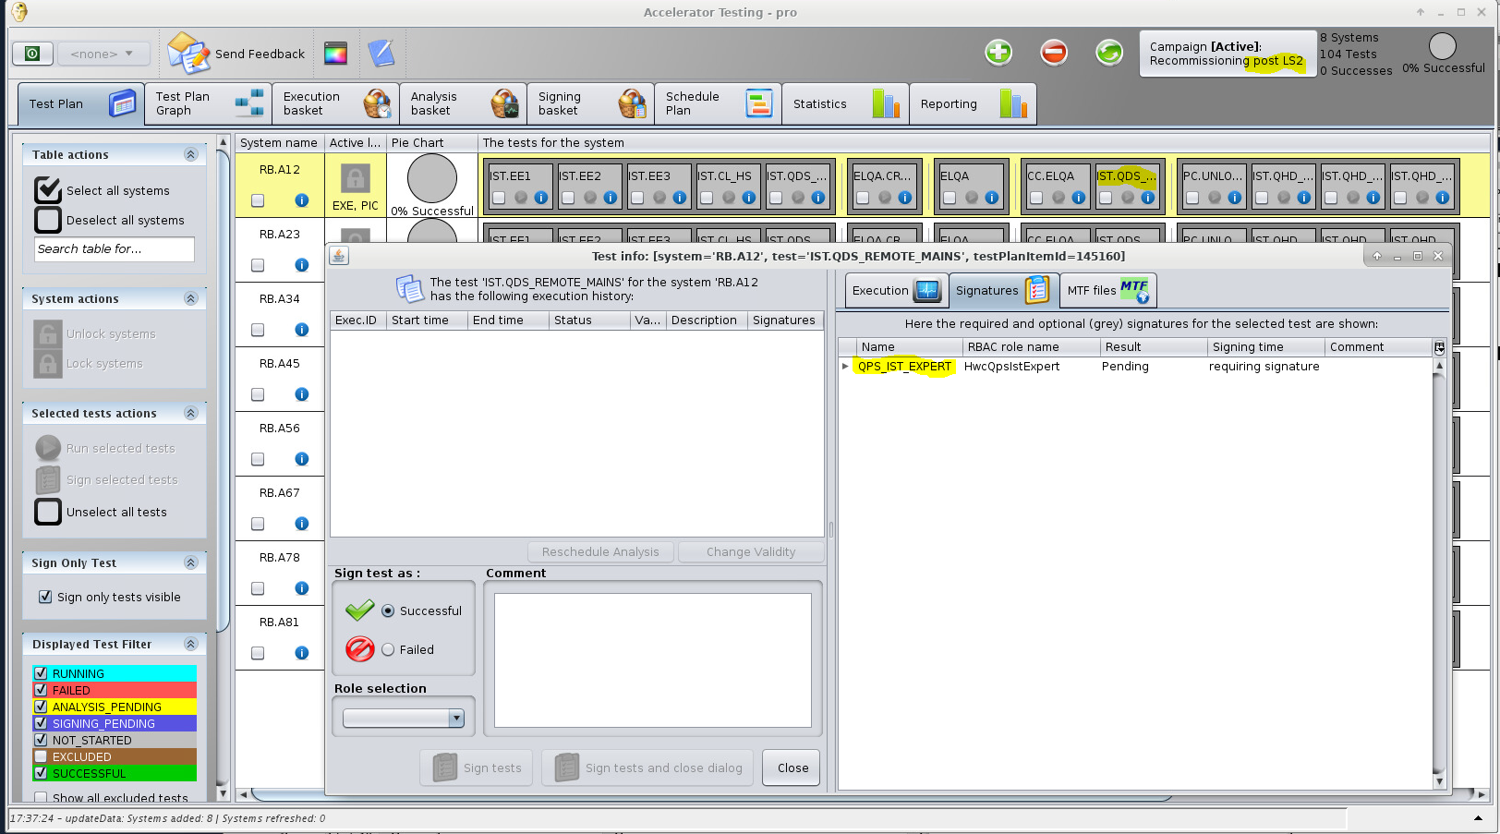
IST.QDS_REMOTE

Slide 6
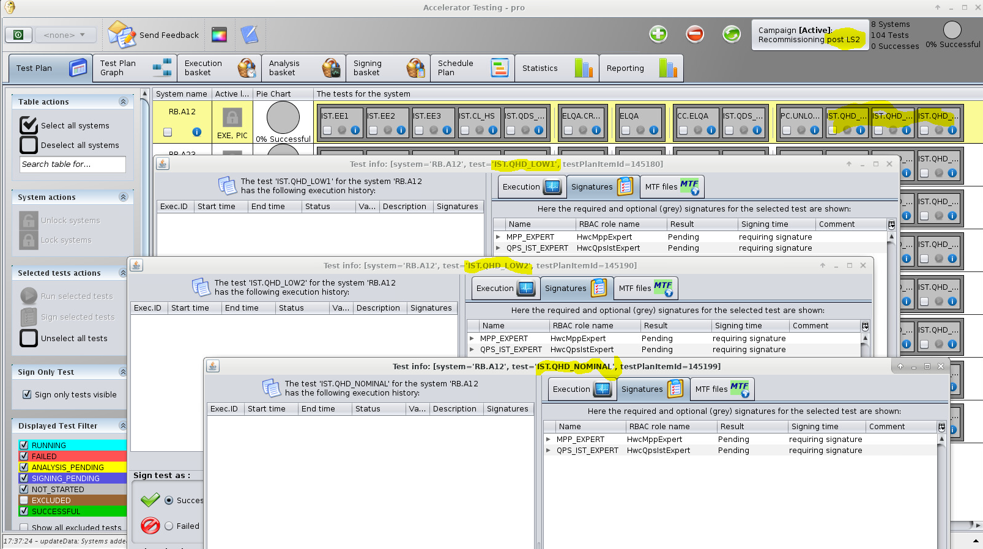
IST.QHD_LOW1/LOW2/NOMINAL

Slide 7
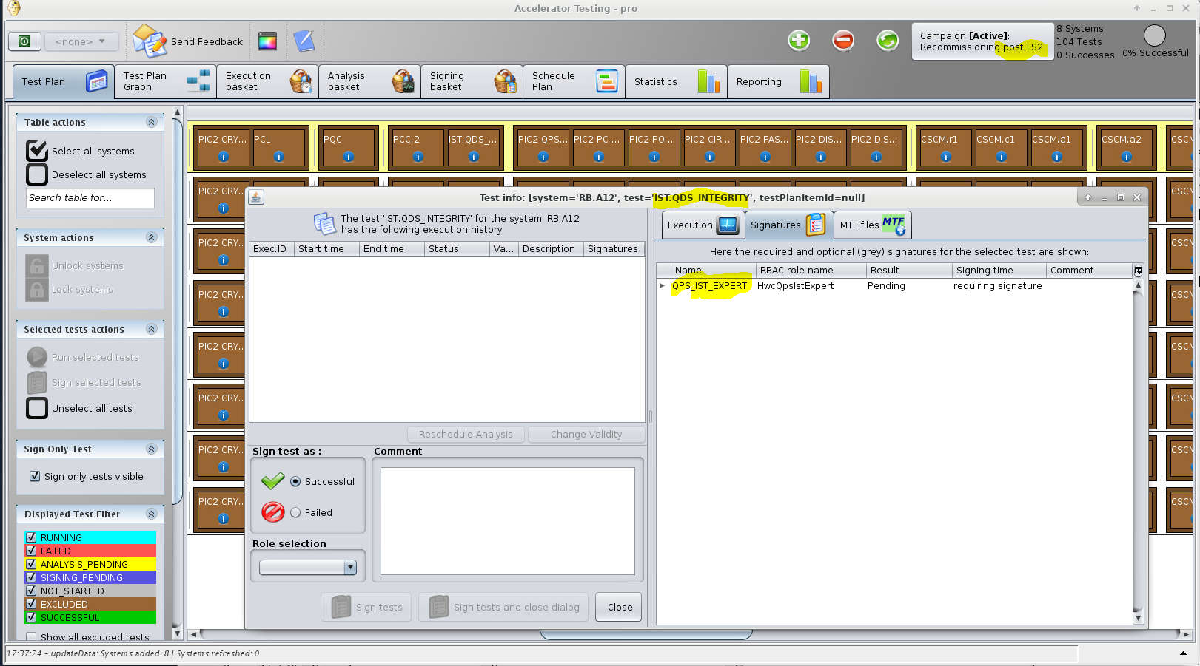
IST.QDS_INTEGRITY

