Slide 1
FZU Computing Center
Jiří Chudoba
with help from A. Mikula, P. Vokáč, M. Svatoš, J. Uhlířová
DAQFET workshop, Prague (virtual), 9.2.2021

Slide 2
Content
  WLCG Tier2 center
  External resources (IT4I, CESNET SD)
  Metacentrum cluster LUNA
  Monitoring
  Network capacities – 100 Gbps to LHCONE
Notes:
Abstract:
We will give an overview of the site including our recent network redesign. We will dedicate a part of the talk to disk servers: report on the newest additions as well as upgraded old hardware. We will also share experience with our distributed HT-Condor batch system.

Slide 3
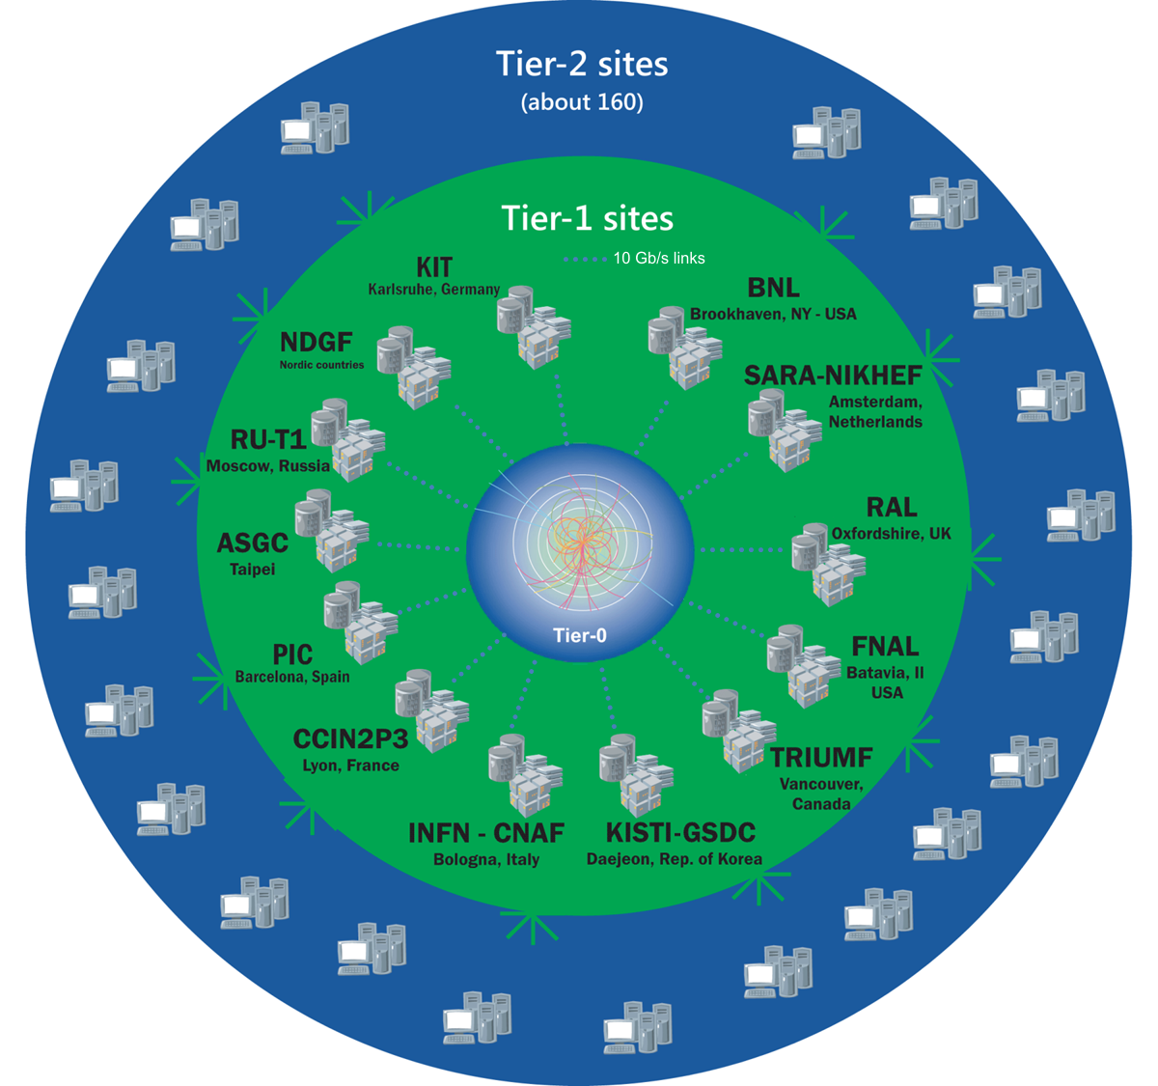
WLCG - distributed resources
42 countries
170 computing centers
Over 2 million tasks daily
1 million computer cores
1 exabyte of storage
Source: WLCG Public web site
https://wlcg-public.web.cern.ch/
Notes:
Change in paradigm, smaller differences between Tier-1 and Tier-2 sites

Slide 4
CZ Tier-2 Site Overview
10400 jobslots shared with other projects (55% for WLCG)
  mostly located at FZU
  770 cores at Charles University
111 kHS06 (avg. 10.7/core – hyper-threading is used)
Plus National HPC center IT4I
5 PBs on site + 1 PB at NPI (Řež u Prahy)
HTCondor, ARC CEs, CentOS7

Slide 5
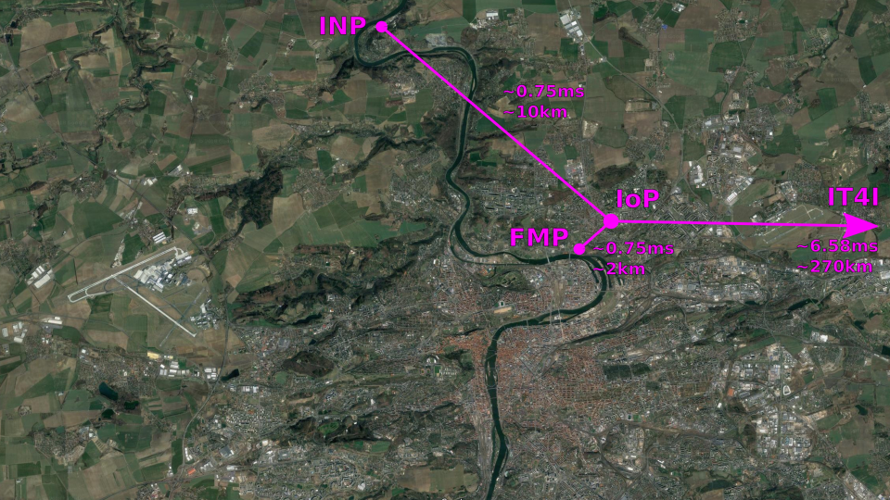

Slide 6
WLCG Site Workflow
Jobs accepted by ARC CEs are submitted to HTCondor
Data mostly read directly by WNs from DPM (ATLAS) or xrootd (ALICE) servers
Challenges:
  big differences in jobs in terms of
    number of cores requirements
    IO
    duration
    memory requirements
  ATLAS: 1 – 8 core jobs, ALICE: 1 core jobs
HPC jobs have special ARC CEs, which resubmit them to PBS@IT4I
  issues with restricted internet access
  no CVMFS
  only whole node jobs – up to 128 cores
  no permanent storage for LHC

Slide 7
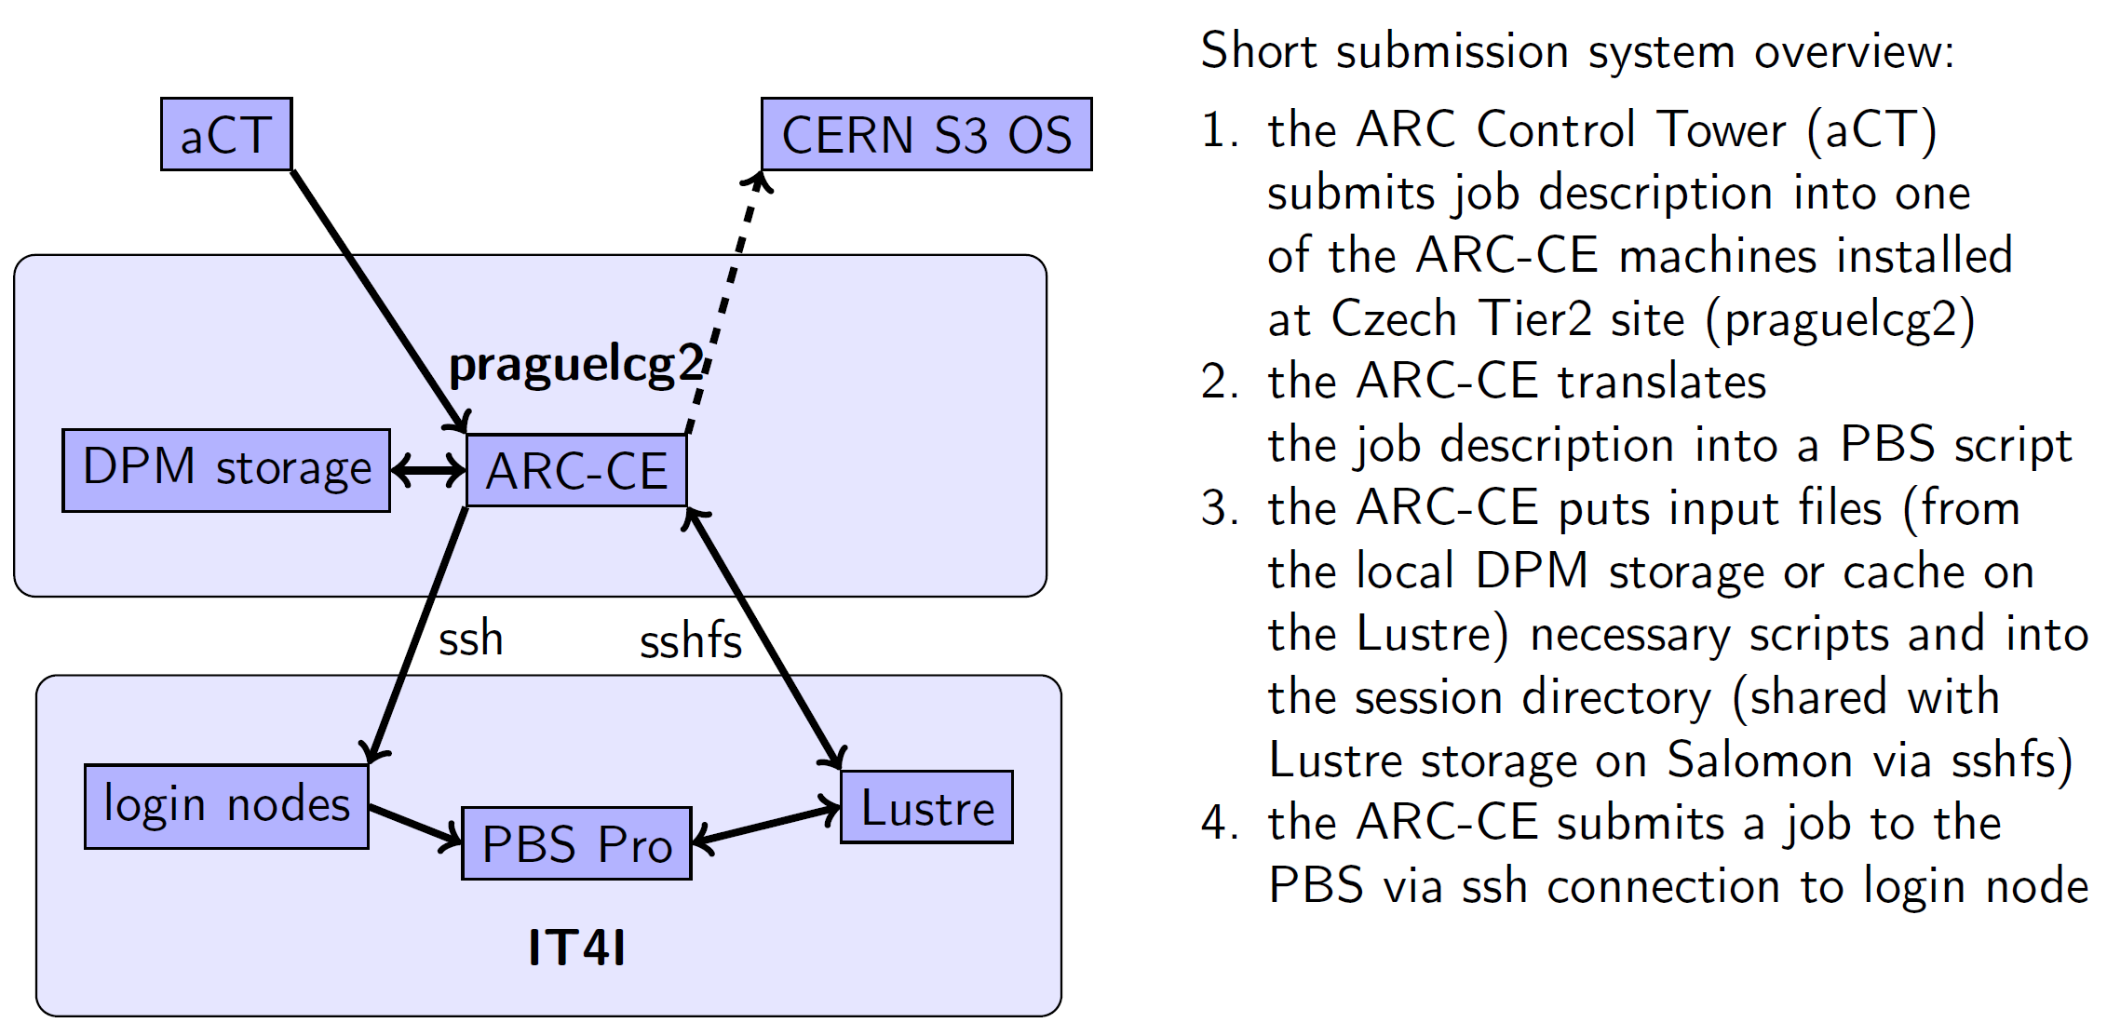
Workflow for IT4I
M. Svatoš

Slide 8
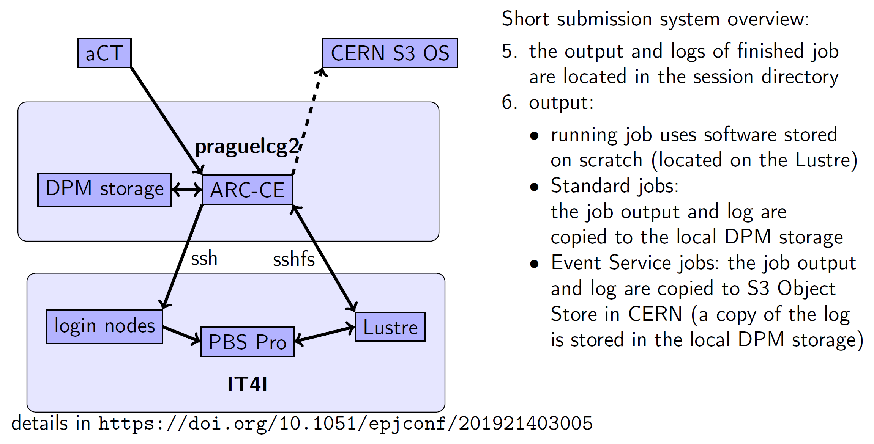
Workflow for IT4I
M. Svatoš

Slide 9
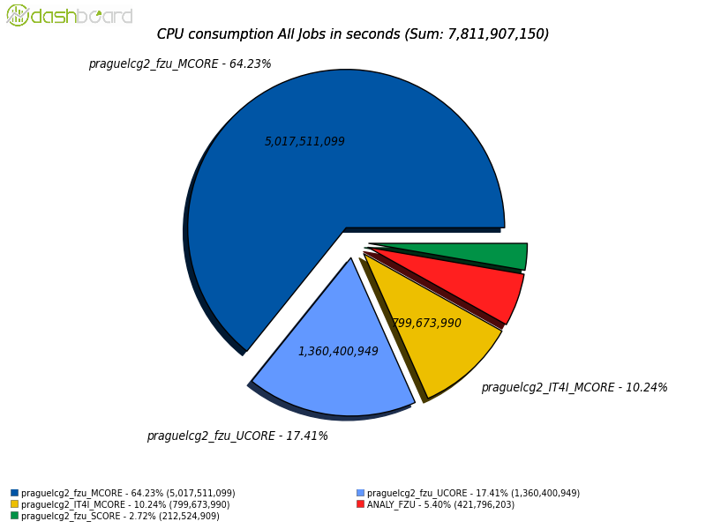
IT4I Usage
10% - 20% of our ATLAS contribution
CPU Normalization not optimal
    No HT on IT4I vs HT on local site

Slide 10
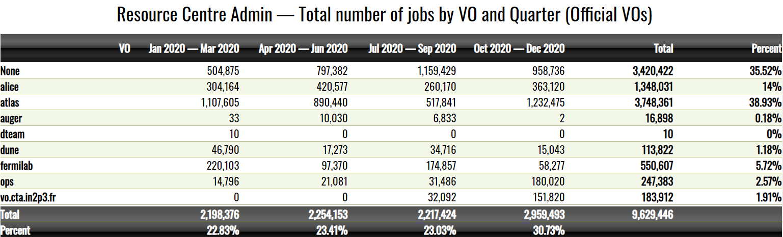
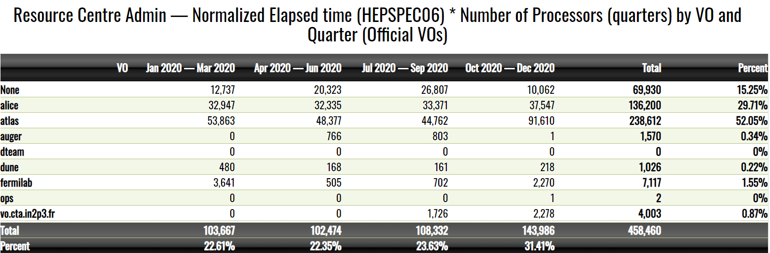
2020 statistics
Notes:
avg 9443 cores used in 2020

Slide 11
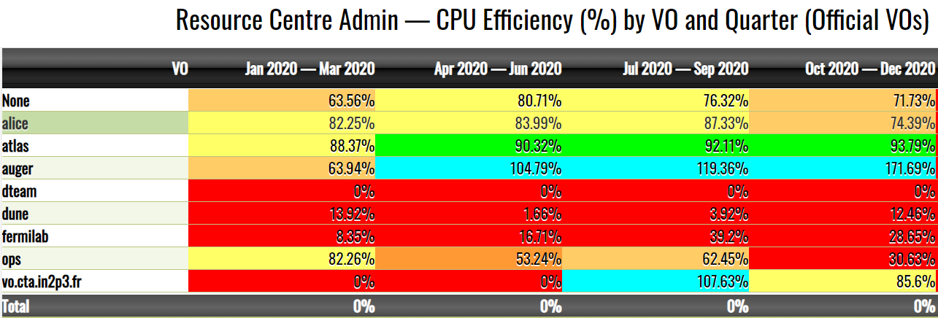
2020 statistics

Slide 12
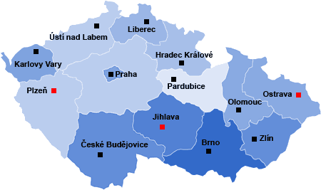
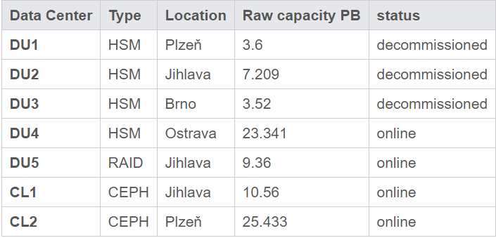
CESNET Storage Department
total capacity 70 PB
FZU use: backups, dCache SE

Slide 13
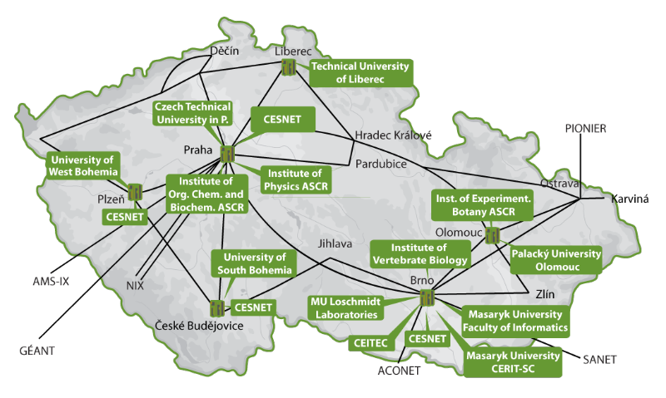
Metacentrum
CZ National Grid operated by CZ NREN CESNET
27300 cores
  2240 at FZU
  priority acces for FZU
  fast turnover important
PBSPro
  no x509 certificate needed
Operations and support

Slide 14
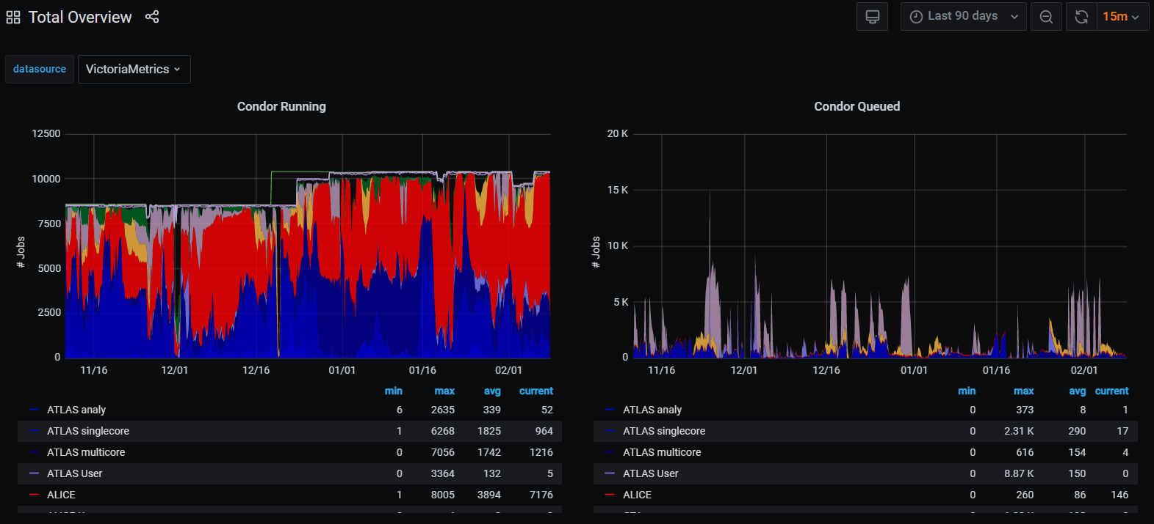
Monitoring
Prometheus

Slide 15
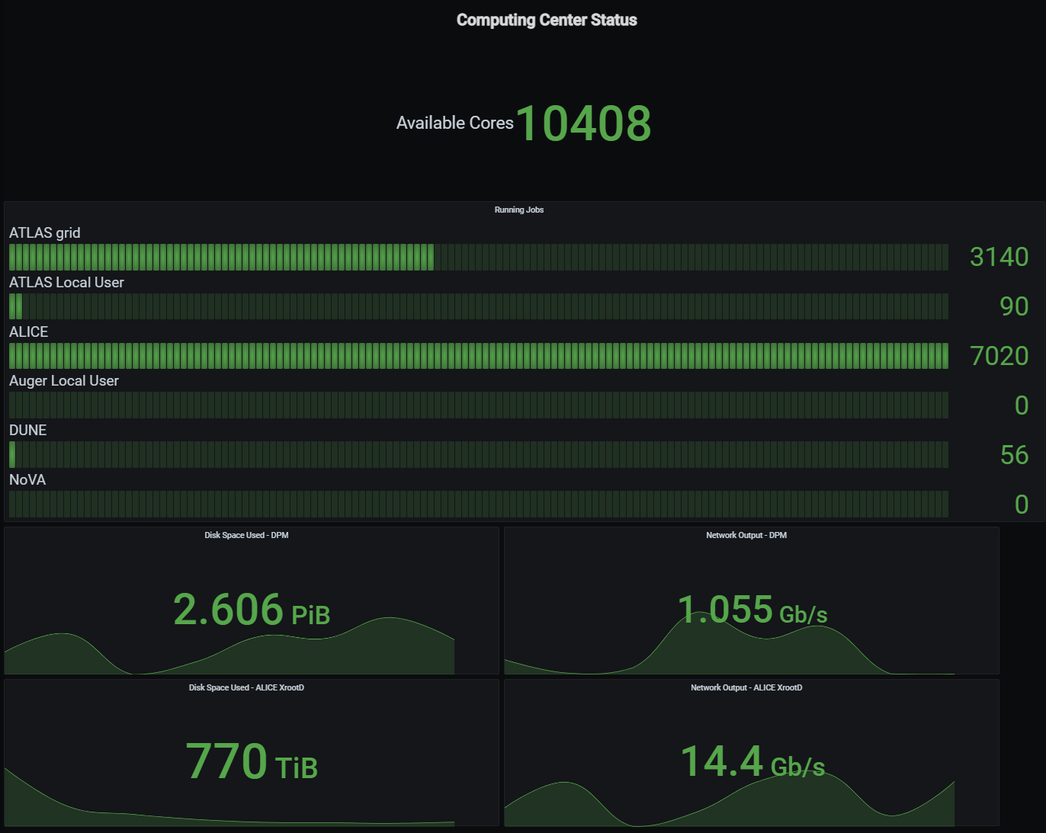

Slide 16
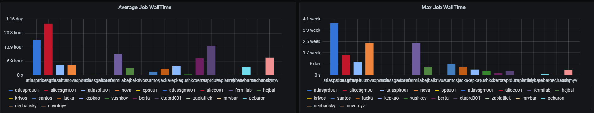

Slide 17
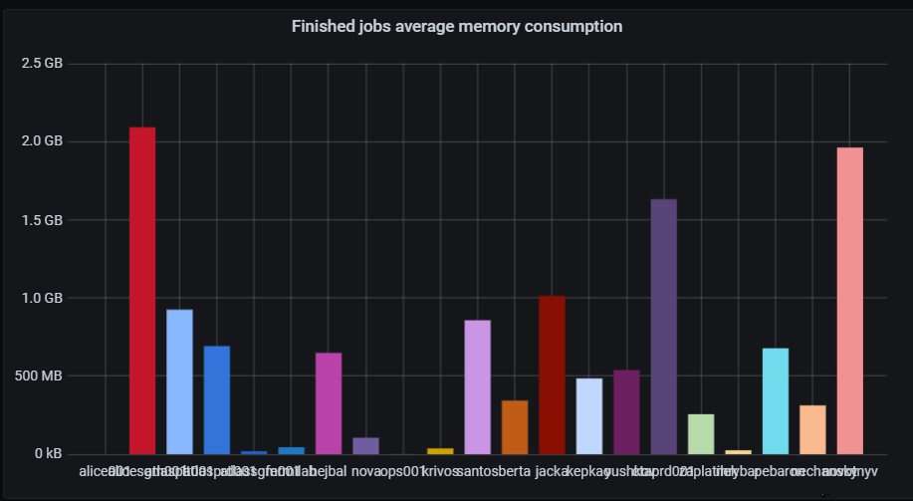
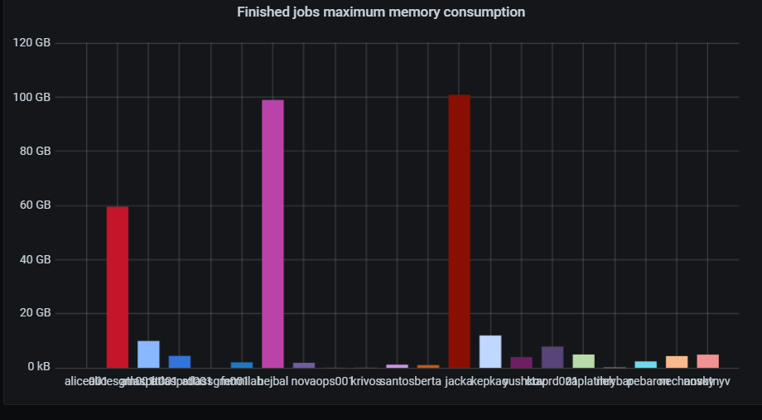

Slide 18
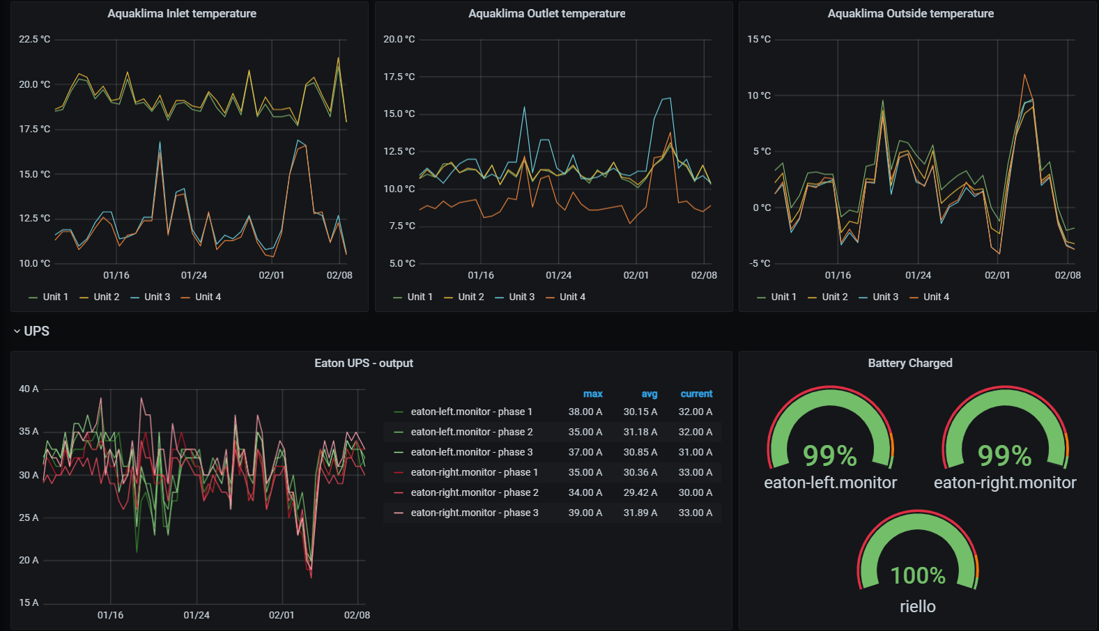
Monitoring

Slide 19
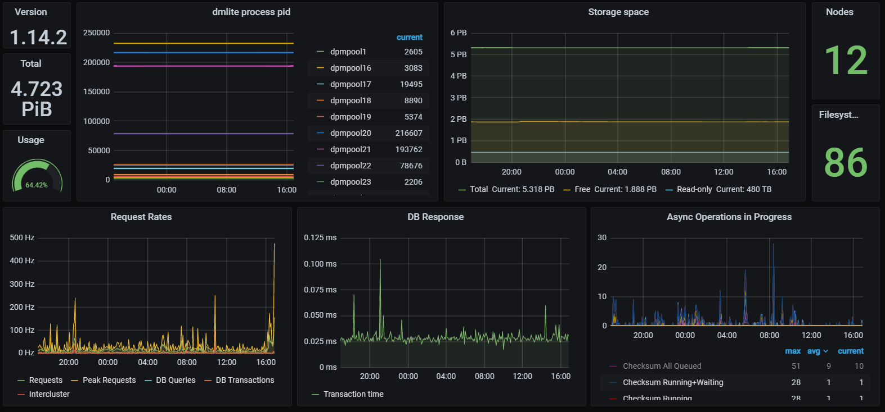
DPM status

Slide 20
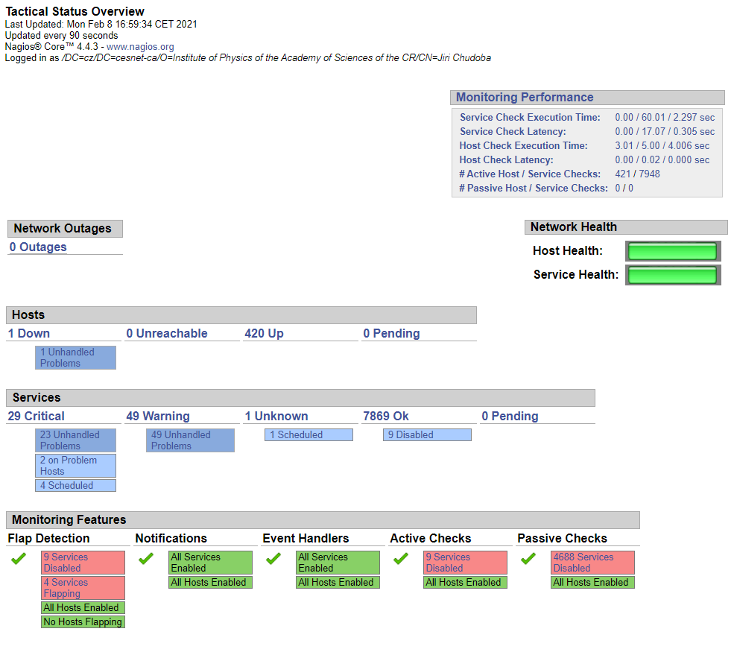
nagios

Slide 21
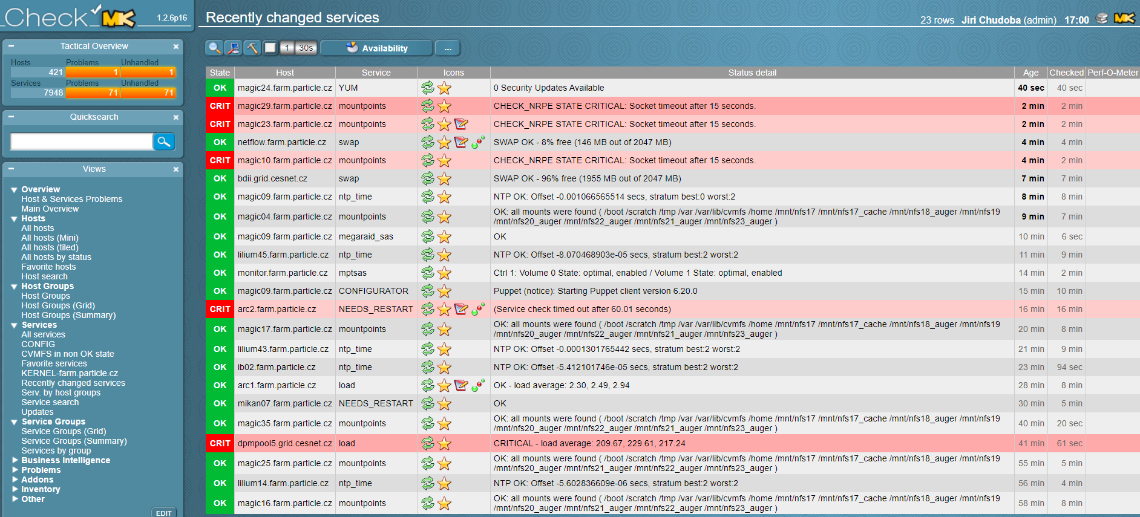
check_mk interface

Slide 22
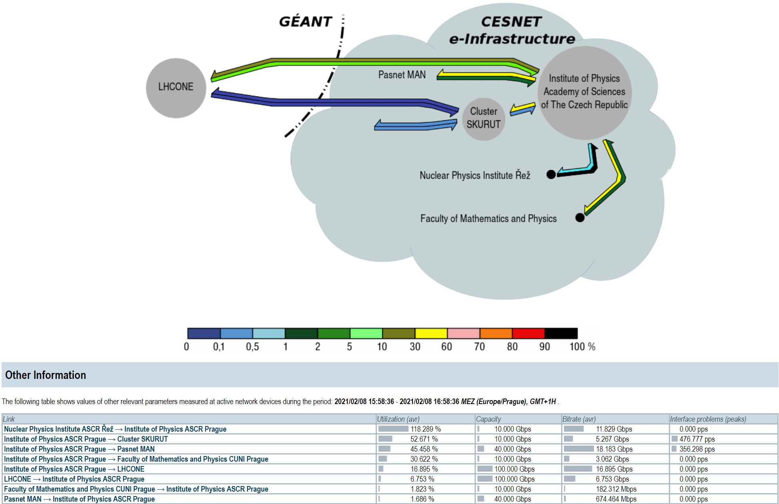
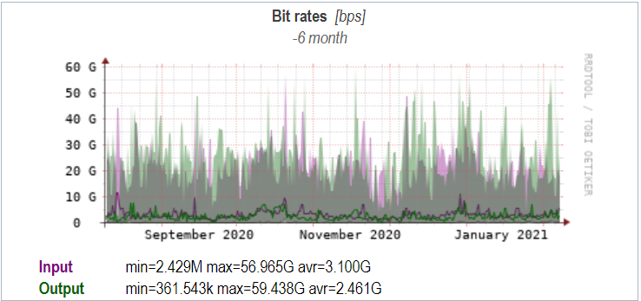
Network Monitoring
100 Gbps LHCONE link

Slide 23
Conclusions
FZU Computing Center delivers CZ Tier-2 pledged resources to LHC experiments ATLAS and ALICE
CZ users have several options to get resources
Close collaboration with CZ e-Infrastructure (CESNET, IT4I, CERIT/SC)
  External resources are vital
Smart team of administrator is the key element

Slide 24

This work is supported by projects OP RDE CERN-CD (CZ.02.1.01/0.0/0.0/18_046/0016013) from EU funds and MEYS and by CERN-CZ - Research Infrastructure for Experiments at CERN (LM2015058)

