Slide 1
PSB Tune Control & Knobs

Slide 2
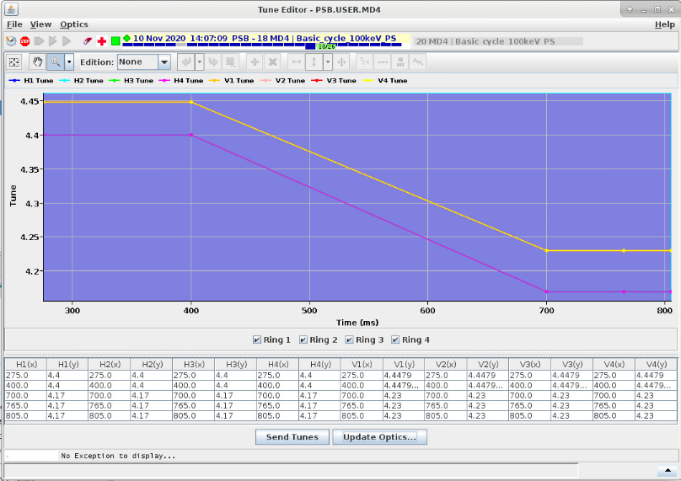
Tune Editor GUI
In this example the tunes of the 4 rings is the same

Slide 3
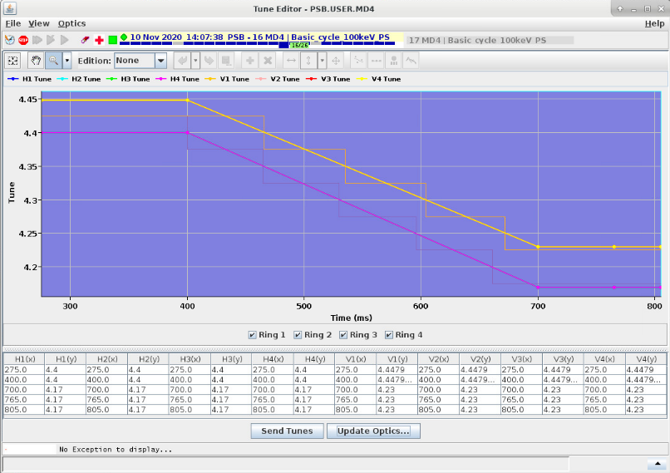
Tune Editor GUI
These are the optics attached
to the PSB Beam Process

Slide 4
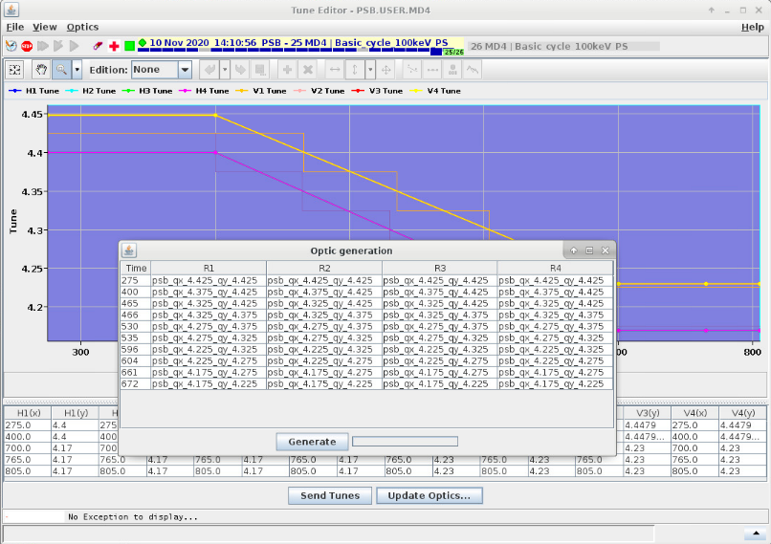
Tune Editor GUI
These are the optics attached
to the PSB Beam Process

Slide 5
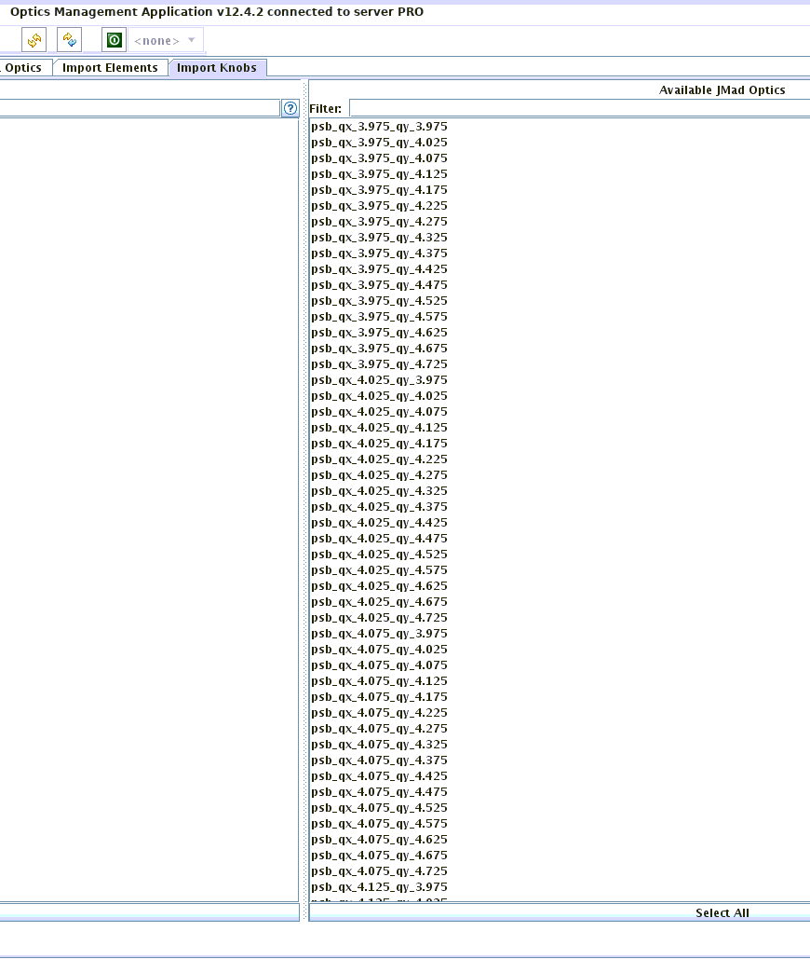
LSA PRO
Thanks to Michi and Alex, we recently uploaded all the optics named psb_qx_X.XXX_qy_Y.YYY
in LSA PRO

Slide 6
Knobs
During the development process, we discussed with Alex and Matt and decided to include the
following knobs for the PSB:
  PSB Shavers,
  PSB BE.BSW Bump,
  PSB Extraction position/angle
And later on Abdel introduced with Michi knobs for the BI.KSW.
All seems great, so what’s the issue?
When preparing the knobs for the PSB Extraction position/angle the bumpers have to be turned
on with nominal strength to close the bump
The knobs need to be associated with an optics, say psb_qx_4.200_qy_4.200 and it means that
this specific optics has the bump turned on and cannot be used reliably during the cycle
The standard solution is to decide a priori a set of optics which have the bumper turned on and
should be used only at extraction

Slide 7
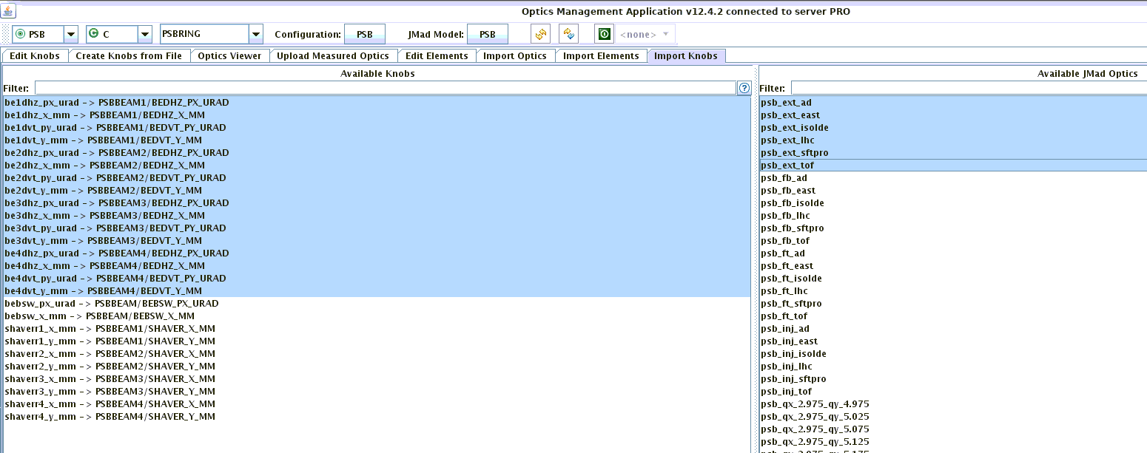
LSA PRO
For the time being Alex created special optics called psb_ext_ad, east, …, tof which contains the ideal tune at extraction for each of these beam types.
Similarly there are optics for injection, flat bottom and flat top.
A first request is to change the name to a more explicit one as psb_ext_lhc_qx_X.XXX_qy_Y.YYY

Slide 8
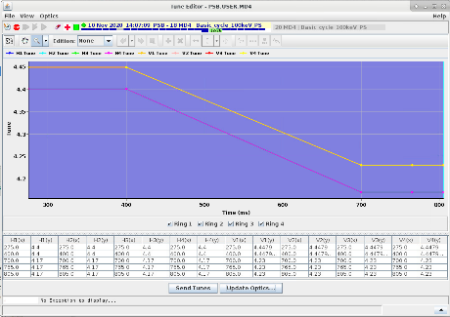
Tune Control Fix Point?
SAME ISSUE WITH THE KSW KNOBS
One approach for mitigating this issue would be to fix the end point of the tune, depending on the beam type
What if we change the tune at extraction from the nominal one? The knobs will still assume the nominal optics, so it will work, but have ‘less’ predictive power. And at least a warning could be raised to tell by how much we are diverging from the set tune.
Another solution could be to duplicate all the optics in psb_qx_X.XXX_qy_Y.YYY and in psb_ext_qx_X.XXX_qy_Y.YYY with the bump on.

Slide 9
SHAVERS
The Shavers have been currently associated with all optics psb_qx_X.XXX_qy_Y.YYY
The Shavers, which we ideally do not plan to use anymore, if needed should be pulsed at ~182 MeV, i.e. C306
The hierarchy is KNOB -> logical/K -> logical/I -> FGC
The momentum (at the right point of the cycle) and the calibration curve will always be taken into account on the K -> I conversion.
The step in question is "KNOB -> K":
  In general, the knob factor (from [mm] to [rad]) is optic/tune dependent.
  Do we need to have a different factor for each optic/tune or will it be good enough to have one that works (more or less) for all optics?

Slide 10
INJECTION POSITION/ANGLE
As the BI.DVT50 and BI.DVT70 have no quadrupole in between, their factor are independent of the debuncher setting and since they are on the injection line, they are independent of the PSB tune at injection.

Slide 11
Supporting Slides

