Slide 1
FCC-ee Twin quadrupole prototype magnetic axis shift
J. Bauche (TE-MSC)
FCC-ee beam optics meeting, 27th November 2020

Slide 2
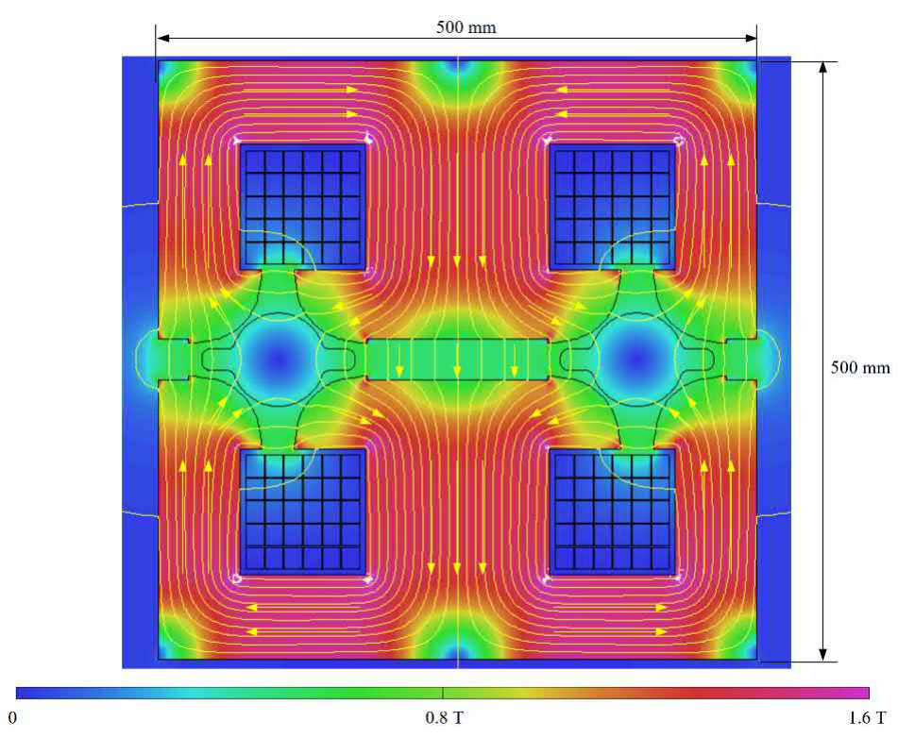
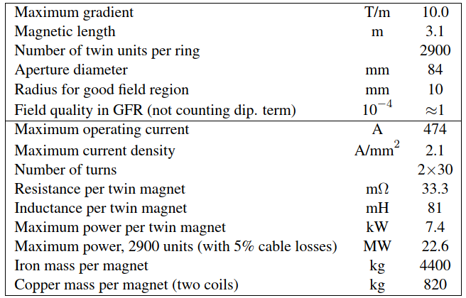
FCC-ee quadrupole design
Courtesy A. Milanese
Magnetically coupled design
CDR parameters FCC-ee quadrupoles
SPACER
Design key feature:
non-magnetic spacer balances the flux between the poles

Slide 3
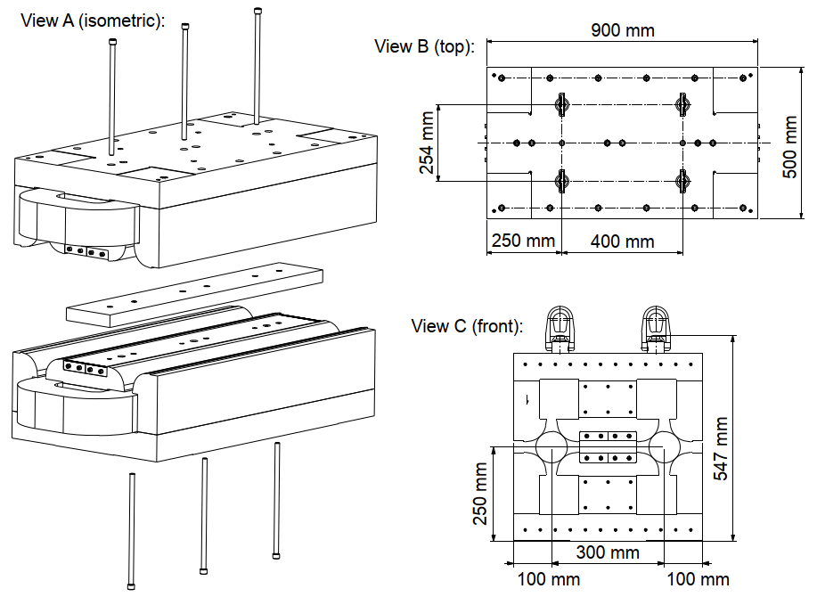
FCC-ee quadrupole – prototype
Short model, ~1 m long (900 mm yoke)
Yoke assembled from machined solid iron (ARMCO)
Assembly tolerances ±20 µm (aperture diameters)
Coils 2 x 64 turns (converter matching)

Slide 4
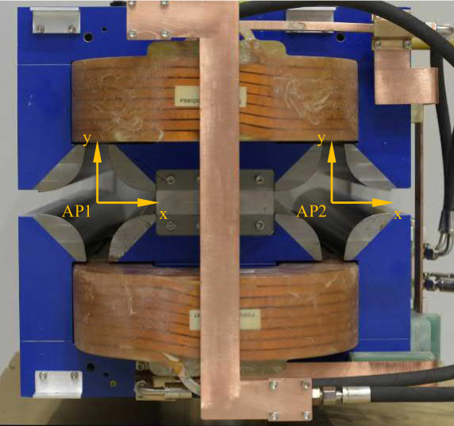
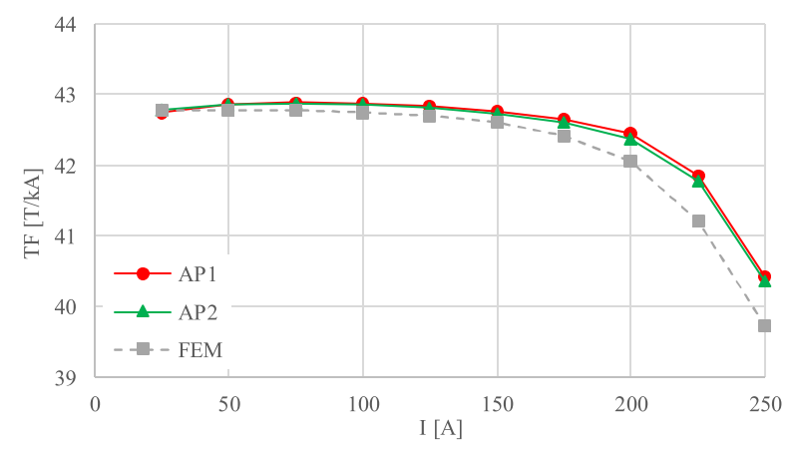
Prototype measurements – transfer function
FCC-ee range
Very good symmetry between the two apertures (diff. < 1.6‰)
Pessimistic BH curve on FEM (µ_{r}), diff ≈1%

Slide 5
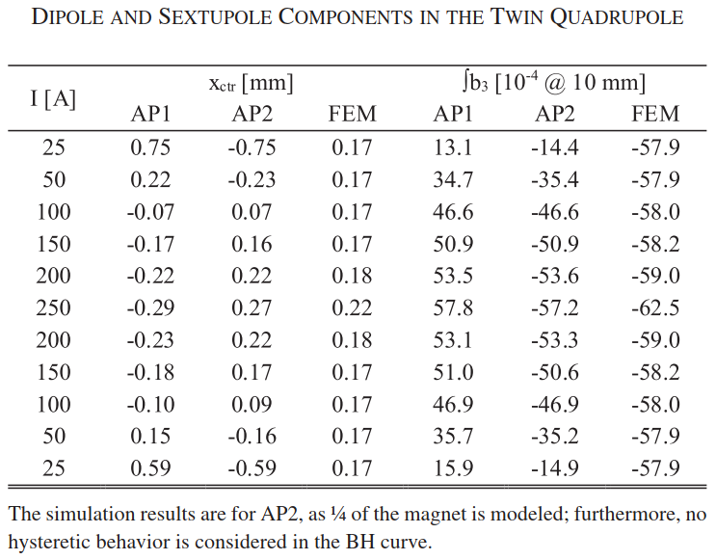
Prototype measurements - magnetic axis shift
FCC-ee range
~0.4 mm shift outwards for each aperture between low and high fields
Mismatch MM vs. FEM at low fields, not completely explained. Refined simulations needed as a next step.

Slide 6
Mitigations of magnetic centre shift
Active compensation with trim coil (busbars) in spacer → to be simulated
Use dipole trim coils for tapering (E saw tooth mitigation) to add dipolar component
Modify passive shimming at extremities at each change of energy → to be measured at manufacture for all energies

