Slide 1
CRP and mechanical structure design for Vertical Drift
B.Aimard, G.Deleglise, D.Duchesneau, N.Geffroy, H.Meringolo
Overview and general characteristics
  Layout and dimensions
  Thermal contraction aspects
Preliminary mechanical calculations
  Anode attachment points
  Supporting PCB frame
  Super CRP structures
Summary

Slide 2
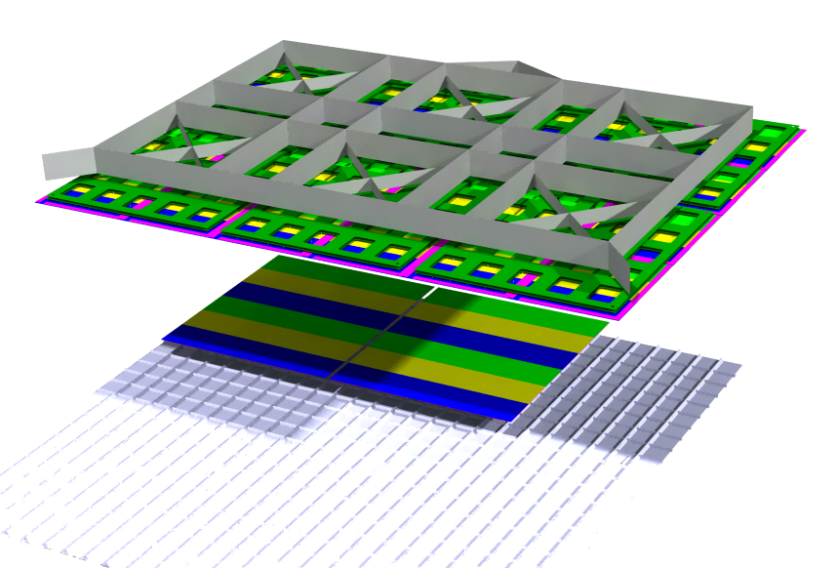
Mechanical design
Super-structure
Top
CRP
CRP
Bottom

Slide 3
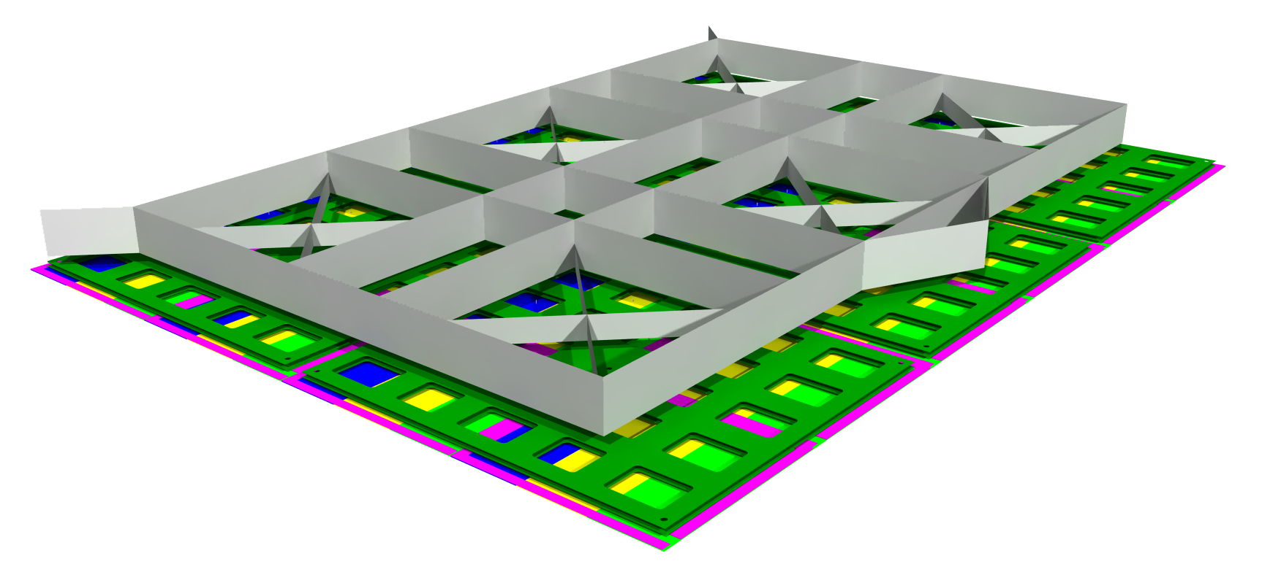
Top Detection plane design
9000 mm
6720 mm

Slide 4
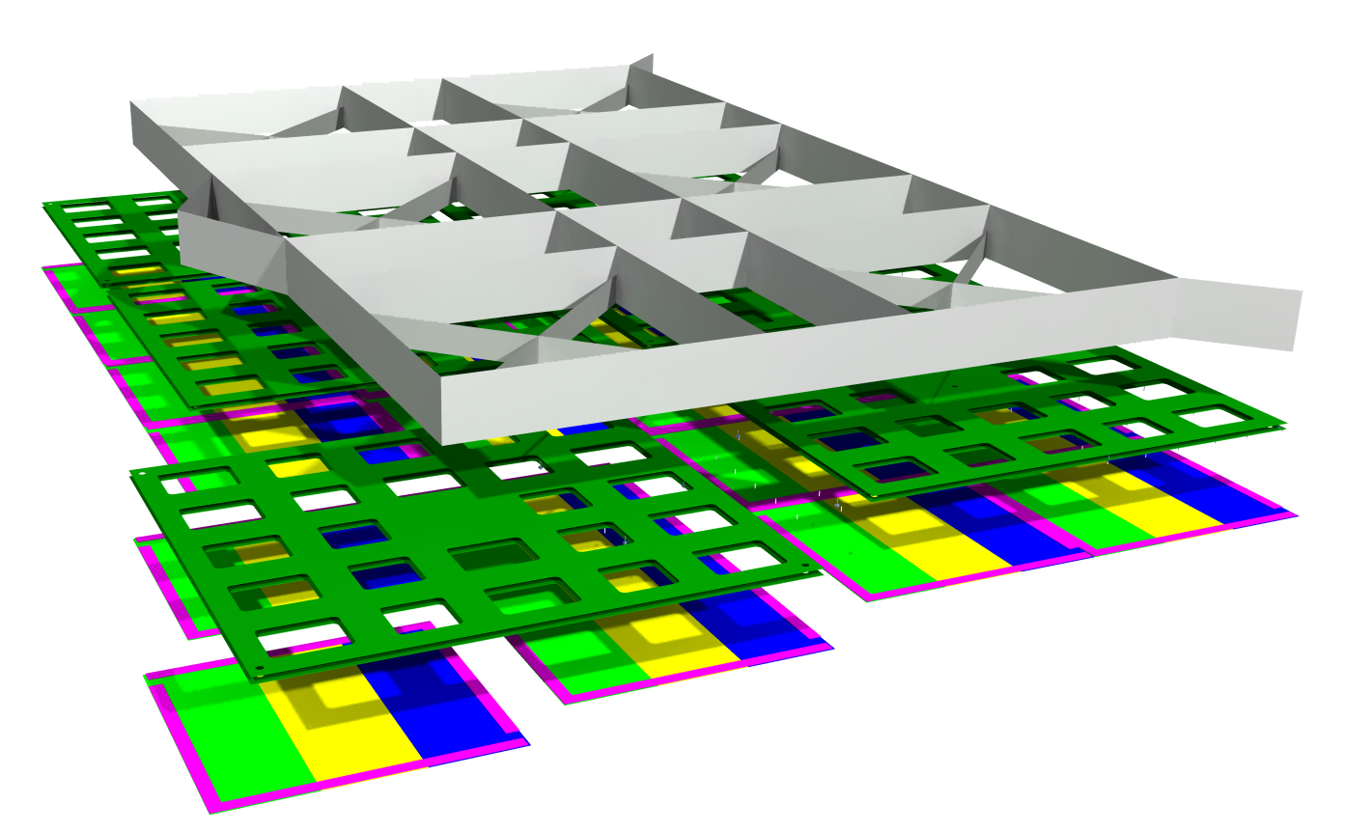
Super-CRP design
Super-structure
Invar
About 1600 kg (before diet)
3 anchoring points
Structural PCB Sandwich
- less than 200 kg (to be refined)
1500 mm
Anode plane
46kg (four panels of 11,5 kg)
3000 x 3375 mm
1680 mm
Total Super-CRP mass : 2800 kg
Cathode mass estimation : 600 kg
Mass/suspension cable : 1200kg
Anode planarity specification : +/-2,5mm @ cold

Slide 5
Top plane – mechanical concepts
Suspension feedthroughs (SPFT)
Cable suspensions
Super-structure (invar)
Liquid level
Suspension
Lateral decoupling
+ Vertical pre-tuning
PCB Sandwich
PCB Sandwich
Anode plane, planarity +/- 2,5mm
Suspension
Planarity tuning from below
Cathode support structure design is started with IJCLab and interface to the superstructure is being defined
Cathode, 10kg/m²
Cathode plane, planarity +/- 5mm

Slide 6
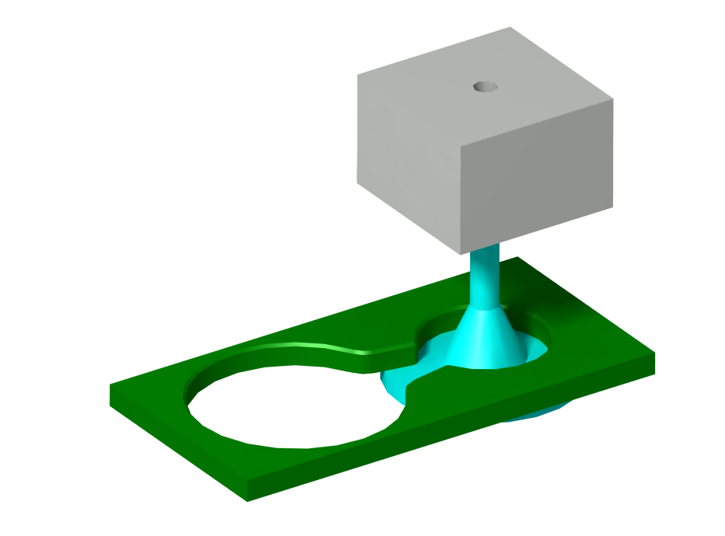
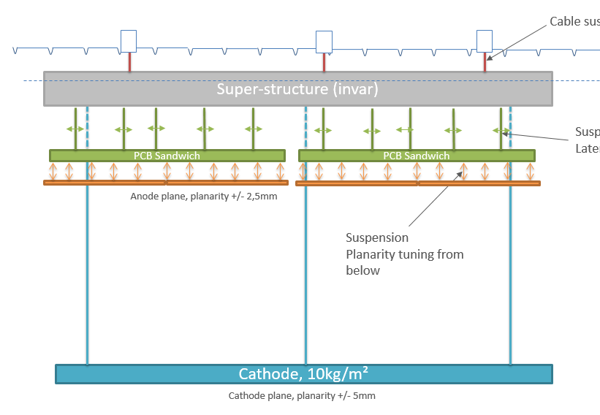
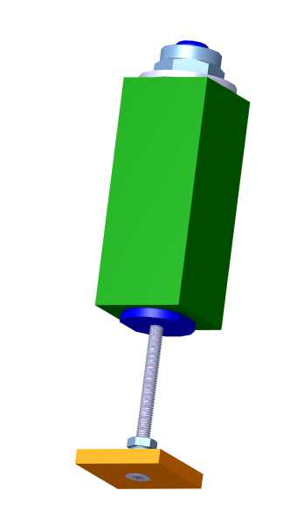
Top plane – Decoupling/adjusting systems
- Easy connection
- Lateral sliding
- Vertical adjustment
-> 5 pieces / CRP
PCB frame
PCB frame
- Vertical adjustment
- Compacity
- Electrical insulation
(non-metallic screw)
-> 36 pieces / Anode plane
Anode

Slide 7
Vertical dimension range:
Top membrane
Ullage space: 4% of total volume = 560mm
Top CRP
Liquid level
13.34m available for:
  bottom CRP (~100mm)
  top CRP (~350mm)
  cathode (~50 mm)
  2 drift regions
~6.4 m
13340mm
14000mm
cathode
~6.4 m
=> vertical space CRP structure to membrane = 100mm
bottom CRP
bottom membrane

Slide 8
Top part – Some dimensions
Suspension FT (SPFT)
560 mm
Liquid level
~ 400 mm ?
~350 mm
~ 550 mm ?
~6400 mm
Indicative numbers to be refined after optimisation steps

Slide 9
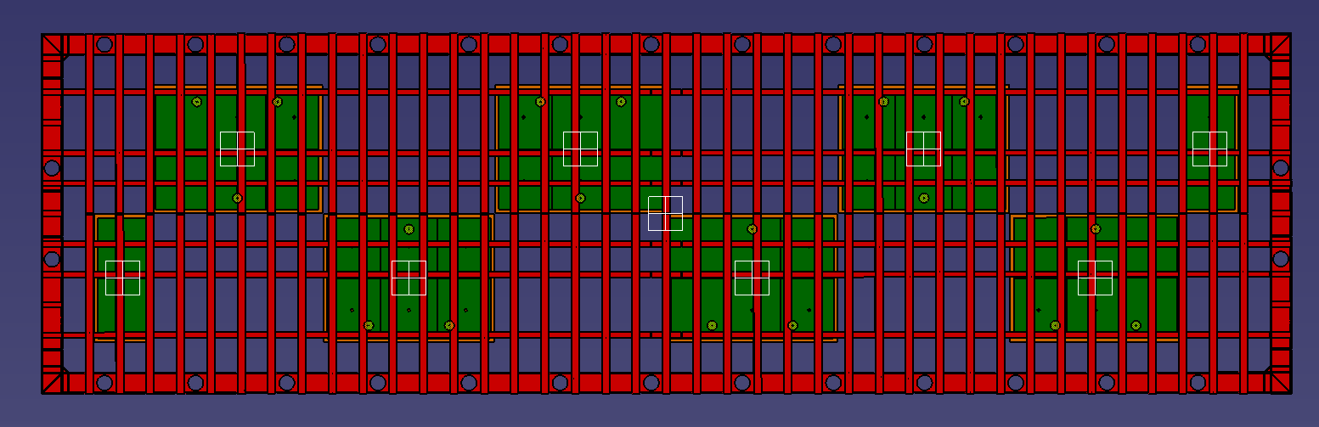
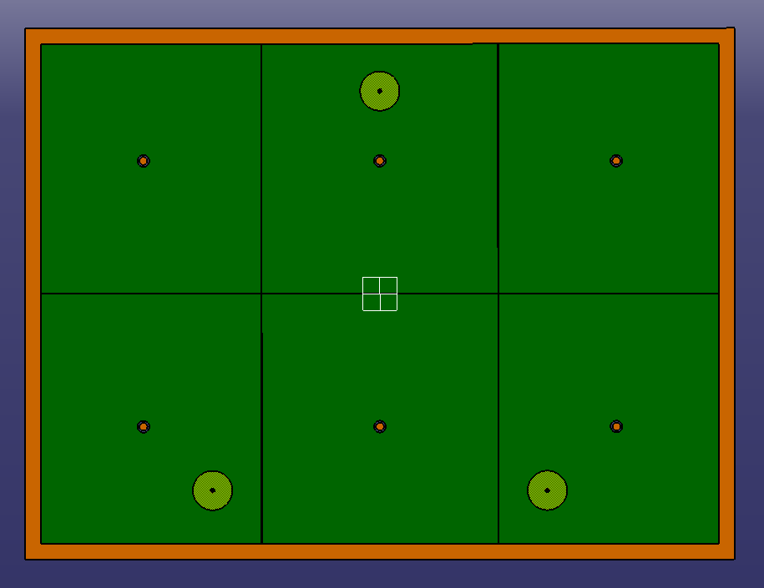
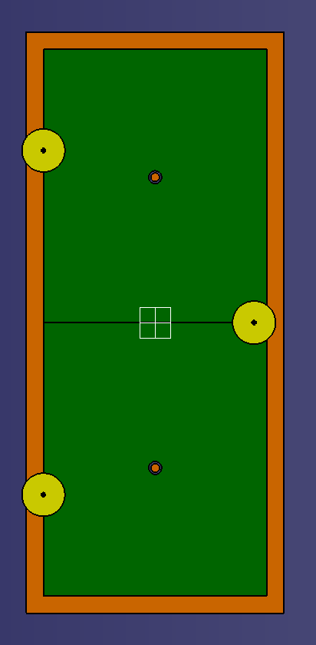
Integration
Total detector max length at warm should be 60200mm and a maximal width of 13700mm
(to stay within the Field Cage area) => even less to have some clearance with FC
SuperStructure type 1 (x12)
SuperStructure type 2 (x4) (proposal)
Functionnal clearances used for this work:
Inside Super-structure : 2mm between CRPs
Inter super-structure: 20-40 mm (for the moment)
=> it adds +140mm along beam direction
=> it adds+24mm along transverse direction
L = 60140 mm (clearance to be studied)
W = 13530 mm ✓
6 CRPs
2 CRPs instead of 4

Slide 10
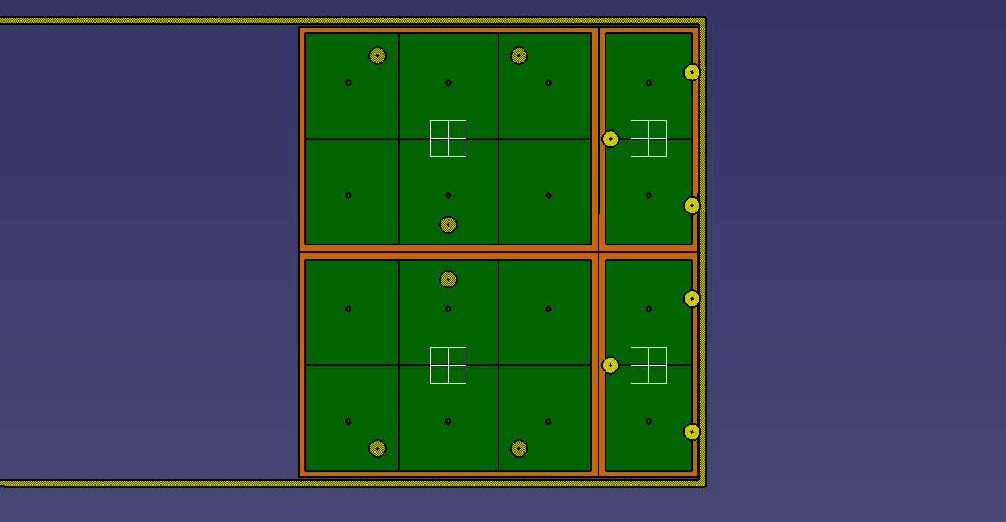
INVAR – Possible Clearances wrt Field Cage
Field Cage
18 mm
78 mm
20 mm
40 mm
Clearance between SuperStructure and Field Cage is small along longitudinal axis

Slide 11
Top plane – Thermal contraction pattern
Superstructure: Invar CRP: PCB material
(comparison with Stainless steel Superstructure material under progress)
Gaps due to thermal shrinkage are uniformly distributed if functional clearances between Superstructures are kept minimal
Sketch of the complete VD area
WARM
COLD
Each interCRP gap increases by about 4mm inside a superstructure and by 7 mm inter Superstructure
– More details in following slides

Slide 12
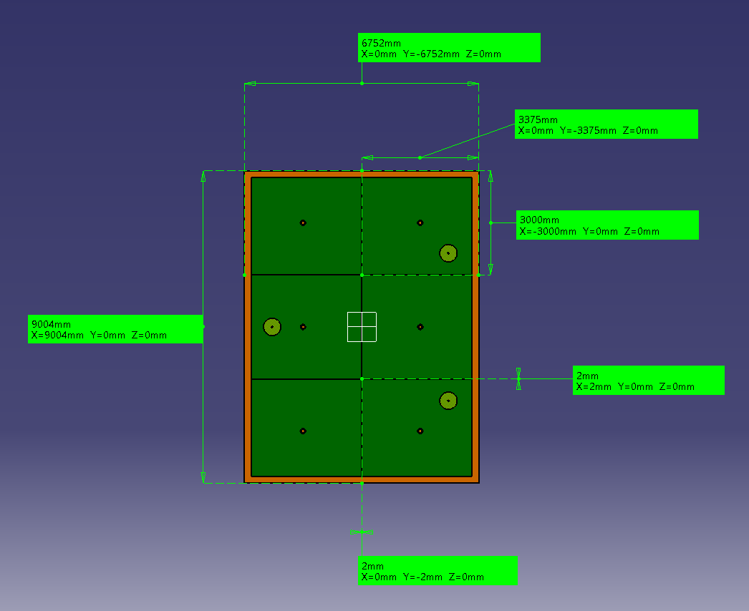
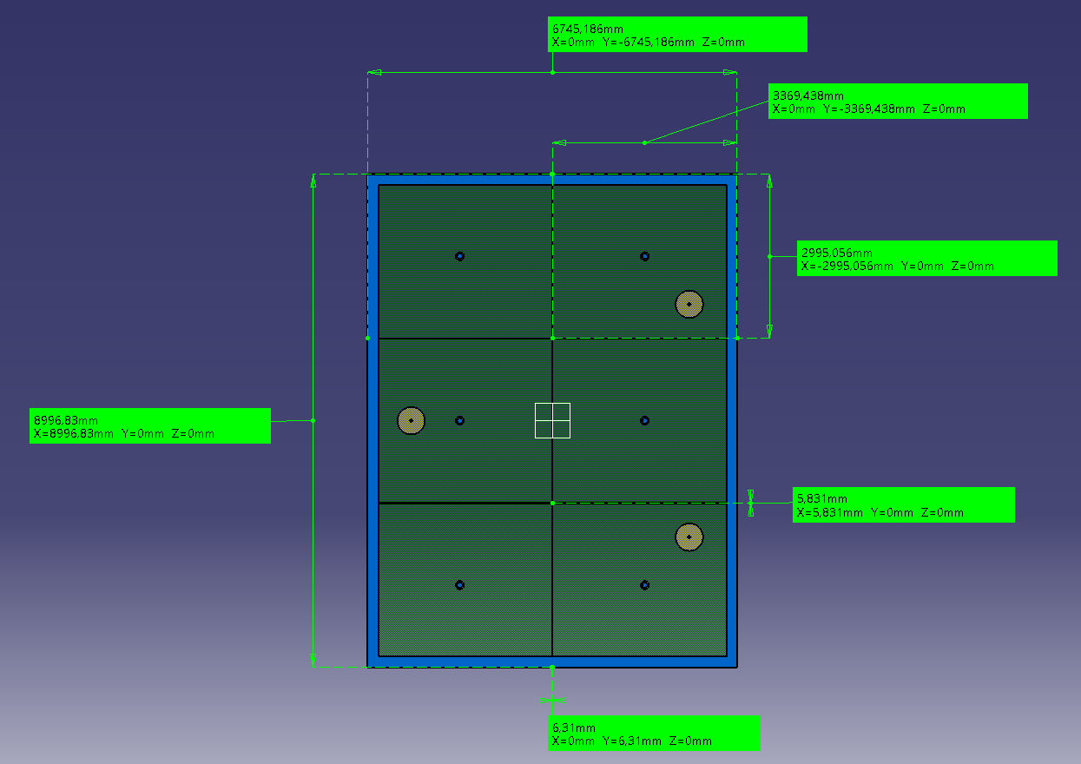
Invar Superstructure Type 1 and CRPs: thermal contraction
WARM
Each individual CRP shrinks by about 5-6 mm
Inter CRP gaps increase from 2mm to 6mm within a superstructure
COLD
Thermal shrinkage (external anode plane dimensions of a full superstructure) :
  Δ(length) = 7,17 mm
  Δ(width) = 6,81 mm

Slide 13
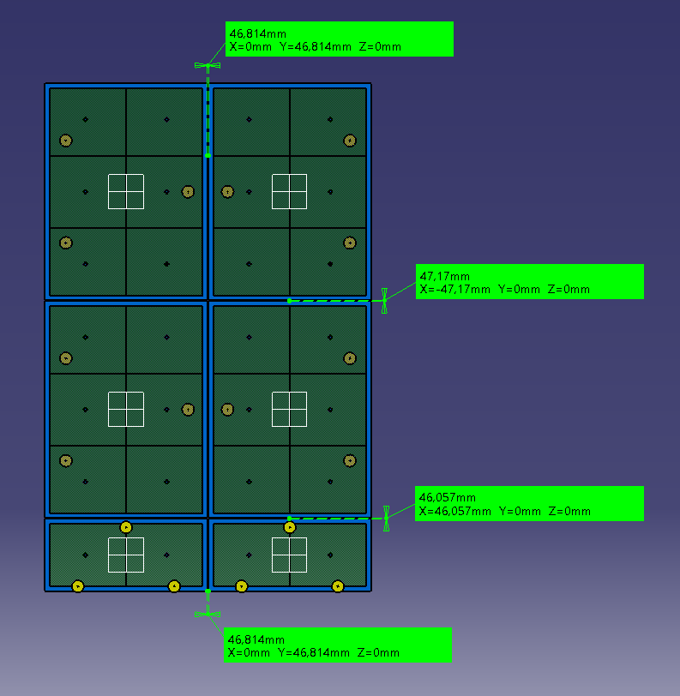


Anode relative positions at COLD
Illustrated gaps are distances between anodes of 2 consecutive SuperStructures
Warm
frame
anode
20
Cold
23,34
frame
anode
26,81
The 20mm functionnal clearance needs to be fine tuned to allow enough for installation and cope with the field cage area

Slide 14
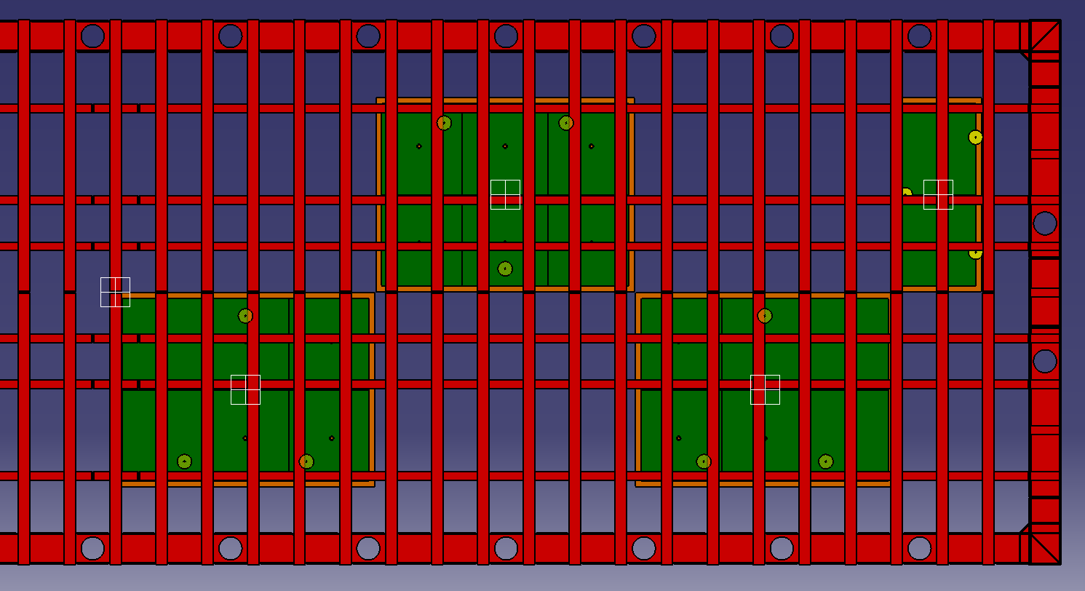
SPFT wrt cryostat
Possible positions of SPFT – Functionnal clearance defines SPFT positions
(yellow circles diameters are arbitrary - just for eye guidance)

Slide 15
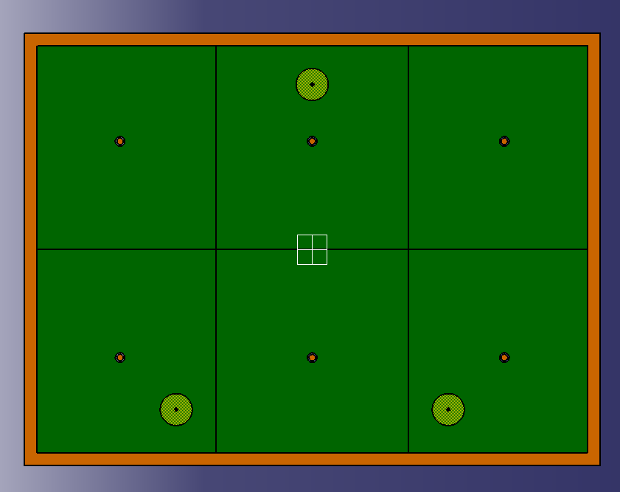
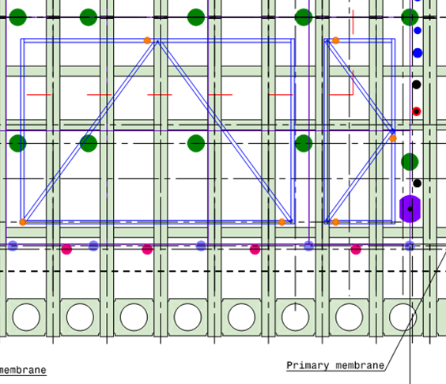
SPFT wrt cryostat
In order to avoid interference with cryostat structure, the position of suspension cables will have to be adjusted
(the optimal would have been to have the triangle centered wrt SSt) but not possible with actual cryostat layout
If the displacement is unavoidable => to be optimised in the calculations for the 3 suspensions to allow enough space between the SPFT and the cryostat structure.
The superstructrure asymmetric deformation will be treated at installation in that case
Example of the SPFT offset
Drawing from Dimitar (5/11/20)

Slide 16
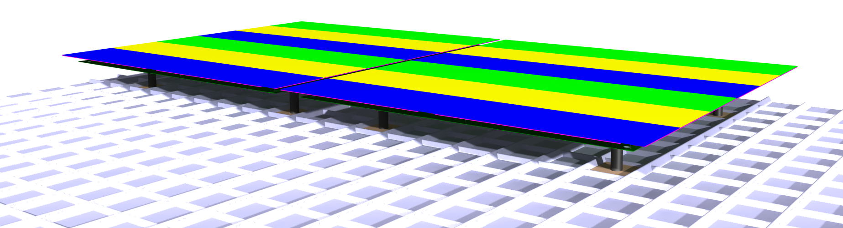
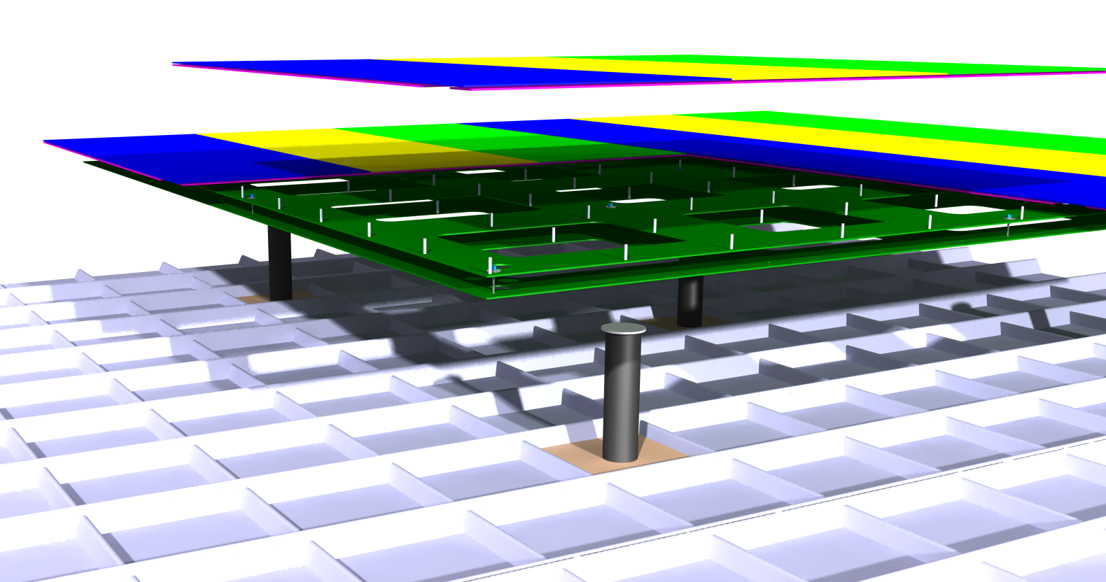
Bottom plane design
3.375m
3m
Individual CRPs structure is identical to Top-plane
Consists of 4 anodes planes
3000 x 3375 mm
Supporting PCB sandwich frame

Slide 17
Bottom plane – Mechanical concepts
Lateral decoupling
(PTFE, bearing, … )
Vertical adjustment
Only laid on the membrane
No fixation, no sliding on the membrane

Slide 18
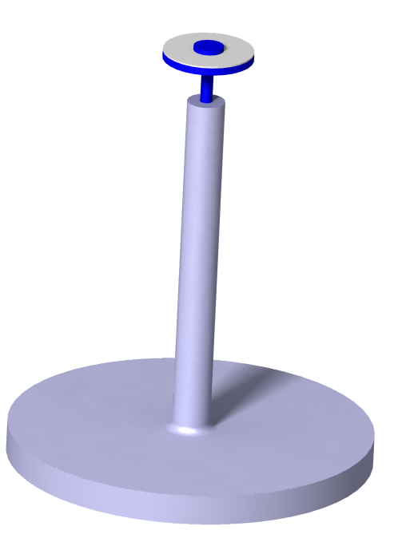
Bottom plane – Mechanical concepts
Thermal contraction pattern is idendical to Top-Plane, based on the membrane
« Squares » of the membrane are contracting around their own center
Center point lateral displacement is locked
One rotation is locked
PCB
100 mm for membrane corrugation + cables

Slide 19
Mechanical simulations
Anode attachement points
PCB support frame
Super-CRP structure
3
2
1

Slide 20
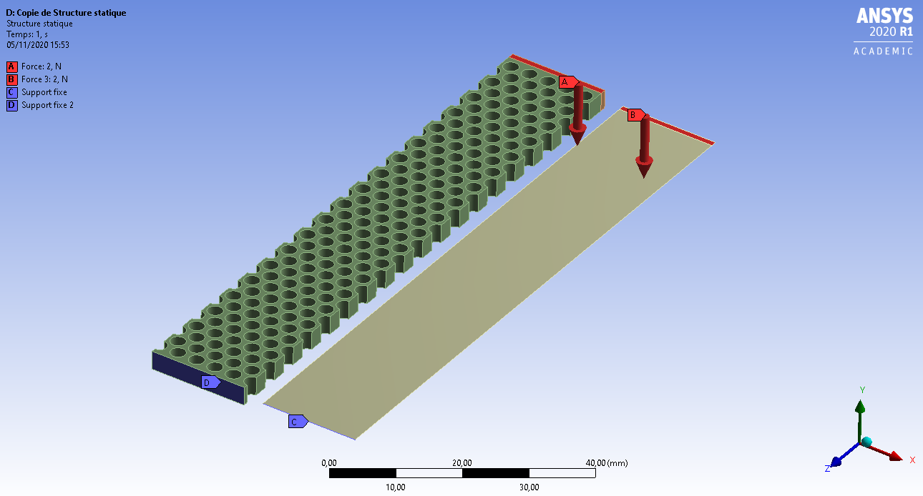
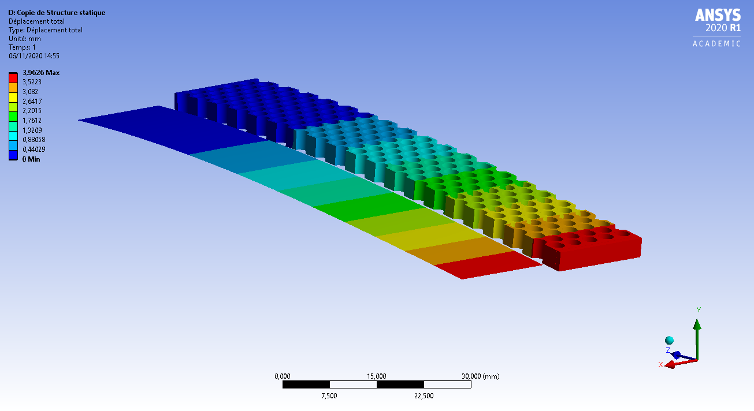
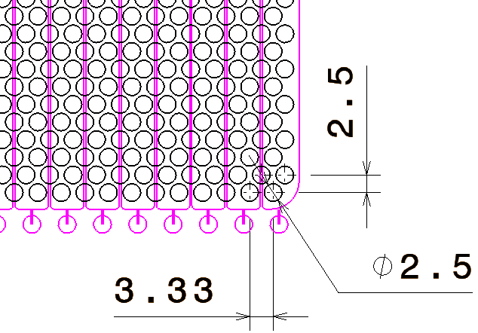
Anode material caracterisation for simulation
Young Modulus adaptation : 3390 MPa (26400 MPa for initial material in Ansys library)
To be confirmed and validated with real tests (to discuss with PCB suppliers)
Dimensions : 1500 x 1680 (=3x0,56) x 3,2 mm
PCB initial density : 1850 kg/m³
PCB corrected density for anode simulation : 1424,32 kg/m³
Corrected Young Modulus : 3390 MPa (26400 for initial material)
Anode Mass for a 3000 x 3375 mm plane : 46 kg
Initial Young Modulus :
26400 MPa
Hole pattern as tested on small scale proto at CERN
Adapted Young Modulus :
3390 MPa

Slide 21
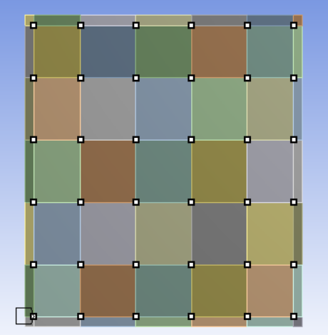
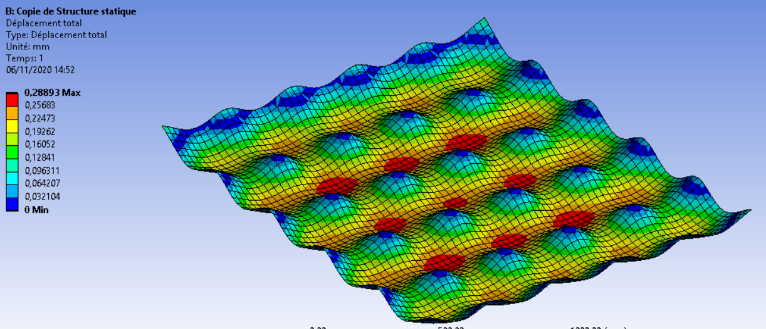
Simulation 1 : Anode support – Initial config
  Initial configuration :
  -> 1,5m x 1,68m anode plane, supported by 36 uniformaly distributed screws
    Max displacement : 0,3 mm
    Average displacement : 0,15 mm (similar along borders)

Slide 22
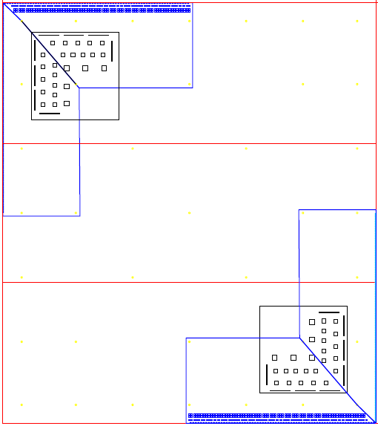
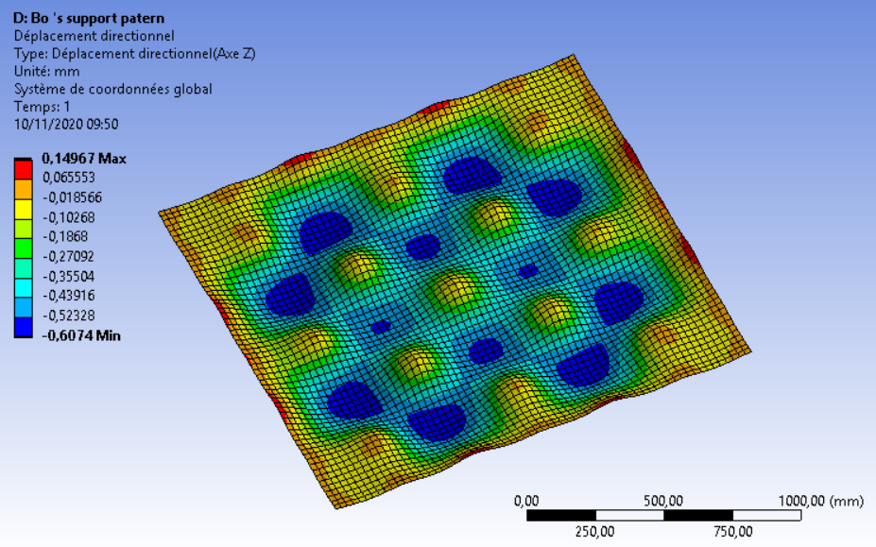
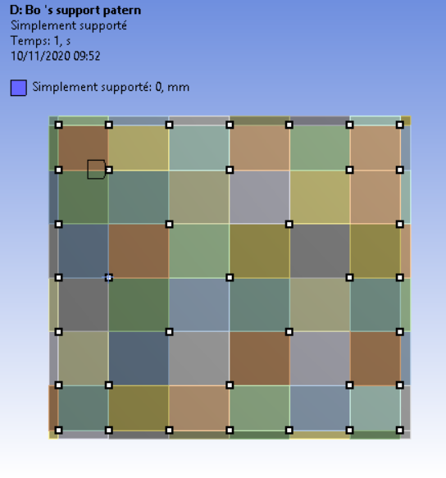
Simulation 1 : Anode support – Bo’s pattern
Bo suggestion from 9/11/2020 : 37 suspension points, higher density along borders
  Results :
    Max displacement (planarity deviation) : 0,75 mm
    Less than 0.2mm on the borders
    Has to be refined with exact screws positions
    Pattern to be discussed to conciliate electronics and deformations

Slide 23
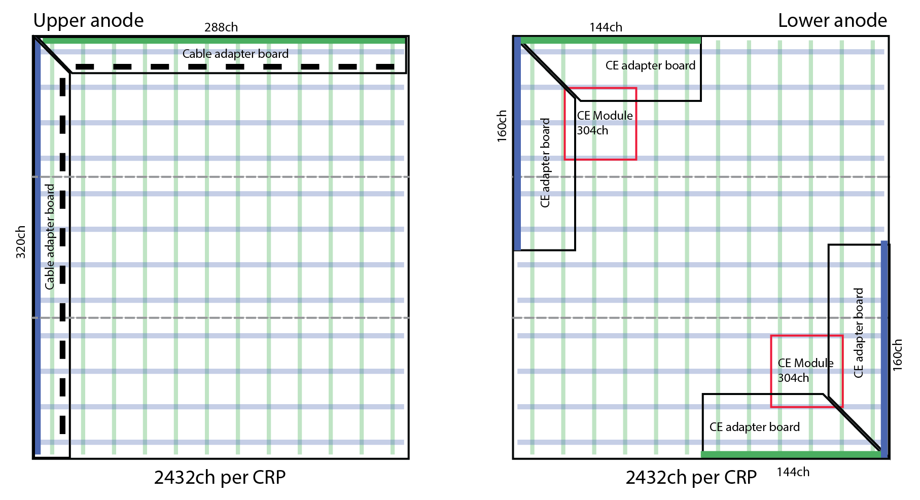
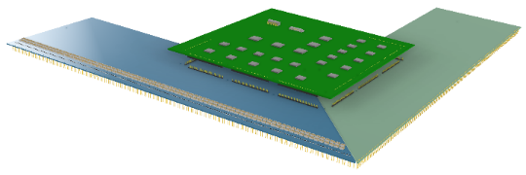
Anode Layout, considered for further developments
the electronic adapter boards to be included in a next step
¼ of a CRP (TOP)
¼ of a CRP (Bottom)
1680 mm
1680 mm
288
288
320
320
Induction: 3.375m
Full CRP (TOP)
1500 mm
320
320
1500 mm
288
288
608
Collection: 3 m
In contact with Bo to integrate the design

Slide 24
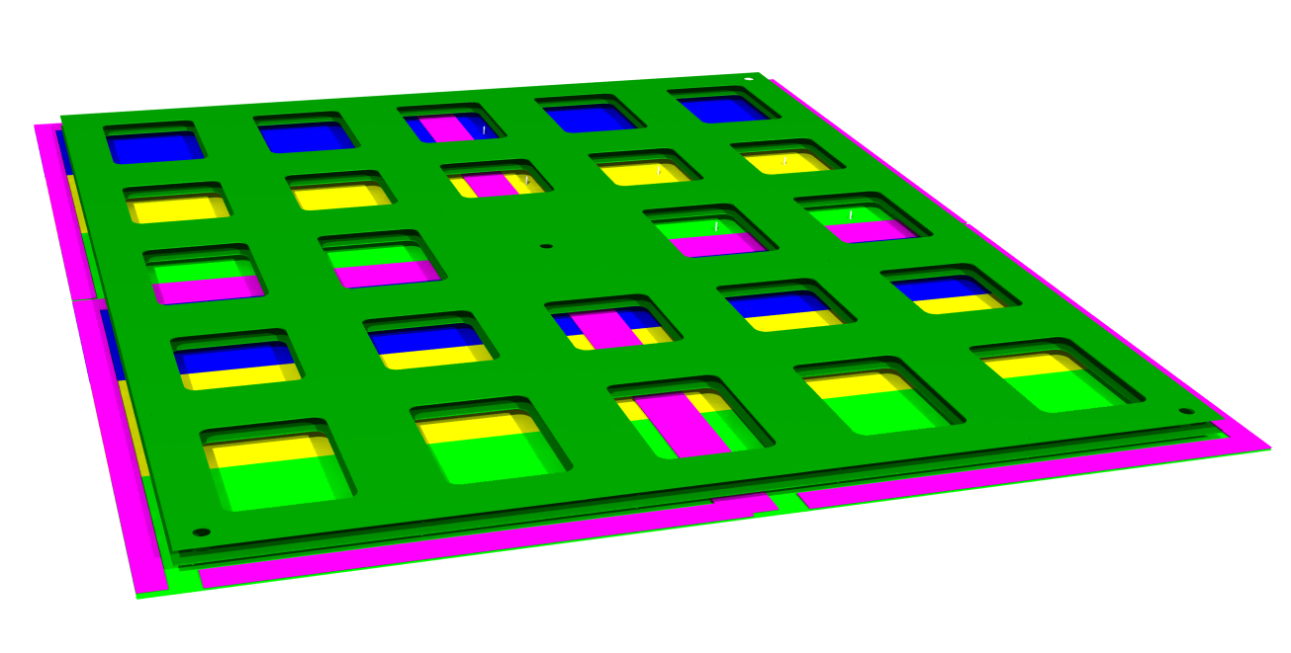
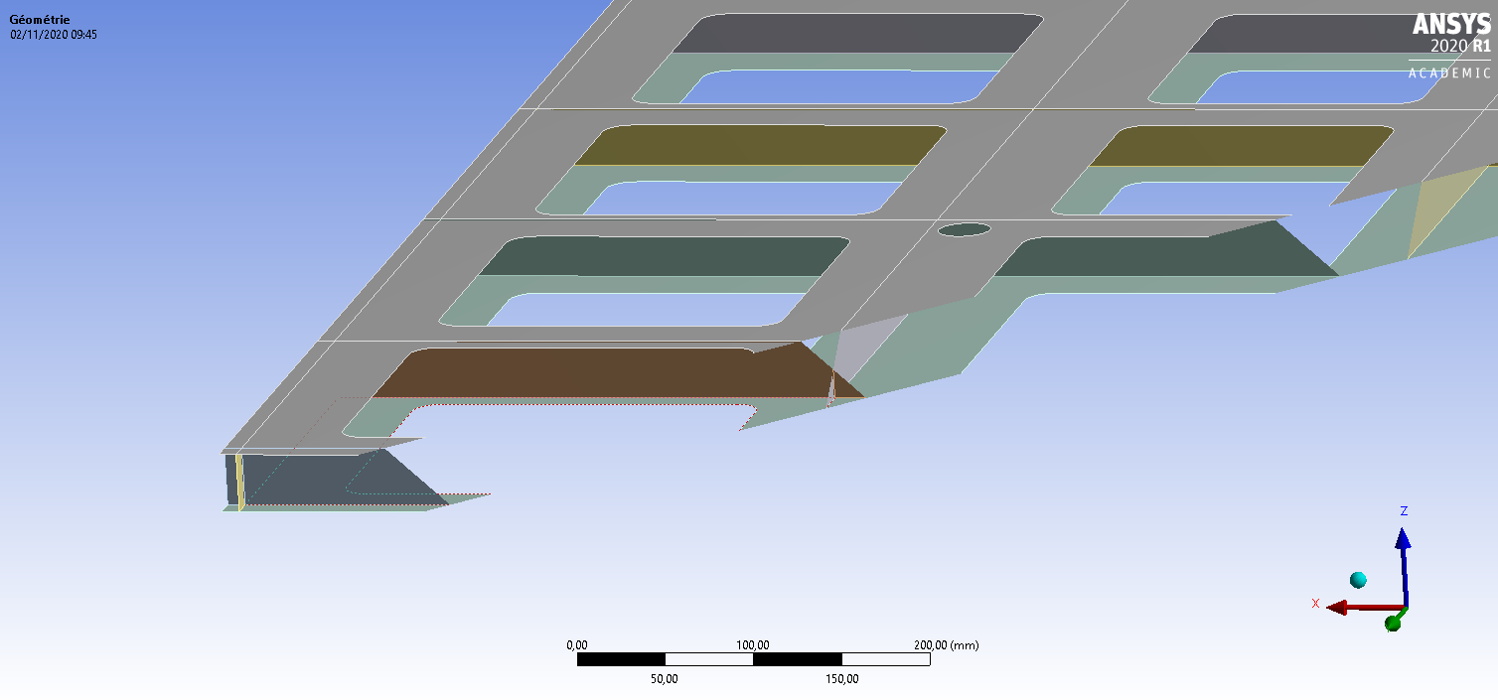
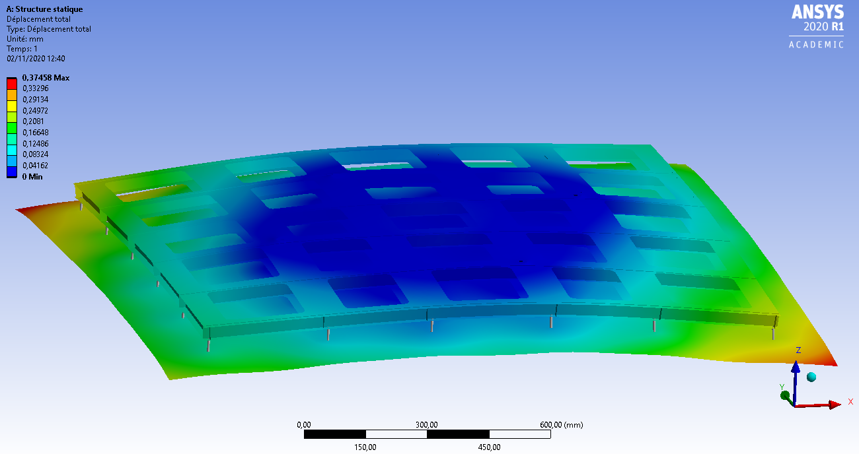
Simulation 2 : Anode supporting structure
Anode plane suspended to PCB sandwich
G10 has different thermo-mechanical behaviour than PCB
=> use PCB to support PCB instead of G10
3000 x 3375

Slide 25
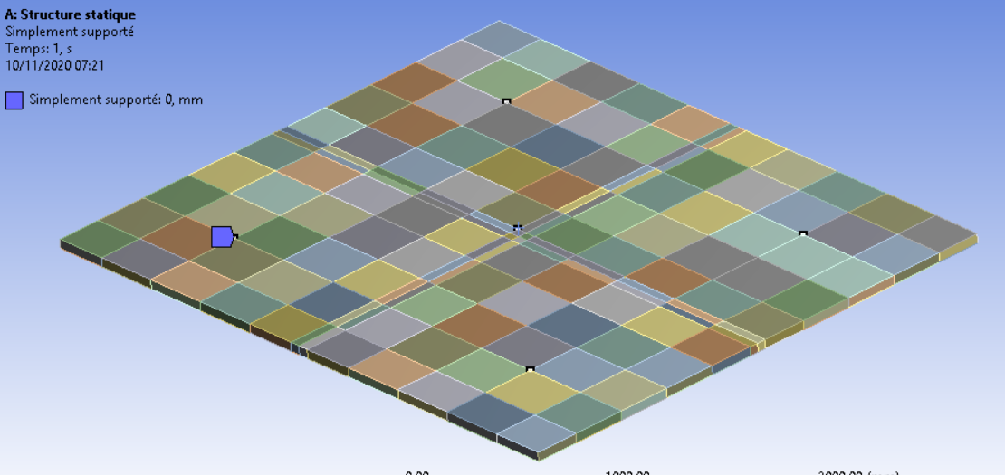
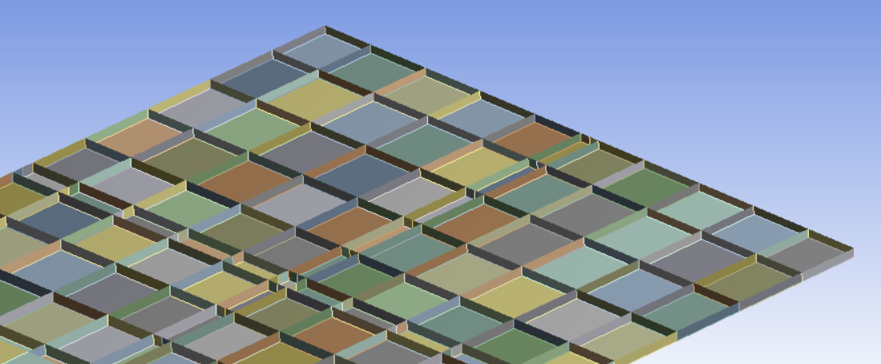
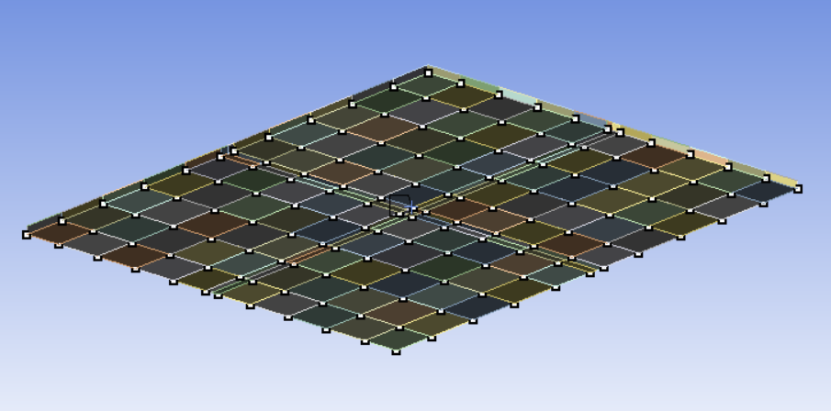
Simulation 2 : Anode supporting structure
5 Anchoring points to super structure
Considered PCB ‘s material properties :
  E =26400 Mpa
  ᵨ =1850 kg/m³
Internal sandwich structure :
- 50 mm high vertical stiffeners
- Pitch corresponding to anode fixation (~300mm)
Loading :
  Gravity
  451 N Force spread over 144
    (36 x 4) anode suspension points to stand for anode weight

Slide 26
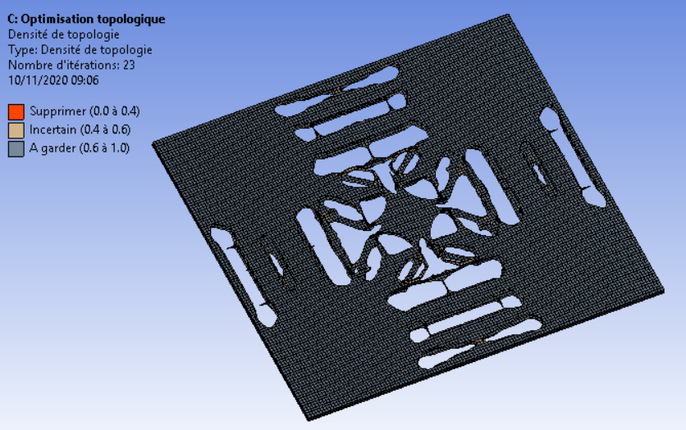
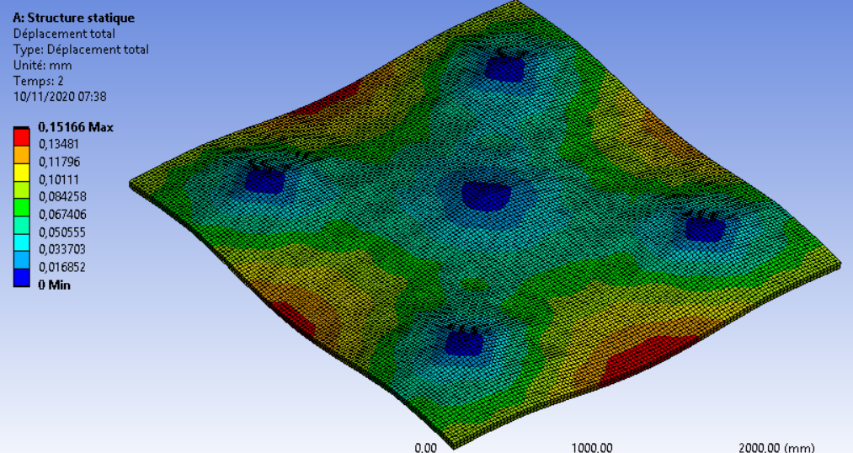
Simulation 2 : Anode supporting structure
  3m x 3,375m PCB supporting structure :
    Max displacement : ~ 0,15 mm
    Weight of the structure : ~120kg, optimisation in progress
Topological optimisation
Can be done to save mass but increases complexity of structure
Can “drive” location of holes that will be necessary to pass signal cables

Slide 27
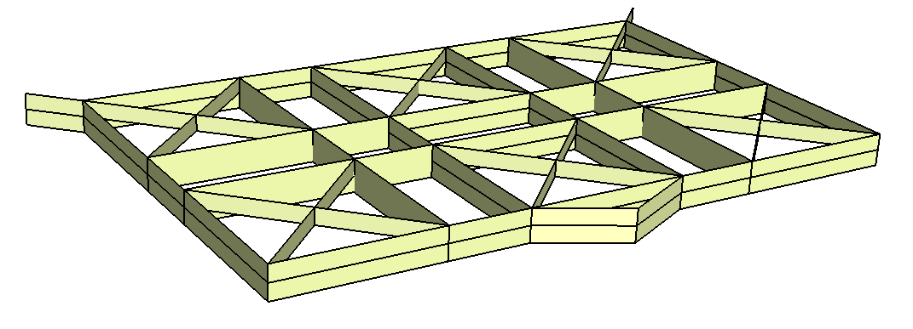
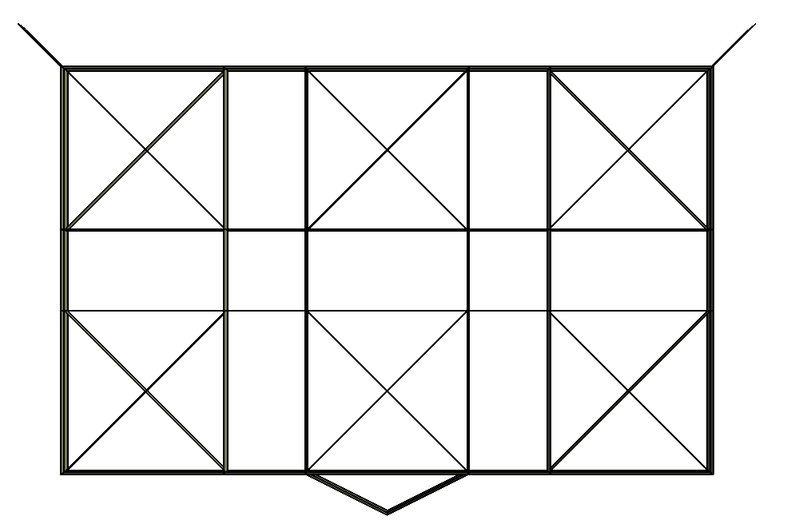
Simulation 3 : Invar Super-Structure
Superstructure supporting 6 CRPs
Dimensions : 8m x 5m
2 Heights : 400mm and 200mm (crosses)
Plates thickness = 6,35mm
Weight : 1,6 tons

Slide 28
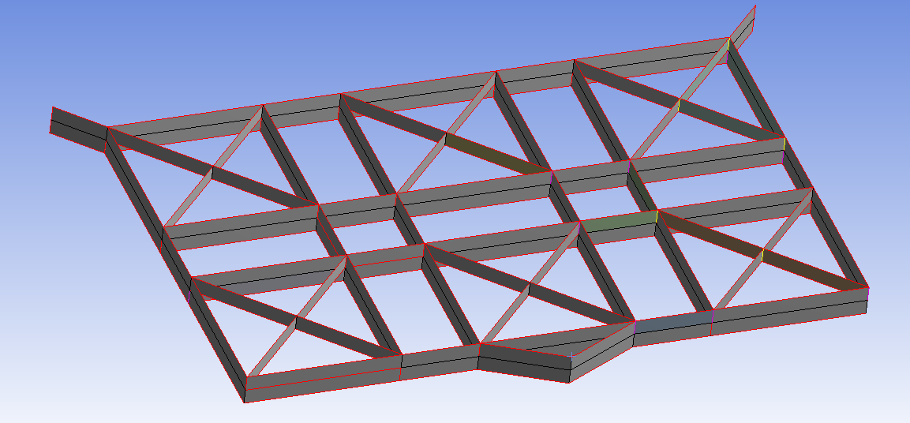
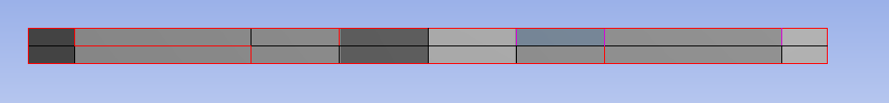
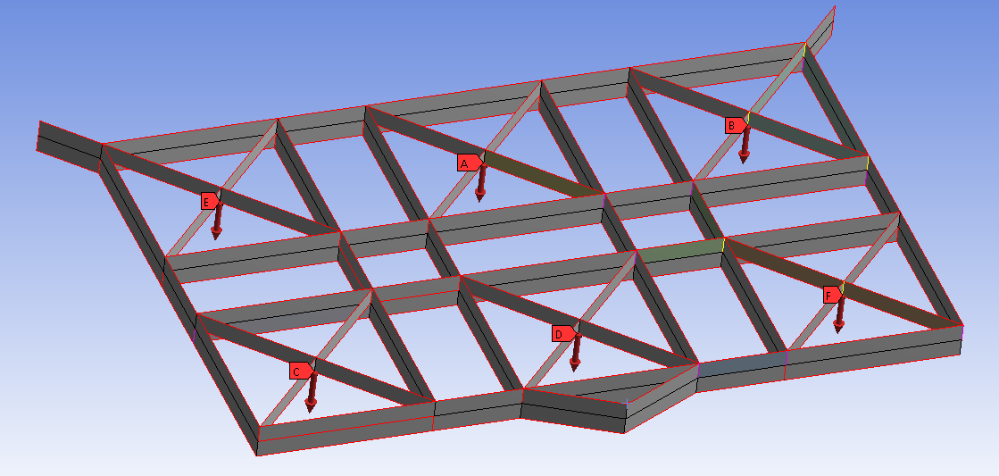
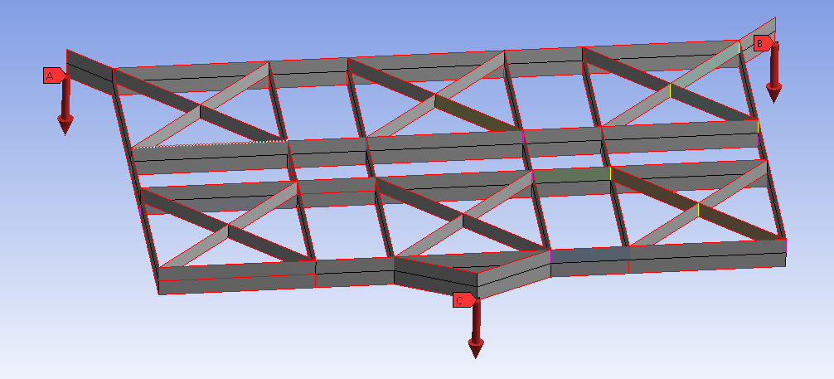
Simulation 3 : Invar Super-Structure - Reference config
3 suspension points
Cathode is directly connected to the « summit » point
Step 1 : gravity (1,6 tons)
Step 2 : CRPs masses (200kg chaque)
Step 3 : Cathode mass (200kg x3)

Slide 29
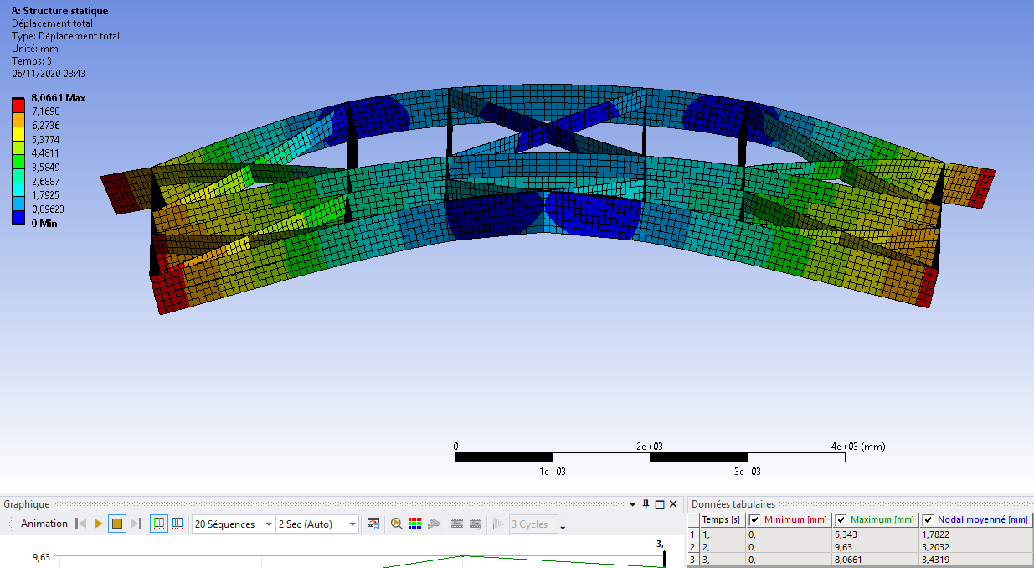
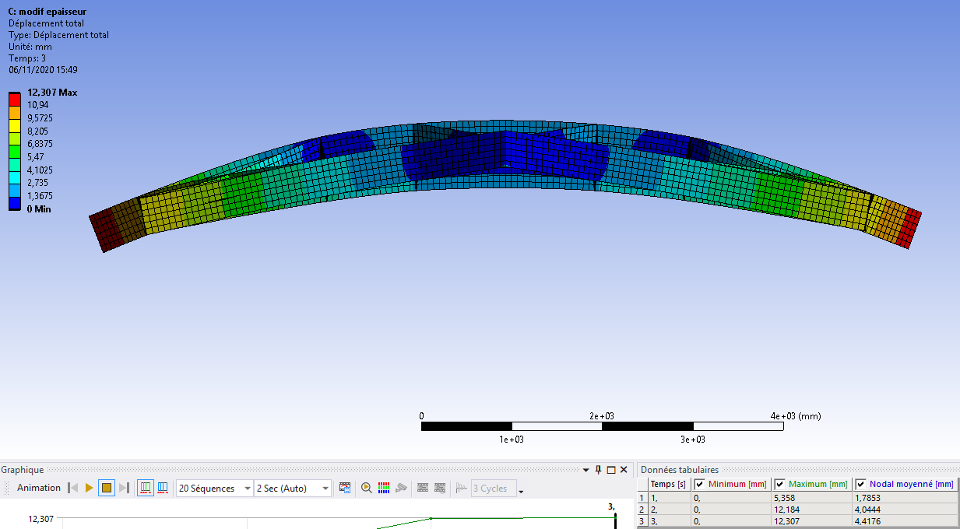
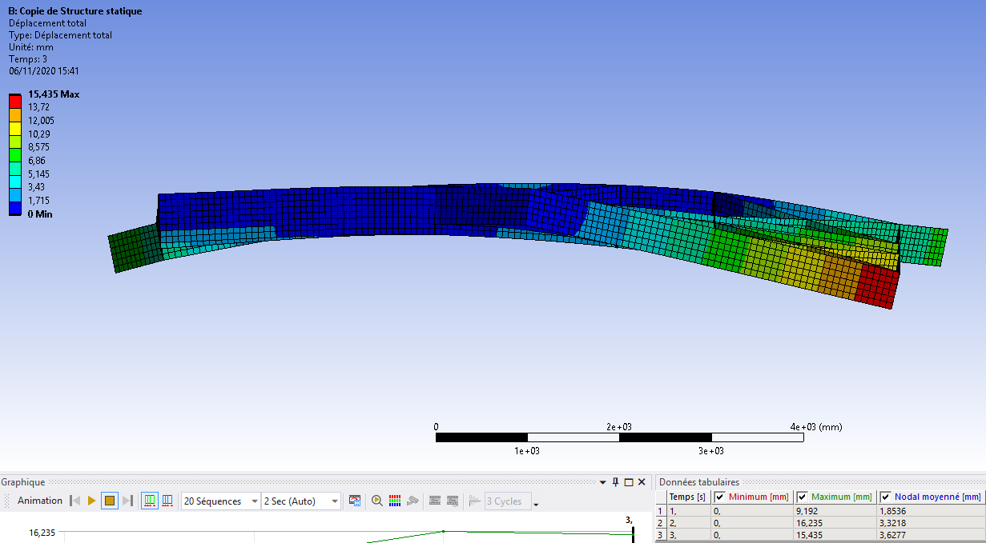
Simulation : Invar Super-Structure
Thickness = 6.35mm
Thickness = 4mm
Reference
Reduced thickness
Step 1 : gravity (1.6 ton) d_{max} = 5.3 mm
Step 2 : CRPs masses (200kg each) d_{max} = 9.6 mm
Step 3 : Cathode mass (200kg x3) d_{max} = 8.1 mm
Step 1 : gravity (1ton) d_{max} = 5.3 mm
Step 2 : CRPs masses (200kg each) d_{max} = 12.2 mm
Step 3 : Cathode mass (200kg x3) d_{max} = 12.3 mm
Thickness = 6.35mm and
Top triangle suspension shifted by 100mm
100mm lateral shift
100mm lateral shift
Shifted SPFT
Step 1 : gravity (1.6 ton) d_{max} = 9.2 mm
Step 2 : CRPs masses (200kg each) d_{max} = 16.2 mm
Step 3 : Cathode mass (200kg x3) d_{max} = 15.4 mm

Slide 30
Invar Super-structure Load behaviour
Reference
Gravity: d_{max} = 5.3 mm
CRP masses: d_{max} = 9.6 mm
Cathode masses : d_{max} = 8.1 mm
Reduced thickness
d_{max} = 5.3 mm
d_{max} = 12.2 mm
d_{max} = 12.3 mm
Shifted anchoring
d_{max} = 9.2 mm
d_{max} = 16.2 mm
d_{max} = 15.4 mm
Immersion effects (Archimède) have to be estimated
More optimisation will be performed on this structure
Other design with stainless steel on going: first calculations performed

Slide 31
Summary
This is a first design work on the CRP structures for VD detector:
Preliminary optimisation and calculations on anode, PCB frames and superstructures have shown results matching the defined criteria (at least for the symmetric suspended SuperStructure design)
CRP mechanical structures are identical between bottom and top
More optimisation and refinements needed and on going
Alternative structure material options are also considered and studied for the superstructure (SS)
Detailed definition of the CRP suspension points with cryostat feedthroughs positions in progress
Work on interface with cathode mechanical structure has started for the cathode frame suspension
Critical aspects to work on:
  Overall anode and superstructure dimensions in the cryostat to fit the area of the field cage
  Given the large SuperStructure dimensions and weights: important to asses reasonable functional clearances especially for installation => it cannot be only a few mm!
  Gaps needed for the cathode suspension to consider

Slide 32
End

Slide 33
Superstructure: Invar
CRP: PCB
Locked points on the structure
Scénario A:
D mm
9m
WARM
2mm
6.6m
9004mm
COLD
4mm
Each interCRP gap increases by about 6mm
Sketck of 2 neighbouring superstructure
D+7 mm

Slide 34
INVAR – Possible Clearances wrt Field Cage
Field Cage
18 mm
78 mm
20 mm
40 mm
Clearance between SuperStructure and Field Cage is small along longitudinal axis

Slide 35
Superstructure: Stainless Steel
CRP: PCB
Locked points on the structure
Scénario C:
D mm
WARM
7mm
7mm
7mm
7mm
9014mm
COLD
5mm
5mm
8995mm
D+18mm

Slide 36
SSteel - Clearances wrt Field Cage
Field Cage
12,5 mm
73 mm
13 mm
40 mm
Clearance between SSt and Field Cage is small along longitudinal axis

Slide 37
Production / installation

Slide 38

Production
Manufacturers
Anodes
PCB panels
Production clean room(s)
Assembly / Glueing of PCB panels 3 x 3,375
Machined parts assembly
Anodes planes assembly 1,5 x 1,68
Electrical cabling
Packaging in transport boxes 3,5 x 3,5m
Machined parts
Tooling
(transport & installation)
Super-structures
Manufactured in separable parts (inserable through TCO)
Max dimensions : 3000 x 3000?
Directly sent to cryostat

Slide 39
Installation : Cryostat
Super-structures assembly, on the cryostat ground
A super-structure cannot be transported in one piece
Super-structure 1/3
Super-structure 2/3
Super-structure 3/3
Super-structure 1/3
Super-structure 2/3
Super-structure 3/3

Slide 40
Installation : Cryostat
Pre-stressed Super-structure
Planarity laser
Super-structure lifting with SPFT winches
Suspension points vertical pre-positioning
Dummy CRP + cathodes masse
Dummy CRP + cathodes masse

Slide 41
Installation : Cryostat
Winch
Winch
Winch
Super-structure
CRP insertion in the cryostat
Lifting
Need for a structure on the ground to lay the CRP flat
Need a system to lift it
  Winches from super-structure?
  Plate-lifter?
Lifting structure

Slide 42
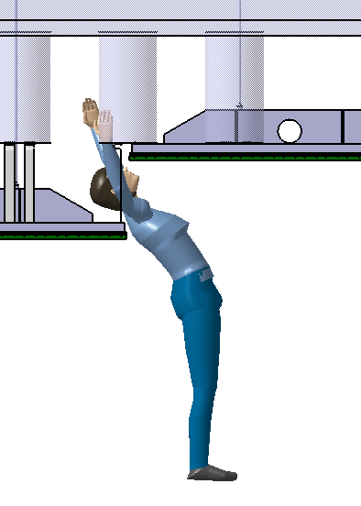
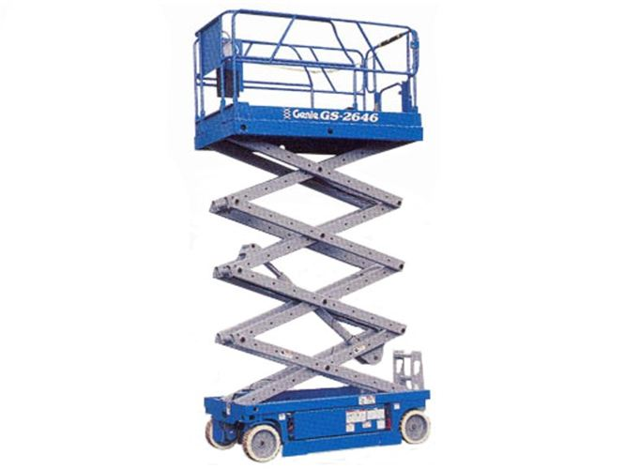
Installation : Cryostat
SGFT
SGFT
Super-structure
Electrical connections
Electrical connections
Mechanical connections
Need for a person lift to work at height
In function of the chimney position, need to step the planes under the super-stucture to do the connections

Slide 43
Connexions CRP - Signal
Top chimney topology: connexion at each CRP corner
20 modules
608
1216
1
2
3
4
5
19
20
1216
2432

Slide 44
Installation : Cryostat
SGFT
SGFT
SGFT
SGFT
Super-structure
Planarity laser
Dummy cathodes masse
Planarity adjustment
Dummy cathodes masse

Slide 45
Installation : Cryostat
Super-structure
Cathode
Cathode lifting and suspension
Winches?
Plate lift?
Lifting structure
Winch

Slide 46
Installation : Bottom plane
Installation and pre-adjusting ot support feet
Laser

Slide 47
Installation : Bottom plane
Installation of CRPs (3000 x 3375mm each)
Merchanical and electrical connections
Planarity fine tuning
  Need to access above the planes
Réglage fin du plan d’anodes
Laser

Slide 48
Spare slides

Slide 49
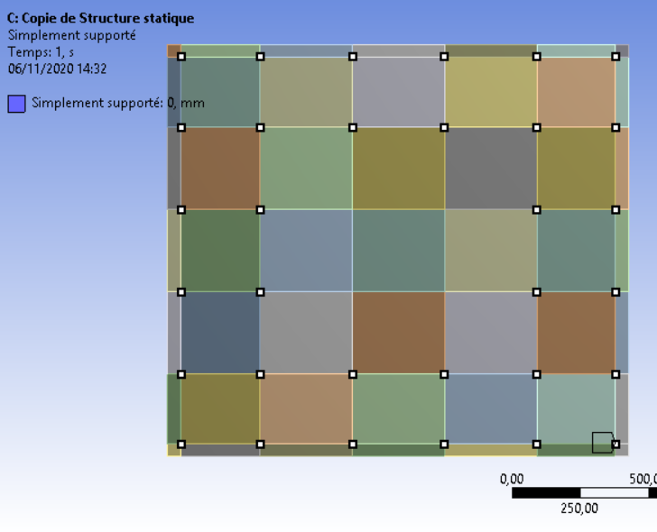
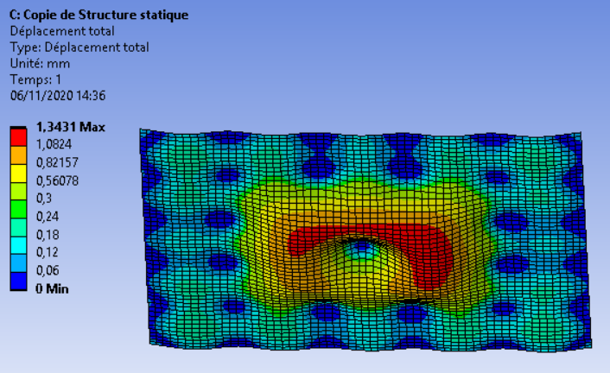
Simu. 1 : Anode support – alternative solution
  Alternative solution : less supporting screws (33 instead of 36)
  -> 1,5m x 1,68m anode plane
    Max displacement, outside part : 0,3 mm
    Max displacement, inside part : 1,3mm
    Few less screws, much higher displacements
    Not worth the change
    Material properties are very influential

Slide 50
Anode material caracterisation for simulation
Dimensions : 1500 x 1680 (=3x0,56) x 3,2 mm
PCB initial density : 1850 kg/m³
PCB corrected density for anode simulation : 1424,32 kg/m³
Corrected Young Modulus : 3390 MPa (26400 for initial material)
Anode Mass for a 3000 x 3375 mm plane : 46 kg
To be validated with real tests
First contact with CCI EUROLAME (PCB supplier)
  Cedric Launay
  Max width : 1225 mm
  Max length : to be defined
  Coppered PCB
  Already in contact with CERN?
Masse volumique PCB plein | 1850 | kg/m^3
Longueur | 1680 | mm
Largeur | 1500 | mm
Epaisseur | 3,2 | mm
Diamètre des trous | 2,5 | mm
Espacement en largeur | 3,333333 | mm
Espacement en longueur | 2 | mm
Volume d'une plaque pleine | 0,008064 | m^3
Masse d'une plaque pleine | 14,92 | kg
Nombre de trous | 378000,0378 | trous
Volume de trous | 0,001855503 | m^3
Masse de trous | 3,43 | kg
Masse d'une anode 15x1,68 | 11,49 | kg
Masse d'un plan d'anode de 3x3,375 | 45,94 | kg
Densité corigée | 1424,32 | kg/m^3

Slide 51
Thermal shrinkage at LAr temperature
CRP (anode + PCB frame)
α_{anode} = 8.10⁻⁶ K⁻¹
α_{invar} = 1,8.10⁻⁶ K⁻¹ (12.5% of PCB)
α_{Stainless steel} = 13.2.10⁻⁶ K⁻¹
WARM
COLD
3369 mm
3375 mm
Δ = -6mm
3000 mm
2995mm
Δ = -5mm
2 suspended point on INVAR structure separated by
3000 mm at warm => 2993mm at cold => -0.7mm between 2 CRPs
3375 mm at warm => 3366 mm at cold =>

