Slide 1

Reliability information for the
Safety Instrumented Systems at CERN
The SM18 cluster F case study
Borja Fernández Adiego (BE-ICS)
Contains Joint work of
Gustavo De Assis, Roberto Speroni, Enrique Blanco (BE-ICS),
Maryline Charrondiere (TE-MSC),
Thomas Otto (DSO of TE dept.)

Slide 2
Outline
Overview of the SM18 cluster F control and safety systems
Impact of the power converters reliability
Comparison with the LHC Powering Interlock System (PIC)

Slide 3
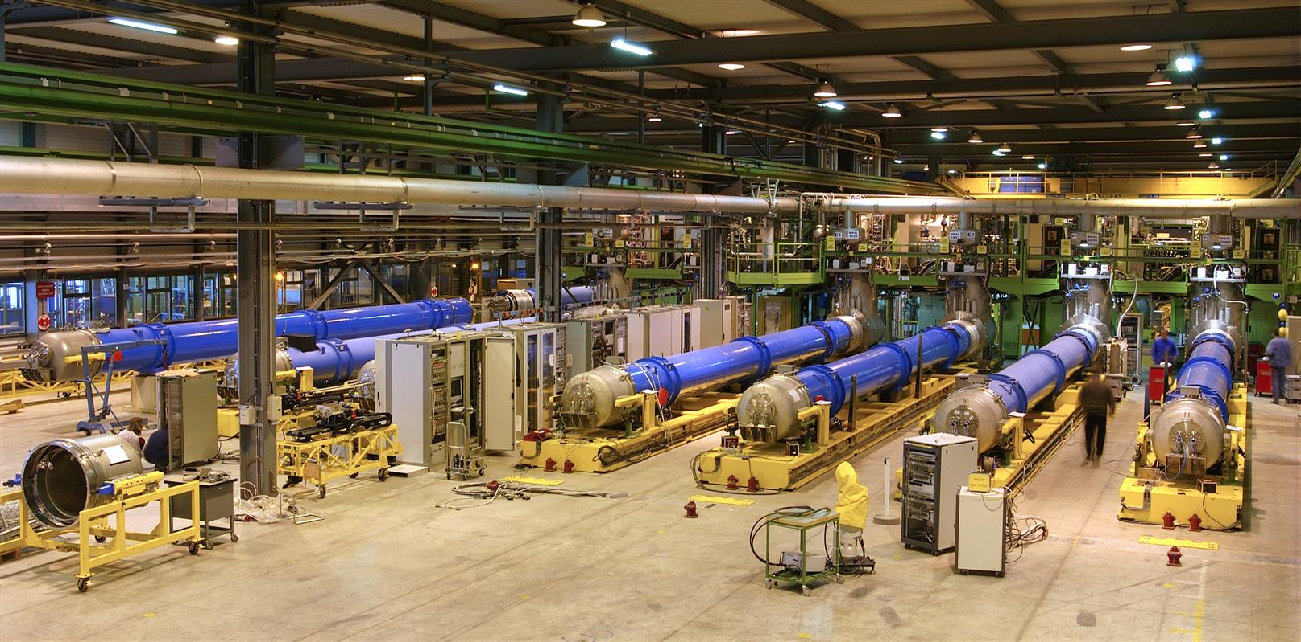
SM18 magnet test benches
Taken from https://cds.cern.ch/record/724733

Slide 4
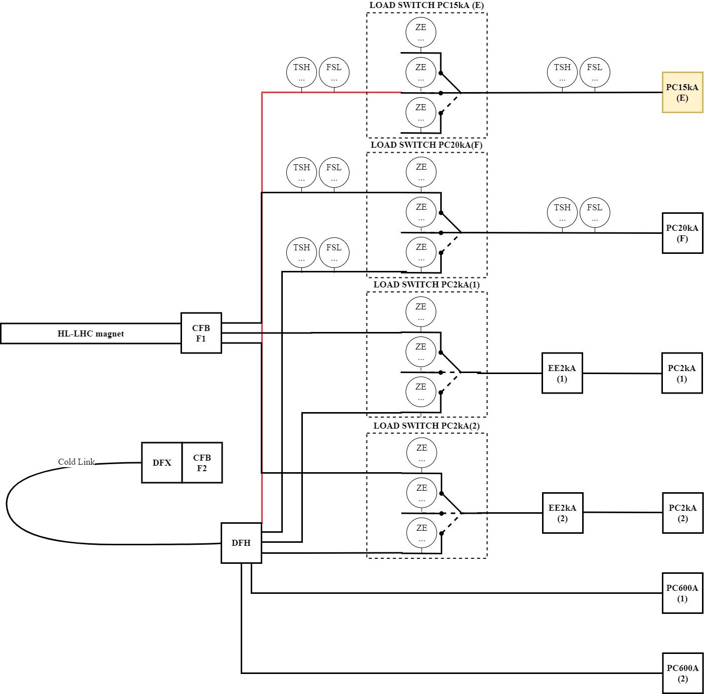
SM18 cluster F
One of the several Magnet test bench facilities located in the SM18 building
6 power converters
It consists of 2 test benches:
HL-LHC magnets
SC link

Slide 5
SM18 cluster F - controls and safety requirements
Operational requirements:
Bench selection
PC selection
Test type selection
Safety requirements:
Machine protection
Personnel protection
Both start-interlock conditions and stop-interlock conditions
(modifications on the test benches happen very often)

Slide 6
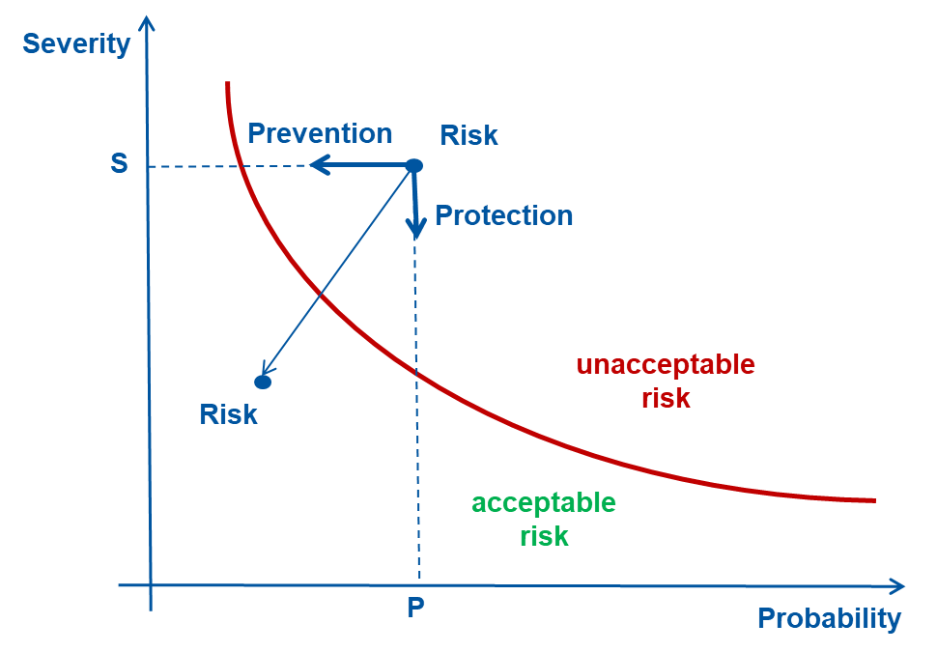
SM18 cluster F - control and safety systems
2 prevention systems:
“Fast control loop”: Quench detection and protection
  Responsibility of the MPE group
  1 uQDS per bench
  For the HL-LHC bench: CLIQ, DQHDS, DAQ for Quench location & timing
“Slow control loop” (ICS group): all the rest (both machine and personnel) ≈ PIC system
We follow the IEC 61511 (and IEC 61508) guidelines
While doing the risk analysis, we are considering other protection systems:
e.g. access control, physical barriers, etc.

Slide 7
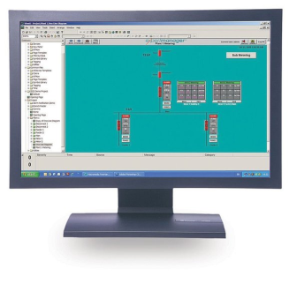
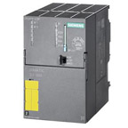

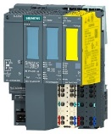



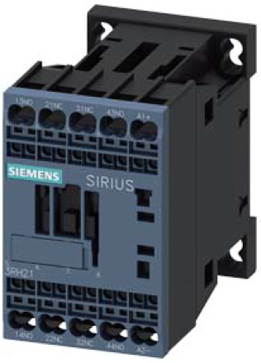

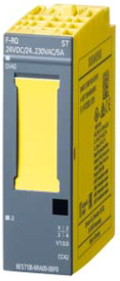
SM18 cluster F - simplified controls architecture
PM
WinCCOA
Labview
PC config.
Supervision
CMW
S7
CMW
Control
QPS
FESA class
DQAmx
UNICOS
+
Safety Functions
S7-317F
PLC
FGC _51
Profisafe
WFIP
Field
uQDS
uQDS
Safety
Matrix
Power
Permit
Fast
Abort
MCB
Config
ScLink
HL-LHC
magnet

Slide 8
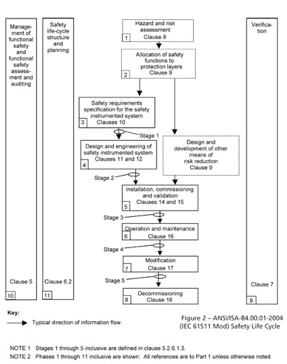
SM18 cluster F – the IEC 61511 standard
1
IEC 61511 safety life cycle
Safety Instrumented System (SIS) - very high engineering cost
Basic Process Control System (BPCS) – limited risk reduction (RR ≤ 10) can be claimed
2

Slide 9
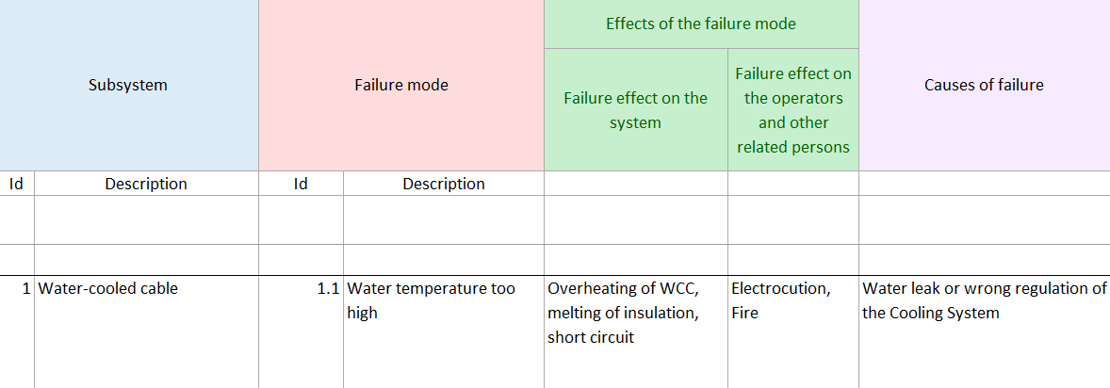
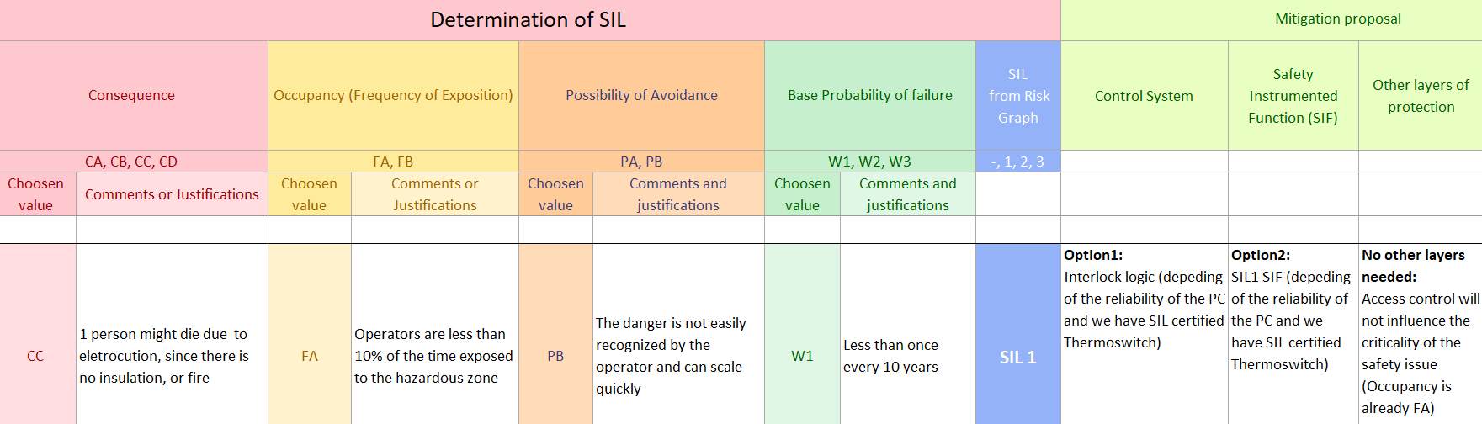
SM18 cluster F – FMEA risk analysis and risk graph method
(IEC 61508-5 Annex E and IEC 61511-3 Annex D)

Slide 10
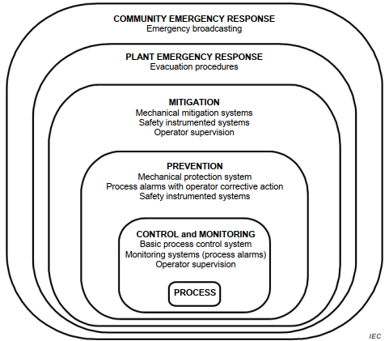
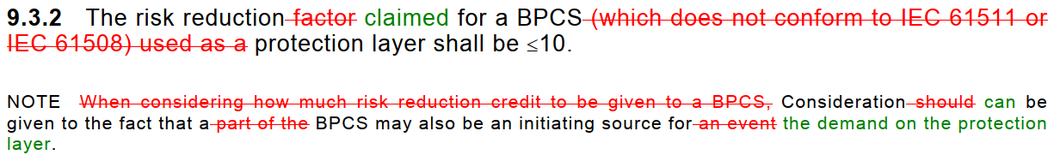
SM18 cluster F – Layers of Protection
IEC 61511-1 (2016) – 9. Allocation of safety functions to protection layers
Other measures (e.g. access control)
Safety Instrumented system (IEC 61508 and IEC 61511)
Basic Process Control system
(interlock)

Slide 11
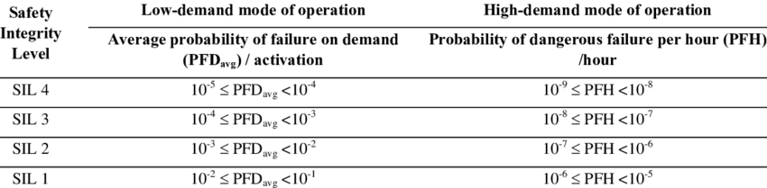
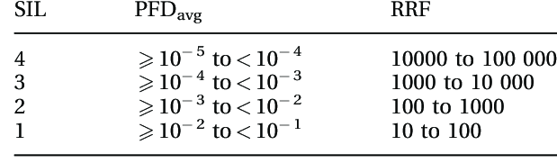
SM18 cluster F – what about SIL?
SIL (Safety Integrity Level) = tool to quantify the risk reduction
But it is not only about hardware reliability

Slide 12
SM18 cluster F – SIL requirements
Requirements to develop a SIF according to the IEC 61511 and IEC 61508 standard
IEC 61508-2(2010) - 7.4.2 General requirements
the requirements for hardware safety integrity comprising;
  the architectural constraints on hardware safety integrity (see 7.4.4), and
  the requirements for quantifying the effect of random failures (see 7.4.5);
the special architecture requirements for ICs with on-chip redundancy (see Annex E), … (Safety PLC)
the requirements for systematic safety integrity (systematic capability) - (Route 1S - see 7.4.7 and IEC 61508-3)
the requirements for system behaviour on detection of a fault (see 7.4.8);
the requirements for data communication processes (see 7.4.11)
IEC 61511-1 (2016) - 12. SIS application program development (comply with req. for Limited Variability Languages)

Slide 13


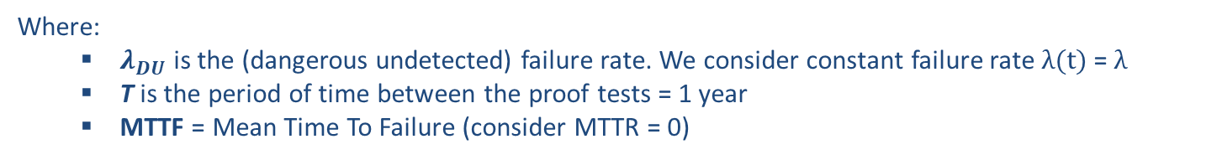
SM18 cluster F – hardware random failures analysis
Safety Chain PC
Reliability block diagram
PFD 1oo1
$$PFD=λ_{DU}.\frac{T}{2}$$
$$MTTF=\frac{1}{λ_{DU}}$$
Where:
  $λ_{DU}$ is the (dangerous undetected) failure rate. We consider constant failure rate $λ(t)$= $λ$
  T is the period of time between the proof tests = 1 year
  MTTF = Mean Time To Failure (consider MTTR = 0)

Slide 14
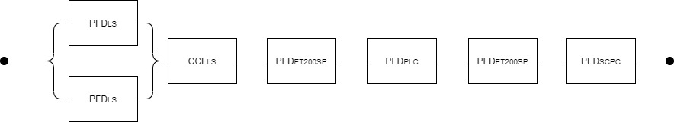
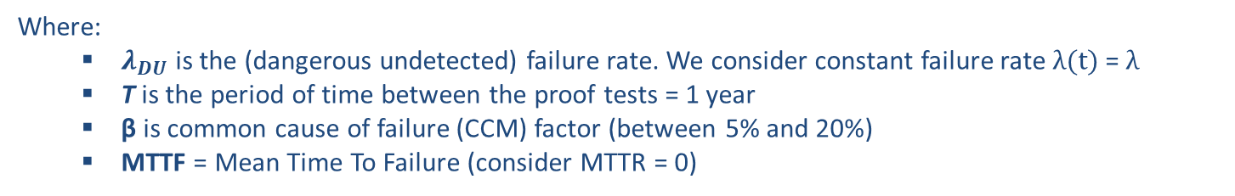



SM18 cluster F – hardware random failures analysis
Safety Chain PC
Reliability block diagram
PFD 1oo2
PFD 1oo1
$$PFD={λ_{DU}}^{2}.\frac{T^{2}}{3}+β.λ_{DU}.\frac{T}{3}$$
$$PFD=λ_{DU}.\frac{T}{2}$$
$$MTTF=\frac{1}{λ_{DU}}$$
Where:
  $λ_{DU}$ is the (dangerous undetected) failure rate. We consider constant failure rate $λ(t)$= $λ$
  T is the period of time between the proof tests = 1 year
  β is common cause of failure (CCM) factor (between 5% and 20%)
  MTTF = Mean Time To Failure (consider MTTR = 0)

Slide 15
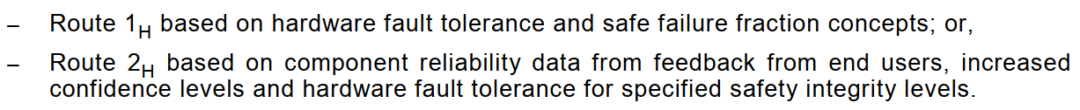
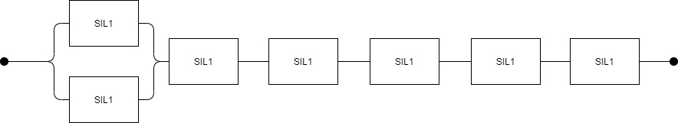
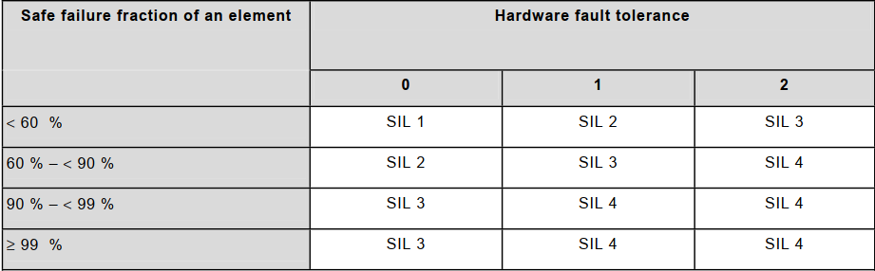
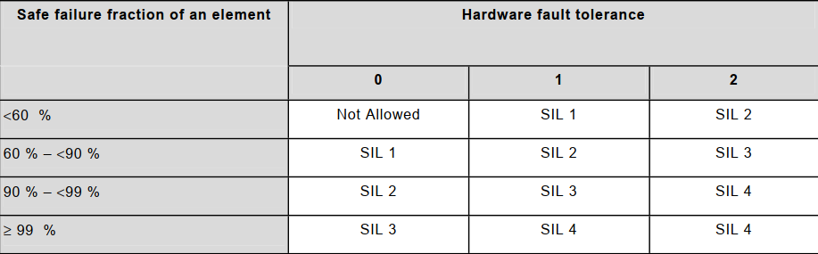
SM18 cluster F – architectural constrains analysis
Type A
(simple devices ≈
Mechanical devices)
Type B
(complex devices ≈
contain microprocessors)

Slide 16
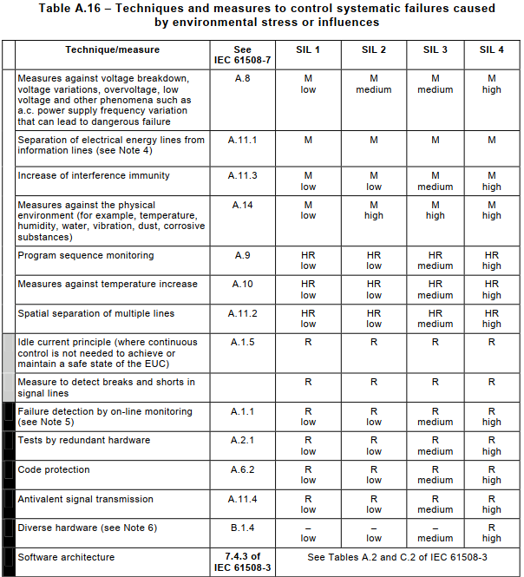
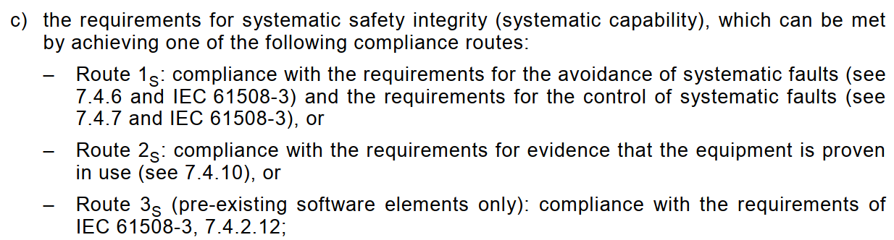
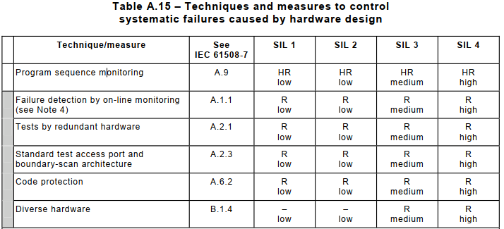
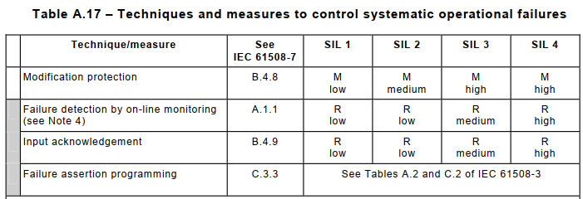
SM18 cluster F – systematic failures analysis

Slide 17
SM18 cluster F - software
IEC 61508-3 (2010). Software requirements
IEC 61511-1 (2016). Clause 12. SIS application program development
IEC 61511-2 (2016). Annex A and Annex B
What do we do?
Provide formalized requirements for the safety functions (CEM or logic diagrams) – unambiguous specification
We apply model checking to guarantee that our software is (fully) compliant with the specifications – PLCverif tool
SAT (Site Acceptance Test)

Slide 18
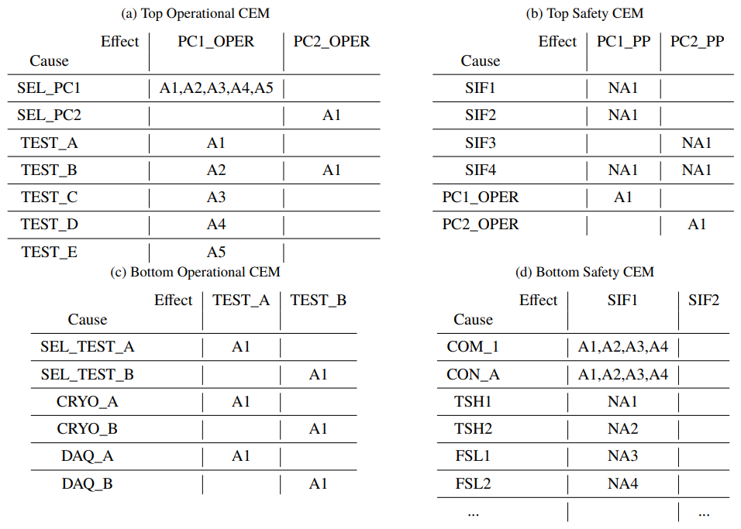
SM18 cluster F – formalized requirements
Both operational and safety requirements are specified using the
“Cause and Effect Matrix” formalism
More details about CEM: http://icalepcs2019.vrws.de/papers/mopha041.pdf

Slide 19
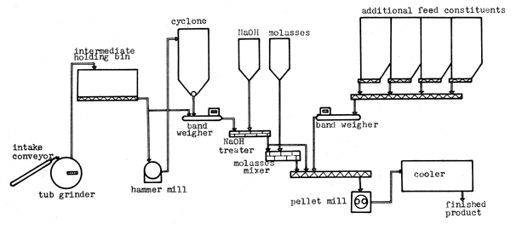


SM18 cluster F – model checking
Given a global model of the system and a formal property, the model checking algorithm checks exhaustively that the model meets the property
Clarke and Emerson (1982) and Queille and Sifakis (1982)
Specifications
Formal
model
Formal requirement
Real System
(hardware, software)
Automata, Timed automata, Petri nets, etc.
Temporal Logic
Model Checker
✗
✓
Property failed
Trace leading to the violation
Property OK

Slide 20
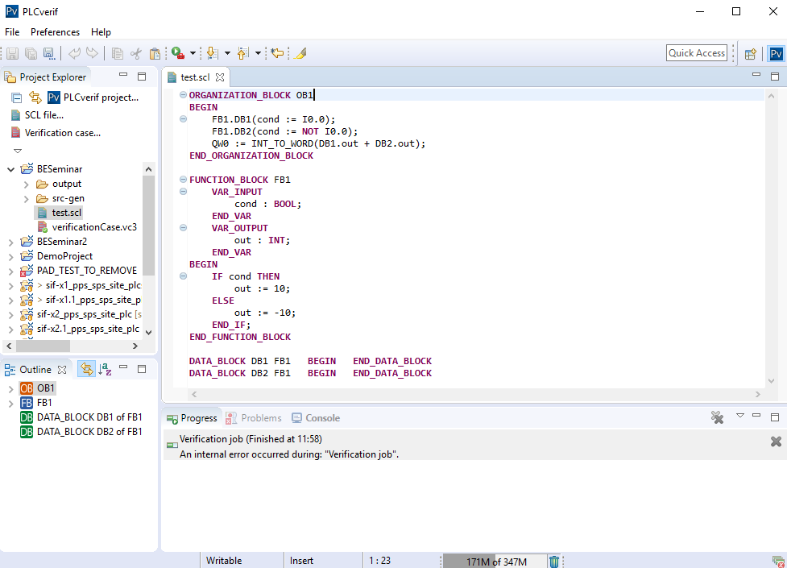
SM18 cluster F – model checking for PLC programs PLCverif (https://cern.ch/plcverif)
By introducing the PLC program, PLCverif automatically creates the formal model

Slide 21
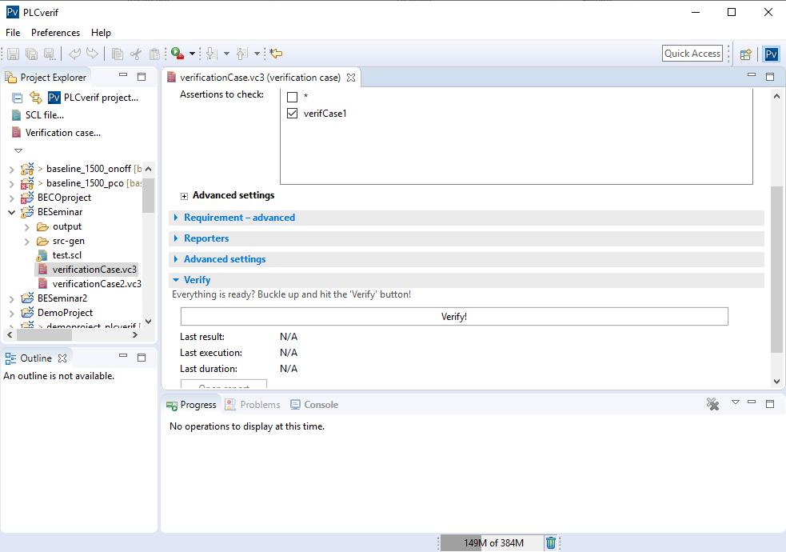

SM18 cluster F – model checking for PLC programs PLCverif (https://cern.ch/plcverif)
Verification cases automatically generated from the CEM

Slide 22
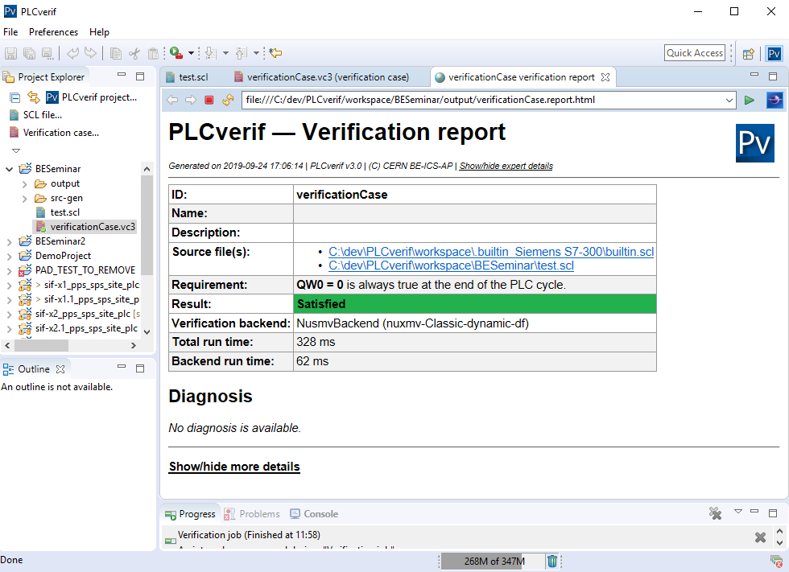
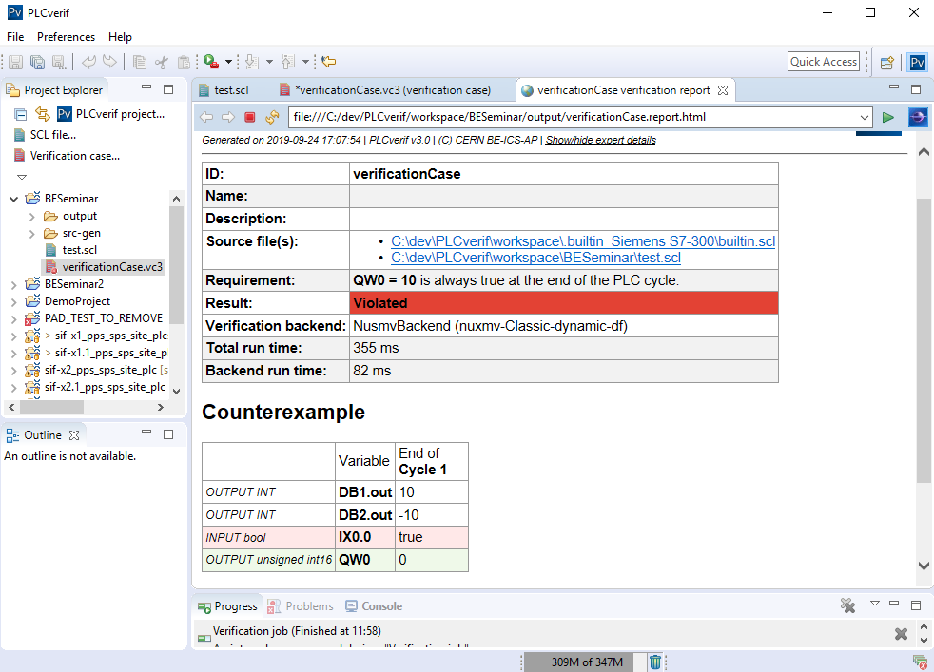
SM18 cluster F – model checking for PLC programs PLCverif (https://cern.ch/plcverif)
The verification results are presented in the verification report

Slide 23
Outline
Overview of the SM18 cluster F control and safety systems
Impact of the power converters reliability
Comparison with the LHC Powering Interlock System (PIC)

Slide 24
Why the reliability information of the PC “Safety Chain”?
It will help us to take better decisions on the mitigation proposals of the risk analysis (the different layers of protection)
Functional Safety Report - we can claim that our design and developments meet the requirements according to the IEC 61511 standard
Other measures (e.g. access control)
Safety Instrumented system (IEC 61508 and IEC 61511)
Basic Process Control system
(interlock)

Slide 25
How can we meet the SIL requirements for the PCs?
For the random hardware failures: MTTF, failure rate (for a specific failure mode)
  How? Modeling with ISOGRAPH? Failure records at CERN (Fault Tracking System)? Both?
For the architectural constrains:
  Route 1H: Safe Failure Fraction (SFF) and Hardware Fault Tolerance (HFT)
  Route 2H: Proven in use
For the systematic failure analysis:
  Route 1S: requirements for of avoidance and control of systematic faults
  Route 2S: Proven in use
  Route 3S: (pre-existing software elements)
Fault detection possible?
Communications? Black or white channel
Software involved? Model checking for VHDL (FPGAs), software testing techniques…

Slide 26
Conclusions
The “safety chain” of the power converters (fast abort, power permit or main circuit breaker commands) is part of the “safety actions” of many safety systems at CERN - both for personnel (e.g. SM18) and machine protection (e.g. LHC)
If we aim to follow the recommended standards and develop a safety instrumented system (IEC 61511, IEC 61508, etc.), a safety analysis of the PC “safety chain” should be done (including hardware, software, systematic failures, etc.)
If we don’t follow the standards and develop a “standard interlock system” (+ other protection layers), the safety and reliability studies don’t need to be that strict/detailed (?) - TBD

Slide 27
Outline
Overview of the SM18 cluster F control and safety instrumented system
Impact of the power converters reliability
Comparison with the LHC Powering Interlock System (PIC)

Slide 28
“SM18 cluster F” and “LHC PIC” differences
Analysis regarding the following points:
Hardware
Functionality
Software

Slide 29
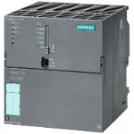


SM18 cluster F - PIC regarding hardware architecture
SM18 cluster F interlock
PIC
WinCCOA
WinCCOA
S7
S7
S7-317F
PLC
S7-319
PLC
Redundant hardware
for the critical parts?
Profisafe
Profibus
Beam dump
AnyBus board
Standard
relay
Safety
relay
optocoupler
optocoupler
Power Permit
command
MCB
command
Power Permit
loop
Fast abort
command

Slide 30
SM18 cluster F - PIC regarding software packages
SM18 cluster F interlock
PIC
SCADA packages
WinCCOA + UNICOS CPC
Generic package
PLC program
Operational requirements and non-critical interlocks: UNICOS and SCL language
Safety Functions (SIFs): LADDER
Specific PLC program for each SM18 test facility (they all use UNICOS but the logic is specific for each project)
SCADA packages
WinCCOA + UNICOS PIC
LHC specific logic (mainly related to the start interlock conditions )
PLC program
Mostly using STL language (SCL is used for minor parts of the code)
Generic PLC program for all the PICs (all PIC PLC run the same logic with a specific configuration)

Slide 31
SM18 cluster F - PIC regarding functionality
SM18 cluster F interlock
PIC
Operational requirements (Test type, Bench and PC selection)
Start interlock conditions (all conditions in the PLC)
Stop interlock conditions:
The “less critical conditions” implemented as a “Basic Process Control System” (interlock system)
The “more critical conditions” implemented as “Safety Instrumented Functions” (IEC 61511 standard)
Deals with Personnel and Machine protection
Monitors the following systems: PCs status, Current leads, Water-cooled cables, commutators, safety matrix, EE, uQPS, Flash box, AUG and Cryo
Safety Action: signal to the power permit and the MCB (command sent “x” seconds after the power permit)
No operational requirements (only the “allow to start command” and “manual stop command”?)
Start interlock conditions (all conditions in the SCADA)
Stop interlock conditions
All of them implemented as a “Basic Process Control System” (interlock control system)
Deals only with Machine protection?
Monitors the following systems: PCs status, status of up to 54 circuits, UPS status, AUG, Quench propagation and Cryo
Safety Action: signal to the power permit (slow abort) and fast abort

Slide 32
SM18 cluster F
Monitoring signals | Actions
PCs feedback: Current Status MCB status Current Leads: Temperature Voltage Water-cooled cables: Flow Temperature Commutators position feedbacks Safety Matrix feedback Energy Extraction (EE) Switch feedbacks: Position Request feedback to the PCs Flash box feedback “QPS OK” feedback “Cryo OK” feedback Emergency stop | Information to Cryo controls: Quench Current Active bench Power Converters (PCs): Power Permit command Fast abort command Main Circuit Breaker (MCB) command Quench Protection System (QPS): QPS open/close command EE order: QPS open/close command Flash box command PC 20K Fan command

Slide 33
Power Interlock Controller (PIC)
Courtesy of
I. Romera
Overview
Cryostat
DFB
Magnet
Magnet
…
QPS
PIC
PC_PERMIT
PC
Magnet
POWERING_FAILURE
CIRCUIT_QUENCH
PC_FAST_ABORT
DISCHARGE_REQUEST
PC_DISCHARGE_REQUEST
All conditions met for powering: PC_PERMIT
Sum of internal converter faults: POWERING_FAILURE
Magnet quench or Fast Abort from PIC: PC_FAST_ABORT
Loss of coolant: PC_DISCHARGE_REQUEST
Up to 54 circuits / PIC

Slide 34




Power Interlock Controller (PIC)
Courtesy of
I. Romera
Overview (2)
Cryostat
DFB
Magnet
Magnet
Magnet
…
QPS
PIC
PC_PERMIT
PC
POWERING_FAILURE
CIRCUIT_QUENCH
PC_FAST_ABORT
DISCHARGE_REQUEST
PC_DISCHARGE_REQUEST
In addition to circuit/circuit treatment, global interlocks will provoke runtime aborts of ALL circuits in a subsector. Exchanged via hardware or between PLC-PLC
CRYO_MAINTAIN
AUG_OK
UPS_OK
Quench_propagation

Slide 35
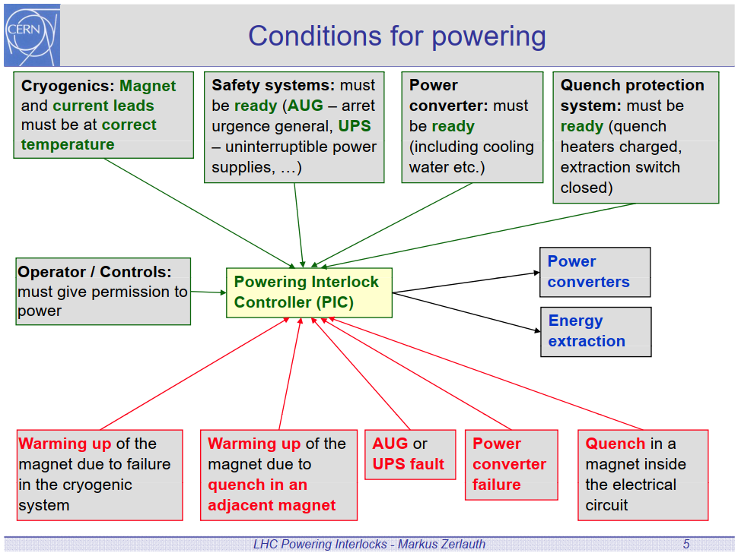

Slide 36
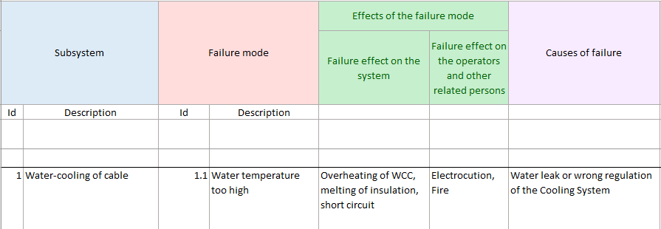
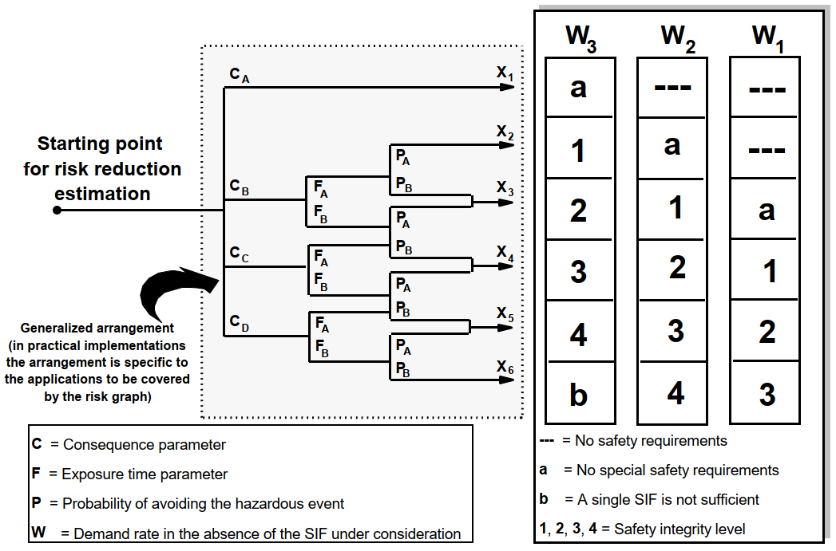
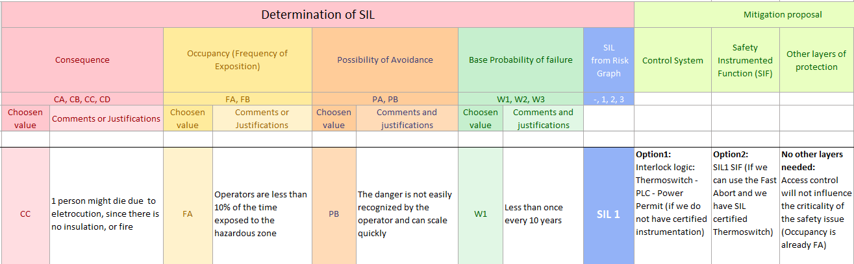
SM18 cluster F – FMEA risk analysis and risk graph method
(IEC 61508-5 Annex E and IEC 61511-3 Annex D)

Slide 37
Why the reliability information of the PC “Safety Chain”?
It will help us to take better decisions on the mitigation proposals of the risk analysis: SIS vs BPCS
Consider the following example:
Outcome of the risk analysis: SIL2 target
Scenario 1: If the PC “safety chain” meets the SIL2 requirements (and the rest of the devices), then there is no need for any extra layer of protection (e.g. Basic Process Control Systems or Access control)
Scenario 2: If the PC “safety chain” meets the SIL1 requirements, then extra layer of protection is needed (e.g. Basic Process Control Systems or Access control)
Scenario 3: If the PC “safety chain” does not meet any of the SIL requirements, then no SIL can be achieved. It does not make any sense to use a Safety PLC, neither to follow the IEC 61511 and IEC 61508 standards)
  In this case, reliability information (MTTF, failure) would be still useful – e.g. preventive maintenance of the BPCS.
Functional Safety Report - we can claim a consistent design according to the IEC 61511 standard

Slide 38

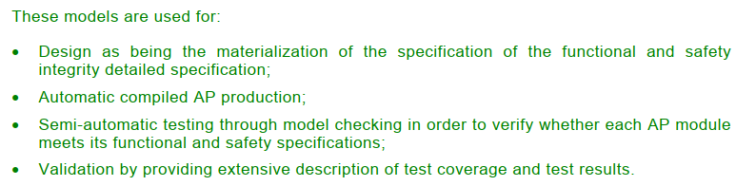
SM18 cluster F - software
IEC 61508-3(2010). Software requirements
IEC 61511 -1. Clause 12. SIS application program development
IEC 61511-2 Annex A and Annex B.
IEC 61511-2 Annex A.10
Recommends the use of the logic diagrams, CEM … and model checking techniques
IEC 61511-2 Annex B.2
IEC 61511-2 Annex B.4.3.3

Slide 39
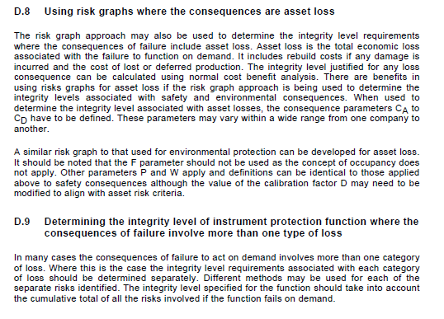
SIL for Machine protection

