Slide 1

PyMASK
G. Iadarola, G. Sterbini
Many thanks to:
R. De Maria, S. Fartoukh, F. Van Der Veken, S. Kostoglou

Slide 2
Outline
Introduction and motivation
  The cpymad interface to MAD-X
pymask
  The approach
  Handling different knob naming conventions
  Configuration of the beam beam interactions
  Structure of the code
  Configuration of the anticlockwise beam (b4)
  Online resources (repository, documentation, examples)
  First experience

Slide 3
Introduction
Traditionally, a “mask file” is a MAD-X script used to build a model of the LHC ring and then generate the corresponding input for tracking simulations (sixtrack)
As described at the Beam-beam and Luminosity Studies Meeting on 28 Feb 2020, to improve its usability and maintainability, the code has been recently split in separate MAD-X scripts for the different functionalities (modules)
Tracked in a git repository (https://github.com/lhcopt/lhcmask/)
Documented in a dedicated website (http://cern.ch/lhcmask)
Here we present a further evolution, which goes beyond the pure MAD-X environment, to handle more advanced simulation scenarions.

Slide 4
Motivation
Recent study cases highlighted limitations of existing mask files that cannot be easily overcome using the the conventional MAD-X scripting:
Difficulty in handling sequences with opposite orientations (b1 and b4) within the same MAD-X environment
Difficulty in storing and handling strings (using knob names as parameters, manipulate file paths, implementing logics on sequence or element names)
Impossibility to allocate and manipulate arrays (e.g. bunch-by-bunch intensities, locations of beam-beam encounters), etc.
Difficulty to profit from interactive development, debuggers, general purpose libraries (FFT, advanced plotting, optimization, special functions etc.)
These issues were addressed by integrating MAD-X with a more powerful programming language
The natural choice is python, which has become a standard for numerical computing and data analysis at CERN and in the world

Slide 5
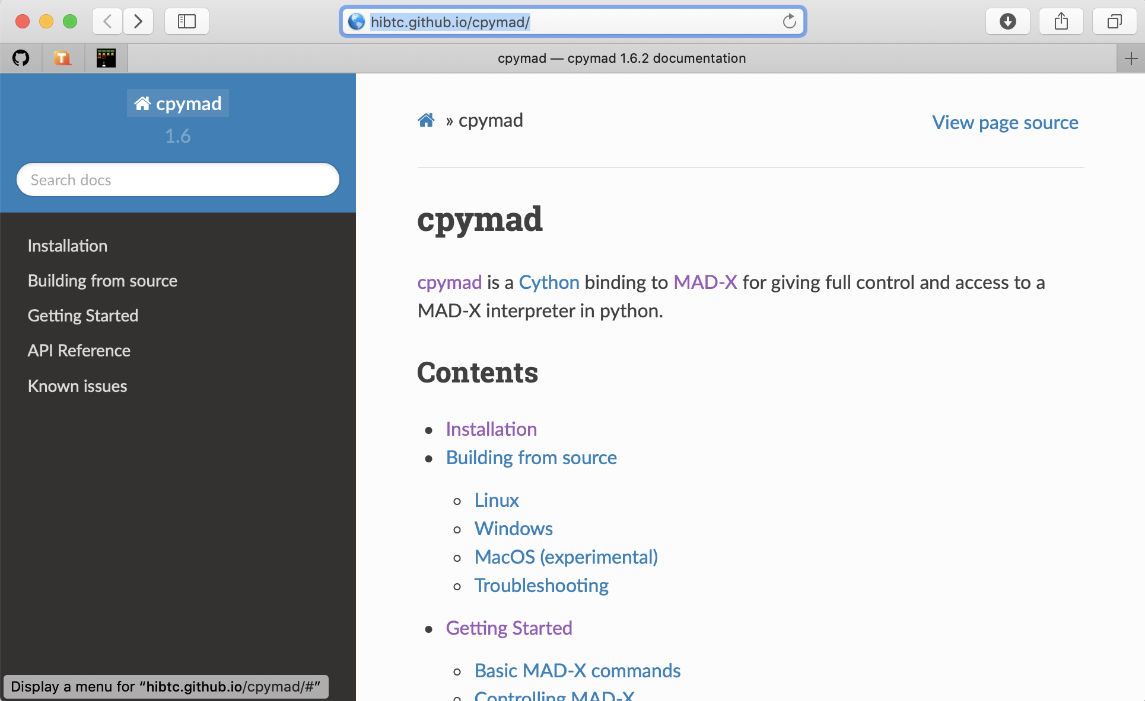
Interfacing MAD-X and python with cpymad
Efforts to integrate MAD-X with python date back to 2011 and led to the development of the cpymad library which provides python bindings to MAD-X.
By now the library is quite mature:
Rather robust (python is never crashed by MAD-X)
Reasonably efficient for the cases of interest
Complete and intuitive interface
Well documented and supported - presently developed at HIT (mainly) and at CERN
Some references:
[1] K. Fuchsberger, Y. Levinsen, “PyMad – Integration of MadX in python”, WEPC119, IPAC11
[2] R. Cee, T. Gläßle, et al. A MAD-X Model of the HIT Accelerator, MOPME010, IPAC2014
[3] http://hibtc.github.io/cpymad/

Slide 6
cpymad – how does it work
MAD-X variables, expressions, sequences and elements are accessible (read/write) in a pythonic way:
An instance of MAD-X is a python object:
from cpymad.madx import Madx
mad = Madx()
mad.globals.on_sep8 = 1
mad.elements['mqml.6l1.b2'].knl = [0, 2e-3]
The usual MAD-X syntax can be used:
mad.input('a = 10;’) # Variable assignment
mad.input('b := 2*a;’) # Def. expression
# Call a mad-x script
mad.input('call, file="optics.madx";’)
# Inject python variables into MAD-X command
qx = 62.31; qy = 60.32
mad.input(f'’’
match;
global, q1={qx}, q2={qy};
vary, name=kqtf, step=1.0E-7 ;
vary, name=kqtd, step=1.0E-7 ;
lmdif, calls=500, tolerance=1.0E-21; endmatch;
''')
Pythonic access to MAD-X tables (no need to parse text files!)
mad.twiss()
tw = mad.table.twiss
plot(tw.s, tw.betx)
Multiple MAD-X instances can be handled within the same python environment:
# Create two instances
mad1 = Madx()
mad2 = Madx()
[...]
# They can interact through python
mad2.globals.a = 2 * mad1.globals.b
These simple features allow accessing all functionalities of MAD-X in python and to combine them with other python packages to obtain very poweful solutions (more in Guido’s slides).

Slide 7
Outline
Introduction and motivation
  The cpymad interface to MAD-X
pymask
  General approach
  Handling different knob naming conventions
  Configuration of the beam beam interactions
  Structure of the code
  Configuration of the anticlockwise beam (b4)
  Online resources (repository, documentation, examples)
  First experience

Slide 8
pymask – general approach
The main file is a python program which controls one or more instances of MAD-X via cpymad:
Some parts of the old mask, for which we are satisfied with the possibilities offered by the legacy MAD-X code, are left untouched and the MAD-X code is simply called
Other parts for which we were limited by the shortcomings of MAD-X scripting, are restructured and handled directly in python
  All capabilities of the legacy mask file are kept
  More features are added
The simulation can be defined by the following three files:
pymask.py: is the main executable. For standard simulation scenarios, it can be left untouched
config.py: defines the simulation settings and parameters.
optics_specific_tools.py: containing the small set of functions that need to be different when changing machine (LHC/HL-LHC) or optics

Slide 9
pymask – configuration
The configuration file (config .py) consists in a python dictionary with settings and configuration (structure is very flexible)
configuration = {
[...]
# Optics file
'optics_file’: ('/afs/cern.ch/eng/lhc/'
+ 'optics/HLLHCV1.4/round'
+ '/opt_round_150_1500_thin.madx’),
# Enable checks
'check_betas_at_ips' : True,
'check_separations_at_ips' : True,
'save_intermediate_twiss' : True,
# Tolerance for check on flat machine
'tol_co_flatness' : 1e-6,
# Beam parameters
'beam_norm_emit_x' : 2.5, # [um]
'beam_norm_emit_y' : 2.5, # [um]
'beam_sigt' : 0.076, # [m]
'beam_sige' : 1.1e-4, # [-]
'beam_npart' : 2.2e11, # [-]
'beam_energy_tot' : 7000, # [GeV]
[...]
# Tunes and chromaticities
'qx0' : 62.31,
'qy0' : 60.32,
'chromaticity_x' : 5., # [-]
'chromaticity_y' : 5., # [-]
# RF voltage
'vrf_total' : 16., # [MV]
# Octupole current
'oct_current' : -235, # [A]
# Luminosity parameters
'enable_lumi_control' : True,
'sep_plane_ip2' : 'x’,
'sep_plane_ip8' : 'y’,
'lumi_ip8' : 2e33, # [Hz/cm2] 'fullsep_in_sigmas_ip2': 5,
knob_naming = {[...]}
knob_settings = {[...]}
[...]
}
pymask includes checks on optics and knob self consistency (not present in MAD-X mask)

Slide 10
Outline
Introduction and motivation
  The cpymad interface to MAD-X
pymask
  The approach
  Handling different knob naming conventions
  Configuration of the beam beam interactions
  Structure of the code
  Configuration of the anticlockwise beam (b4)
  Online resources (repository, documentation, examples)
  First experience

Slide 11
Handling different knob naming convention
The proliferation of versions and “quasi-copies” of the old mask (a nightmare to propagate bug fixes) was largely caused by the need of adapting to different knob naming conventions for different optics
Pymask file is intead built to be independent on the specific knob naming (exact same code is used for LHC Run 3 and HL-LHC optics):
Closed orbit is configured by a user-provided list of knobs (the mask is agnostic w.r.t. naming)
Macros (crossing_save, crossing_disable, crossing_restore) are used to switch to flat orbit and back, as already done in the most recent versions of the MAD-X mask
For LHC Run 3 optics
For HL-LHC
'knob_settings': {
'on_x1’ : 150, # [urad]
'on_sep1' : 0, # [mm]
'on_x2h' : 0, # [urad]
'on_x2v' : 200, # [urad]
'on_sep2h' : 1.0, # [mm]
'on_sep2v' : 0, # [mm]
'on_x5' : 150, # [urad]
'on_sep5' : 0, # [mm]
'on_x8h' : -250, # [urad]
'on_x8v’ : 0, # [urad]
'on_sep8h' : 0., # [mm]
'on_sep8v' : -1.0, # [mm]
[...]
},
'knob_settings': {
'on_x1' : 250, # [urad]
'on_sep1' : 0, # [mm]
'on_x2' : -170, # [urad]
'on_sep2' : 0.138, # [mm]
'on_x5' : 250, # [urad]
'on_sep5' : 0, # [mm]
'on_x8' : -250, # [urad]
'on_sep8' : -0.043, # [mm]
[...]
},

Slide 12
Handling different knob naming convention
The proliferation of versions and “quasi-copies” of the old mask (a nightmare to propagate bug fixes) was largely caused by the need of adapting to different knob naming conventions for different optics
Pymask file is intead built to be independent on the specific knob naming (exact same code is used for LHC Run 3 and HL-LHC optics):
Closed orbit is configured by a user-provided list of knobs (the mask is agnostic w.r.t. naming)
Macros (crossing_save, crossing_disable, crossing_restore) are used to switch to flat orbit and back, as already done in the most recent versions of the MAD-X mask
For knobs that need to be directly set by the mask, naming convention is provided in input
For LHC Run 3 optics
For HL-LHC
'knob_names' : {
'qknob_1':{'lhcb1':'dQx.b1_sq’,
'lhcb2':'dQx.b2_sq'}, 'qknob_2':{'lhcb1':’dQy.b1_sq’,
'lhcb2':’dQy.b2_sq'}, 'chromknob_1':{'lhcb1':'dQpx.b1_sq’,
'lhcb2':'dQpx.b2_sq’},
chromknob_2':{'lhcb1':'dQpy.b1_sq’,
'lhcb2':'dQpy.b2_sq’}, 'cmrknob':{'lhcb1':'CMRS.b1_sq','lhcb2':'CMRS.b2_sq’}, 'cmiknob':{'lhcb1':'CMIS.b1_sq','lhcb2':’CMIS.b2_sq’},
},
'knob_names' : {
'qknob_1':{'lhcb1':'kqtf.b1’,
'lhcb2':'kqtf.b2'}, 'qknob_2':{'lhcb1':'kqtd.b1’,
'lhcb2':'kqtd.b2'}, 'chromknob_1':{'lhcb1':'ksf.b1’,
'lhcb2':'ksf.b2'}, 'chromknob_2':{'lhcb1':'ksd.b1’,
'lhcb2':'ksd.b2'}, 'cmrknob':{'lhcb1':'cmrskew','lhcb2':'cmrskew'}, 'cmiknob':{'lhcb1':'cmiskew','lhcb2':'cmiskew'}, },

Slide 13
Outline
Introduction and motivation
  The cpymad interface to MAD-X
pymask
  The approach
  Handling different knob naming conventions
  Configuration of the beam beam interactions
  Structure of the code
  Configuration of the anticlockwise beam (b4)
  Online resources (repository, documentation, examples)
  First experience

Slide 14
Configuration of beam-beam interactions
The MAD-X macros to configure the beam-beam interactions in the legacy mask have the following limitations:
They are not usable for the anticlockwise beam (b4)
They are difficult to extend to a general filling scheme
They are difficult to extend to handle bunch-by-bunch differences in intensity or emittances
The management of the beam-beam interactions in pymask is fully restructured and handled directly in python in order to allow these features
The procedure to configure the beam-beam elements from the MAD-X model is documented in this note (containing all assumptions and sign conventions)

Slide 15
Outline
Introduction and motivation
  The cpymad interface to MAD-X
pymask
  The approach
  Handling different knob naming conventions
  Configuration of the beam beam interactions
  Structure of the code
  Configuration of the anticlockwise beam (b4)
  Online resources (repository, documentation, examples)
  First experience

Slide 16
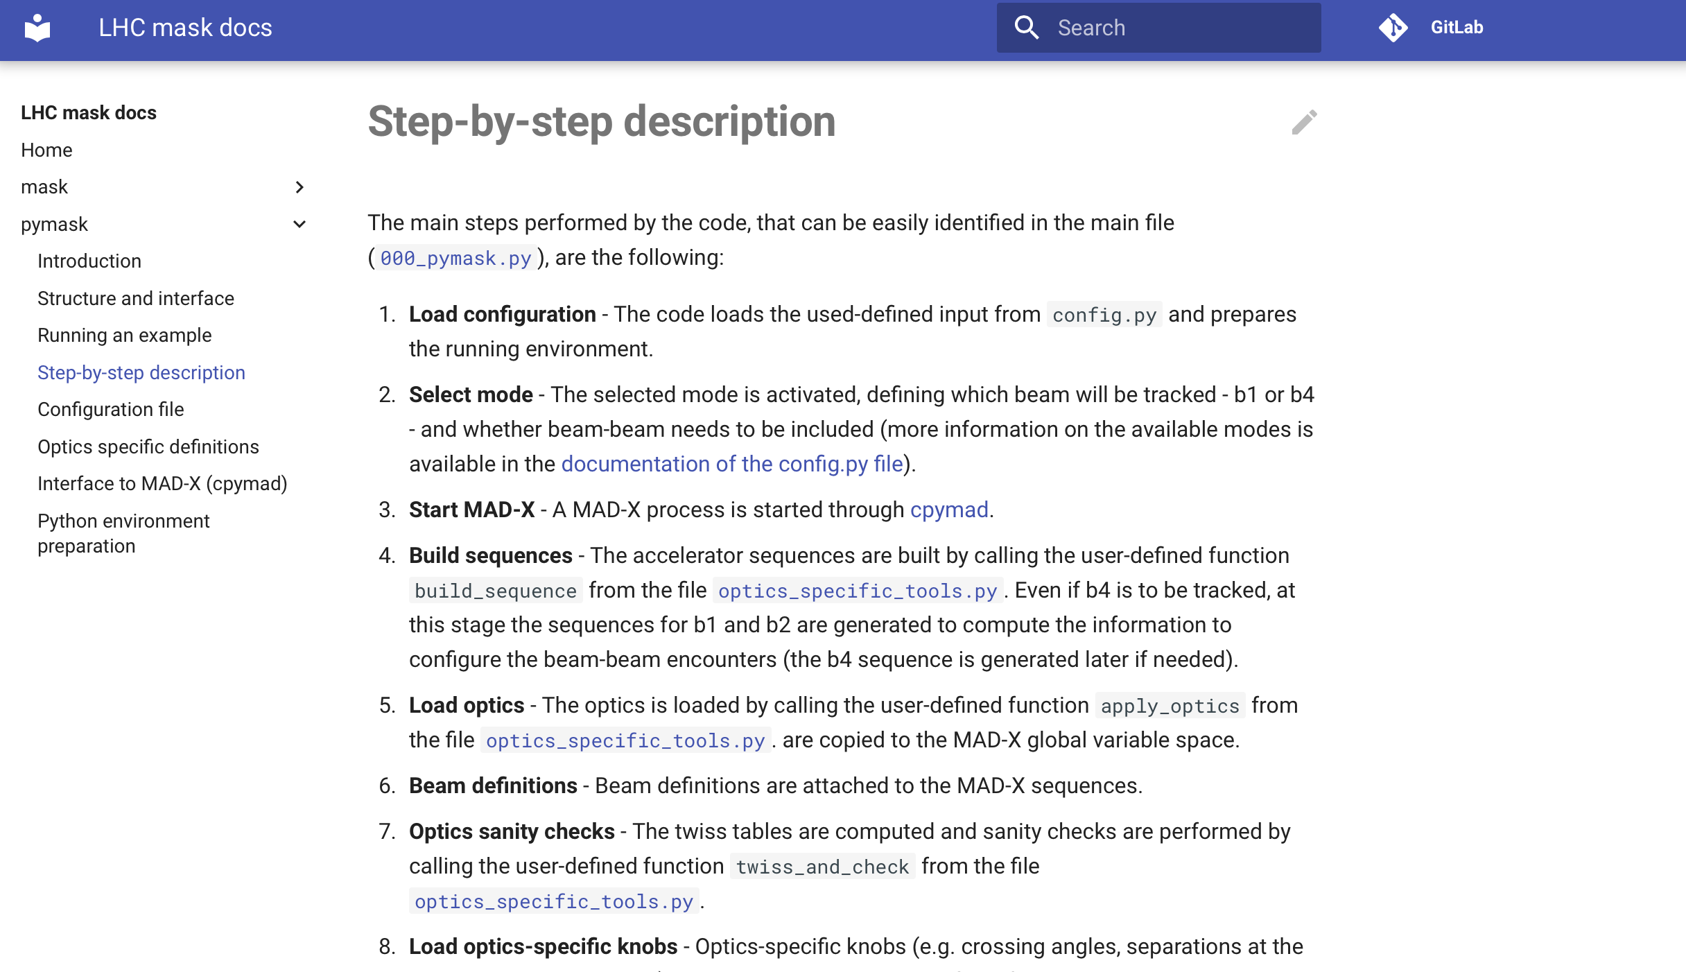
How does it work
A detailed step-by-step description of the code is available in the documentation pages
a sympified schematic is presented in the following

Slide 17
How does it work (b1)
MAD instance 1
As already mentioned, the “outside shell” is a python program in which cpymad is used to launch an intance of MAD-X controlled via python
Python

Slide 18
How does it work (b1)
MAD instance 1
As already mentioned, the “outside shell” is a python program in which cpymad is used to launch an intance of MAD-X controlled via python
The MAD-X model of the collider is built including the two clockwise sequences (B1 and B2)
Python
Build sequences (B1 and B2)
Load optics
Define beams
Sequences: B1 and B2
Set orbit knobs
(angles, separations, leveling etc.)

Slide 19
How does it work (b1)
MAD instance 1
As already mentioned, the “outside shell” is a python program in which cpymad is used to launch an intance of MAD-X controlled via python
The MAD-X model of the collider is built including the two clockwise sequences (B1 and B2)
Twiss and survey are performed for the two sequences
Python
Build sequences (B1 and B2)
Load optics
Define beams
Sequences: B1 and B2
Set orbit knobs
(angles, separations, leveling etc.)
Twiss and survey

Slide 20
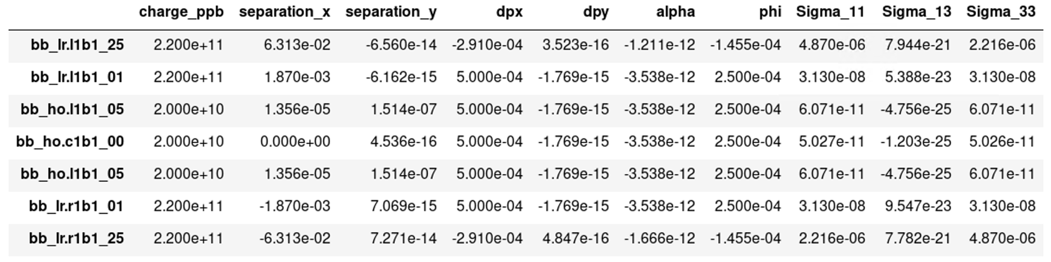
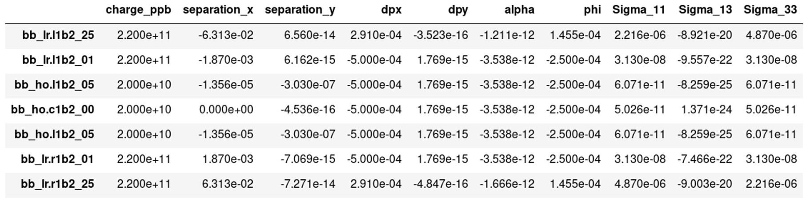
How does it work (b1)
We build tables with the info on the beam-beam interactions using twiss and survey results:
This stage is performed entirely in python
The tables are handled as pandas dataframes (standard approach for the manipulation data)
The tables can be edited to customize the simulation (e.g. with bbb intesities and emittances)
MAD instance 1
Python
Build sequences (B1 and B2)
Load optics
Define beams
Sequences: B1 and B2
Set orbit knobs
(angles, separations, leveling etc.)
Twiss and survey
Compute beam-beam tables
(locations, separations, sigmas)
BB table B1
BB table B2

Slide 21
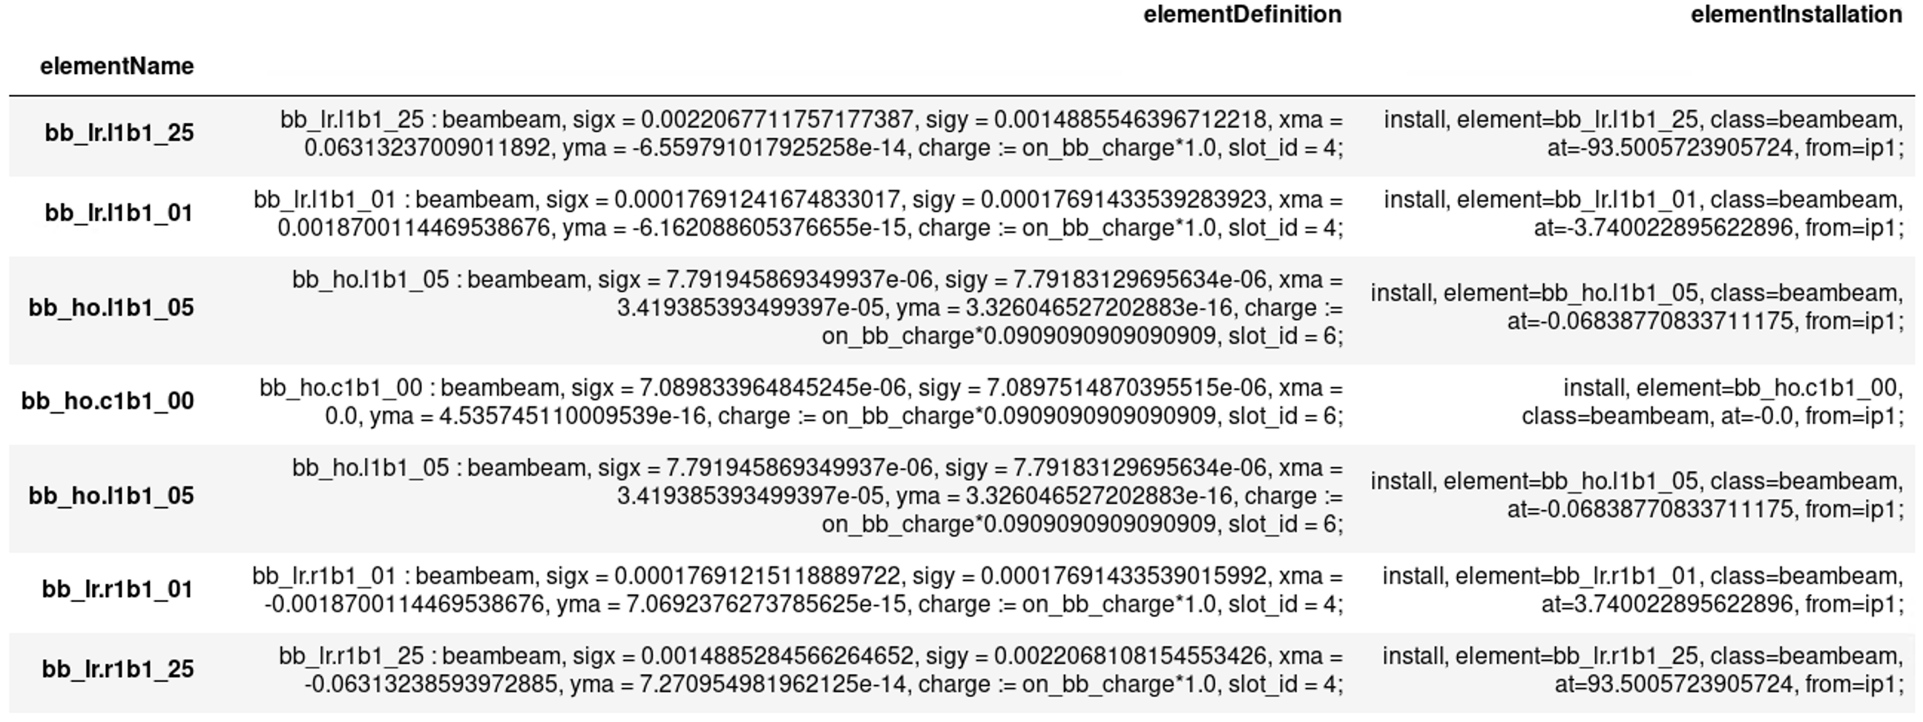
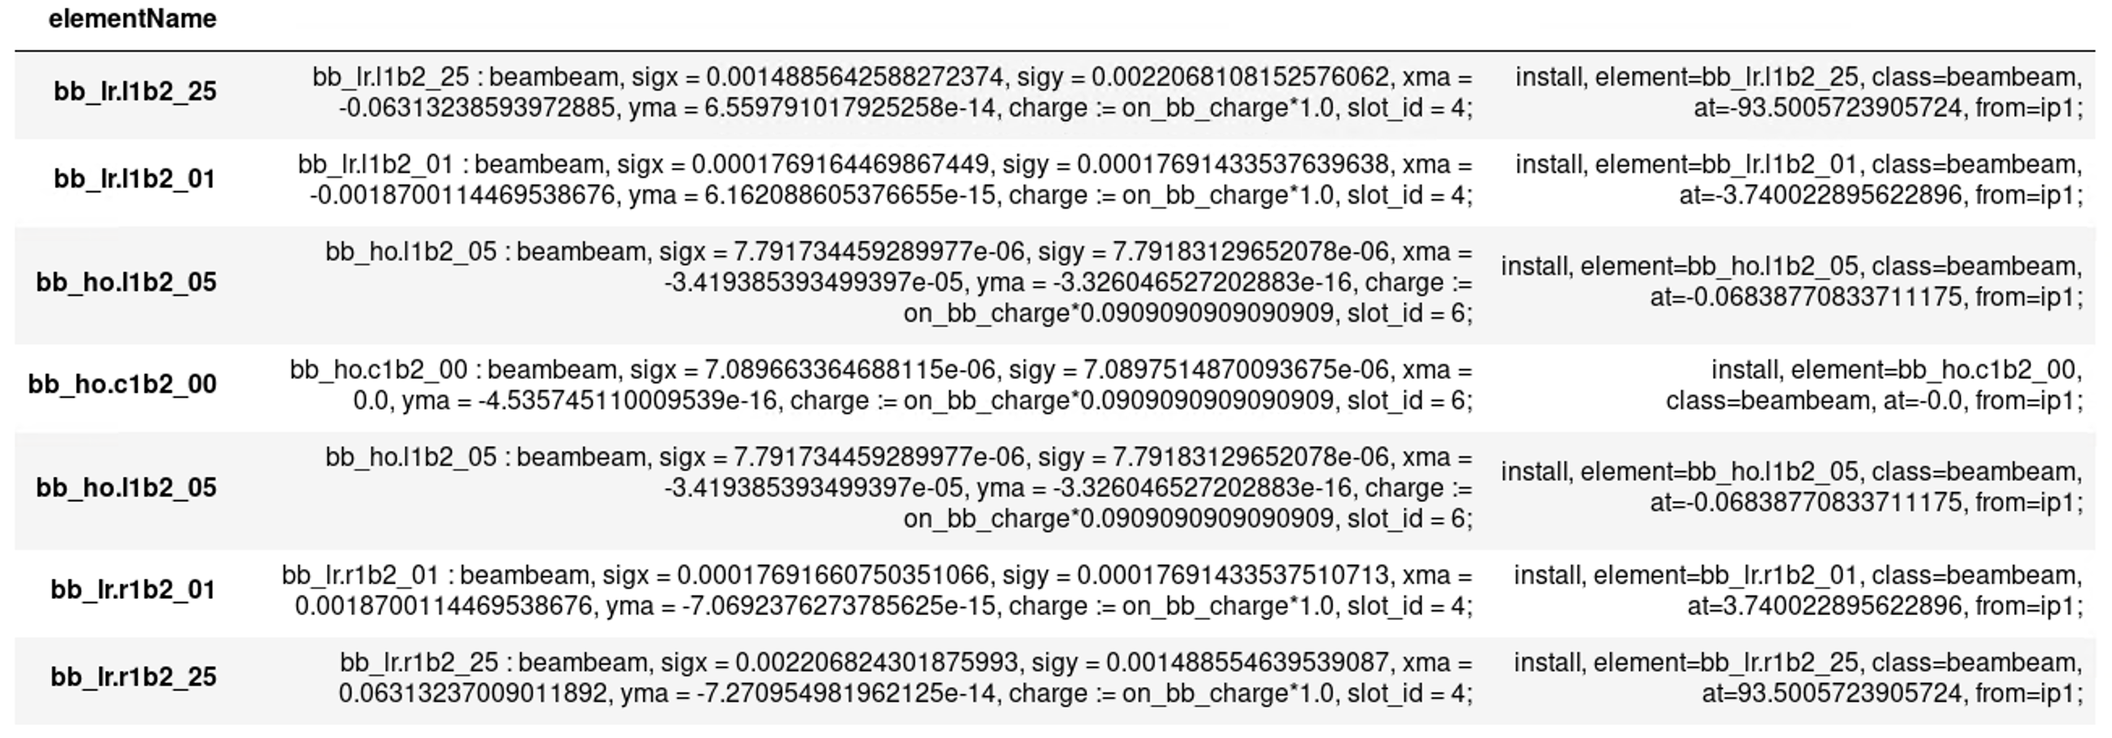
How does it work (b1)
MAD instance 1
Definition and installation commands of MAD-X beam-beam lenses are easily generated in python (using pandas)
Python
Build sequences (B1 and B2)
Load optics
Define beams
Sequences: B1 and B2
Set orbit knobs
(angles, separations, leveling etc.)
Twiss and survey
Compute beam-beam tables
(locations, separations, sigmas)
BB table B1
BB table B2

Slide 22
How does it work (b1)
MAD instance 1
From this point we drop the B2 sequence and work exlusively on b1 (beam to be tracked):
Beam-beam lenses are installed in the sequence using commands in the tables
Reference quantities like betas and orbit at the IPs are saved (with bb off)
Machine imperfections are installed, and corrections are introduced
Orbit, coupling, tunes, chromaticities are corrected
The Sixtrack input is generated by MAD-X and the beam-beam part in fort.3 generated in python from the bb tables
Python
Build sequences (B1 and B2)
Load optics
Define beams
Sequences: B1 and B2
Set orbit knobs
(angles, separations, leveling etc.)
Twiss and survey
Compute beam-beam tables
(locations, separations, sigmas)
Install beam-beam lenses in MAD-X sequences
BB table B1
BB table B2
Measure references for
re-matchings
Sequence: B1
Install and correct
machine imperfections
Match orbit, coupling, tunes, and chromaticities
Generate B1 sixtrack input

Slide 23
Outline
Introduction and motivation
  The cpymad interface to MAD-X
pymask
  The approach
  Handling different knob naming conventions
  Configuration of the beam beam interactions
  Structure of the code
  Configuration of the anticlockwise beam (b4)
  Online resources (repository, documentation, examples)
  First experience

Slide 24
How does it work (b4)
MAD instance 1
Python
Build sequences (B1 and B2)
Load optics
The anticlockwise beam (B4) is handled by opening a second instance of MAD-X within the same python environment.
Define beams
Sequences: B1 and B2
Set orbit knobs
(angles, separations, leveling etc.)
Twiss and survey
Compute beam-beam tables
(locations, separations, sigmas)
Install beam-beam lenses in MAD-X sequences
BB table B1
BB table B2
Measure references for
re-matchings
Sequence: B1
Install and correct
machine imperfections
Match orbit, coupling, tunes, and chromaticities
Generate B1 sixtrack input

Slide 25
How does it work (b4)
MAD instance 1
MAD instance 2
Python
Build sequences (B1 and B2)
Build sequence (B4)
Load optics
The anticlockwise beam (B4) is handled by opening a second instance of MAD-X within the same python environment.
Define beams
Sequences: B1 and B2
Set orbit knobs
(angles, separations, leveling etc.)
Twiss and survey
Compute beam-beam tables
(locations, separations, sigmas)
Install beam-beam lenses in MAD-X sequences
BB table B1
BB table B2
Sequence: B4
Measure references for
re-matchings
Sequence: B1
Install and correct
machine imperfections
Match orbit, coupling, tunes, and chromaticities
Generate B1 sixtrack input

Slide 26
How does it work (b4)
MAD instance 1
MAD instance 2
Python
Build sequences (B1 and B2)
Build sequence (B4)
All MAD-X the variables are transferred from the first to the second instance via python
Load optics
Define beams
Transfer
beam, knobs, variables
Sequences: B1 and B2
Optics, beam and orbit knobs
from twin MAD-X instance
Set orbit knobs
(angles, separations, leveling etc.)
this automatically configures optics and orbit of B4 based on the configuration of B2 (including angles, seperations etc.)
Twiss and survey
Compute beam-beam tables
(locations, separations, sigmas)
Install beam-beam lenses in MAD-X sequences
BB table B1
BB table B2
Sequence: B4
Measure references for
re-matchings
Sequence: B1
Install and correct
machine imperfections
Match orbit, coupling, tunes, and chromaticities
Generate B1 sixtrack input

Slide 27
How does it work (b4)
MAD instance 1
MAD instance 2
Python
Build sequences (B1 and B2)
Build sequence (B4)
Load optics
Define beams
Transfer
beam, knobs, variables
Sequences: B1 and B2
Optics, beam and orbit knobs
from twin MAD-X instance
Set orbit knobs
(angles, separations, leveling etc.)
Twiss and survey
Compute beam-beam tables
(locations, separations, sigmas)
Install beam-beam lenses in MAD-X sequences
BB table B1
BB table B2
Sequence: B4
Measure references for
re-matchings
Sequence: B1
Install and correct
machine imperfections
The beam-beam tables for the anticlockwise beams (b3 b4) can be generated in python from those of the clockwise beams
→ it’s a simple reference frame transformation
Match orbit, coupling, tunes, and chromaticities
Generate B1 sixtrack input

Slide 28
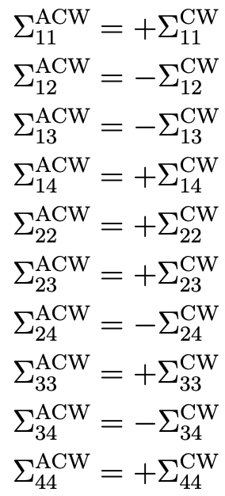
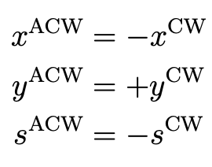
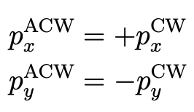
How does it work (b4)
Coordinate transformations
Σ-matrix
MAD instance 1
MAD instance 2
Python
Build sequences (B1 and B2)
Build sequence (B4)
Positions
Momenta
Load optics
Define beams
Transfer
beam, knobs, variables
Sequences: B1 and B2
Optics, beam and orbit knobs
from twin MAD-X instance
Set orbit knobs
(angles, separations, leveling etc.)
Twiss and survey
Compute beam-beam tables
(locations, separations, sigmas)
Install beam-beam lenses in MAD-X sequences
BB table B1
BB table B2
Sequence: B4
Measure references for
re-matchings
Reference frame transformations
Sequence: B1
BB table B3
BB table B4
Install and correct
machine imperfections
The beam-beam tables for the anticlockwise beams (b3 and b4) can be generated in python from those of the clockwise beams
→ it’s a simple reference frame transformation
Match orbit, coupling, tunes, and chromaticities
Generate B1 sixtrack input

Slide 29
How does it work (b4)
MAD instance 1
MAD instance 2
Python
Build sequences (B1 and B2)
Build sequence
Load optics
Define beams
Transfer
beam, knobs, variables
Sequences: B1 and B2
Optics, beam and orbit knobs
from twin MAD-X instance
Set orbit knobs
(angles, separations, leveling etc.)
Twiss and survey
Compute beam-beam tables
(locations, separations, sigmas)
Install beam-beam lenses in MAD-X sequences
Install beam-beam lenses in MAD-X sequences
BB table B1
BB table B2
Sequence: B4
Measure references for
re-matchings
Reference frame transformations
Measure references for
re-matchings
Sequence: B1
BB table B3
BB table B4
Install and correct
machine imperfections
Install and correct
machine imperfections
Match orbit, coupling, tunes, and chromaticities
Once BB tables are available the next steps are the same as for B1
Correct Coupling/Tunes/Chrom’s
Generate B1 sixtrack input
Generate B4 sixtrack input

Slide 30
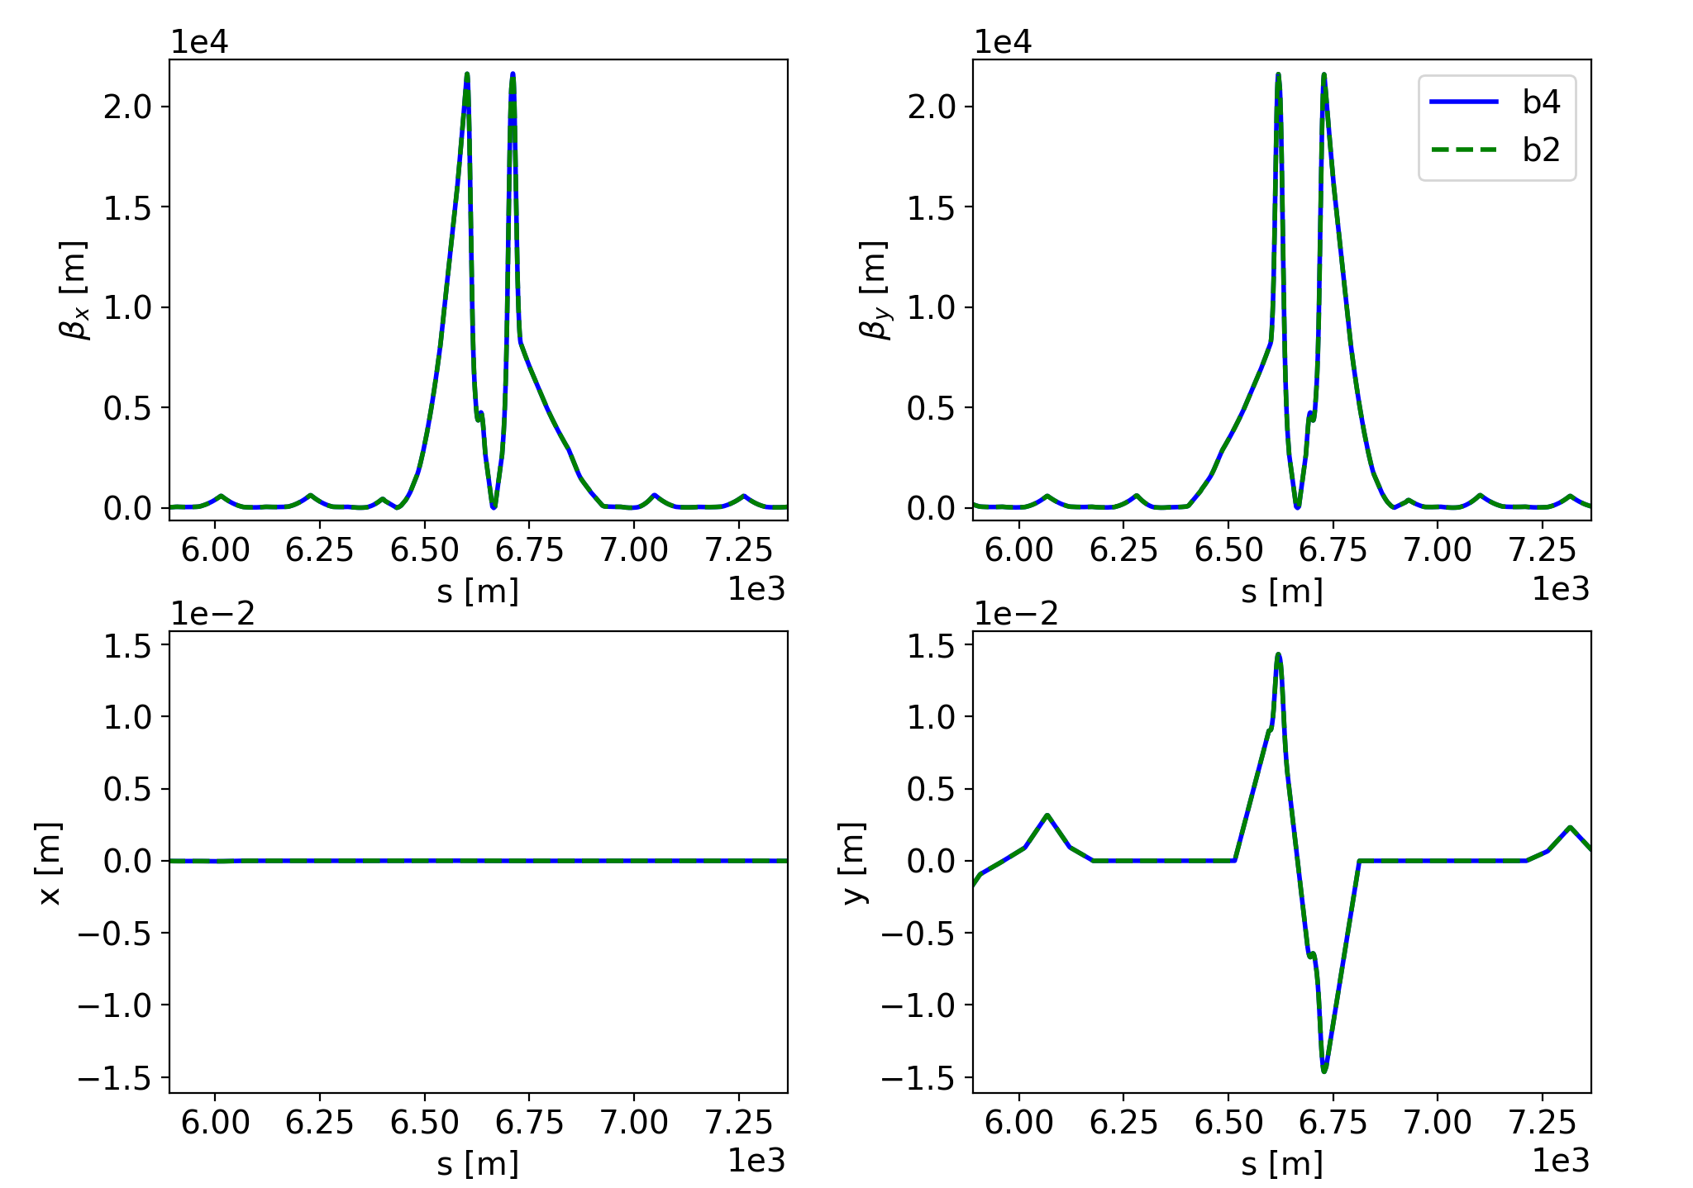
Checks
The approach was extensively tested. In particular:
Linear optics is found to be identical for b2 and b4 (once appropriate transformations are applied)
In the absence of bb, the sixtrack input obtained with pymask is identical (to the bit) to the one obtained by the legacy MAD-X mask on b4 alone

Slide 31
Outline
Introduction and motivation
  The cpymad interface to MAD-X
pymask
  The approach
  Handling different knob naming conventions
  Configuration of the beam beam interactions
  Structure of the code
  Configuration of the anticlockwise beam (b4)
  Online resources (repository, documentation, examples)
  First experience

Slide 32
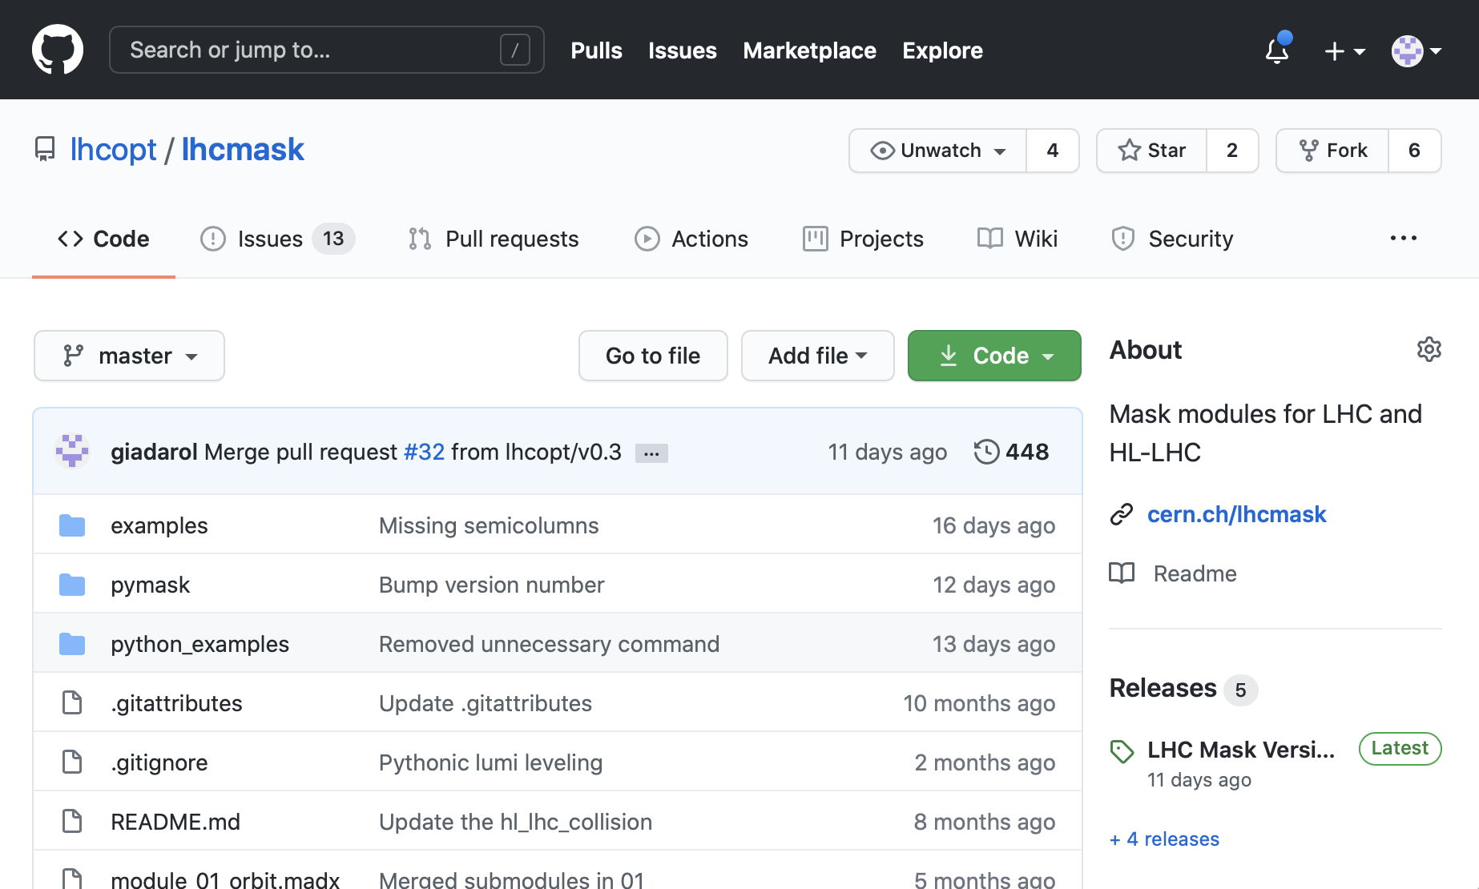
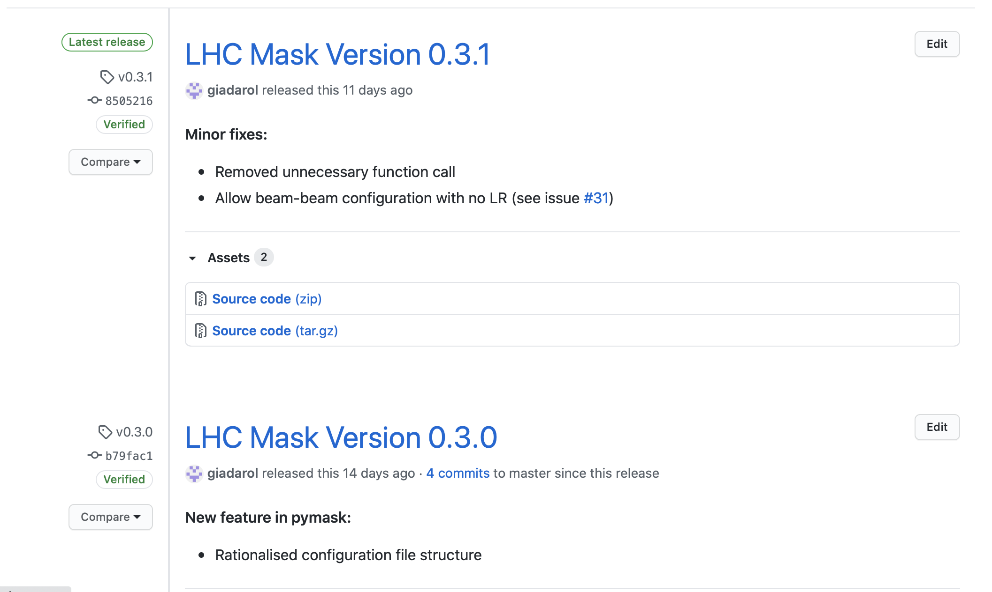
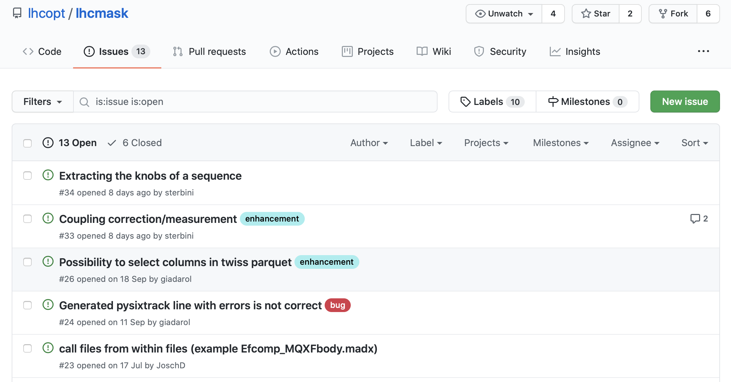
Online resources
The development of pymask is managed on github:
Code hosted at https://github.com/lhcopt/lhcmask
Github releases used to deploy new features and fixes
  New version number associated with each release
Github issues used to track bugs, enhancements, and future work to do

Slide 33
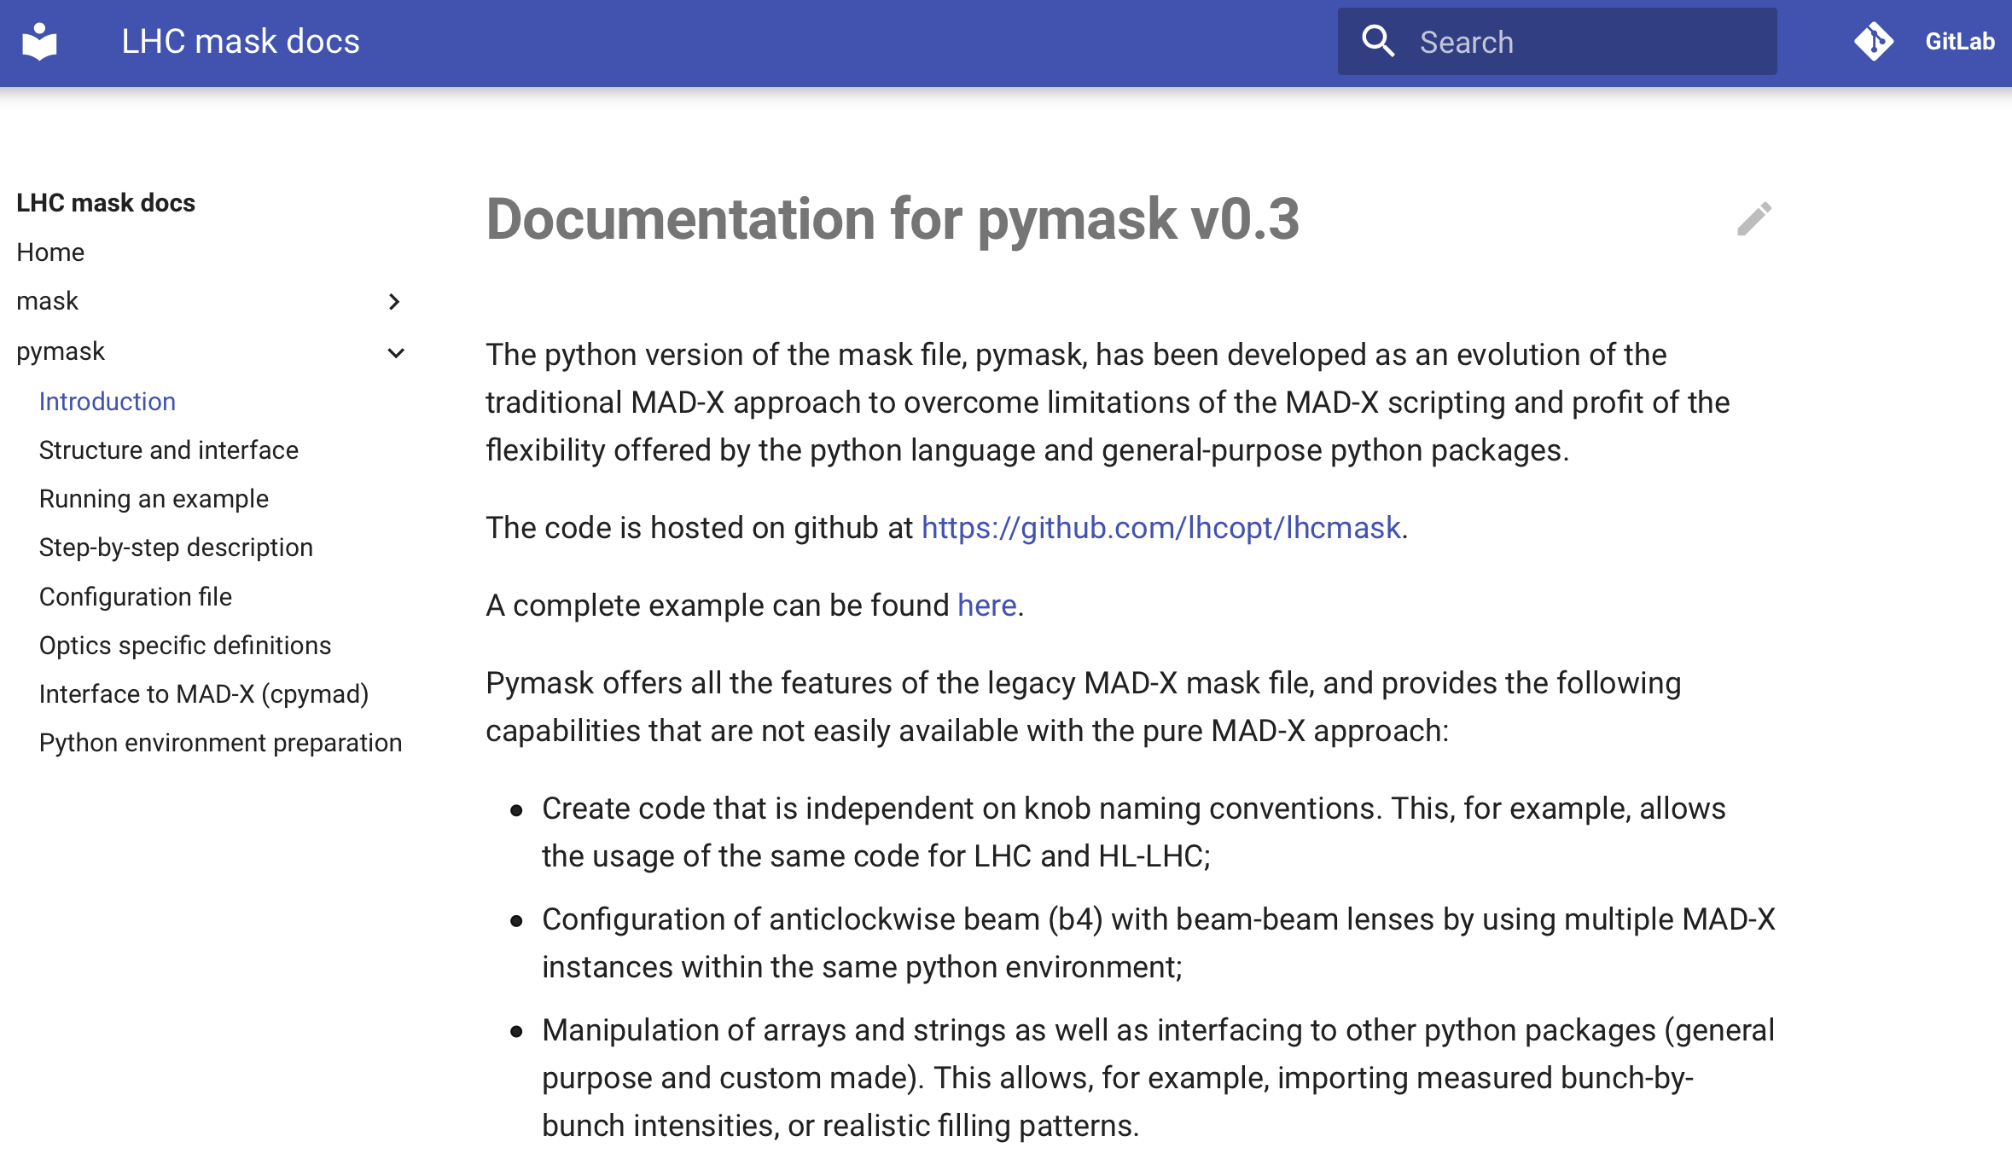
Online resources
Documentation is available at http://cern.ch/lhcmask/pymask
It includes:
“Getting started” guide (how to run at example)
Description of the interface
Step-by-step description of the algorithm
A guide to setup the python environment (not required on lxplus and lxbatch)
Working exaples for LHC Run 3 and HL-LHC are available in the repository (here)

Slide 34
Outline
Introduction and motivation
  The cpymad interface to MAD-X
pymask
  The approach
  Handling different knob naming conventions
  Configuration of the beam beam interactions
  Structure of the code
  Configuration of the anticlockwise beam (b4)
  Online resources (repository, documentation, examples)
  First experience

Slide 35
Experience
pymask has been (is being) used in pilot applied studies:
  HL-LHC DA studies for B1 and B2 (Sofia)
    pymask used within sixdesk
    Several sanity checks passed
  Effect of BB on beta-beating for LHC Run 3 scenarios (Guido)
  Quench heater failure scenarios simulations (TE-MPE, Cedric, Oscar)
  HL-LHC studies on crab-bump non-closure (Sofia)
Overall experience was rather smooth:
  Users could leverage their knowledge of python to make advanced customization of their simulations
  The python interactive interpreter and debugger allow for quick and powerful checks!
Many thanks to the present users for the very useful feedback!
The tool is ready for more use cases, so feel free to give it a try…
(of course we are here to help)

Slide 36
Thanks for your attention!

