Slide 1


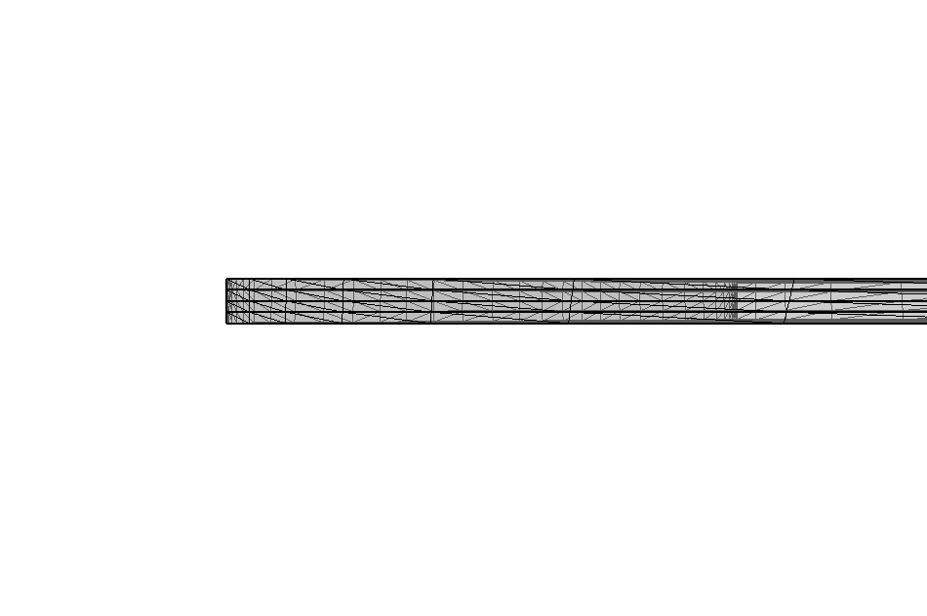
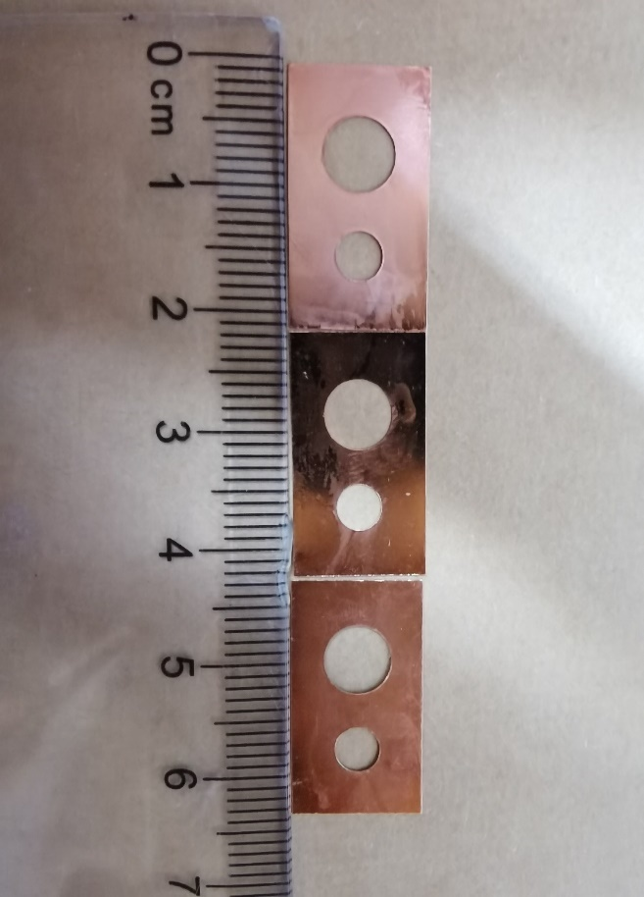
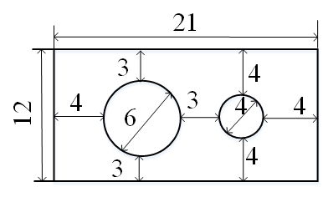
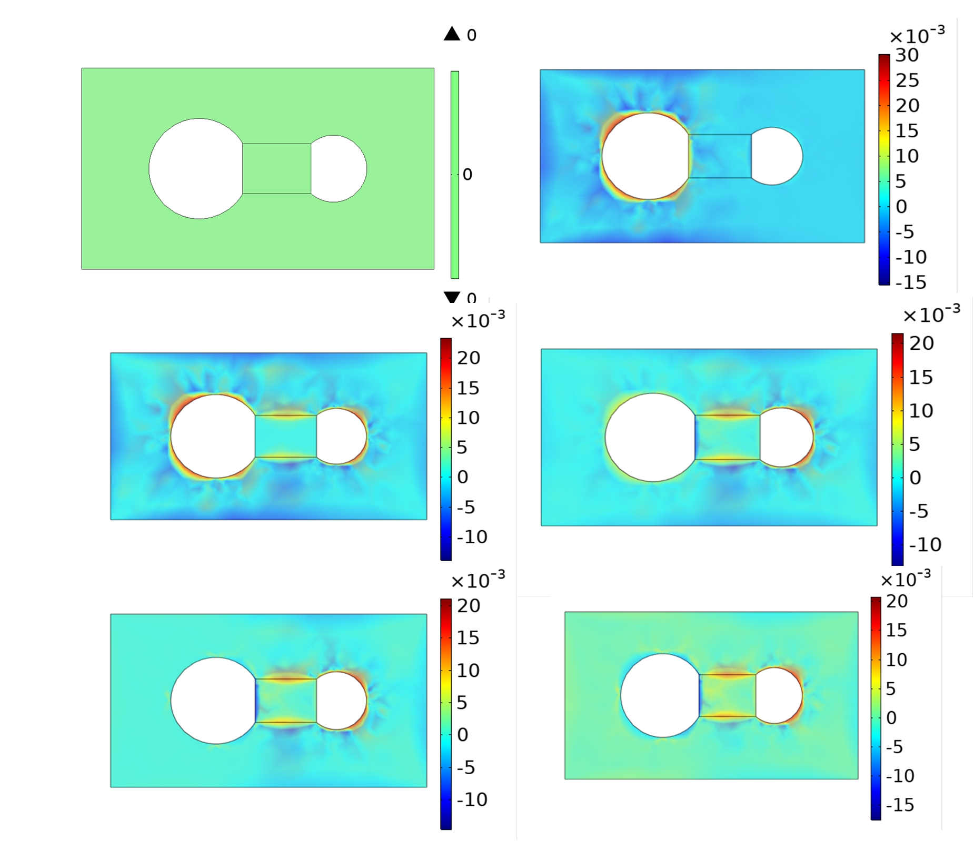
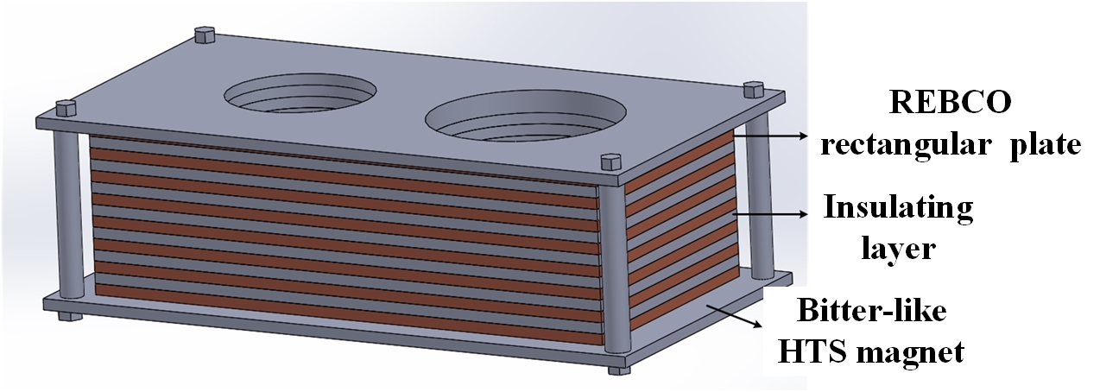
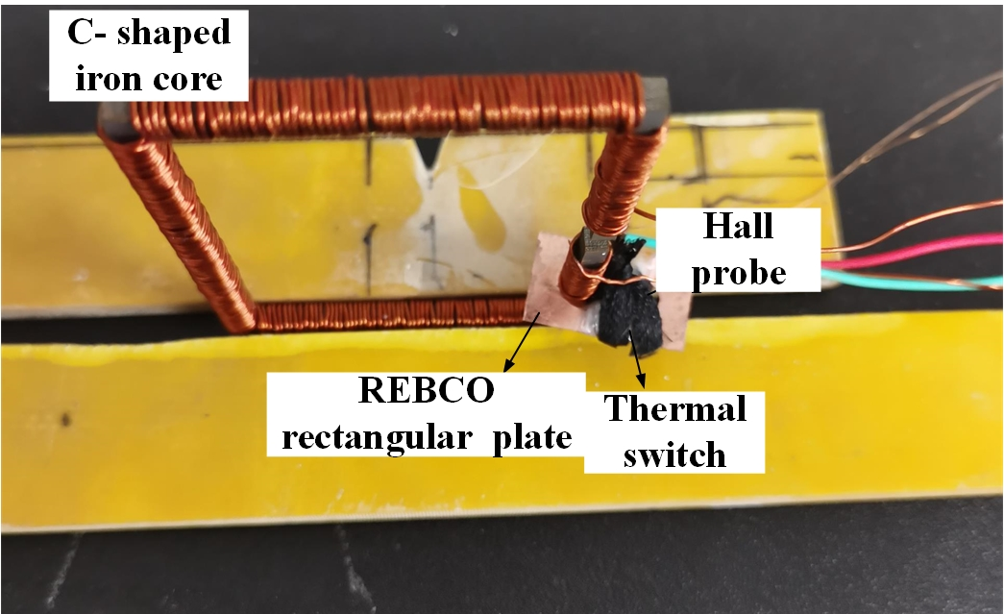
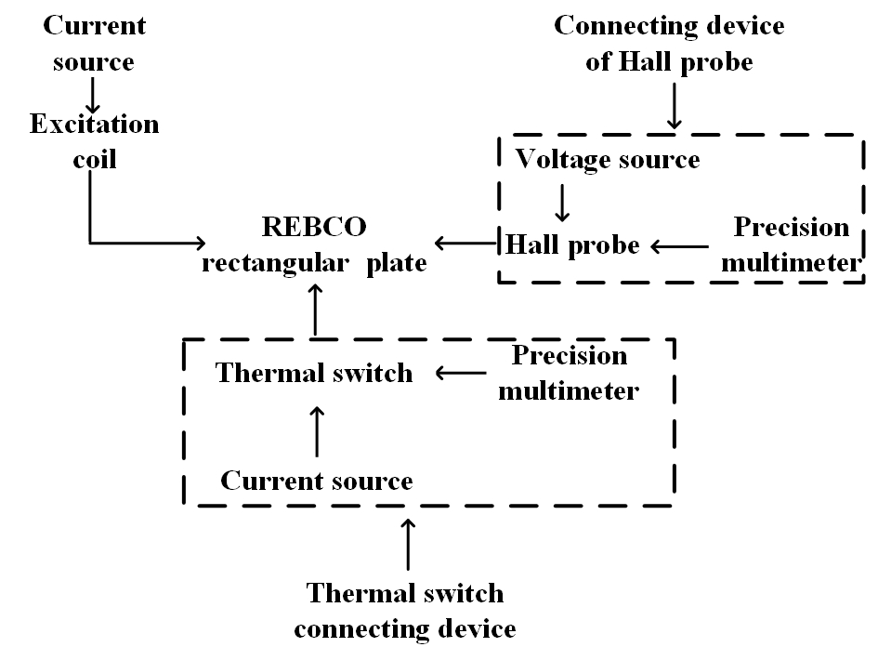
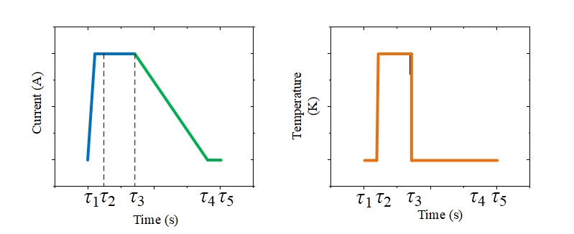
THU-PO3-617-03
Electromagnetic Characteristics of a Bitter-like HTS Magnet Excited by Flux Pump with Thermal Switch
Jiawen Wang, Yinshun Wang, Xindan Zhang, Zhenghao Huang, and Wei Pi
State Key Lab. of New Energy Renewable Power System, North China Electric Power University, Beijing, 102206, China
Introduction
Numerical Analysis
HTS made by BEBCO tapes are extensively applied in recent years.
Difficult to realize the closed-loop operation because of the immature soldering technique.
Bitter-like HTS magnet stacked by rectangle REBCO plates and magnetized by flux pump or field-cooling is a promising to overcome such drawbacks without joint resistance.
Bitter-like HTS magnet is excited by flux pump with thermal switch, and the magnetic flux of rectangular REBCO plates are unevenly distributed. Therefore, it is important to analyze the electromagnetic characteristics, which lays a crucial foundation for the application of magnets.
This paper use the finite element method to solve Maxwell equations in 3D dimension.
Initial condition
Boundary condition
Experimental Setup and Measuring System of a Bitter-Like HTS Magnet
Mesh of REBCO rectangular plate using triangle division.
Results and Discussion
Time: τ₁
Time: τ₂
Picture drawing and size of REBCO rectangular plate
Time: τ₃
Time: τ₃-τ₄
Time: τ₄-τ₅
Time: τ₅
The structure of Bitter-like HTS magnet.
Magnetic field distribution of single REBCO rectangular at magnetized current amplitude of 10 A
Schematic view of experimental setup
The simulation induced magnet flux density at the center of small loop at the amplitude 10 A (magnet made from four REBCO rectangular plates).
Schematic of measuring system
Conclusion
Bitter-like magnet can be excited by flux pump with thermal switch and realize the closed-loop operation.
Magnetic flux density of the HTS magnet increases until the resistance characteristics do not change any more.
Although available sizes, the conclusions can be extended to other sizes.
Schematic of excitation coil flux waveform
Schematic of temperature in thermal switch

