Slide 1

Minimizing the heat losses of a self-switching kA-class rectifier flux pump
Muhammad Haseeb Iftikhar muhammad.iftikhar@strath.ac.uk
Dr. Min Zhang min.zhang@strath.ac.uk
Professor Weijia Yuan weijia.yuan@strath.ac.uk
APPLIED SUPERCONDUCTIVITY GROUP
University of Strathclyde, Glasgow UK.

Slide 2
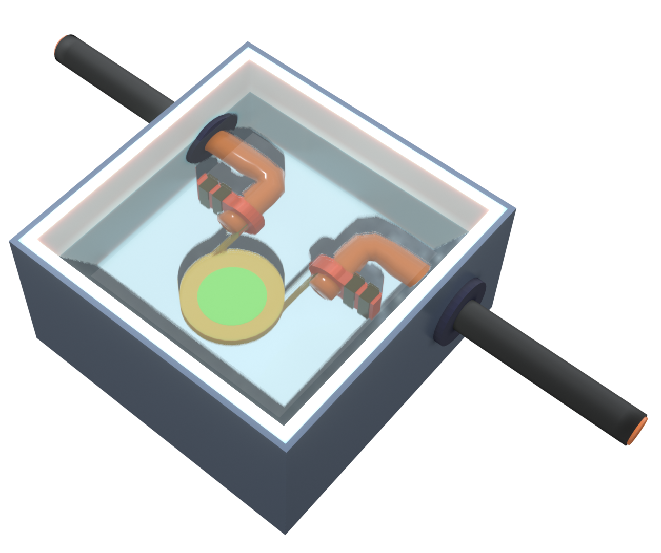
Introduction
Superconducting coil magnets are normally working in driven model with thick current leads.
  Generating considerably heat load
  Complicating thermal insulation
  Enlarging footprint
  Higher cost
Magnetisation of HTS ring magnets using field cooling.
  Requires high external magnetic field
  Cryogenic temperature should be maintained to keep HTS magnet alive
  Magnets decay over time
HTS flux pumps can inductively generate DC voltage in a closed superconducting loop, avoiding the current lead problems
  Flux pumping is a promising technology for HTS DC magnets, in motor/generator, MRI/NMR, high field magnets, etc.
3D rendered image of HTS coil in the liquid Nitrogen bath

Slide 3
Joule heating and heat leakage due to copper at 77K
To calculate the resistance of the copper lead we use equation 1, where R, ρ, l, A are resistance, electrical resistivity, length of lead and cross-sectional area.
$$R=ρ\left(\frac{l}{A}\right)$$ | (1)
Joule loss (P) can be calculated using Equation no 2.
$$P=i^{2}R$$ | (2)
For the heat leakage or heat flux/power we can use equation no 3, where Q, κ, T_{H}, T_{L}, are heat flux, thermal conductivity.
$$Q=i\sqrt{2κρ(T_{H}−T_{L})}$$ | (3)
Table 1. gives the values used in calculations ^{1,2}.
Symbol | Value | Unit
ρ | 2.00E-9 | Ωm
κ | 781 | Wm⁻¹K⁻¹
T_{H} | 273 | K
T_{L} | 77 | K
Table 1. Parameters values used in this analysis
Blondelle, F., Electrical Conductance of Bolted Copper Joints for Cryogenic Applications. https://doi.org/10.1007/s10909-014-1142-4
Le, Conceptual design of current lead for large scale high temperature superconducting rotating machine. https://doi.org/10.9714/PSAC.2014.16.2.054

Slide 4
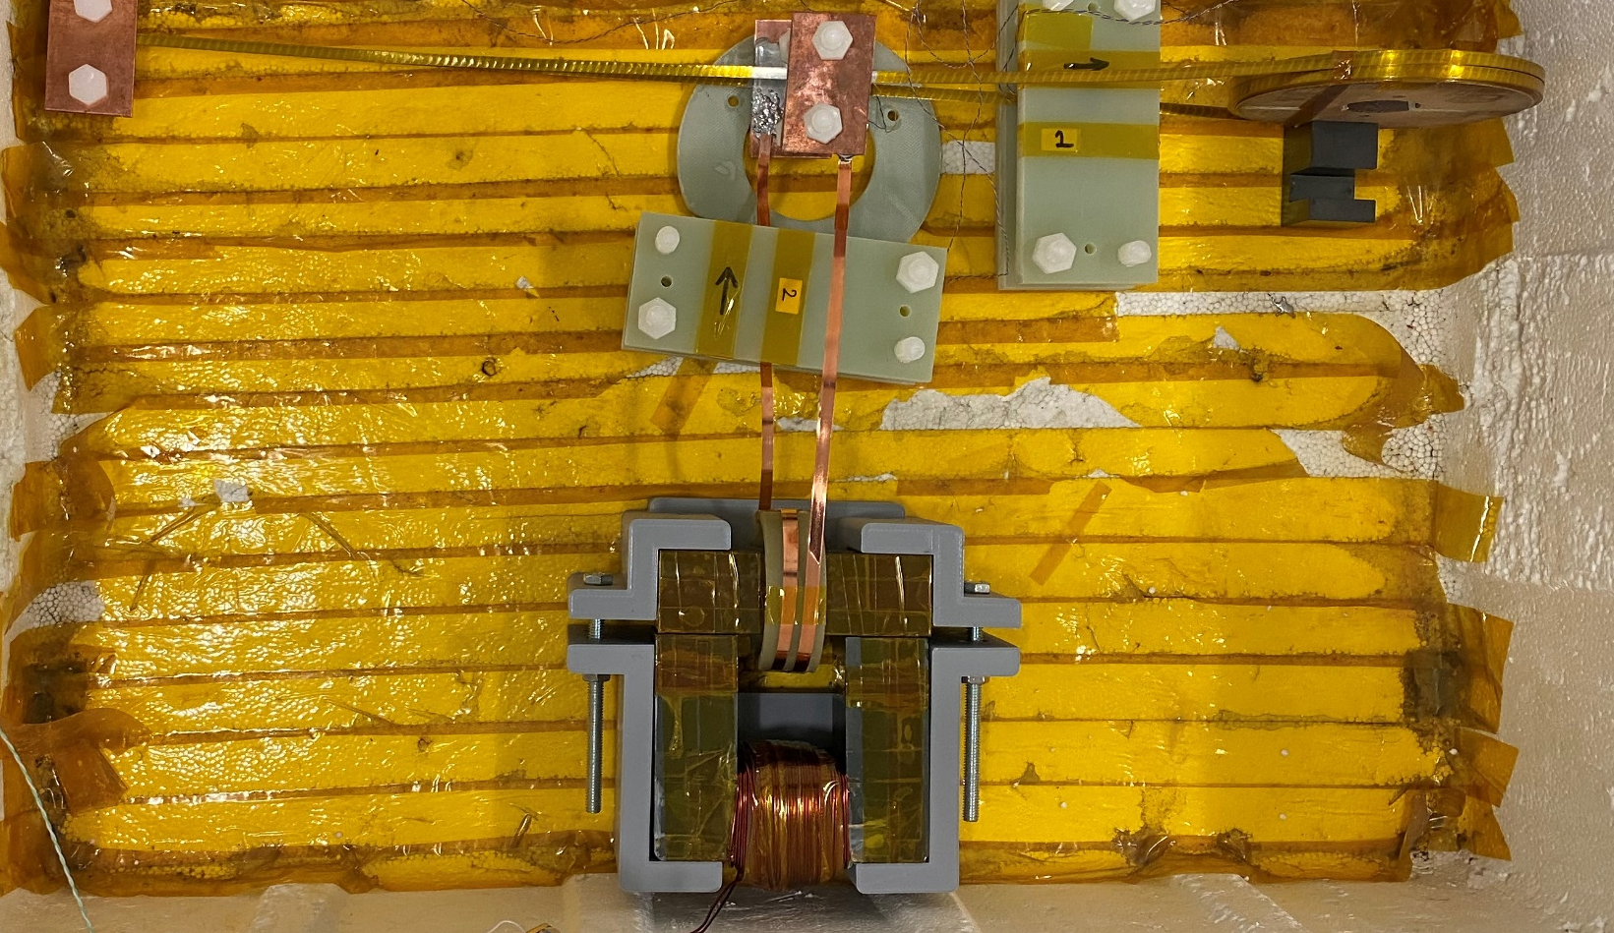
Comparison of instantaneous heat losses in copper
1- Conventional HTS coil
2- HTS flux pump
Copper Terminals
Bifilar Bridge
Load Coil
Charging
secondary
Load Coil
Target current in coil | 100A
Applied current (i) | 100A
Copper lead length x2 | 0.2m
Copper lead diameter | φ30mm
Joule Heating | 0.0056W
Heat Flux/Power | 1.18W
Sum | 1.1856W
Target current in coil | 100A
Applied current (i) | 3A
Copper lead length 500 Nturns | 60m
Copper lead diameter | φ1.5mm
Joule Heating | 0.61W
Heat Flux/Power | 0.03W
Sum | 0.64W
Blondelle, F., Electrical Conductance of Bolted Copper Joints for Cryogenic Applications. https://doi.org/10.1007/s10909-014-1142-4
Le, Conceptual design of current lead for large scale high temperature superconducting rotating machine. https://doi.org/10.9714/PSAC.2014.16.2.054

Slide 5
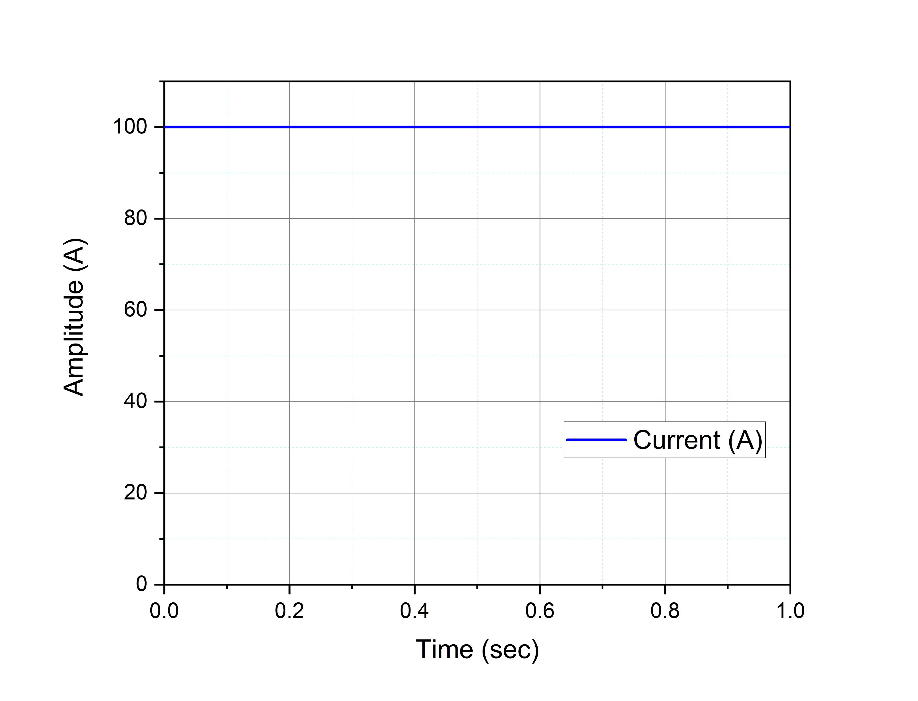
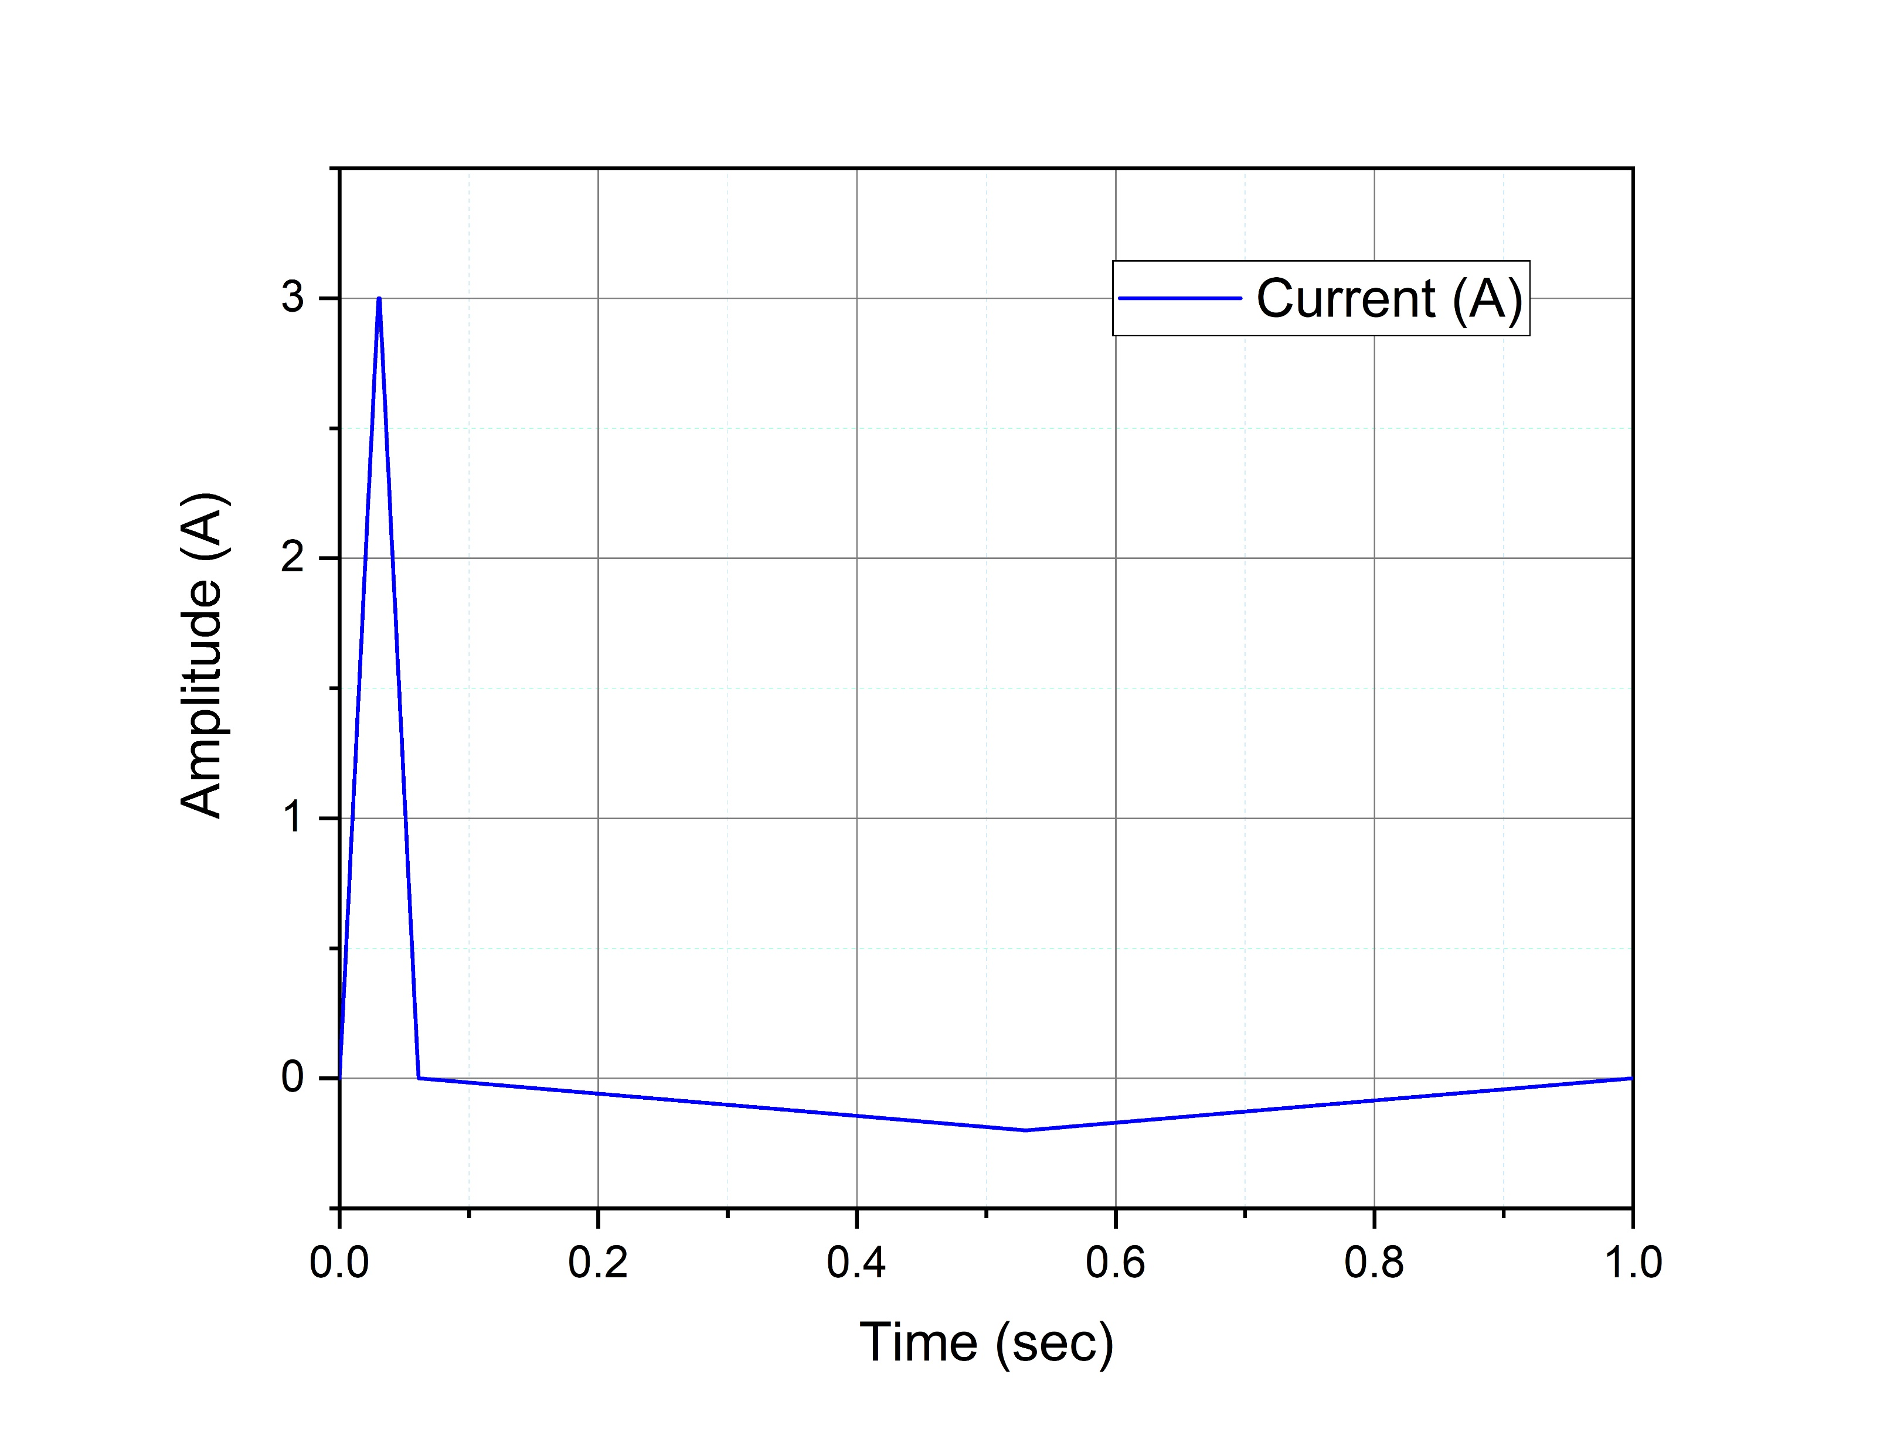
Applied current signals
As mentioned previously the conventional HTS coil magnets are operated in driven mode, so a constant DC supply is connected to the ends of the coil. Whereas the HTS flux pump is operated inductively by a non symmetric signal.
Fig 1: Applied signal for conventional HTS coil
Fig 2: Applied signal for Flux pump

Slide 6
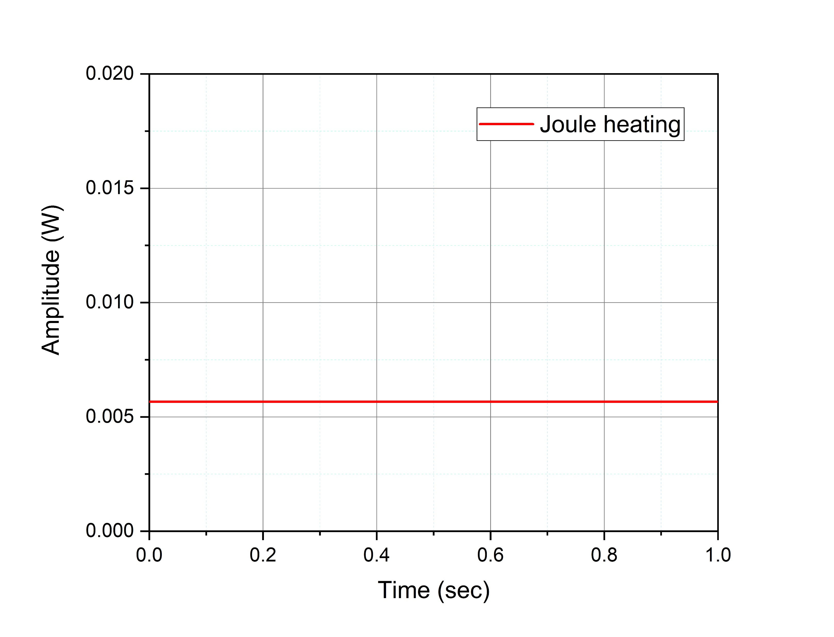
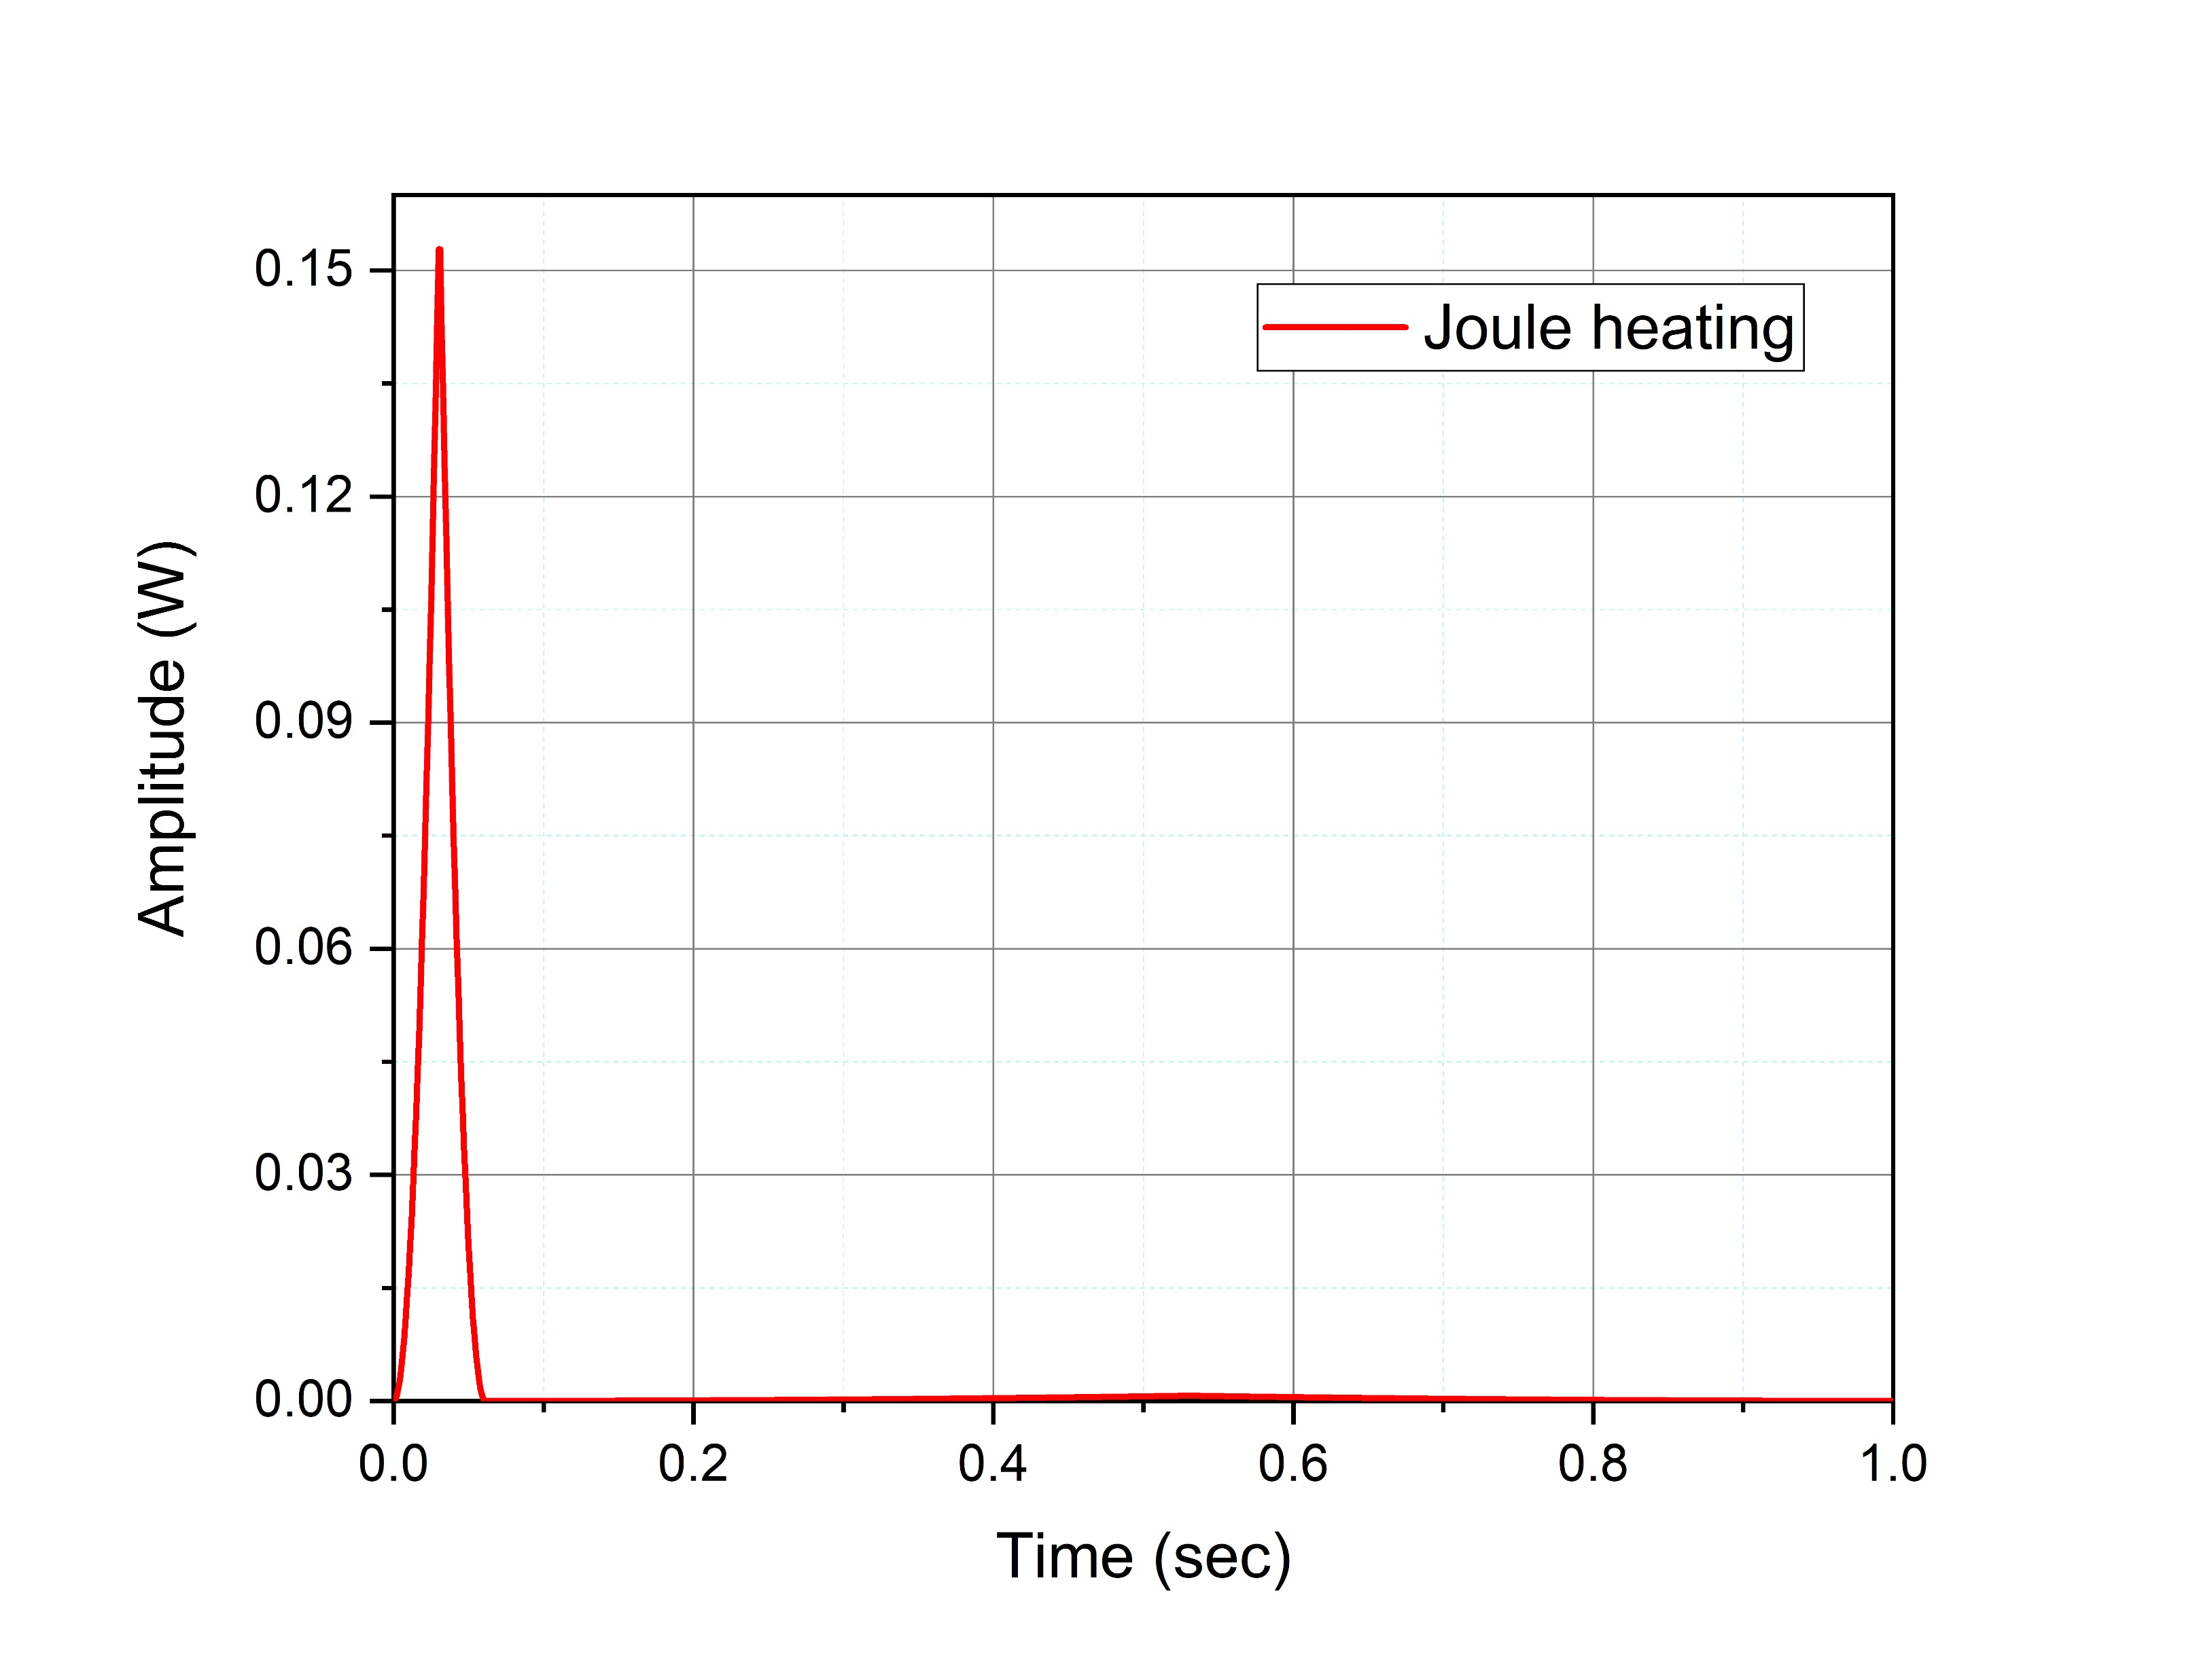
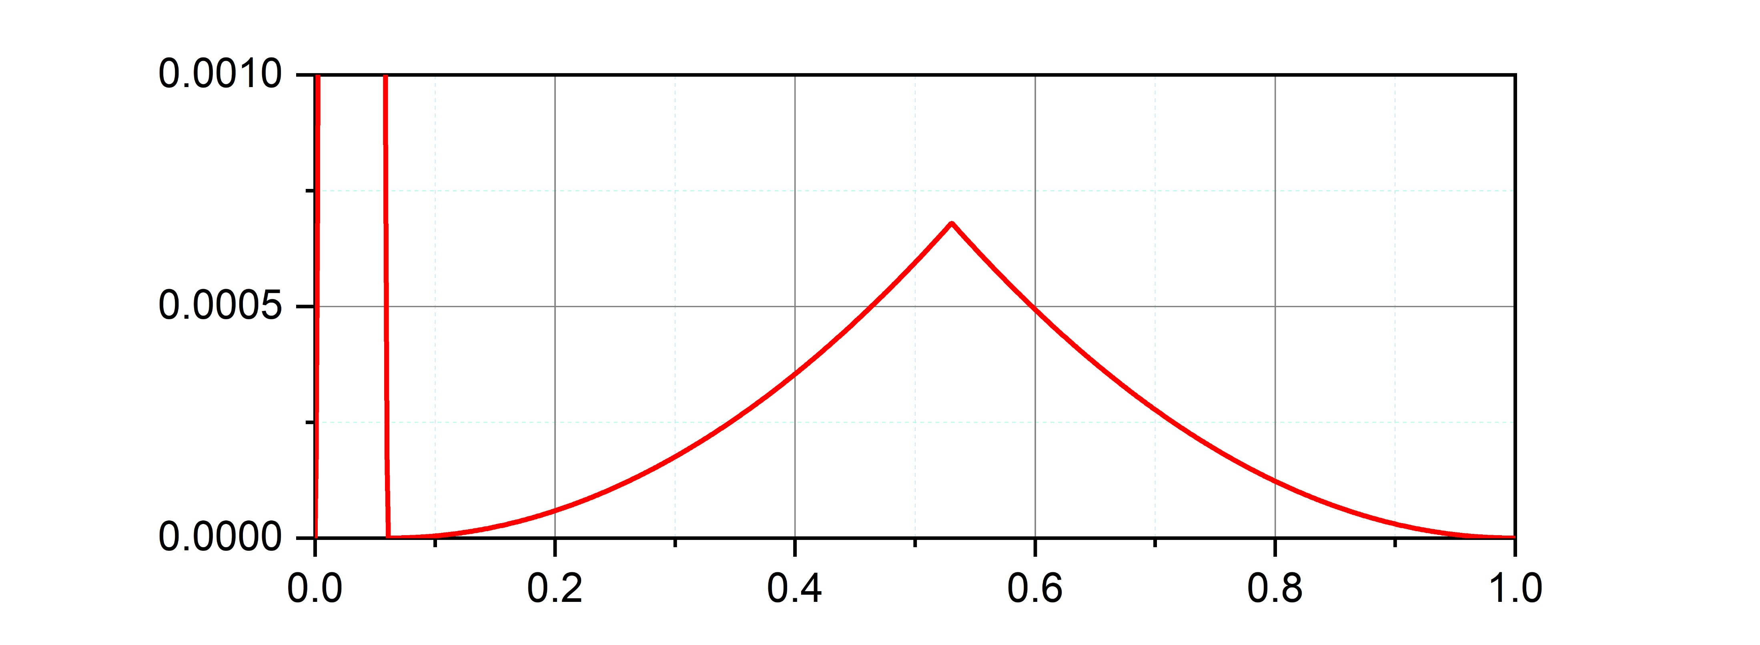
Joule heating over 1 second
Joule heating in the HTS coil and flux pump plotted over one cycle. In case of flux pump the peak current is applied in a fraction of a second and only during this time instant we see a comparatively high loss, for the rest of the cycle the losses are less then 0.001W.
Fig 1: Joule heating in conventional HTS coil
Fig 2: Joule heating in flux pump
By integrating the total joule heating will comes as;
P= 5.6W
P= 3.4W

Slide 7
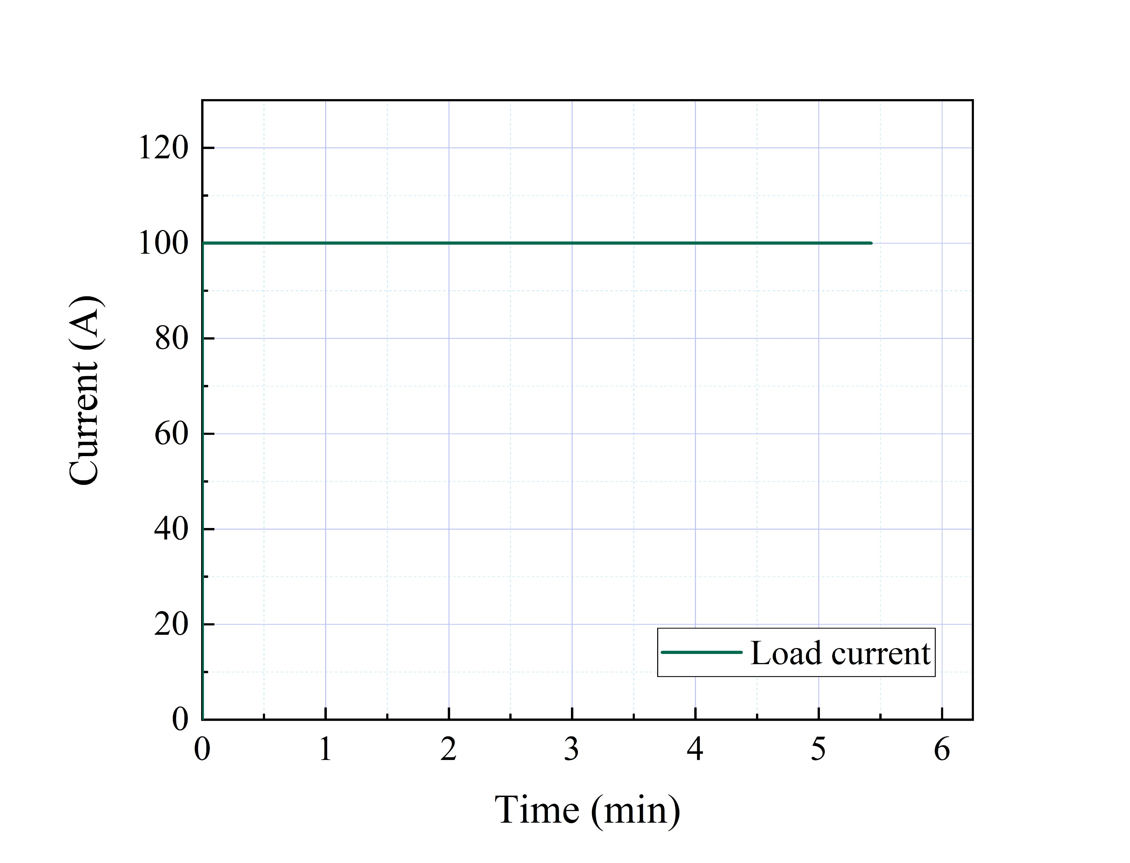
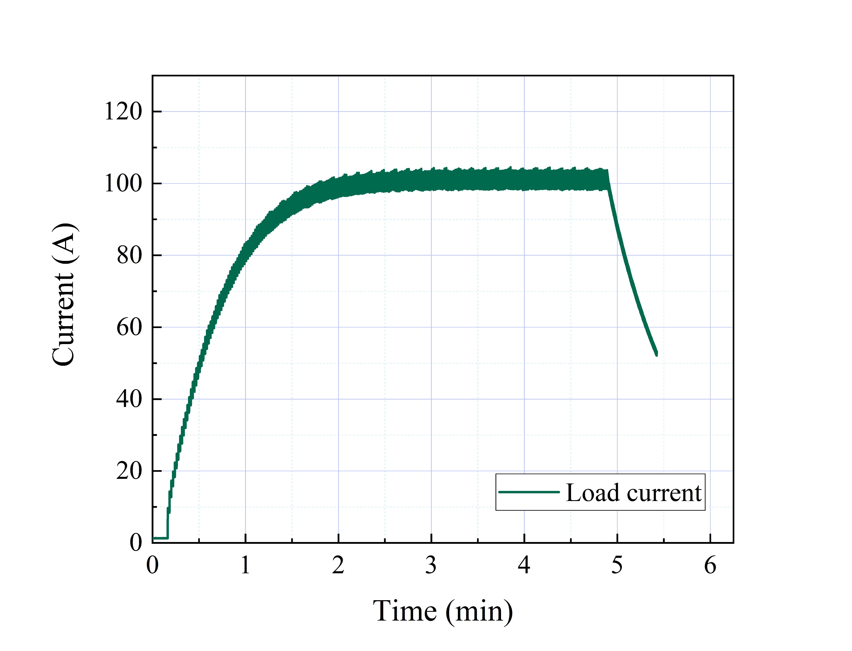
Current in the load coil
The current waveforms for both conventional HTS coil and flux pump operated HTS coil.
Fig 1: Current in conventional HTS coil
Fig 2: Current in coil pumped by using flux pump

Slide 8
Conclusion and further studies
This study is performed at lower scale as a fraction of the 1kA level target to give a brief insight of the importance of flux pump to reduce the heat losses in the cryogenic systems.
A quantitively study is performed to estimate the total heal losses in the copper for conventional HTS coil magnets and comparison is presented with the promising flux pump technology.
The study proved that the heat losses will be minimized to a 60% and has a potential to go further down with optimal topology, as well as reducing the footprint of the whole HTS magnet.
In this study only copper losses are considered, joule heat and heat leaking. It is well kept in mind there is another kind of source present in the flux pump system in the form of iron core. Heat loss due to iron core is kept for future study, since there is an ongoing study on different core materials and their performance in cryogenic systems.

Slide 9


Applied Superconductivity Laboratory,
University of Strathclyde Glasgow UK.
1- Muhammad Haseeb Iftikhar
muhammad.Iftikhar@strath.ac.uk
2- Dr. Min Zhang
min.zhang@strath.ac.uk
3- Prof. Weijia Yuan
weijia.yuan@strath.ac.uk

