Slide 1
Data analysis for MM
Lucio Fiscarelli
25/11/2020

Slide 2
Data analysis for MM
Standard and non-standard systems
Online and offline post-processing
Data processing environment
Automatic generation of reports
Ongoing development (already covered by Eleni and Matthias)

Slide 3
Standard and non-standard systems
A standard test is usually associated to a system that can perform only one type of test
Calibration (dipole, quadrupole)
Rotating coils (311-type, mole-type, SM18-type)
Stretched wire (all the same)
Helmholtz coils for permanent magnet blocks (pilot system FFMM-INFOR)
3D mapper (still under development)
SPS fluxmeter (quite old system)
Split-coil permeameter
Non-standard tests are usually performed by using general purpose systems (acquisitions card)
Fixed coils in ramp mode
Others…

Slide 4
Rotating coils 311-type
Used for test of small/medium size NC magnets (1x1x1 m)
Limited number of channels (2 integrators)
Direct control of the current via point-to-point serial com (USB)
Direct reading of the current (DCCT next to the system)
Short acquisitions (˜minutes)
Online processing within FFMM based on compiled Matlab scripts
Results in text file with a standard format (can be open in excel for further processing)

Slide 5
Rotating coils mole-type
Used for test at warm of SC magnets (˜10 m)
Limited number of channels (2 integrators)
Direct control of the current (on-board power converter)
Direct reading of the current (on-board DCCT)
Many short acquisitions (˜10 seconds)
Online processing within FFMM based on compiled Matlab scripts
Results in text file with a standard format (can be open in excel for further processing)

Slide 6
Rotating coils SM18-type
Used for test at cols of SC magnets (˜10 m)
Larger number of channels (12 integrators)
No direct control of the current (current controlled from the c.room)
Reading of the current from TN (asynchronous)
Long continuous acquisitions (˜hours)
Offline processing by using Matlab scripts
Results in text file with a standard format (can be open in excel for further processing) but Matlab is more convenient due to the large number of rows (turns)

Slide 7
Stretched wire
It is the most generic system (any length from 0.1 to 20 m)
Large range of field level
It used for both NC and SC magnets
Direct control of the current when possible (serial connection)
Reading of the current from a DCCT when possible
Short acquisitions (˜seconds)
On-line processing for the standard measurement (TF, axis, angle)
Results in text file (few numbers)

Slide 8
Non-standard tests
Ad-hoc post processing and format for the results

Slide 9
Online and offline processing
Online processing provides immediate feedback to the operator
Proven to be useful in the 311, mole, and wire
More difficult to implement in SM18 because
the signals are asynchronous
Many signals in parallel
More complex connection scheme
Not really beneficial for shoer models
We would like to have it for the series magnets

Slide 10
Data processing environment
We have many scripts working under Matlab for the offline processing
We tried to use the same scripts for the online processing (Matlab code compiled and then used in FFMM as a library)
It works for slow and short acquisitions (311 and mole)
More problems in SM18

Slide 11
Automatic generation of reports
At the moment it is quite limited
We tried for the mole systems used for the 11T:
Matlab script able to generate an Excel file with plots
Then same plots automatically copied in a Word document
For the SM18 systems we have additional Matlab scripts
Automatic generation of plots for reports and presentations
Automatic generation of Excel files to share the numerical results
We would like to do more

Slide 12
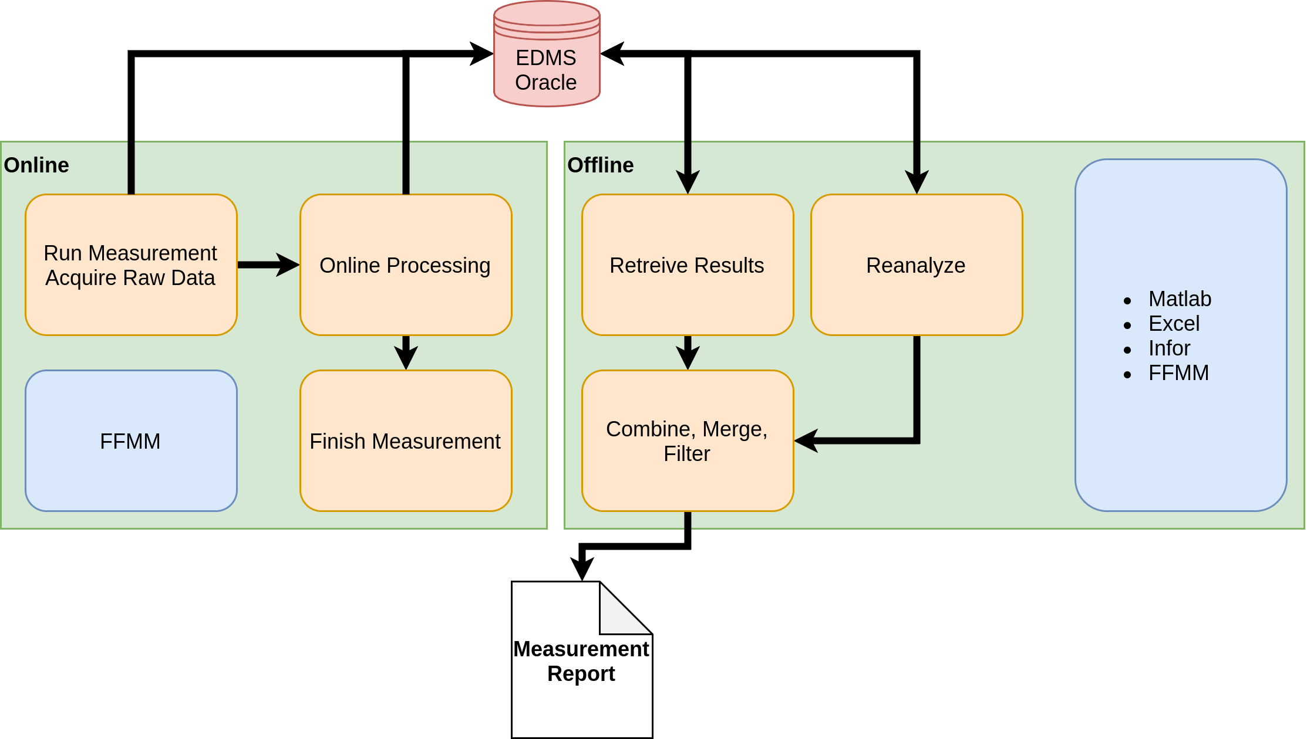
Ongoing development

Slide 13
