Slide 1
MM Databases
Eleni Tournaki
Wednesday 25th November 2020

Slide 2

Structure of Presentation
Introduction: Workflow of Measurements
The concept of 3MIS
Architecture of implemented solution
Why is each component used?
Data Storage in main MM Section’s Activities
Summary

Slide 3
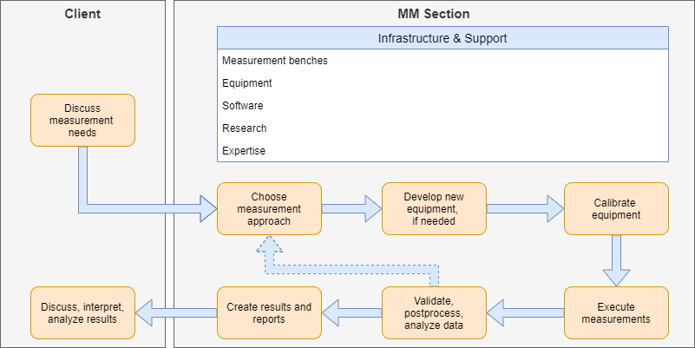

Workflow of Measurements
MM Request
Calibration Data
Equipment used
Meas. Info
Raw Data
Processed Data
Released data
MM Report
Source: Bonora, M. (2020). An Integrated Software Framework for Magnetic Measurements - From Raw Data to Assets. TE-MSC Seminar, CERN, Geneva.

Slide 4
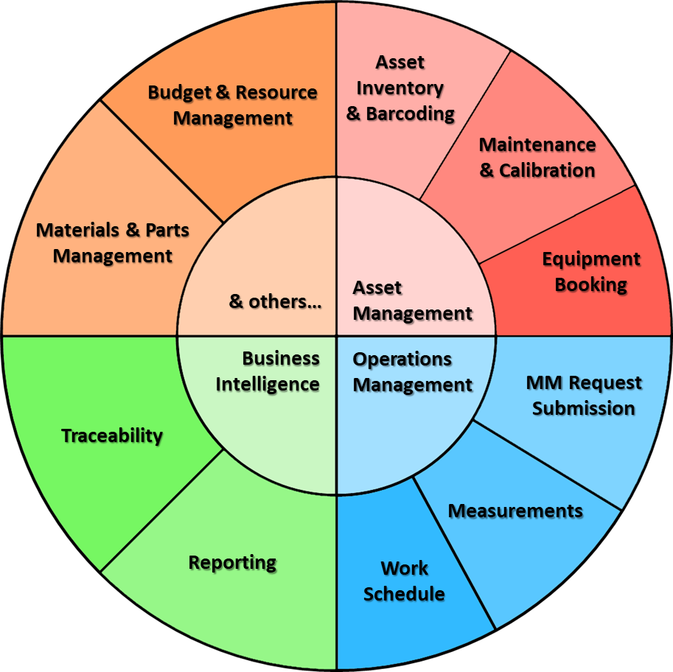
The concept of 3MIS
Problem
Use of various tools, that do not exchange information
Lack of centralised database
Information not accessible easily
Manual entry/retrieval of data
Solution
3MIS: Magnetic Measurement Management & Information System

Slide 5
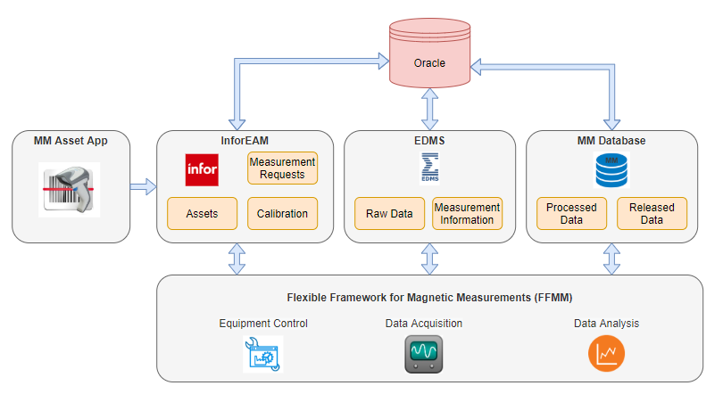
Architecture of Solution
Source: Bonora, M. (2020). An Integrated Software Framework for Magnetic Measurements - From Raw Data to Assets. TE-MSC Seminar, CERN, Geneva.

Slide 6
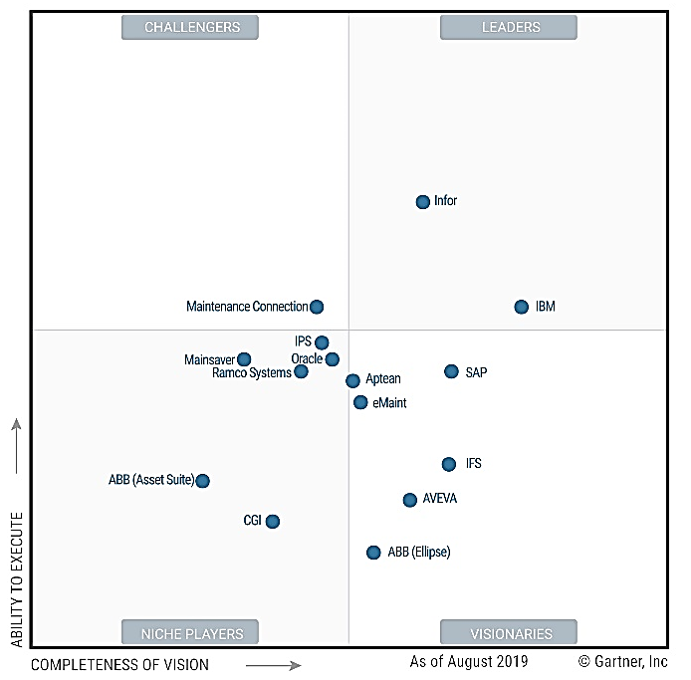

Why Infor EAM and EDMS?
Used throughout CERN
Service, maintenance & support provided by dedicated Sections at CERN
Available solutions for common problems
Already integrated with each other and with other CERN systems & applications (GIS, MTF, TREC, etc.)
Can be integrated with other systems (web-services)
No extra costs implied
Quickly and easily customisable, but with some restrictions & limitations
Source: Steenstrup, K., Foust, N. (2019, October 14).
Gartner’s Magic Quadrant for Enterprise Asset Management Software.
Retrieved from www.infor.com

Slide 7
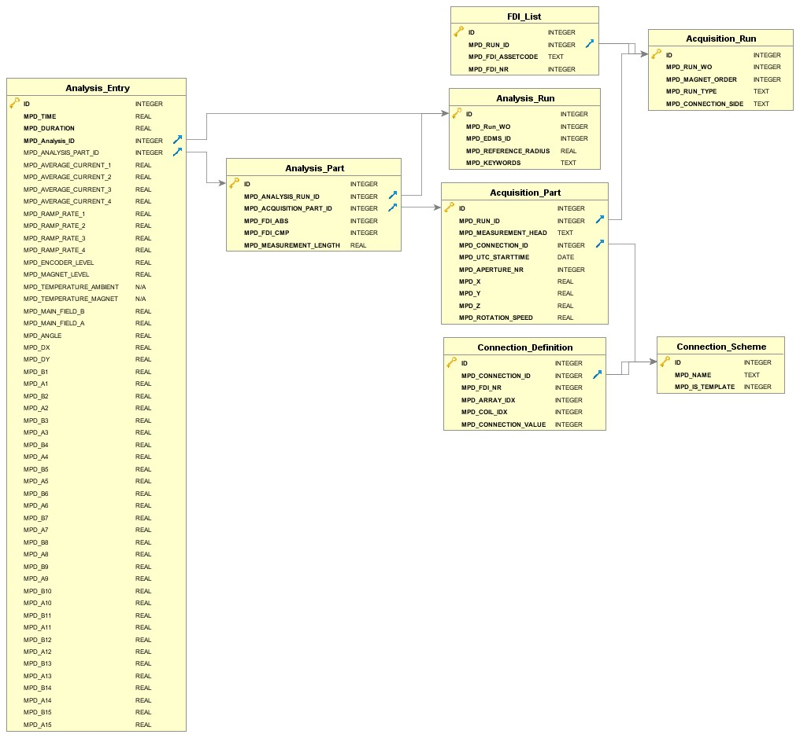



Why MM Database?
Limited datatypes supported by Infor
Big volume of data
Complex data structure
MM

Slide 8
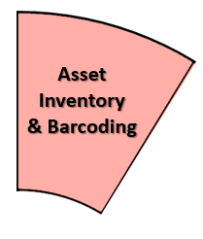
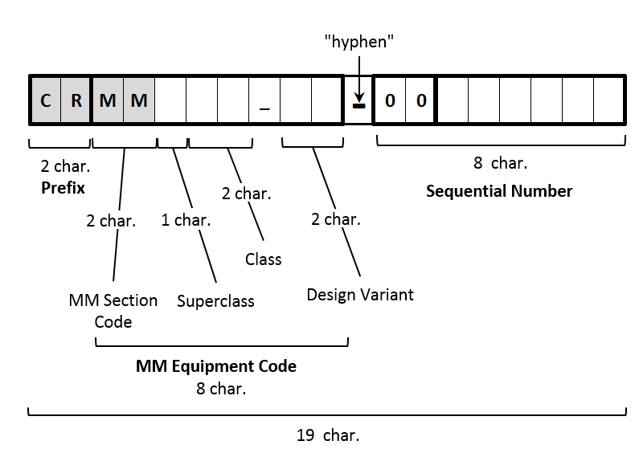
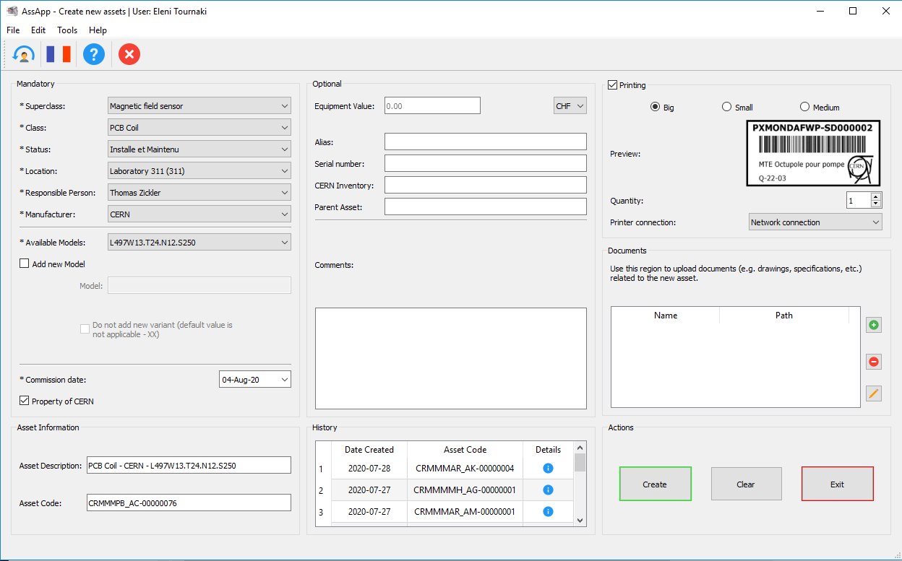
MM Assets Creation & Printing Application
Encapsulates the logic of the MM Equipment Codes
Create the Assets in Infor (generates Asset code and description)
Courtesy: R. Martinez Estebanez, S. Gutzeit, M. Bonora

Slide 9

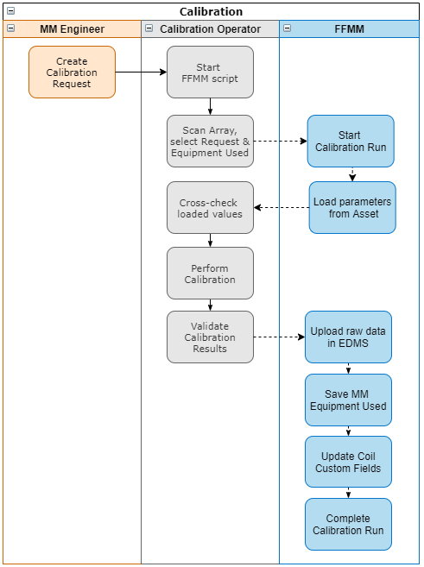

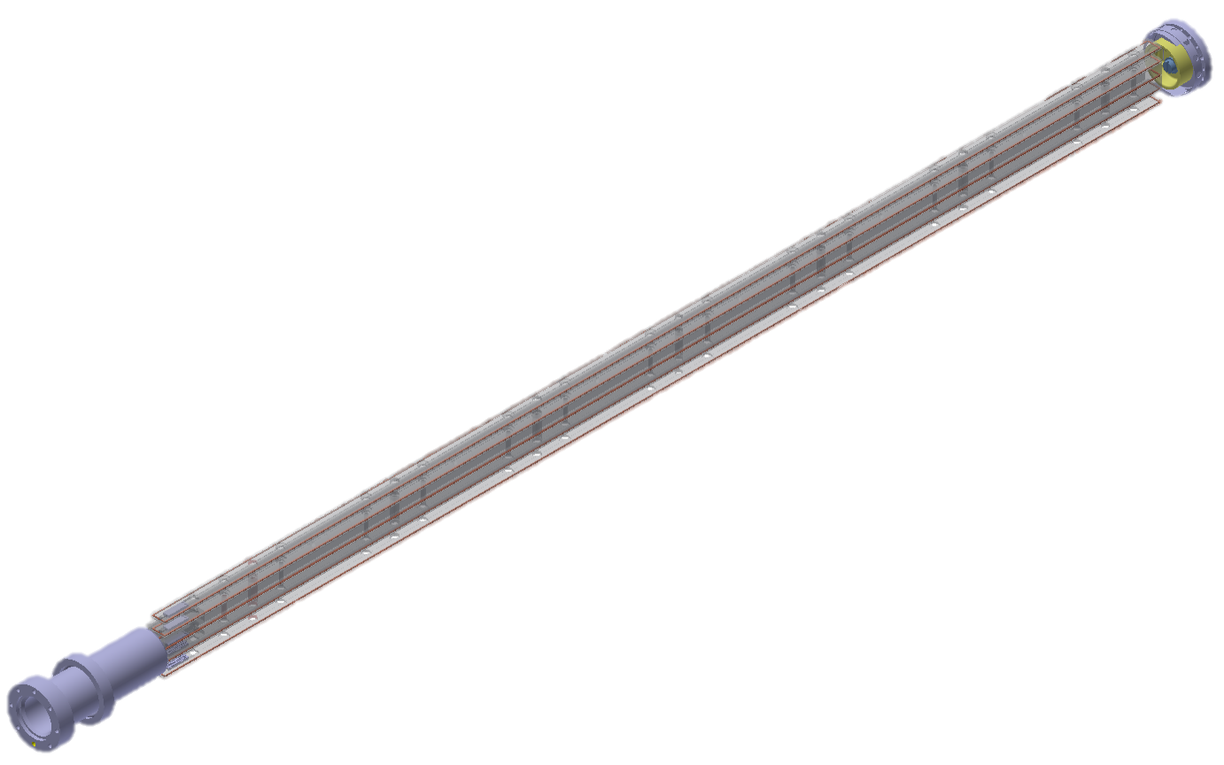
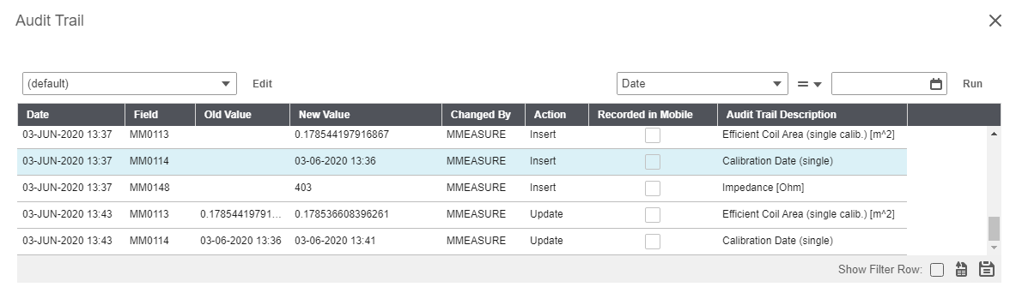
Calibration
Automatic retrieval of design values & structure
Automatic archiving of results:
Raw data and Parameters saved in
All other data saved in Infor
History of calibration values available

Slide 10

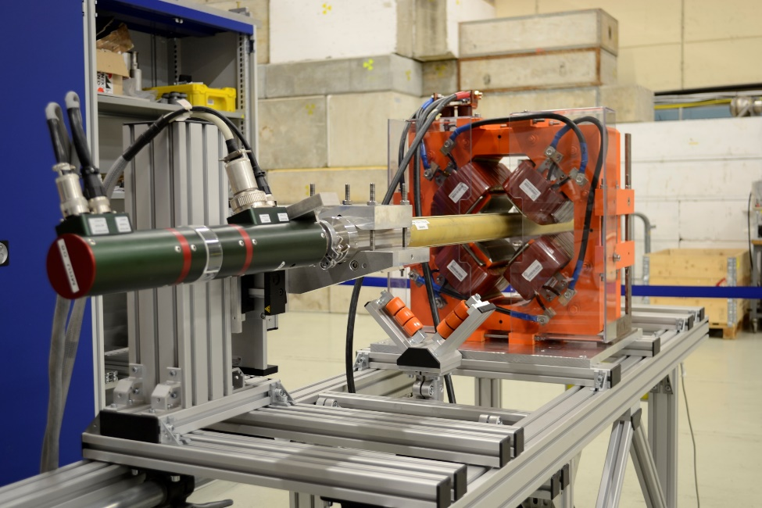
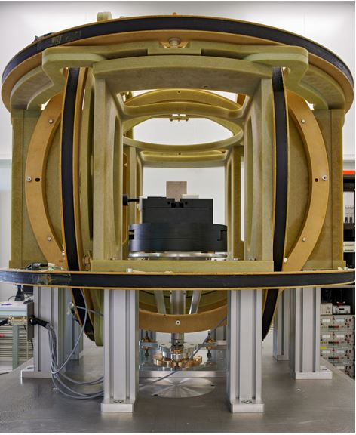
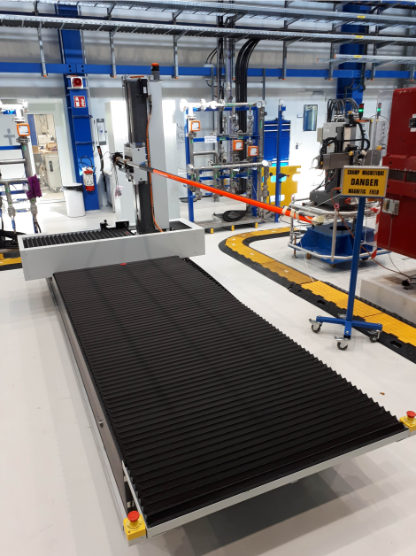
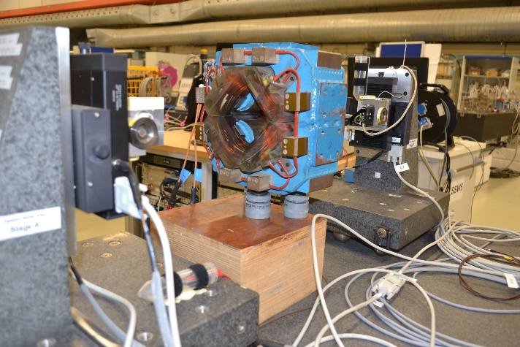
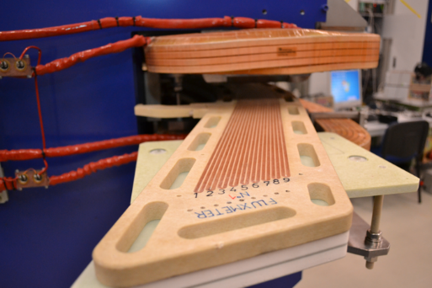

Measurement Systems

Slide 11
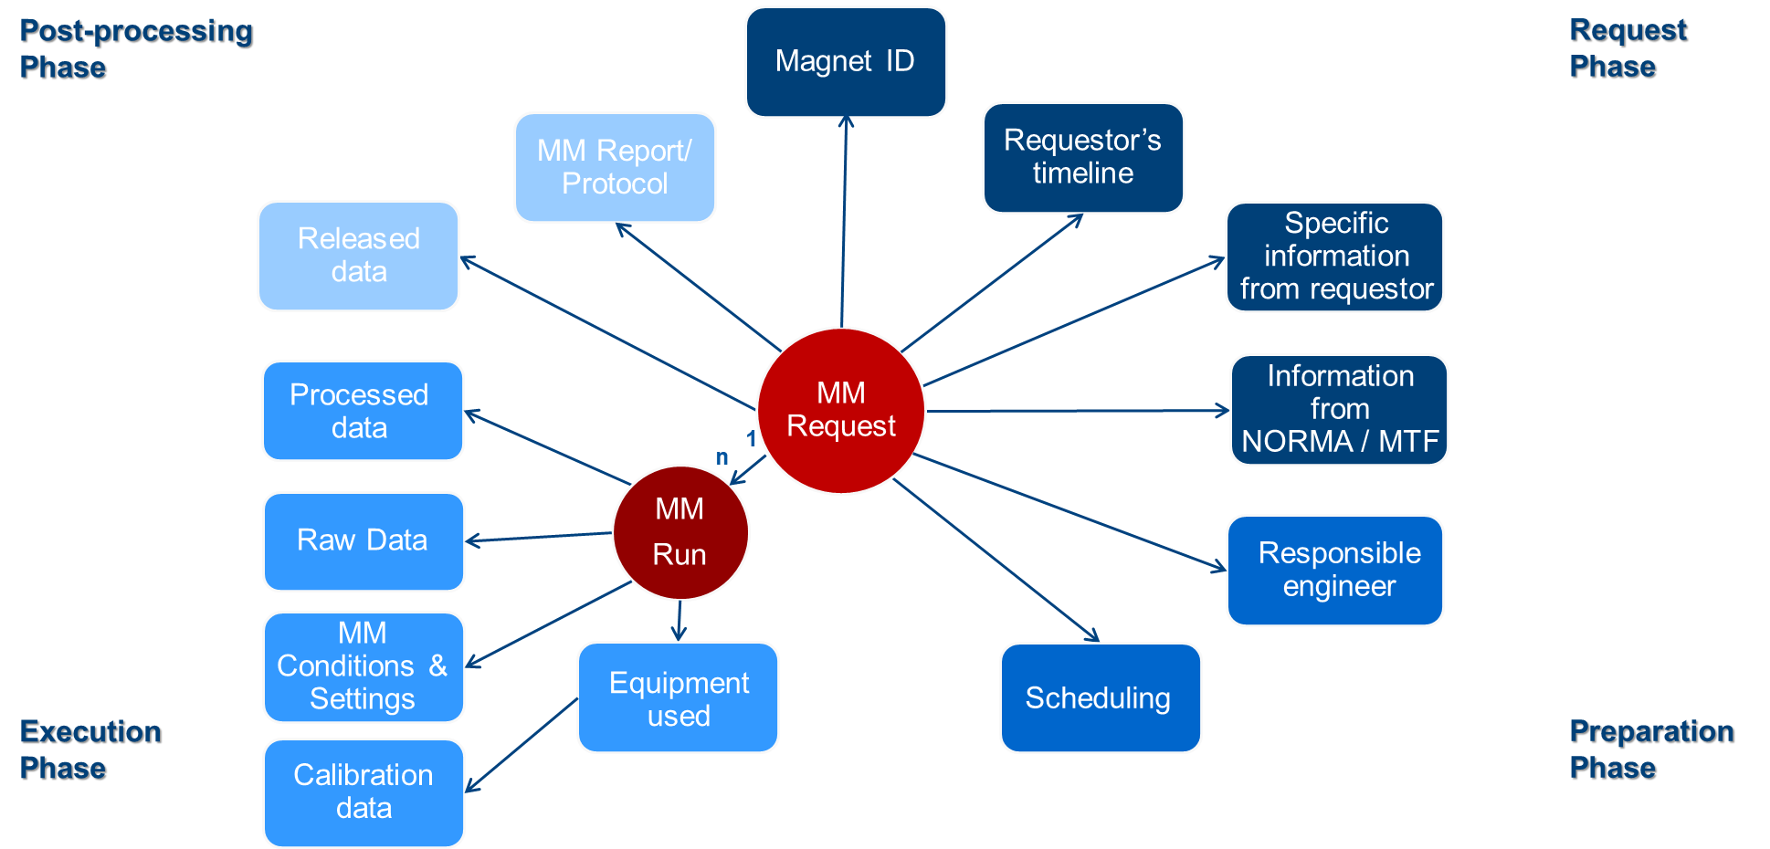

MM Requests: the Central Point of our New IS
or
Processed Data
or
Notes:
Demo of Helmholtz Coil Request: 27533987

Slide 12
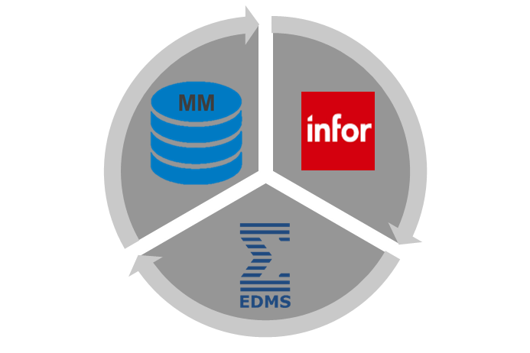
Summary
MM Data Storage:
Infor EAM:
Assets, WOs (MM Requests & Runs), Calibration, Equipment Used and MM Settings, Conditions & Results of simple MM Systems.
EDMS:
Raw data of calibration and MMs, MM Reports/Protocols.
MM Database:
MM Processed & Released data of complex MM Systems.
All information integrated across all the components of the 3MIS.

Slide 13



Slide 14
Additional slides

Slide 15
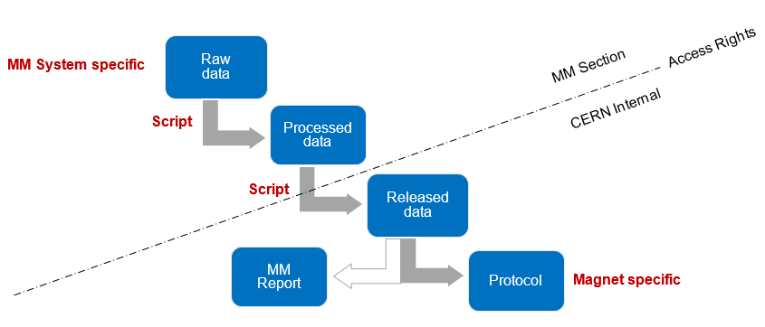
MM Results Levels (1/2)

Slide 16
MM Results Levels (2/2)
Results Level | Description | Format | Structure | Access Rights
Raw Data | Flux and current acquisitions as a function of time and/or position (no separation turn by turn). | ASCII files | Flexible | MM Section only
Processed Data | Position and field data in a tabular format, understood without knowing information about the MM system used, just information about the magnet (splitting turn by turn, flux and current synchronization, cumulative sum of flux increments, ramp-rate compensation, drift correction, standard harmonic analysis, etc.). Calibration data of the equipment used were applied to the raw data to make the data of this level independent of the system. | Database table | Fixed (standard) | MM Section only
Released Data | Summary, selection or combination of the processed data of different runs in a tabular format, easily understood by anyone and with all the relevant information (script, runs from which the data are combined) to be able to reproduce the same data from the processed data (subset of measurement turns, average of turns, combination of measurements at positive and negative current, combination of positions to get the integral, cross-calibrations, etc.). | Database table | Fixed (standard) | CERN Internal (if requested)
Protocol | Representation of the released results in a format that suits the MM client’s specific needs (with plots, numeric values, etc.) | Document (pdf, word, excel) | Template based | CERN Internal
MM Report | Detailed report that describes, apart from results, the MM method used and many meta-data. It often contains comparisons of results of different magnets or comparisons of measured and simulations data. | Document (pdf, word, excel) | Template based | CERN Internal

Slide 17
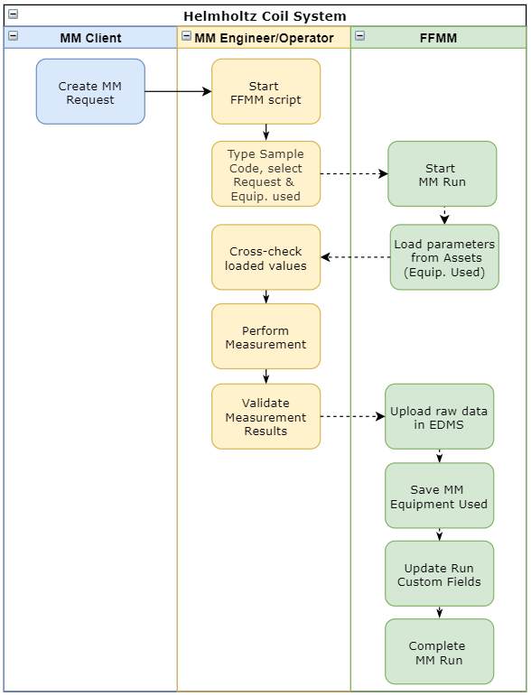
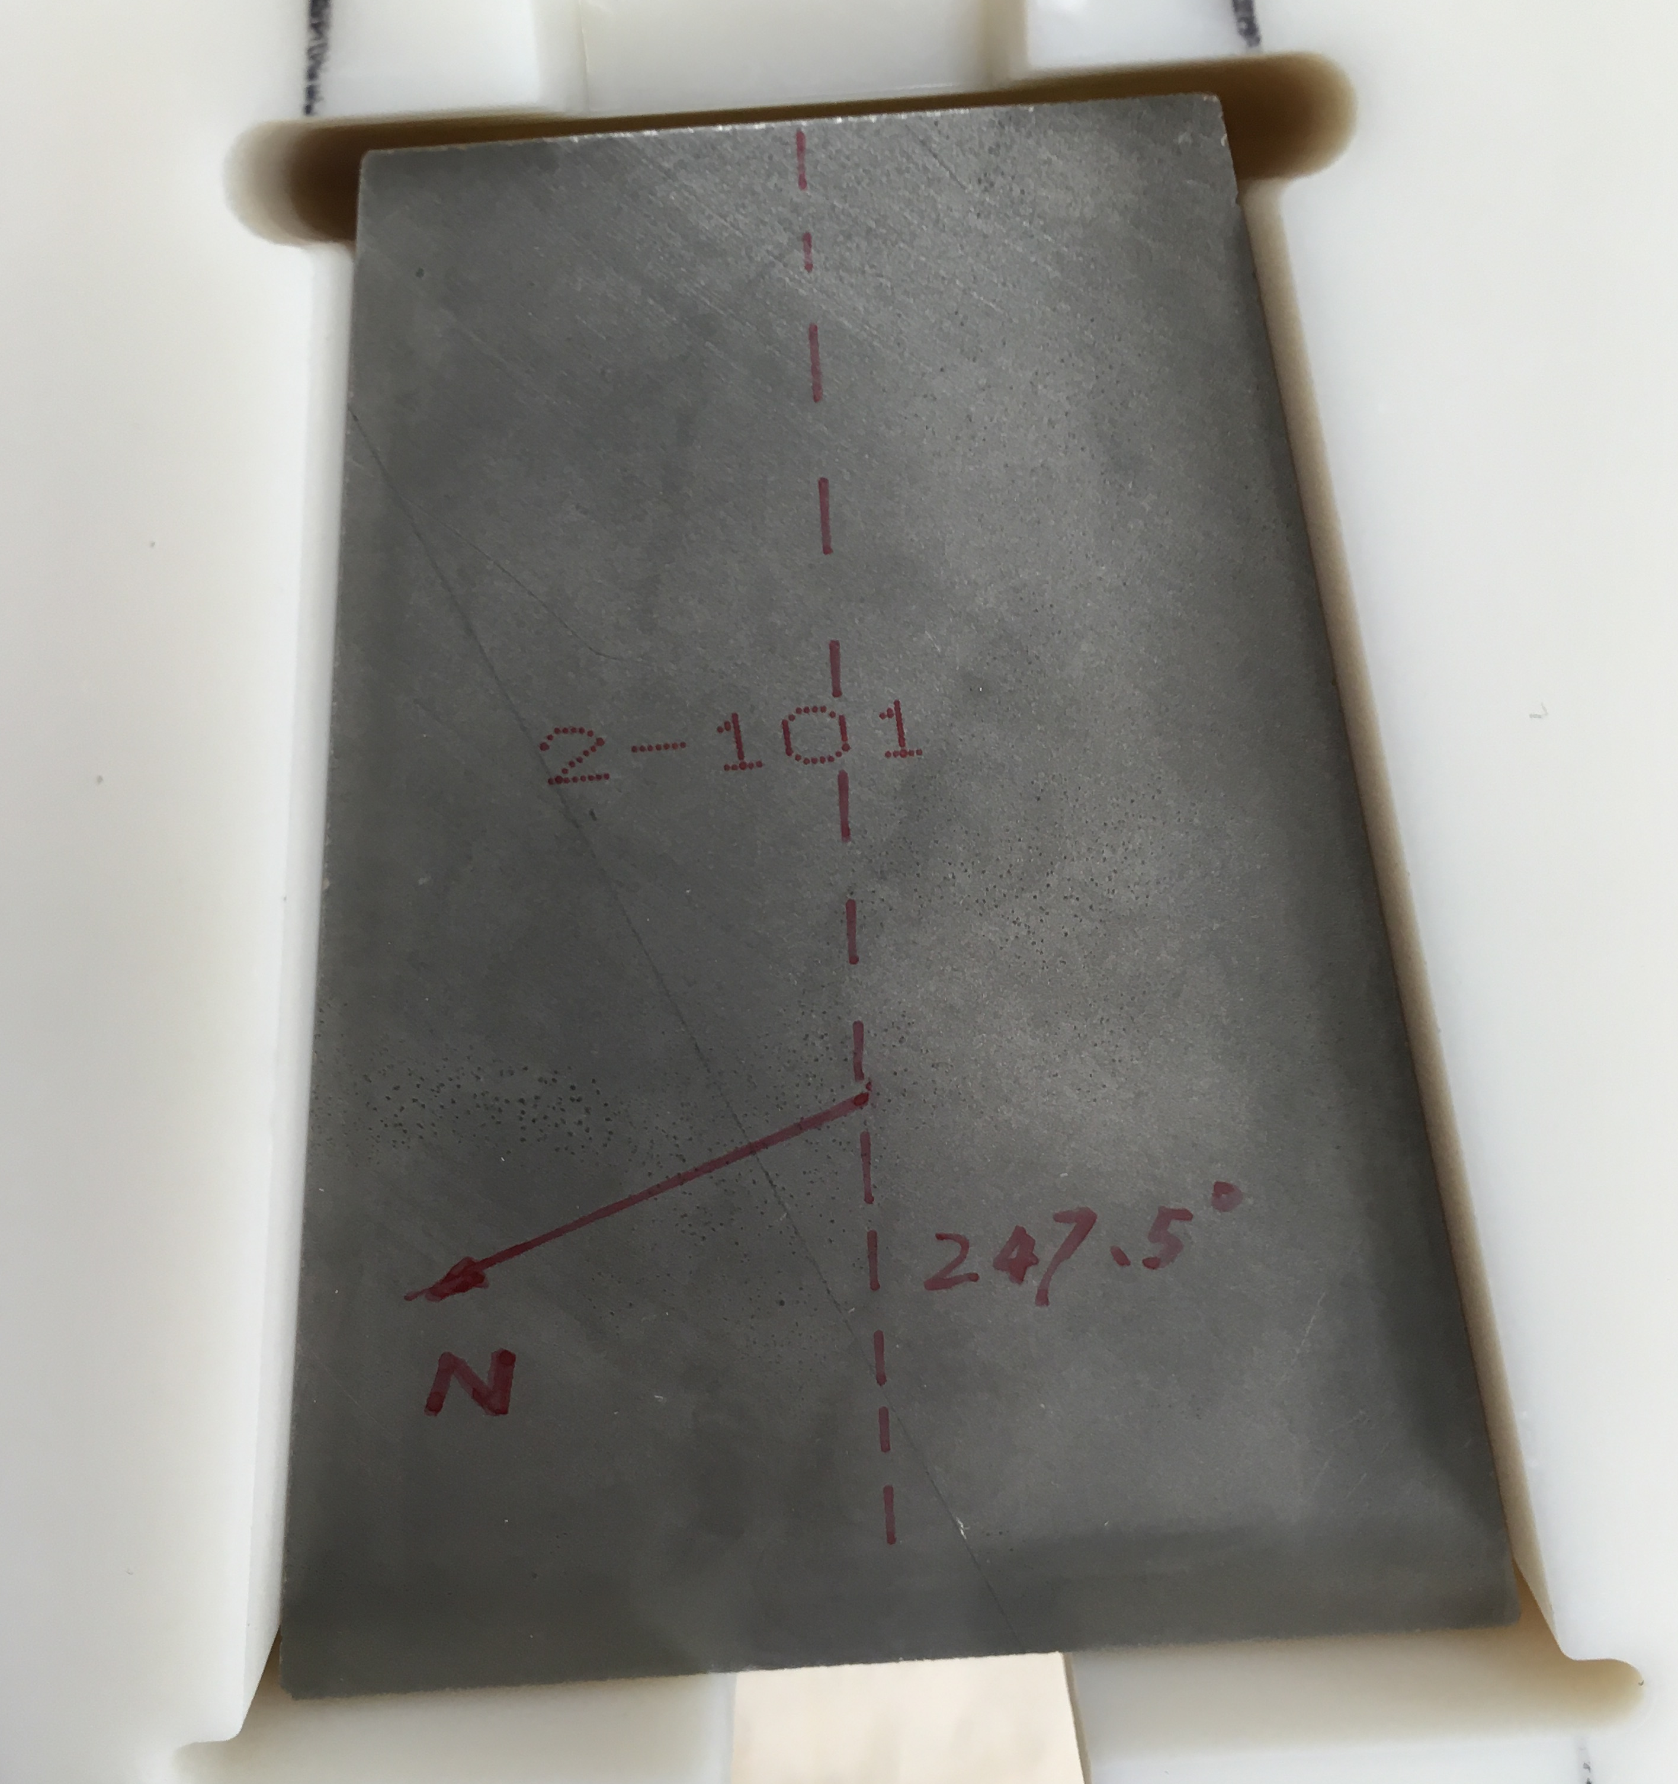
Measurements: Helmholtz Coil System
Workflow similar to calibration
Automatic archiving of results:
Raw data and Parameters saved in EDMS
All other data saved in Infor
Results available immediately & with one click

Slide 18
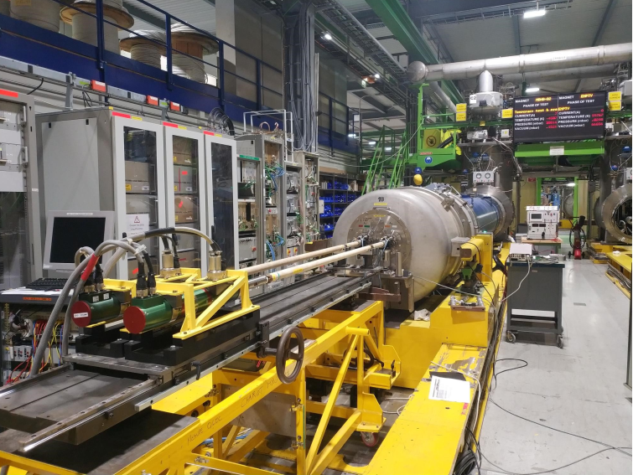
Measurements: Rotating Coil System
Next milestone: upcoming measurement campaign for HL-LHC
More complex system:
Measurements in cryogenics conditions
Need for reduced feedback loop
Complex data structure
High volume of data
Preparation already done
Re-use of features of existing scripts & development of advanced features

