Slide 1

WP5: Update on Undulator Options
Neil Thompson, STFC, 17/06/20
Third CompactLight Midterm Meeting
‘Virtual Glasgow’

Slide 2
Introduction
The original assessment was that for best performance in the HXR (up to 16keV) we should use a helical Superconducting Undulator (SCU) with a period of 11mm.
This was based on studying the performance of different undulator technologies.
For WP5 Deliverable 5.1 the decision was made to relax the period slightly to 13mm, to allow a little margin, and adjust the undulator a_{w} range accordingly.
In the meantime Vitaliy made calculations of the output in the SXR and found that pulse energies were not competitive with other facilities (for example LCLS). His results were consistent with Genesis simulations in the SXR.
Partly this is expected – for example we have a lower bunch charge and beam energy than LCLS, both of which will affect the FEL pulse energy.
Nevertheless, it was agreed to re-assess the undulator parameters to answer the question:
Have we been too concerned with the FEL output at 16keV to the detriment of the SXR, and can we ‘rebalance’?
This talk shows the results. I have looked at three variables – minimum gap, tuning range and undulator period – to illustrate the impact they have and see what improvements could be made.
I have also compared the optimum SCU option with a non-superconducting technology (APPLE-X) to confirm the benefits

Slide 3
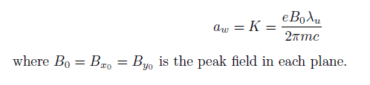
Introduction
Here have assumed a helical SCU with parameterisation given in D5.1
Most calculations use the Ming Xie parameterisation with a ‘filling factor’ of FF = 0.6 used when calculating pulse energies from peak powers (to account for SASE spikiness).
Some results cross checked with Genesis1.3
The initial constraint assumed is that the maximum beam energy is 5.5GeV

Slide 4
Effect of Minimum Gap Choice (NbSn)
Tuning range factor of two where possible.
Gap choice makes no difference to output at 11-16keV (same period, aw, beam energy)
At E_{ph} < 11keV output is better for 4mm gap – higher aw and beam energy available.
A gap of 4.3mm gives on average about a 15% increase in pulse energy compared to using a 5.3mm gap (for the same period). Zafer’s results indicate increased wakefield losses acceptable.

Slide 5
Effect of Tuning Range Choice – X2 vs X1.5
No difference from 8 – 16keV
For E_{ph} < 8keV pulse energies higher on average because minimum a_{w} is higher and beam energy is higher
BUT need more beam energies to cover wavelength range so less practical
If a particular experiment at <8keV wanted maximum pulse energy we could always operate at the optimum beam energy and a_{w} for that wavelength – in this case the nominal tuning range is irrelevant.

Slide 6
NbTi, 4.2mm gap: Effect of Period Choice –
X2 tuning range where possible, 4.2mm gap
HOWEVER:
THERE IS A LIMIT ON THE MAXIMUM BEAM ENERGY FOR SXR OPERATION @ 1kHz

Slide 7
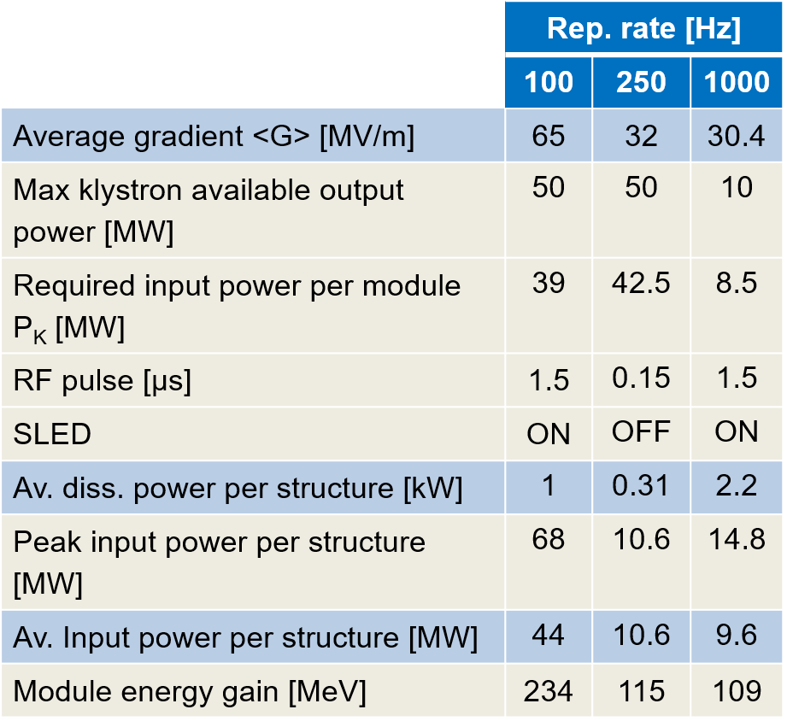
1khZ Beam Energy Considerations
From Walter: “For the exact energies of the different cases, there are some more levels of precision. The first is a detail of the rf pulse compression change due to different klystron pulse length. The exact numbers for energy gain per module can be found on Marco Diomede’s presentation at the annual meeting https://indico.cern.ch/event/867582/timetable/#20200121.detailed, slide 13. In addition there was some discussion during the Athens meeting about off crest acceleration (needed for short-range longitudinal wakefield compensation), which changes along the length of the linac, so there are further corrections to the exact energies. The accounting of the number of modules is being taken care of by Avni, Markus and Carlo, consistently I hope! All that together would give you the HXR and SXR energies. I start to wonder how close the numbers are to those you give in the facility overview slides. It should all be double checked.”
Therefore estimate max energy at 1kHz:
5.5GeV * 109/234 * cos(23.4 deg) = 2.35GeV

Slide 8
WP4 Assessment (Xiaowei)

Slide 9
SXR: 0.25 – 2.0 keV
HXR: 8 – 12 keV
HXR: 16 keV – Xie vs Genesis1.3

Slide 10
13 mm SCU Max Pulse Energy vs E_{ph}
100 Hz
N.B. Peak photon pulse energy in 2-4keV range: this region (tender X-rays) is still not well covered by other FEL facilities and there is an increased interest from users in this region.
(At LCLS -I they even had a gap from 3 to 5 keV because the main effort was on the higher energy operation)
1kHz
100 Hz
100 Hz
1kHz
100 Hz

Slide 11
SCU

Slide 12
SCU (13mm) vs APPLE-X (13mm)

Slide 13
SCU (13mm) vs APPLE-X (15mm)

Slide 14
SCU (13mm) vs APPLE-X (17mm)

Slide 15
SCU (13mm) vs APPLE-X (19mm)

Slide 16
Conclusion
The original SCU period of 11mm does give the best performance in the HXR from 8-16keV.
An SCU period of 13mm gives a more balanced performance across the whole wavelength range, notably about double the pulse energy in SXR
  15mm gives too long saturation length at 16keV, and better performance in SXR only in the range 0.25 – 0.65keV
  11mm gives marginally better performance from 8 – 16keV
The tuning range by adjusting the undulator field strength is only a matter of convenience – it doesn’t limit the potential performance at any photon energy.
Minimum gap of 4.2mm gives better performance than 5.2mm, balanced against the increased wakefield degradation.
It is not possible to find a period for an APPLE-X undulator that matches the performance of the SCU across the whole photon energy range.
The SCU is the best choice for a facility such as CompactLight where we wish to use the same undulators for SXR and HXR

Slide 18
Extra……

Slide 19
Effect of Minimum Gap Choice: Data Source
5.3mm
4.3mm
5.3mm gap
NB on these plots gap (g) is proxy for SCU current
4.3mm gap

