Slide 1
CPMU back-up for SC helical undulator
& Afterburner options
T. Schmidt
Paul Scherrer Institute
November 25, 2020

Slide 2
Feedback form SAC
SAC requests:
SC helical undulator maybe to risky to base the entire project on
Tolerance study for sc helical undulator reamining
Back-up based on permanent magnet technology

Slide 3
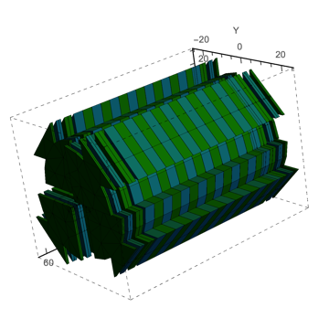
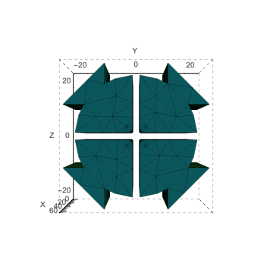
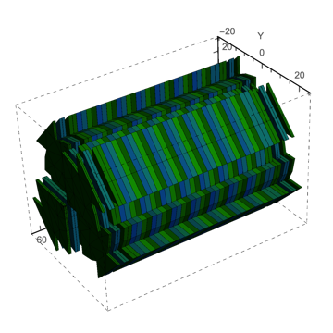
Back-up CPMU fixed helical
helical SCU:
13mm period, 4.2mm magnetic gap, (3mm beam pipe inner diameter)
a_{w} = 1.33 – 0.617 (K_{eff} = 1.87 – 0.87), B_{eff} = 1.54T
250eV, (0.97GeV) - 16keV (5.5 GeV)
CPMU
gap = 4.2mm
slit = 2.5mm
4 magnets / period
8 magnets / period

Slide 4
Undulators summary
Type | period [mm] | magn / vac gap [mm] | slit [mm] | N_{Mag} per period | B_{r} [T] | E [GeV] | aw | K | E [eV]
helical scu | 13 | 4.2 / 3 |  |  |  | 0.97 | 1.33 | 1.87 | 250
CPMU A | 13 | 4.2 / 4.0 | 2.5 | 8 | 1.67 | 0.97 | 0.85 | 1.20 | 400
B | 14 |  |  |  |  |  | 1.0 | 1.40 | 322
C | 15 | 4.2 / 4.0 | 2.5 | 8 | 1.67 |  | 1.14 | 1.61 | 259
D | 15 |  |  | 4 |  |  | 1.05 | 1.49 | 283
E | 14 |  | 0.5 | 8 |  |  | 1.46 | 2.05 | 205
F | 13 | 4.2 / 4 | 0.5 | 8 | 1.67 |  | 1.27 | 1.78 | 265
G |  | 3.7 / 3.5 | 1 |  |  |  | 1.30 | 1.83 | 256
H |  | 3.2 / 3.0 | 1.5 |  |  |  | 1.27 | 1.83 | 263
AB CPMU A | 18 | 5.2 / 5 opt (3)¹ | 3 | 4 | 1.67 | 0.97 | 1.24 | 1.76 | 194
 |  |  |  |  |  | 5.5 | 0.57 | 0.81 | 12000
B | 17 | 5.2 / 5 opt (3)¹ | 3 | 4 |  | 0.97 | 1.10 | 1.56 | 235
 |  |  |  |  |  | 5.5 | 0.23 | 0.33 | 16000
C | 16 | 4.2 / 4 | 3 | 4 |  | 0.97 | 1.15 | 1.62 | 225
¹ with beam pipe | CPMU C ok | CPMU F critical | AB B best? |  |  | 5.5 | 0.35 | 0.49 | 16000

Slide 5
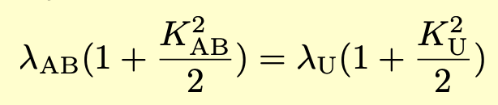
CPMU backup
yes, with 15mm period - with lower performance
yes, with 13mm period - but very demanding
After-Burner
is 12keV sufficient or do we need to go to 16keV?
12keV: reserve, 18mm or longer ok
16keV: matched tuning with FEL
17mm or less

Slide 6
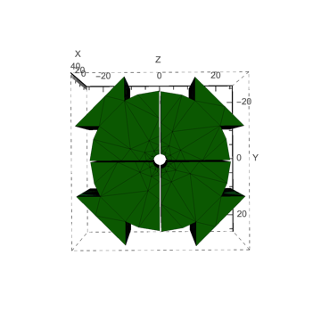
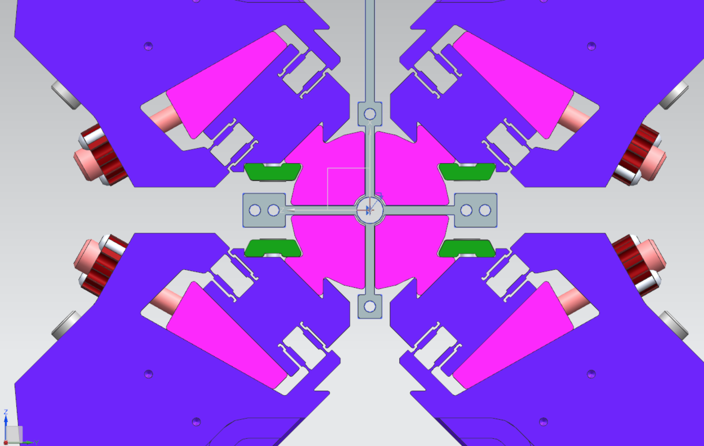
measurements through the hole only
(like for sc undulator)
foil coated magnets only
slit = > 2.5mm
access for measurements
(slotted) pipe possible
wall thickness 200μm
courtesy Suren Karabekyan, EUXFEL, here with water cooiing
not required for XLS

