Slide 1
Services activities in 2020 and 2021
ADO / TC meeting
30-November-2020
Marco Ciapetti

Slide 2
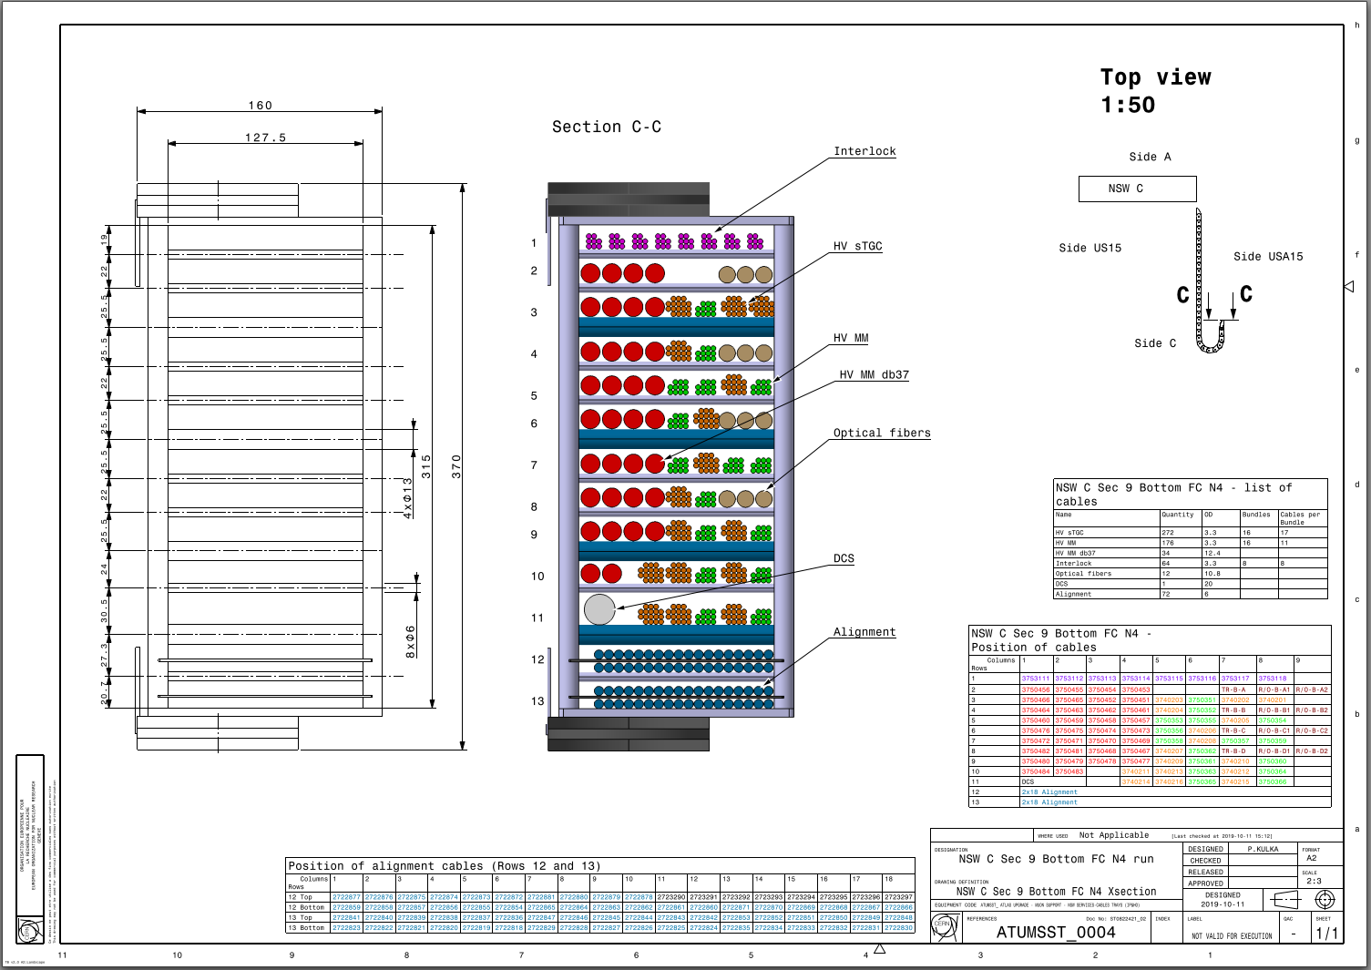
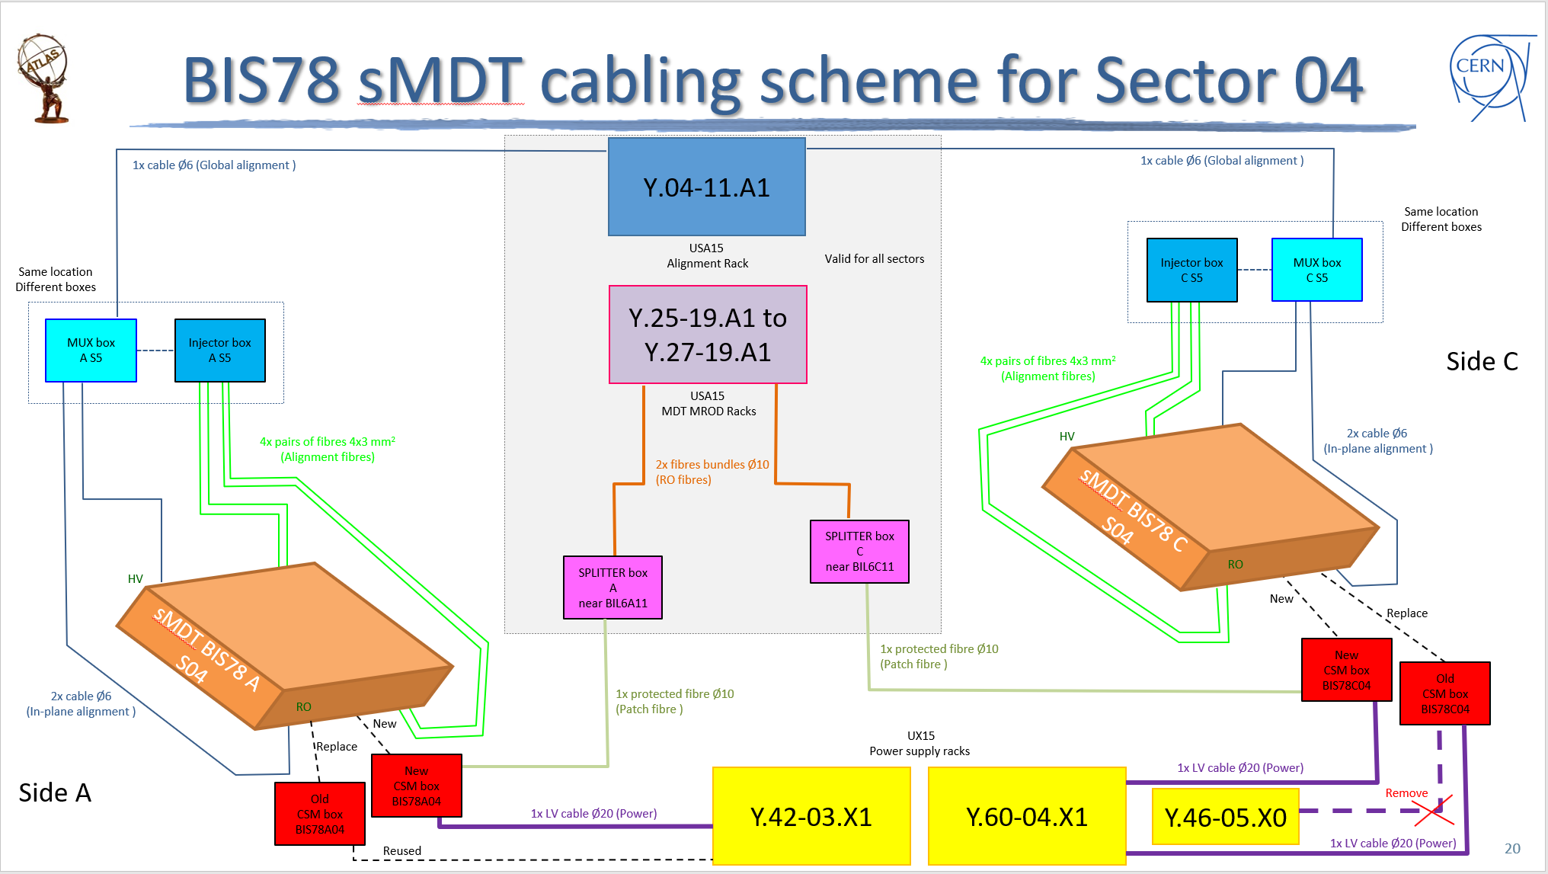
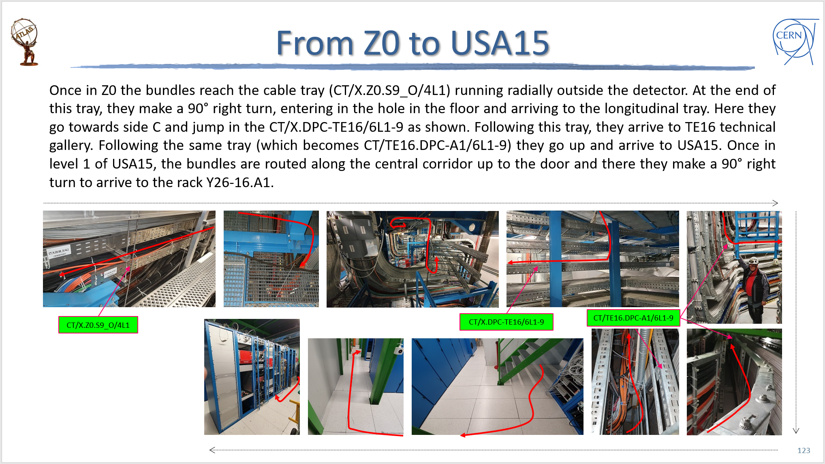
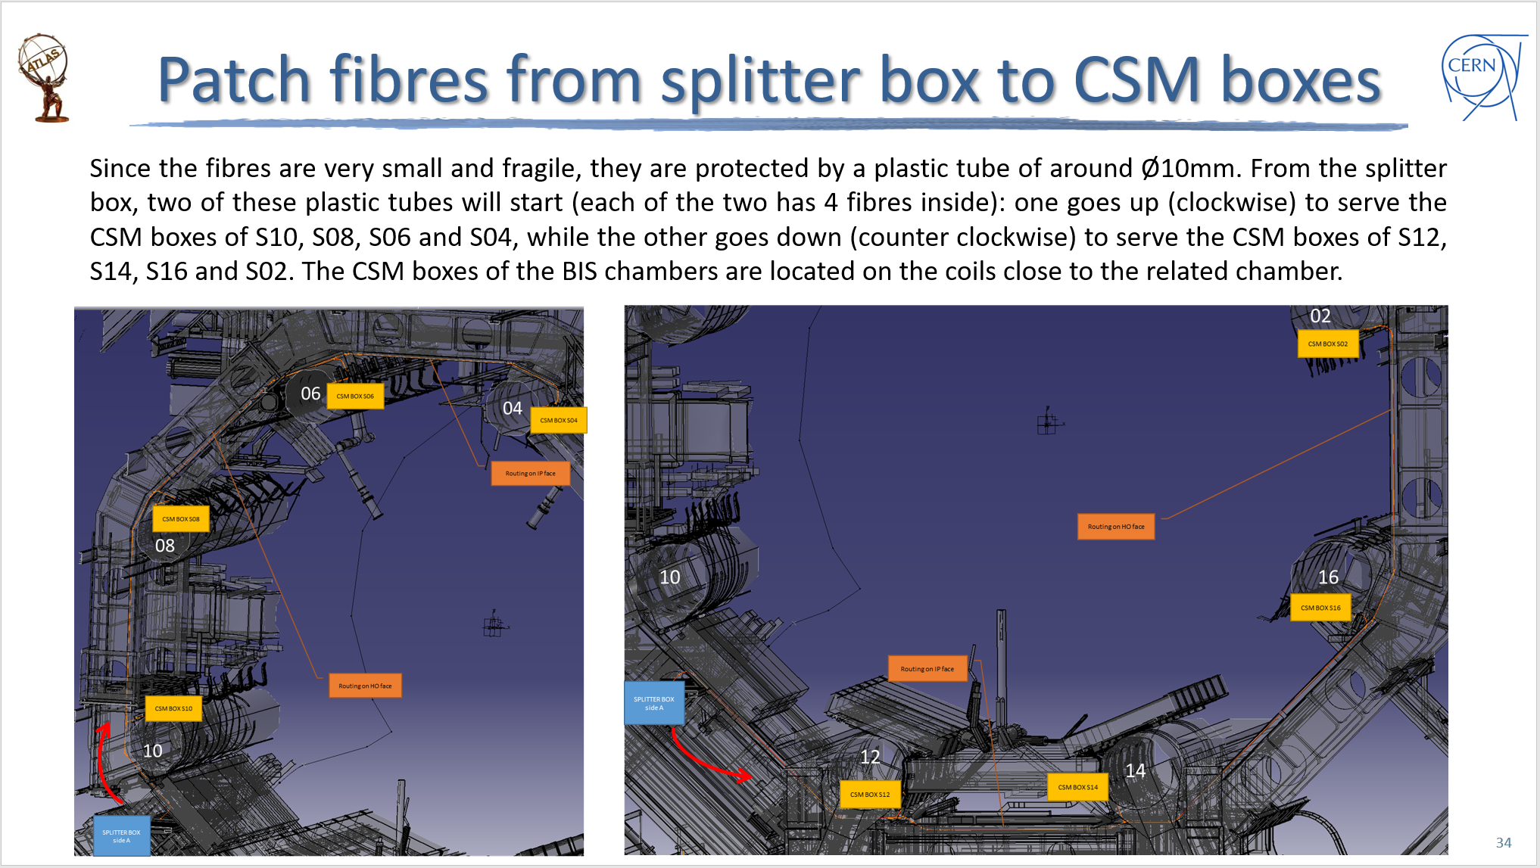
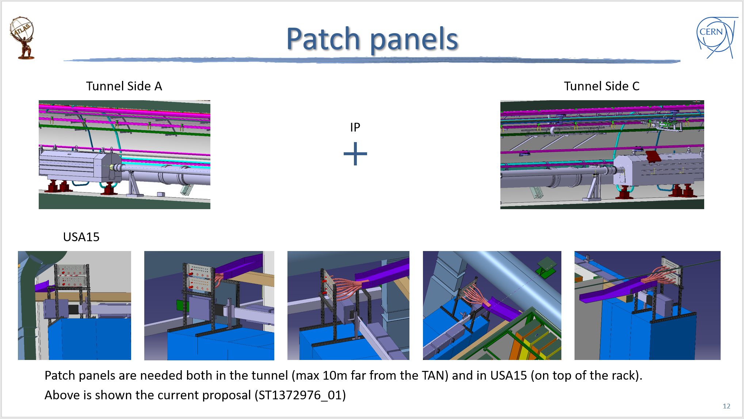
LS2 cabling activities
Cabling is not just the installation!
1
Cabling schedule for the remaining part of LS2 is still a bit uncertain.
Some important decisions are driving it (i.e. current SW cables removals, BIS78 side C installation, etc.)
Design of components and related routing is still ongoing (i.e. TPX3, ZDC/RPD, etc.)
NSW-C cabling is on going and almost over
Additional requests will be processed after the NSW cabling or in the spare time (when possible)
Collect requests and information and summarize them into tables and drawings
Prepare a simplified scheme (for complex routing)
Study the routing on the CAD and estimate lengths
Check the feasibility in the cavern and prepare detailed document with routing instructions
Install new cable trays and supports (if needed)
Proceed to the cable pulling
2
4
5
3

Slide 3

LS2 cabling activities up to now
Cabling/piping for TRT, ID foreseen in LS2 (side A and C)
Cabling for Tile foreseen in LS2 (side A and C)
Cabling for LAr foreseen in LS2 (side A and C)
Removing TPX sensors and their cables
Cabling for BIS78 foreseen in LS2 (side A) *
Other cabling requested for LS2 (network, TDAQ, water leak detection in USA15, etc.)
Cabling for destratification project (AHUs)
Cabling for RPC gas system upgrade project
Cabling for NSW side A is done, BUT:
  SW cables removal not done (no green light from TC yet)
  Part of the cables are routed up to outside toroid (to be completed)
  Few cables are still missing (procurement on going)
COMPLETED
* RPC signal cables for 3 sectors still need to be install → waiting chamber removal
Cabling for NSW side C is on going. Mostly done but to be completed in 2021
Cabling for L1Calo foreseen to be completed before the end of 2020

Slide 4
LS2 cabling activities in 2021
Schedule might
(and will!) change
according to updated
needs and constraints
We still have a lot of work to do in 2021:
NSW-C fibers (foreseen January 2021)
NSWs Sniffer pipes installation (foreseen February 2021)
Complete cabling for NSW side A → at least 2 months (maybe more!) after the green light to remove current SW cables (currently foreseen in February-March 2021 or as soon as TC gives the green light)
NSW-C additional HV cables for High Granularity (foreseen March 2021)
Cabling for TPX3 detectors (schedule to be clarified. Probably April 2021 or later)
Complete cabling for NSW side C → at least 2 months (maybe more!) after the green light to remove current SW cables (currently foreseen in May-June 2021)
ZDC/RPD additional cabling (schedule to be clarified. Probably after July 2021)
Installation of prototypes of strips Type III cables for setup in SR1 (waiting for info and cables availability → not in schedule
BIS78 cabling for RPC and sMDT chambers side C (cancelled by requestor (*) → not in schedule)
* Is it still the case?
As usual, if your cabling request is not in this list, it means TC does not know about it → Please inform us!

Slide 5
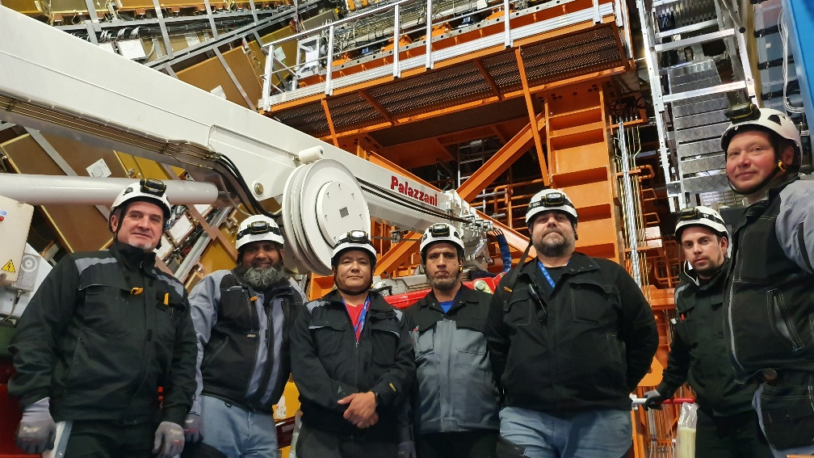
Cabling Team
THANKS!
Team Leader: Mito Tasevsky
Full time in LS2: Pasang Nuri Sherpa, Muhammad Sajid, Muhammad Naeem
Alternating in LS2 (3 each period): Sergey Mokrenko, Andrey Pluzhnikov, Dimitrii Liubimtcev, Mikhail Vinogradov, Alexander Shutov, Ivan Fomichev
Engineers in the office: Peter Kulka and myself

Slide 6
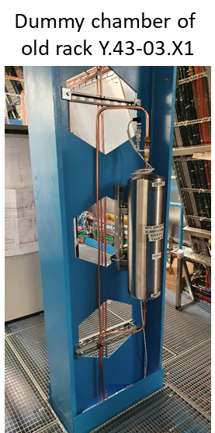
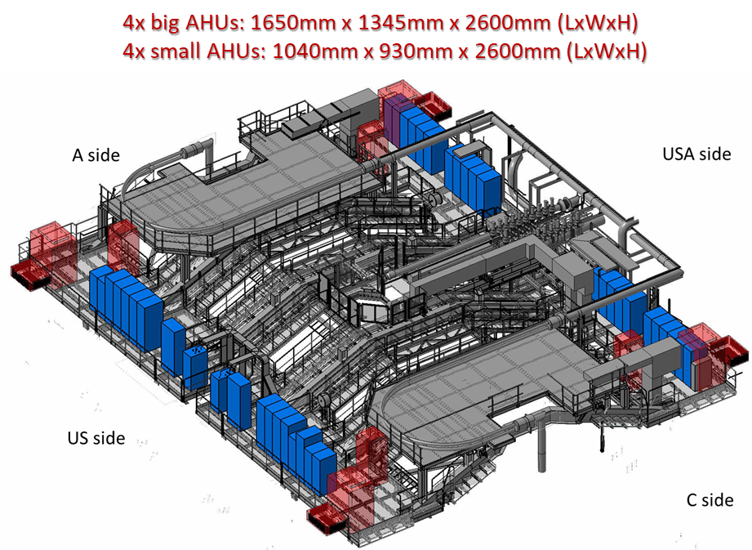
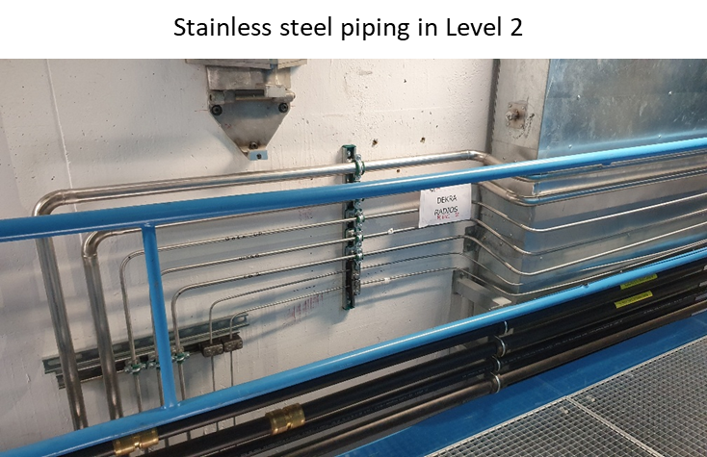
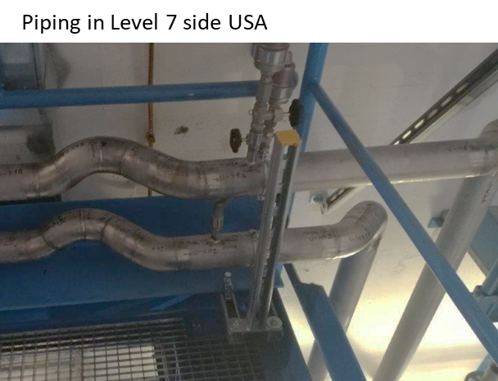
Other services → Piping
Our job is not only cabling!
We have also to take care about piping into the underground caverns.
Most of the times, supervising external companies works (i.e. big projects: the RPC gas system upgrade or the Destratification project).
Few times installing the pipes ourself (i.e. sniffer pipes, cooling lines between racks, TRT gas distribution exhaust, etc.)
RPC Gas system upgrade
Destratification project
Pressure and leak tests on going
Commissioning foreseen beginning of 2021
Pressure and leak tests on going
Commissioning foreseen by the end of 2020

