Slide 1
ADO – TC meeting
Raphaël Vuillermet
November 30th 2020

Slide 2
Resources in ATLAS Design Office
  Raphaël Vuillermet Design office supervisor & Project Engineer
  Giancarlo Spigo RSO & Project Engineer
  Tatiana Klioutchnikova Integration & Project Engineer
  Joffrey Malaquin Opening operations & Project Engineer
  Lorenzo Quercia BIS 78 installation & Project Engineer
  Marco Ciapetti EAM, Project Engineer in charge of services installation
  Pavel Maly Fellow until July 2021
  Alexander Seletskiy Designer, User
  Edouard Demeure Designer
  Peter Kulka Engineer, User
  Jamie Pinnell Technical activities & Design Office
  Gevorg Akhperjanyan Technical activities & Design Office
  Technical Student from beginning of 2021
  Albert Davletov (Dubna) User, from beginning of 2021
  Czech engineer User, from spring 2021 (still under discussion)

Slide 3
LS2 activities
  Coordinate the installation of BIS78 chambers (Lorenzo, Tatiana, Alexandre, Christian, Armen)
  Preparation and control of the NSW (Alexandre, Tatiana + technical team)
  Coordination Integration of new services all over UX15 (Peter, Marco + service team) talk of Marco
  Prepare and participate in the ATLAS closing operations at the end of 2021 (Lorenzo, Joffrey, Raphael + technical team)

Slide 4
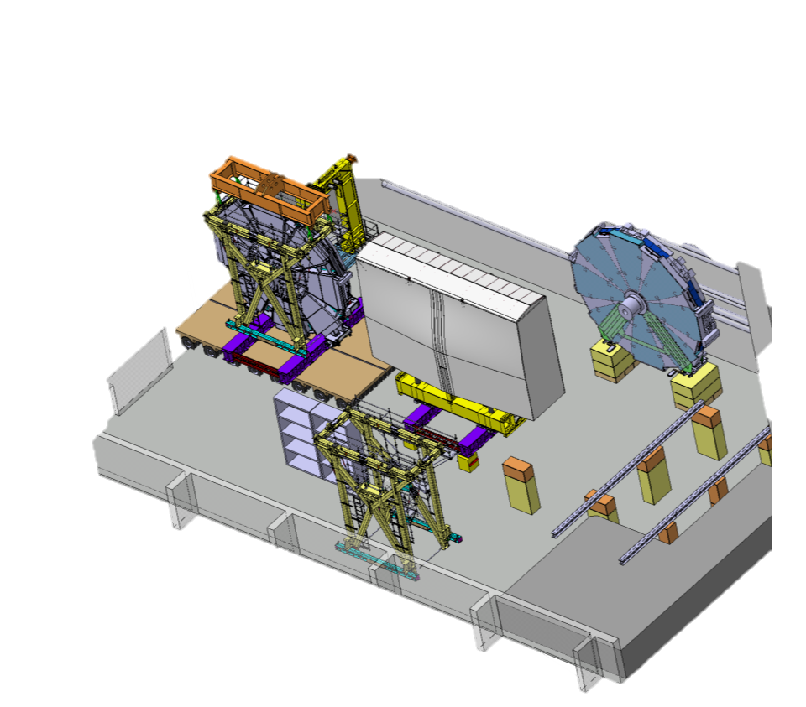
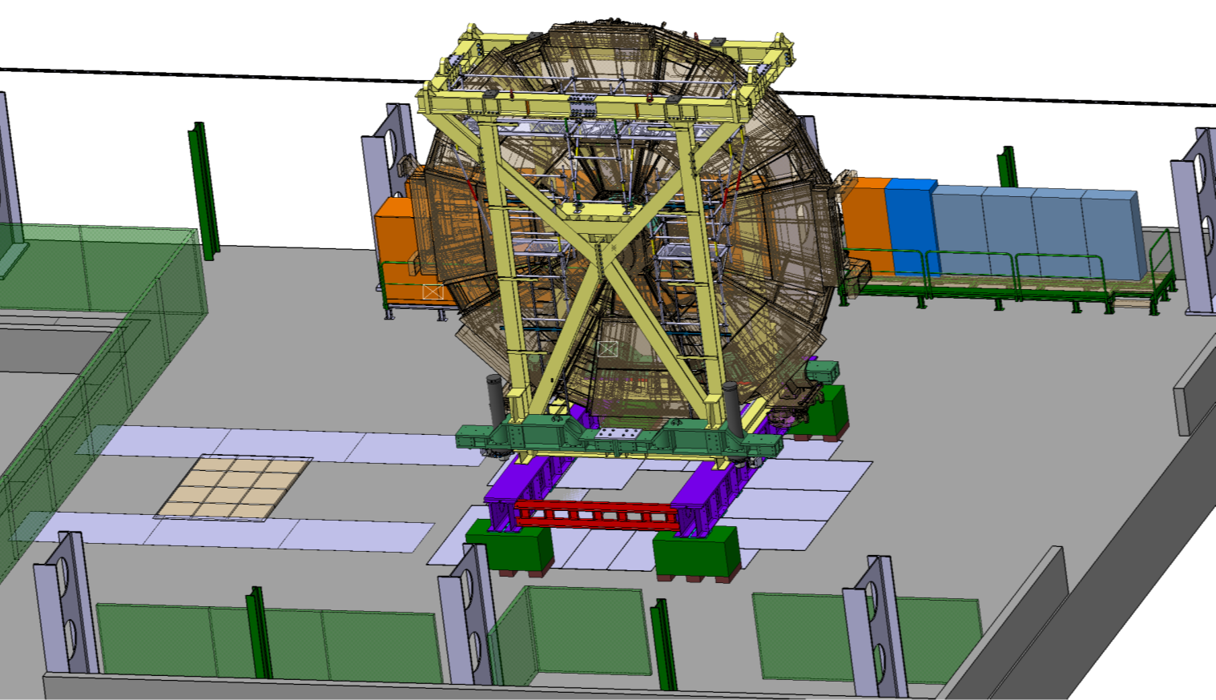
LS2 activities
  Coordinate the preparation and the transport of the SW & NSW (Pavel, Joffrey, Raphael,+ technical team)
SW in SX1 ready for the transport
SW and NSW in b191

Slide 5
LS3 studies and engineering activities
Several studies has already started with gradually increase during 2021
Important use the benefice of this additional year of LS2 to collect information (reverse engineering), study and already perform preparation work to anticipate the huge amount of work that LS3 will require.
A larger and larger fraction of the engineering effort in the Atlas design office is now focusing on LS3 activities.

Slide 6
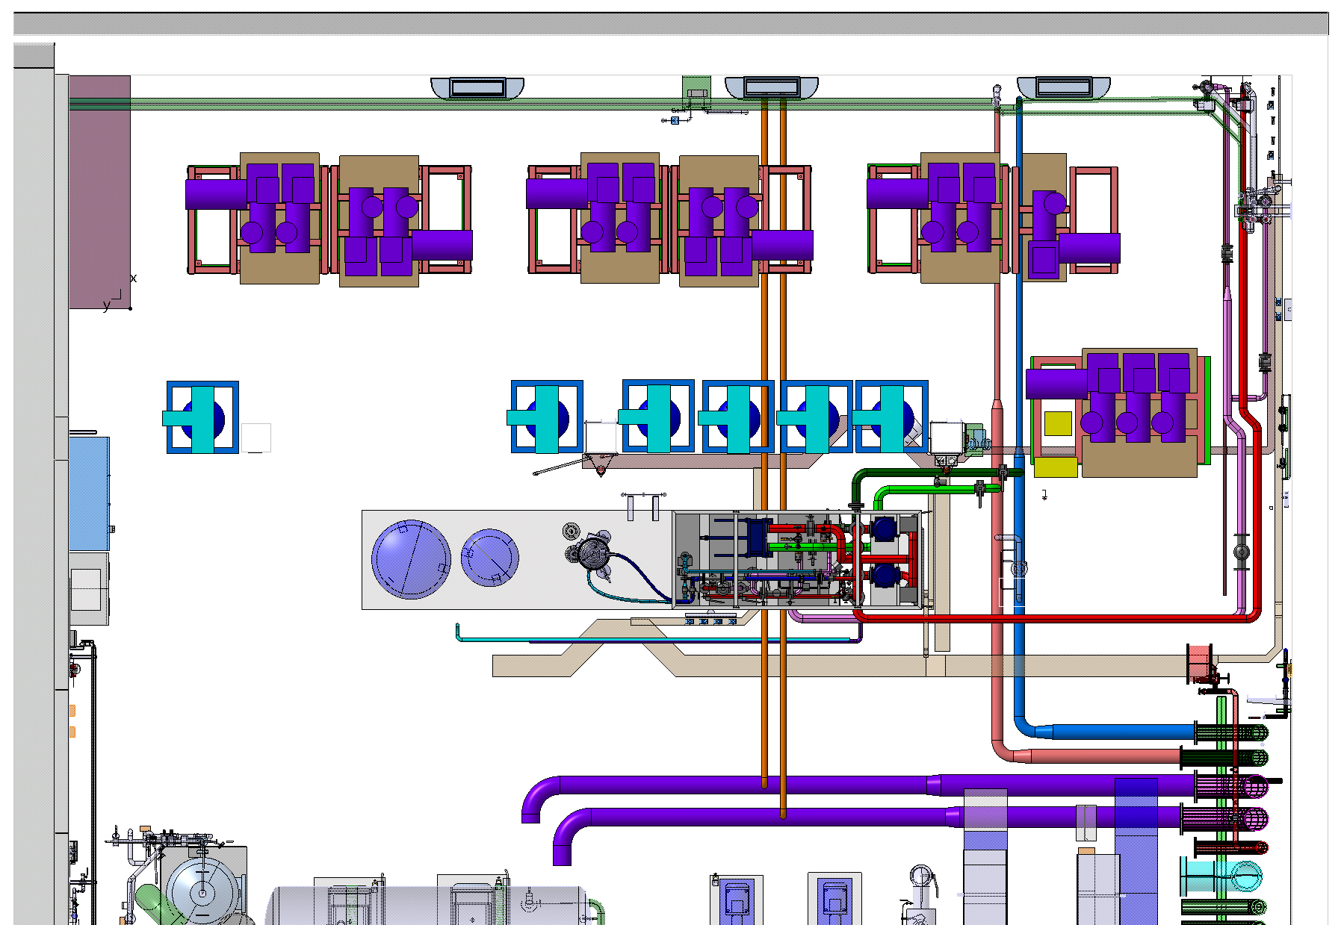
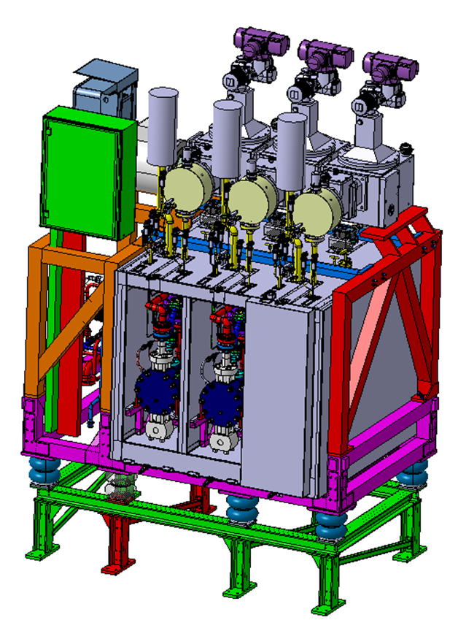
CO2 cooling system for ITK and HGTD
  CO2 plant installation in USA15-CV room (Pavel, Edouard, Martin, Claudio, Raphael)
    Integration of the CO2 cooling plants
    Design of the cooling plant supporting frame (Technical Student, Pavel)
USA15-CV room

Slide 7
CO2 cooling system for ITK and HGTD
    Integration of the control cabinets (42 in total ! -> a challenge for the integration) (Pavel, Edouard, Raphael)
      Prepare the area, integrate the rack, modify the supporting structure, prepare sequence of installation …
Considered rack location
Today
After LS3

Slide 8
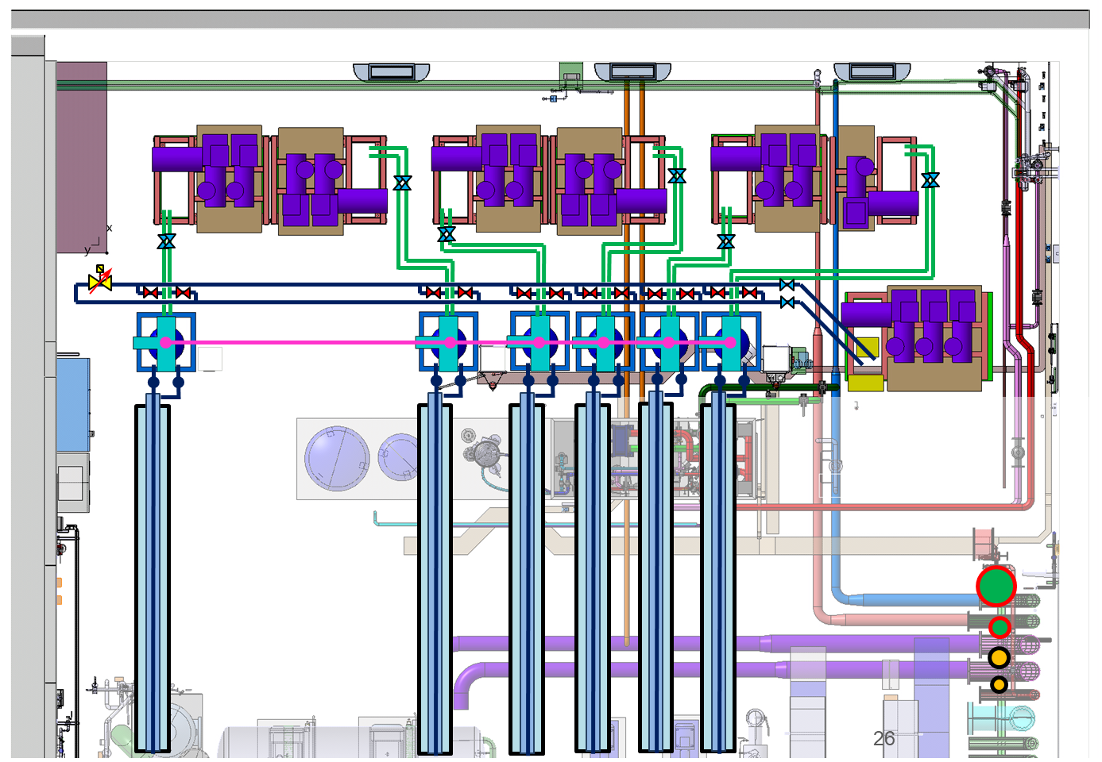
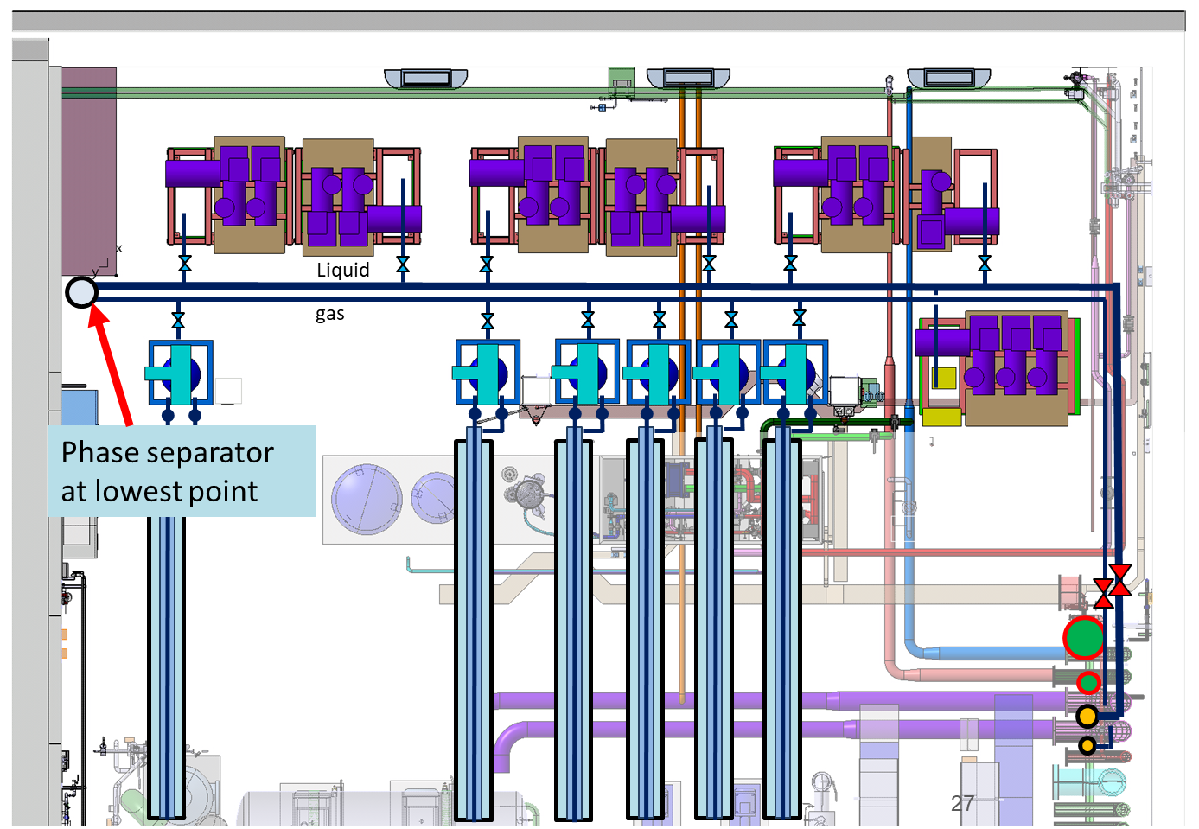
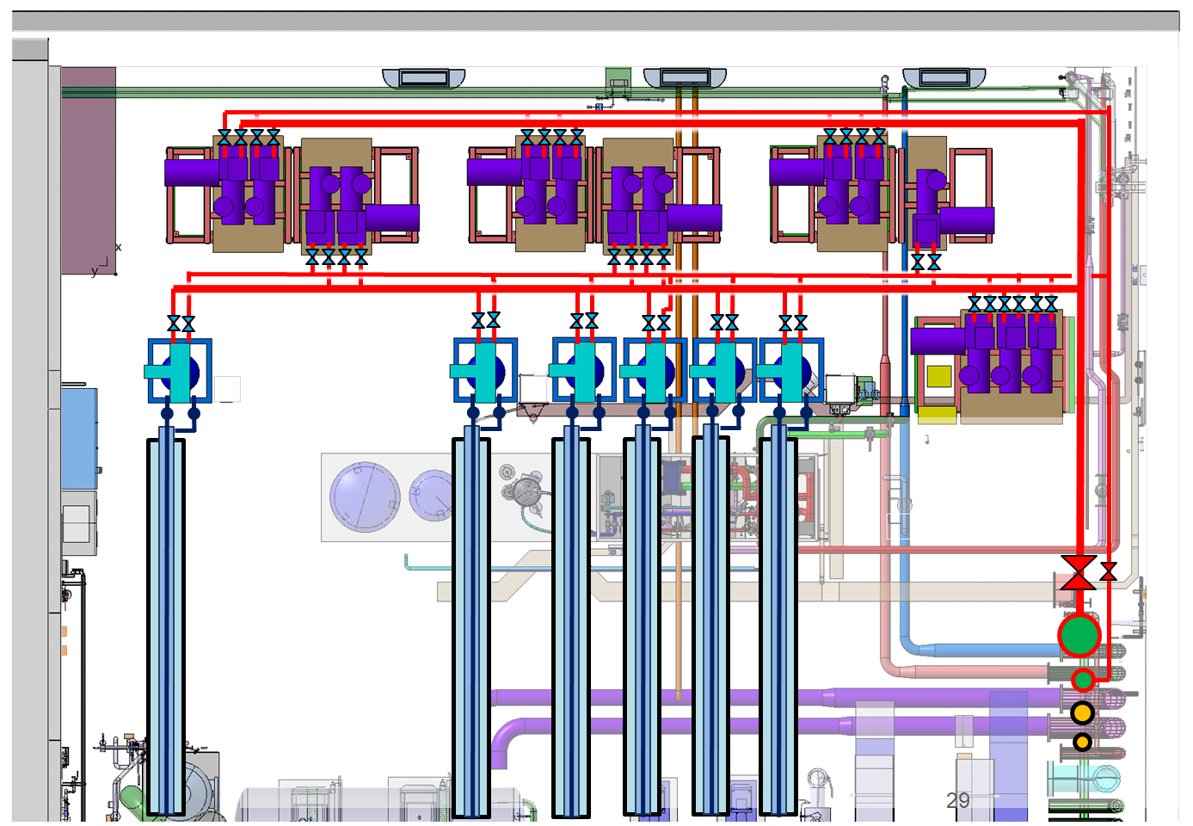
CO2 cooling system for ITK and HGTD
Integration piping under the false floor (Pavel, technical student, Raphael, + support)
  Between surface storage, new Cooling building and USA15
  Between CO2 Plants, accumulators and transfer lines
  Concern the primary cooling R744 and CO2
CO2 plant
Accumulators
Transfer lines

Slide 9
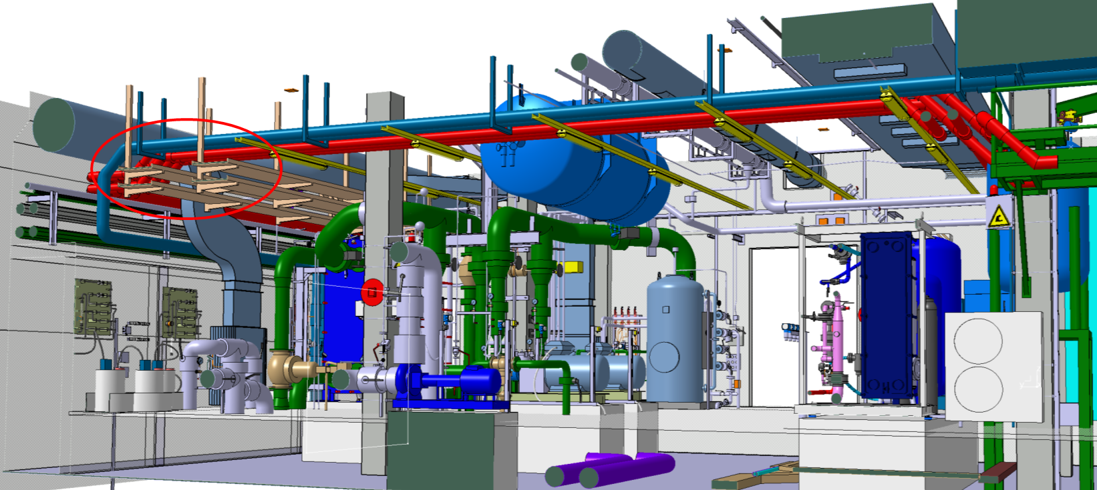
CO2 cooling system for ITK and HGTD
Integration of the CO2 transfer lines inside USA15-CV (Pavel, Martin, Raphael)
  Make the installation of the transfer line possible for a commissioning before LS3
CO2 Transfer lines

Slide 10
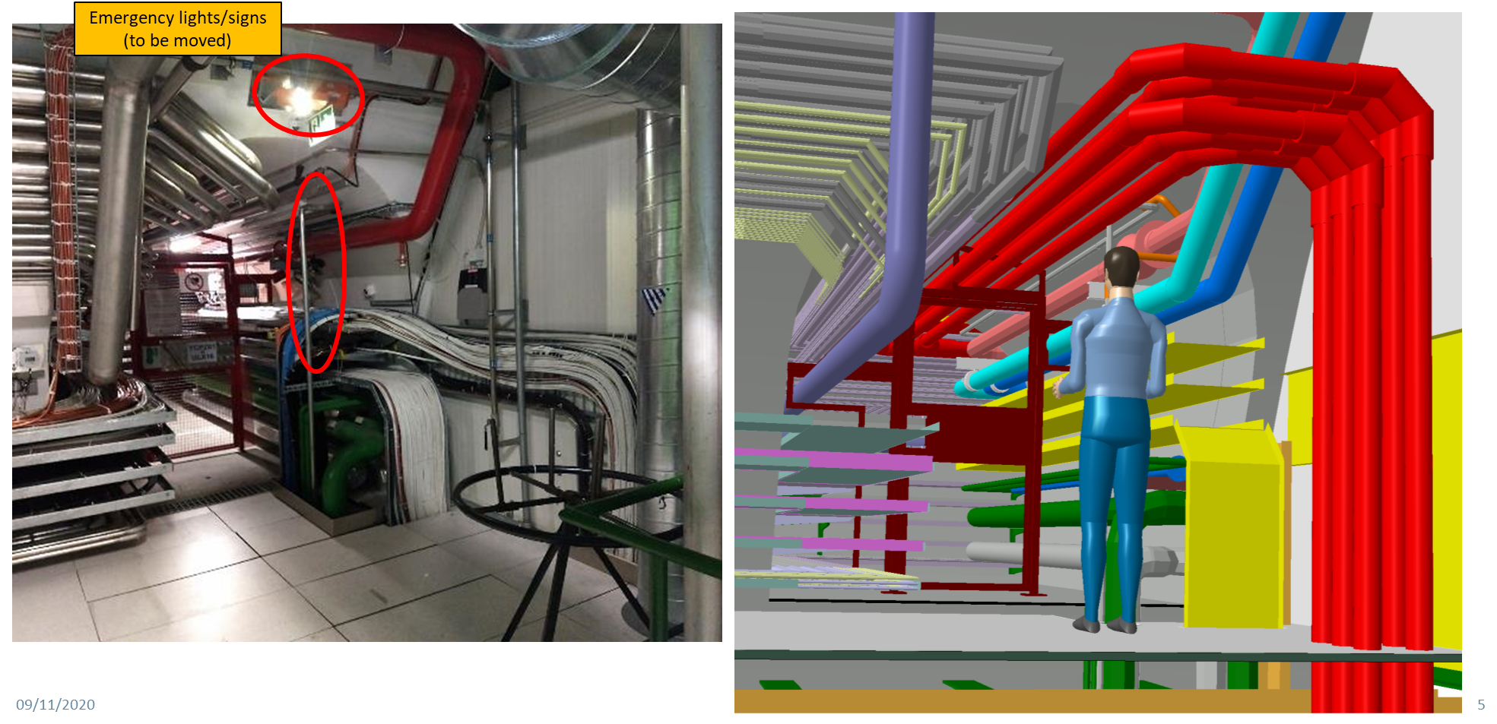
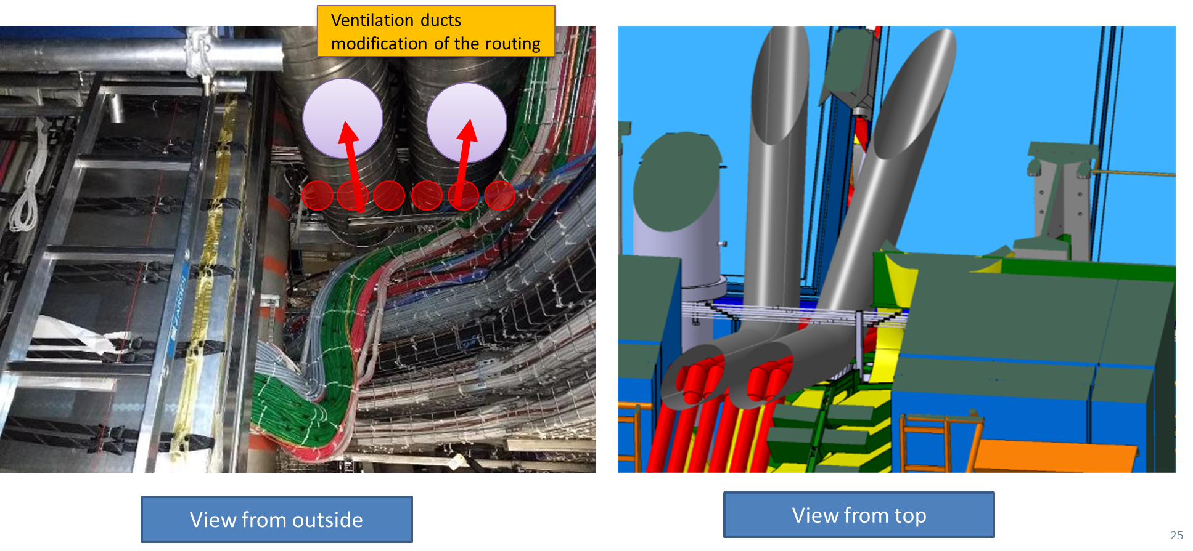
CO2 cooling system for ITK and HGTD
    Follow-up some preparatory work in toroid, UX15, ULX16 and USA15 areas (Pavel, Laetitia, Raphael)
      Electrical equipment (lightening)
      GSM
      Fire detection
      Emergency lightening system

Slide 11
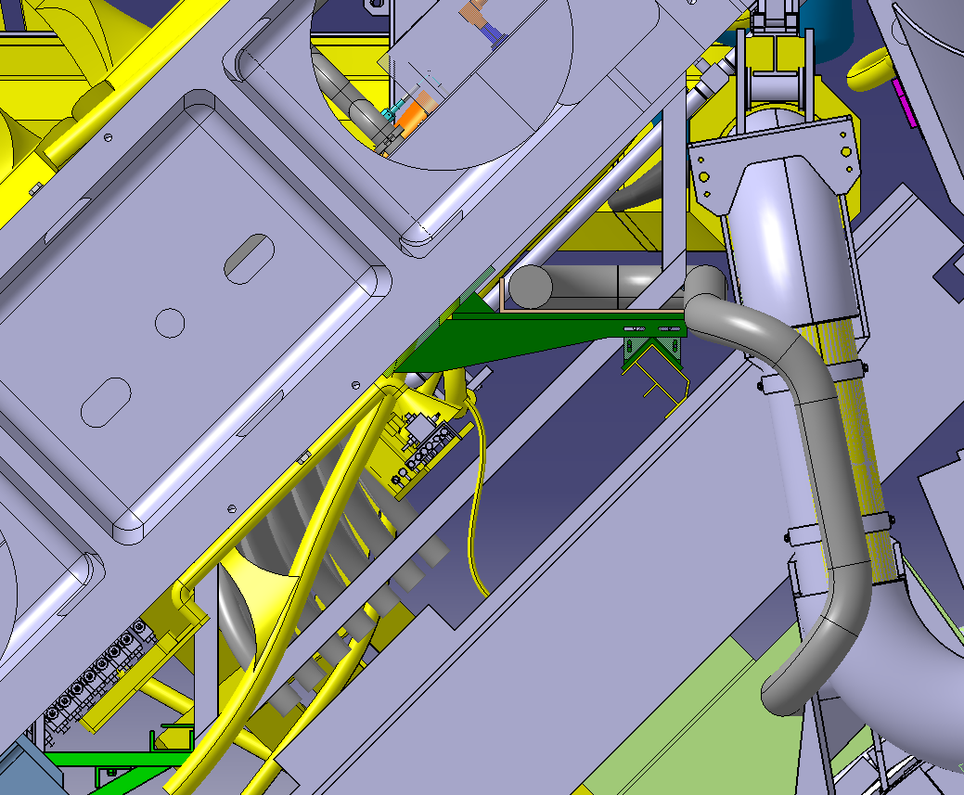
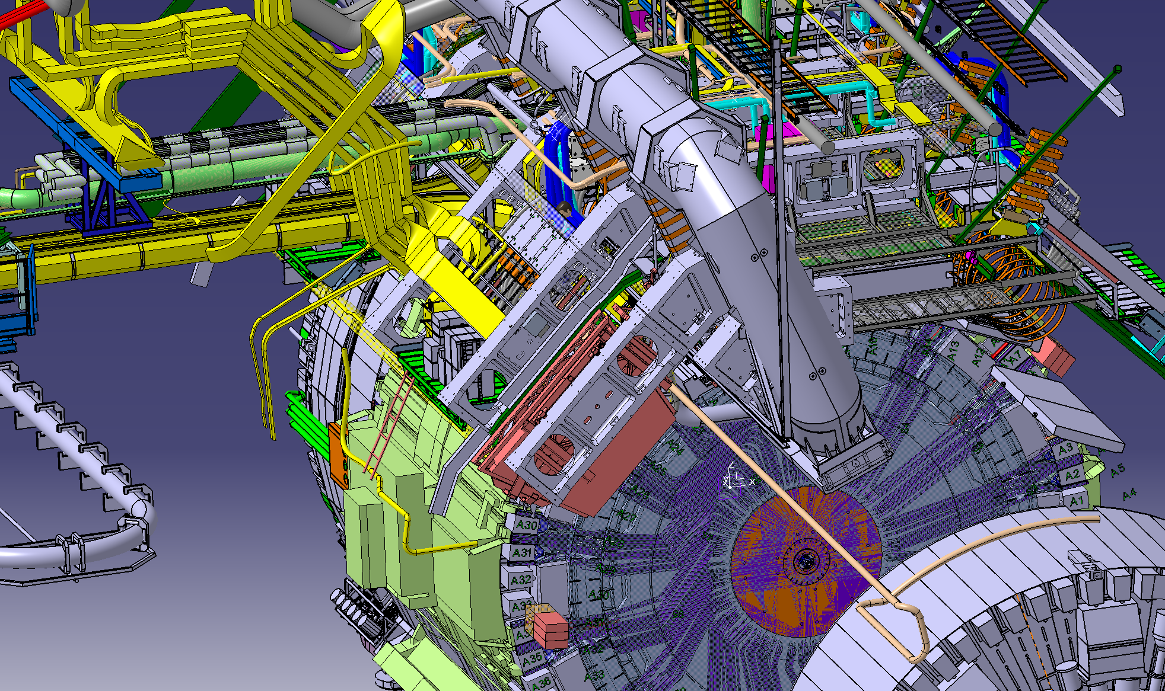
CO2 cooling system for ITK and HGTD
    Integration of CO2 manifold boxes in the toroid (Jamie, Pavel, Peter, Martin, Raphael)
      Integration of the HGTD cooling lines and manifold boxes
      Integration of the Pixel manifold boxes at Z=0
Possible integration of HGTD C02 flex line in sector 7

Slide 12
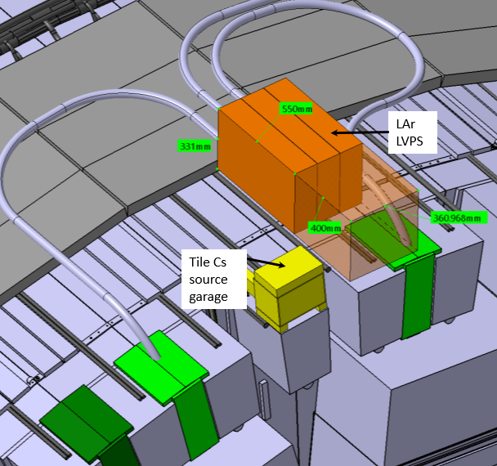
Patch Panel positioning and repositioning
  Consolidate of the ITK PP2 Integration in sector 1 ,3, 7, 9, 13 (Pavel, Raphael)
  Integration of HV and LV equipment on the rim of the End-Cap and Barrel Calorimeter surface (Alexandre, Tatiana)
    Integration of LArg Barrel LVPS
    Integration of the HGTD LVPS and HVPP
    Organisation and Study of cabling feasibility on calorimeter surface + cooling for LVPS
    Control the accessibility

Slide 13
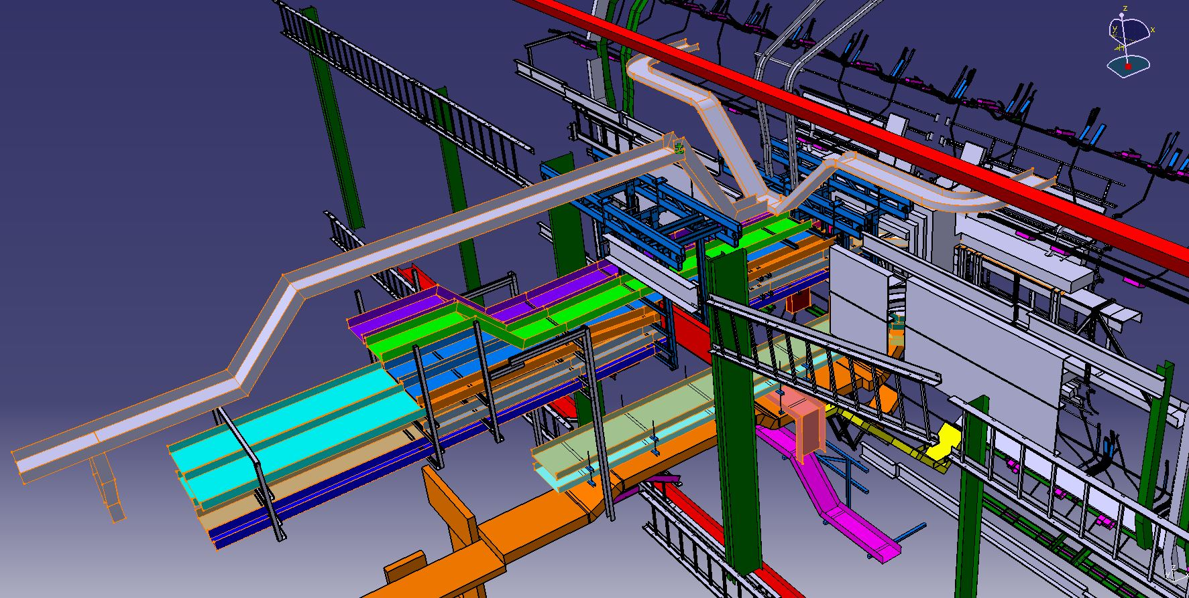
Cabling activity
  Services activity
    Finish the reverse engineering of the cable tray in the toroid and up to USA15 (support of EN-EA, Peter, Marco)
      Reverse engineering to update the CAD model of the cable trays
      To be able to identify the path and length for new services installation
      To update and fil in the cable tray database for long term traceability
    Integration of Liquid Argon and Tile services in the flexible chains (Peter/Marco)

Slide 14
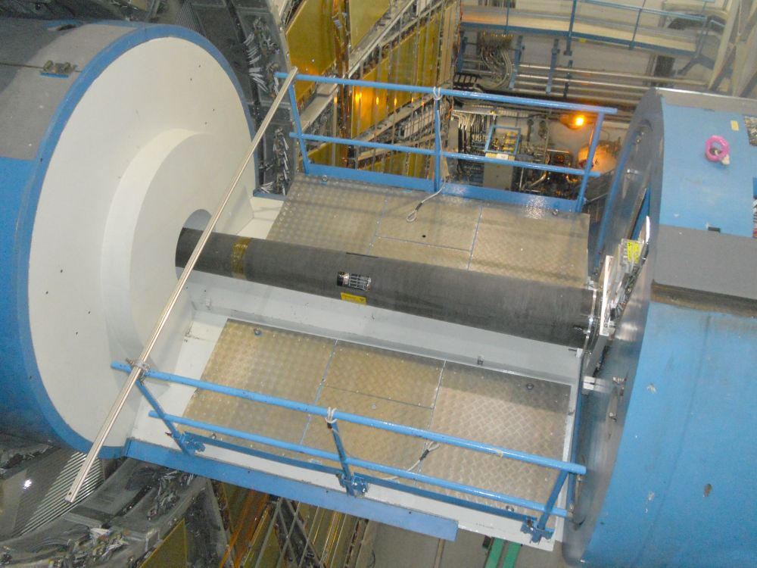
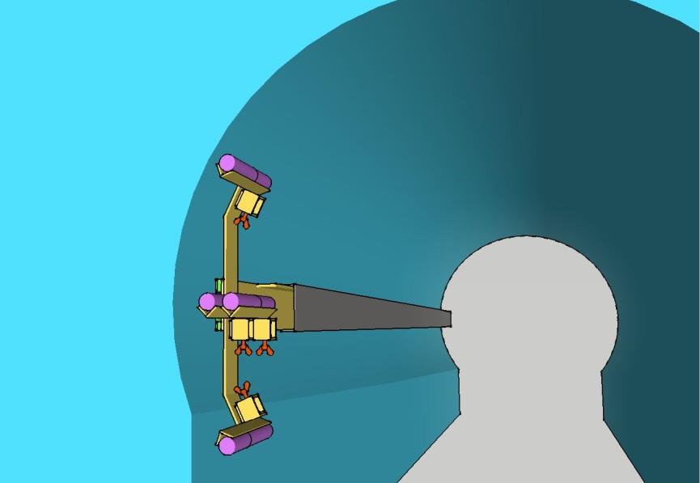
LUCID-3
  Design the LUCID-3 detector (Edouard/Raphael)
    Develop and integrate the new support of the LUCID on JFC3
    Integrate services
PMT
services

Slide 15
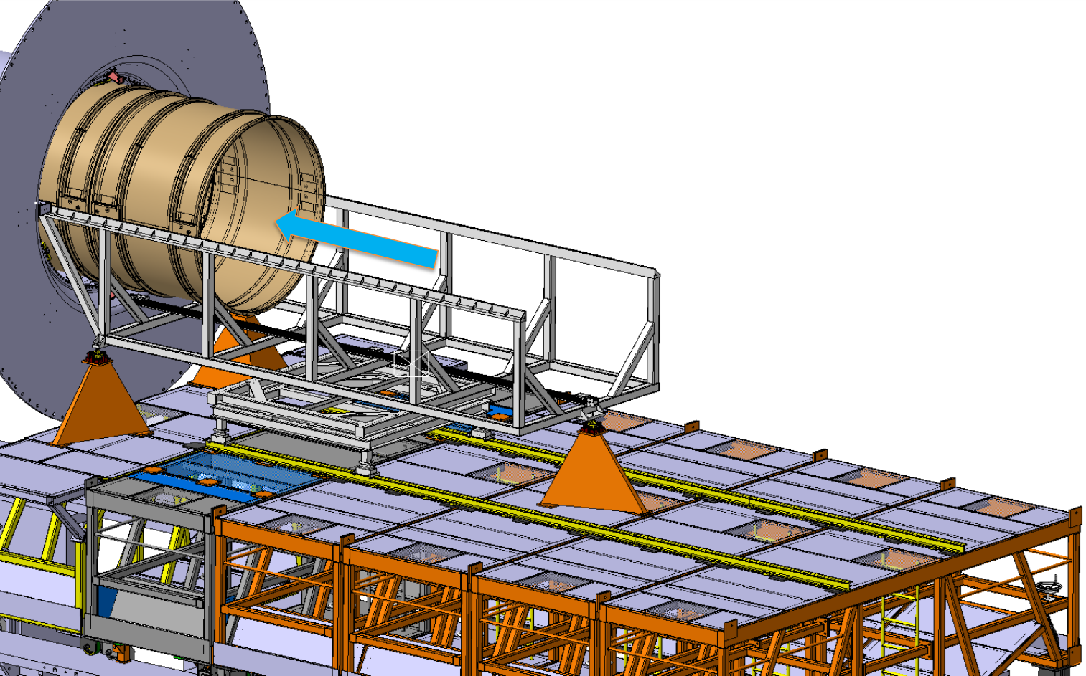
ITK insertion tooling
  Design ITK insertion tooling (Edouard, Joffrey)
    Finalise the pre-design
    Prepare a cost estimate
    Define the installation sequence
Insertion cradle
Motorization for insertion
Positioning columns

Slide 16
Muon activities
  Talk of Lorenzo

Slide 17
Management of the CAD structure and database
  CAD data management
      Organize the CAD structure (Edouard, Lorenzo, Tatiana)
      Maintain the CAD structure (all)
      Test use cases for new PLM system ARAS (Lorenzo, Edouard)

Slide 18
Conclusion
In 2021 the Design Office will focus his engineering effort on :
The completion of the LS2 detector and services installation (NSW, BIS) as well as infrastructure (cooling skid, AHU, UPS, ventilation, …)
The preparation of the detector for the next Run
The extensive “data taking” (pictures, scan, reverse engineering, measurement) to prepare the office activities during run period, when no access is possible in UX15. The extension of the LS2 is an opportunity for these activities.
The ramping-up of the engineering work to prepare LS3
  To launch and follow-up activities on the field that can already be done on the infrastructure during LS2 or next YETS.
  To support and help the systems to structure their upgrade effort (Cooling, HGTD, Larg, Muon, etc…)
Thanks all for the dedication in your tasks and flexibility to cover the large variety of activities that require ATLAS

