Slide 1
Welcome to JUAS 2021 Course 1
The science of particle accelerators
John Jowett
Director, JUAS
European Scientific Institute (ESI), ArchParc,
Archamps, France
11 January – 11 February 2021

Slide 2
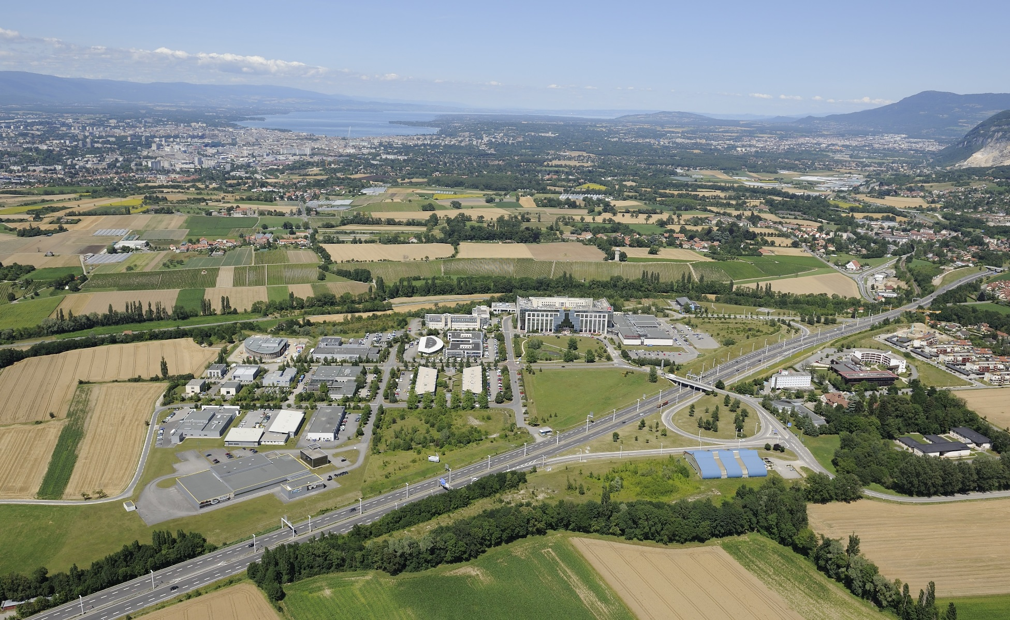
ESI host of JUAS, located in ArchParc, Archamps, France
Geneva
CERN
Chamonix
Paris

Slide 3
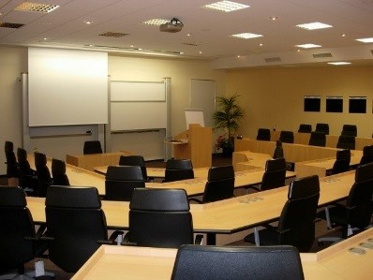
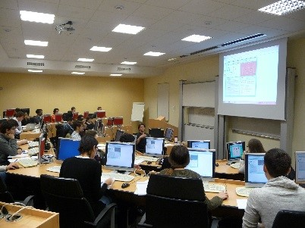
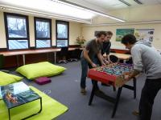
ESI Archamps Technopole, host of JUAS
Lecture hall
Computer room
Student foyer

Slide 4
JUAS mission
Invented a century ago as instruments of basic science, particle accelerators have also become essential tools of applied science, engineering and medicine. There are today more than 40,000 particle accelerators in operation worldwide. Their design, construction and operation have developed into a specific domain of science and technology, resulting in a growing demand for training
The mission of the Joint Universities Accelerator School (JUAS) is primarily to train graduate students from its Partner Universities in the science, technology and applications of particle accelerators
For this purpose, JUAS holds two five-week courses yearly at the European Scientific Institute (ESI) in Archamps, taught by renowned experts from universities and laboratories and accredited by the Partner Universities:
  A course on the Science of Particle Accelerators
  A course on the Technology and Applications of Particle Accelerators
Depending on the availability of places, JUAS also welcomes graduate students from other universities as well as professionals
Additionally, JUAS contributes to knowledge dissemination and outreach in the field of particle accelerators

Slide 5
A brief history of JUAS
Origins (1994)
  Accelerator courses given by CERN staff at Université Joseph Fourier in Grenoble
  Creation of ESI by Département de la Haute-Savoie (France) – next presentation
Previous directors of JUAS
  M. Rey-Campagnolle (founder)
  J. Le Duff
  F. Méot
  L. Rinolfi
  Ph. Lebrun
More than 1000 students trained
JUAS alumni active in many accelerator laboratories worldwide
The 25th session of JUAS was celebrated in 2018, and the 25th anniversary of ESI in 2019
I want to thank the previous directorsfor their work in creating this uniquely valuable institution and, especially Philippe Lebrun, helping me into the job,

Slide 6
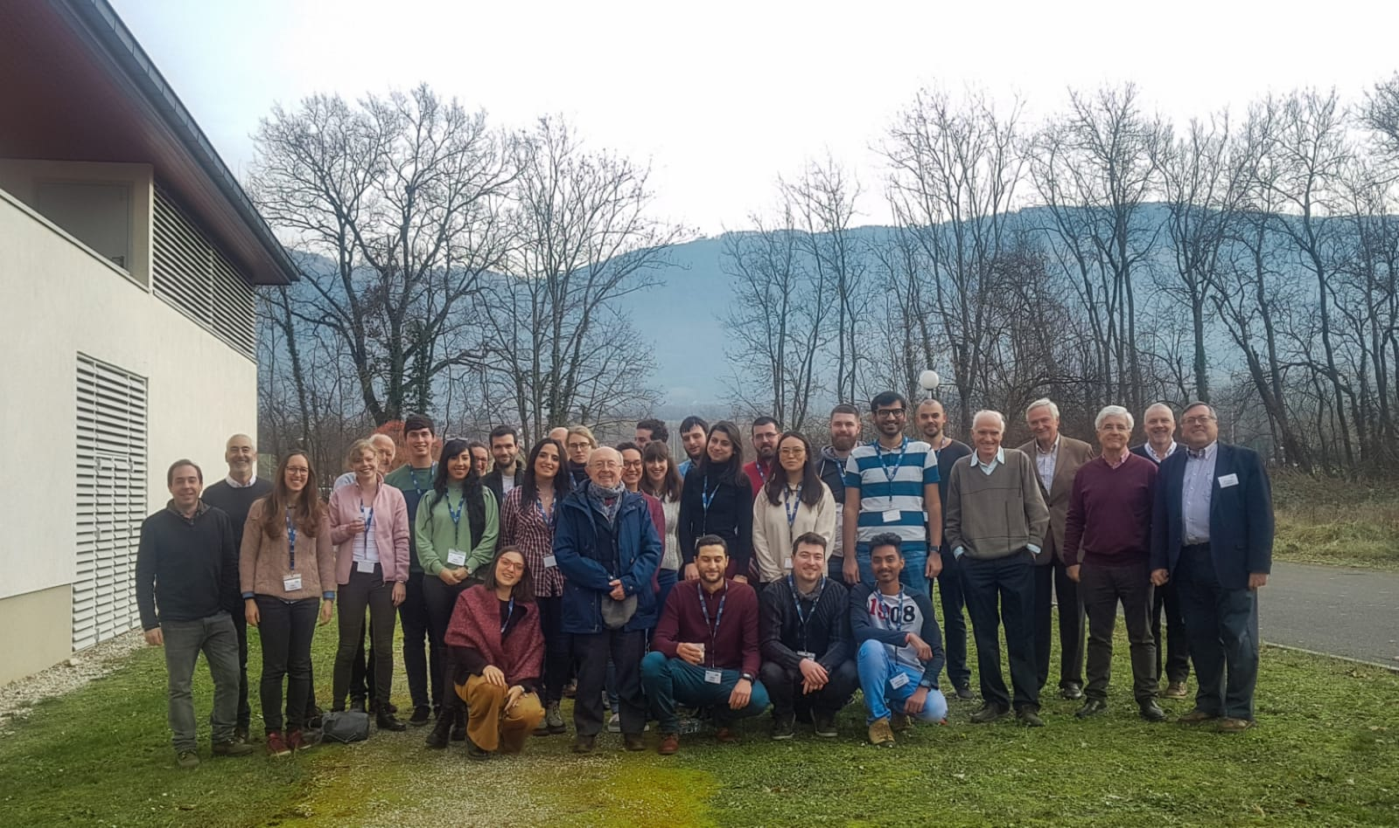
JUAS Course 1
The science of particle accelerators
13 January – 14 February 2020

Slide 7
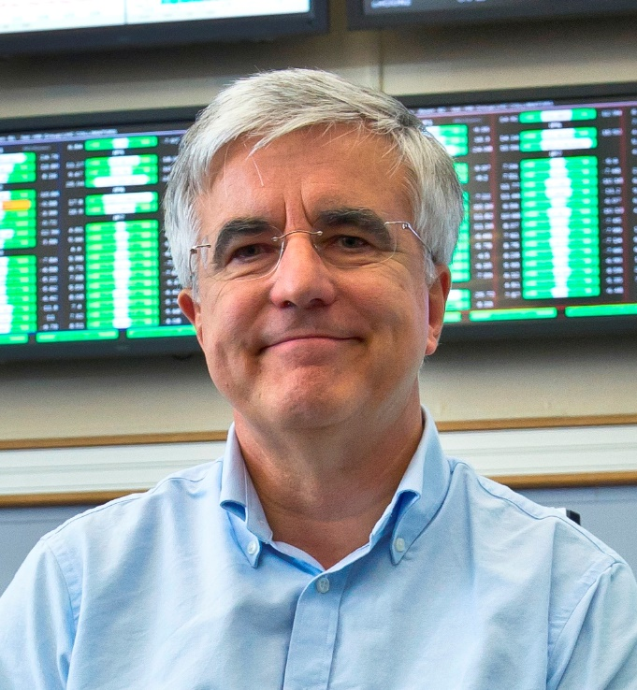
Introducing myself ..
This is my first session as Director of the school.
Initially studied Mathematical Physics before converting to particle accelerator physics on the job at CERN.
  No schools, very few books, at that time.
  Necessary to learn from colleagues.
Recently retired from a long career at CERN, working mainly on LEP and LHC colliders (but several other projects, some not built…).
Last member of CERN Staff who worked in the original LHC feasibility study.
In recent years, I was responsible for the heavy-ion collision programme of the LHC.

Slide 8
JUAS Student Certification
JUAS and home institutions of students
  Master Students: Partner University may give ECTS credits to their students who have passed the examination for each Course
  Doctoral Students: credits may be given by the doctoral schools according to their own policy
  Professionals: JUAS Course may be considered part of professional training («Formation Continue» in France)
Certification
  JUAS issues a Certificate for each Course containing all information
  Subjects studied and numbers of hours
  Exam taken or not
  Marks obtained in relation to class averages

Slide 9
Usual JUAS approach to teaching accelerator physics and technology
Two courses, each 4 weeks + 1 week exams
  The science of particle accelerators
  The technology and applications of particle accelerators
Expert lecturers from universities, national labs and CERN
Lectures + tutorials + seminars + workshops + practical work + lab visits
Syllabus and appointment of lecturers submitted to Advisory Board
Lecture slides are available in INDICO, sometimes prior to the lectures/tutorials, download for personal use and annotation
Students are required to have a computer (preferably) or tablet, with memory space to download material
Written exams
Oral presentations by students on design workshops and practical work
Unfortunately, this year, we have the pandemic and are obliged to adapt to the remote format.

Slide 10
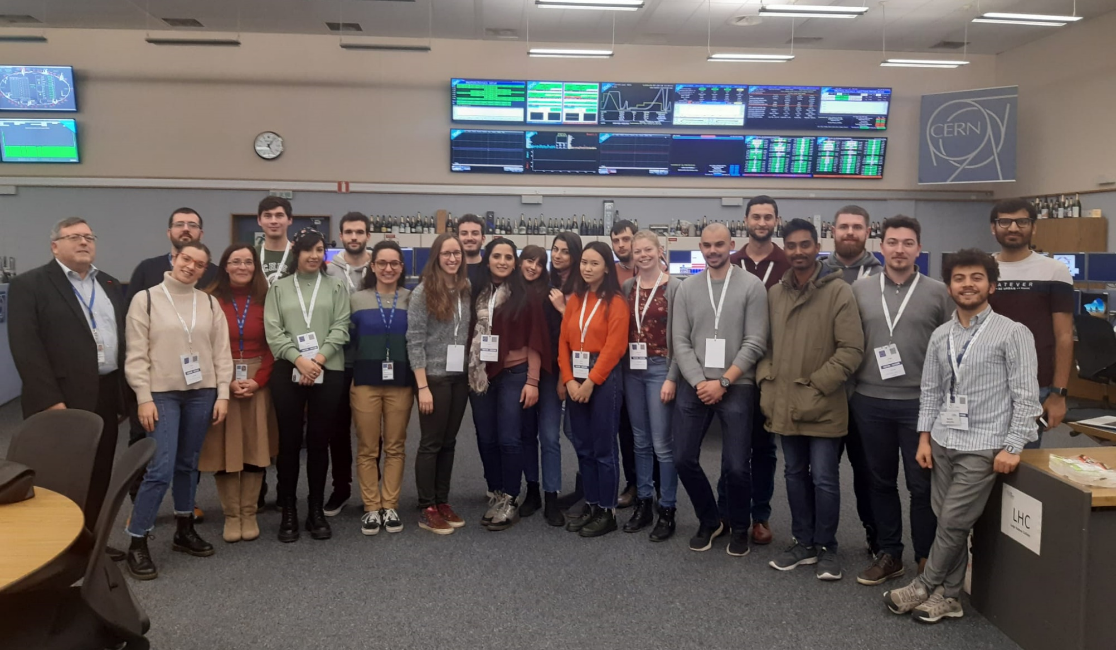
Visit to CERN on Friday 17 January 2020
Control Center

Slide 11
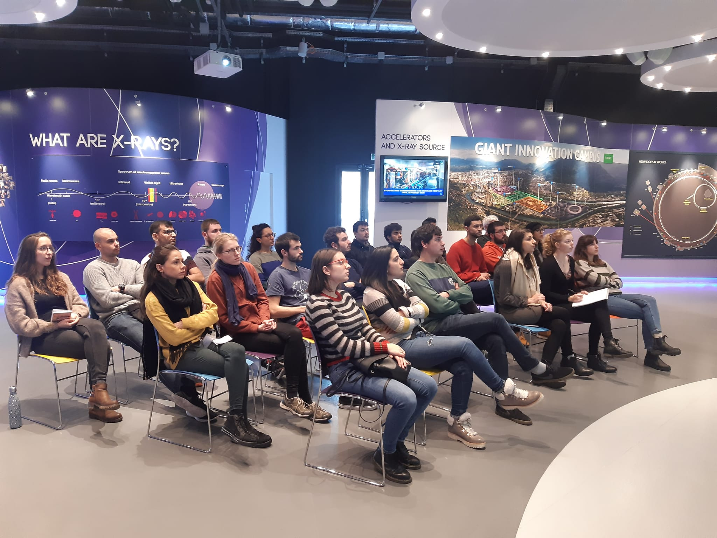
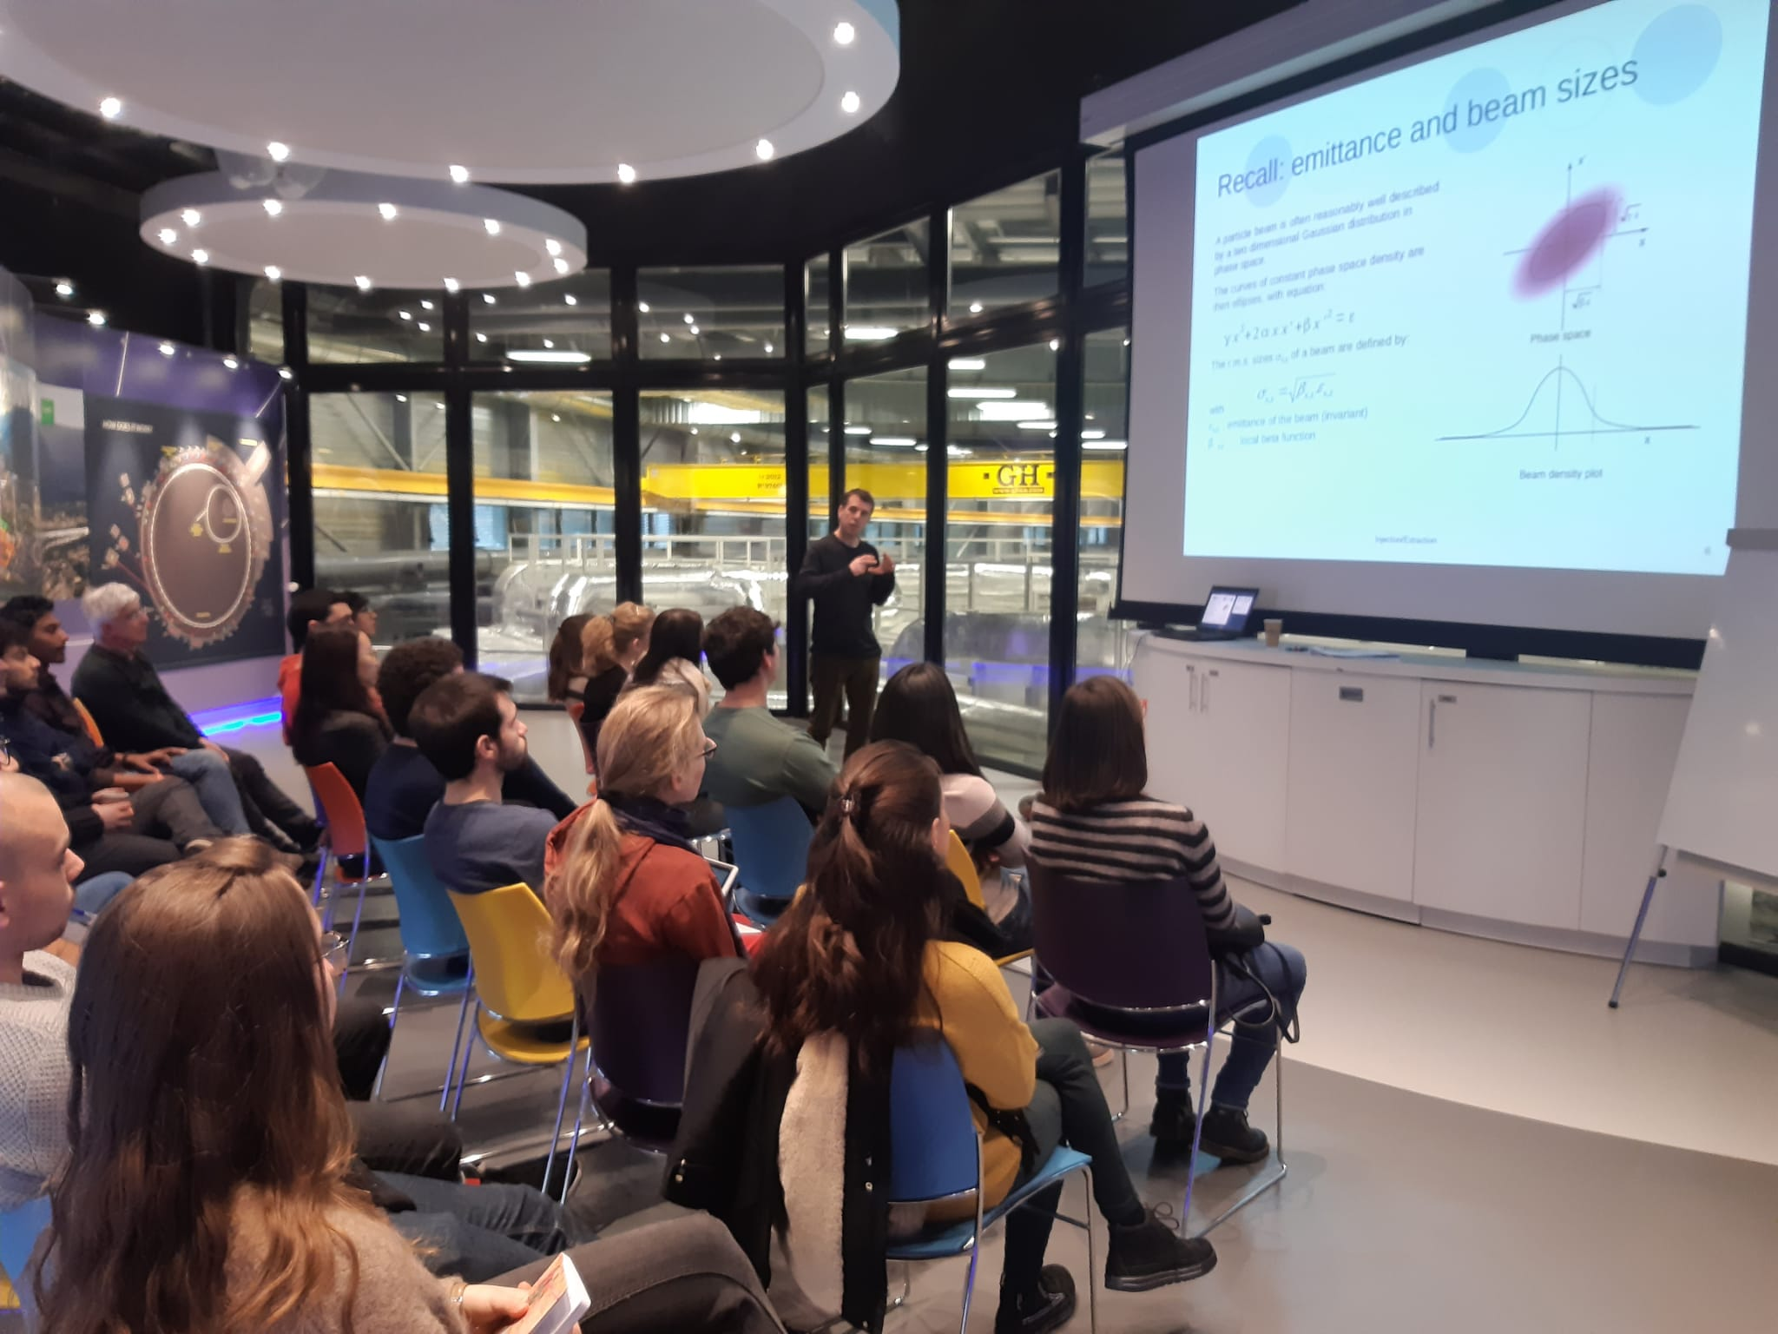
Visit to ESRF Grenoble
Friday 31 January 2020
Lecture and tutorial by Th. Perron on Injection & Extraction

Slide 12
Prerequisites to JUAS Courses
The JUAS courses are of graduate level (Master or Doctoral) and the students are expected to have knowledge of general physics at the Bachelor level
Prerequisites include elementary knowledge of
  Special relativity
  Electromagnetism
  Nuclear physics
  Mathematical methods of physics (vector analysis, vector spaces and matrices, differential & partial differential equations, Laplace & Fourier transforms)
  Some knowledge of signal theory could also be useful
Refresher courses and tutorials are provided in some key subjects

Slide 13
JUAS in remote format
Like many other educational institutions, we have been forced to adapt.
So far we have no experience … that starts today.
We will do the best we can but please remember that this is a learning process for us too!
Almost everything will come over Zoom with Indico support.
  Lectures are relatively straightforward, tutorials a little less so
  Visits and lab work are much more difficult, please make allowances.
Discussions can take place in the various Slack channels.
We received many good applications and have tried to welcome all qualified students
However, for certain sessions, there are limitations and we introduced the Full and Abridged versions of the school
  Priority for Full course given according to JUAS Mission statement (Partner Universities, exams)
  Some students taking courses à la carte

Slide 14
Etiquette for remote sessions
Make sure you are familiar with Zoom controls on your device
  Start Zoom logged in with your CERN account before clicking the link for the sessions
  microphone off until you are asked to speak by session moderator
  Silence your phone and other sources of noise in your environment (where possible …)
Moderators will manage questions, usually submitted by Zoom chat
Attendance will be logged for certificates of attendance
Try to keep your video on so that we can all see and get to know each other and associate names with faces
  Not obligatory but preferred
  Unless you have bandwidth limitations that also limit your ability to see and listen to lectures
  In that case, please at least upload your photo to your Zoom account
Social aspect, continuous Zoom session during breaks (see later)
  Again, be aware of your microphone status!
Feedback via Slack outside sessions
Possible recording of some sessions (Zoom will warn you)

Slide 15
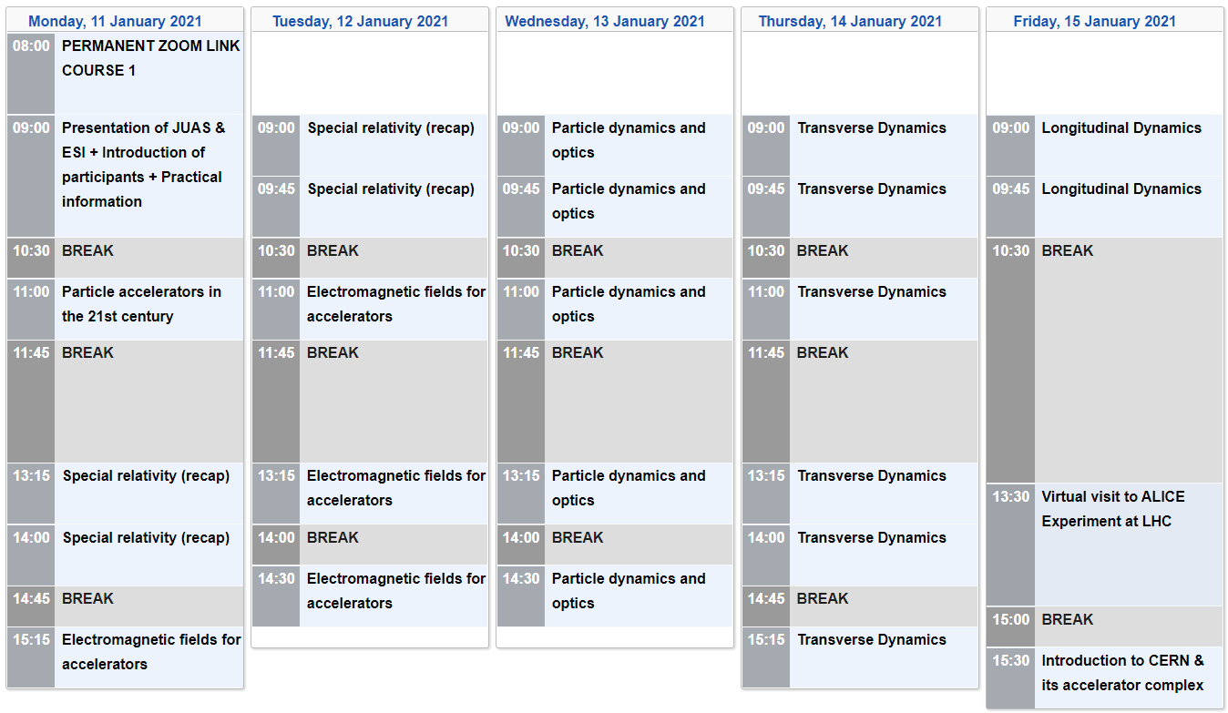
JUAS 2021, Course 1, Week 1

Slide 16
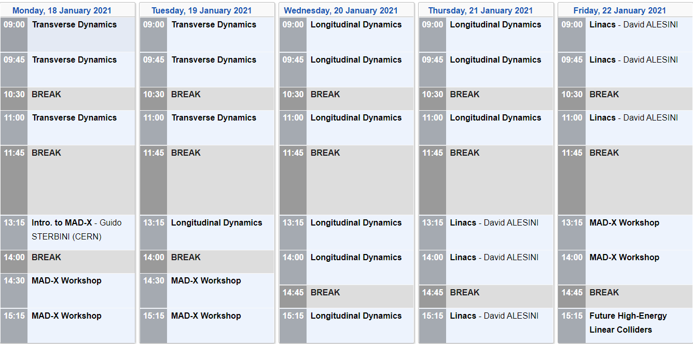
JUAS 2021, Course 1, Week 2

Slide 17
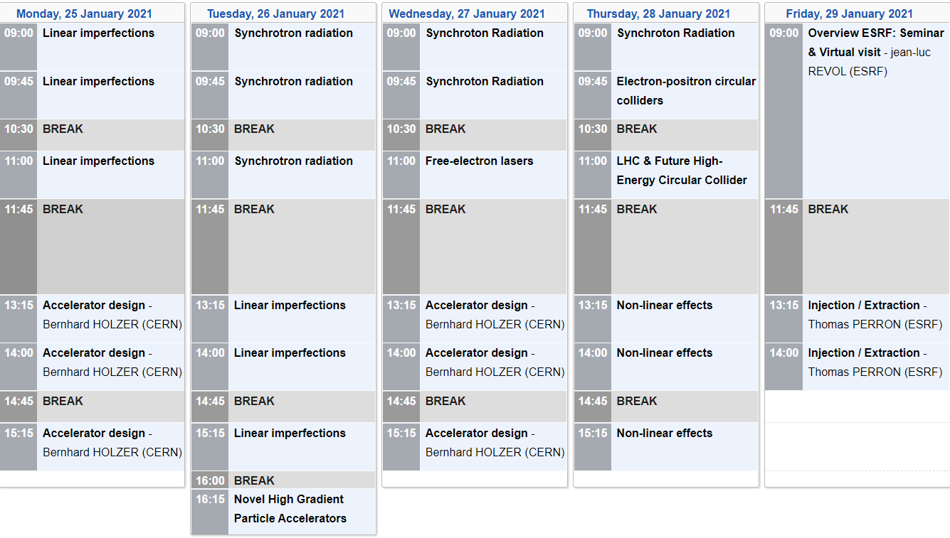
JUAS 2021, Course 1, Week 3

Slide 18
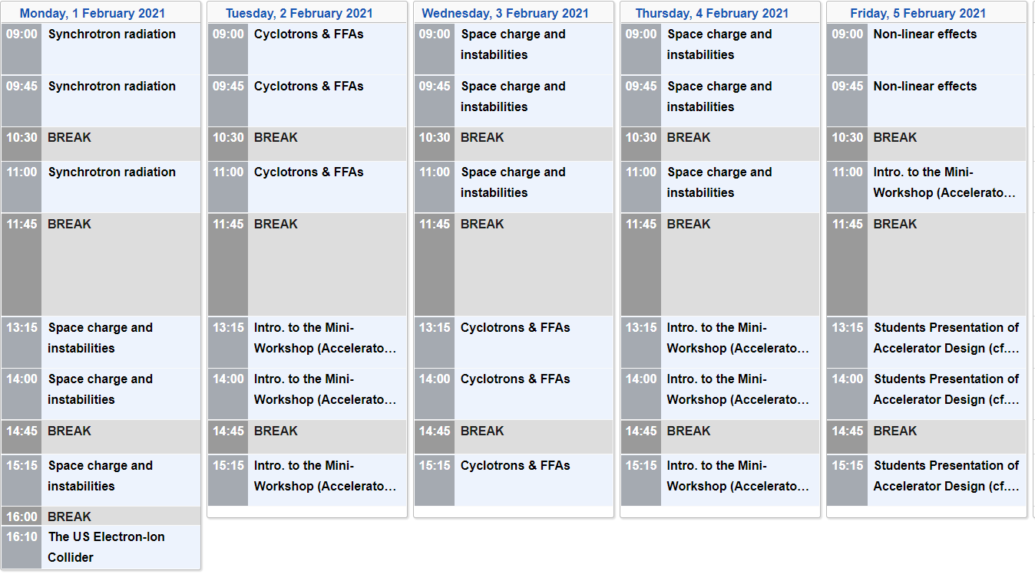
JUAS 2021, Course 1, Week 4

Slide 19
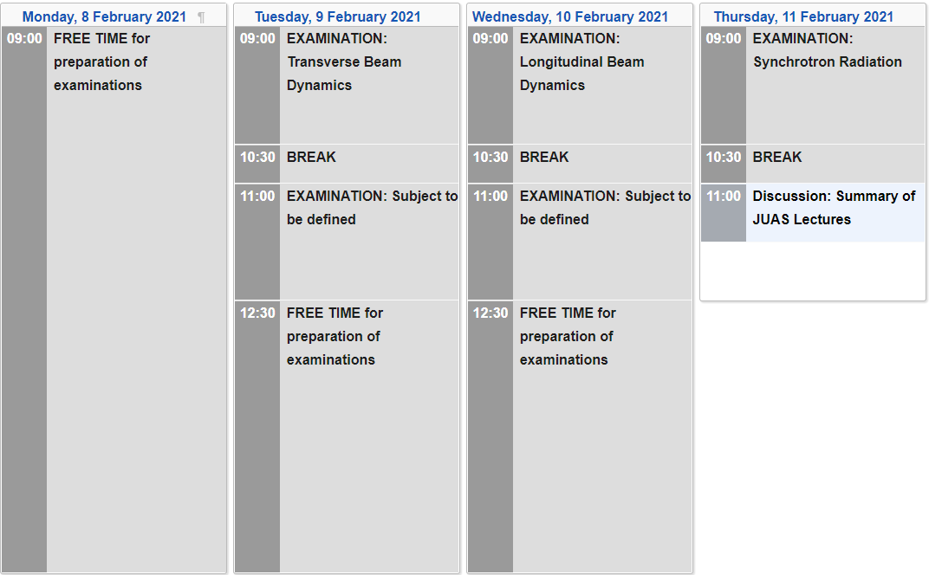
JUAS 2021, Course 1, Week 5
Updates to the programme remain possible at any time?
Please note and regularly check the Indico page:
JUAS 2021 - COURSE 1 - The Science of Particle Accelerators (Indico)

Slide 20
Software installation
Some courses require software installation on your personal computer
You should install as far in advance as possible to fix any glitches before the course starts
  In case of any problems, you can contact appropriate lecturer or course assistant via Slack channel for course
  Slack is important so that others can see the solutions too
Instructions given on the Indico pages for the course – please look ahead
For now, please take some time to install the PyHEADTAIL software for the Longitudinal Dynamics course.

Slide 21
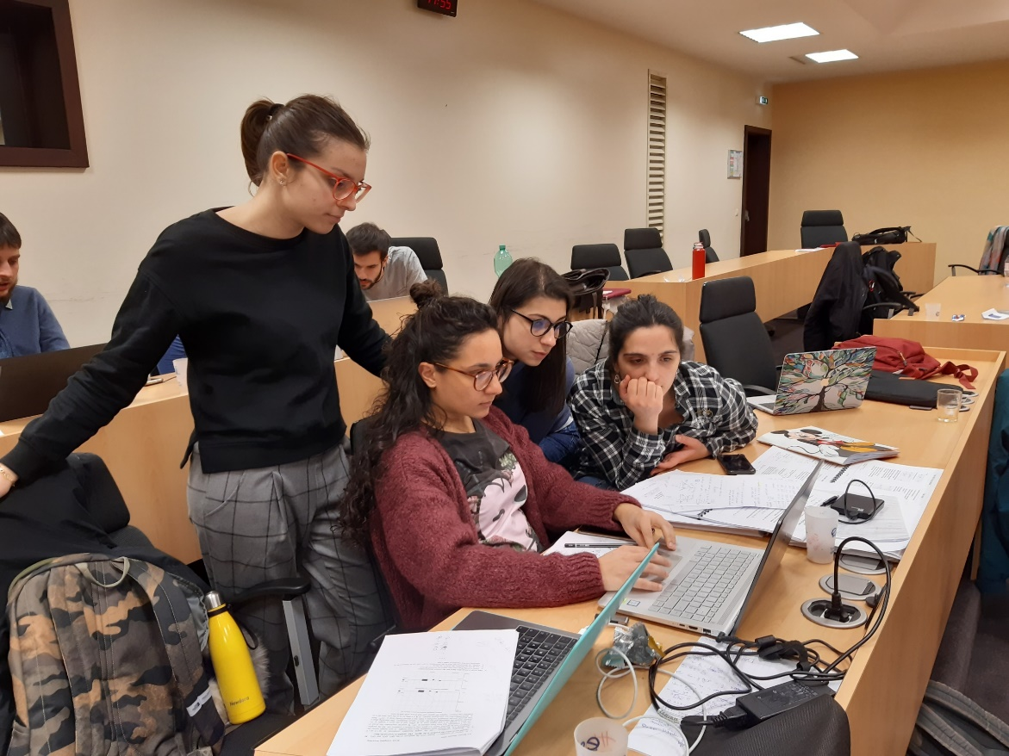
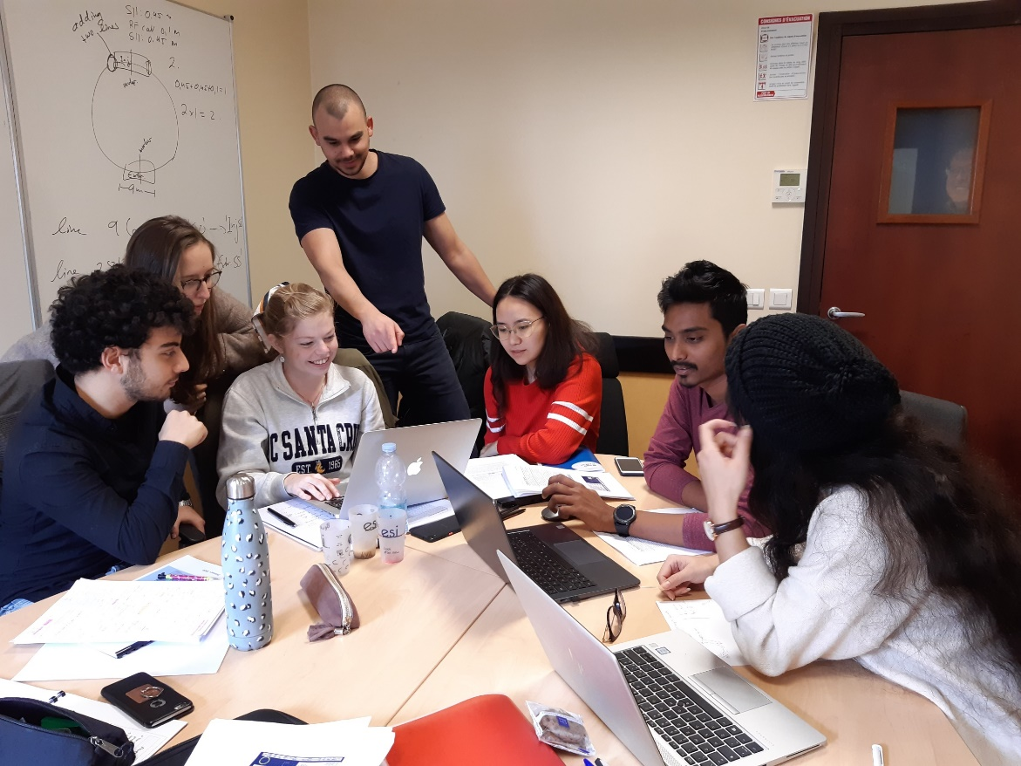
Mini-workshop on accelerator design
Upgrade of SR light source
Working in topical groups

Slide 22
JUAS 2021 Course 1 Examinations
Written examination
5 topics, each allocated one and a half hours
  Transverse beam dynamics (coefficient 12)
  Longitudinal beam dynamics (coefficient 12)
  Synchrotron radiation (coefficient 9)
  Remaining two topics (each coefficient 6) will be announced in week 4 (i.e. one week before examination)
Students have access to paper or downloaded documents on computer/tablet
WIFI and wire connections disabled in exam room
No mobile phone or other connected electronic device allowed
Arrangements for invigilation of the exams have been made with your home institutions. All students will take exams simultaneously.

Slide 23
Attendance Certificates & Grade Sheets
Master and Doctoral students
If not taking the exams (usually Abridged course), they get
  Certificate of Attendance with note that they have “opted not to take the examinations”
If taking the exams, they get
  Certificate of Attendance with
    Overall grade of student
    Overall class average grade & standard deviation
  Grade Sheet with, for each subject
    Student grade
    Class average grade
Class average grades are based only on results of Master and Doctoral students
All grades out of 20 (French system!)

Slide 24
Attendance Certificates & Grade Sheets
Professional students
All students get
  Certificate of Attendance, bearing no mention of examinations
If taking the exams (mostly not in 2021, Abridged Course), they get additionally
  Grade Sheet with, for each subject, the student grade
Grades of Professional students are not included in class averages
All grades out of 20

Slide 25
Evaluation of lectures and seminars by students
The students are asked (anonymously) to evaluate the lectures and seminars, on the basis of several criteria:
  Fulfilment of personal learning expectations
  Quality of slides and written documents
  Level of treatment of the subject
  Quality of oral presentation
  Guidance during lectures and tutorials
The students are also asked for possible improvements to the course
Evaluation is done on-line using Google Forms
Evaluation results are communicated
  Individually to the lecturers
  Statistically to the JUAS Advisory Board

Slide 26
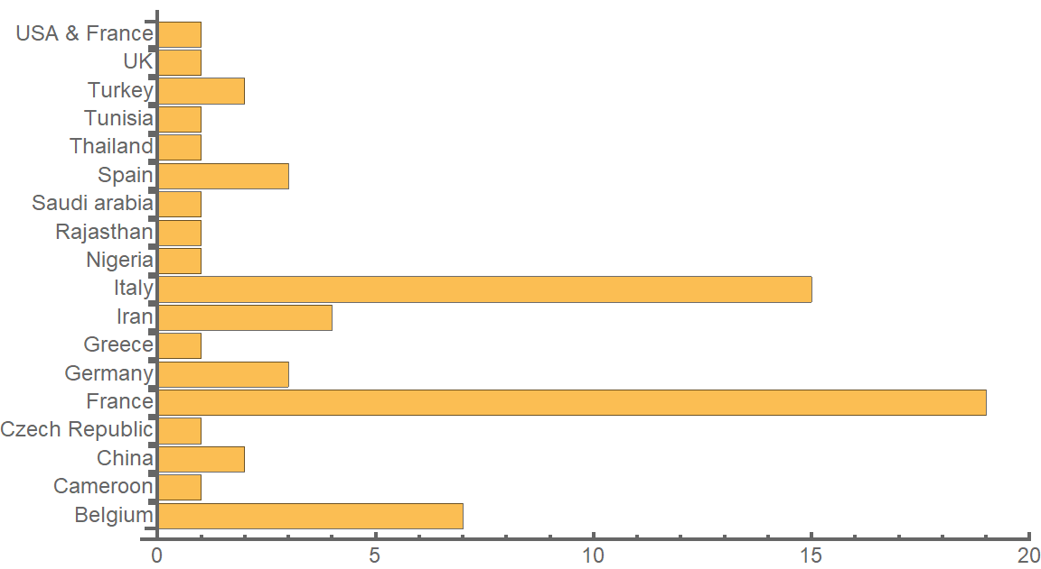
JUAS 2021 students by country of citizenship

Slide 27
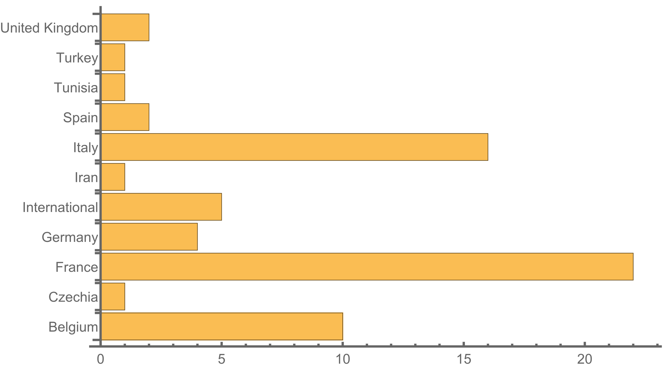
JUAS 2021 students by country of university/institute/company
“International” = CERN or ITER

Slide 28
Social aspects of JUAS
Normally, the social interactions between lectures, at breaks, lunch, after-works, journeys to lab visits, etc. are an important and valuable part of the JUAS experience.
  Making friends with people from a diversity of backgrounds
  Learning about their experiences of other students, as well as professionals and the faculty
  NB most faculty are accelerator experts at national or international labs, not university lecturers, giving their time voluntarily
We would like to reproduce this as much as we can in 2021
  Not so easy to see how … but your ideas are welcome
  Zoom link for main session will generally remain open for interactions during breaks
  We may generate break-out sessions for smaller groups and interests
  Try to avoid meeting the same small group of people all the time: mix with others!

Slide 29
JUAS code of conduct [1/2]
Mutual respect
  Freedom of opinion and of belief
  Cultural diversity
  Gender equality
  ⇒ Constitution of France, Article 1
    La France… assure l'égalité devant la loi sans distinction d'origine, de race ou de religion. Elle respecte toutes les croyances
    France… shall ensure the equality before the law, without distinction of origin, race or religion. It shall respect all beliefs

Slide 30
Job opportunities
Studying at JUAS is a good opportunity to find a position
  Internship in national or international laboratory
  Summer job
  PhD grant
  Post doctoral
  …
Do not hesitate to
  Talk to the lecturers during coffee and lunch breaks
  Talk to the people you may meet during laboratory visits
Consult our job opportunity web site and Alumni network
http://www.esi-archamps.eu/Thematic-Schools/JUAS/Job-opportunities

Slide 31
Developing the JUAS network
CV Yearbook
  We publish a CV (curriculum vitae) Yearbook
    Introducing JUAS,
    Containing the curriculum vitae of each JUAS 2021 student (with his/her agreement)
    Distributed to our partner universities and industrial sponsors
Alumni network
  Build up the JUAS Alumni network using social media
More information will be communicated to you on these matters during the Course

Slide 32
Last word
Welcome to JUAS Course 1!
We hope, that despite the present limitations, you will have a rewarding experience and get a good start in learning the fascinating physics of particle accelerators

