Slide 1

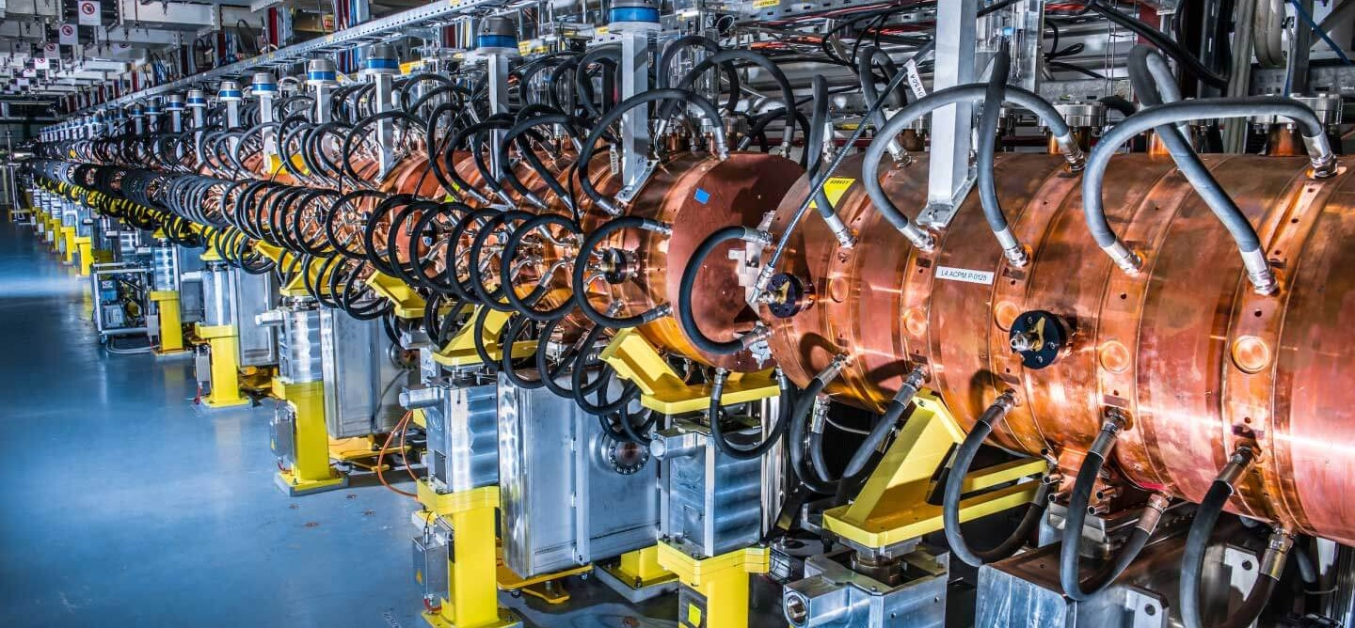
Particle Accelerators in the XXI Century
Maurizio Vretenar CERN ATS-DO (Project Office) JUAS 11.01.2021

Slide 2
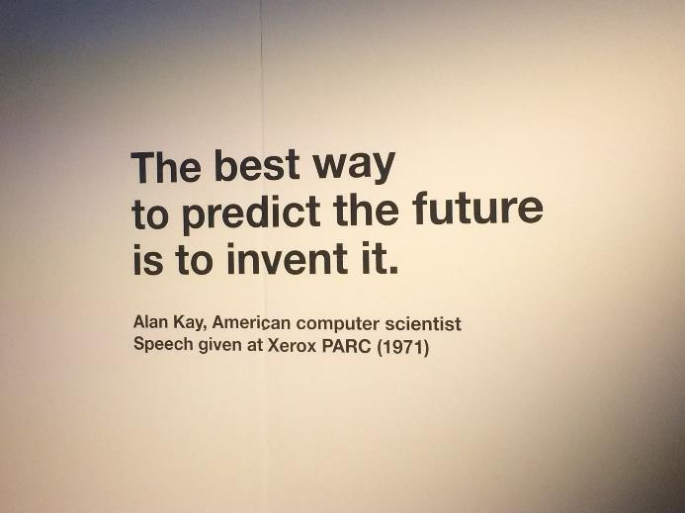
Outline and motivations for this Seminar
Thanks to the JUAS Organisers for their invitation and for the ambitious title!
Motivations:
Give an overview of accelerator technologies and applications, with no maths;
Give some hints to guide your study and (maybe) your future choices.
Outline:
Accelerators as a tool to access the subatomic world
Origin and development of a technology
2021: accelerators in transition
Key challenges and R&D strategies
Innovation in accelerator science: where and how?
The future… is for you to write!

Slide 3

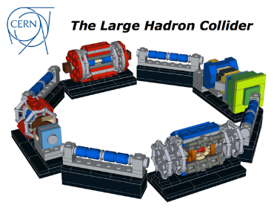
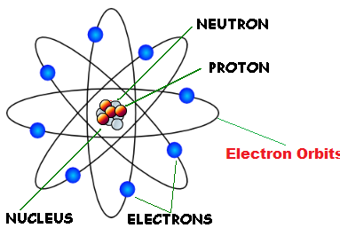


Accelerators: our key to enter the subatomic world
Particle accelerators are our door to access the subatomic dimension… to study and exploit the atom and its components
When we extract particles from an atom (protons, electrons, charged nuclei) and we accelerate them we concentrate enormous amounts of energy in tiny volumes
proton
 | Proton out of LHC | 150g Yoghurt | TGV train
Energy | 1.1 10⁻⁶ J | 5 10⁵ J | 3.6 10⁸ J
Energy density | 5.3 10³⁸ J/m³ | 3.3 10⁹ J/m³ | 1.5 10¹¹ J/m³
Type of energy | Kinetic Subatomic scale | Chemical Macroscopic scale | Kinetic Macroscopic scale
Energy full LHC beam | 3.6 10⁸ J
TGV train:
400 tons, 200 m, 150 km/h
Where will this energy go? An accelerated subatomic particle sent towards an atom will:
Deliver some energy to the electrons.
Deliver some energy to the nucleus (if the particle has sufficient energy to penetrate the Coulomb barrier).

Slide 4
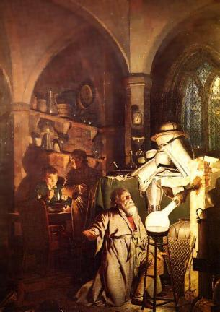
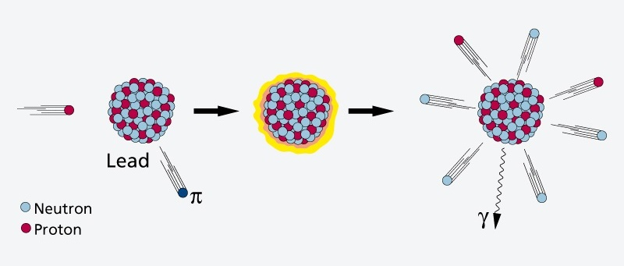
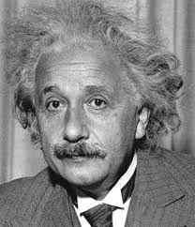
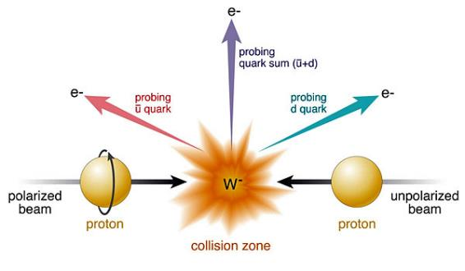
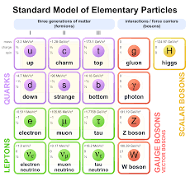
Accelerators can modify the nuclei and create new particles
If the energy is sufficiently high, the particles in the beam transfer energy to the nucleus and its components (and are then scattered, reflected or absorbed).
It’s the dream of the ancient alchemists coming true!
NUCLEAR PHYSICS
Particles in the beam can break and modify the nucleus (and then generate new elements and transform the matter!)
PARTICLE PHYSICS
In the collisions can be generated new particles.
E = m c²

Slide 5
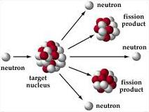
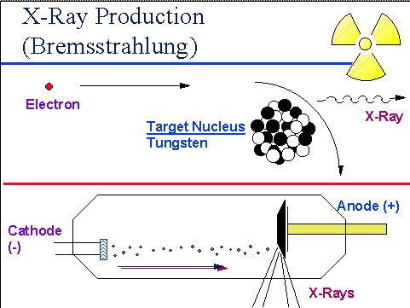
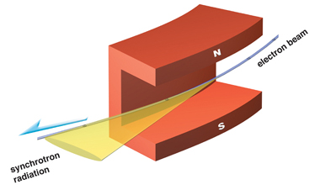
Accelerators can produce intense secondary beams
Accelerated electrons produce X-ray beams by interaction with a metal target (bremsstrahlung) or by synchrotron radiation in accelerator magnets)
Accelerated protons produce neutron beams by spallation reactions in a heavy metal target
X-rays generated by accelerators are commonly used in medicine
Both X-rays and neutrons generated from accelerators are used for advanced imaging in many fields: life sciences, condensed matter, energy, material science, cultural heritage, life sciences, pharmaceuticals,…
Additional applications are appearing for other types of secondary beams.

Slide 6
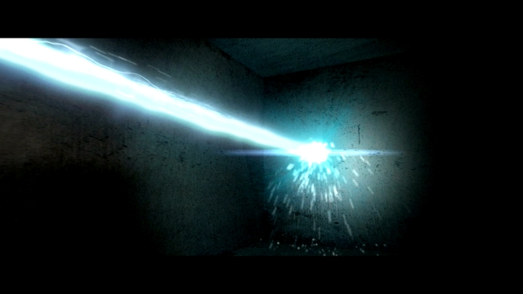
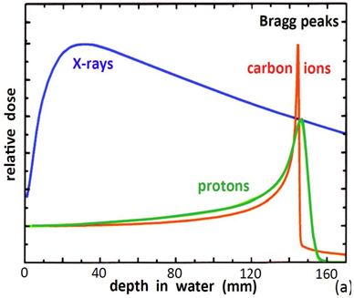
Accelerators can precisely deliver energy
A «beam» of accelerated particles is like a small “knife” penetrating into the matter
A particle beam can deliver energy to a very precisely defined area, interacting with the electrons and with the nucleus.
Particles can penetrate in depth
(different from lasers!).
Particle beams are used in medical and industrial applications,
e.g. to cure cancer, delivering their energy at a well-defined depth inside the body (Bragg peak)

Slide 7
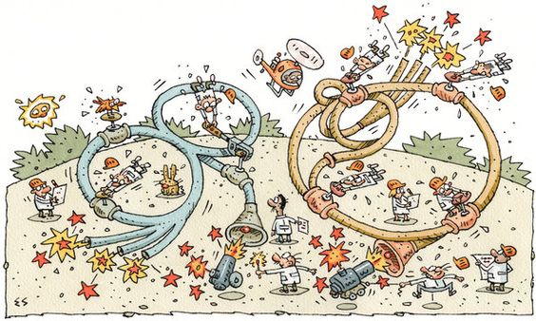
Accelerators have a long history…

Slide 8
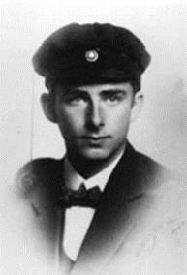
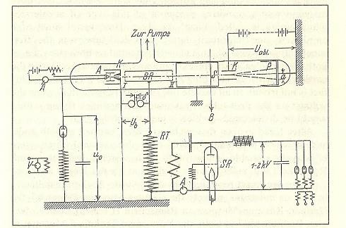
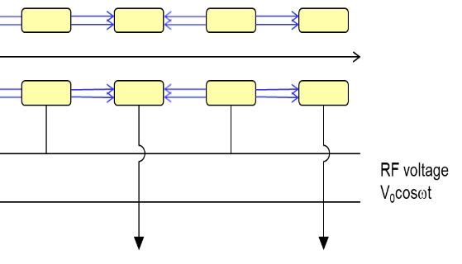
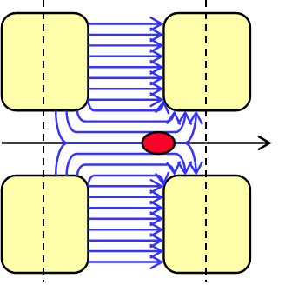
Modern particle accelerators are 93 years old
In 1928 a PhD Thesis introduced the basic concept of modern particle accelerators, using periodic acceleration provided by electric field at Radio-Frequency (RF).
This was a major step from the previous DC (constant voltage) acceleration, limited to few MeV
Rolf Wideröe’s PhD thesis, 1928, University of Aachen
Acceleration of potassium ions 1+ with 25kV of RF at 1 MHz → 50 keV acceleration in a 88 cm long glass tube) “at a cost of four to five hundred marks”, less than 2’000 € today!
use of Radio-Frequency technology (at the time limited to 1-2 MHz) → marrying radio technology and accelerators.
Use of a drift tube separating 2 accelerating gaps → invention of periodic acceleration.
complete accelerator: ion source, RF accelerator, detector, all in vacuum.
Ion source
Accelerating tube at
V=V₀sinωt
RF generator
Detector

Slide 9

At the roots of innovation
What were the ingredients of Rolf Wideröe’s innovation?
He was young (PhD student, fresh ideas and time available)
He was under pressure to complete his thesis («necessity is the mother of invention»)
He was merging information and experience from different fields (cross-fertilisation)
He was going all the way down to practical realisation (to «innovate»).
The Oslo Manual (OECD/Eurostat, 2005), defines innovation as “the implementation of a new or significantly improved product or process …”

Slide 10
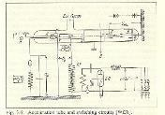
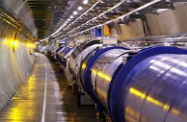
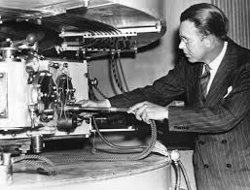
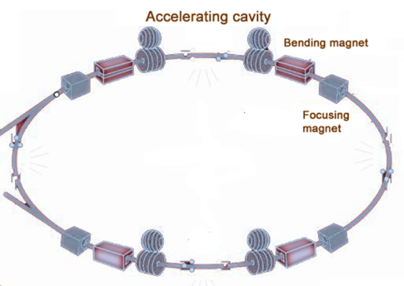
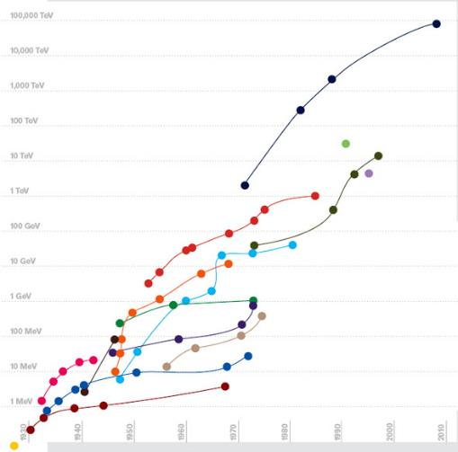
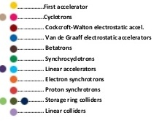
Innovation in the particle accelerator field
1931………….1945/48….1952…………..1965/90’s….…
XXI century
?
Cyclotron: cyclic acceleration with magnets (Lawrence)
Strong focusing (Courant, Livingston, Snyder, Christofilos)
Superconducting magnets and acc. cavities
2008: the Large Hadron Collider
Application of WW2 radar technology to accelerators (Hansen, Alvarez)
Succession of enabling technologies (technology leaps)
Energy*
2009 Livingston plot, Symmetry magazine
*: for colliders, energy to reach same c.o.m. energy in collision with proton at rest
S. Livingston, 1959:
Accelerator energy increases by a factor of 10 every 6 years
(Moore’s law of accelerators)

Slide 11
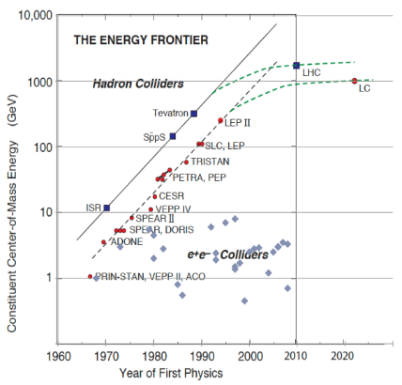
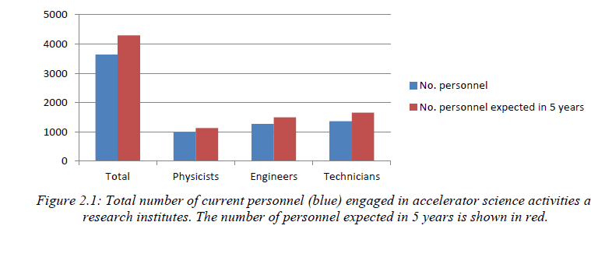
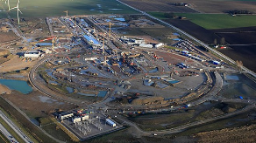

Particle Accelerators in 2020
Apparently, we have reached the end of exponential energy growth
But the field has never been so flourishing…
?
TIARA, Need for Accelerator Scientists report, 2013: 3’700 people engaged in accelerator science in Europe, expected growth to 4’400 by 2018.
Updated Livingstone-type chart (Wikipedia 2014, uploaded by J.Nash, Imperial College)
As many as 50 ongoing accelerator construction or upgrade projects listed in the 2017 IPAC Conference (13 America, 11 Asia, 26 Europe)
2’200 abstracts submitted at IPAC20

Slide 12
Multiple challenges for accelerator science
For the entire XXth century, fundamental science has been the driving force for the development of new accelerators, with its continuous quest for high energies required to discover new particles.
In this transition XX-XXI century, we are moving to a new paradigm where applied science (photon and neutron science) and health appear as new driving forces for innovation. Particle physics remains an important technology driver but after the completion of the standard model has more problems in attracting investments.
Advanced medicine and new materials are becoming the technology drivers of the XXIst century.
There are more than 35’000 particle accelerators in the world:
Research |  | 6%
 | Particle Physics | 0,5%
 | Nuclear Physics, solid state, materials | 0,5%
 | Biology | 5%
Medical Applications |  | 35%
 | Diagnostics/treatment with X-ray or electrons | 33%
 | Radio-isotope production | 2%
 | Proton or ion treatment | 0,1%
Industrial Applications |  | 60%
 | Ion implantation | 34%
 | Cutting and welding with electron beams | 16%
 | Polymerization | 7%
 | Neutron testing | 3.5%
 | Non destructive testing | 2,3%
What is the rôle of accelerators in this transition?
12

Slide 13

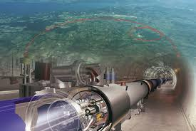
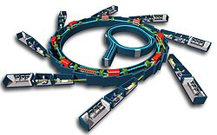
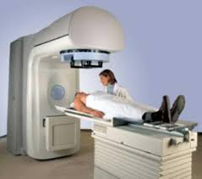
Accelerators in transition – not only particle physics!
Transition to new more affordable and sustainable technologies for basic science
Transition from basic science as main technology driver to a multiple system where basic and applied science, medicine and industry will together drive accelerator development.
Transition from a centralised configuration based on large laboratories to a distributed scheme (project clusters of small and large laboratories and industry)
Limitations related to size, cost, energy.
New ideas and technologies
Fundamental science
Societal applications (medicine, industry, environment, etc.)
Applied science (photon and neutron sources)
The electron linac for cancer radiotherapy, the most widespread accelerator in the world (> 12000 units)

Slide 14
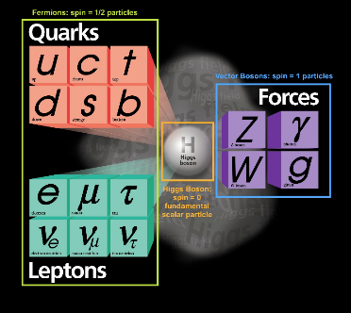
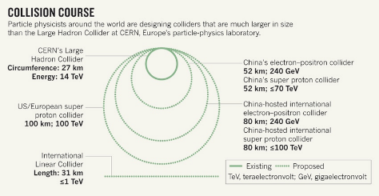
Reaching the limits of sustainability ?
Particle physics has been from the very beginning the technology driver for the development of particle accelerators: the quest for new particles at increasingly higher energies has motivated the development, construction and financing of increasingly large accelerators. And now?
Physics:
After the discovery of the Higgs boson the Standard Model is complete – many questions remain open (dark matter, antimatter asymmetry, etc.) and their solutions are probably related to new unknown particles, but so far no clear predictions exist to be verified by an accelerator.
Accelerators:
The size, cost and energy consumption of the accelerators required to go beyond the standard model rise questions on the long term sustainability of accelerator-based particle physics.
From the 19 December 2018 report of the Science Council of Japan on the construction of an International Linear Collider in Japan:
“In view of the finite resources available to humanity, the research style that presupposes an ever-growing scale-up of gigantic experimental facilities would eventually reach the limit of sustainability. The future way of “big science” is a theme to be deliberated by the whole academic community.”
Difficulty to justify new large projects
Difficulty to implement new large projects
«Nature», July 2014

Slide 15

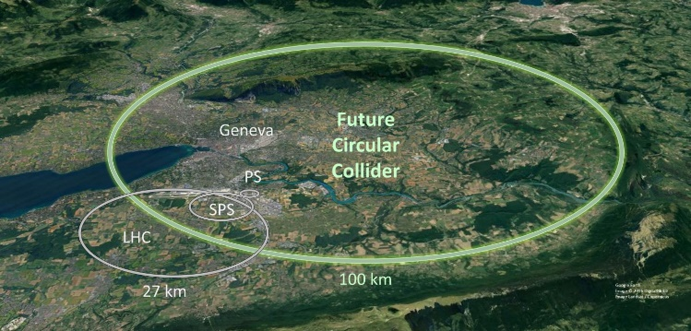
The big challenges for accelerator science
Making accelerator-based particle physics research more sustainable is going to be one of the main challenges to the accelerator community in this XXIst century.
After the LHC, the next generation of accelerators for basic science will reach unprecedented dimensions and costs.
Developing their technology requires new ideas to be developed in a larger environment than basic science
At the same time, we need to work to bring accelerator technology outside of our traditional laboratories, to be used for applied science (materials, biology, etc.), medicine and industry.
We need new ideas (innovation!)
We need a collaborative and creative environment for these ideas to grow
From the LHC (27 km) to the Future Circular Collider (100 km) ?

Slide 16
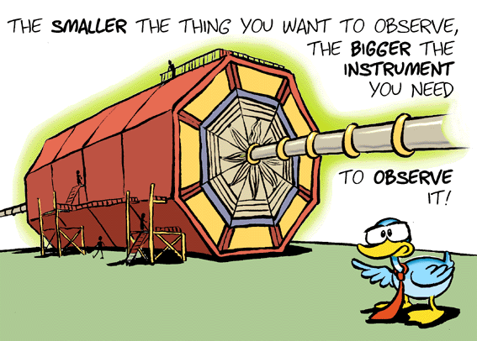
Multiple dimensions of accelerator R&D

Slide 17
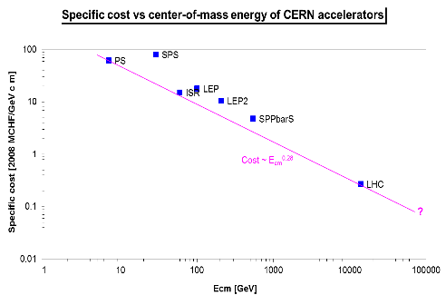
Frontier accelerators – economic sustainability
Moving along this line was made possible by new technologies
(colliders – antiproton production and storage – superconductivity)
FCC-ee
collider
p-pbar
collider
superconducting
collider
scaling of present technology
reduction in cost with new technologies?
Plot courtesy of P. Lebrun
Where is the limit of sustainability? It depends on the economical environment and on the priorities of a given society.
To remain within the present limits we need an effort to produce innovative technologies.

Slide 18
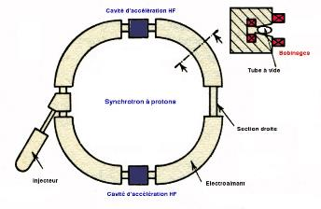
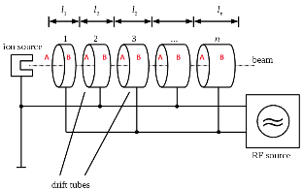
Step 1: smaller accelerators
Synchrotrons: p/q=Bρ
Need to maximise magnetic field
Superconductivity is mandatory, the limitations is the critical current density Jc for SC magnets
Linear accelerators: W=El
Need to maximise electric field
Limitations: arcing between electrodes, field emission, etc.
(and RF power, proportional to V² !)

Slide 19
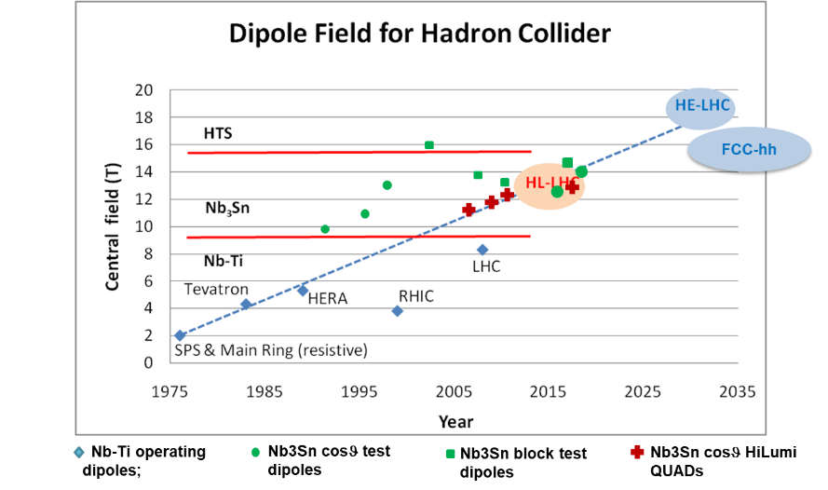
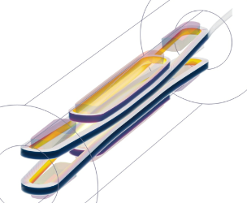
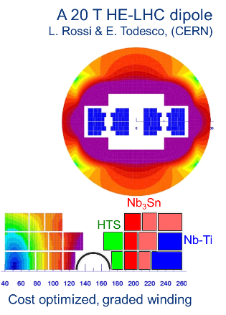
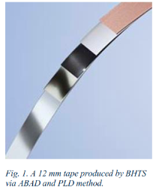
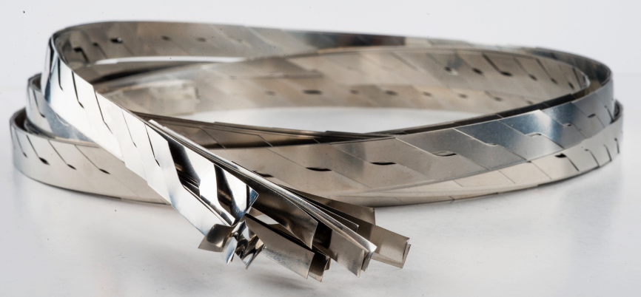
The magnetic field frontier in superconducting magnets
Three technologies under consideration
1. NbTi (Niobium Titanium as in the LHC): mature but limited to about 9T field.
2. Nb₃Sn (Niobium Tin) technology has seen a great boost in the past decade (factor 3 in J_{C} w/r to ITER) but is not yet used in an accelerator – The HL-LHC upgrade will be the first one.
3. HTS (High-Temperature Superconductor) technology still in the experimental phase (Production quantities, homogeneity and cost need to evolve!) but can be a disruptive technology for future high-field magnets.
Courtesy L. Rossi, CERN
R&D towards a 20 T HTS dipole magnet, develop 10 kA cable.
REBCO (rare earth barium copper oxyde) deposition on stainless substrate, tape arranged in Roebel cables.
values of 900-1200 A/mm2 at 4.2 K , 18-20 T have been obtained
Right: layered structures with sections of different conductors
Left: new magnet designs are required for HTS

Slide 20
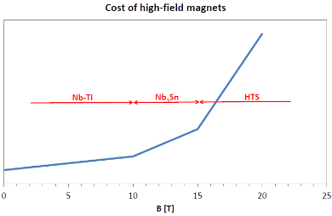
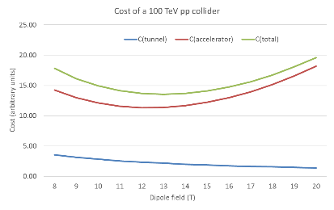
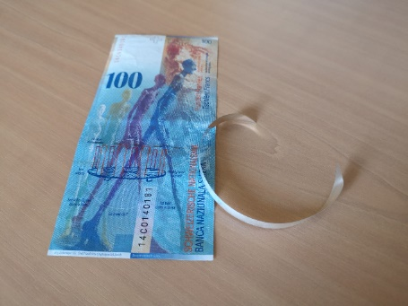
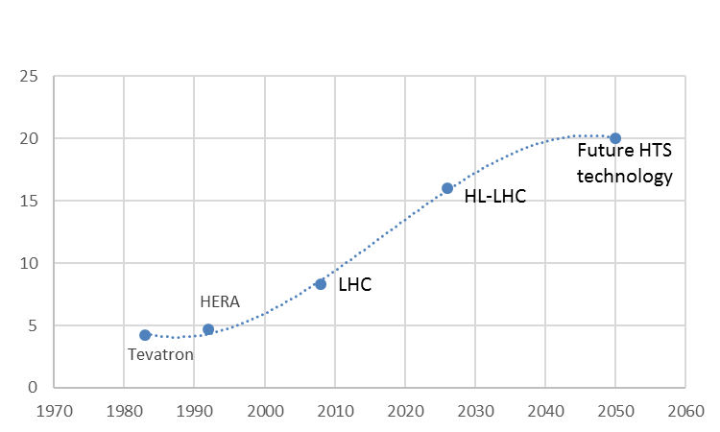
HTS magnets – reducing cost is the main challenge
HTS allows reducing the size of the accelerator but not (yet) the cost.
HTS is presently about 5 times the cost of Nb3Sn, but other communities (e.g. fusion) could contribute to reducing the price in the next years.
(courtesy of P. Lebrun)
100 CHF (=100$) of YBCO HTS tape built by Bruker HTS for CERN
Is superconducting magnet technology approaching saturation ? Large increase in cost for minor performance improvements

Slide 21
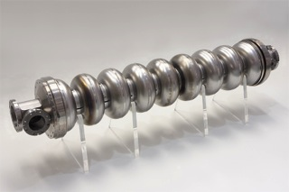
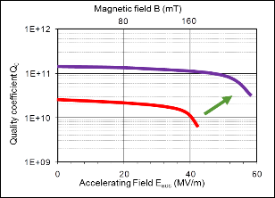
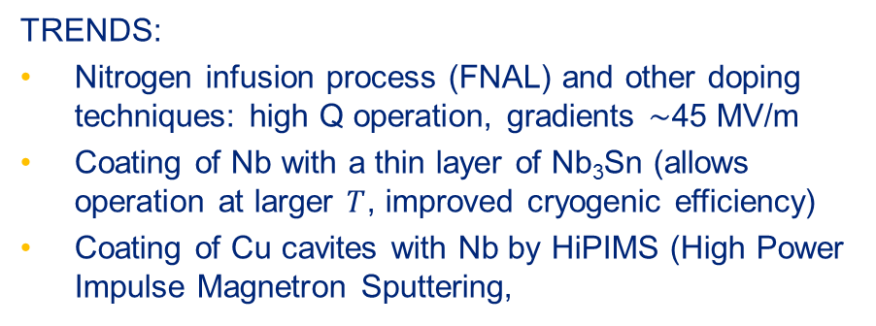
The electric field frontier – superconducting cavities
TRENDS:
Nitrogen infusion process (FNAL) and other doping techniques: high Q operation, gradients ∼45 MV/m
Coating of Nb with a thin layer of Nb₃Sn (allows operation at larger $T$, improved cryogenic efficiency)
Coating of Cu cavites with Nb by HiPIMS (High Power Impulse Magnetron Sputtering,
Multi-layer
SRF Thin Film
Bulk Nb
Long-term goal: 60 → 90 MV/m

Slide 22


The electric field frontier – normal conducting cavities
Most advanced results by the Compact Linear Collider (CLIC) study based at CERN (X-band, 12 GHz)
Large international collaboration to understand the physics of breakdown phenomena.
Pulsed systems, characterised by a BreakDown Rate (BDR), pulses lost because of vacuum arcing in the structure
100 MV/m gradient can be achieved (and exceeded)
… but the power scales as the square of the gradient! High gradient means smaller dimensions but higher power consumption.

Slide 23

Efficient energy management – a must for future projects
Total electricity consumption (GWh/y)
PSI | 125
ESRF | 60
ISIS | 70
KVI | 4
INFN | 25
ALBA-CELLS | 20
GSI | 60
CERN | 1200
SOLEIL | 37
ESS | 317
MAX IV | 66
DESY | 150
Future large projects require huge amounts of electrical power.
Example: the ILC needs about 1/3 of a Fukushima-type nuclear reactor.
Going green? to supply CLIC500 or ILC would be needed 200 large windmills (80m diameter, 2.5 MW, 50% efficiency) covering a 100 km distance.
Overall efficiency (grid to beam): 13%
Electrical power consumption (MW) for LHC and future projects (estimated)
 | normal | Stand-by
LHC | 122 | 89
HL-LHC | 141 | 101
ILC | 230
CLIC 500 GeV | 235 | 167
CLIC 1.5 TeV | 364 | 190
FCC pp | 250? | 150?
Example: power flow in the PSI cyclotron facility
«From the energy point of view, particle accelerators are large water heaters, which occasionally produce some particles…»

Slide 24



Some initiatives to improve power efficiency
Energy recovery from cooling, more efficient RF systems, energy storage, virtual power plant, low-power transport channels.
Development of high-efficiency RF power sources
Tunable high-gradient permanent magnet quadrupoles

Slide 25


New acceleration techniques using lasers and plasmas
Accelerating field of today’s RF cavities or microwave technology is limited to <100 MV/m
  Several tens of kilometers for future linear colliders
Plasma can sustain up to three orders of magnitude much higher gradient
  SLAC (2007): electron energy doubled from 42GeV to 85 GeV over 0.8 m → 52GV/m gradient
Lasers can produce huge transverse electric fields (TV/m !)
Can we convert the transverse fields into longitudinal and use them for acceleration?
(1) Micro/Nano-Accelerators
(2) Plasma Accelerators
Use a plasma to convert the transverse electrical field of the laser (or the space charge force of a beam driver) into a longitudinal electrical field, by creating plasma waves.
Send THz Laser into Dielectric Waveguide (Micro-Accelerator)
The «accelerator on a chip»

Slide 26



Towards a plasma-based linear collider?
Main challenges
W.P. Leemans & E. Esarey, Physics Today, March 2009

Slide 27



Other options for high energy: muon collider
Low EMittance Muon Accelerator
Positrons on target, annihilation
Colliding muons:
Muons are leptons, similar to electrons but heavier (207 times),
produced by pion decay or electron/positron annihilation, have a lifetime of only 2.2 μs.
Critical components:
Muon production complex (proton or positron beam, MAP or LEMMA)
Muon acceleration complex
Neutrino radiation
Excellent in term of power/luminosity, potential for cost savings
Many critical technical challenges requiring R&D

Slide 28


Directions of the new European Strategy for Particle Physics
2020 Update of the European Strategy for Particle Physics (May 2020):
Development of innovative accelerator technology as driver for science and industry.
In particular:
high-field magnets and high temperature superconductors
Plasma wakefield and other high-gradient acceleration
Muon beams
Energy recovery linacs

Slide 29

Accelerator for society
The Economist, October 2013

Slide 30





Accelerators for medicine and industry
>35000 accelerators in use world-wide:
  44% for radiotherapy
  41% for ion implantation
  9% for industrial applications
  4% low energy research
  1% medical isotope production
  <1% research
Treating cancer
Making better semi-conductors
“Curing” materials:
sterilisation; carbon dating; treating flue gases or water; etc
Microanalysis of materials, mass spectroscopy, PIXE, etc
PET and SPECT medical imaging
Radiotherapy electron linac
30
A tandem accelerator for material and artwork analysis
A commercial system for ion implantation
The IBA Rhodotron for production of intense electron beams
Proton cyclotron for radioisotope production

Slide 31

Particle accelerators: a formidable tool for medicine
Particles beams can activate the nuclei generating radiation that can destroy cancerous cells or can be detected from outside.
The energy deposited by a proton or ion beam has a well-defined peak (Bragg peak) inside the body: can destroy the cancer cells with minimum damage to other tissues.
Accelerators are the way to realise the old dream of a bloodless surgery and imaging: penetrate into the human body to treat diseases and to observe internal organs without using surgical tools.
Operating facilities
≈ 75
12
>300
0
≈ 14’000
7
≈ 1’500
0
Cancer treatment
Imaging
New cancer treatments
≈ 16’000 particle accelerators operating for medicine worldwide, in cancer therapy and imaging
M. Vretenar | NIMMS
Notes:
One step back

Slide 32


Accelerator production of radioisotopes
Used for imaging:
- Positron Emission Tomography (PET)
- Single Particle Emission Computed Tomography (SPECT)
Therapy:
- brachytherapy
Commonly used for PET:
18F – 2*511 keV photons, 2 hour half-life
Produced in large cyclotron-based production centres and shipped overnight to hospitals
Interest in compact accelerators that can produce the isotopes directly in hospitals:
Shorter supply chain, easier availability
Lower dose to patient
Allows shorter lifetime isotopes with better resolution:
    11C: ~20 min
    13N: ~10 min
    15O: ~2 min

Slide 33








Compact accelerators for medicine
The trend is to move the accelerator inside the hospital, but how can we miniaturise the accelerator ?
The challenges are the same as for future particle physics facilities: high field SC magnets, high-gradient and high frequency accelerating structures.
Carbon ion cancer therapy facility in <1000 m² based on a superconducting synchrotron (CERN, SEEIIST)
AMIT superconducting cyclotron for isotope production (CIEMAT, Spain)
CLIC 12 Ghz technology for FLASH therapy in hospitals (CERN, CHUV)
RFQ linac system for isotope production in hospitals (CERN)

Slide 34

Environmental applications of accelerators
Low-energy electrons can break molecular bonds and be used for:
Flue gas treatment (cleaning of SOx from smokes of fossil fuel power plants)
Wastewater and sewage treatment
Treatment of marine diesel exhaust gases (removal of SOx and NOx).
Maritime transport is the largest contributor to air pollution: a cruise ship emits as much sulphur oxides as 1 million cars!
Ships burn Heavy Fuel Oil, cheap but rich in Sulphur. Diesels (high efficiency) emit Nitrogen oxides and particulate matter.
New legislation is going to drastically limit SOx and NOx emissions from shipping, with priority to critical coastal areas.
So far, technical solutions exist to reduce SOx or NOx, but there is no economically viable solution for both.
150 kV electron accelerator to break the high order molecules that are then cleaned by a water jet (scrubber)
To air
Hybrid Exhaust Gas Cleaning Retrofit Technology for International Shipping (HERTIS)
A project based on a patent from INCT Warsaw promoted by a collaboration of research institutions (including CERN), accelerator industry, shipyards, maritime companies, maritime associations (Germany, UK, Switzerland, Poland, Latvia, Italy).
From engine

Slide 35





Test of HERTIS at Riga Shipyard, July 2019
Mobile electron accelerator system from FAP Dresden commonly used to treat crops connected to the exhaust funnel of the Orkāns, an old Soviet-built tugboat. The fumes then passed through a small water scrubber before being released in the air.
The tests confirmed the laboratory measurements and the overall effectiveness of the system.
Measured NOx removal rate 45% at full engine power with the available scrubber and accelerator. Estimated removal with optimised scrubber and homogeneous e-beam 98%.
SOx removal only measured in laboratory (no Sulphur allowed in port) with similar removal rates.

Slide 36






Accelerators for art
Ion Beam Analysis (e.g. PIXE, Proton Induced X-ray Emission)
A beam of particles (protons) from an accelerator is sent on a sample (e.g. a painting)
The atoms are excited and emit different types of radiation (X-rays, gammas, etc.)
Different atomic elements emit X-rays at different energies – Spectral analysis from one or more detectors allows determination of the chemical composition (e.g. of the pigments).
Radiation detection and spectral analysis
Emission of radiation of characteristic energies (X-rays, γ, particles…)
Ritratto Trivulzio by Antonello da Messina, 1476 – analysis at INFN-LABEC (Florence)
particle beam
particle accelerator
Portable PIXE system based on an RFQ linac being built by CERN and LABEC
2 m

Slide 37

Some conclusions - at the roots of innovation
Particle accelerators are facing a critical moment in their evolution.
The expectations on accelerators from basic science, applied science, medicine and industry are increasing but some of our technologies are still the same as Wideröe’s invention almost 100 years ago.
There is today a lot of space and encouragement for innovative ideas!
But, what are the ingredients of innovation? Remember the first slide on Wideröe’s invention!
  Merge inputs from different science and technology fields (look around you!)
  Challenge the established traditions (but respect experience!)
  Take risks (but foresee mitigations!)
The 4 industrial revolutions (4th still ongoing!)
Particle accelerators can become crucial actors of the future industrial revolution
allowing industry and medicine to exploit technologies based on the usage of subatomic particles
Image credit: B. Horvath, S. Mundi, 2018

Slide 38

The final words…
Particle accelerators are a vibrant and growing field, in full transition from basic science to applied science and to wider societal applications.
But to drive this transition and to push further the frontiers of accelerators we need fresh ideas, technology jumps, and (why not!), some change in paradigm…
The secret for the success are novel ideas by young people developed in a collaborative environment, jumping across borders between different scientific fields.
To achieve this we need multinational research programmes with wide support from governments and scientific communities, but above all…
Thank you for your attention! maurizio.vretenar@cern.ch

