Slide 1


Special Relativity, Part 1
A recap (for most of you …), emphasising its use in particle accelerators
John Jowett (GSI, CERN)

Slide 2
Suggested preparation and further study
There is a copious literature, just a few personal favourites among many:.
  E.F. Taylor & J.A. Wheeler, Spacetime Physics, W.H. Freeman, 1966
    Better than later edition, introductory but rigorous, excellent for intuition
  L.D. Landau & E.M. Lifshitz, The Classical Theory of Fields, Pergamon Press 1975
  S. Weinberg, Gravitation and Cosmology, Wiley
    Initial chapters on special relativity only, advanced
  J.D. Jackson, Classical Electrodynamics, Wiley, 1975 and later
    Good condensed summary, advanced level
  L. Susskind, Special Relativity – YouTube (lectures 1-3)
There are many bad/obsolete books (not listed).
Other approaches (conceptually different …)
  Relativity (H. Henke in JUAS 2020)
  Aries MOOC on Special Relativity (Elias Metral et al) - YouTube

Slide 3
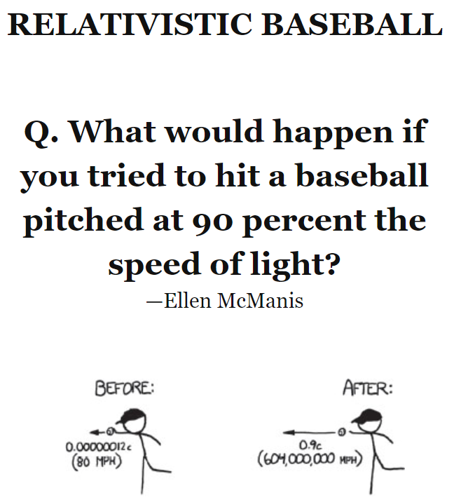
For further understanding
D. Lincoln, Why can't you go faster than light? - YouTube
L. Okun, The Concept of Mass: Physics Today
D. Lincoln, Is relativistic mass real? – YouTube
The invisibility of length contraction – Physics World
Motion near the cosmic speed limit (spacetimetravel.org)
What If? Serious Scientific Answers to Absurd
Hypothetical Questions, Randall Munroe,
John Murray, 2014.

Slide 4
Special Relativity
Special Relativity is the basic framework describing space and time in physics, and how matter moves, and forces propagate, in it.
  As a framework, it constrains how the theories of physics are constructed.
  It is a part of “classical physics”.
  It replaced the old picture of Galileo and Newton around the turn of the last century.
The differences become noticeable when things move fast or when electromagnetic radiation (“light” for short) is considered.
  We are here to learn about particle accelerators whose raison d’être is (usually) to make matter move fast. So special relativity is going to be important for us.
  Moreover, accelerators work by means of electromagnetic fields and waves so we need to describe them properly and consistently.
  Many of you, but perhaps not all, have already learned it as undergraduates – so these lectures will be a recap, with more emphasis on what we need in accelerators.
We do not need to cover General Relativity, which is a theory of gravitation, because gravitational forces are extremely weak compared with the electromagnetic forces brought to bear on particles in accelerators.

Slide 5
Approach of these lectures
Fast-track approach to the main results (time is short …)
  Other course and books will provide more detailed justification of certain steps and more detailed formulas
  Many of you will already have a good knowledge of special relativity
Emphasis on natural relativistic concepts, not anchoring them back to Newtonian
Emphasis on what is useful for accelerators
No history, personalities

Slide 6
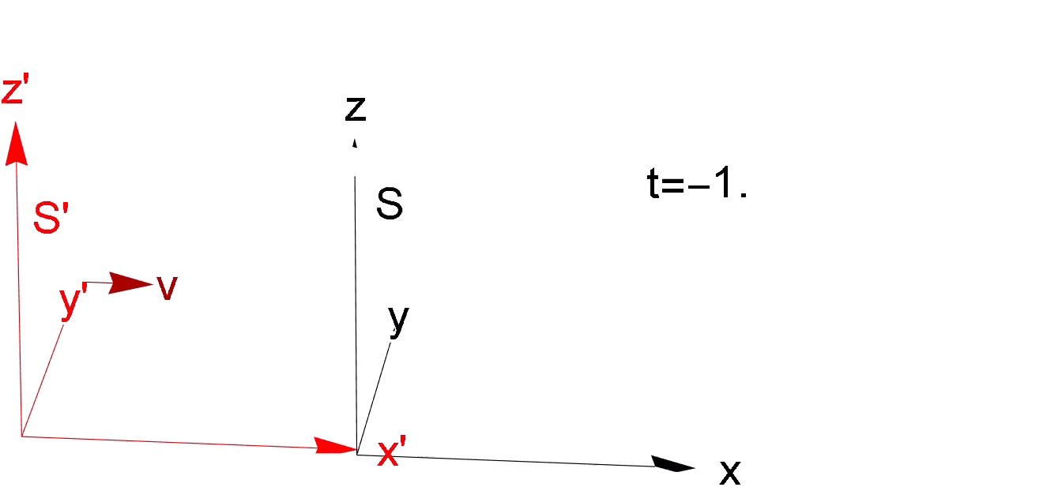
Galilean Relativity
Consider two reference frames, S’ is moving at a constant velocity v with respect to S. Laws of physics should look the same in each frame.
  Take v in x-direction for simplicity in examples
  Assume the origins of S and S’ coincide at time t = 0

Slide 7
Newtonian mechanical system example vs. waves in Galilean Relativity
An inconsistency!

Slide 8
Resolution of the inconsistency
Possibilities, at the start of 20th century:
  The theory of electromagnetism (Maxwell’s equations, see tomorrow) was incorrect, despite spectacular success in many applications.
  Galilean Relativity worked only for mechanics, and there was a preferred reference frame for electromagnetism
  Galilean Relativity should be replaced by something new that would work for both mechanics and electromagnetism.
[History was a bit more complicated than the simplified versions in many physics books.
  Pressure in favour of possibility 3. also came from certain experiments.
  Einstein seems to have been mainly motivated by the theory.
We do not try to summarise the story here.]

Slide 9
Postulates leading to Special Relativity
The laws of physics and all physical phenomena are independent of the translational motion of the system. There are an infinite number of equivalent Euclidean reference frames (inertial frames) moving with constant velocity in rectilinear paths.
The speed of light is independent of the motion of its source, ie, is the same in all inertial frames.
  “Light” means any electromagnetic wave in vacuum.
  Actually, the speed of light is not necessarily related to electromagnetism. As we shall see, it is a kind of “cosmic speed limit”, other waves might travel at the same speed.

Slide 10
About the speed of light
For small speeds, we expect Galilean Relativity to approximate Special Relativity.
Dimensions of physical quantities are, to some extent, a matter of convention.
In physics it is often convenient to use units such that c=1 and this also serves to underline the unity of time and space as spacetime that emerges from relativity theory.
We could also choose to assign different dimensions to, say, horizontal and vertical lengths and this can indeed be useful (eg, in ballistics).

Slide 11
The Lorentz Transformation
The Lorentz Transformation will replace the Galilean Transformation. Let us now derive it.

Slide 12
Form of the Lorentz Transformation

Slide 13
A flash of light and the invariant interval

Slide 14
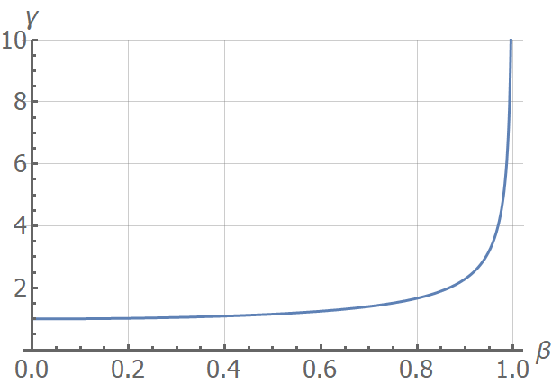
Final steps to the Lorentz Transformation

Slide 15
Lorentz transformation in various notations

Slide 16
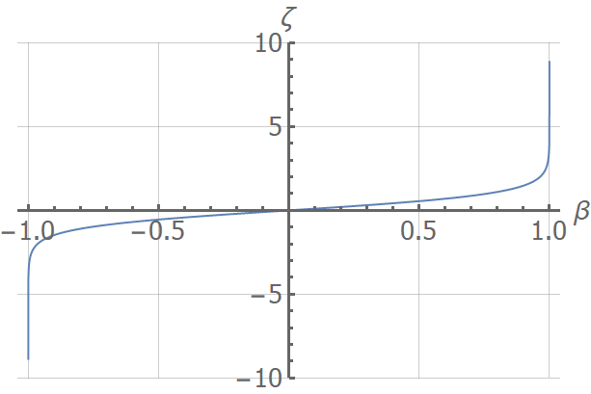
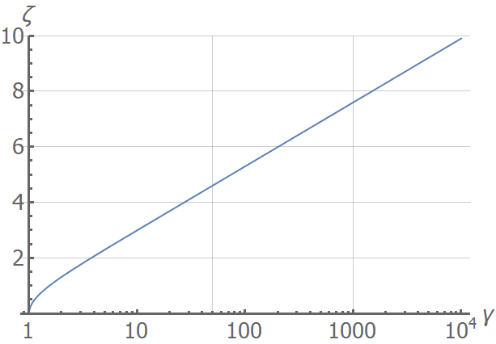
Rapidity

Slide 17
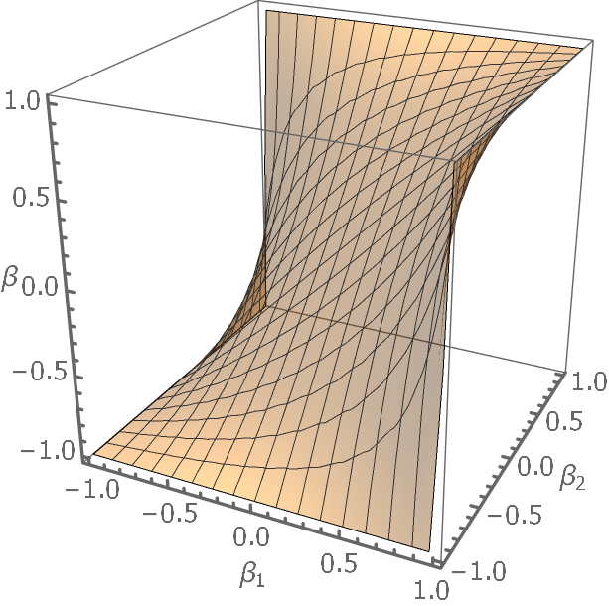
Composition of collinear boosts, velocity “addition” in Special Relativity
Galilean velocity addition, tangent plane in nehghbourhoold of the origin.

Slide 18
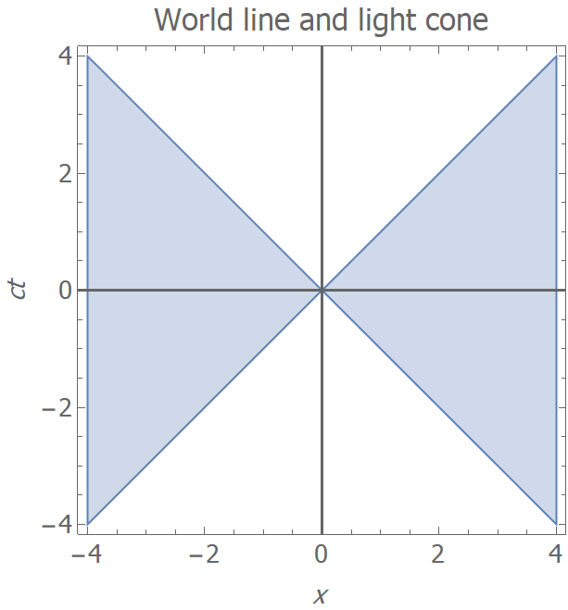

Spacetime and the light cone
In (1+3)D “Minkowski space”, points (ct,x,y,z) are events.
One dimension is timelike (why only one?).
Illustrations in (1+1)D (ct,x) plane.
Future, timelike separation
World-line of a particle
Elsewhere, spacelike separation
Past, timelike separation

Slide 19
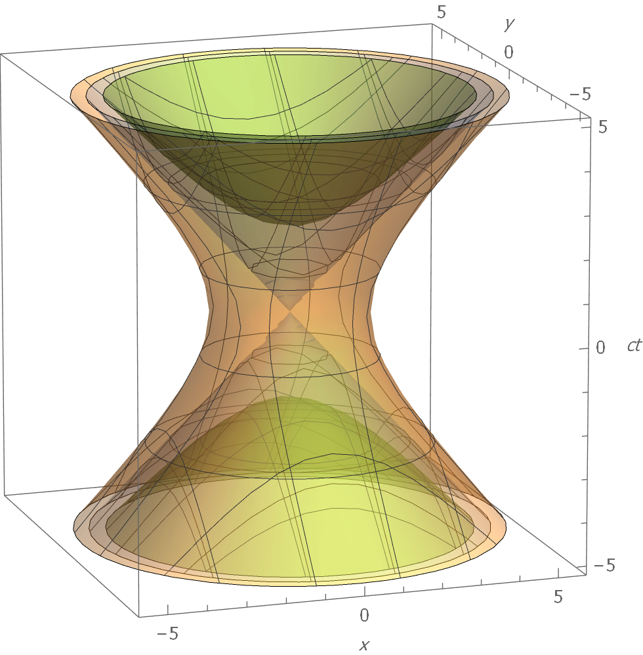
(1+2)D Minkowski spacetime and light cone

Slide 20
Proper time

Slide 21
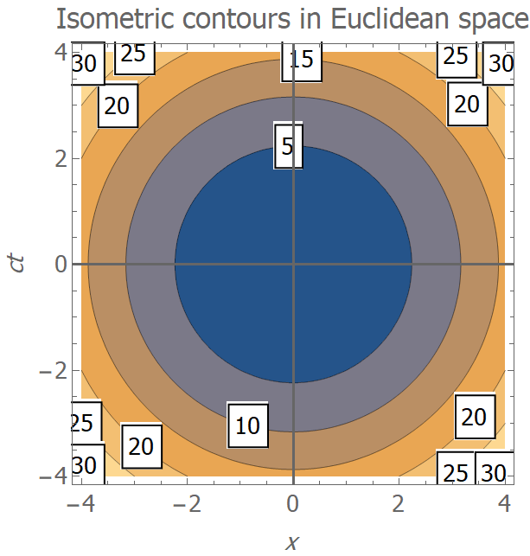
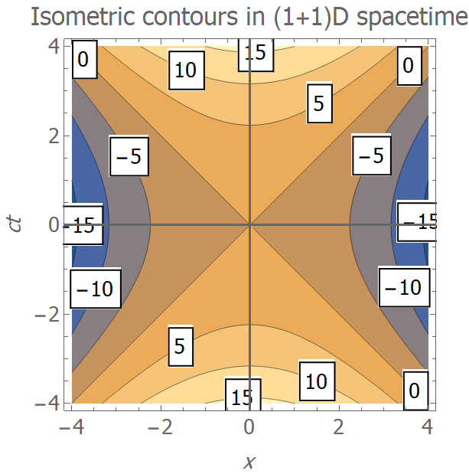
Euclidean space vs Minkowski space

Slide 22
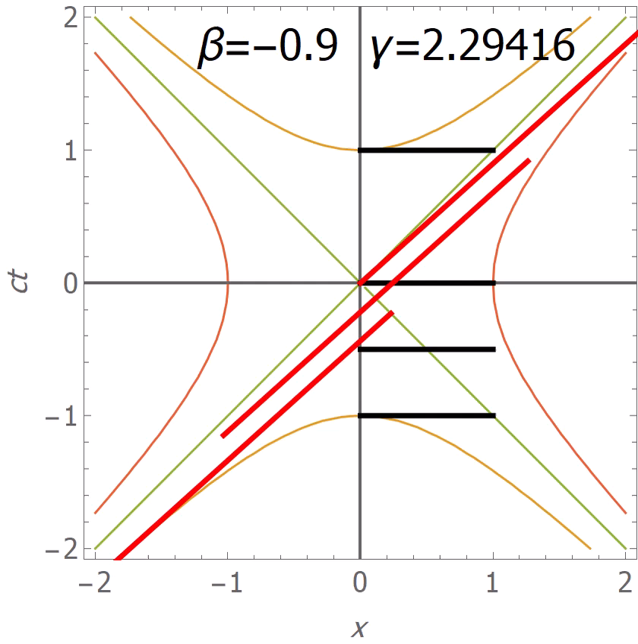
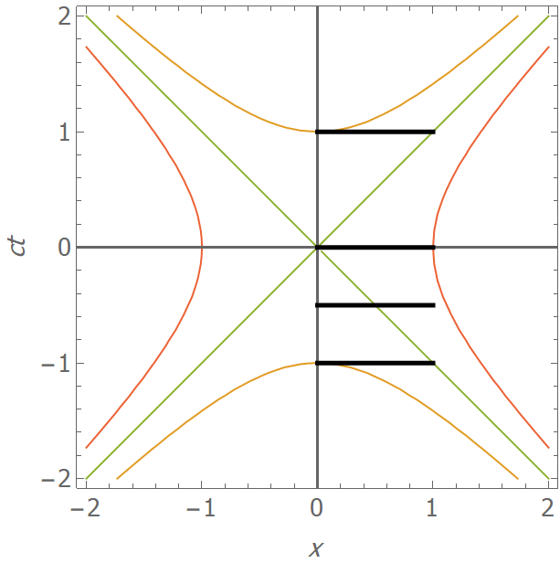
Lorentz contraction: a rod’s life
Note that the events at the ends of the rods (or any other events) simply move along their original isometric contours in all other frames S’.
Now let’s look at a specially chosen S’ from this sequence…

Slide 23
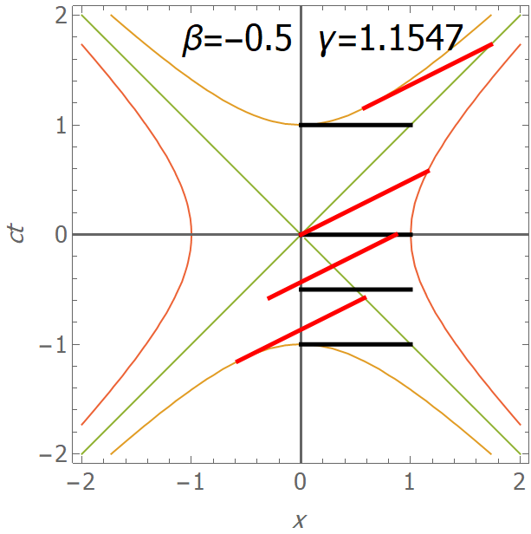
Lorentz contraction

Slide 24
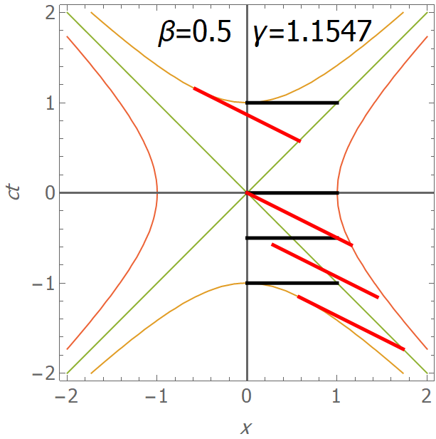
Simultaneity and time-order inside the light cone

Slide 25
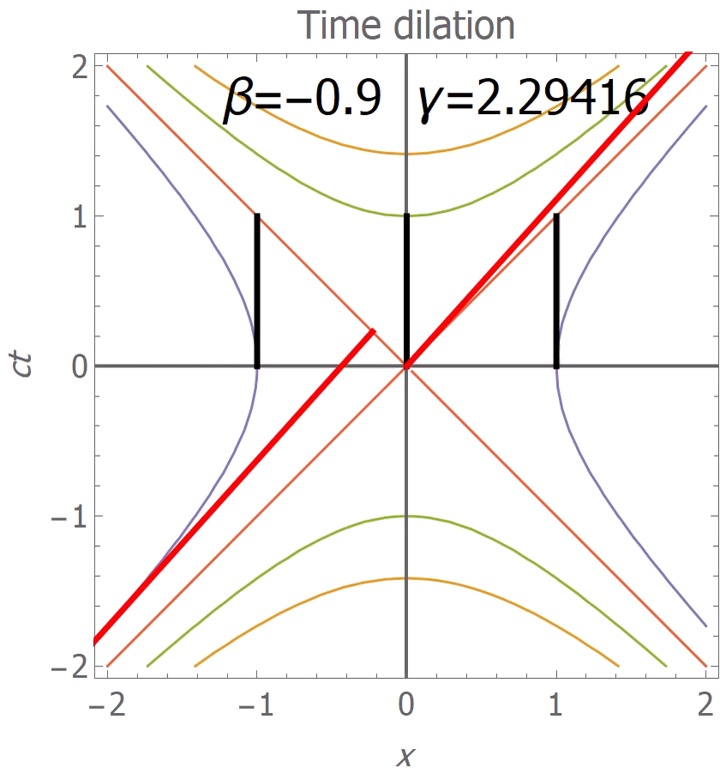
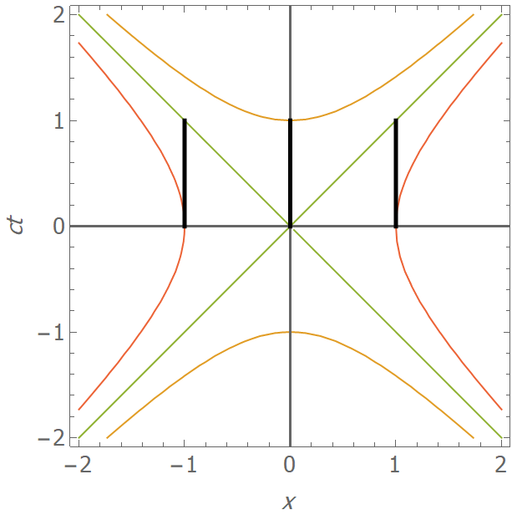
Time dilation
Again the events at the ends of the lives (or any other events) simply move along their original isometric contours in all other frames S’.
Now let’s look at a specially chosen S’ from this sequence…

Slide 26
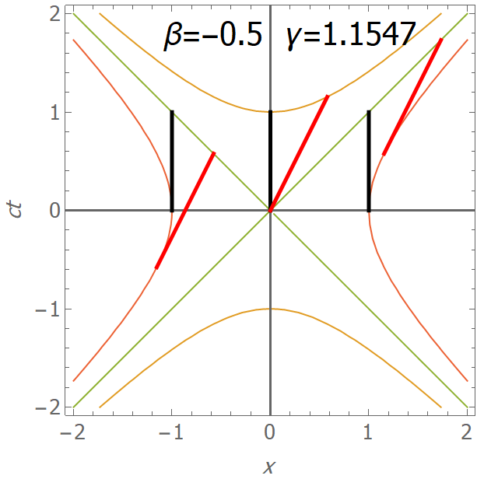
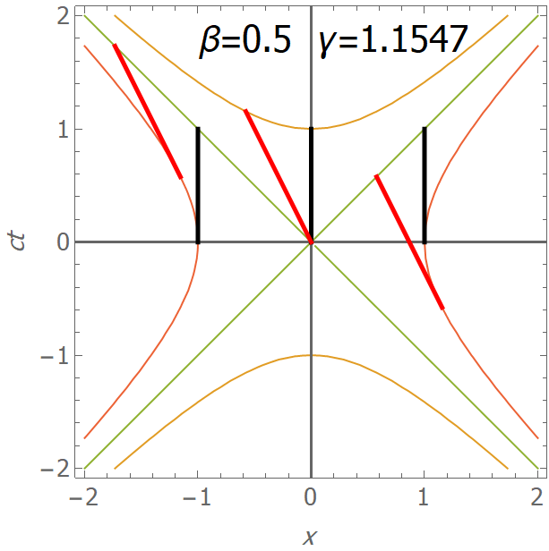
Time dilation and relativity of simultaneity

Slide 27
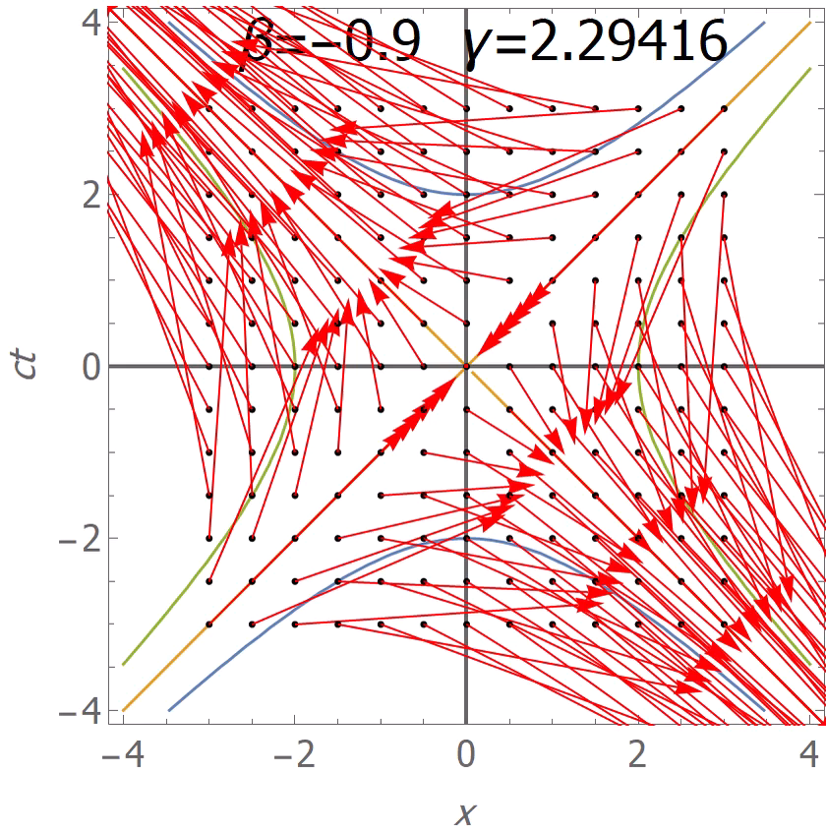
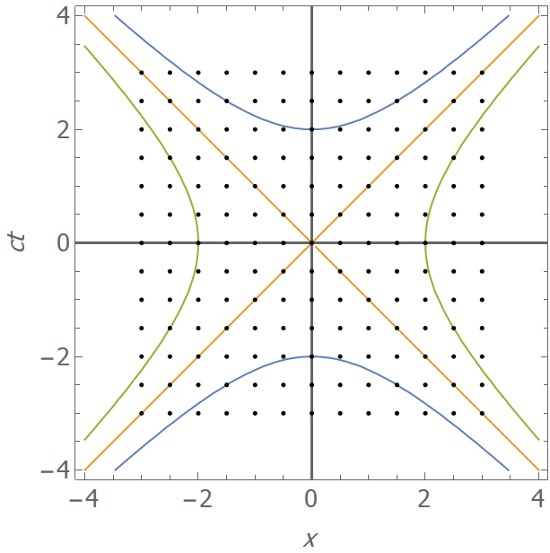
Lorentz Transformations as a flow
Look at the effect of the Lorentz Transformation on a grid of events in spacetime.
Tangents to isometric curves remain as tangents to different points on the same curve.

Slide 28
Other physical 4-vectors?

Slide 29
4-momentum

Slide 30
4-momentum

Slide 31
Next lectures
So far we have mainly discussed kinematics and not said much about mass, energy and momentum
We will look at relativistic dynamics in the next lecture
Practical examples related to accelerators

