Slide 1
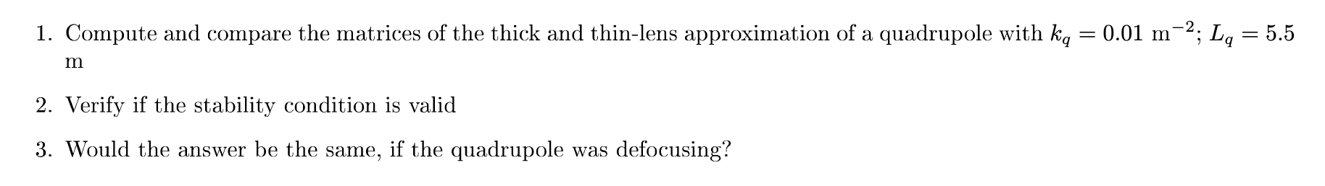
4 Exercise: Thin-lens approximation

Slide 2
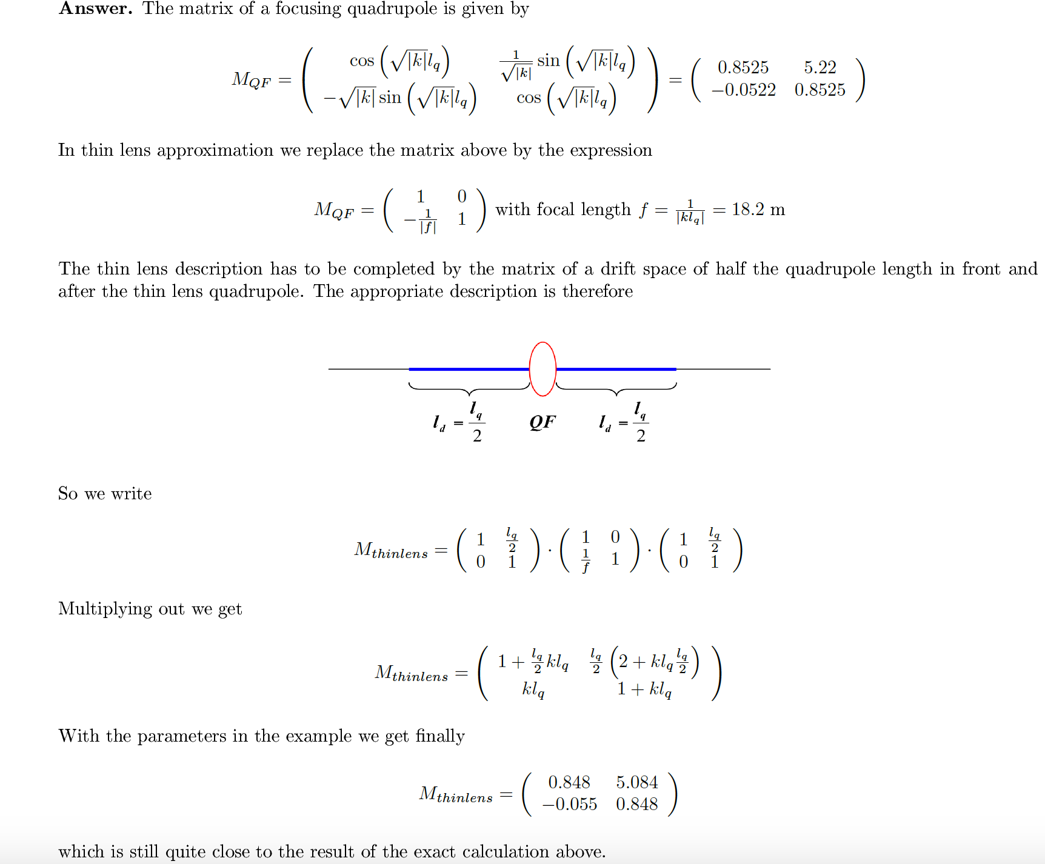
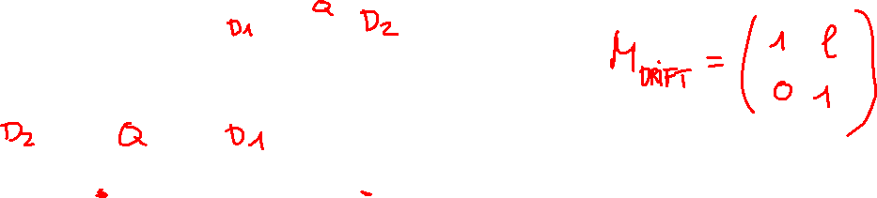
4 Exercise: Thin-lens approximation

Slide 3
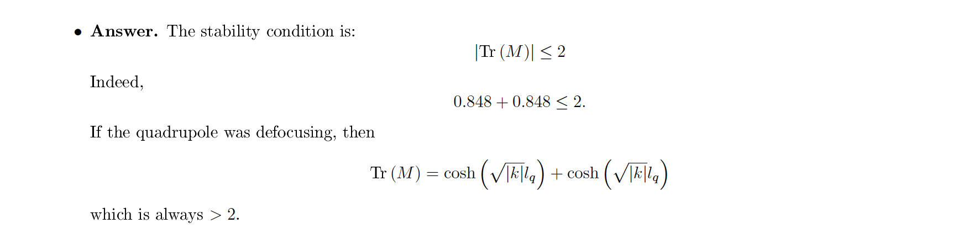
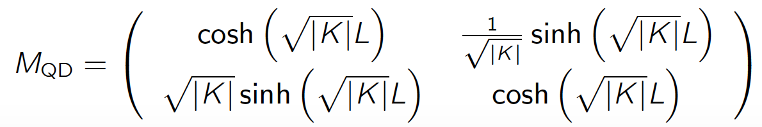
4 Exercise: Thin-lens approximation
Range of cosh(x) [1,+∞], 1 for k=0 !

Slide 4
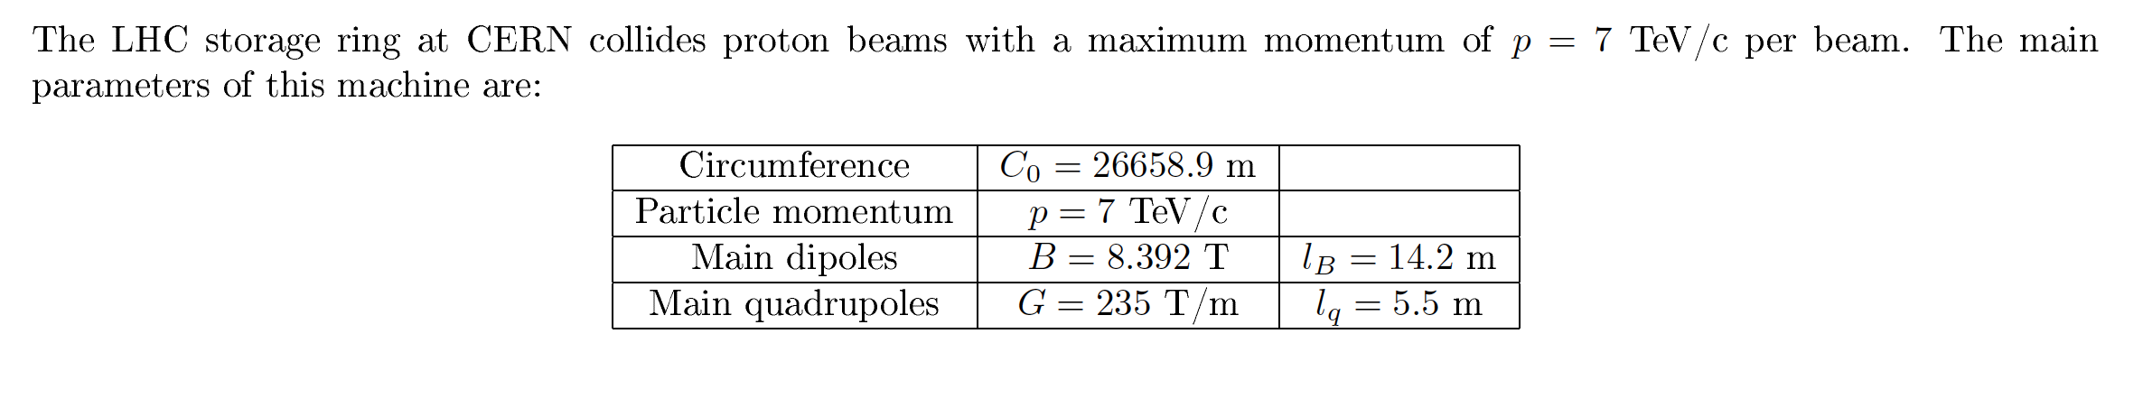
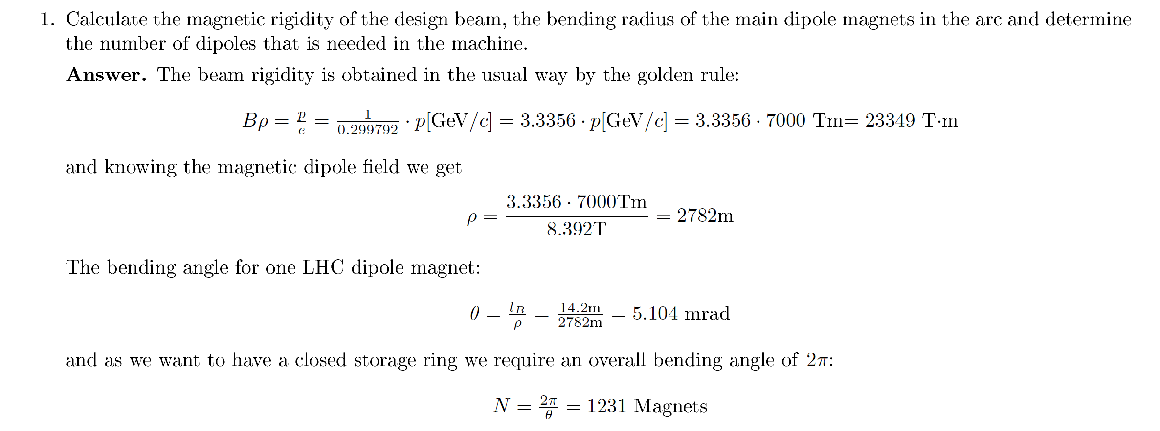
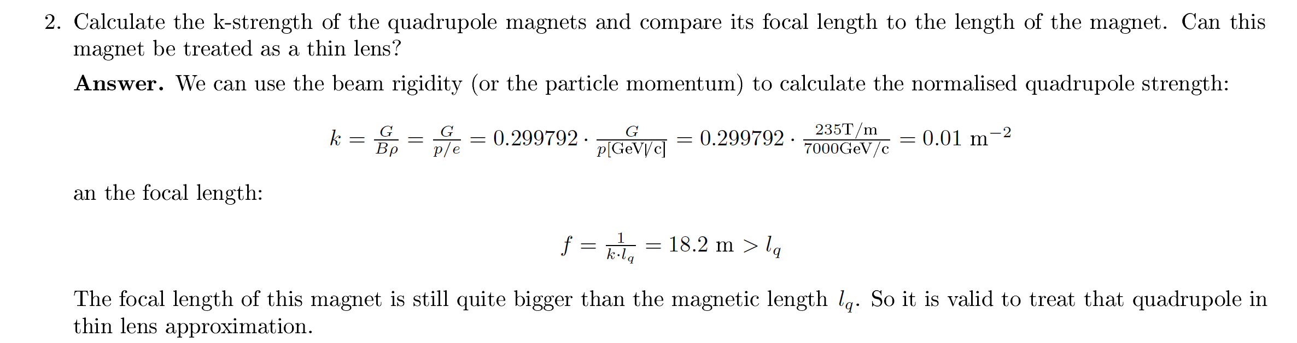
6 Exercise: Particle momentum, geometry of a storage ring and thin lenses

Slide 5
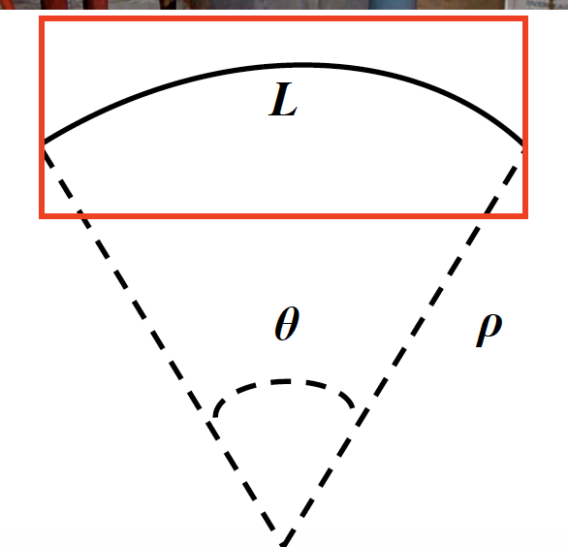
6 Exercise: Particle momentum, geometry of a storage ring and thin lenses

Slide 6

6 Exercise: Particle momentum, geometry of a storage ring and thin lenses

Slide 7
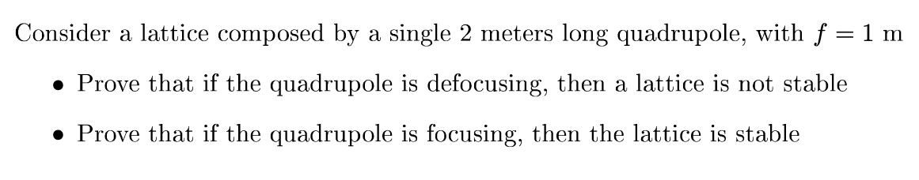
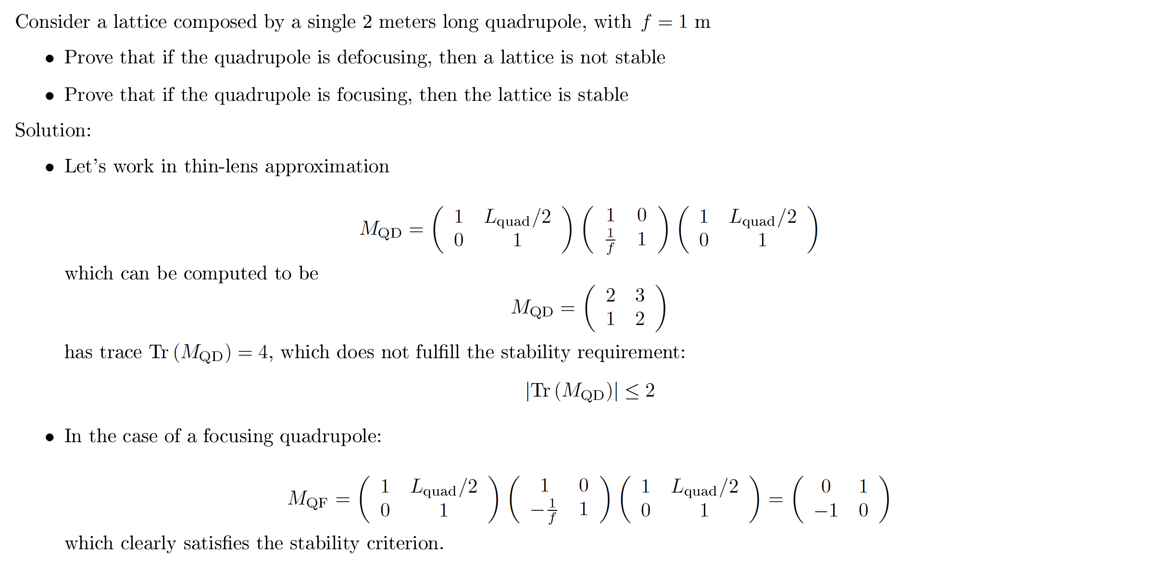
7 Exercise: Stability condition

Slide 8
7 Exercise: Stability condition
QD

